Slide 1
Maximizing coverage while ensuring fairness: a tale of conflicting objectives⸸
Bhaskar DasGupta
Department of Computer Science
University of Illinois at Chicago
Chicago, IL 60607
bdasgup@uic.edu
⸸ Joint result with Abolfazl Asudeh, Tanya Berger-Wolf and Anastasios Sidiropoulos
Notes:
A very good afternoon to everyone.
Welcome to my masters thesis defense and as you can see, the topic of my research is gerrymandering! But this is not just about our research and findings. This is the journey of a 23 year old girl from Italy who had big dreams in her eyes as she burgeoned on her journey to the United States of America with no idea about the vast country she was stepping into. And now thanks to UIC and her professors and advisor professor Dasgupta that she became able enough to not only carry out a research on the topic of gerrymandering but present her findings in front of highly knowledgeable people like you. And she is more than honored for this humbling opportunity. Without further ado, lets delve into this journey.

Slide 2
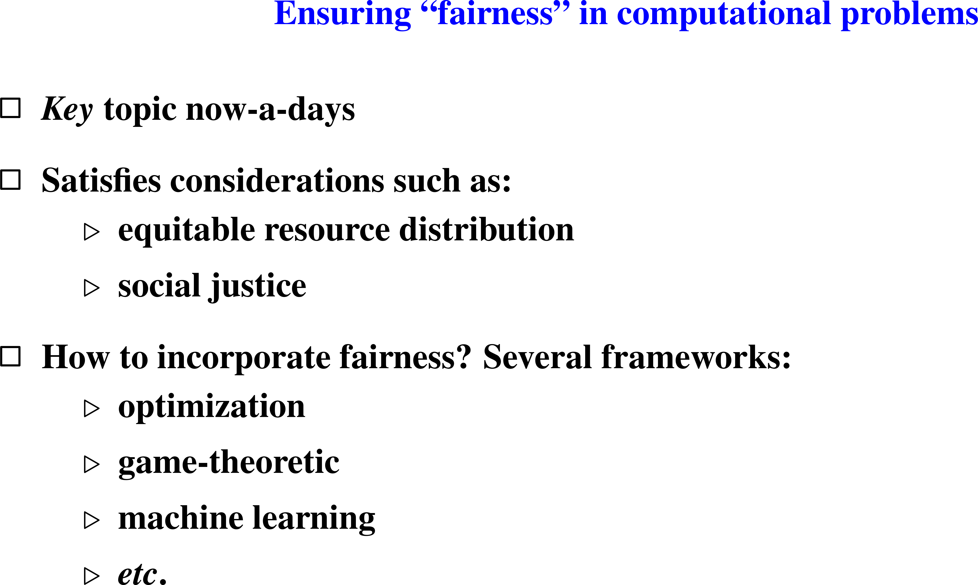
framework for this talk

Slide 6
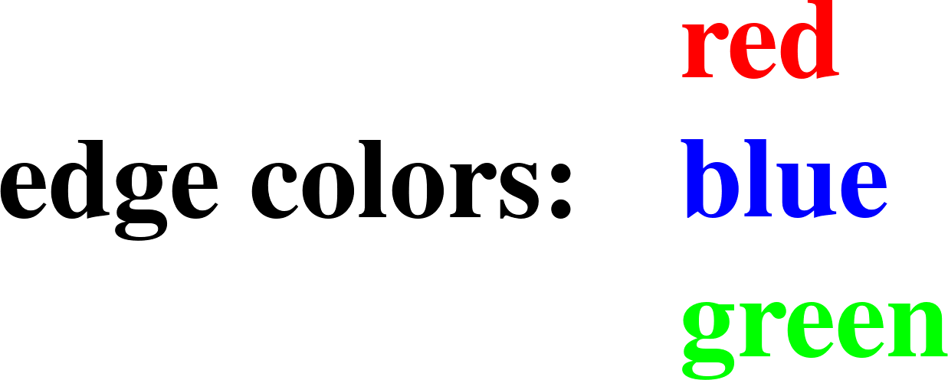
Optimal solution without fairness constraints (11 edges)
Optimal solution (6 edges)

Slide 11
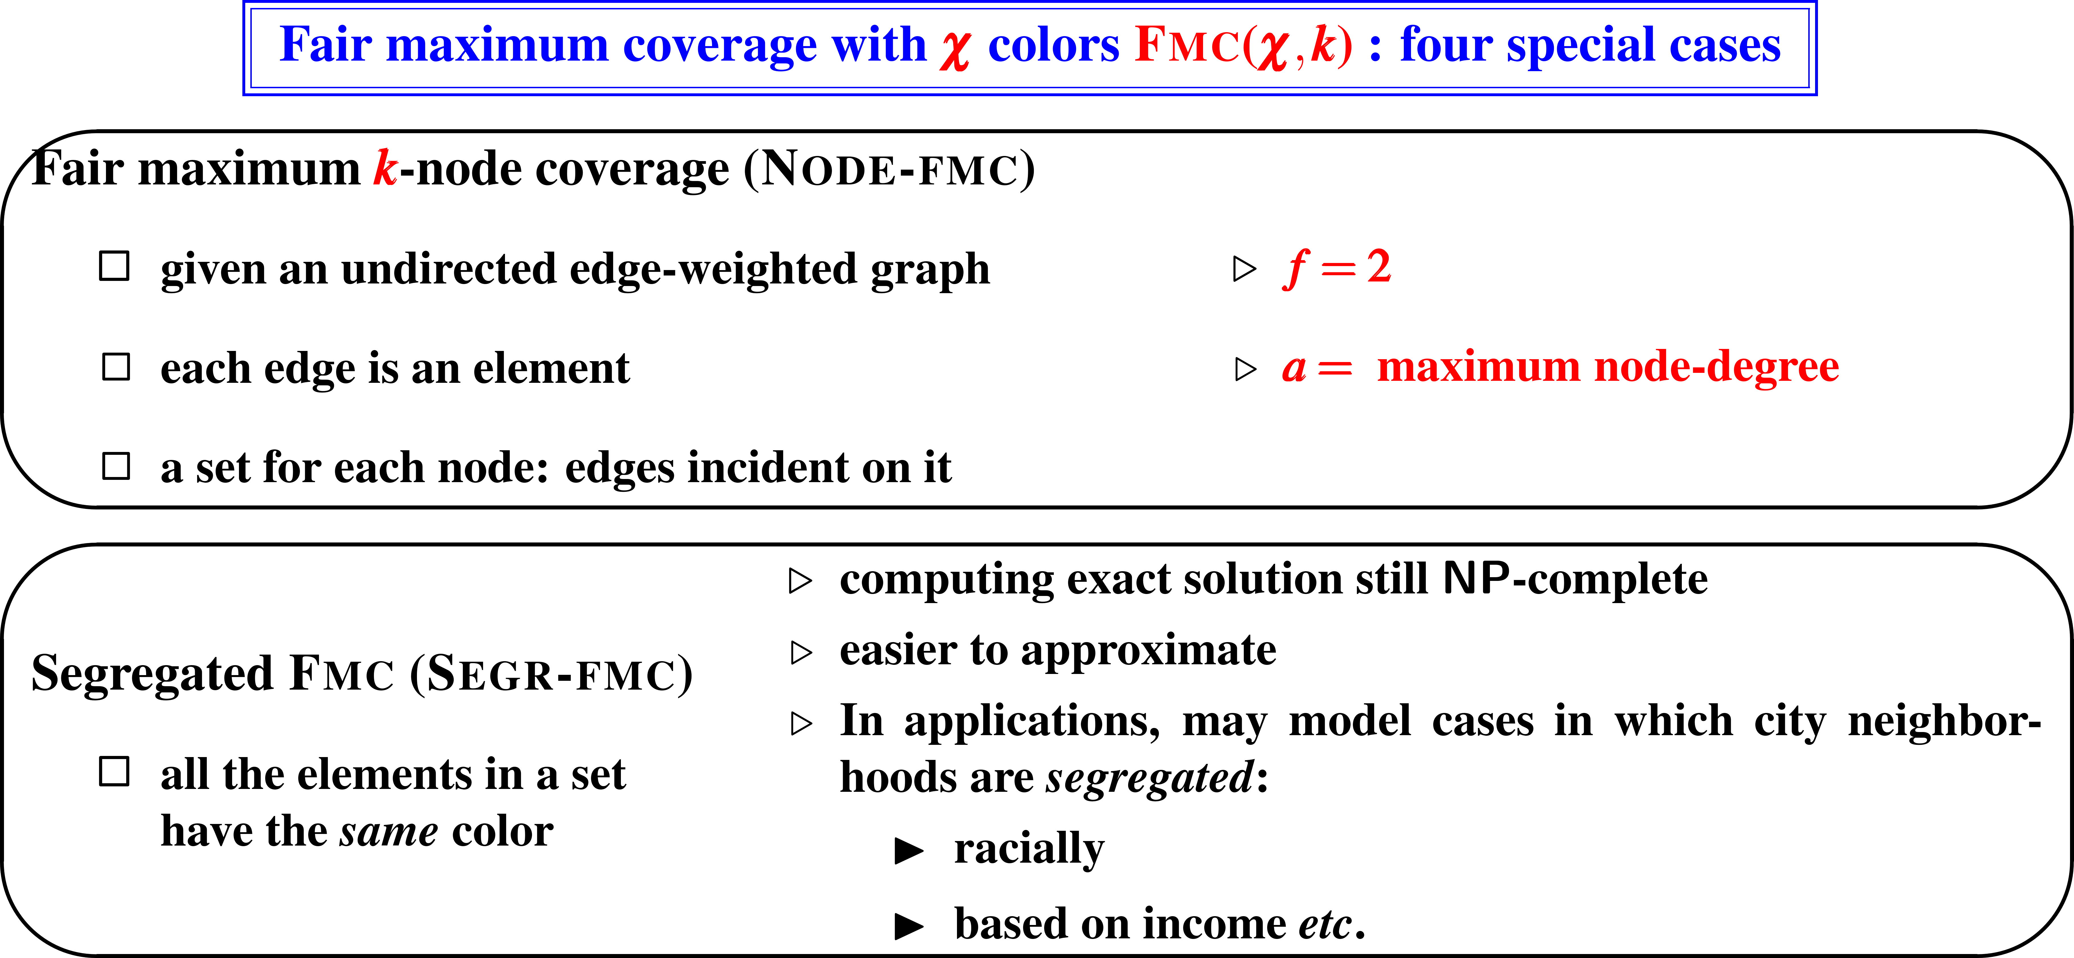

Slide 20
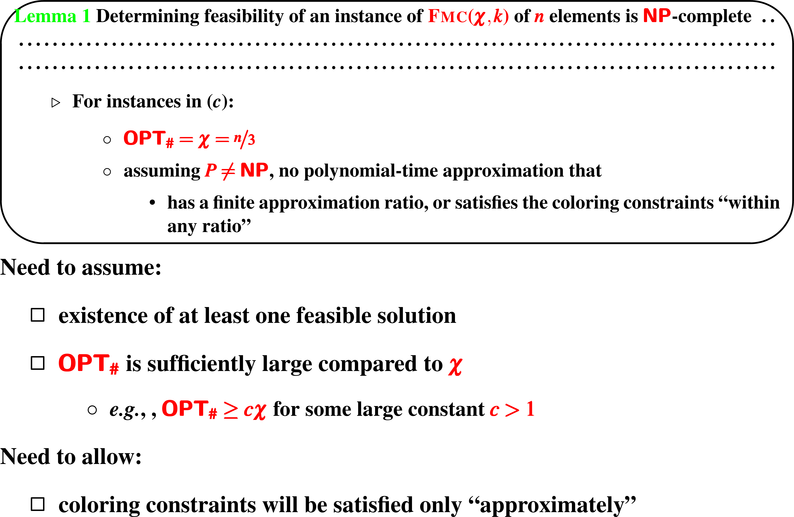

Slide 24
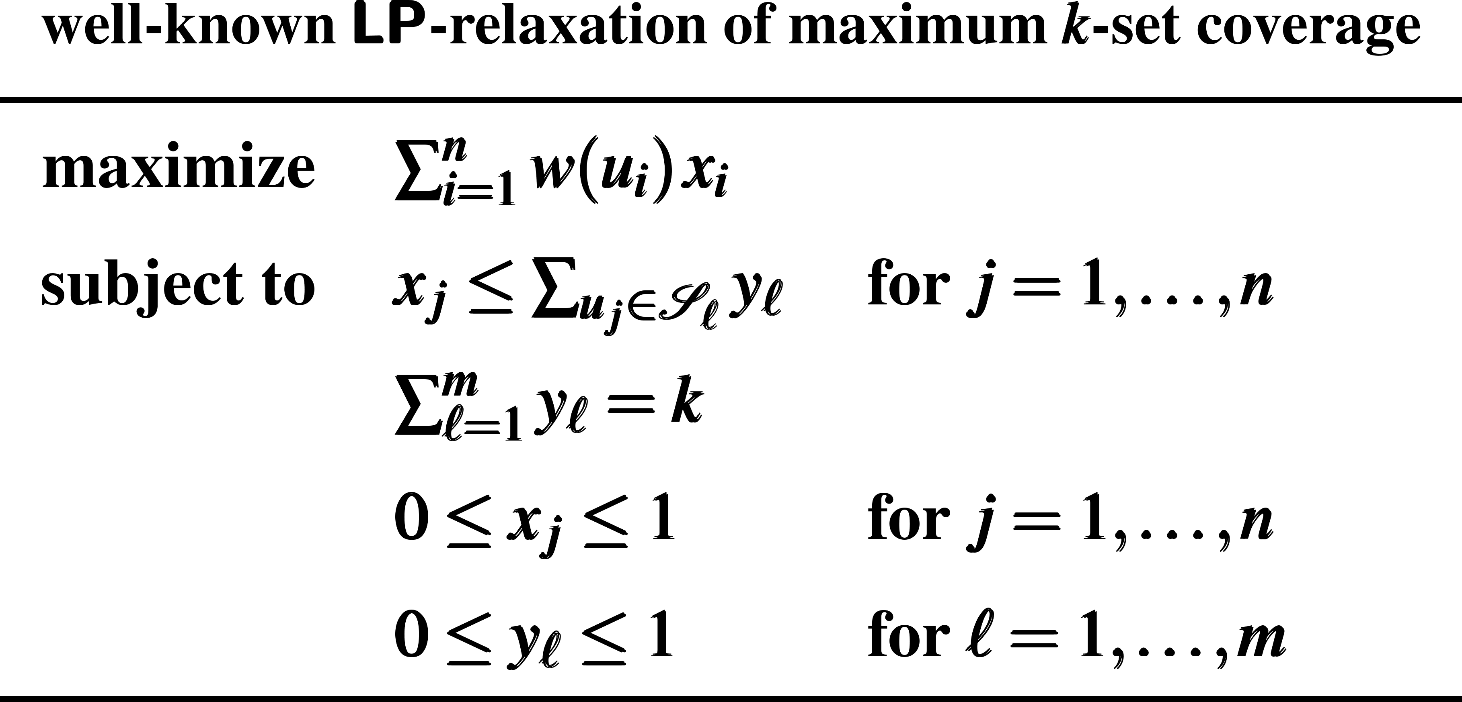
Proof techniques, failed approaches, intuitions etc.
add extra O(f n) covering inequalities
e.g., Carr, Fleischer, Leung, Phillips,
SODA 2000
workaround
will not work
integrality gap too large
even for 2 colors

Slide 25
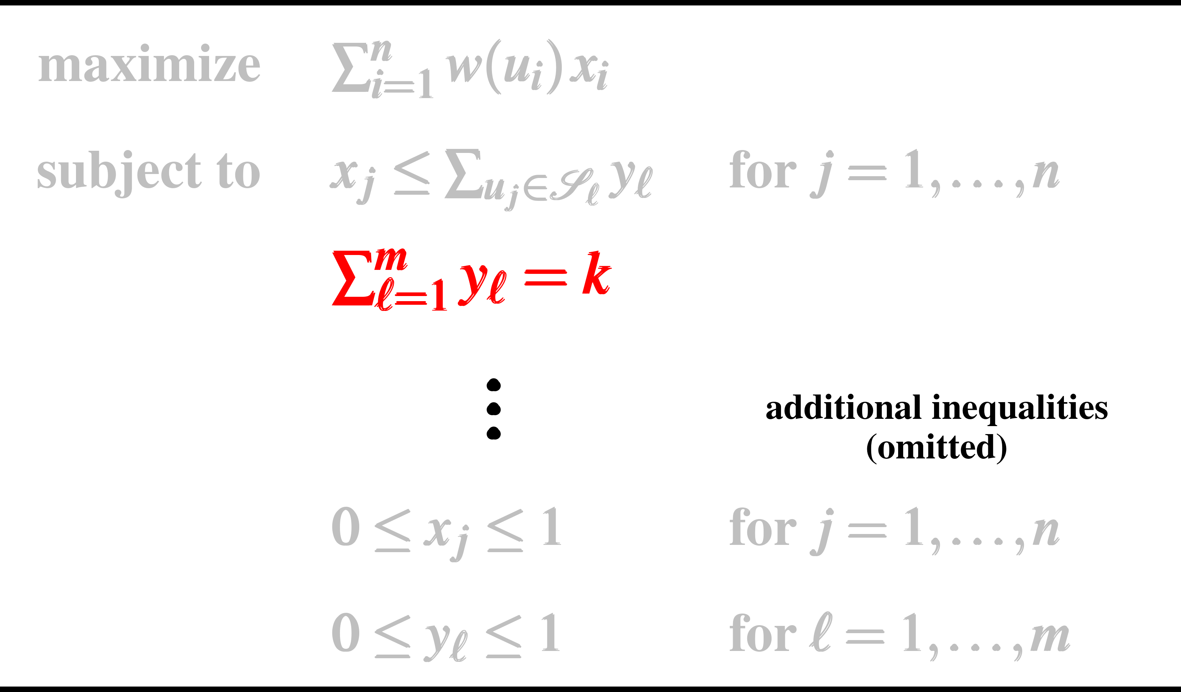
Proof techniques, failed approaches, intuitions etc.

Slide 26
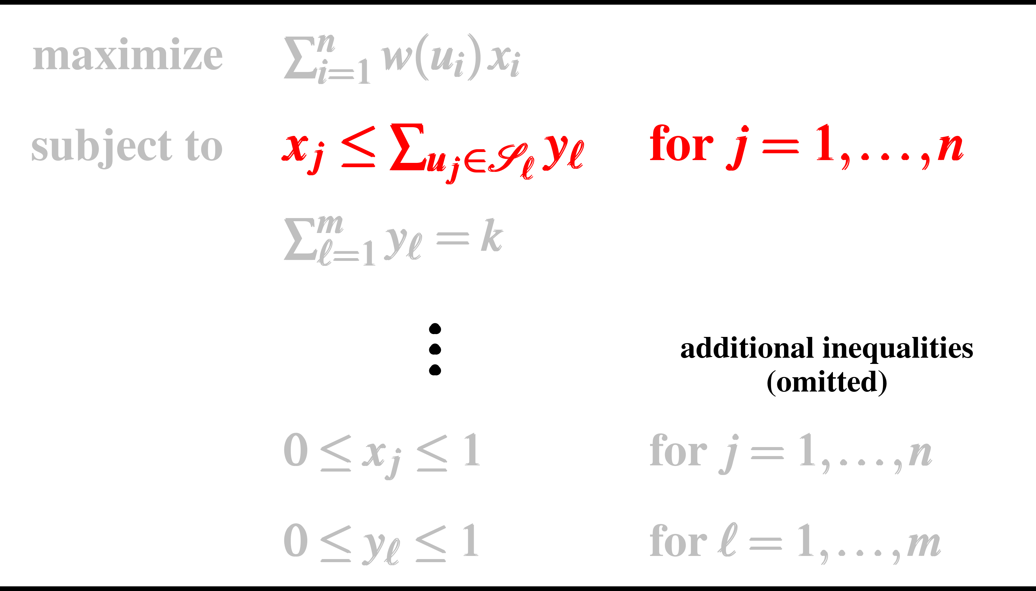
Proof techniques, failed approaches, intuitions etc.

Slide 27
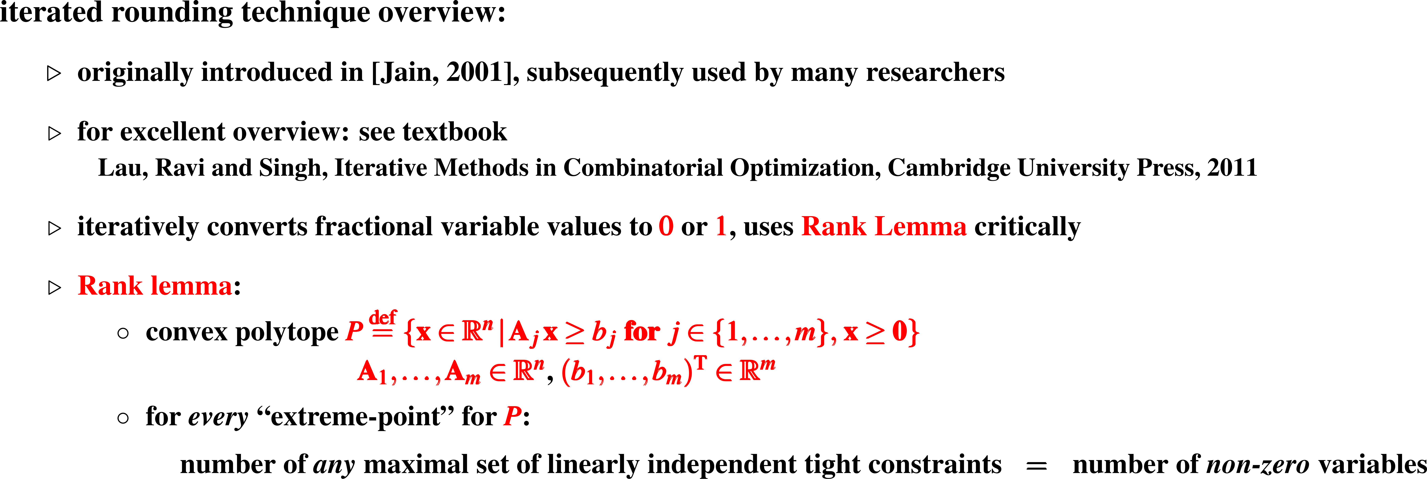
Proof techniques, failed approaches, intuitions etc.

Slide 28
Proof techniques, failed approaches, intuitions etc.

Slide 29
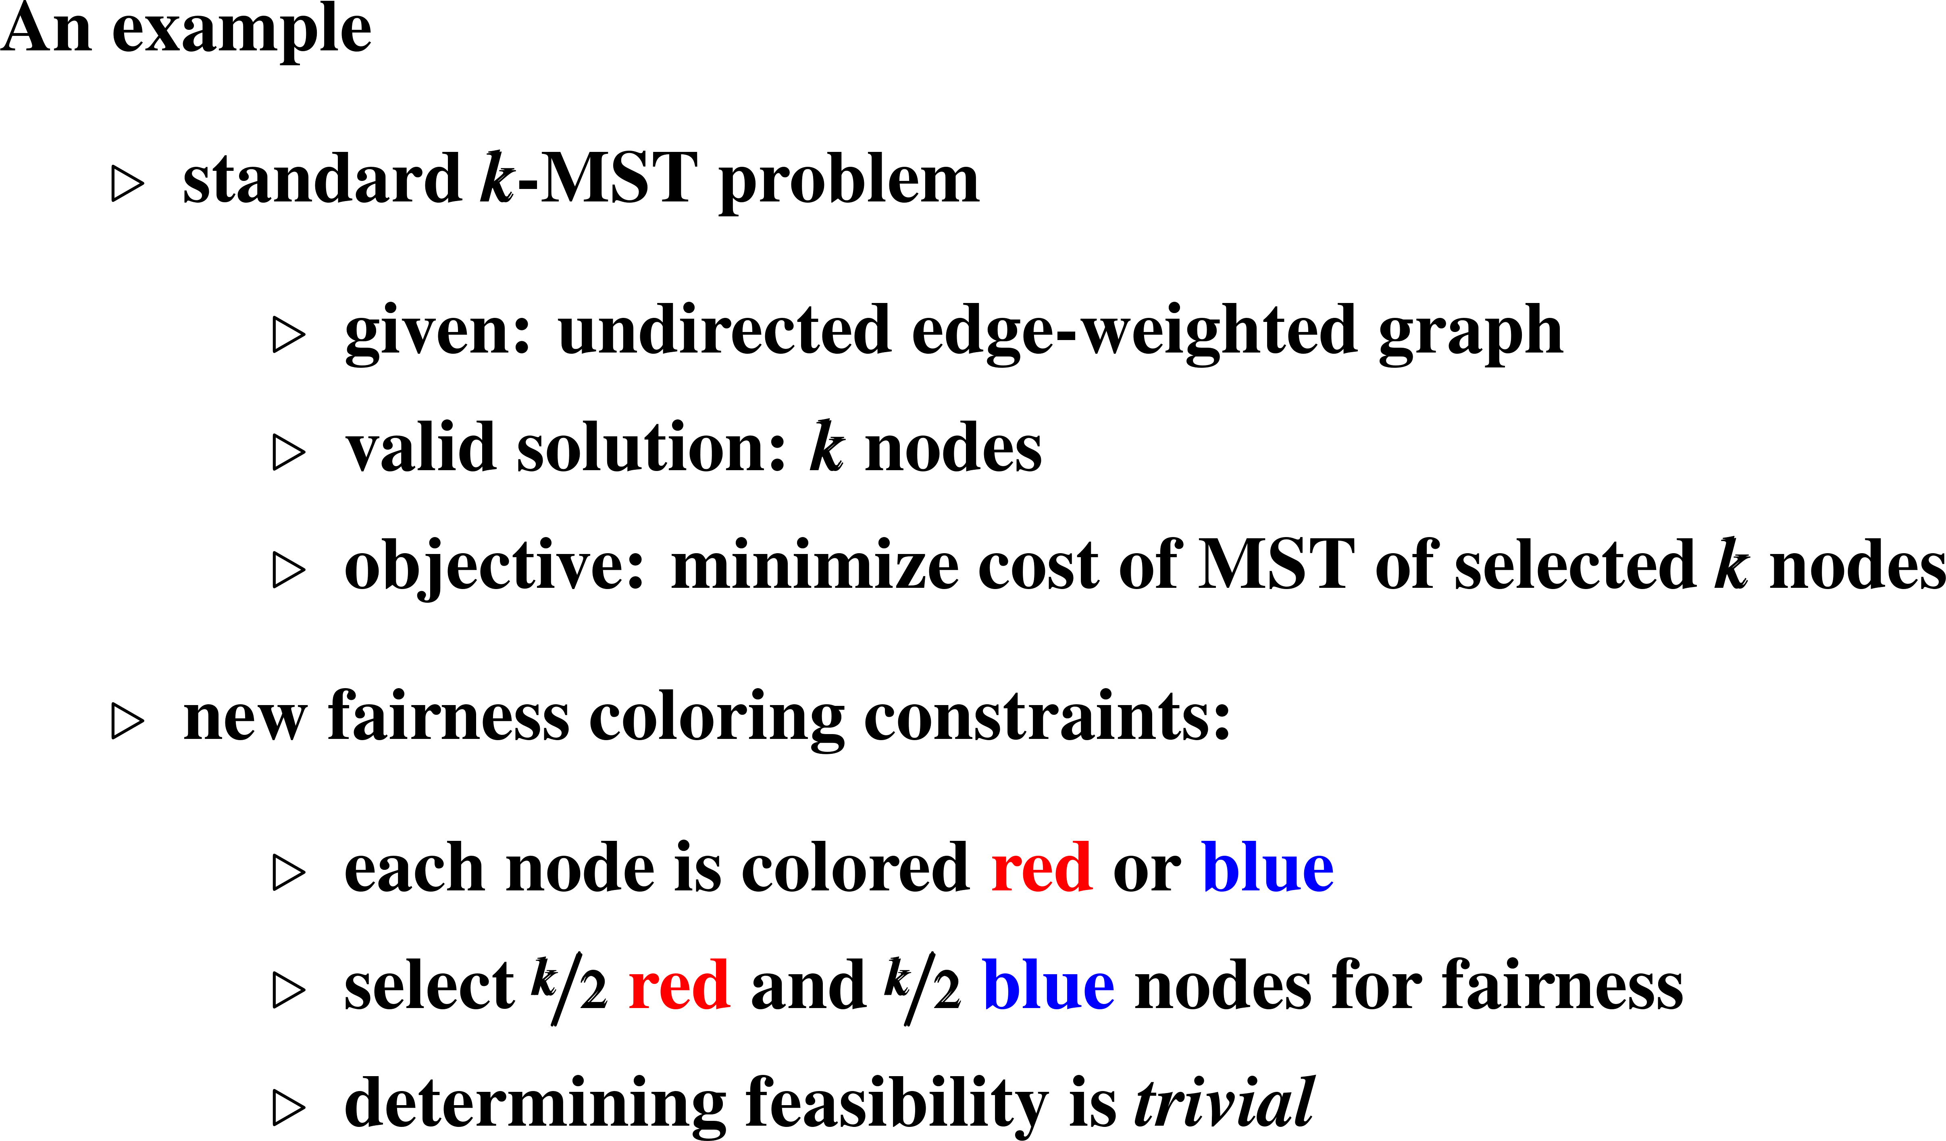
Future research problems

Slide 30
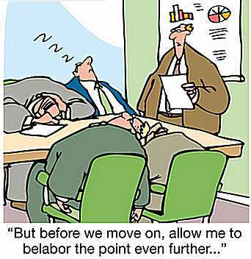
Full paper: https://arxiv.org/abs/2007.08069
Questions?
Thank you for your attention

