Slide 1

Sentiment Analysis and Opinion Mining
Bing Liu
Department of Computer Science
University Of Illinois at Chicago
liub@cs.uic.edu
Cambridge U. Press

Slide 2
Introduction
Sentiment analysis (SA) or opinion mining
computational study of opinion, sentiment, appraisal, evaluation, and emotion.
Why is it important?
Opinions are key influencers of our behaviors.
Our beliefs and perceptions of reality are conditioned on how others see the world.
Whenever we need to make a decision we often seek out the opinions from others.
Rise of social media –> opinion data

Slide 3
Terms defined - Merriam-Webster
Sentiment: an attitude, thought, or judgment prompted by feeling.
A sentiment is more of a feeling.
“I am concerned about the current state of the economy.”
Opinion: a view, judgment, or appraisal formed in the mind about a particular matter.
a concrete view of a person about something.
“I think the economy is not doing well.”

Slide 4
Rise of social media
The rise of social media popularized two major research directions
Social network analysis
Sentiment analysis
Social network analysis started in 1940s when management science researchers studied people’s relations and roles in organizations
Inception of sentiment analysis and opinion mining is manly due to social media.

Slide 5
SA: A fascinating problem!
Intellectually challenging & many applications.
A popular research topic in NLP, and data mining (Shanahan, Qu, and Wiebe, 2006 (edited book); Surveys - Pang and Lee 2008; Liu, 2006 and 2011; 2010)
spread from computer science to management science (Hu, Pavlou, Zhang, 2006; Archak, Ghose, Ipeirotis, 2007; Liu Y, et al 2007; Park, Lee, Han, 2007; Dellarocas, Zhang, Awad, 2007; Chen & Xie 2007).
> 300 companies in USA alone
It touches every aspect of NLP and yet is confined.
A “simple” semantic analysis problem.
Potentially a major technology from NLP.
But it is hard.

Slide 6
Roadmap
Sentiment analysis problem
Document sentiment classification
Sentence subjectivity & sentiment classification
Aspect-based sentiment analysis
Mining comparative opinions
Summary

Slide 7
Problem statement
It consists of two abstractions
(1) Opinion definition. What is an opinion?
Can we provide a structured definition?
If we cannot structure a problem, we probably do not understand the problem.
(2) Opinion summarization. why?
Opinions are subjective. An opinion from a single person (unless a VIP) is often not sufficient for action.
We need opinions from many people, and thus the need for opinion summarization.

Slide 8
Two main types of opinions (Jindal and Liu 2006; Liu, 2010)
Regular opinions: Sentiment/opinion expressions on some target entities
Direct opinions:
“The touch screen is really cool.”
Indirect opinions:
“After taking the drug, my pain has gone.”
Comparative opinions: Comparisons of more than one entity.
E.g., “iPhone is better than Blackberry.”
We focus on regular opinions first, and just call them opinions.

Slide 9
(I): Definition of an opinion
Id: Abc123 on 5-1-2008 -- “I bought an iPhone yesterday. It is such a nice phone. The touch screen is really cool. The voice quality is clear too. It is much better than my Blackberry. However, my mom was mad with me as I didn’t tell her before I bought the phone. She thought the phone was too expensive”
Definition: An opinion is a quadruple (Liu, 2012),
(target, sentiment, holder, time)
This definition is concise, but not easy to use.
Target can be complex, e.g.,“I bought an iPhone. The voice quality is amazing.”
Target = voice quality? (not quite)

Slide 10
A more practical definition (Hu and Liu 2004; Liu, 2010, 2012)
An opinion is a quintuple
(entity, aspect, sentiment, holder, time)
where
entity: target entity (or object).
Aspect: aspect (or feature) of the entity.
Sentiment: +, -, or neu, a rating, or an emotion.
holder: opinion holder.
time: time when the opinion was expressed.
Aspect-based sentiment analysis

Slide 11
Our example blog in quintuples
Id: Abc123 on 5-1-2008 “I bought an iPhone a few days ago. It is such a nice phone. The touch screen is really cool. The voice quality is clear too. It is much better than my old Blackberry, which was a terrible phone and so difficult to type with its tiny keys. However, my mother was mad with me as I did not tell her before I bought the phone. She also thought the phone was too expensive, …”
In quintuples
(iPhone, GENERAL, +, Abc123, 5-1-2008)
(iPhone, touch_screen, +, Abc123, 5-1-2008)
….
We will discuss comparative opinions later.

Slide 12
Two closely related concepts
Subjectivity and emotion.
Sentence subjectivity: An objective sentence presents some factual information, while a subjective sentence expresses some personal feelings, views, emotions, or beliefs.
Emotion: A mental state that arises spontaneously rather than through conscious effort and is often accompanied by physiological changes.

Slide 13
(II): Opinion summary (Hu and Liu 2004)
With a lot of opinions, a summary is necessary.
Not traditional text summary: from long to short.
Text summarization: defined operationally based on algorithms that perform the task
Opinion summary (OS) can be defined precisely,
not dependent on how summary is generated.
Opinion summary needs to be quantitative
60% positive is very different from 90% positive.
Main form of OS: Aspect-based opinion summary

Slide 14
Aspect-based opinion summary¹ (Hu & Liu, 2004)
““I bought an iPhone a few days ago. It is such a nice phone. The touch screen is really cool. The voice quality is clear too. It is much better than my old Blackberry, which was a terrible phone and so difficult to type with its tiny keys. However, my mother was mad with me as I did not tell her before I bought the phone. She also thought the phone was too expensive, …”
1. Originally called feature-based opinion mining and summarization
….
Feature Based Summary of iPhone:
Feature1: Touch screen
Positive: 212
The touch screen was really cool.
The touch screen was so easy to use and can do amazing things.
…
Negative: 6
The screen is easily scratched.
I have a lot of difficulty in removing finger marks from the touch screen.
…
Feature2: voice quality
…
Note: We omit opinion holders

Slide 15
Opinion Observer (Liu et al. 2005)
+
Summary of reviews of Cell Phone 1
_
Voice
Screen
Battery
Size
Weight
+
Comparison of reviews of
Cell Phone 1
Cell Phone 2
_

Slide 16
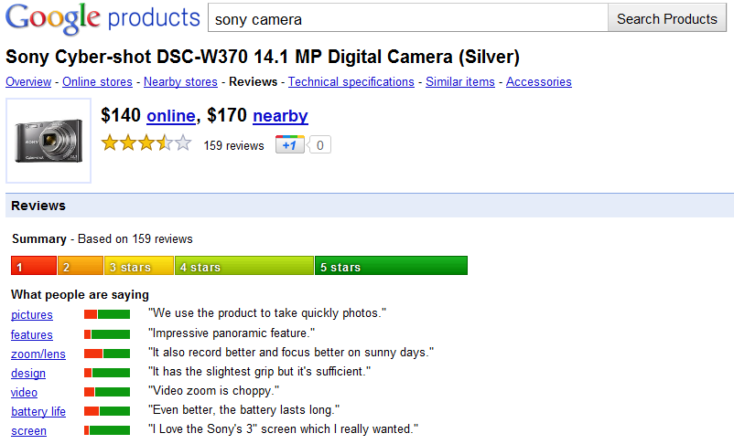
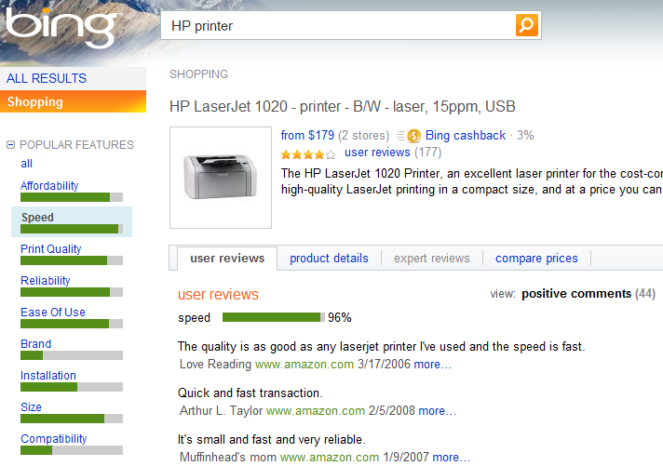
Aspect-based opinion summary

Slide 17
Not just ONE problem
(entity, aspect, sentiment, holder, time)
target entity: Named entity extraction, more
aspect of entity: Aspect extraction
sentiment: Sentiment classification
opinion holder: Information/data extraction
time: Information/data extraction
Other NLP problems
Synonym grouping (voice = sound quality)
Lexical semantics
Coreference resolution
…..

Slide 18
Roadmap
Sentiment analysis problem
Document sentiment classification
Sentence subjectivity & sentiment classification
Aspect-based sentiment analysis
Mining comparative opinions
Summary

Slide 19
Sentiment classification
Classify a whole opinion document (e.g., a review) based on the overall sentiment of the opinion holder (Pang et al 2002; Turney 2002)
Classes: Positive, negative (possibly neutral)
An example review:
“I bought an iPhone a few days ago. It is such a nice phone, although a little large. The touch screen is cool. The voice quality is clear too. I simply love it!”
Classification: positive or negative?
It is basically a text classification problem

Slide 20
Assumption and goal
Assumption: The doc is written by a single person and express opinion/sentiment on a single entity.
Goal: discover (_, _, so, _, _),
where e, a, h, and t are ignored
Reviews usually satisfy the assumption.
Almost all papers use reviews
Positive: 4 or 5 stars, negative: 1 or 2 stars
Many forum postings and blogs do not
They can mention and compare multiple entities
Many such postings express no sentiments

Slide 21
Supervised learning (Pang et al, 2002)
Directly apply supervised learning techniques to classify reviews into positive and negative.
Three classification techniques were tried:
Naïve Bayes, Maximum Entropy, Support Vector Machines (SVM)
Features: negation tag, unigram (single words), bigram, POS tag, position.
SVM did the best based on movie reviews.

Slide 22
Features for supervised learning
The problem has been studied by numerous researchers subsequently
Probably the most extensive studied problem
Including domain adaption and cross-lingual, etc.
Key: feature engineering. A large set of features have been tried by researchers. E.g.,
Terms frequency and different IR weighting schemes
Part of speech (POS) tags
Opinion words and phrases
Negations
Syntactic dependency

Slide 23
Lexicon-based approach (Taboada et al. (2011)
Using a set of sentiment terms, called the sentiment lexicon
Positive words: great, beautiful, amazing, …
Negative words: bad, terrible awful, unreliable, …
The SO value for each sentiment term is assigned a value from [−5, +5].
Consider negation, intensifier (e.g., very), and diminisher (e.g., barely)
Decide the sentiment of a review by aggregating scores from all sentiment terms

Slide 24
Roadmap
Sentiment analysis problem
Document sentiment classification
Sentence subjectivity & sentiment classification
Aspect-based sentiment analysis
Mining comparative opinions
Summary

Slide 25
Sentence sentiment analysis
Usually consist of two steps
Subjectivity classification (Wiebe et al 1999)
To identify subjective sentences
Sentiment classification of subjective sentences
Into two classes, positive and negative
But bear in mind
Many objective sentences can imply sentiments
Many subjective sentences do not express positive or negative sentiments/opinions
E.g.,”I believe he went home yesterday.”

Slide 26
Assumption
Assumption: Each sentence is written by a single person and expresses a single positive or negative opinion/sentiment.
True for simple sentences, e.g.,
“I like this car”
But not true for compound and “complex” sentences, e.g.,
“I like the picture quality but battery life sucks.”
“Apple is doing very well in this poor economy.”

Slide 27
Subjectivity and sentiment classification (Yu and Hazivassiloglou, 2003)
Subjective sentence identification: a few methods were tried, e.g.,
Sentence similarity.
Naïve Bayesian classification.
Sentiment classification (positive, negative or neutral) (also called polarity): it uses a similar method to (Turney, 2002), but
with more seed words (rather than two) and based on log-likelihood ratio (LLR).
For classification of each word, it takes the average of LLR scores of words in the sentence and use cutoffs to decide positive, negative or neutral.

Slide 28
Segmentation and classification (Wilson et al 2004)
Since a single sentence may contain multiple opinions and subjective and factual clauses
A study of automatic clause sentiment classification was presented in (Wilson et al 2004)
to classify clauses of every sentence by the strength of opinions being expressed in individual clauses, down to four levels
neutral, low, medium, and high
Clause-level may not be sufficient
“Apple is doing very well in this lousy economy.”

Slide 29
Supervised & unsupervised methods
Numerous papers have been published on using supervised machine learning (Pang and Lee 2008; Liu 2012).
Recently, deep neural networks have been used. E.g., Socher et al (2013) used the Recursive Neural Network to work on the sentence parse tree based on words/phrases compositionality in the framework of distributional semantics.
Lexicon-based methods have been applied too (e.g., Hu and Liu 2004; Kim and Hovy 2004).

Slide 30
Roadmap
Sentiment analysis problem
Document sentiment classification
Sentence subjectivity & sentiment classification
Aspect-based sentiment analysis
Mining comparative opinions
Summary

Slide 31
We need to go further
Sentiment classification at both the document and sentence (or clause) levels are useful, but
They do not find what people liked and disliked.
They do not identify the targets of opinions, i.e.,
Entities and their aspects
Without knowing targets, opinions are of limited use.
We need to go to the entity and aspect level.
Aspect-based opinion mining and summarization (Hu and Liu 2004).
We thus need the full opinion definition.

Slide 32
Recall the opinion definition (Hu and Liu 2004; Liu, 2010, 2012)
An opinion is a quintuple
(entity, aspect, sentiment, holder, time)
where
entity: target entity (or object).
Aspect: aspect (or feature) of the entity.
Sentiment: +, -, or neu, a rating, or an emotion.
holder: opinion holder.
time: time when the opinion was expressed.
Aspect-based sentiment analysis

Slide 33
Aspect extraction
Goal: Given an opinion corpus, extract all aspects
Four main approaches:
(1) Finding frequent nouns and noun phrases
(2) Exploiting opinion and target relations
(3) Supervised learning
(4) Topic modeling

Slide 34
(1) Frequent nouns and noun phrases (Hu and Liu 2004)
Nouns (NN) that are frequently mentioned are likely to be true aspects (frequent aspects).
Why?
Most aspects are nouns or noun phrases
When product aspects/features are discussed, the words they use often converge.
Those frequent ones are usually the main aspects that people are interested in.

Slide 35
(2) Exploiting opinion & target relation
Key idea: opinions have targets, i.e., opinion terms are used to modify aspects and entities.
“The pictures are absolutely amazing.”
“This is an amazing software.”
The syntactic relation is approximated with the nearest noun phrases to the opinion word in (Hu and Liu 2004).
The idea was generalized to
syntactic dependency in (Zhuang et al 2006)
double propagation in (Qiu et al 2009).

Slide 36
Extract aspects using DP (Qiu et al. 2009; 2011)
Double propagation (DP)
Based on the definition earlier, an opinion should have a target, entity or aspect.
Use dependency of opinions & aspects to extract both aspects & opinion words.
Knowing one helps find the other.
E.g., “The rooms are spacious”
It extracts both aspects and opinion words.
A domain independent method.

Slide 37
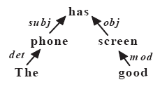
The DP method
DP is a bootstrapping method
Input: a set of seed opinion words,
no aspect seeds needed
Based on dependency grammar (Tesniere 1959).
“This phone has good screen”

Slide 38
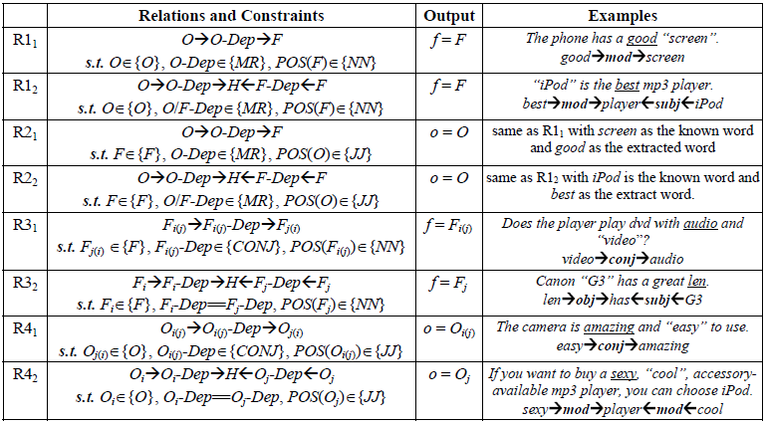
Rules from dependency grammar

Slide 39
Explicit and implicit aspects (Hu and Liu, 2004)
Explicit aspects: Aspects explicitly mentioned as nouns or noun phrases in a sentence
“The picture quality is of this phone is great.”
Implicit aspects: Aspects not explicitly mentioned in a sentence but are implied
“This car is so expensive.”
“This phone will not easily fit in a pocket.”
“Included 16MB is stingy.”
Some work has been done (Su et al. 2009; Hai et al 2011)

Slide 40
(3) Using supervised learning
Using sequence labeling methods such as
Hidden Markov Models (HMM) (Jin and Ho, 2009)
Conditional Random Fields (Jakob and Gurevych, 2010).
Other supervised or partially supervised learning.
(Liu, Hu and Cheng 2005; Kobayashi et al., 2007; Li et al., 2010; Choi and Cardie, 2010; Yu et al., 2011).

Slide 41
Identify aspect synonyms (Carenini et al 2005)
Once aspect expressions are discovered, group them into aspect categories.
E.g., power usage and battery life are the same.
Method: based on some similarity metrics, but it needs a taxonomy of aspects.
Mapping: The system maps each discovered aspect to an aspect node in the taxonomy.
Similarity metrics: string similarity, synonyms and other distances measured using WordNet.

Slide 42
Group aspect synonyms (Zhai et al. 2011a, b)
Unsupervised learning:
Clustering: EM-based.
Constrained topic modeling: Constrained-LDA
By intervening Gibbs sampling.
A variety of information/similarities are used to cluster aspect expressions into aspect categories.
Lexical similarity based on WordNet
Distributional information (surrounding words context)
Syntactical constraints (sharing words, in the same sentence)

Slide 43

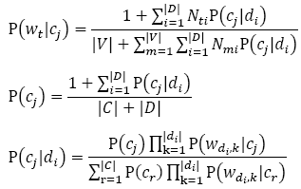
EM method
WordNet similarity
EM-based probabilistic clustering

Slide 44
Aspect sentiment classification
For each aspect, identify the sentiment about it
Work based on sentences, but also consider,
A sentence can have multiple aspects with different opinions.
E.g., The battery life and picture quality are great (+), but the view founder is small (-).
Almost all approaches make use of opinion words and phrases. But notice:
Some opinion words have context independent orientations, e.g., “good” and “bad” (almost)
Some other words have context dependent orientations, e.g., “long,” “quiet,” and “sucks” (+ve for vacuum cleaner)

Slide 45
Aspect Sentiment Classification
“Apple is doing very well in this poor economy”
Lexicon-based approach: Opinion words/phrases
Parsing: simple sentences, compound sentences, conditional sentences, questions, modality verb tenses, etc (Hu and Liu, 2004; Ding et al. 2008; Narayanan et al. 2009).
Supervised learning is tricky:
Feature weighting: consider distance between word and target entity/aspect (e.g., Boiy and Moens, 2009)
Use a parse tree to generate a set of target dependent features (e.g., Jiang et al. 2011)

Slide 46
A lexicon-based method (Ding et al. 2008)
Input: A set of opinion words and phrases. A pair (a, s), where a is an aspect and s is a sentence that contains a.
Output: whether the opinion on a in s is +ve, -ve, or neutral.
Two steps:
Step 1: split the sentence if needed based on BUT words (but, except that, etc).
Step 2: work on the segment s_{f} containing a. Let the set of opinion words in s_{f} be w₁, .., w_{n}. Sum up their orientations (1, -1, 0), and assign the orientation to (a, s) based on:
where w_{i}.o is the opinion orientation of w_{i}. d(w_{i}, a) is the distance from a to w_{i}.

Slide 47
Sentiment shifters (e.g., Polanyi and Zaenen 2004)
Sentiment/opinion shifters (also called valence shifters are words and phrases that can shift or change opinion orientations.
Negation words like not, never, cannot, etc., are the most common type.
Many other words and phrases can also alter opinion orientations. E.g., modal auxiliary verbs (e.g., would, should, could, etc)
“The brake could be improved.”

Slide 48
Sentiment shifters (contd)
Some presuppositional items can change opinions too, e.g., barely and hardly
“It hardly works.” (comparing to “it works”)
It presupposes that better was expected.
Words like fail, omit, neglect behave similarly,
“This camera fails to impress me.”
Sarcasm changes orientation too
“What a great car, it did not start the first day.”
Jia, Yu and Meng (2009) designed some rules based on parsing to find the scope of negation.

Slide 49
Basic rules of opinions (Liu, 2010; 2012)
Opinions/sentiments are governed by many rules, e.g., (many such rules)
Opinion word or phrase: “I love this car”
P ::= a positive opinion word or phrase
N ::= an negative opinion word or phrase
Desirable or undesirable facts: “After my wife and I slept on it for two weeks, I noticed a mountain in the middle of the mattress”
P ::= desirable fact
N ::= undesirable fact

Slide 50
Basic rules of opinions
High, low, increased and decreased quantity of a positive or negative potential item: “The battery life is long.”
PO ::= no, low, less or decreased quantity of NPI | large, larger, or increased quantity of PPI
NE ::= no, low, less, or decreased quantity of PPI
| large, larger, or increased quantity of NPI
NPI ::= a negative potential item
PPI ::= a positive potential item

Slide 51
Basic rules of opinions
Decreased and increased quantity of an opinionated item: “This drug reduced my pain significantly.”
PO ::= less or decreased N
| more or increased P
NE ::= less or decreased P
| more or increased N
Deviation from the desired value range: “This drug increased my blood pressure to 200.”
PO ::= within the desired value range
NE ::= above or below the desired value range

Slide 52
Basic rules of opinions
Producing and consuming resources and wastes: “This washer uses a lot of water”
PO ::= produce a large quantity of or more resource
| produce no, little or less waste
| consume no, little or less resource
| consume a large quantity of or more waste
NE ::= produce no, little or less resource
| produce some or more waste
| consume a large quantity of or more resource
| consume no, little or less waste

Slide 53
Roadmap
Sentiment analysis problem
Document sentiment classification
Sentence subjectivity & sentiment classification
Aspect-based sentiment analysis
Mining comparative opinions
Summary

Slide 54
Comparative Opinions (Jindal and Liu, 2006)
Gradable
Non-Equal Gradable: Relations of the type greater or less than
“The sound of phone A is better than that of phone B”
Equative: Relations of the type equal to
“Camera A and camera B both come in 7MP”
Superlative: Relations of the type greater or less than all others
“Camera A is the cheapest in market”

Slide 55
Analyzing Comparative Opinions
Objective: Given an opinionated document d, Extract comparative opinions:
(E₁, E₂, A, po, h, t),
E₁ and E₂; entity sets being compared
A: their shared aspects - the comparison is based on
po: preferred entity set
h: opinion holder
t: time when the comparative opinion is posted.
Note: not positive or negative opinions.

Slide 56
An example
Consider the comparative sentence
“Canon’s optics is better than those of Sony and Nikon.”
Written by John in 2010.
The extracted comparative opinion/relation:
({Canon}, {Sony, Nikon}, {optics}, preferred:{Canon}, John, 2010)

Slide 57
Common comparatives
In English, comparatives are usually formed by adding -er and superlatives are formed by adding -est to their base adjectives and adverbs
Adjectives and adverbs with two syllables or more and not ending in y do not form comparatives or superlatives by adding -er or -est.
Instead, more, most, less, and least are used before such words, e.g., more beautiful.
Irregular comparatives and superlatives, i.e., more most, less, least, better, best, worse, worst, etc

Slide 58
Some techniques (Jindal and Liu, 2006, Ding et al, 2009)
Identify comparative sentences
Supervised learning
Extraction of different items
Label sequential rules
Conditional random fields (CRF)
Determine preferred entities (opinions)
Lexicon-based methods: Parsing and opinion lexicon
(Yang and Ko, 2011) is similar to (Jindal and Liu 2006)

Slide 59
Analysis of comparative opinions
Gradable comparative sentences can be dealt with almost as normal opinion sentences.
E.g., “optics of camera A is better than that of camera B”
Positive: (camera A, optics)
Negative: (camera B, optics)
Difficulty: recognize non-standard comparatives
E.g., “I am so happy because my new iPhone is nothing like my old slow ugly Droid.”

Slide 60
Identifying preferred entities (Ganapathibhotla and Liu, 2008)
The following rules can be applied
Comparative Negative ::= increasing comparative N
| decreasing comparative P
Comparative Positive ::= increasing comparative P
| decreasing comparative N
E.g., “Coke tastes better than Pepsi”
“Nokia phone’s battery life is longer than Moto phone”
Context-dependent comparative opinion words
Using context pair: (aspect, JJ/JJR)
Deciding the polarity of (battery_life, longer) in a corpus

Slide 61
Roadmap
Sentiment analysis problem
Document sentiment classification
Sentence subjectivity & sentiment classification
Aspect-based sentiment analysis
Mining comparative opinions
Summary

Slide 62
Summary
We discussed
The problem of sentiment analysis
It provides a structure to the unstructured text.
It shows that summarization is crucial.
Main research directions and their representative techniques.
It is a fascinating NLP or text mining problem.
Every sub-problem is highly challenging.
Despite the challenges, applications are flourishing!

