Slide 1
Detecting human activities using smartphones and maps
Leon Stenneth
Adviser: Professor Ouri Wolfson
Co-Adviser: Professor Philip Yu

Slide 2
Road map
Outdoor transportation mode detection
Indoor and outdoor transportation mode detection
Parking status detection
Parking availability estimation

Slide 3
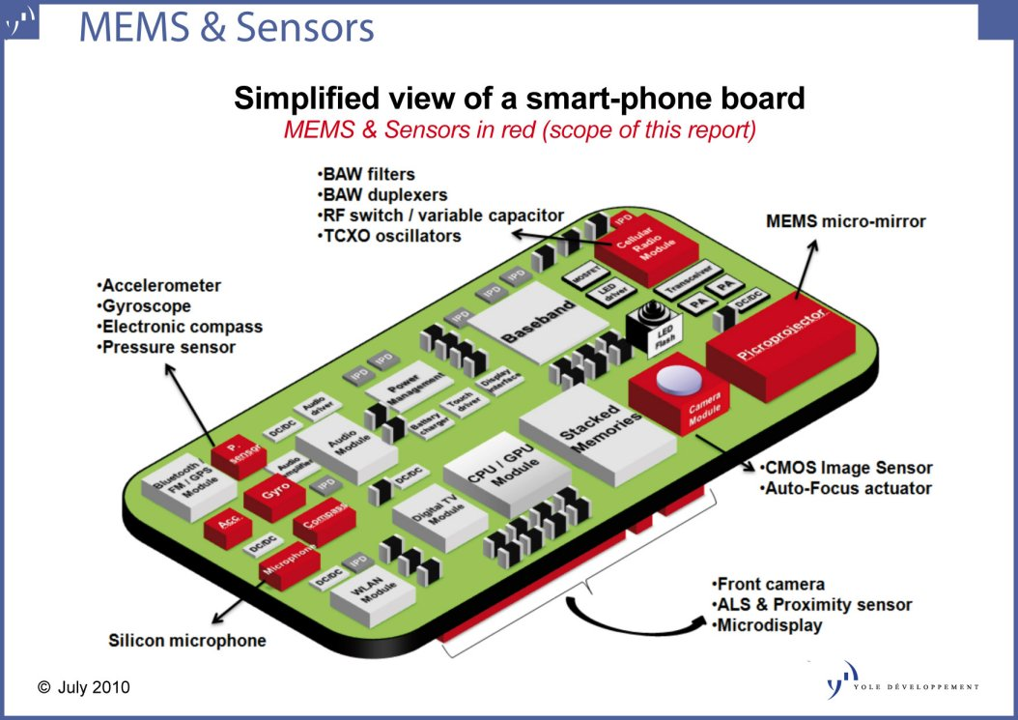
Sensors
Image source:
www.i-micronews.com

Slide 4
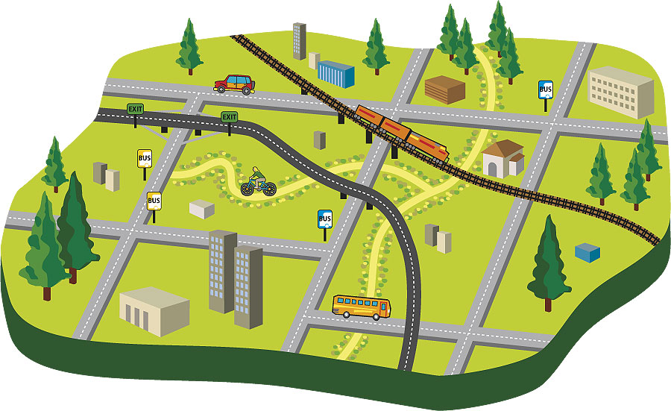
Maps
Bus stop locations, real time bus locations, road network, rail line trajectory, location of parking pay boxes, etc.

Slide 5
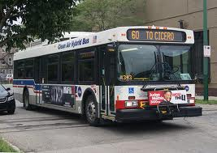
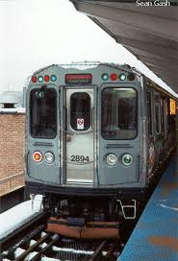
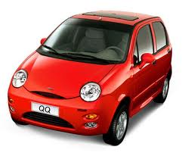
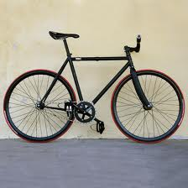

Transportation mode detection using mobile phones and GIS information
Patent filed
Paper published at ACM SIGSPATIAL GIS 2011
20 external citations
Notes:
My name is Leon Stenneth. I am a PhD student at the University of Illinois, Chicago. I work under supervision of Professor Ouri Wolfson and Professor Philip Yu.

Slide 6
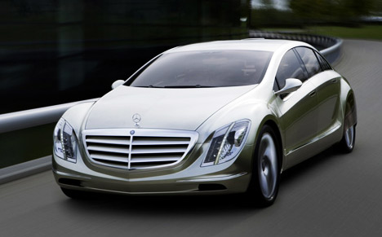

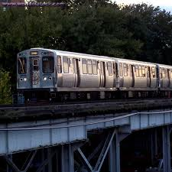
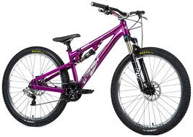


Problem
Detecting a mobile user’s current mode of transportation based on GPS and GIS.
Possible transportation modes considered are:

Slide 7
Motivations
  Value added services (e.g. in Google Maps)
  More customized advertisements can be sent
  Providing more accurate travel demand surveys instead of people manually recording trips and transfers
  Determining a traveler’s carbon footprint.
Notes:
More customized advertisements with example ……….
More accurate travel demand picture.
Carbon Footprint

Slide 8
Contributions
Improve accuracy of detection by 17% for GPS only models
Improve accuracy of detection for 9% compared to GPS/GIS models
Introduce new classification features that can distinguish between motorized and non-motorized modes.

Slide 9
Technique
A supervised machine learning model
New classification features derived by combining GPS with GIS
Trained multiple models with these extracted features and labeled data.

Slide 10
Data model
GPS sensor report: pi = <lat, lon, t, v, h, acc>
GPS trace: T = p0 → p1 → · · · → pk

Slide 11
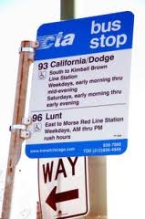
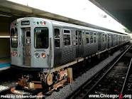
Approach
In addition to traditional features on speed, acceleration, and heading change. We build classification features using GPS and GIS data
Notes:
Chicago transit authority has over 1000 active buses. The real time location of theses buses are available. Likewise, in some other cities. Over 14,000 bus stops. Rail line data is also available.

Slide 12
Features
Traditional
  Speed, acceleration, and heading change
Combining GPS and GIS
  Rail line closeness
  Average bus closeness
  Candidate bus closeness
  Bus stop closeness rate

Slide 13
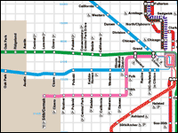
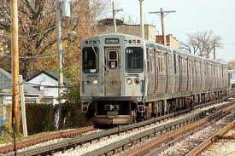
Rail line closeness
ARLC - average rail line closeness
Let {p₁, p₂, p₃, p₄…p_{n}} be a finite the set of GPS reports submitted within a time window.
ARLC = ∑_{i=1 to n} d_{i}^{rail} / n
Notes:
Spatial data on the rail network is considered in the model.

Slide 14
Average bus closeness (ABC)
Let {p₁, p₂, p₃, p₄…p_{n}} be a finite the set of GPS reports submitted within a time window.
ABC = (∑_{i=1 to n} d_{i}^{bus}) / n
Notes:
From the set of all buses we selected the closest bus.

Slide 15
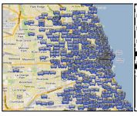
Candidate Bus closeness (CBC)
d_{j.t}^{bus} 1≤j≤m - Euclidian distance to each bus bus_{j}
D_{j} - total Euclidian distance to bus j over all reports submitted in the time window
  D_{j} = ∑_{t=1 to n} d_{j.t}^{bus} 1≤j≤m
Given D_{j} for all the m buses, we compute CBC as follows.
  CBC = min (D_{j}) 1≤j≤m
Notes:
We compute the Euclilidian distance to each bus in the set of all buses that are active in the city. Then the bus with the minimum total Euclilidian distance over the time window is chosen as the candidate bus. The distance to this bus is used as a classification feature.

Slide 16
Bus stop closeness rate (BSCR)
| PS | is the number of GPS reports who's Euclidian distance to the closest bus stop is less than the threshold
BSCR = | PS | / window size
Notes:
Just say the threshold is computed from experiments…..

Slide 17
Machine learning models
We compared five different models then choose the most effective
  Random Forest (RF)
  Decision trees (DT)
  Neural networks (MLP)
  Naïve Bayes (NB)
  Bayesian Network (BN)
WEKA machine learning toolkit

Slide 18
Evaluation matrices
Precision(M)=(number of correctly classified instances of mode M) / (number of instances classified as mode M)
Recall (M) = (number of correctly classified instances of mode M) / (number of instances of mode M)

Slide 19
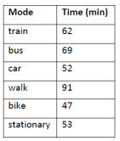

Data set
6 individuals
3 weeks

Slide 20
Results
Random Forest was the most effective model

Slide 21
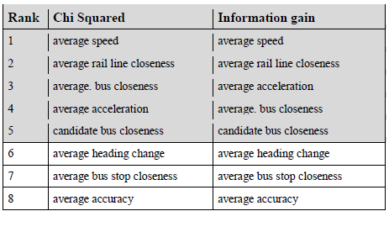
Feature Ranking
Below we rank the features to determine the most effective.

Slide 22
Results
Using the top ranked features only
Precision and recall is shown below

Slide 23
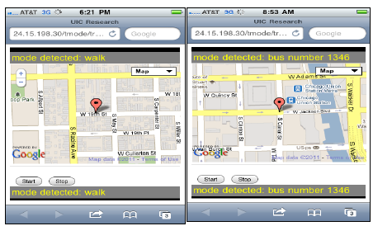
Deployed System
We can provide further information (i.e. route, bus id) on the particular bus one is riding.

Slide 24
Related work with GPS
Liao et. al (2004) – consider the user’s history such as where one parked or bus stop boarded.
Zheng et. al (2008) – Robust set of GPS only features and a change point segmentation method.
Reddy et. al (2010) – Combined accelerometer and GPS to achieve high accuracy.
Notes:
Several papers exist on transportation mode detection……..For a complete list please see the paper. On this slide I just list the three popular related papers.

Slide 25
Conclusion
Using GIS data improves transportation mode detection accuracy.
This improvement is more noticeable for motorized transportation modes.
Only a subset of our initial set of features are needed.
Random forest is the most effective model
We can provide further information about the bus that a user is riding

Slide 26
Limitations and solutions
Using GPS consumes battery power aggressively [explore low power sensors such as BT or accelerometer]
Misclassification of car as rail [map matching using both road and rail artifacts]
The effects of window size on classification feature effectiveness [more experiments]

Slide 27
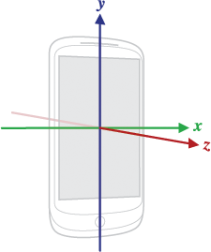
Adding Accelerometer sensor to the model
Acceleration in all three axes
Consumes less energy than GPS
Common on today’s mobile phone (e.g. iPhone)

Slide 28
Adding accelerometer to the model

Slide 29
Contribution of accelerometer
4 % increase in outdoor detection accuracy
Effective for indoor transportation mode detection (stairs, elevator, escalator)
Finer granularity on mode detection (e.g. calorie trackers)

Slide 30
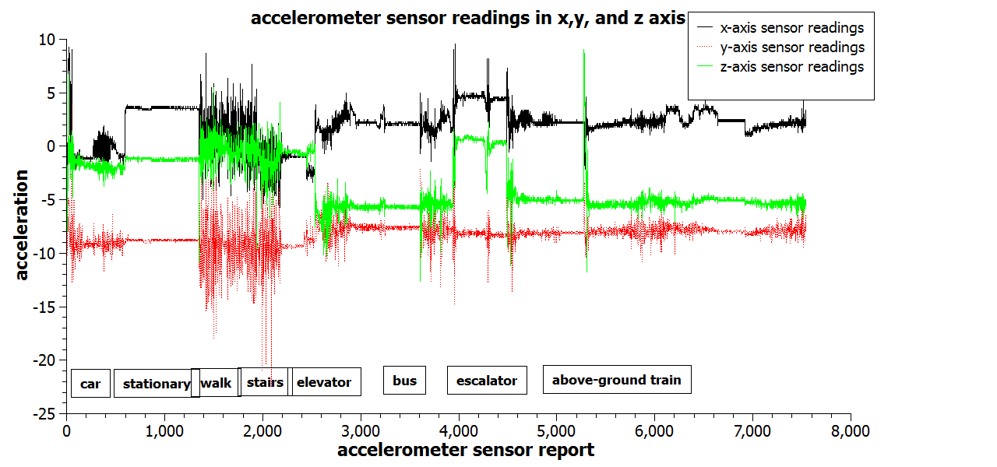
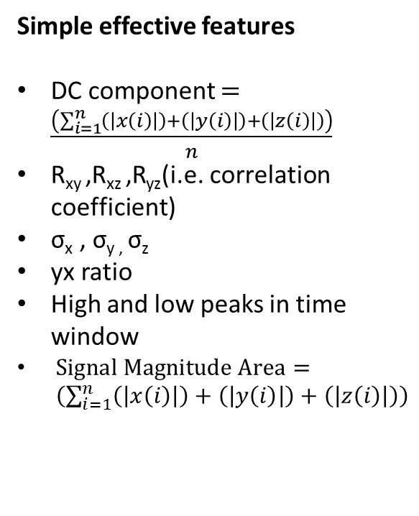
Accelerometer readings
Simple effective features
DC component $=\frac{\left(\sum_{i=1}^{n}{\left(\left|x\left(i\right)\right|\right)+\left(\left|y\left(i\right)\right|\right)+\left(\left|z\left(i\right)\right|\right)}\right)}{n}$
R_{xy} ,R_{xz} ,R_{yz}(i.e. correlation coefficient)
σ_{x} , σ_{y ,} σ_{z}
yx ratio
High and low peaks in time window
$Signal Magnitude Area= \left(\sum_{i=1}^{n}{\left(\left|x\left(i\right)\right|\right)+\left(\left|y\left(i\right)\right|\right)+\left(\left|z\left(i\right)\right|\right)}\right)$

Slide 31
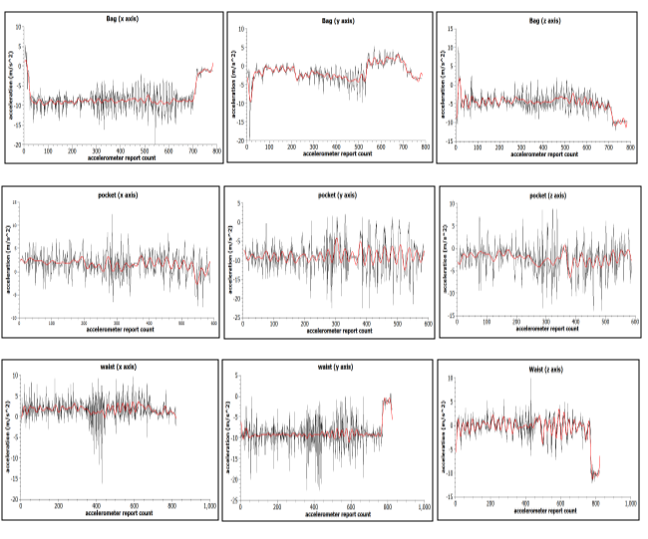
Accelerometer and body position

Slide 32
Results
Random Forest is most effective
Increase in 5.5% for outdoor transportation mode
Detects each indoor (i.e. stairs, elevator, escalator) mode by over 80% accuracy
GPS and GIS model by itself is not effective for indoor transportation mode detection

Slide 33
Limitations of accelerometer study
Small data set
Constrained mobile phone position

Slide 34
Real time street parking availability estimation
Motivation
  Vehicles searching for parking in LA business district
    CO2 emission (730 tons in 1yr)
    Waste gasoline (burnt 47K gals 1yr)
    Waste time (38 trips around the world)

Slide 35
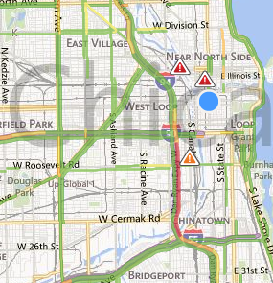
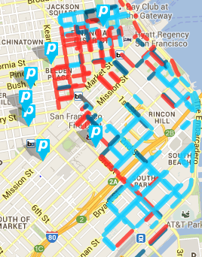
Real-time street parking availability estimation
The traffic product – sparse probes, map matching, map, travel speed, tta, color maps indicating current travel speed.

Slide 36

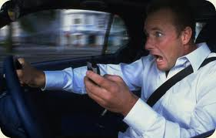
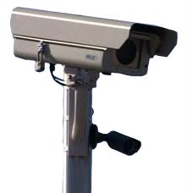
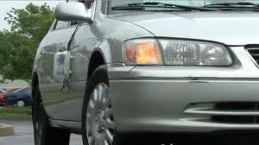
Parking status detection (PSD)
Determines spatial-temporal property of parking event (maybe parking probes)
Image sources: http://videos.nj.com/, http://pocketnow.com/smartphone-news/
http://sf.streetsblog.org

Slide 37
Parking status detectors (PSD)
Contribution to PSD: Three less expensive techniques to detect spatial and temporal property parking events using mobile phones [patent pending]

Slide 38
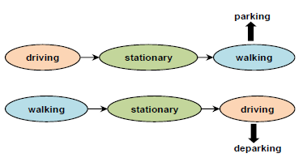
Our schemes for PSD

Slide 39
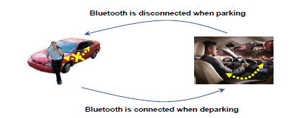
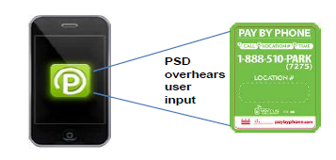
Our schemes for PSD

Slide 40
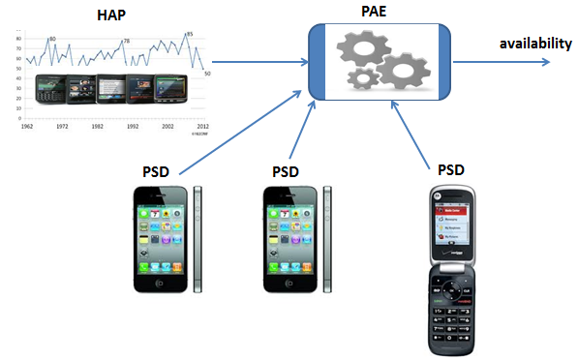
Street parking estimation model
Estimate the number of available parking spaces on a street block.
  PSD – Parking status detector
  HAP – Historical availability profile
  PAE – Parking availability estimator
false +
false -
location errors
false –
false +

Slide 41
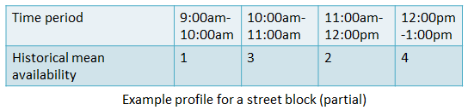


HAP construction scheme
estimates the historic mean (i.e. ) and variance (i.e. ) of parking
relevant terms
  prohibited period, permitted period (PP_{i}), fp, fn, b, N
  $\hat{q}\text{(}\text{t}\text{)}$
  $\hat{Q}\text{(}\text{t}\text{)}$

Slide 42
Historical availability profile (HAP) Algorithm
Start with a time at which the street block is fully available, e.g., end of a prohibited time interval (start permitted period)
When a parking report is received, availability is reduced by:
Deparking causes increase of availability by same factor
fp: false positive probability
b: penetration ratio
(uniform distribution)
fn: false negative probability
Justification:
1. Each report (statistically) corresponds to 1/b actual parking
2. 1/(1−fn) reports should have been received if there were no false negatives
3. The report is correct with 1−fp probability

Slide 43
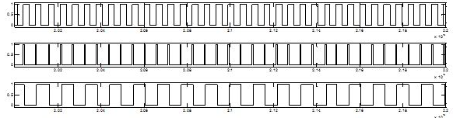
HAP algorithm
Permitted period 1
Permitted period 2
Permitted period 3
Permitted
period m

Slide 44

HAP algorithm termination condition
HAP terminates when the difference between q(t) and is less than x parking spaces with k% confidence.
Automatically determines m.
  $\hat{q}\text{(}\text{t}\text{)}$

Slide 45
Computing confidence
Assumptions
  PSD vehicles are uniformly distributed among all vehicles
  Parking activities are detected independently of each other.
  are identically and independently distributed
See upcoming lemmas:

Slide 46
Computing confidence
Lemma 1:
Proof
  p_{i}(t)|P_{i}(t)∼Binomial(P_{i}(t), b⋅(1−fn)) 1.
  d_{i}(t)|D_{i}(t)∼Binomial(D_{i}(t), b⋅(1−fn)) 2.
  From 1.
  Thus,

Slide 47
Computing confidence
Also showed that for i=1,2,…, m.
.

Slide 48
More specifically:
Example:
  If we want error < 2 with 90% confidence,
    standard deviation of the estimation is 10 (i.e., the average fluctuation of estimated availability at the 8:00am is 10).
  then we need 68 permitted periods.
    i.e. about two months of data.
Cumulative distribution function of normal distr.
Number of samples , or permitted periods
Estimation average
True average
Estimation variance

Slide 49
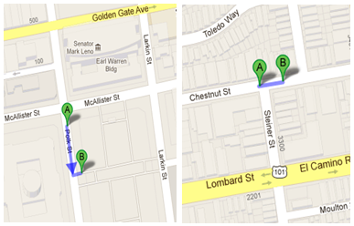
Evaluation of HAP
Real parking signals from SF Park
Simulated errors (i.e. fp and fn)

Slide 50
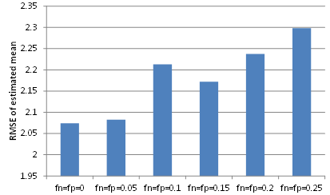

HAP Results
  RMSE between q$\text{(}\text{t}) and \hat{q}\text{(}\text{t}\text{)}$ , b = 1%
Polk St. block
12 spaces available

Slide 51
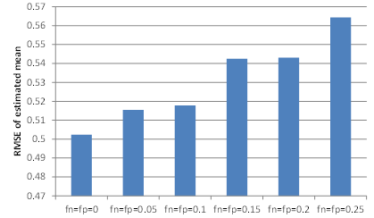
HAP Results
  RMSE between q$\text{(}\text{t}) and \hat{q}\text{(}\text{t}\text{)}$ , b = 1%
Chestnut St. block
4 spaces available

Slide 52
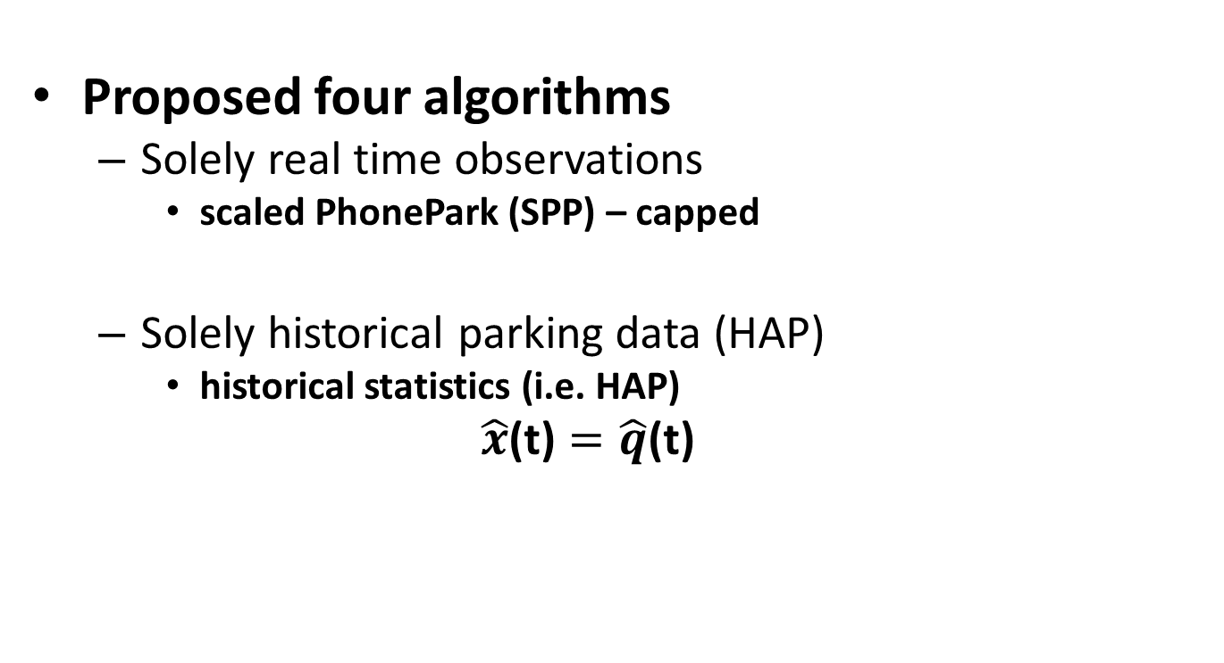
Parking availability estimation (PAE) algorithms
Proposed four algorithms
  Solely real time observations
    scaled PhonePark (SPP) – capped
  Solely historical parking data (HAP)
    historical statistics (i.e. HAP)
  $$\hat{x}\text{(}\text{t}\text{)}=\hat{q}\text{(}\text{t}\text{)}$$

Slide 53
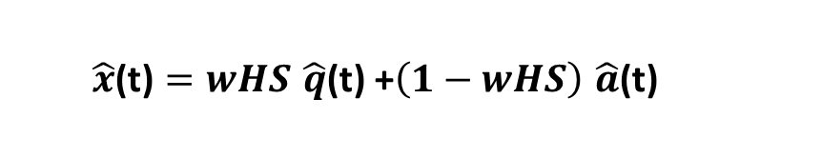
Parking Availability Estimation (PAE)
Combining history (i.e. HAP) with real time
  Weighted average with pre-fitted weights
  $$\hat{x}\text{(}\text{t}\text{)}=wHS \hat{q}\text{(}\text{t}\text{) +}\left(1−wHS\right) \hat{a}\text{(}\text{t}\text{)}$$

Slide 54
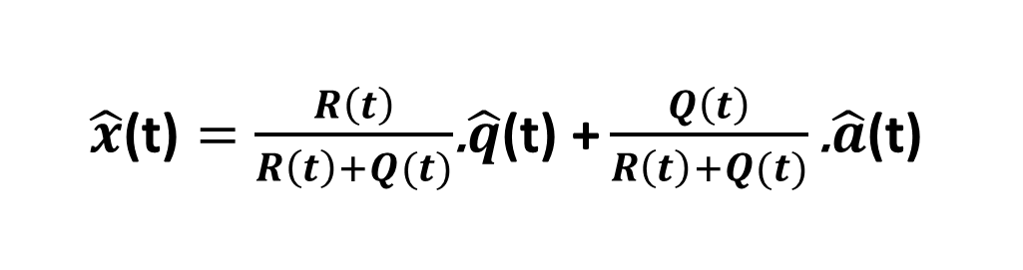
Parking Availability Estimation (PAE)
combining history (i.e. HAP) with real time
  Kalman Filter estimation (KF)
  $\hat{x}\text{(}\text{t}\text{)}=\frac{R\left(t\right)}{R\left(t\right)+Q(t)}$.$\hat{q}\text{(}\text{t}\text{) +}\frac{Q\left(t\right)}{R\left(t\right)+Q(t)}\text{.} \hat{a}\text{(}\text{t}\text{)}$

Slide 55

PAE results
  RMSE between x$\text{(}\text{t}) and \hat{x}\text{(}\text{t}\text{)}$ for street block
  b =1 % , see for b = 50% in paper

Slide 56
PAE results
  Boolean availability i.e. at least one slot available
  b =1 %

Slide 57
Conclusion
We can provide reasonable parking availability estimation that does not deviate from the true availability by too much.
Works under low penetration ratio (e.g. b=1%)
Robust to false+ and false- errors

Slide 58
Limitations and solutions
PSD penetration ratio can be low. [Can we use signals from neighboring blocks?]
PAE algorithms did not consider the previous known parking availability at time t-1 for a street block [try to combine history & previous & current parking observations]

Slide 59
Current work
Increasing parking signals by using signals from neighboring blocks

Slide 60
Current work

Slide 61
Future work
Temporal correlations
Incorporating neighboring signals in Kalman Filter
Incorporating parking availability at previous epoch in the model
New parking status detectors(e.g. acoustic sensors)

Slide 62
The end
Thanks you for your time
Questions……….

