Slide 1
ADA: Arithmetic Operations with Adaptive TCAM Population in Programmable Switches
Mojtaba Malekpourshahraki¹
Brent E. Stephens²
Balajee Vamanan¹
1: University of Illinois at Chicago
2: The University of Utah
Email: mmalek3@uic.edu

Slide 2
Arithmetic operations are ubiquitous
Most real-world applications involve arithmetic operations
Programmers assume arithmetic operations are universally supported in all devices
Also true for most network applications
RCP
XCP
Conga
Programmable switches do NOT support many arithmetic operations

Slide 3
PISA architecture limits arithmetic operations
Programable switches
Support packet header modifications at high rate
Match on headers and modify headers
Match
Action
Match on all or some part of
the header
Header modification by hashing
operation or basic arithmetic
The architecture of programable switches is not amenable to support complex arithmetic operations such as multiplication

Slide 4
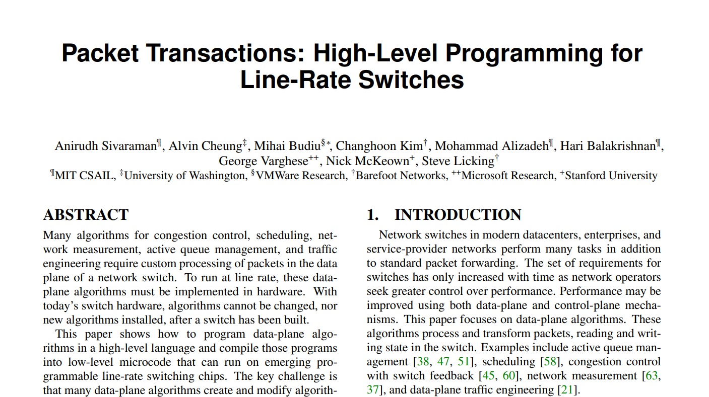
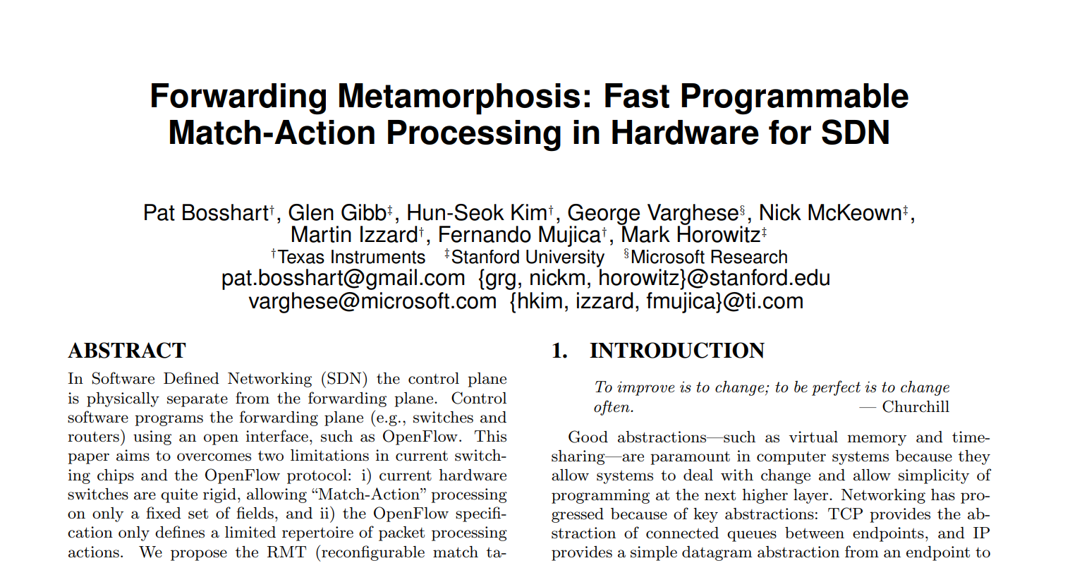
Programable networks are hot
Introducing data plane processing flexibility
Use reconfigurable match-action table (RMT)
2013
2016
2017
2018
2019
2020
2021
SilkRoad
Load Balancing
PIFO, UPS
PIEO, Ether
AIFO, SP-PIFO
Scheduling
Forwarding
metamorphosis
Mantis
NFV
Precision
NetSeer, Mantis
Aquila
Measurement/Monitoring
Loom
FairNIC
HCSFQ, Nimble, Sailfish
Fairness
NetLock
System

Slide 5
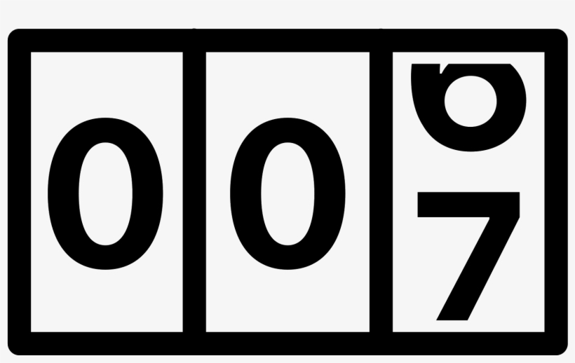
Our experience with programable networks …
Simple rate limiter on PISA via packet drops
Rate limiters using counters
Using counters to emulate a queue
Drop the packet if queue size exceeds drop threshold
2013
2016
2017
2018
2019
2020
2021
SilkRoad
Load Balancing
PIFO, UPS
PIEO, Ether
AIFO, SP-PIFO
Scheduling
Forwarding
metamorphosis
Mantis
NFV
Precision
NetSeer, Mantis
Aquila
Measurement/Monitoring
Loom
FairNIC
HCSFQ, Nimble, Sailfish
Fairness
NetLock
System
Tracking time
Desirable rate
Incoming packets
$$Queuebytes= time×TargetRate$$
Drop?
Outgoing packets

Slide 6
And heartburns!
Programmer
BMv2
PISA Switches
expression too complex
Supported operations
Arithmetic operations: addition, subtraction
Logical operations: left and right bit-shifts
Header modification
Hashing operation
ALU is limited
Process standard arithmetic operations, shift bit, header modification, hashing operation
Unsupported operations
Multiplication
Division

Slide 7
Agenda
Problem statement
Background
Motivation
Design
Control plane
Data plane
Evaluation

Slide 8
Naive solution: Lookup tables
Using TCAM to lookup the result
Requires too many entries
$$X$$
$$Y$$
$$Q$$
$$0 0 0$$
$$0 0 0$$
$$0 0 0$$
$$0 0 1$$
$$0 0 0$$
$$0 0 0$$
$$0 1 0$$
$$0 0 0$$
$$0 0 0$$
$$0 1 1$$
$$0 0 0$$
$$0 0 0$$
$$1 0 0$$
$$0 0 0$$
$$0 0 0$$
$$1 0 1$$
$$0 0 0$$
$$0 0 0$$
$$1 1 0$$
$$0 0 0$$
$$0 0 0$$
$$1 1 1$$
$$0 0 0$$
$$0 0 0$$
$$0 0 0$$
$$0 0 1$$
$$0 0 0$$
$$0 0 1$$
$$0 0 1$$
$$0 0 1$$
E$ntries= 2^{3}×2^{3}=64$
$$0 1 0$$
$$0 0 1$$
$$0 1 0$$
$$0 1 1$$
$$0 0 1$$
$$0 1 1$$
$$1 0 0$$
$$0 0 1$$
$$1 0 0$$
$$1 0 1$$
$$0 0 1$$
$$1 0 1$$
$$1 1 0$$
$$0 0 1$$
$$1 1 0$$
$$1 1 1$$
$$0 0 1$$
$$1 1 1$$

Slide 9
Slightly improved solution: longest prefix match (LPM)
Grouping numbers such that
Numbers in the group are close
Each group has a group head
Using group head to calculate the product
$$X$$
$$Y$$
$$Q$$
$$0 0 0$$
$$0 0 0$$
$$0 0 0$$
$$0 0 1$$
$$0 0 0$$
$$0 0 0$$
$$0 1 0$$
$$0 0 0$$
$$0 0 0$$
$$0 1 1$$
$$0 0 0$$
$$0 0 0$$
$$1 0 0$$
$$0 0 0$$
$$0 0 0$$
$$1 0 1$$
$$0 0 0$$
$$0 0 0$$
$$1 1 0$$
$$0 0 0$$
$$0 0 0$$
$$1 1 1$$
$$0 0 0$$
$$0 0 0$$
$$0 0 0$$
$$0 0 1$$
$$0 0 0$$
$$0 0 1$$
$$0 0 1$$
$$0 0 1$$
$$0 1 0$$
$$0 0 1$$
$$0 1 0$$
$$0 1 1$$
$$0 0 1$$
$$0 1 1$$
$$1 0 0$$
$$0 0 1$$
$$1 0 0$$
$$1 0 1$$
$$0 0 1$$
$$1 0 1$$
$$1 1 0$$
$$0 0 1$$
$$1 1 0$$
$$1 1 1$$
$$0 0 1$$
$$1 1 1$$

Slide 10
Slightly improved solution: longest prefix match (LPM)
Using longest prefix match to group entries
Less entries is needed
No flexibility in adjusting error rate and
number of entries
New $X$
$$X$$
$$Y$$
$$Q$$
$$0 0 0$$
$$0 0 0$$
$$0 0 0$$
$$0 0 0$$
$$0 0 1$$
$$0 0 1$$
$$0 0 0$$
$$0 0 0$$
$$0 1×$$
$$0 1 0$$
$$0 0 0$$
$$0 0 0$$
$$0 1 1$$
$$0 0 0$$
$$0 0 0$$
$$1 0 0$$
$$0 0 0$$
$$0 0 0$$
$$1× ×$$
$$1 0 1$$
$$0 0 0$$
$$0 0 0$$
$$1 1 0$$
$$0 0 0$$
$$0 0 0$$
$$1 1 1$$
$$0 0 0$$
$$0 0 0$$
$$0 0 0$$
$$0 0 0$$
$$0 0 1$$
$$0 0 0$$
$$0 0 1$$
$$0 0 1$$
$$0 0 1$$
$$0 0 1$$
Entries $=4×2^{3}$
$$0 1×$$
$$0 1 0$$
$$0 0 1$$
$$0 1 0$$
$$0 1 1$$
$$0 0 1$$
$$0 1 1$$
$$1 0 0$$
$$0 0 1$$
$$1 0 0$$
$$1× ×$$
$$1 0 1$$
$$0 0 1$$
$$1 0 1$$
$$1 1 0$$
$$0 0 1$$
$$1 1 0$$
$$1 1 1$$
$$0 0 1$$
$$1 1 1$$

Slide 11
LPM with adjustable significant bit
Significant bits (b=2)
Significant bits (b=1)
New $X$
$$X$$
New $X$
$$X$$
$$Y$$
$$Q$$
$$0 0 0$$
$$0 0 0$$
$$0 0 0$$
$$0 0 0$$
$$0 0 0$$
$$0 0 0$$
$$0 0 1$$
$$0 0 1$$
$$0 0 1$$
$$0 0 1$$
$$0 0 0$$
$$0 0 0$$
$$0 1 0$$
$$0 1 0$$
$$0 1×$$
$$0 1 0$$
$$0 0 0$$
$$0 0 0$$
$$0 1 1$$
$$0 1 1$$
$$0 1 1$$
$$0 0 0$$
$$0 0 0$$
$$1 0×$$
$$1 0 0$$
$$1 0 0$$
$$0 0 0$$
$$0 0 0$$
$$1 0 1$$
$$1× ×$$
$$1 0 1$$
$$0 0 0$$
$$0 0 0$$
$$1 1×$$
$$1 1 0$$
$$1 1 0$$
$$0 0 0$$
$$0 0 0$$
$$\text{Entries} =6×2^{3}$$
$$1 1 1$$
$$1 1 1$$
$$0 0 0$$
$$0 0 0$$
Entries $=4×2^{3}$
$$0 0 0$$
$$0 0 0$$
$$0 0 0$$
$$0 0 0$$
$$0 0 1$$
$$0 0 0$$
$$0 0 1$$
$$0 0 1$$
$$0 0 1$$
$$0 0 1$$
$$0 0 1$$
$$0 0 1$$
$$0 1 0$$
$$0 1 0$$
$$0 1×$$
$$0 1 0$$
$$0 0 1$$
$$0 1 0$$
$$0 1 1$$
$$0 1 1$$
$$0 1 1$$
$$0 0 1$$
$$0 1 1$$
$$1 0×$$
$$1 0 0$$
$$1 0 0$$
$$0 0 1$$
$$1 0 0$$
$$1 0 1$$
$$1× ×$$
$$1 0 1$$
$$0 0 1$$
$$1 0 1$$
$$1 1×$$
$$1 1 0$$
$$1 1 0$$
$$0 0 1$$
$$1 1 0$$
$$1 1 1$$
$$1 1 1$$
$$0 0 1$$
$$1 1 1$$

Slide 12
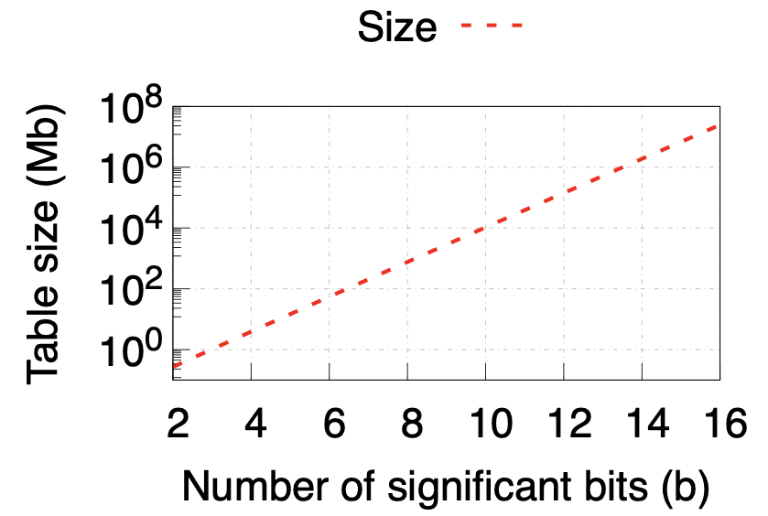
Problems with TCAM population
Error propagation
Large error for larger values
Large table sizes
It can make the system unstable
Regardless of the number of
significant bits, large numbers
incur large error
There are less than 300 entries
Very small portion of the variables can fit in
$$X$$
$$x_{new}=f(x_{old})$$
0
$$0 0 0$$
1
$$0 0 1$$
$$RTT_{n}=α∗rtt+\left(1−α\right)∗RTT_{n−1}$$
2,3
$$0 1×$$
Logscale
4,5,6,7
$$1× ×$$
Propagated error
Drop
Queue size
Error (%)
Error
0
Iteration
n
0
0
0
Value
$$2^{|X|}$$
How to use limited size TCAMs and avoid these problems?

Slide 13
Key insights
Repopulate when distribution change
Populate based on distribution
$$R×T$$
R=100,50,25Gbps
T=[0,6000]
Naïve
Finding the distribution of variables is the key to reduce TCAM usage without sacrificing accuracy.
R
T
100Gbps
0ns
Distribution of R, T
R
T
100Gbps
6000ns
100Gbps
0ns
50Gbps
0ns
R
T
2ns
100Gbps
0ns
0-1s
0-1s
300ns
50Gbps
6000ns
25Gbps
0ns
100Gbps
6000ns
1000ns
100Gbps
4000ns
6000ns
25Gbps
6000ns

Slide 14
Agenda
Problem statement
Background
Motivation
Design
Control plane
Data plane
Evaluation

Slide 15
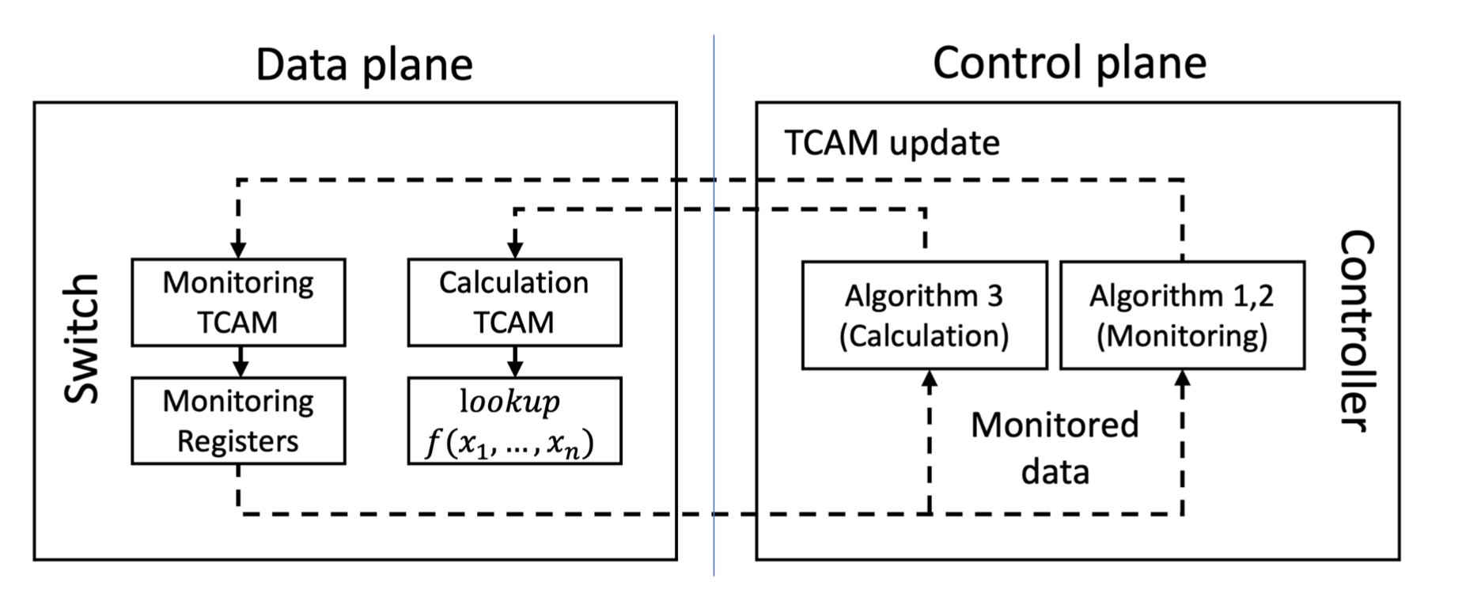
ADA design
Data plane goals
Control plane goals
Find the distribution of the variables
Lookup the multiplication
Collect distribution data
Generate a new multiplication TCAM table
Change the monitoring TCAM table if needed
Calculate the result of the operand
Monitor variables
Populate arithmetic table
Update Monitoring table

Slide 16
How to detect distribution?
Using binning mechanism to find the distribution
Using TCAM to implement bins and trie structure to abstract bins
Using registers to keep statistics
Find bin
Bin3
$$X=300$$
Bin 1
Bin 2
Bin 3
Bin 4
A trie structure
$$X×Y$$
Bin 3
Bin2
$$Y=15$$
Registers
LPM on TCAM
Bin 1
Bin 2
Bin 3
Bin 4
Bin 2

Slide 17
Binnig abstraction
Using a trie to model the bins
Traverse from root to leaf → find an entry for TCAM
Example: 3 bits:
Init
Init
Monitoring TCAM(s)
Registers for V1
$$r_{1}$$
$$E R$$
0
1
0
1
Bin 1
$$\text{00}\text{X}$$
$$r_{1}$$
5
0
1
0
1
0
1
0
1
Bin 2
$$\text{0}\text{1}\text{X}$$
$$r_{2}$$
14
Bin 3
$$\text{1}\text{0}\text{X}$$
$$r_{3}$$
1
X
X
X
X
00X
01X
10X
11X
Bin 4
$$\text{1}\text{1}\text{X}$$
$$r_{4}$$
2
00X
01X
10X
11X
Bin 1
Bin 2
Bin 3
Bin 4

Slide 18
ADA design
Multiplication TCAM
$$X × Y = Q$$
$$x_{1}$$
$$y_{1}$$
$$q_{1}$$
$$x_{2}$$
$$y_{2}$$
$$q_{2}$$
$$x_{3}$$
$$y_{3}$$
$$q_{3}$$
Monitoring TCAM(s)
Registers
$$E R$$
Init
Bin 1
$$\text{00}\text{X}$$
$$r_{1}$$
Increase
$$r_{1}$$
0
v1=2
Bin 2
$$\text{0}\text{1}\text{X}$$
$$r_{2}$$
$$r_{2}$$
0
0
1
Bin 3
$$\text{1}\text{0}\text{X}$$
$$r_{3}$$
$$r_{3}$$
0
Bin 4
$$\text{1}\text{1}\text{X}$$
$$r_{4}$$
$$r_{4}$$
0
0
1
0
1
00X
01X
10X
11X
Update v1

Slide 19
ADA design
Multiplication TCAM
$$X × Y = Q$$
$$x_{1}$$
$$y_{1}$$
$$q_{1}$$
$$x_{2}$$
$$y_{2}$$
$$q_{2}$$
$$x_{3}$$
$$y_{3}$$
$$q_{3}$$
Registers
Monitoring TCAM(s)
Registers
$$E R$$
Init
$$\text{00}\text{X}$$
$$r_{1}$$
$$r_{1}$$
Bin 1
$$r_{1}$$
3
0
$$\text{0}\text{1}\text{X}$$
$$r_{2}$$
$$r_{2}$$
Bin 2
$$r_{2}$$
14
0
1
1
Bin 3
$$\text{1}\text{0}\text{X}$$
$$r_{3}$$
$$r_{3}$$
$$r_{3}$$
1
0
0
1
Bin 4
$$\text{1}\text{1}\text{X}$$
$$r_{4}$$
$$r_{4}$$
0
1
$$r_{4}$$
2
0
00X
01X
10X
11X
Update v1

Slide 20
ADA design
Example: proportion to frequency
Bin 1
$$\text{00}\text{X}$$
15% of entries
Bin 2
$$\text{0}\text{1}\text{X}$$
80% of entries
Multiplication TCAM
Bin 3
$$\text{1}\text{0}\text{X}$$
5% of entries
$$X × Y = Q$$
Bin 4
$$\text{1}\text{1}\text{X}$$
10% of entries
$$x_{1}$$
$$y_{1}$$
$$q_{1}$$
$$x_{2}$$
$$y_{2}$$
$$q_{2}$$
$$x_{3}$$
$$y_{3}$$
$$q_{3}$$
Update TCAM. Based on Algorithm 3
Monitoring TCAM(s)
Registers
$$E R$$
Init
Bin 1
$$\text{00}\text{X}$$
$$r_{1}$$
$$r_{1}$$
3
Bin 2
$$\text{0}\text{1}\text{X}$$
$$r_{2}$$
$$r_{2}$$
14
0
1
Bin 3
$$\text{1}\text{0}\text{X}$$
$$r_{3}$$
$$r_{3}$$
1
Feedback
Bin 4
$$\text{1}\text{1}\text{X}$$
$$r_{4}$$
$$r_{4}$$
2
0
1
0
1
00X
01X
10X
11X
14
1
2
Divide
Merge
Update v1

Slide 21
ADA design
Example: proportion to frequency
Bin 1
$$\text{00}\text{X}$$
15% of entries
Bin 2
$$\text{0}\text{1}\text{X}$$
80% of entries
Multiplication TCAM
Bin 3
$$\text{1}\text{0}\text{X}$$
5% of entries
$$X × Y = Q$$
Bin 4
$$\text{1}\text{1}\text{X}$$
10% of entries
$$x_{1}$$
$$y_{1}$$
$$q_{1}$$
$$x_{2}$$
$$y_{2}$$
$$q_{2}$$
$$x_{3}$$
$$y_{3}$$
$$q_{3}$$
Update TCAM. Based on Algorithm 3
Registers
Monitoring TCAM(s)
Registers
$$E R$$
Init
$$\text{00}\text{X}$$
$$r_{1}$$
$$r_{1}$$
Bin 1
$$r_{1}$$
0
0
$$\text{0}\text{1}\text{X}$$
$$r_{2}$$
$$r_{2}$$
0
1
Bin 2
$$r_{2}$$
0
1
Bin 3
$$\text{1}\text{0}\text{X}$$
$$r_{3}$$
$$r_{3}$$
$$r_{3}$$
0
0
Feedback
0
1
1XX
Bin 4
$$\text{1}\text{1}\text{X}$$
$$r_{4}$$
$$r_{4}$$
$$r_{4}$$
0
0
3
00X
0
1
010
011
6
8
Update v1

Slide 22
Evaluation
Network Stand-alone simulator
Accuracy and integrity
Adaptive increment
Testbed Experiments
Experiment with limited entries
Large scale simulation

Slide 23
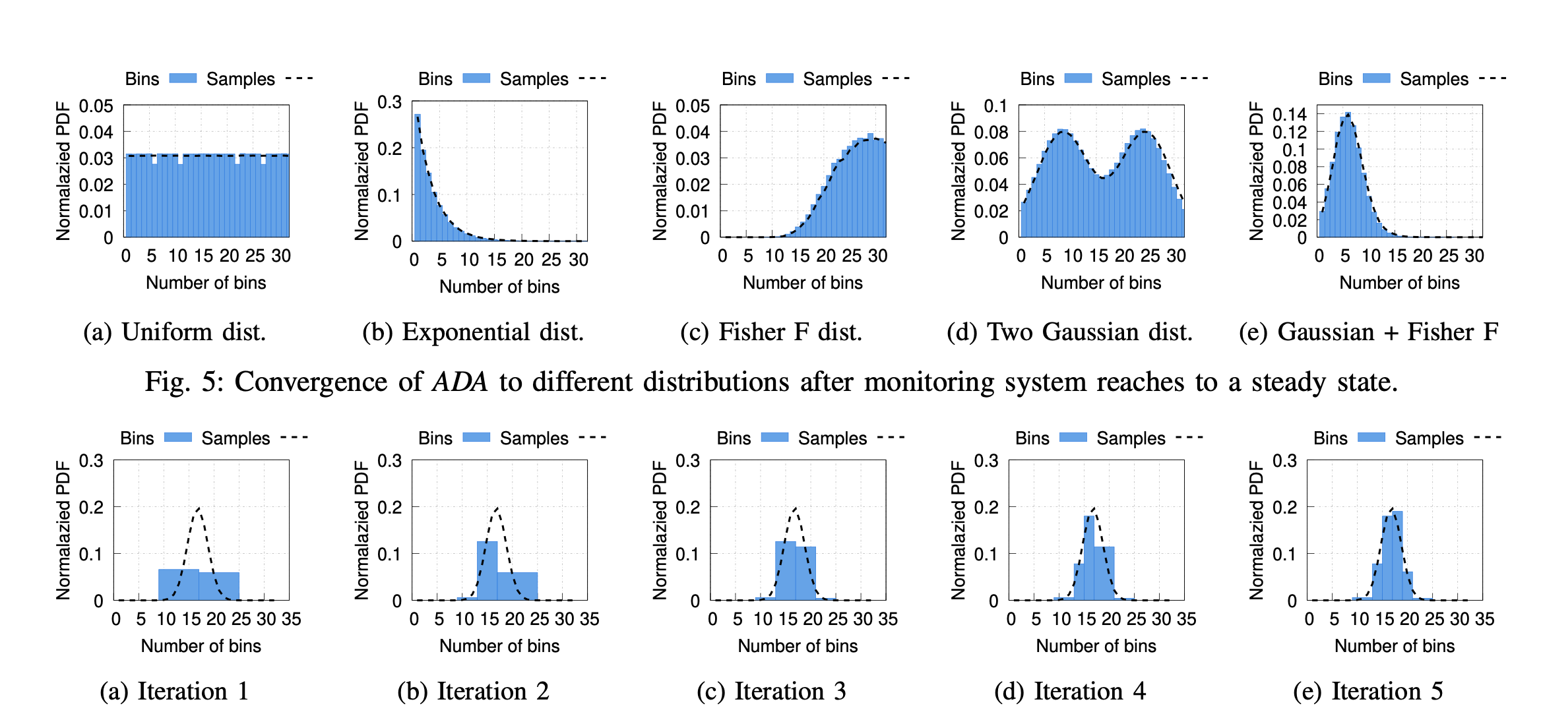
Stand-alone simulator - Accuracy and integrity
Binning of different distributions

Slide 24
Stand-alone simulator - Adaptive increment
Convergence if ADA with increasing entries in each iterations

Slide 25
Real implementation in Tofino
Language: ADA Implementation in P4, and Python
Running agent: Barefoot Tofino Wedge 100BF-32X Ethernet switch
Traffic:
Single flow between two machines
Using 16 parallel iperf3 connections
Traffic from a DCTCP enabled client to a server at a full line
ADA parameters
Total of 128 entries for approximate multiplication
Total of 12 entries for the monitoring each variable
$$Nimble$$

Slide 26
Real implementation - ADA with limited entries
Nimble fails without ADA due to the match with entries with large errors
ADA change the table adaptively and doesn’t interrupt the system
ADA prevents the system
from being unstable

Slide 27
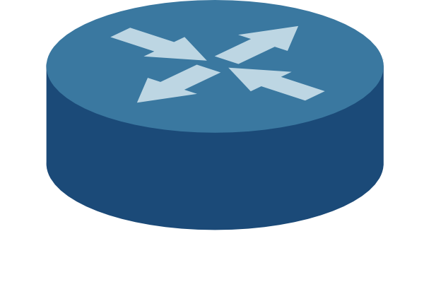
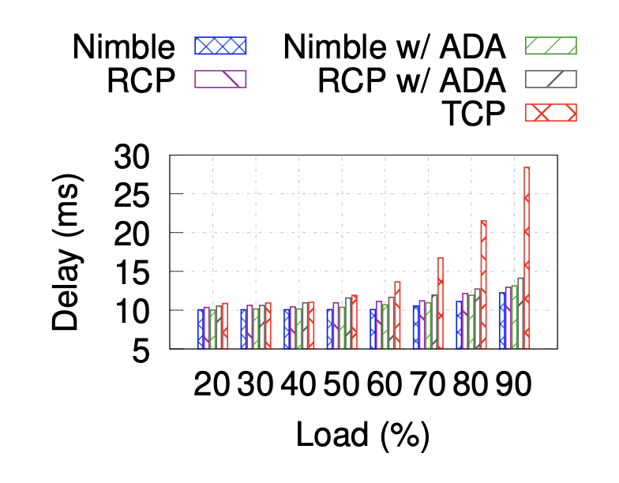
Large scale simulation
Topology
Leaf-spine topology with 400 servers and 20 ToR switches
100 Gbps links with a link delay of 1 µs
Workloads
Mix of short flows (8 - 32 KB) and long flows (1 MB)
Testing 99th percentile FCT for ideal Nimble and
RCP with and without ADA
All approaches with ADA work as good as
the ideal case
Notes:
Tcp is baseline

Slide 28
Thank you for your attention
Questions?
Mojtaba Malekpourshahraki
Email: mmalek3@uic.edu
Website: cs.uic.edu/~mmalekpo

