Slide 1
Ward: Implementing Arbitrary Hierarchical Policies using Packet Resubmit in Programmable Switches
Mojtaba Malekpourshahraki
Brent Stephens
Balajee Vamanan

Slide 2
Modern datacenter
Datacenters host multiple applications with different requirements
Memcache
Spark
Backup and replication
Datacenters host multiple competing tenants
Private datacenters
Facebook → Product and applications groups
Public datacenters
Microsoft Azure → Users renting virtual machines
Multiple tenants and diverse applications per tenant cause contention problem

Slide 3
Multi-tenancy problems
Fairness
Large flows may saturate the whole bandwidth
Long delay for short flows
Pricing and SLA
Better service for more money
How to handle these problems?
Datacenter needs to isolate the traffic based on a predefined policy

Slide 4
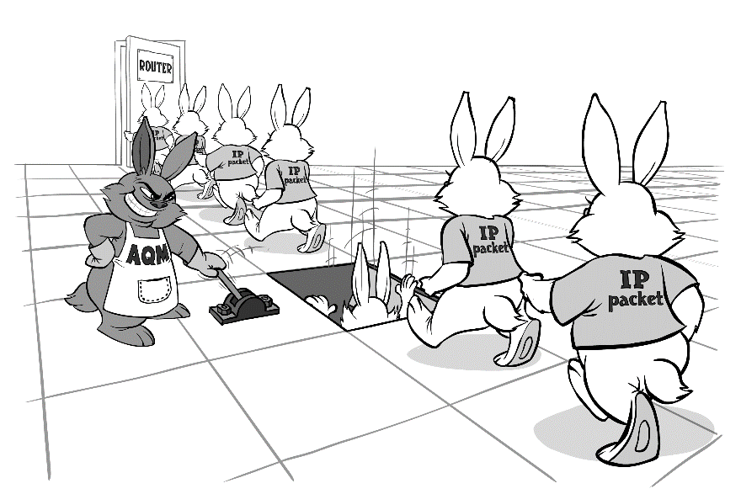
How to enforce desirable policies
Enforce policies using:
Congestion control algorithms
Use congestion signals to change the source sending rate
Schedulers
Change the dequeue to enforce desirable policy

Slide 5
Approaches with policy considerations
Two types of approaches
End-host based (end-to-end)
Switch based
At end-hosts
Fastpass
Sincronia
Trinity
EyeQ
pHost
Silo
Utopia
2013
2014
2015
2016
2017
2018
2019
PIAS
UPS
AFQ
In switches
pFabric
PIFO
Slytherin
PIEO

Slide 6
End-host based approaches
End-host
Has many queues → only at the end host doesn’t need our requirement
Shortcomings
Waste of resource
pHost (Sending RTS)
Silo (Limiting burst size)
High computational overhead
Fastpass (Centralized)
At end-hosts
Fastpass
Sincronia
Trinity
EyeQ
pHost
Silo
Utopia
2013
2014
2015
2016
2017
2018
2019
In switch approaches perform faster than end-to-end schedulers
Notes:
Hard to implement
Utopia (Flow classifier)

Slide 7
PIFO [SIGCOMM, 2016]/PIEO [SIGCOMM, 2019]
PIFO/PIEO:
Can implement complex hierarchical programmable scheduling policies
PIFO/PIEO resources on a switch are limited (less than 100 queues)
Cannot have all possible scheduler
The number of required queues increases with the number of traffic class
2013
2014
2015
2016
2017
2018
2019
PIAS
UPS
AFQ
In switches
pFabric
PIFO
Slytherin
PIEO

Slide 8
Key question!
Can we implement any arbitrary hierarchical policy with limited switch resources in programmable switches?
Ward

Slide 9
Ward - Policy abstraction
Different types of flows, applications, and tenants
Represent with hierarchical policy
Directed acyclic graph (DAG)
Tenant 1
$$\frac{C}{2}$$
Tenant 1
Tenant 2
$$C$$
Tenant 2
Pri
WFQ
Strict priority for Memcashed over backup traffic
Equal share for tenants

Slide 10
Ward framework
Ward uses control boxes
One control box for each level of the tree
First box process the root of the tree
Tenant 2
Tenant 1
Flow 3
Flow 2
Flow 1
Control box 2
Pri
Control box 1
WFQ
Control box 1
Control box 2
Egress
Parser
Egress
Parser
Queues

Slide 11
Ward framework
Each control box has three steps:
Counter update
Comparison engine
Policy enforcement
Tenant 2
Tenant 1
Flow 3
Flow 2
Flow 1
Control box 2
Pri
Control box 1
WFQ
Control box 1
Egress
Parser
Counter
Update
Comparison
Engine
Policy Enforcement
Egress
Parser
Queues

Slide 12
Ward framework – Counter update
Dual counter
Use a single counter to compare two streams of packets (e.g., flow, tenants)
One counter per flow
One counter per policy node
Flow1
Flow4
Flow5
Flow1
Flow4
Flow6
Flow5
Flow2
Flow6
Flow3
Flow2
Flow3
C1
C2
C3
C4
C5
C6
Pri
Pri
Pri
Pri
C1
C2
WFQ
WFQ
C3
Six counters
Three dual counters
Counter
Update
Comparison
Engine
Policy Enforcement

Slide 13
Ward framework – Counter update
Dual Update counter:
Packet from left → increase the counter by a packet size unit
Packet from right → decrease the counter by a packet size unit
Increase the
dual counter
Decrease the
dual counter
Switch
Packet size: 1500 bit
Flow1
Flow2
Flow3
-3000
1500 B
0 B
-1500
Dual Counter 1
0 B
Pri
Counter
Update
Comparison
Engine
Policy Enforcement

Slide 14
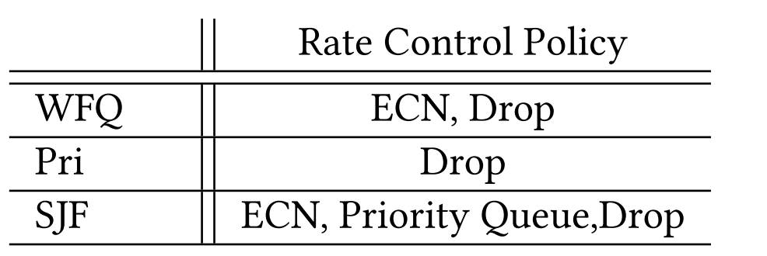
Ward framework – Comparison engine
Check the value of the corresponding dual center
Check if the traffic violates the current policy or not
If yes: use a rate control policy
Flow1
Flow2
Flow3
If (packet class is in left leaf and counter < 0):
Choose a policy and add it as meta-data
If (packet class is in right leaf and counter > 0):
Choose a policy and add it as meta-data
Otherwise
Bypass the packet
Policy node
Counter
Counter
Update
Comparison
Engine
Policy Enforcement

Slide 15
Ward framework – Policy enforcement
Merge the result of the previous rate control decisions with the current one
Enforce the strongest rate control
Order of rate control decisions
Drop > Enqueue > ECN mark
Counter
Update
Comparison
Engine
Policy Enforcement

Slide 16
Example
Two level of policy
Incoming packet belongs to Flow 2
Flow 2 has lower priority than Flow 3
Tenant 2
Tenant 1
Flow 3
Flow 2
Flow 1
Pri
 | Policy | Counter | Comparison | Enforce
First Box | WFQ | Update | ECN | $$(ECN,∅)=ECN$$
Second Box | Pri | NA | Drop | $$(ECN,Drop)=Drop$$
WFQ
Enough stages
Egress
Parser
Counter
Update
Comparison
Engine
Policy Enforcement
NA
Comparison
Engine
Policy Enforcement
Using resubmit
Egress
Parser
Counter
Update
Comparison
Engine
Policy Enforcement

Slide 17
Example
Tenant 2
Tenant 1
Two level of policy
Incoming packet belongs to Flow 2
Flow 2 has lower priority than Flow 3
Flow 3
Flow 2
Flow 1
Pri
 | Policy | Counter | Comparison | Enforce
First Box | WFQ | Update | ECN | $$(ECN,∅)=ECN$$
Second Box | Pri | NA | Drop | $$(ECN,Drop)=Drop$$
WFQ
Enough stages
Egress
Parser
Counter
Update
Comparison
Engine
Policy Enforcement
NA
Comparison
Engine
Policy Enforcement
Using resubmit
Egress
Parser
Counter
Update
Comparison
Engine
Policy Enforcement

Slide 18
Evaluation
Evaluation goals
Can Ward enforces a hierarchical policy in the network?
Measured parameters
Jain’s index fairness
99 percentile tail flow completion time
Evaluate Ward in both Mini-net/BMv2 and ns3
Leaf-spine topology
All links are 10 Gbps
Tenant 2
Tenant 1
Flow 3
Flow 2
Flow 1
Pri
WFQ

Slide 19
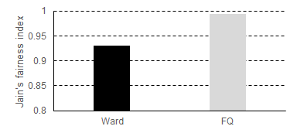
Fairness BMv2
Ward provides fairness with only 6% lower index compared to the ideal fair queuing

Slide 20
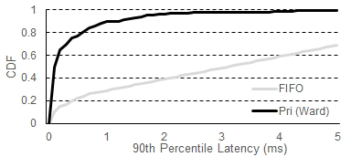
90th percentile for short flows
Ward can enforce strict priority compared to FIFO

Slide 21
Conclusion
We proposed Ward
Implementing hierarchical policies
Use packet resubmit in programmable switches if needed
We observed that Ward
Ward can enforce two-level policy
Future work:
Implement Ward on programmable switches
Study the balance of performance loss and the depth of the policy tree
Optimize Ward architecture to reduce the number of required stages

Slide 22
Thanks for the attention
Mojtaba Malekpourshahraki
Email: mmalek3@uic.edu
Website: cs.uic.edu/~mmalekpo

Slide 23
Reserved Slides

