Slide 1
User Oriented Trajectory Similarity Search
Haibo Wang uqhwan15@uq.edu.au
The University of Queensland
Kuien Liu kuien@iscas.ac.cn
Institute of Software,
Chinese Academy of Sciences
Kuien Liu University of California, Riverside

Slide 2
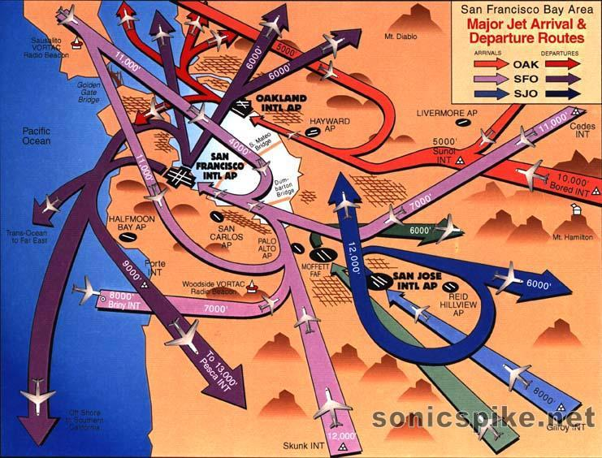
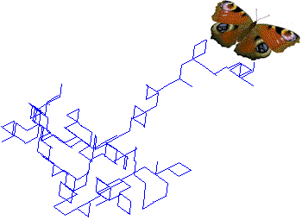
Trajectory data is everywhere
GPS-equipped moving objects
E.g., vehicles, people, animal
Social information collected from smart devices
Geo-tagged photos
e.g., Flickr
Route-sharing services
e.g., GeoLife, Bikely, GPS-Waypoints and Share My Routs
Social network services with venue check-in functions
e.g., Foursquare, Facebook, Jiepang
Location-enabled applications
e.g., Skyhook
Positioning technique from the Internet of Things (IoT)
RFID, ultrasonic, ultra-wideband, infrared, vibrated sensors etc.
E.g., Meat traceability, logistics supervision.
Haibo Wang, Kuien Liu. User Oriented Trajectory Similarity Search (UrbComp’12).

Slide 3
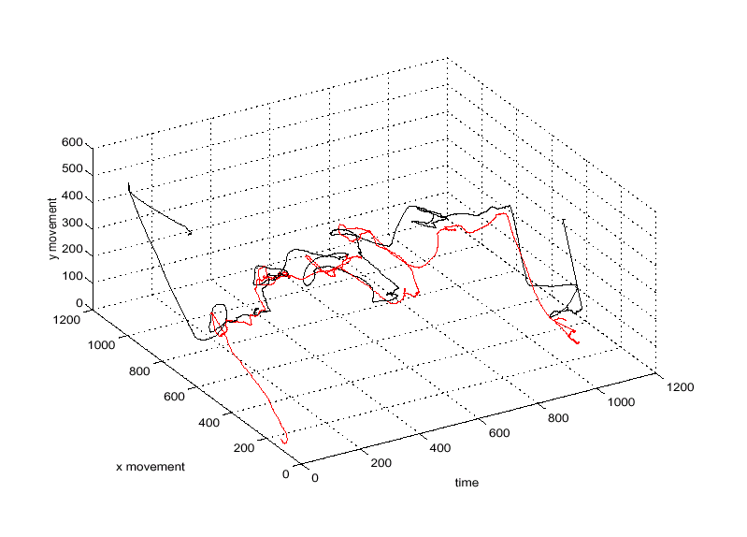
Trajectory Similarity Search
Friends recommendation
Trip planning
Traffic analysis
Carpooling
Urban commute patterns
Urban logistics truck sharing
E.g., DHL, EMS, SF/YD/YT/ZT serving e-commerce.
…
Haibo Wang, Kuien Liu. User Oriented Trajectory Similarity Search (UrbComp’12).
Notes:
Given a query trajectory, find out a data trajectory from the trajectory databases so that it is most similar to the query trajectory

Slide 4
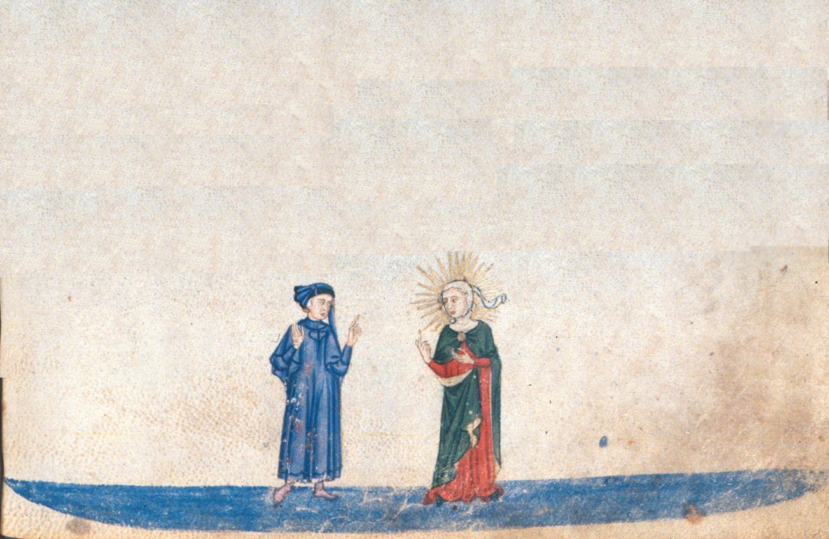
Existing Method I: Shape-based
Treat each sample point equally
Not necessary true in some cases
Wait a minute! All sample points share the same importance? That’s not true for some cases.
I know! Points in a highway and points in a small country road are obviously not the same important!
The picture is borrowed from Prof. Eamonn Keogh’s slides

Slide 5
Existing Method II: Semantic-based
Mining semantically important points
Not necessary true for everybody
Mining semantically important parts. Sounds much better.
Agree! But what I want is to fit my own needs, instead of compromising my needs because most people do that!
The picture is borrowed from Prof. Eamonn Keogh’s slides

Slide 6
Above methods do not always work
Example 1: traveling route recommendation
It may recommend a traveling route missing some intended sightseeing places to a tourist.
E.g., whose traveling route without passing by some intended places to a traveler.
Example 2: the last-kilometer-logistics
It may transport goods to some yards beyond the latest delivery time when sharing trucks.
Haibo Wang, Kuien Liu. User Oriented Trajectory Similarity Search (UrbComp’12).
Notes:
Given a query trajectory, find out a data trajectory from the trajectory databases so that it is most similar to the query trajectory

Slide 7
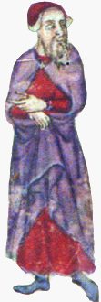
User Oriented Trajectory Similarity
Our work
User-specified important points
through a front-end tool
Provide personalized service to different users
Problem
Given a query trajectory Q with personal preferences, retrieve the trajectories which are most similar to Q.
This is exactly what I need. Perfect!
The picture is borrowed from Prof. Eamonn Keogh’s slides
Haibo Wang, Kuien Liu. User Oriented Trajectory Similarity Search (UrbComp’12).

Slide 8
Data Model and Problem Definition
Query trajectory Q = {(x₁,y₁,w₁), …, (x_{m},y_{m},w_{m})}
w: user-specified weight
Heaviest Common Subsequence HCSS(T,Q)
Most Similar Trajectory (MST)
Haibo Wang, Kuien Liu. User Oriented Trajectory Similarity Search (UrbComp’12).
Notes:
Given a query trajectory Q, find the most similar trajectory T, i.e., find a data trajectory T from trajectory database DB such that
Given a query trajectories Q and a data trajectory T, the more matched parts with higher weights between them, the more similar they are
Similar to LCSS, we call it Heaviest Common Subsequence (HCSS)

Slide 9
Naïve Method
Sequential scan
IO cost: Tons of IO
CPU cost: O(Nmn)
given |TrajectoryDB|=N, |Query|=m, |Trajectory|=n
In this paper, we focus on the efficiency issue of user oriented trajectory similarity search.
Haibo Wang, Kuien Liu. User Oriented Trajectory Similarity Search (UrbComp’12).

Slide 10
Observation 1
Haibo Wang, Kuien Liu. User Oriented Trajectory Similarity Search (UrbComp’12).

Slide 11
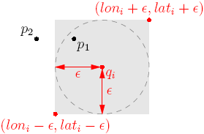
Observation 1
Retrieve only those trajectories which intersect the small range of Q (or Q’s buffer).
For each sample point q in Q, we only check the rectangular area, e.g., q’s epsilon buffer
Haibo Wang, Kuien Liu. User Oriented Trajectory Similarity Search (UrbComp’12).

Slide 12
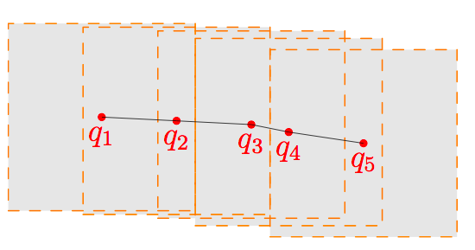
Baseline Method - MST
Index all sample points with an R-tree
Preprocessing
For each point q in Q, return those trajectories that have at least one point in q’s epsilon buffer as candidates
Filter Phase
For every candidate trajectory, compute the exact HCSS value and return the one with largest value
Refinement Phase
Haibo Wang, Kuien Liu. User Oriented Trajectory Similarity Search (UrbComp’12).

Slide 13
Observation 2
The query trajectory Q consists of a set of sequential points which are usually spatially close to each other.
No need to search every sample point’s epsilon buffer, as there are many overlap between buffers
Redundant IOs
Haibo Wang, Kuien Liu. User Oriented Trajectory Similarity Search (UrbComp’12).

Slide 14
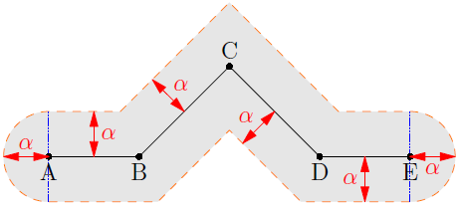
Adaptive Filter Strategy
Basic idea
group consecutive points together
$∝$-boundary
Haibo Wang, Kuien Liu. User Oriented Trajectory Similarity Search (UrbComp’12).
Notes:
The original/rectangle boundary is NOT tight enough

Slide 15
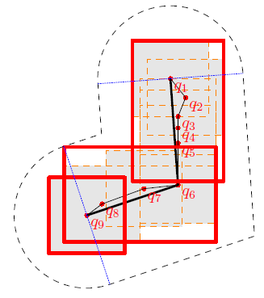
Adaptive Filter Strategy
Heuristic Method
1. Simplify the query trajectory with DP-linear method
2. Partition the query trajectory into restricted segments
3. Group consecutive segments in $∝$-boundary
Haibo Wang, Kuien Liu. User Oriented Trajectory Similarity Search (UrbComp’12).

Slide 16
Observation 3
No need to do the computation-expensive HCSS value for every candidate
Introduce an computation-cheap upper bound HGSS to prune trajectory candidates.
$HGSS\left(T,Q\right)=\sum_{i=1}^{k}{F\left(i\right)}≥HCSS(T,Q)$
See the paper for details
Haibo Wang, Kuien Liu. User Oriented Trajectory Similarity Search (UrbComp’12).
Notes:
Among all candidates, only a few trajectories have the chance to be the most similar trajectory

Slide 17
Optimization Method - OMST
In the Filter phase
Using the adaptive filtering strategy
Restrain candidates by un-overlapping boundary.
In the Refinement phase
Using the upper bound HGSS for pruning
Fast the refinement by pruning candidates.
Haibo Wang, Kuien Liu. User Oriented Trajectory Similarity Search (UrbComp’12).

Slide 18
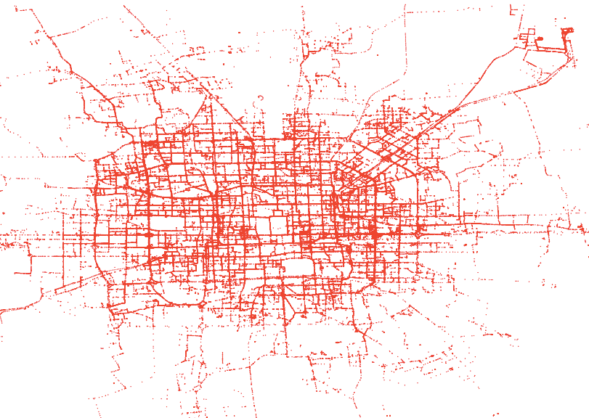
Experiments
Beijing Taxi Data Set
30284 trajectories
Haibo Wang, Kuien Liu. User Oriented Trajectory Similarity Search (UrbComp’12).

Slide 19
Effectiveness
Haibo Wang, Kuien Liu. User Oriented Trajectory Similarity Search (UrbComp’12).

Slide 20
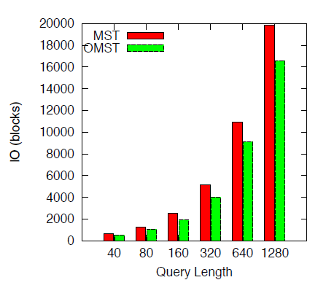
Optimization Power
Haibo Wang, Kuien Liu. User Oriented Trajectory Similarity Search (UrbComp’12).

Slide 21
Conclusion
User-oriented trajectory similarity search
Provide personalized search experience
Develop a baseline algorithm
Develop two optimization techniques
Adaptive filter strategy
An upper bound
The experiments demonstrate the high efficiency of the method
Haibo Wang, Kuien Liu. User Oriented Trajectory Similarity Search (UrbComp’12).

Slide 22
Q&A
Thanks!
Haibo Wang uqhwan15@uq.edu.au
The University of Queensland
Kuien Liu kuien@iscas.ac.cn
Institute of Software,
Chinese Academy of Sciences
Kuien Liu University of California, Riverside

