Slide 1
Efficient distributed computation of human mobility aggregates through user mobility profiles
Mirco Nanni, Roberto Trasarti,
Giulio Rossetti, Dino Pedreschi
KDD Lab - ISTI CNR
Pisa, Italy

Slide 2
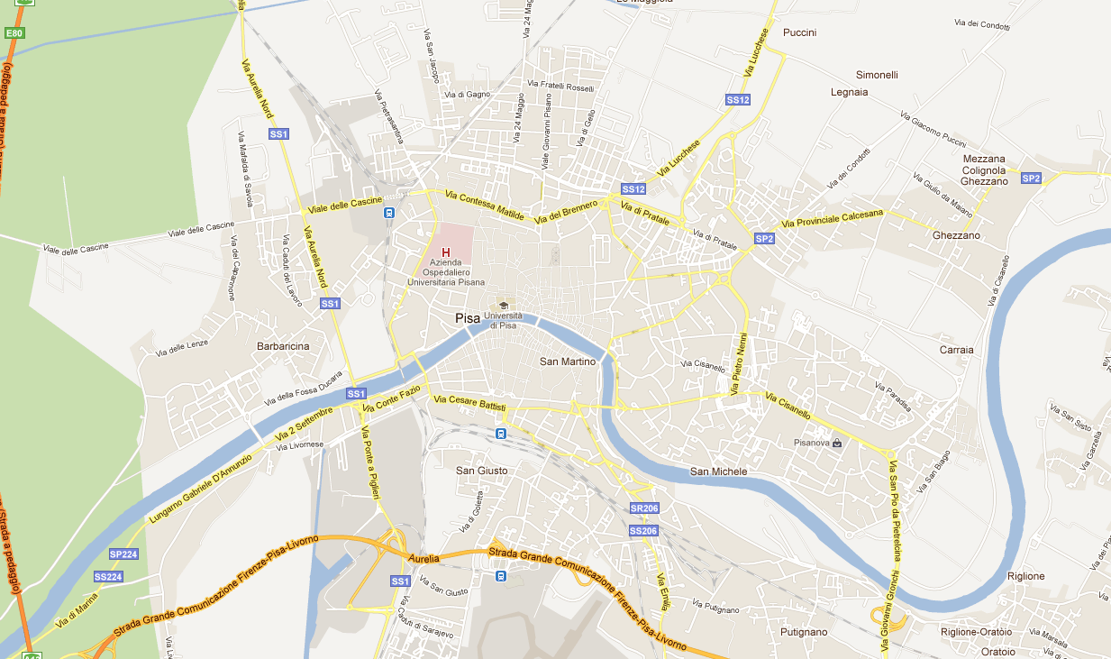
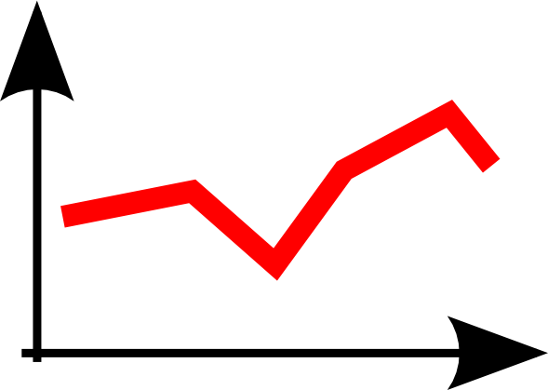
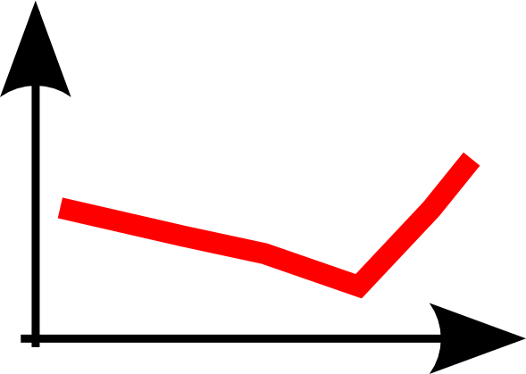
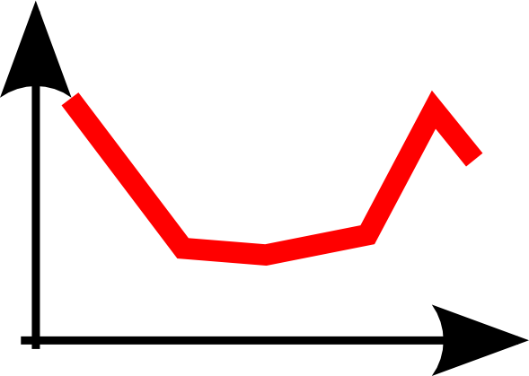
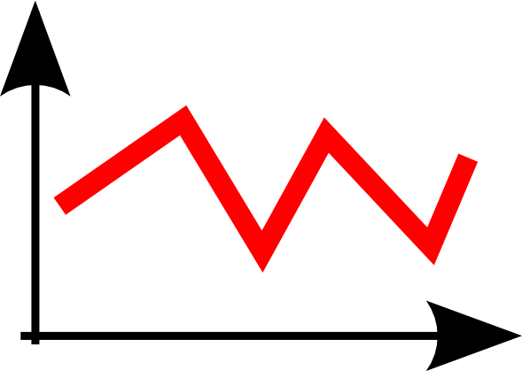
Objective and Motivations
Reference application: real-time traffic density estimation at key locations
Possible approach: Exploit on board GPS devices
GPS devices can transmit their position real-time to the mobility management central
The mobility management central uses collected positions to compute the density around a specified set of locations
Vehicles closer to the location contribute to density with higher weight

Slide 3
Issues
Mobility data come from large number of devices on the territory. The communications between these devices and the central server is unsustainable.
Central Server
GSM network
GPS Devices

Slide 4
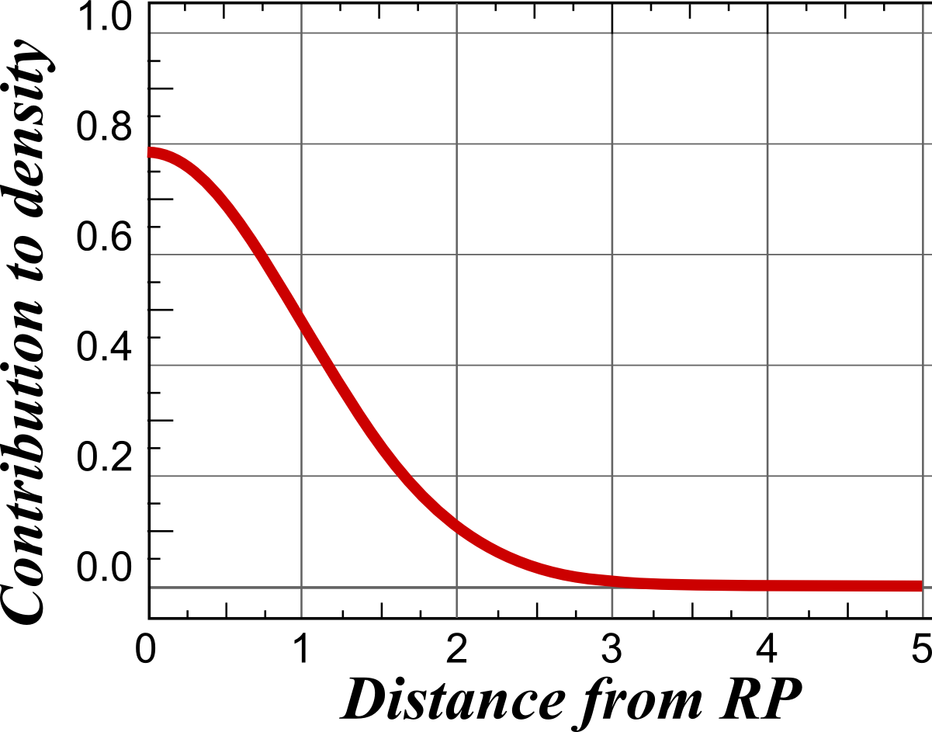
Outline of Approach: Global function
Density estimation of each reference point RP_{i} based on some kernel K
n_{V} = n. vehicles
V_{i}^{xy} = vehicle positions
RP_{i}^{xy} = RP positions
Basic case: radial function, e.g. Gaussian
Error tolerance: each density is computed with approximation ε

Slide 5
Which “intelligence” to put into the framework?
Level 0: Static “Safe Zones”
Compute a “default location area” around the most frequent (dense) location, from historical data
Safe zone = default location ± ε/N
Whenever the vehicle is inside the area, no communication occurs
Level 1: Adaptive “Safe Zones”
As above, but when a vehicle exits its SZ, a new one is computed, centered around the last location sent

Slide 6
Which “intelligence” to put into the framework?
Level 2: Learn from historical data
Try to exploit the high predictability of human mobility¹
Level 2.1
Assumption: “Average user tends to visit (or cross) everyday the same places at the same hour of the day”
Single spatio-temporal locations need not to be linked
Level 2.2
Assumption: “Average user tends to repeat the same trips everyday”
The “regular trip” is an higher level concept, requires a coherent sequence of spatio-temporal locations
¹ ⁻ C. Song, Z. Qu, N. Blumm, A.-L. Barabási. Limits of Predictability in Human Mobility. Science

Slide 7
Which “intelligence” to put into the framework?
Level 2.1: Most Frequent Location Model
For each user:
Discretize and align daily movements into time slots of M minutes each to obtain a complete schedule for each day;
Assign to each time slot the corresponding most frequent position – thresholds on distance and min frequency required
(x,y)
(x’,y’)
(x”,y”)
Daily schedules
(x,y)
(x,y)
(x”,y”)
(x,y)
(x”,y”)
Frequency based profile

Slide 8
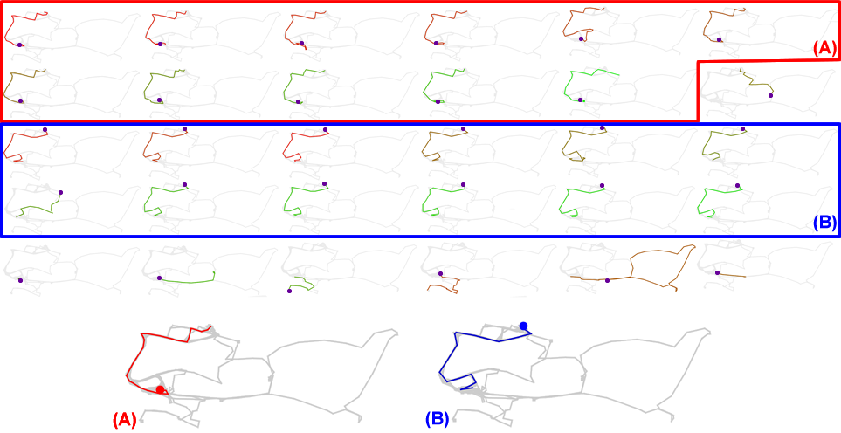
Which “intelligence” to put into the framework?
Level 2.2: Mobility profiles
The central controller is provided with “Mobility profiles” individually extracted from the history of each vehicle²
Trajectories of
the individual
Extracted
mobility profiles
2 - Roberto Trasarti, Fosca Giannotti, Mirco Nanni, Fabio Pinelli: Mining mobility user profiles for car pooling. KDD 2011

Slide 9
Outline of Approach: Flow of the application
Each vehicle computes its model and sends it to the Controller
The Controller sends to each vehicle an error ε'
Basic solution: ε' = ε / n_{V} in the worst-case scenario
Loop:
Each vehicle evaluates, for each RP, its kernel contribution K based on its actual position, and contribution K' based on predicted position. If |K-K'|>ε' sends a correction:
In case of profiles: a temporal shift dt, if the vehicle is slightly late/early
In case of frequent location or large dt: the actual position (x,y) or its Ks
The Controller evaluates the kernel contributions based on the model (aligned through dt, if based on profiles) or last position of each vehicle

Slide 10
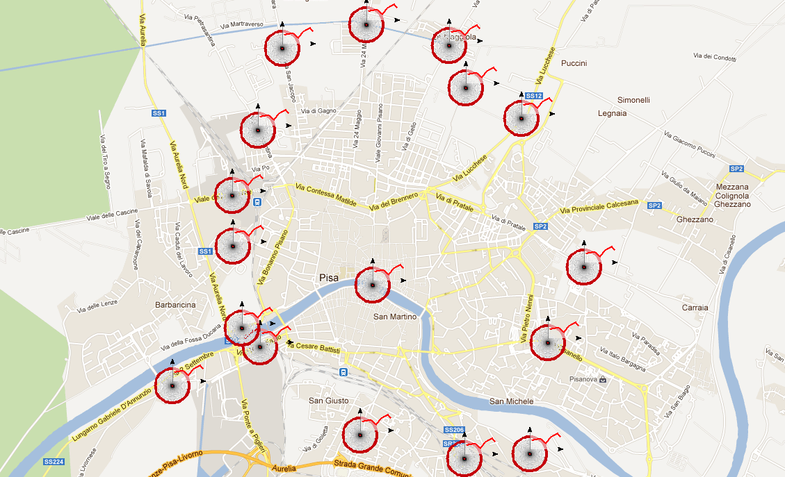
Experiments
GPS real car users
around 40,000 users
locate in Tuscany
time period of 5 weeks
mixed territories
Data by OCTOTELEMATICS
Approaches compared:
Level 1 (Adaptive Szs)
Level 2.1 (Freq. Locations)
Level 2.2 (Profiles)
RPs used in experiments

Slide 11
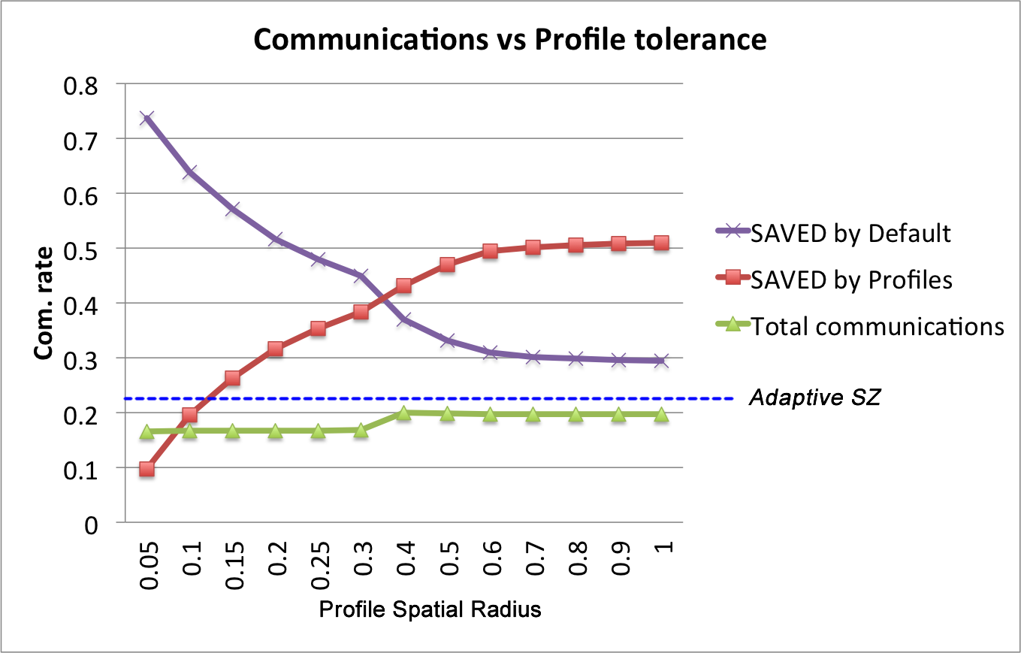
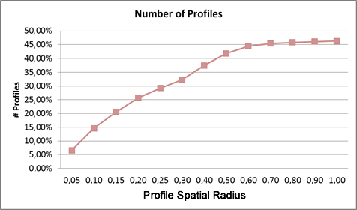
Experiments
Lev. 2.2 vs Lev. 1

Slide 12
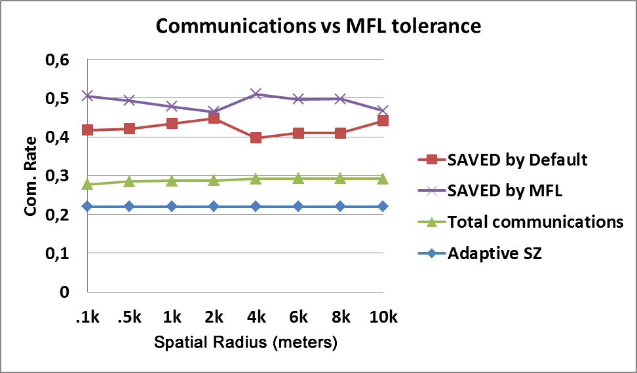
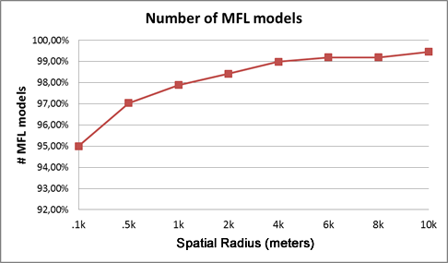
Experiments
Lev. 2.1 vs Lev. 1

Slide 13
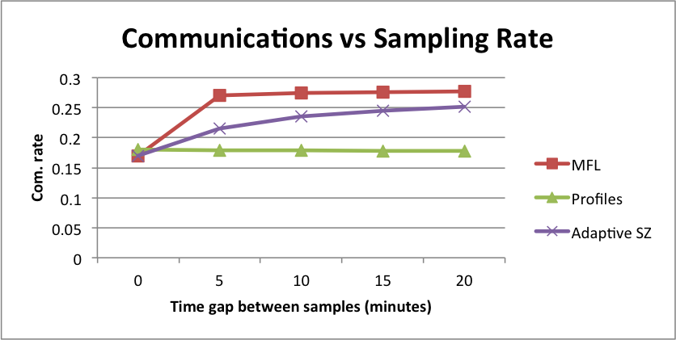
Experiments
Lev. 2 vs Lev. 1

Slide 14
Conclusion and Future Works
SUMMARY
Several approaches to the problem of computing population density over key areas have been proposed using different levels of “intelligence”
Significant reduction in communications was achieved
The results suggest that a high level knowledge boosts to the performances
ONGOING WORKS
Can the proposed framework be made privacy-preserving?
Are there parts of the map more difﬁcult to "learn"?
E.g. Highways are expected to be difﬁcult, due to high presence of occasional trips and passers-by
If taken collectively, individual non-systematic behaviors might form typical paths, e.g. vehicles on the highways: how to integrate them in the framework?

Slide 15
Thanks!
Questions?
kdd.isti.cnr.it/
www.lift-eu.org/
giulio.rossetti@isti.cnr.it

