Slide 1
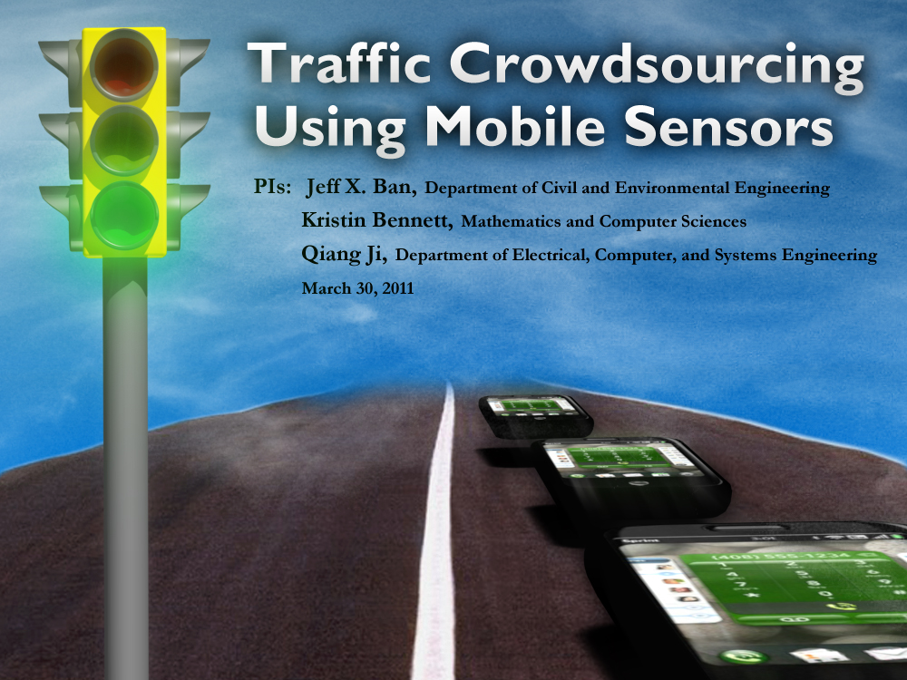
Privacy-Preserving IntelliDrive Data for Signalized Intersection Performance Measurement
Fine-Grained Urban Traffic Knowledge Extraction Using Mobile Sensing
Xuegang (Jeff) Ban
Rensselaer Polytechnic Institute
Marco Gruteser
Rutgers University
August 12, UrbComp 2012 Workshop
Xuegang (Jeff) Ban
Rensselaer Polytechnic Institute (RPI)
January 24, 2011
Session 228, TRB-2011

Slide 2
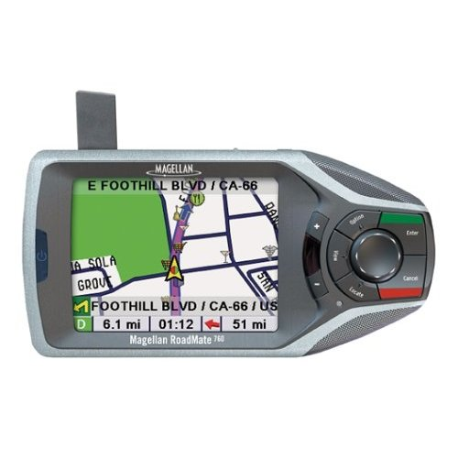
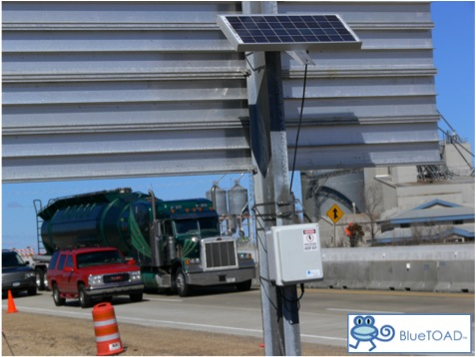
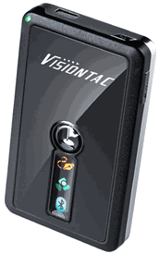
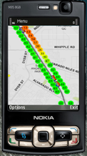
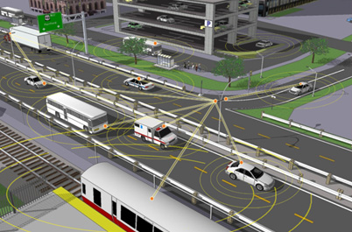
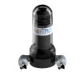
What Is Mobile Sensing?
The advances of wireless communications enabled the wide deployment of tracking devices
Those tracking devices move with the flow they are monitoring and can provide detailed movement of the flow – mobile sensors
BlueTOAD
Cellular Phones
Navigation System
GPS loggers
Connected vehicles
Motorized drifter

Slide 3
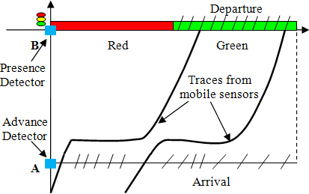
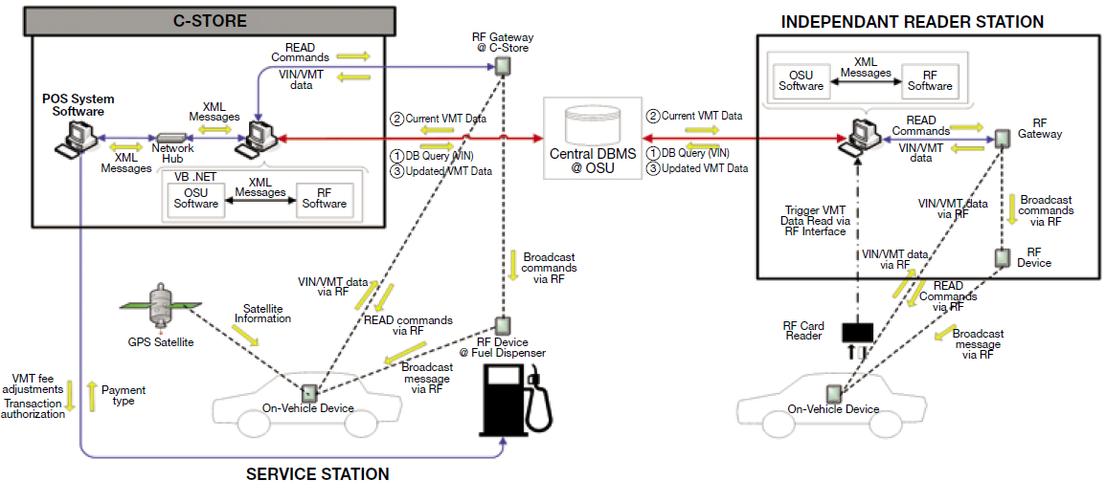
Why Mobile Sensing Is Important in Transportation?
Mobile sensing produces mobile data with unique characteristics
Fixed location sensor data: spatially discrete aggregated or disaggregated volume, speed, occupancy for the entire traffic flow
Mobile data: spatially continuous traces of a sample of the traffic flow
Mobile sensing can provide tracking capability for individual vehicles
Enables more advanced/flexible dynamic traffic management strategies, such as path-based congestion pricing/ charging schemes (e.g., mileage fee)
Oregon Pilot Test (2007)

Slide 4
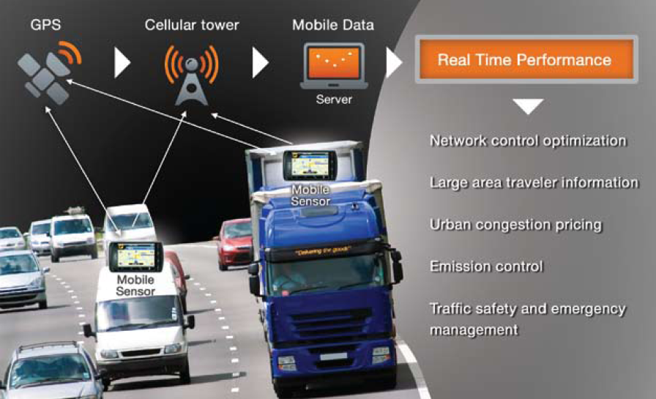
What can we do using mobile sensing?
City-scale transportation knowledge extraction
Fine-grained urban traffic knowledge extraction (FGUTKE)

Slide 5
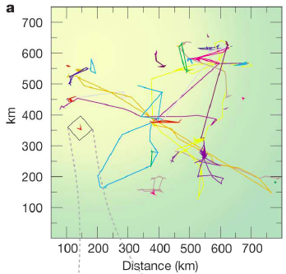
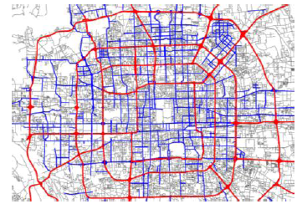
City-scale Transportation Knowledge Extraction
Human mobility pattern (Gonzalez et al., 2008)
Urban congestion pattern (Yuan et al., 2010)
Land-use pattern (Toole et al., 2012)
Urban Planning (Zheng et al., 2011)
Beijing congestion map (Zheng et al., 2011)
Basic human mobility pattern (Gonzalez et al., 2008)

Slide 6
FGUTKE - Opportunities
Mobility patterns: individual micro-level behavior - > aggregated system mobility pattern (new form of data)
Emergency situations: evacuation, emergency recovery, etc.
Accidents / heavy congestion
Traffic information and system performance
Travel time / delay and reliability
Bottleneck locations and severity
Queue length at traffic intersections/signals
Signal timing estimation
Vehicle classification (passenger cars, trucks, …)
Safety measures: the most dangerous spots
Freight performance measures
Sustainability measures: fuel consumption/emissions
Traffic Safety

Slide 7
FGUTKE – Challenges
Inferring useful traffic knowledge (traffic modeling methods)
Privacy / security
Sparse samples / Encourage participating / critical mass
Data fusion
Energy / battery use
Data transmission (communication issues)

Slide 8
What Mobile Data to Use – Co-Designing Privacy Protection Mechanisms and Traffic Modeling Methods (Privacy by Design)

Slide 9
Privacy Research in Transportation
An under-researched field
Subject search on “Privacy” results in: 77 papers (out of over 50,000) via TRB Publication Index; 52papers via Transportation Research Part A since 1995
Focus on privacy issues in ITS
Garfinkel (1996) : “If ITS systems are developed and deployed which do not respect the privacy of the American driver, there is a good chance that Americans will demand that the system be shut off. Without strong privacy provisions, ITS will not succeed.”
Privacy protection and modeling data needs are largely disconnected now in transportation

Slide 10
An Integrative Modeling and Privacy Protection Framework
Privacy-aware transportation modeling and Application-aware privacy protection
Focus on interactions of the two: investigate simultaneously what mobile data elements need to be collected for modeling purposes and what the implications to privacy
This is possible as modeling traffic states does not need to know every piece of each vehicle’s trajectory
Assumption: the pattern of aggregated mobile data measures, when penetration is high, can systematically reflect traffic flow states
Proper privacy schemes can be designed to collect only these aggregated measures by anonymity and obfuscation

Slide 11
VTL-based Intersection Travel Times
What mobile data to collect/use?
Modeling needs
Privacy protection
Cost of collecting the data (collecting every piece of vehicle traces is an “over-kill”)
VTL Intersection travel times
Collected through Virtual Trip Lines
(VTL); see Hoh et al. (2008)
Preserve privacy if properly designed
(Hoh et al., 2008; Herrera et al., 2010)
Works fine for modeling isolated intersections
VTL2
VTL1

Slide 12
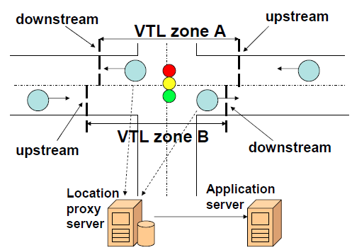
Short Vehicle Traces via VTL-zone System
System structure
Location proxy server (trusted)
Centralized anonymization
Data Filtering
Application server (public)
Available for application
Various filtering algorithms to ensure
privacy (unlinkability of short traces)

Slide 13
Case Studies of Fine-Grained Urban Traffic Knowledge Extraction: Intersection delay pattern estimation Dynamic signal timing estimation

Slide 14
Modeling Method Overview
Mobile-sensing based (MSB) traffic modeling methods
A combination of traffic theories/principles and advanced learning/optimization techniques
Traffic theories/principles: systematic patterns of traffic flow
Learning/optimization techniques: discover the systematic traffic patterns from mobile data, and estimate the parameters of the patterns

Slide 15
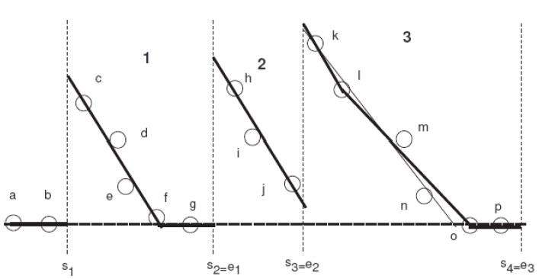
I: Delay Pattern Estimation of Signalized Intersections Using VTL Data
What is intersection delay pattern?
The delay an imaginary vehicle would have experienced if it had arrived at the intersection at a given time
A continuous approximation of the (discrete) measured vehicle delays
Helpful to answer questions like (e.g. at 3:00 pm):
What was the vehicle delay at 8:00 am at this intersection (estimation)?
What will the vehicle delay be at 8:00 pm (prediction)?
D_{t}
t

Slide 16
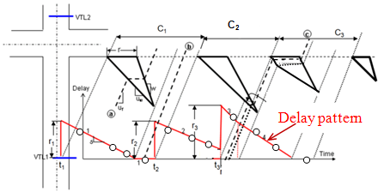
Delay Pattern Estimation Method
Travel time / delay pattern reflects signal and traffic state changes
Queue forming and discharging process at a traffic signal
Shockwave theory
Uniform arrival assumption
Linear approximation
Well known: Liu et al. (2009)
Skabardonis and Geroliminis
(2005); Lighthill and Whitham (1955); Richards (1956)
Characteristics of signalized intersection delay patterns
Discontinuities: start of red
Non-smoothness: change of traffic states such as clear of the queue
Delay estimation method
Reconstruct the piece-wise linear delay pattern from measured delays
Vehicle delay

Slide 17
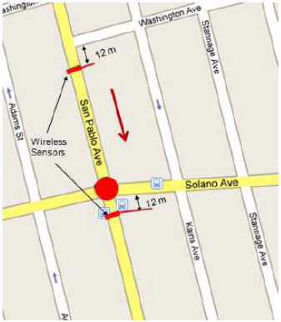
Results - Albany, CA
Test site: the intersection of San Pablo Ave and Solano Ave in Albany, CA;
Intersection is actuated/coordinated with a cycle length 108 s;
Two sets of wireless traffic sensors installed upstream and downstream of the intersection
Travel times of 140 vehicles for a 30 minute period (1:00- 1:30 pm) were generated via a vehicle re-identification algorithm, 50% - 60% of all vehicles

Slide 18
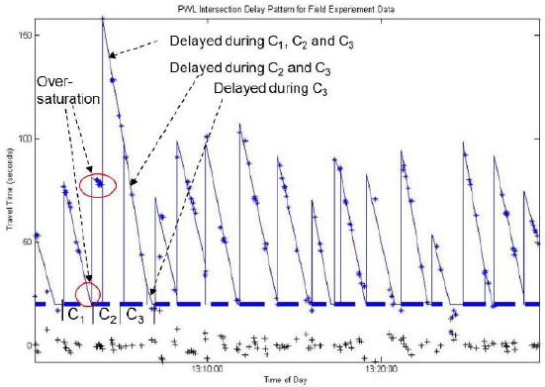
Estimated Delay Pattern
Results: 88% of estimated delays are within 15% of the observed delays

Slide 19
II: Signal Timing Parameters
Signal timing parameters are critical input to signal/arterial performance measurement models
They have been assumed to be available in almost all existing approaches
However, obtaining dynamic signal timing parameters (such as cycle length, cycle-by-cycle red/green times) for wide area arterial streets is not trivial
VTL-based intersection travel times can be used to estimate cycle-by-cycle traffic signal timing parameters

Slide 20
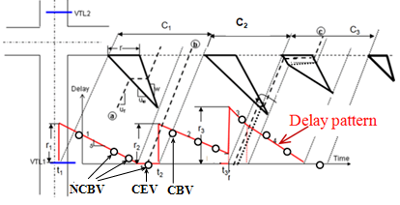
A 3-Step Approach
Step 1 Cycle breaking: find the sample vehicle (i.e. the CBV) that indicates the start of a new cycle (in particular, the red time); support vector machine (SVM)
Step 2 Exact cycle boundary estimation: estimate when the red time starts exactly for each cycle; nonlinear program
Step 3 Effective red/green time estimation: calculate the duration of the effective red/green time for each cycle
CBV: cycle breaking vehicle
NCBV: non cycle breaking vehicle
CEV: cycle ending vehicle

Slide 21
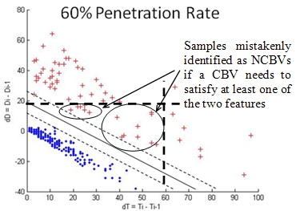
Robust Cycle Breaking
Observation: the start of a new cycle (defined as the start of the red) leads to a “jump” in vehicle delay
Such jump can be used to find the CBV
Mathematically, it can be
formulated as a
support vector
machine (SVM)
problem
Delay difference of two consecutively sampled vehicles
Arrival time difference of two consecutively sampled vehicles
w, b: vectors that define the support plane (line)
ε: the vector for error term
y: data vector
M: the number of training data points

Slide 22
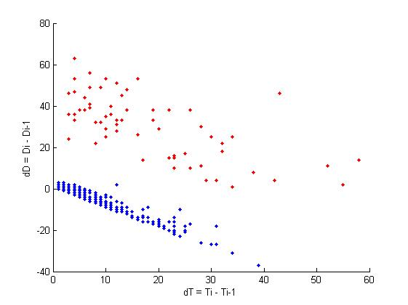
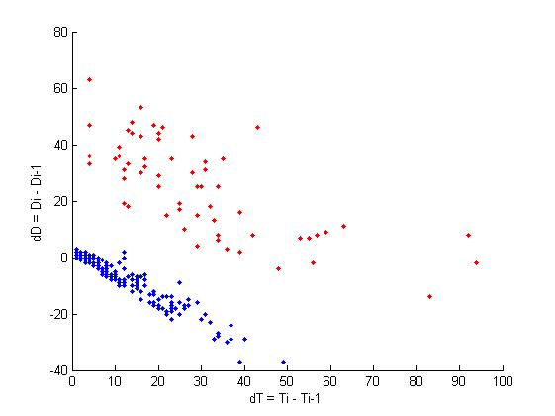
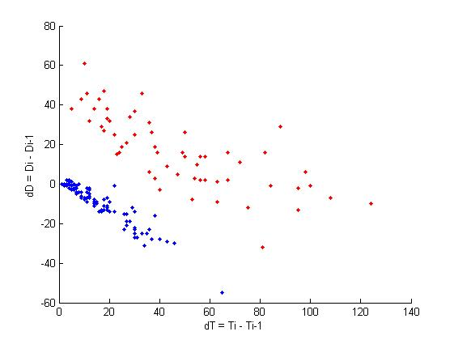
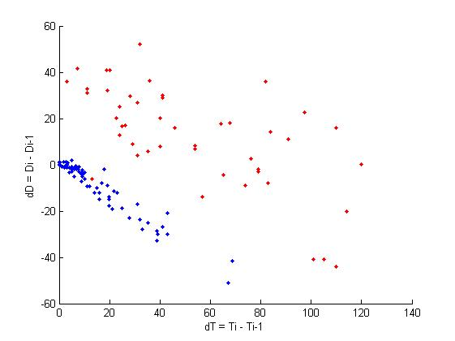
Cycle Breaking Results: Field Test
100% Penetration Rate, Video Data
60% Penetration Rate, Video Data
30% Penetration Rate , Video Data
30% Penetration Rate , GPS Logger Data

Slide 23
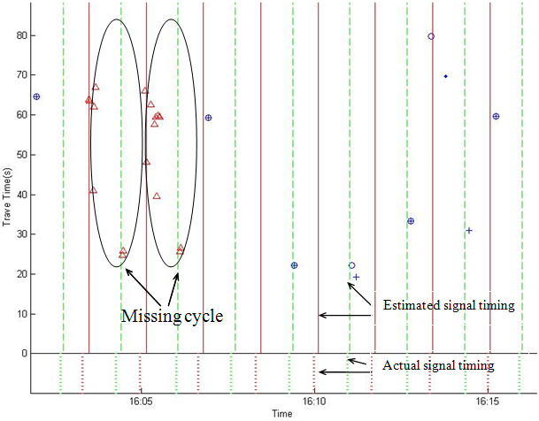
The Model Can Detect Missing Cycles
Simulation data (50%): one missing cycle
NGSIM data (20%): two missing cycles

Slide 24
Key Take-away Messages
Fine-Grained Urban Traffic Knowledge Extraction Using Mobile Sensing (FGUTKE-MS) is the next-generation methods for urban traffic knowledge extraction.
FGUTKE-MS calls for close collaboration among technical experts (computer sciences, communications, hardware, software), data-mining experts, domain experts (transportation researchers), and privacy experts.

Slide 25
Collaborators
Rutgers: Dr. Marco Gruteser
UC-Berkeley: Dr. Alexandre Bayen
University of Alabama: Dr. Yingyan Lou
Nokia Palo-Alto Research Lab: Dr. Quinn Jacobson, Dr. Baik Hoh
RPI: Dr. Kristin Bennett, Dr. Qiang Ji, Dr. Jose Holguin-Veras, Dr. Cara Wang
Graduate Students: Eric Richardson, Hao Peng, Zhanbo Sun, Rui Ma, Michael Kowalczyk
Undergraduate student: David Hill, Patrick Kenny, Eric Klepadlo, Ashley Vissell

Slide 26
Sponsors
US National Science Foundation
CMMI-1031452
EFRI-1024647
CAREER: CMMI-1055555
CMMI-1031400
CNS-0845896
USDOT/RITA/UTRC-Region 2
Caltrans/UC-Berkeley
NYSDOT
NYSERDA
RPI (Seed Fund)

Slide 27
Publications
Ban, X., Gruteser, M., 2012. Towards fine-grained urban traffic knowledge extraction using mobile sensing. Presented at the 2012 Urban Computing Workshop.
Hao, P., Guo, D., Ban, X., and Ji, Q., 2012. Vehicle index estimation for signalized intersections using sample travel times. Submitted to the 20th International Symposium on Transportation and Traffic Theory (ISTTT).
Sun, Z., Zan, B., Ban, X., and Gruteser, M., 2012. Privacy protection method for fine-grained urban traffic modeling using mobile sensors. To be submitted to Transportation Research Part B.
Hao, P., and Ban, X., 2012. Long queue estimation for urban signalized intersections. Submitted to the 92nd Transportation Research Board Annual Meeting.
Sun, Z., and Ban, X., 2012. Vehicle trajectory reconstruction for signalized intersections using mobile traffic sensors. Submitted to Transportation Research Part C.
Sun, Z., and Ban, X., 2012. Vehicle classification using mobile sensors. Submitted to Transportation Research Part C.
Hao, P., Ban, X., Bennett, K., Ji, Q., and Sun, Z., 2011. Signal timing estimation using intersection travel times. IEEE Transactions on Intelligent Transportation Systems 13(2), 792-804.
Hoh, B., Iwuchukwu, T., Jacobson, Q., Gruteser, M., Bayen, A., Herrera, J.C., Herring, R., Work, D., Annavaram, M., and Ban, X, 2011. Enhancing Privacy and Accuracy in Probe Vehicle Based Traffic Monitoring via Virtual Trip Lines. IEEE Transactions on Mobile Computing, 11(5), 849-864.
Ban, X., Hao, P., and Sun, Z., 2011. Real time queue length estimation for signalized intersections using sampled travel times. Transportation Research Part C, 19, 1133-1156.
Zan, B., Sun, Z., Gruteser, M., and Ban, X., 2011. VTL zone-based path cloaking algorithm. Presented at the IEEE conference on Intelligent Transportation Systems, Washington, DC.
Sun, Z., Zan, B., Ban, X., Gruteser, M., and Hao, P., 2011. Evaluation of privacy preserving algorithms using traffic knowledge based adversary models. Presented at the IEEE conference on Intelligent Transportation Systems, 2011.
Hao, P., and Ban, X., 2011. Estimation of queue location for signalized intersections using sample travel times from mobile sensors. Submitted to Journal of Intelligent Transportation Systems.
Sun, Z., and Ban, X., 2011. Vehicle Trajectory Reconstruction for Signalized Intersections Using Variational Formulation of Kinematic Waves. Presented at the 90th Transportation Research Board Annual Meeting.
Herrera, J.C., Work, D.B., Herring, R., Ban, X., and Bayen, A., 2010. Evaluation of traffic data obtained via GPS-enabled mobile phones: the Mobile Century field experiment. Transportation Research Part C 18(4) , 568-583.
Ban, X., and Gruteser, M., 2010. Mobile sensors as traffic probes: addressing transportation modeling and privacy protection in an integrated framework. In Proceedings of the 7th International Conference on Traffic and Transportation Studies, Kunming, China.
Ban, X., Herring, R., Hao, P., and Bayen, A., 2009. Delay pattern estimation for signalized intersections using sampled travel times. Transportation Research Record 2130, 109-119.
Hoh, B., Gruteser, M., Herring, R., Ban, X., Work, D., Herrera, J., and Bayen, A., 2008. Virtual trip lines for distributed privacy-preserving traffic monitoring. In Proceedings of The International Conference on Mobile Systems, Applications, and Services (AR: 18%).

Slide 28
Thanks!
Questions?
Email: banx@rpi.edu
URL: www.rpi.edu/~banx

