Slide 1
Exploration of Ground Truth from Raw GPS Data
Huajian Mao¹, Wuman Luo², Haoyu Tan²,
Lionel M. Ni², Nong Xiao¹
1. State Key Laboratory of High Performance Computing, Hunan 410073, China
2. Hong Kong University of Science and Technology, Hong Kong
Notes:
Thanks for your attention.
This talk will talk about a method of ground truth data exploration from the raw GPS data.
The authors are from National university of defense technology and Hong kong university of science and technology.

Slide 2
Outline
Background
Related work
Design of TruthFinder
Evaluation
Conclusions
Notes:
In this talk, I will present the background of the work including the observation, challenges and the motivation. Then I will talk about the related work of the ground truth exploration methods. The design of truthFinder and the evaluation then will be talked. At the last I will conclude this work.

Slide 3
Background
Map matching
to align the raw GPS data onto the corresponding road network to find out a sequence of road segments to denote that a vehicle has traveled along (ground truth).
Ground truth data is important.
to validate the accuracy of a map matching algorithm
to tune and evaluate the effectiveness of various map matching algorithms
Notes:
Because of various reasons, the GPS data collected is always not very precise. So in order to use the GPS data, such as traffic estimation, hot spot detection, driving pattern recognition, traffic mining, and similar routes discovery, we need to align the raw GPS data onto the corresponding road network to find out a sequence of road segments to denote that a vehicle has traveled along. This process is called map matching. For map matching, ground truth data is important. It is needed to validate the accuracy of a map matching algorithm, and it is also needed to tune and evaluate the effectiveness of various map matching algorithms.

Slide 4
Background
In practice, however, there is no (or only a little) ground truth data to validate the calibrated GPS data.
Observation
Most of the ground truth path of the trajectories can be correctly identified by human-labeling on the historical raw GPS dataset.
Notes:
However, the ground truth data is always lack. As the GPS data is collected from the vehicles like Taxi and Bus, there is always no (or only a little) ground truth for the collected GPS raw data. However, as we talked before, ground truth data is important, we try to find a way to explore the ground truth data from the historical raw GPS data.
Fortunately, most of the ground truth path of the trajectories can be correctly identified by human-labeling on the historical raw GPS dataset.

Slide 5
Motivation
Challenges
Pure human labeling costs a lot of time
Pure map matching algorithms cannot keep the precision
TruthFinder
Find the ground truth by incorporating traditional map matching algorithms and human intelligence
Notes:
However, exploring ground truth from the raw GPS data is not trivial. Pure human labeling will cost a lot of time and human effort. While the pure map matching can not assure the precision.
So we propose truthFinder to explore the ground truth by incorporating traditional map matching algorithms and human intelligence.

Slide 6
Related work
Ground truth exploration methods
Datasets collected by driving vehicles (drive around the city, and periodically record the GPS positions together with the roads where they drive on)
Human labeled datasets (find the most likely road segment for each of the GPS records in the trajectory to represent the GPS record is reported from)
Synthetic datasets (pick up a path from the road network, periodically select some points on the path, and introduce some errors with normal distribution to generate the synthetic data)
Notes:
There are mainly three ground truth exploration methods, which is exploring the ground truth dataset by driving vehicles, exploring the data by human labeling and synthetically generate the ground truth data.
For the first one, the researches drive on the road, and periodically record the GPS positions together with the roads where they drive on. At the end the will get the raw GPS data together with the driving path as the ground truth. For the second one, the ground truth data is explored by pure human labeling and the third one is synthetically generated.
However, these three methods are not good enough. For the first one, it costs a lot of time, while the collected ground truth dataset is small. For the pure human label one, it is always time cost. While for the synthetic dataset, it is simulated but not from the real world.

Slide 7
TruthFinder
Principle
to find the ground truth data from historical raw GPS data
to explore the ground truth data by interactively matching the GPS reports which incorporates traditional map matching algorithms and human intelligence in an unified manner.
Notes:
So, we propose truthFinder, to find the ground truth data from the historical raw GPS data with low human operation cost.
TruthFinder explores the ground truth data by interactively matching the GPS reports which incorporates traditional map matching algorithms and human intelligence in an unified manner.

Slide 8
TruthFinder
Overview of truthFinder system architecture
Notes:
This picture shows the system architecture.
In truthFinder, the original GPS raw data is used as the input. The system will first find the candidate roads for each report and generate a recommendation path using traditional map matching algorithms like HMM and STM. After these information, the candidate roads and the recommendation path is generated, they are sent to be visualized on the map. The users can assess the recommendation path, if it is precise enough, it can be exported as the ground truth data. Otherwise, the users can tune the mapping of the reports, the system will generate a new recommendation path and visualize it for the users. These process is iteratively tuned and assessed until the ground truth is found. At the end, the ground truth path will be explored.

Slide 9
TruthFinder
Recommendation Preparation
Information Presentation
Assessing and Tuning
Ground Truth Data Exploring
Notes:
In summary, the truthFinder system consists of four parts.
The recommendation preparation component, which is used to prepare the recommendation path and the candidate roads for each report. Then these information is presented by the Information presentation component. With the visualized information, the users can assess and tune the recommendation path to generate a more precise path. After iteratively assessing and tuning, a ground truth path will be found, and can be explored by the forth compoent.

Slide 10
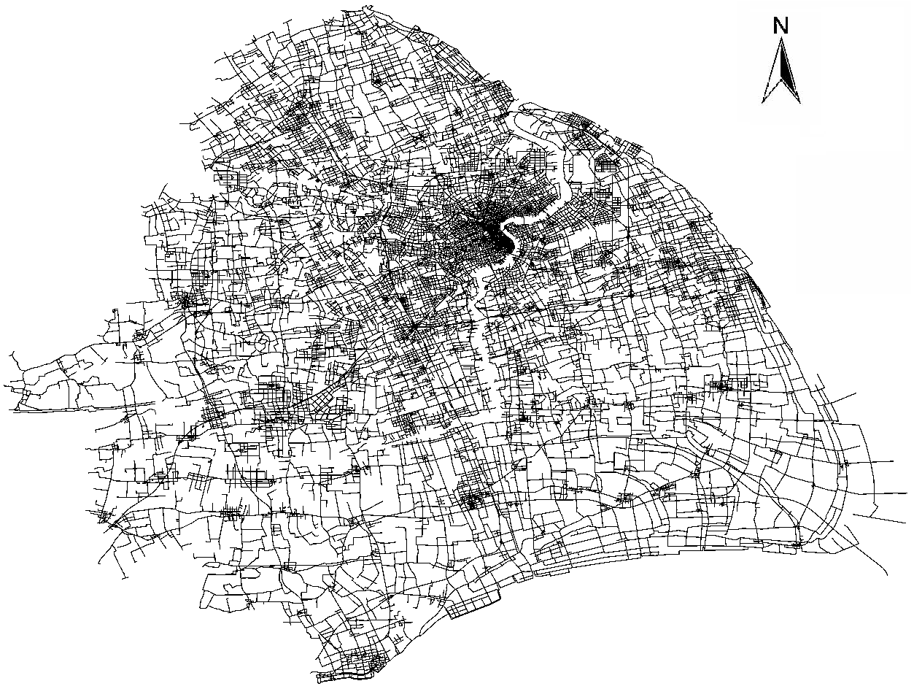
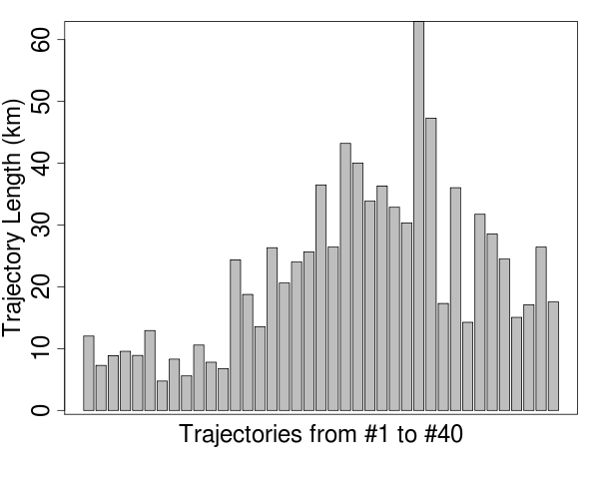
Evaluation
Dataset
Road network of Shanghai
Lengths of the trajectories
Notes:
In the evaluation, we use the data collected from Shanghai by the Taxies.
The left figure shows the road network of Shanghai.
The right figure shows the length of the trajectories we used in the evaluation.

Slide 11
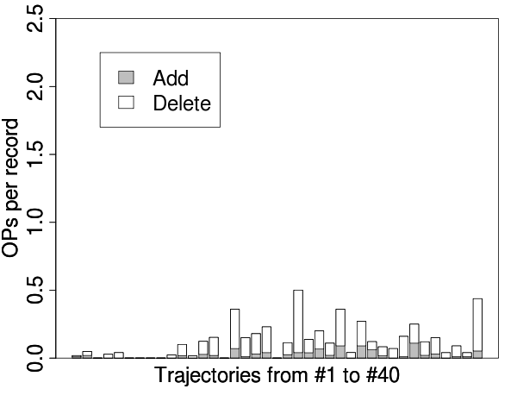
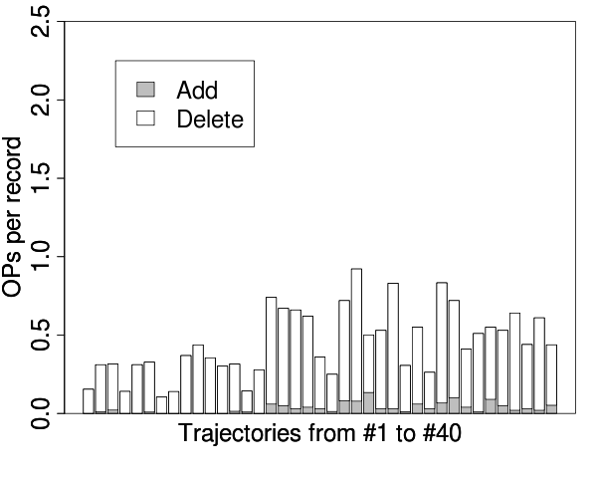
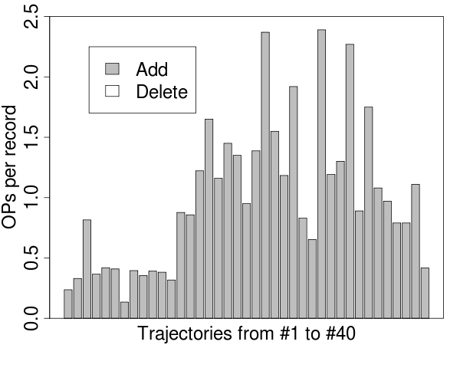
Evaluation
Comparison of operation numbers
OP# of TF (HMM)
OP# of TF (STM)
OP# of EPScratch
Notes:
We compare TruthFinder (we use TF in the figure) with the pure human labeling (we use the EPScratch in the figure) in terms of operation number.
We used two map matching algorithms in the recommendation path generating, they are HMM and STM.
From the result, we can find that, TF uses much smaller operation numbers for the ground truth exploration, especially the add operation. While in the ground truth exploration, the add operation is always more time consuming than the delete operation.
So, in total, TF is with much higher efficiency than that of the pure human labeling method.

Slide 12
Conclusions
We propose TruthFinder, a system of interactive map matching the collected raw GPS trajectory data.
It employs human intelligence to aid the map matching algorithms to explore ground truth data from raw GPS data.
Notes:
OK, let’s conclude for the work.
TruthFinder is a system of interactive map matching system for the collected raw GPS trajectory data.
It employs human intelligence to aid the map matching algorithms to explore ground truth data from raw GPS data.

Slide 13
Thank you!
Questions?
Please contact huajianmao@nudt.edu.cn
Notes:
Thank you!
If you have any questions, please contact the authors with email.

