Slide 1
Exploiting Large-Scale Check-in Data to Recommend Time-Sensitive Routes
Hsun-Ping Hsieh, Cheng-Te Li, Shou-De Lin
Graduate Institute of Networking and Multimedia National Taiwan University, Taipei, Taiwan

Slide 2
Outline
Introduction
Problem Statement
Measure the Goodness of time-sensitive route
Greedy Solution
Experiment
Conclusion

Slide 3
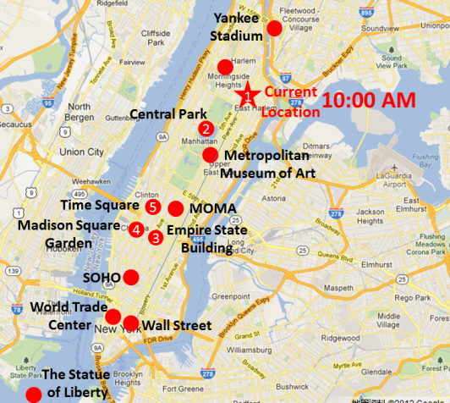
Goal
Given a query location with the starting time, our goal is to recommend a suitable route in one-day trip.
Design a novel function to measure the goodness of a route.
We consider the time-sensitive context in the goodness function
We aim to leverage the user-check-in data for trip route recommendation

Slide 4
Four elements for a good route
A proper time-sensitive route recommendation work considers the following factors:
The popularity of a place
The proper time to visit a place
The amount of time required to transit from one place to another
The visiting order of places

Slide 5
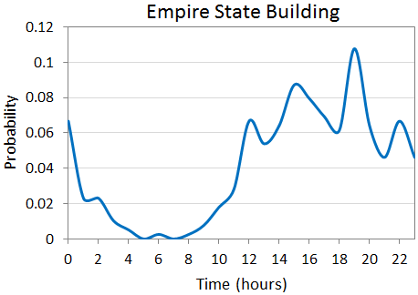
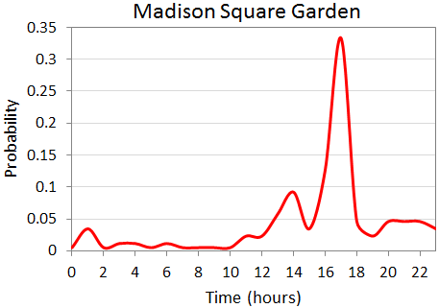
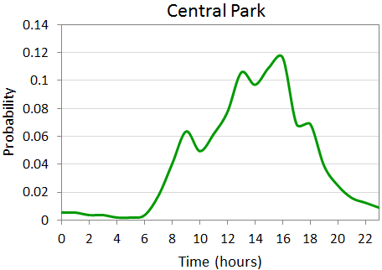
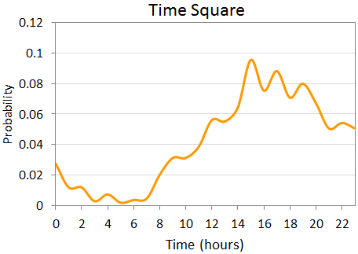
The proper visiting time of a place
Places are sensitive to the visiting time, for example,
People usually visit the Empire State Building from about 12:00 to the mid night (this place is famous for its night view)
People tend to visit the Madison Square Garden in the early evening for a basketball game
The proper time to visit the Central Park is during daytime
Time Square is preferred from afternoon to midnight.

Slide 6
Summarization of differences between this paper and other related work
Important issues about route planning:
allows the Query of certain Locations (QL)
Popularity (PO)
Visiting Order (VO)
Visiting Time (VT),
Transit Time (TT)
User Preference (UP)
Distance (DI)
Travel Duration (TD)
Top-k retrieval (TK).
 | QL | PO | VO | VT | TT | UP | DI | TD | TK
Yuan et al. (2010, 2011) |  | O | O |  |  | O | O | O
Chen et al. (2011) | O | O | O
Wei et al. (2010) |  | O | O |  |  |  |  |  | O
Chen et al. (2010) | O |  | O |  |  |  |  |  | O
Yoon et al. (2011) | O | O | O |  | O | O |  | O | O
Zheng et al. (2009, 2011) | O | O | O |  |  | O |  |  | O
Tang et al. (2011) | O |  |  |  |  |  | O |  | O
Wei et al. (2012) | O | O |  |  |  |  |  | O | O
This work | O | O | O | O | O |  |  | O

Slide 7
Gowalla dataset
Utilize the Gowalla dataset crawled by Dr. Jure Leskovec
contains 6,442,890 check-in records from Feb. 2009 to Oct. 2010. The total number of check-in locations is 1,280,969.
<User id, check-in time, Latitude, Longitude, Location id >
Considering a route as a sequence of check-in locations of a user within a day, we construct the route database RouteDB containing 2,605,867 routes.
Extract three subsets of the check-in data, which corresponds to cities of New York, San Francisco, and Paris.
 | Total Number of Check-ins | Avg. Route Length | Variance of Route Length | Distinct Check-in Locations
RouteDB | 6,442,890 | 4.09 | 48.04 | 1,280,969
New York | 103,174 | 4.46 | 71.24 | 14,941
San Francisco | 187,568 | 4.09 | 58.36 | 15,406
Paris | 14,224 | 4.45 | 75.73 | 3,472

Slide 8
Problem Statement
Measure the goodness of a route
Given:
A sequence of locations (i.e., a route)
Each location is associated with a check-in time stamp
Output:
A score of the route (the higher, the better)
Time-sensitive route recommendation
Given:
The starting time and location
The number of locations in the final route
Output:
A route with highest goodness score,
And satisfies the starting time and location

Slide 9
Contributions
Propose a novel time-sensitive trip route recommendation problem using the check-in data in location-based services.
The first work considering four elements
(a) the popularity of a place, (b) the visiting order of places, (c) the proper visiting time of a place, and (d) the proper transit time between places
Model the four requirements of a good route into the our design of the goodness function by exploiting some statistical methods.
For the given time-sensitive location query, we develop a greedy algorithm to search for the route by optimizing the goodness function

Slide 10
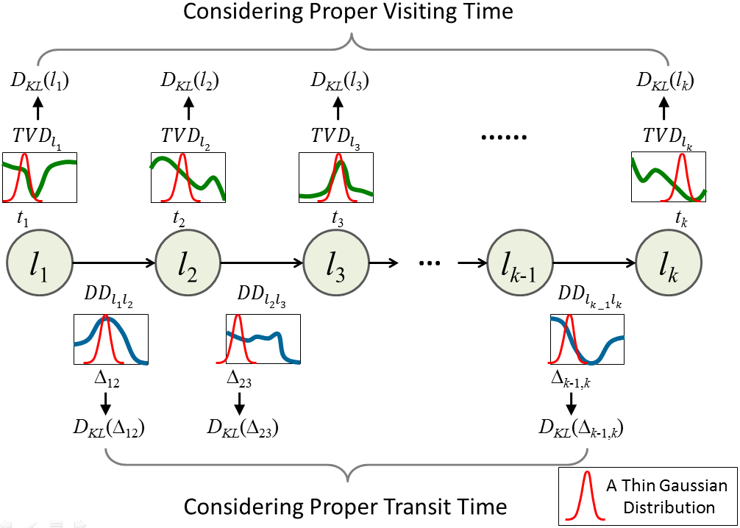
Overview of time-sensitive goodness

Slide 11
Proper Visiting Time (1)
Definition: Temporal Visiting Distribution (TVD), TVD_{l} (t_{i}) for a location l, as the probability distribution of a randomly picked check-in record of l occurs at time t_{i}

Slide 12
Proper Visiting Time (2)
Assuming we want to know how well a decision is to visit a place at 8:00AM
Generate a thin Gaussian distribution whose mean value is 8 with a very small variance (e.g. standard deviation is 1).
Measure the difference between the Gaussian distribution with the learnt TVD of such location.
Adopt the symmetric Kullback-Leibler (KL) Divergence between such Gaussian distribution and TVD to represent the fitness of the assignment.
A smaller KL value indicates better match between the assignment and the distribution learned from data!
We will take the reciprocal KL to indicate the score of visiting time!

Slide 13
Proper Visiting Time (3)
The temporal visiting goodness function f_{visit}(s) of a route s=<(l₁,t₁), (l₂,t₂), ..., (l_{n},t_{n})>, as a combination of the popularity of places together with the fitness of each location over time.
If the places in a route s are visited during the proper time period, the f_visit (s) value would become higher.

Slide 14
Proper Transit Time Duration(1)
Definition: Duration Distribution (DD), define DD_{lilj}(t) between locations l_{i} and l_{j} as the probability distribution over time duration t, , which can be obtained from the following experiment: pick two consecutive check-in records (l_{i}, t_{i}), (l_{j},t_{j}) of a person, and calculate the probability that t_{j}-t_{i}=t.

Slide 15
Proper Transit Time Duration(2)
Similar to what we do to TVD, given a pair of locations l_{i} and l_{j} together with an assignment of a given duration among them, we can model ∆ as a thin Gaussian distribution and compare it with learnt DD using symmetric KL divergence.
The f_duration score then generates by similar approach in f_{visit}(s).
In check-in data, a route s with higher value of f_{duration}(s) indicates such route can be visited with proper “transit+staying” time between places!

Slide 16
Summarization of TVD and DD
The goodness of a trip route
compute 2k-1 values of KL-divergence and then take the geometric mean of such values as the time-dependent goodness of a route

Slide 17
Proper Visiting Order (1)
Exploit the idea of the n-gram language model to measure the quality of the order of visits in a trip route
Uni-gram, bi-gram, and tri-gram

Slide 18
Proper Visiting Order (2)
Average value of the probabilities of uni-gram, bi-gram, and tri-gram to estimate the goodness of orders
The goodness of visiting order of a route can be defined:
Higher f_{order}(s) value represents better quality of visiting order!

Slide 19
Final Goodness Function
Integrate the proper visiting time, the proper duration time, and the proper visiting order into the final goodness function f(s).
Use a parameter α ϵ [0,1] to devise a linear combination of such two parts
A route s with higher value of f(s) will be considered as a better route

Slide 20
Greedy Algorithm TimeRoute
Devise a greedy algorithm, TimeRoute, to achieve the local-optimal solution
Select next place based on the goodness function f(s)
Starting from the query location
When selecting next location l_{i} (i >2), we first identify a set of candidate locations C_{i} by collecting locations which have been ever followed by l_{i}
For each location in the candidate set , we select the candidate l_{c} with the maximum goodness value given the existing route
Append l_{c} to the final route s_{r}. Such procedure will terminate when k spots are identified in the route

Slide 21
Observation & Analysis for whole check-in data
Distribution of route length in RouteDB
Distributions of time duration in RouteDB
People usually prefer visiting few locations in a day.(but with some exceptions)
People consider places closer to where they are when they are planning the next destination

Slide 22
Observations in three cities

Slide 23
Evaluation Plans(1)
Pair-wise Time-sensitive Route Detection exploiting two replacing strategies(Whether our fitness function is proper)
For a existing route in database, we replace a location with a ‘plausible’ one instead of a randomly selected one.
Choose randomly from candidate locations that ever appear right after the location at position i-1
Perturb the time stamps of certain locations in an existing route
Evaluation measure
Accuracy: is calculated as the number of successfully detected routes divided by the number of pair instances.

Slide 24
Compared baseline methods
Distance-based Approach: Choose the closest location to the current spot as the next spot to move to.
Popular-based Approach: Choose the most popular spot of a given time in that city as the next spot to move to.
Forward Heuristic Approach: Chooses a location l_{i} that possesses the largest bi-gram probability with the previous location P(l_{i}|l_{i-1}) as the next location to move to.
Backward Heuristic Approach: chooses a location l_{i} that possesses the largest bi-gram probability with the next location P(l_{i+1}|l_{i}) as the next location to move to.

Slide 25
Experiment 1: Pairwise Time-Sensitive Route Detection
Accuracy by varying the number of replaced locations in New York
Accuracy by varying the number of replaced locations in San Francisco
Accuracy by varying the number of replaced locations in Paris
Accuracy by varying the number of replaced time stamp for our method in the three cities

Slide 26
Evaluation Plans(2)
Time-sensitive Cloze Test of Locations in Routes (Measure the quality of recommendation)
Given some real trip routes with time stamp in each location, by removing some middle locations,
the goal is to test whether a method can successfully identify the removed location.
Evaluation measure
Hit rate: means the ratio of guessing correctly instances

Slide 27
Experiment 2: Time-Sensitive Cloze Test in Routes
Accuracy by varying the position of missing location in New York
Accuracy by varying the position of missing location in San Francisco
Accuracy by varying the position of missing location in Paris

Slide 28
Impact of α
Examine how sensitive our model is to the parameter α
Report the hit rate of cloze test by varying the α value
α performs well while varying from 0.5 ～ 0.9 in three cities
The impact of α on the time-sensitive cloze test for the three cities

Slide 29
Conclusions
This work addresses an important research question: how much the check-in data can provide in terms of designing a suitable trip route .
The proposed goodness function seems can indeed squeeze a lot of knowledge from check-in data to design a time-sensitive trip route that has higher potential of satisfying the users.
The proposed greedy method can not only help planning one-day trip in the certain area but perform real-time recommendation while consider the next location.

Slide 30
Thank you ☺

