Slide 1



Identifying users profiles from mobile calls habits
B Furletti, L. Gabrielli, C. Renso, S. Rinzivillo
KddLab, ISTI – CNR, Pisa (Italy)
August 12, 2012 - Beijing, China

Slide 2
Outline
Profiling of user behaviors from GSM data
  GSM data
  Validation of the dataset
  Two complementary approaches
    Deductive approach (TOP DOWN)
    Inductive approach (BOTTOM UP)
New findings and future developments

Slide 3
Objective and Methods
Partition the users tracked by GSM phone calls into profiles like:
  Residents
  Commuters
  People in transit
  Visitors/Tourists
Analysis of the users’ phone call behaviors with:
  A deductive technique (the Top-Down) based on spatio-temporal rules.
  An inductive technique (the Bottom Up) based on machine learning.
Refinement and integration of the Top Down result with the Bottom Up.

Slide 4
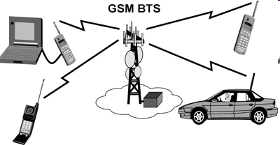
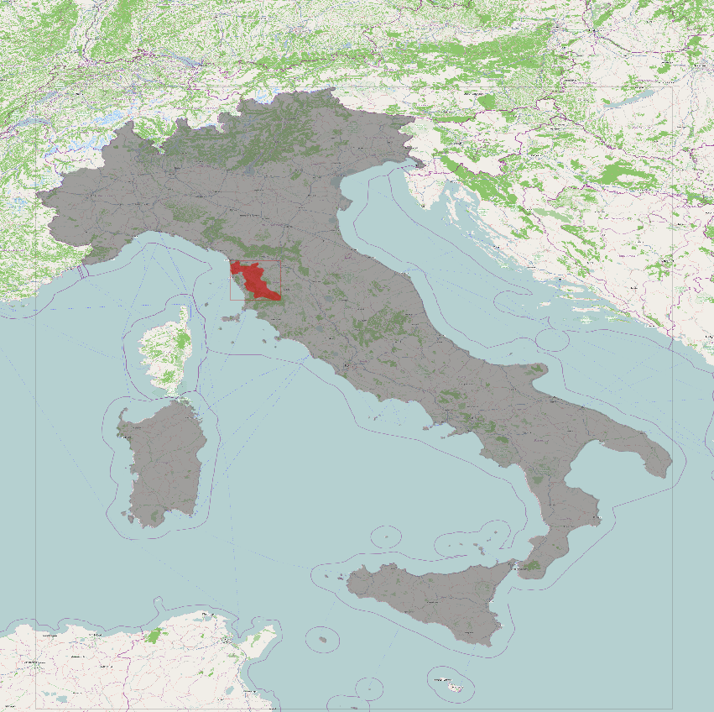
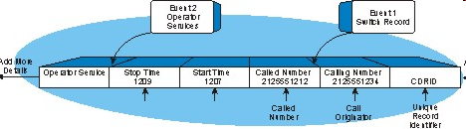
The data
GSM data provided by an Italian mobile phone operator on the whole province of Pisa
Call Data Records (CDR)
Data of the users’ calls.

Slide 5
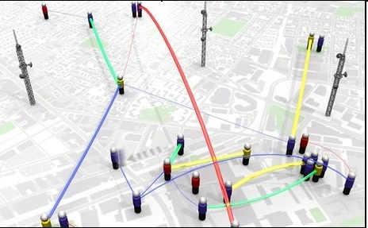
GSM data to identify Visitors
Definition:
  A foreign tourist is identified as «in roming user».
  A Italian tourist is a user that, in the observation window, appears for a certain period of time and than disappear.

Slide 6
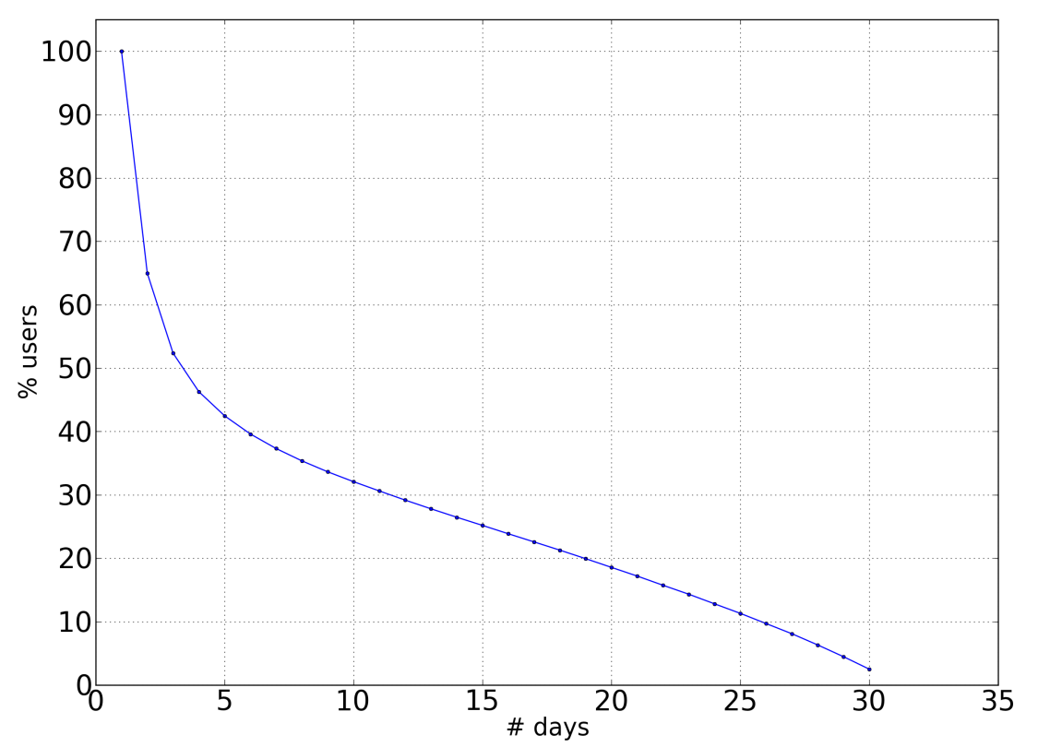
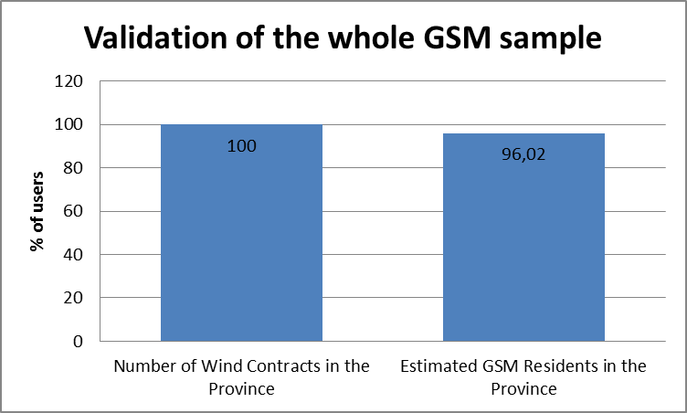
Validation of the GSM sample
Validation of the GSM data sample using the market penetration factor claimed by the mobile operator in the province of Pisa.
  This factor is used to estimate the total number of residents in the province of Pisa.
  RESULT: The GSM sample (Resident population in the province) is in line with the number of mobile contracts in the province.
Notes:
Nr. Utenti distinti con telefonate nelle 4 settimane = 226.473
Contratti Wind: circa 111.000
Residenti stimanti: 104.928

Slide 7
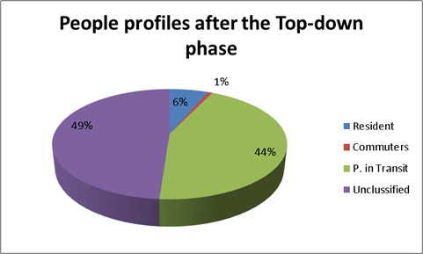
Rule Bases Classifier (Top Down)
Deductive approach
Objective: Partition the users seen in the urban area of Pisa in: Residents, Commuters, and People in Transit. Basing on the definition of these categories, a set of spatio-temporal rules are implemented in order to separate the set of users.
Resident. A person is resident in an area A when his/her home is inside the A. Therefore the mobility tends to be from and towards his/her home.
Commuter. A person is a commuter between an area B and an area A, if his/her home is in B while the workplace is in A. Therefore the daily mobility of this person is mainly between B and A.
In Transit. An individual is “in transit” over an area A, if his/her home and work places are outside area A, and his/her presence inside area A is limited by a temporal threshold representing the time necessary to transit through A.

Slide 8
User’s Temporal Profile
Preliminary data preparation before the Bottom Up analysis…
Aggregation od the call data in a Temporal Profiles for each user:
  Daily profile
  Weekly profile
  Shifted profile
Notes:
Il profilo temporale cattura un certo comportamento dell’utente (numero di chiamate o presenza) sulla finestra temporale di analisi.
Preso il calendario delle chiamate, si puo’ identificare:
un profilo giornaliero: un vettore di dimensione uguale al numero di giorni della finestra temporale di analisi, in cui ogni cella contiene numero di chiamate o presenza.
Un profilo settimanale: un vettore di 7 elementi che contiene l’aggregazione su un settimana del numero di chiamate o della presenza.
Profilo ruotato: si allinea a sinistra il giorno in cui l’utente ha fatto la prima chiamata (o si è rilevato la sua presenza). Questo profilo ha l’obiettivo di far emergere in numero di giorni di presenza.

Slide 9

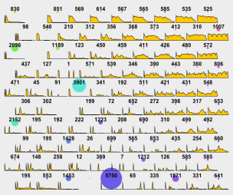

Bottom Up: SOM Clustering
Inductive approach
Objectives:
  Integrate and refine the Top Down results trying to partition the unclassified users.
  Identify the Visitors/Tourists, and Residents and Commuters not “captured” discovered with the Top Down method.
Definition of user Temporal Profile by using the call behavior.
Analysis of the temporal profiles by using a data mining strategy* in order to group similar profiles and identify the categories.
  *Self Organizing Maps (SOM): a type of neural network based on unsupervised learning. It produces a one/two-dimensional representation of the input space using a neighborhood function to preserve the topological properties of the input space.
Temporal Profile
Commuters
Computation
Visitors/Tourists
SOM Map
Residents

Slide 10
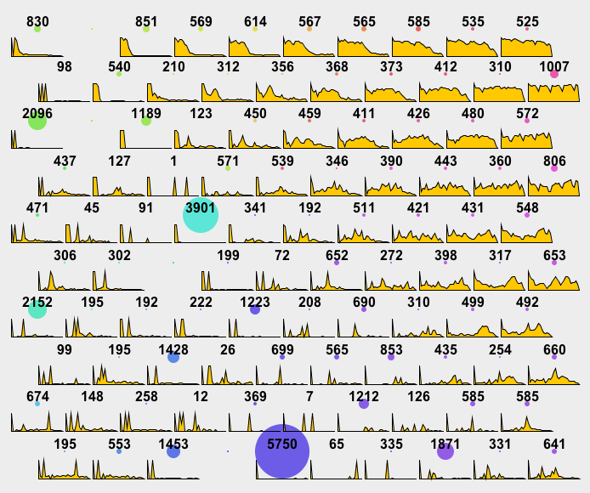
SOM result: Visitors/Tourists
Rotated Temporal Profile to identify Visitors/Tourists categories.
Visitors/Tourists: Limited presence for few consecutive days

Slide 11
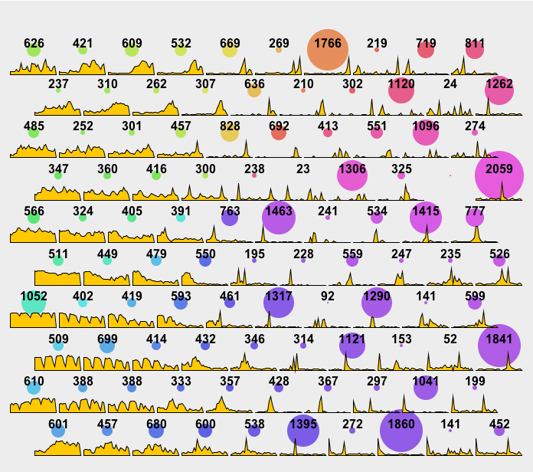
SOM results: Residents and Commuters
Residents: Uniformly distributed presence along the period (on the left, center and top).
Commuters: general presence during the weekdays. Noticeable absence during the weekends (bottom-left corner)

Slide 12
Future steps and work in progress
Improving the whole strategy: using the Top Down and Bottom Up analysis on the whole dataset.
Use the Top Down as validation set for the Bottom Up.
Modifying the user’s temporal profile in a more informative data structure.

Slide 13
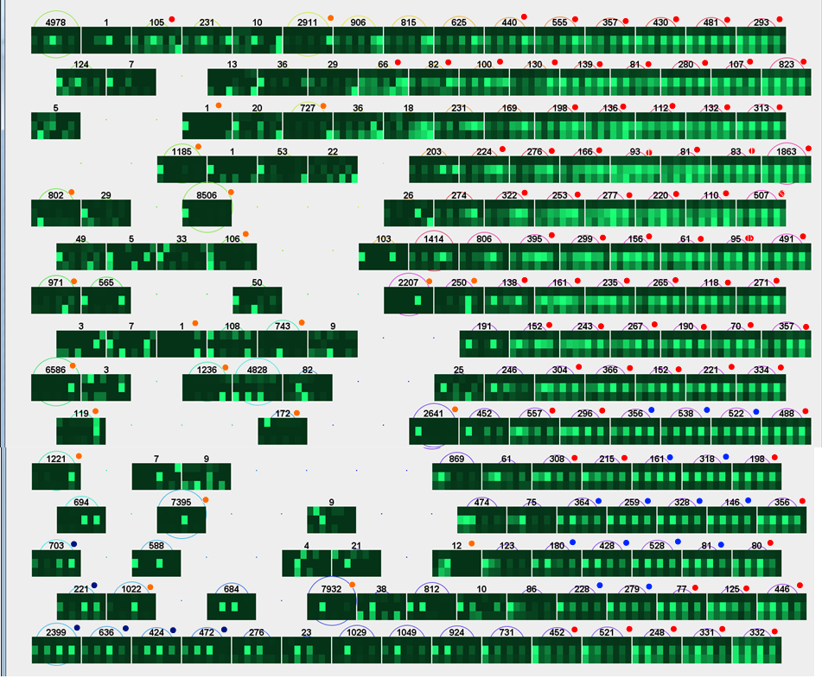
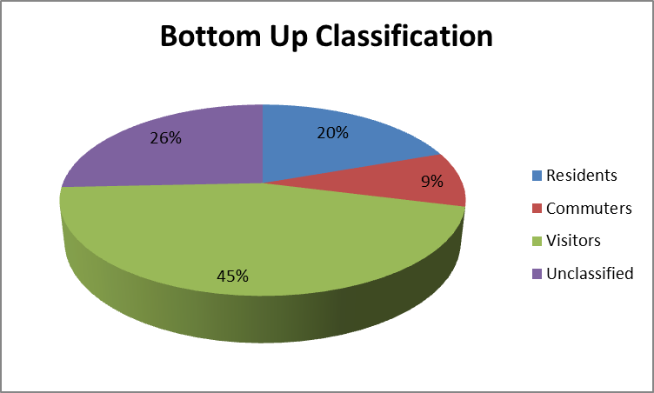


New results
Resident profile
Commuter profile
Visitor profile
Among the unclassified there are other interesting profiles:
- The occasional visitors;
- The «night visitors».

Slide 14
Conclusions
  Profiling of users by mean of an automatic GSM analytical procedure
  Definition of a middle-aggregation: temporal profiles
    Sensible information is preserved during the transformation
    Profiling can operate only on the TP
    Complete separation of data provider and data analysts
      This may enable a continuous profiling service

