Slide 1
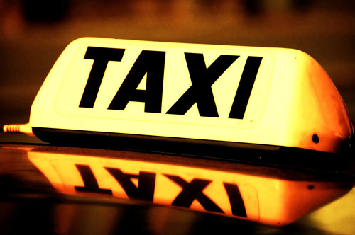
Where to Wait for a Taxi?
Xudong Zheng, Xiao Liang, Ke Xu
State Key Laboratory of Software Development Environment
Beihang University, Beijing, China
Notes:
Hello everyone, now let me make the presentation of our paper, where to wait for a taxi.
I’m Xudong Zheng. And our research team is from Beihang University.

Slide 2
Motivation
Background
Taxis play an important role in the transportation of cities
Problem
Many people are often annoyed with waiting for taxis, especially in some big cities of China
Cause
Passengers lack the information about vacant taxis
Notes:
Let’s start from our motivation.
Taxis play more and more important role in the transportation of cities. As far as I know, Beijing has more than 60,000 taxis to provide about 2,000,000 services every day now.
But, many people are still often annoyed with waiting for taxis, especially in some big cities of China. For example, if I want to take a taxi in a strange place for me, there are some roads nearby, I would be very confused which road is better to go to wait for a taxi.
I think the cause of that problem is the lack of information about vacant taxis provided to passengers. If we know which road have more vacant taxis or more probability to have vacant taxis, we would make a better choice.

Slide 3
Solution
Estimation
Estimate the waiting time for a vacant taxi at different times on road segments.
Recommendation
Recommend the waiting place to potential passenger.
Notes:
To address this problem, we propose our solution, which is to provide more information mined from taxis data to passengers.
We would first manage to estimate the waiting time for vacant taxi at different times on road segments and then we could recommend the best waiting place to the passengers based on our estimated waiting time.

Slide 4
Estimation of Waiting Time
Two situations:
There are some vacant taxis just stopping beside the road, you could take a taxi immediately.($p_{imm}$)
There are no vacant taxis at hand, you should wait for the coming of next vacant taxi.($t_{next}$)
$$t_{wait}=\left(1−p_{imm}\right) ⋅t_{next}$$
Notes:
Now, we first try to estimate the waiting time for vacant taxis at a given time and road.
We found two situations before we take a taxi. The first one is, there are some vacant taxis just stopping beside the road, then you could take the taxi immediately. This situation usually occurs during the idle time, or around some popular places, such as railway station or airport. We denote the probability of this situation as p_imm, imm means immediately.
And the second situation is, there are no vacant taxis at hand, so you should wait for the coming of next vacant taxi. This situation is more common, we will pay more attention to it. And we denote the waiting time of this situation as t_next.
Then we could express the average waiting time in probability as that. Namely one minus p_imm, then multiply t_next. Because we needn’t to wait at the first situation.

Slide 5
Estimation of Waiting Time
Estimation of $p_{imm}$
Consider it as a constant at each timeslot and road segment.
Approximate it by the proportion of time when there is at least one vacant taxi parking beside the road.
$${\hat{p}}_{imm}=\frac{t_{park}}{ΔT}$$
Notes:
For the estimation of p_imm, we consider it as an constant at each timeslot and road segment. And we approximate it by the proportion of time when there is at least one vacant taxi parking beside the road.
So we could express the estimation of p_imm as that. Here t_park is the time when there is at least one vacant taxi parking beside the road during the timeslot. Delta_T is the span of the timeslot.

Slide 6
Estimation of Waiting Time
Estimation of $t_{next}$
It’s related to the frequency of vacant taxis leaving a road
Non-homogeneous Poisson Process (NHPP)
Event: a vacant taxi leaving a road
Rate parameter $λ$: frequency of vacant taxis leaving
Rate function $λ(t)$: piecewise linear function (1 hour as a timeslot)
Expectation of $t_{next}$
$E\left(t_{next}\right)=\frac{1}{λ}$
MLE of $λ$
$\hat{λ}=\frac{{\overline{N}}_{vacant}}{ΔT}$
$${\hat{t}}_{next}=\frac{ΔT}{{\overline{N}}_{vacant}}$$
Notes:
For the estimation of t_next, we regard it as an random variable, and we think it’s related to the frequency of vacant taxis leaving a road. In fact, the waiting time is determined by the demand and supply of taxis. But because we do not have the data to directly show the demand for taxis, we think the number of vacant taxis leaving a road approximately reveals the remaining chance for a passenger to take a taxi here.
Here we use NHPP to model the behavior of the vacant taxis leaving a road. NHPP is a Poisson Process whose arriving rate is a function of time. In this NHPP, we regard a vacant taxi leaving a road as a event, so rate parameter lambda is the frequency of vacant taxis’ leaving. And we adopt a piecewise linear rate function and regard each hour as a timeslot for simplicity.
Then we could deduce the expectation of t_next, which is reciprocal of lambda. And we also could get the maximum likelihood estimation of lambda, which is N_vacant_bar over delta_T. Here N_vacant_bar is the average count of vacant taixs leaving during a timeslot.
So we could express the estimation of t_next as Delta_T over N_vacant_bar.

Slide 7
Estimation of Waiting Time
Calculation
$$\begin{aligned}{\hat{t}}_{wait}&=\left(1−{\hat{p}}_{imm}\right) ⋅{\hat{t}}_{next}& \\ &=\left(1−\frac{t_{park}}{ΔT}\right)⋅\frac{ΔT}{{\overline{N}}_{vacant}}\end{aligned}$$
Detect the valid parking time of vacant taxis
Count the number of vacant taxis leaving
Notes:
Now we can finally calculate the estimation of t_wait, which is expressed as that.
During the calculation. Our main tasks are detecting the parking time of vacant taxis and counting the number of vacant taxis leaving.

Slide 8
Evaluation of Estimation
Data Sets
Trajectories from more than 12,000 taxis in Beijing
Sampling interval: about 60 seconds
Training: Oct. 2010 ~ Dec. 2010
Testing: Jan. 2011
Notes:
Then let’s see the evaluation of our estimation. But before that, let me introduce our data sets.
We analyze the trajectories from more than 12,000 taxis in Beijing. The sampling interval of each taxi is about 60 seconds. We regard the data from Oct. 2010 to Dec. 2010 as training, and the data of Jan. 2011 as testing.

Slide 9
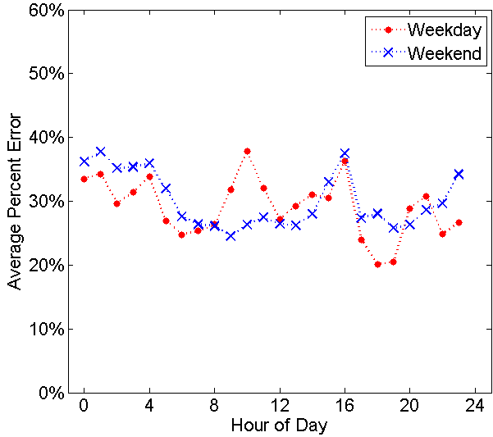
Evaluation of Estimation
Simulation
Generate passengers with random timestamps for each road.
Calculate the actual time spent to wait for a vacant taxi just staying on the road according to the testing taxi trajectories.
The percent error of the estimated waiting time during simulation
Notes:
Then we calculate the estimated waiting time based on this data, and evaluate it through simulation.
During the simulation, we generate passengers with random timestamps for each road. Then for each passenger, we calculate the actual time spent to wait for a vacant taxi just staying on this road according to the testing taxi trajectories. And then compare it with our estimation.
This figure shows the average percent error of the estimated waiting time at different hours in a day during simulation. We also make the estimation of weekday and weekend separately. We could see from this figure, the average error is about 30 percent, which shows our estimation is relatively accurate.

Slide 10
Recommendation on Waiting Place
Limit the range of candidate roads:
$$R_{cand}=\{r:distance(P,r)<d_{max}\}$$
Estimate the total time spent for each candidate road:
$$\begin{aligned}{\hat{t}}_{total}^{r,T}&={\hat{t}}_{walk}+{\hat{t}}_{wait}^{r,T} \\ &=\frac{distance\left(P,r\right)}{\hat{v}}+{\hat{t}}_{wait}^{r,T}\end{aligned}$$
Recommend the road with minimal time spent:
$$r_{best}=\arg{\min_{r∈R_{cand}}{{\hat{t}}_{total}^{r,T}}}$$
Notes:
Based on our estimated waiting time, we could do some recommendation on waiting place to passenger.
Considering the speed of pedestrian is slow, we limit the candidate roads to be recommended within a small distance. Here the r denote a candidate road, and distance_P_r means the distance from the current position to the road r. And d_max is max distance the passenger want to walk.
Then we could estimate the total time spent before take a taxi for each candidate road. The total time spent contains the time needed to walk to the road and the time needed to wait on the road.
Finally, we would recommend the road with minimal total time spent to the potential passenger.

Slide 11
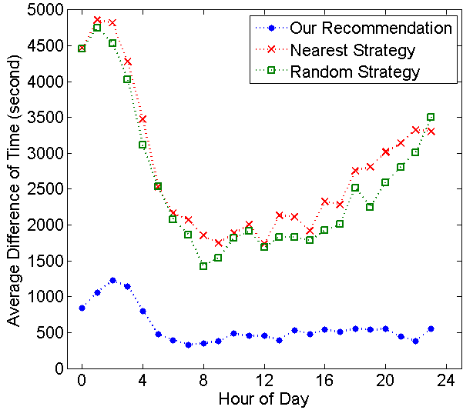
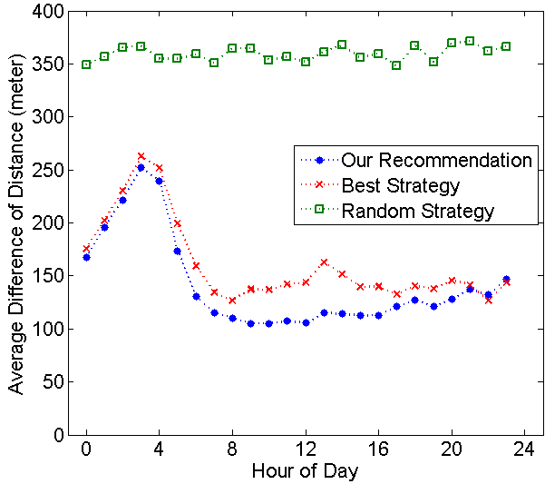
Evaluation of Recommendation
We compare our recommendation with three strategies
Best strategy
Nearest strategy
Random strategy
Difference of total time spent compared with the best strategy
Difference of walking distance compared with the nearest strategy
Notes:
Then, let’s see the evaluation of our recommendation.
We compare our recommendation with three strategies:
The first is best strategy, which always chooses the road with the really best total time spent according to the actual testing data. But it’s a virtual strategy, because it’s based on posterior knowledge of taxi trajectories.
The second is the nearest strategy. It always chooses the nearest road to wait. It is a common strategy in reality because many people often are reluctant to walk too long.
The third is the random strategy, it just randomly selects a road within the range. It is a possible strategy for the passenger who has no knowledge about the surroundings.
Let’s see the two figures. The left one shows the difference of total time spent compared with the best strategy, because best strategy always leads the shortest total time spent. The blue line is our recommendation. We could see our recommendation is obviously better than the nearest strategy and random strategy, but very close to the best strategy.
The right one shows the difference of walking distance compared with the nearest strategy, because the nearest strategy always leads the shortest distance to walk. We could see our recommendation is a little better to the best strategy, and is not far from the nearest strategy.
These results show that, the recommendation made by our approach is a trade off between the time spent and walking distance, which make the two aspects are all not much different from the best situations.

Slide 12
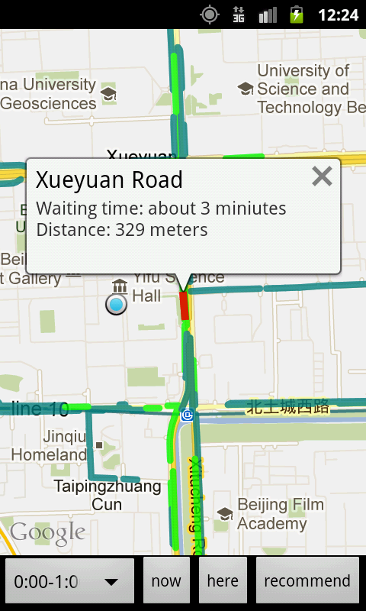
Application
We develop an Android mobile application to visualize the waiting time for vacant taxis on roads and also could provide a suggestion on where to wait for a taxi.
http://lbs.nlsde.buaa.edu.cn/taxiwaiter
Notes:
Finally, we develop an Android application to visualize the waiting time for vacant taxis on roads and also could provide a suggestion on where to wait for a taxi.
As we can see from the snapshot, the roads are painted with different colors to demonstrate the different waiting time on them, which could make the users intuitively understand the availability of taxis on these roads at some time. The application also could recommend waiting place for the user according to current time and position. In the snapshot, the blue point is the current position of the user, and the red road is the recommendation, it also displays the possible waiting time and walking distance.
Here is a URL of our web site, you can download the application from it and it also contain a web version of the waiting time visualization.

Slide 13
Thanks for your attention! Any questions?
zhengxudong@nlsde.buaa.edu.cn
Notes:
OK, that’s all. Thank you very much! And welcome to ask me any questions.

