Slide 1
Avoiding the crowds
Understanding Tube Station Congestion Patterns from Trip Data
Irina Ceapa, Chris Smith, Licia Capra
University College London

Slide 2
No one likes a crowded train.
Notes:
supply is at maximum

Slide 3
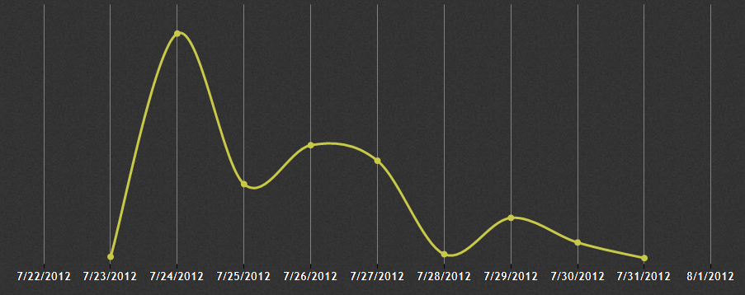
Encouraging off-peak travel
Fare differentiation doesn’t work. (Lathia & Capra, Ubicomp 2011)
Personal requests from the mayor don’t work.
#f**koffboris
Notes:
not scientifically verified!

Slide 4
Why do we do it?

Slide 5
“In truth, to attain interior peace, one must be willing to pass through the contrary to peace.”
Swami Brahmananda
or, we all just need to get to work on time!
Notes:
With such a strict constraint how can we help people avoid congestion

Slide 6
Proposal
Analyse station congestion patterns.
Predict congestion.
TODO: How can predictions benefit users of the system?
Notes:
Will users change their behaviour?
By changing travel time does the user’s experience improve?

Slide 7
Advanced Traveller Information Systems

Slide 8
Advanced Traveller Information Systems

Slide 9
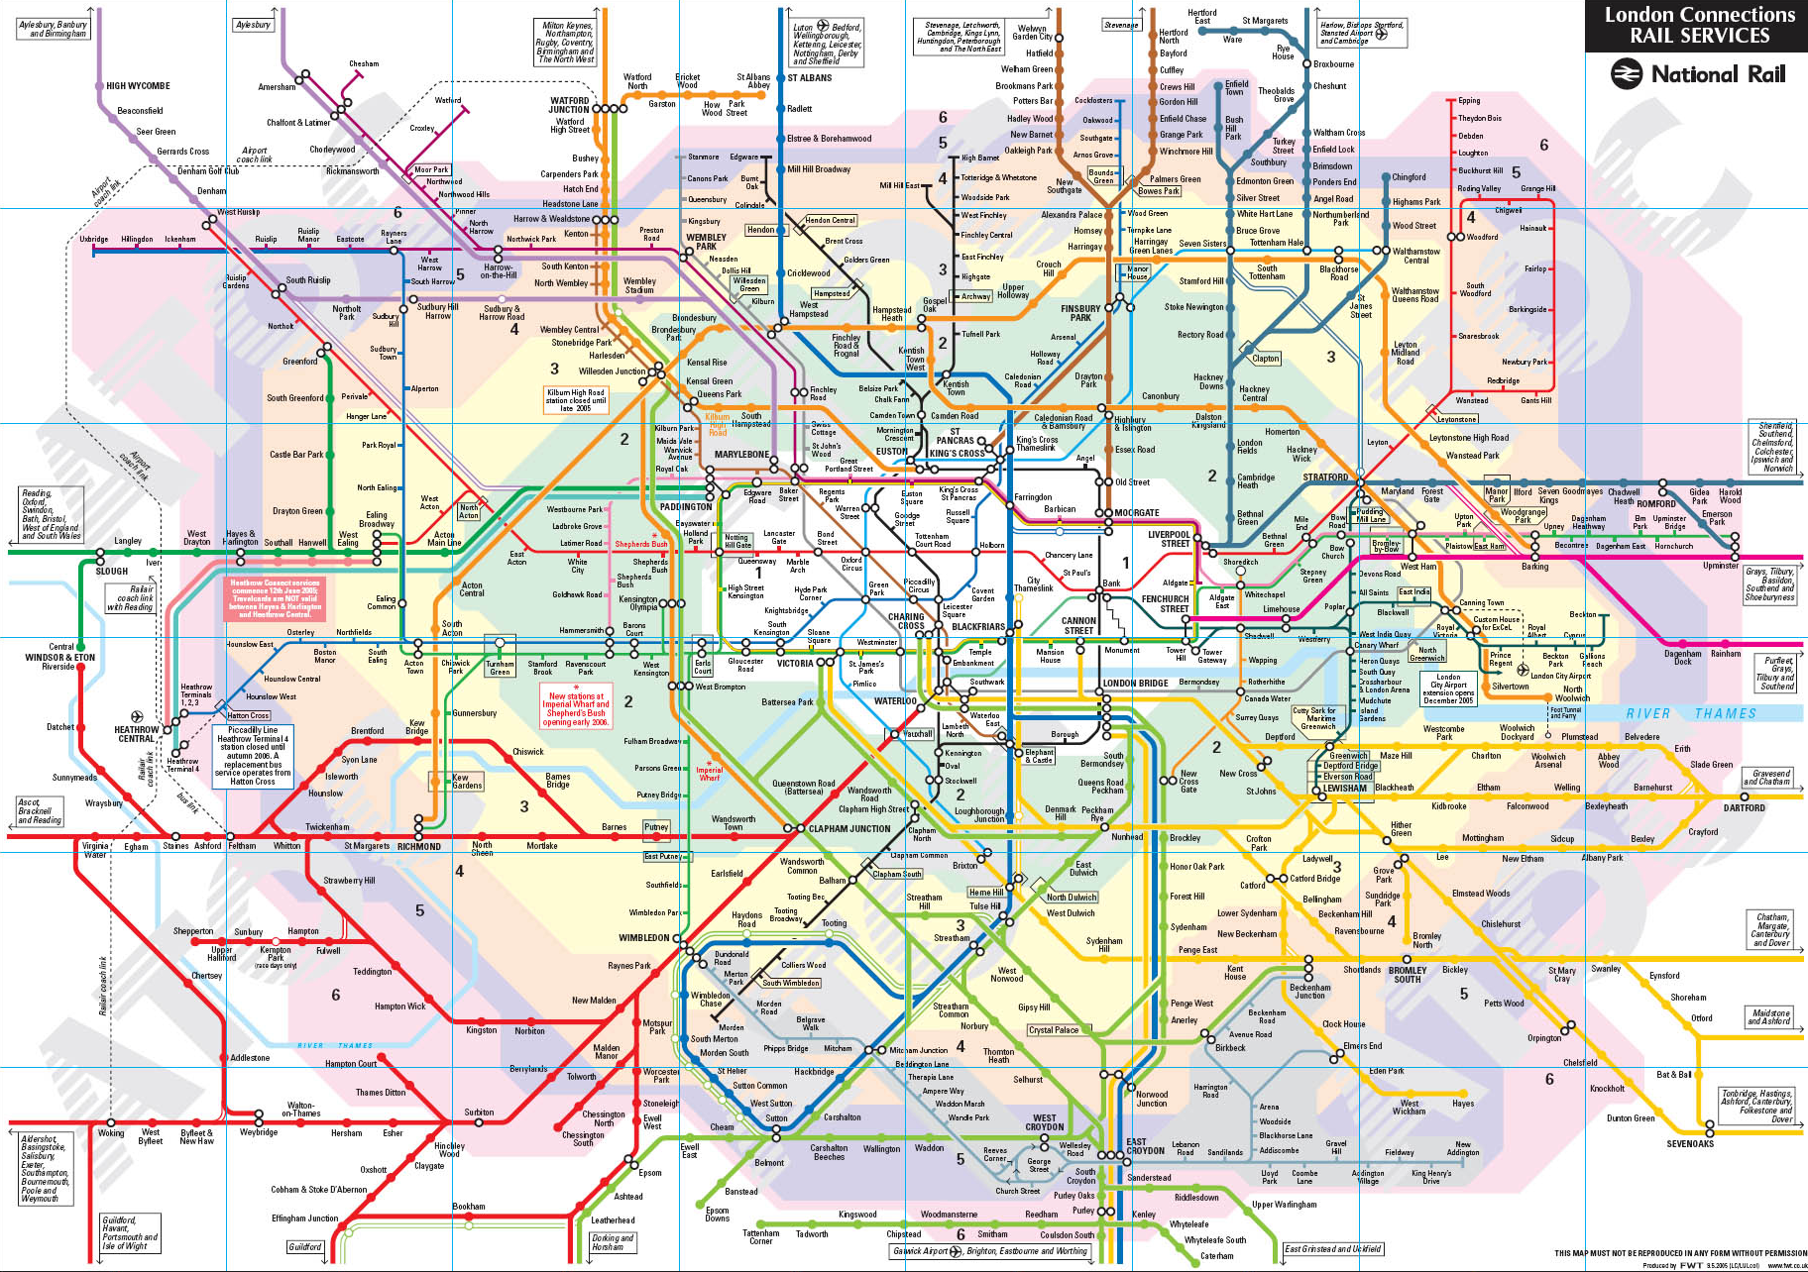
London Underground
31 days (23 weekdays)
270 stations
5 million travellers
64 million trips
Notes:
270 stations
64 million trips
5 million users

Slide 10
Station Activity Patterns

Slide 11
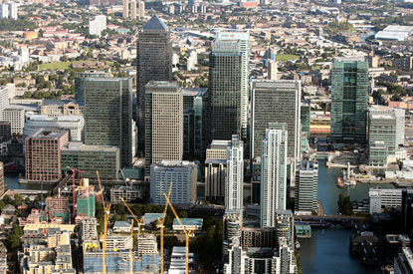
Station Activity Patterns

Slide 12
Station Activity Patterns

Slide 13
Clustering

Slide 14
Prediction
Classify a station as either overcrowded (above threshold) or not overcrowded (below threshold).
Predictors
Historic Value
Historic Mean
Historic Trend
Vary
threshold
prediction window
proportion of training data
Notes:
problem: no official station capacities.
FOI request
TODO: make more visual e.g. pic of crowded and not crowded

Slide 15
Evaluation
Sensitivity =
true positives
-------------------------------
true positives + false negatives
Notes:
sensitivity – probability of a positive test given that the station is overcrowded.

Slide 16
Results
Notes:
Predicting all positives will give 100% sensitivity
also high precision and accuracy

Slide 17
Results

Slide 18
Results

Slide 19
Nudging
User study required to determine threshold.
different users may have different thresholds.
a single user may have different thresholds in different contexts.
User study required to asses potential for encouraging users to change travel time, and asses benefit (in terms of comfort) of change.

Slide 20
Limitations
We only have data pertaining to stations – predicting train congestion would be better.
Potentially victim of own success – if many people change travel habits, congestion will become much harder to predict.
Notes:
----- Meeting Notes (02/08/2012 14:51) -----
remove first limitation √

Slide 21
Take homes
Crowdedness is highly regular and easy to predict
Congestion often occurs in brief spikes, suggesting that altering travel time by as little as 20 minutes could help travellers to avoid crowds.
Thanks!

