Slide 1
Checkpointing & Rollback Recovery
Chapter 13
Anh Huy Bui
Jason Wiggs
Hyun Seok Roh

Slide 2
Introduction
Rollback recovery protocols
restore the system back to a consistent state after a failure
achieve fault tolerance by periodically saving the state of a process during the failure-free execution
treats a distributed system application as a collection of processes that communicate over a network
Checkpoints
the saved states of a process
Why is rollback recovery of distributed systems complicated?
messages induce inter-process dependencies during failure-free operation
Rollback propagation
the dependencies may force some of the processes that did not fail to roll back
This phenomenon is called “domino effect”
Notes:
2

Slide 3
Introduction
If each process takes its checkpoints independently, then the system can not avoid the domino effect
this scheme is called independent or uncoordinated checkpointing
Techniques that avoid domino effect
Coordinated checkpointing rollback recovery
processes coordinate their checkpoints to form a system-wide consistent state
Communication-induced checkpointing rollback recovery
forces each process to take checkpoints based on information piggybacked on the application
Log-based rollback recovery
combines checkpointing with logging of non-deterministic events
relies on piecewise deterministic (PWD) assumption
Notes:
3

Slide 4
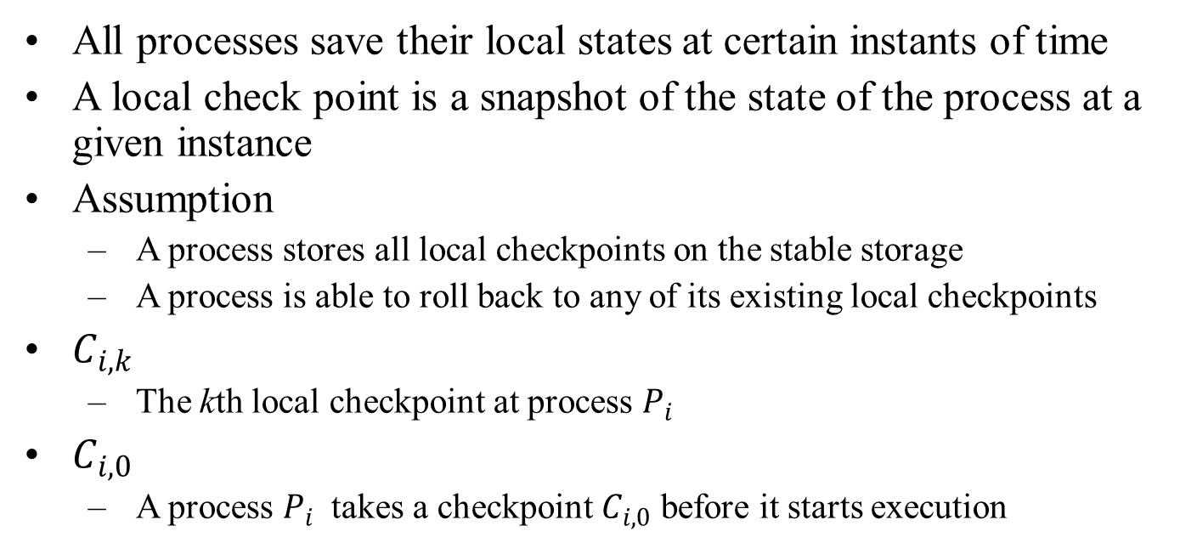
A local checkpoint
All processes save their local states at certain instants of time
A local check point is a snapshot of the state of the process at a given instance
Assumption
A process stores all local checkpoints on the stable storage
A process is able to roll back to any of its existing local checkpoints
$C_{i,k}$
The kth local checkpoint at process $P_{i}$
$C_{i,0}$
A process $P_{i}$ takes a checkpoint $C_{i,0}$ before it starts execution
Notes:
4

Slide 5
Consistent states
A global state of a distributed system
a collection of the individual states of all participating processes and the states of the communication channels
Consistent global state
a global state that may occur during a failure-free execution of distribution of distributed computation
if a process’s state reflects a message receipt, then the state of the corresponding sender must reflect the sending of the message
A global checkpoint
a set of local checkpoints, one from each process
A consistent global checkpoint
a global checkpoint such that no message is sent by a process after taking its local point that is received by another process before taking its checkpoint
Notes:
5

Slide 6
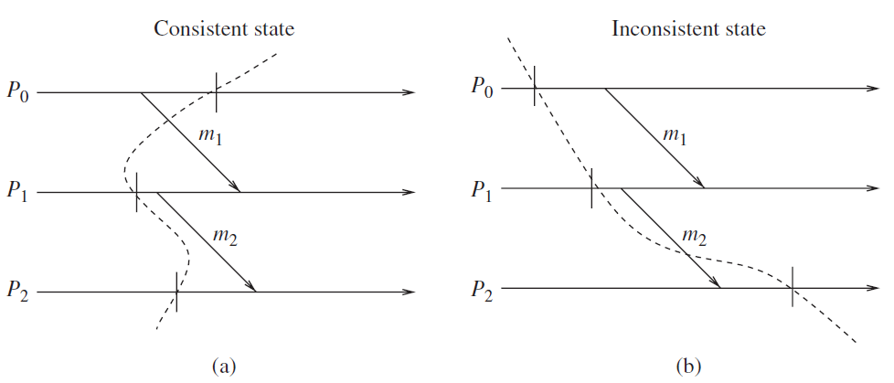
Consistent states - examples
Notes:
6

Slide 7
Interactions with outside world
A distributed system often interacts with the outside world to receive input data or deliver the outcome of a computation
Outside World Process (OWP)
a special process that interacts with the rest of the system through message passing
A common approach
save each input message on the stable storage before allowing the application program to process it
Symbol “||”
An interaction with the outside world to deliver the outcome of a computation
Notes:
7

Slide 8
Messages
In-transit message
messages that have been sent but not yet received
Lost messages
messages whose ‘send’ is done but ‘receive’ is undone due to rollback
Delayed messages
messages whose ‘receive’ is not recorded because the receiving process was either down or the message arrived after rollback
Orphan messages
messages with ‘receive’ recorded but message ‘send’ not recorded
do not arise if processes roll back to a consistent global state
Duplicate messages
arise due to message logging and replaying during process recovery
Notes:
8

Slide 9
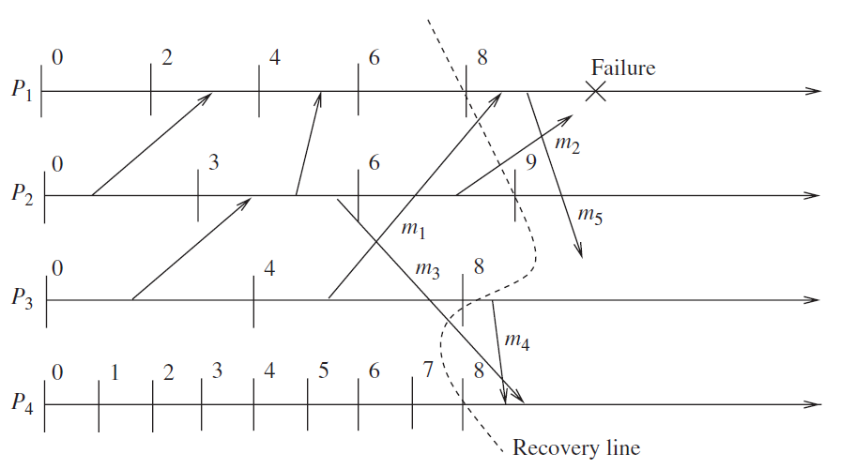
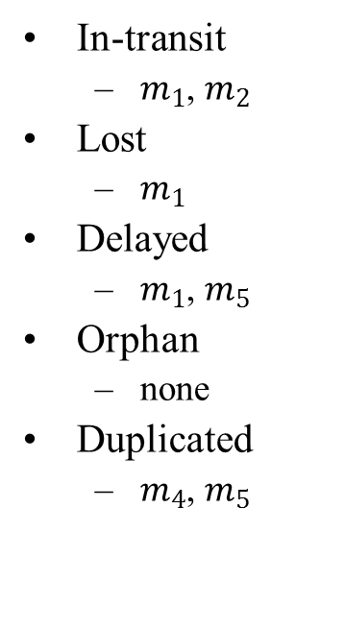
Messages – example
In-transit
$m_{1}$, $m_{2}$
Lost
$m_{1}$
Delayed
$m_{1}$, $m_{5}$
Orphan
none
Duplicated
$m_{4}$, $m_{5}$
Notes:
9

Slide 10
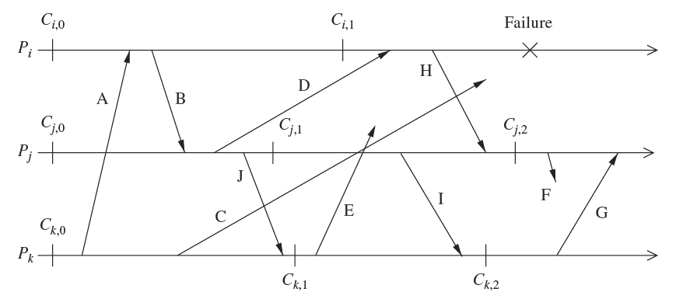
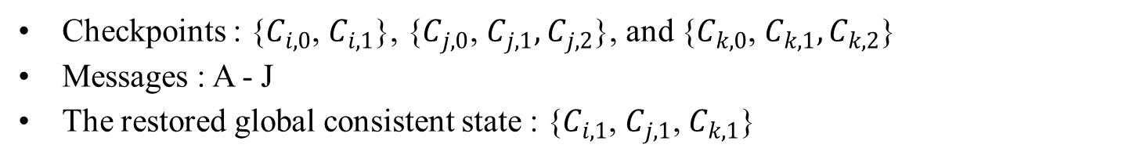
Issues in failure recovery
Checkpoints : {$C_{i,0}$, $C_{i,1}$}, {$C_{j,0}$, $C_{j,1},C_{j,2}$}, and {$C_{k,0}$, $C_{k,1},C_{k,2}$}
Messages : A - J
The restored global consistent state : {$C_{i,1}$, $C_{j,1}$, $C_{k,1}$}
Notes:
10

Slide 11
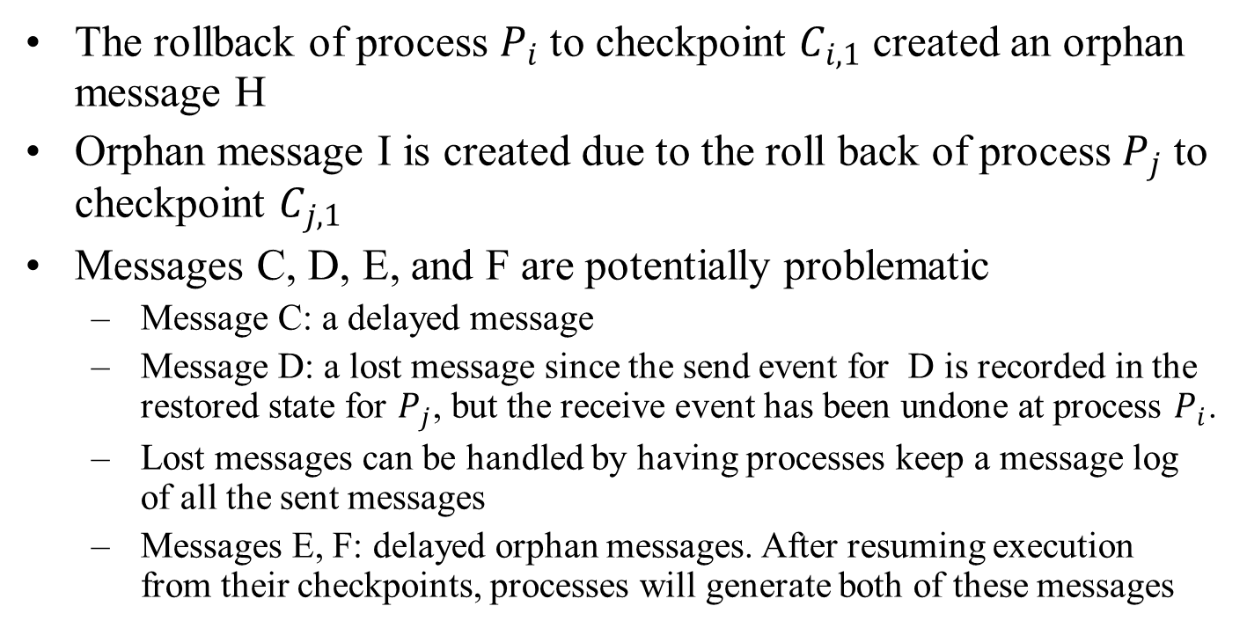
Issues in failure recovery
The rollback of process $P_{i}$ to checkpoint $C_{i,1}$ created an orphan message H
Orphan message I is created due to the roll back of process $P_{j}$ to checkpoint $C_{j,1}$
Messages C, D, E, and F are potentially problematic
Message C: a delayed message
Message D: a lost message since the send event for D is recorded in the restored state for $P_{j}$, but the receive event has been undone at process $P_{i}$.
Lost messages can be handled by having processes keep a message log of all the sent messages
Messages E, F: delayed orphan messages. After resuming execution from their checkpoints, processes will generate both of these messages
Notes:
11

Slide 12
Uncoordinated Checkpointing
Each process has autonomy in deciding when to take checkpoints
Advantages
The lower runtime overhead during normal execution
Disadvantages
Domino effect during a recovery
Recovery from a failure is slow because processes need to iterate to find a consistent set of checkpoints
Each process maintains multiple checkpoints and periodically invoke a garbage collection algorithm
Not suitable for application with frequent output commits
The processes record the dependencies among their checkpoints caused by message exchange during failure-free operation
Notes:
12

Slide 13
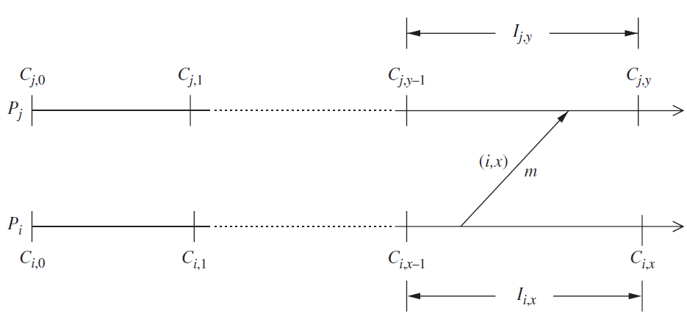
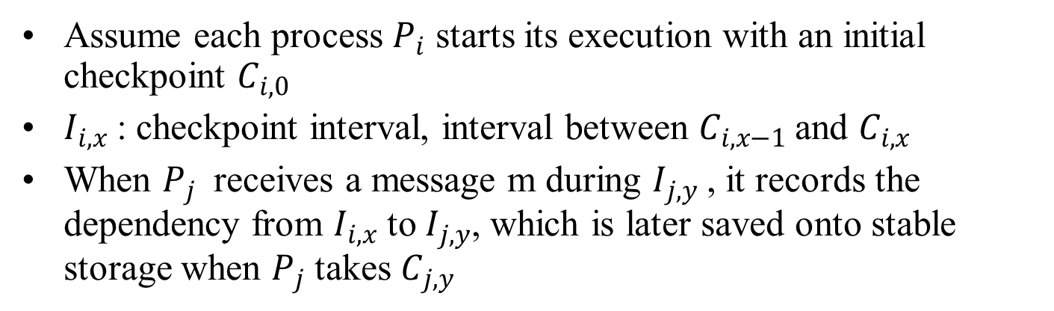
Direct dependency tracking technique
Assume each process $P_{i}$ starts its execution with an initial checkpoint $C_{i,0}$
$I_{i,x}$: checkpoint interval, interval between $C_{i,x−1}$and $C_{i,x}$
When $P_{j}$ receives a message m during $I_{j,y}$, it records the dependency from $I_{i,x}$ to $I_{j,y}$, which is later saved onto stable storage when $P_{j}$ takes $C_{j,y}$
Notes:
13

Slide 14
Coordinated Checkpointing
Blocking Checkpointing
After a process takes a local checkpoint, to prevent orphan messages, it remains blocked until the entire checkpointing activity is complete
Disadvantages
the computation is blocked during the checkpointing
Non-blocking Checkpointing
The processes need not stop their execution while taking checkpoints
A fundamental problem in coordinated checkpointing is to prevent a process from receiving application messages that could make the checkpoint inconsistent.
Notes:
14

Slide 15
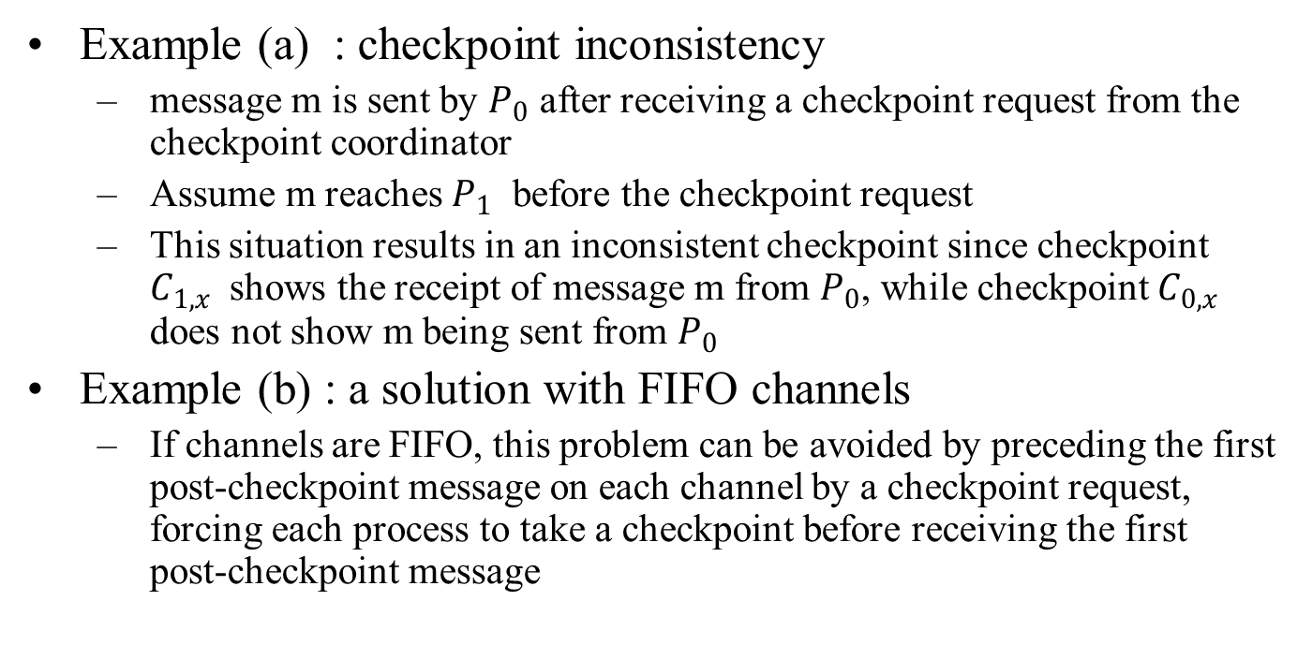
Coordinated Checkpointing
Example (a) : checkpoint inconsistency
message m is sent by $P_{0}$ after receiving a checkpoint request from the checkpoint coordinator
Assume m reaches $P_{1}$ before the checkpoint request
This situation results in an inconsistent checkpoint since checkpoint $C_{1,x}$ shows the receipt of message m from $P_{0}$, while checkpoint $C_{0,x}$ does not show m being sent from $P_{0}$
Example (b) : a solution with FIFO channels
If channels are FIFO, this problem can be avoided by preceding the first post-checkpoint message on each channel by a checkpoint request, forcing each process to take a checkpoint before receiving the first post-checkpoint message
Notes:
15

Slide 16
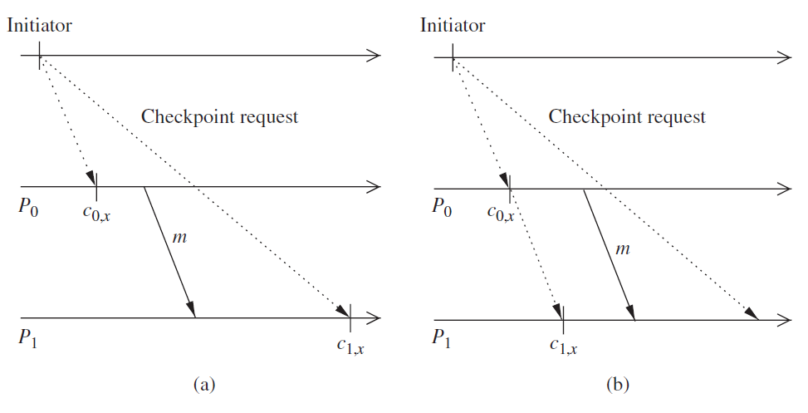
Coordinated Checkpointing
Notes:
16

Slide 17
Communication-induced Checkpointing
Two types of checkpoints
autonomous and forced checkpoints
Communication-induced checkpointing piggybacks protocol- related information on each application message
The receiver of each application message uses the piggybacked information to determine if it has to take a forced checkpoint to advance the global recovery line
The forced checkpoint must be taken before the application may process the contents of the message
In contrast with coordinated checkpointing, no special coordination messages are exchanged
Two types of communication-induced checkpointing
model-based checkpointing and index-based checkpointing.
Notes:
17

Slide 18
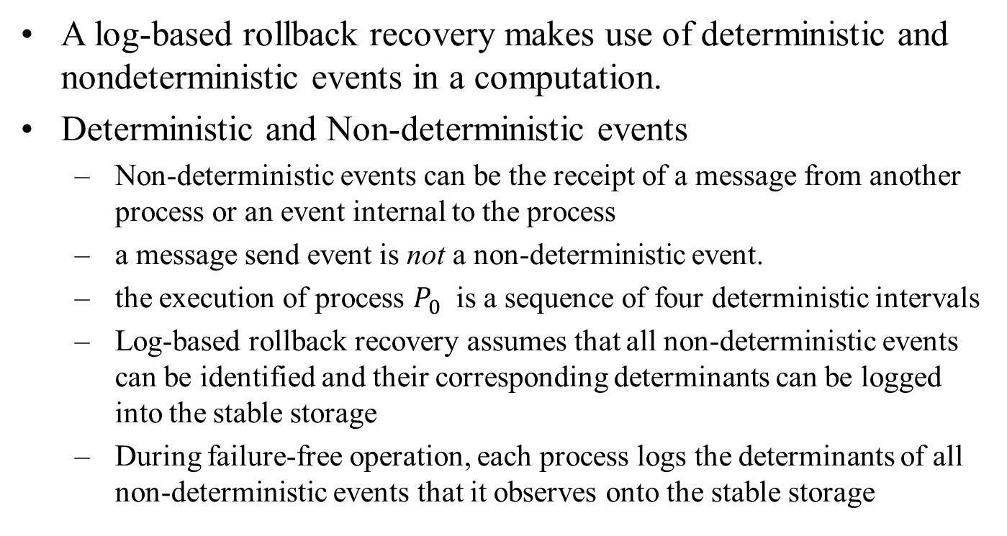
Log-based Rollback Recovery
A log-based rollback recovery makes use of deterministic and nondeterministic events in a computation.
Deterministic and Non-deterministic events
Non-deterministic events can be the receipt of a message from another process or an event internal to the process
a message send event is not a non-deterministic event.
the execution of process $P_{0}$ is a sequence of four deterministic intervals
Log-based rollback recovery assumes that all non-deterministic events can be identified and their corresponding determinants can be logged into the stable storage
During failure-free operation, each process logs the determinants of all non-deterministic events that it observes onto the stable storage
Notes:
18

Slide 19
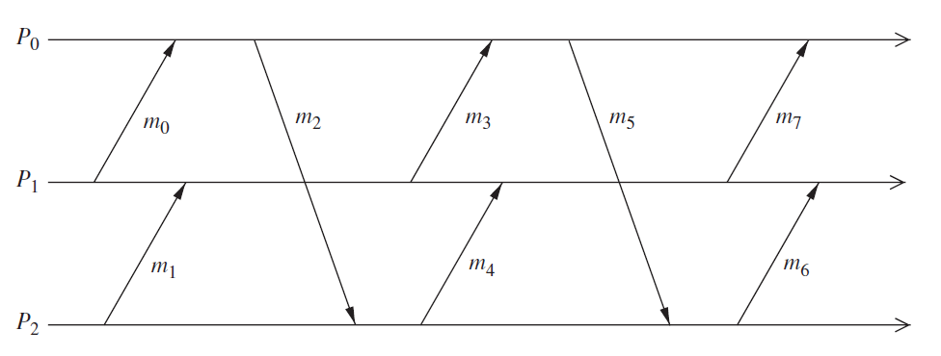
Log-based Rollback Recovery
Notes:
19

Slide 20
No-orphans consistency condition
Let e be a non-deterministic event that occurs at process p
Depend(e)
the set of processes that are affected by a non-deterministic event e. This set consists of p, and any process whose state depends on the event e according to Lamport’s happened before relation
Log(e)
the set of processes that have logged a copy of e’s determinant in their volatile memory
Stable(e)
a predicate that is true if e’s determinant is logged on the stable storage
always-no-orphans condition
∀(e) :￢Stable(e) ⇒ Depend(e) ⊆ Log(e)
Notes:
20

Slide 21
Pessimistic Logging
Pessimistic logging protocols assume that a failure can occur after any non-deterministic event in the computation
However, in reality failures are rare
synchronous logging
∀e: ￢Stable(e) ⇒ |Depend(e)| = 0
if an event has not been logged on the stable storage, then no process can depend on it.
stronger than the always-no-orphans condition
Notes:
21

Slide 22
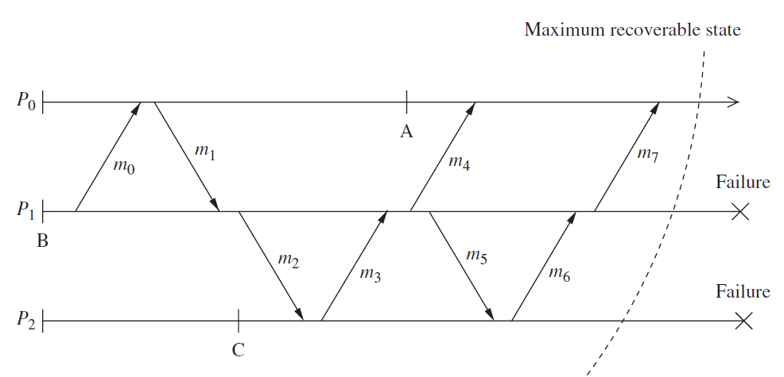
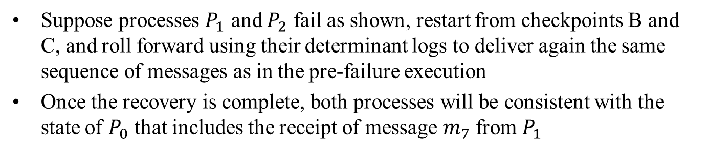
Pessimistic Logging
Suppose processes $P_{1}$ and $P_{2}$ fail as shown, restart from checkpoints B and C, and roll forward using their determinant logs to deliver again the same sequence of messages as in the pre-failure execution
Once the recovery is complete, both processes will be consistent with the state of $P_{0}$ that includes the receipt of message $m_{7}$ from $P_{1}$
Notes:
22

Slide 23
Optimistic Logging
Processes log determinants asynchronously to the stable storage
Optimistically assume that logging will be complete before a failure occurs
Do not implement the always-no-orphans condition
To perform rollbacks correctly, optimistic logging protocols track causal dependencies during failure free execution
Optimistic logging protocols require a non-trivial garbage collection scheme
Pessimistic protocols need only keep the most recent checkpoint of each process, whereas optimistic protocols may need to keep multiple checkpoints for each process
Notes:
23

Slide 24
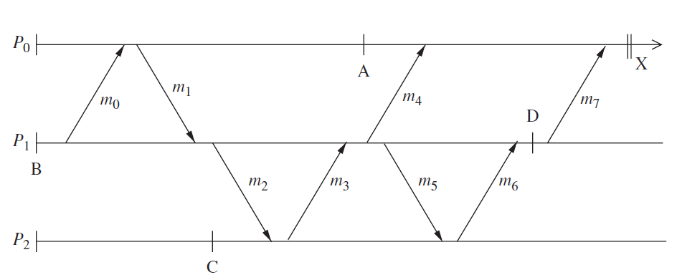
Optimistic Logging
Notes:
24

Slide 25
Causal Logging
Combines the advantages of both pessimistic and optimistic logging at the expense of a more complex recovery protocol
Like optimistic logging, it does not require synchronous access to the stable storage except during output commit
Like pessimistic logging, it allows each process to commit output independently and never creates orphans, thus isolating processes from the effects of failures at other processes
Make sure that the always-no-orphans property holds
Each process maintains information about all the events that have causally affected its state
Notes:
25

Slide 26
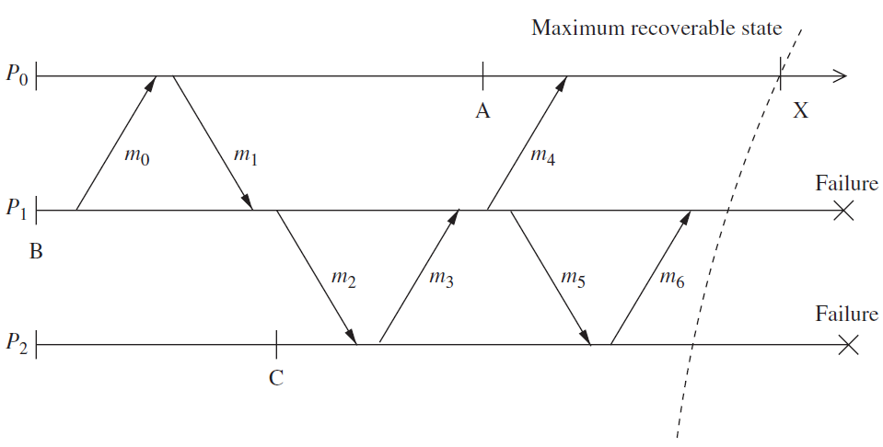
Causal Logging
Notes:
26

Slide 27
Koo-Toueg coordinated checkpointing algorithm
A coordinated checkpointing and recovery technique that takes a consistent set of checkpointing and avoids domino effect and livelock problems during the recovery
Includes 2 parts: the checkpointing algorithm and the recovery algorithm

Slide 28
Koo-Toueg coordinated checkpointing algorithm(cont.)
Checkpointing algorithm
Assumptions: FIFO channel, end-to-end protocols, communication failures do not partition the network, single process initiation, no process fails during the execution of the algorithm
Two kinds of checkpoints: permanent and tentative
Permanent checkpoint: local checkpoint, part of a consistent global checkpoint
Tentative checkpoint: temporary checkpoint, become permanent checkpoint when the algorithm terminates successfully

Slide 29
Koo-Toueg coordinated checkpointing algorithm(cont.)
Checkpointing algorithm
2 phases
The initiating process takes a tentative checkpoint and requests all other processes to take tentative checkpoints. Every process can not send messages after taking tentative checkpoint. All processes will finally have the single same decision: do or discard
All processes will receive the final decision from initiating process and act accordingly
Correctness: for 2 reasons
Either all or none of the processes take permanent checkpoint
No process sends message after taking permanent checkpoint
Optimization: maybe not all of the processes need to take checkpoints (if not change since the last checkpoint)

Slide 30
Koo-Toueg coordinated checkpointing algorithm(cont.)
The rollback recovery algorithm
Restore the system state to a consistent state after a failure with assumptions: single initiator, checkpoint and rollback recovery algorithms are not invoked concurrently
2 phases
The initiating process send a message to all other processes and ask for the preferences – restarting to the previous checkpoints. All need to agree about either do or not.
The initiating process send the final decision to all processes, all the processes act accordingly after receiving the final decision.

Slide 31
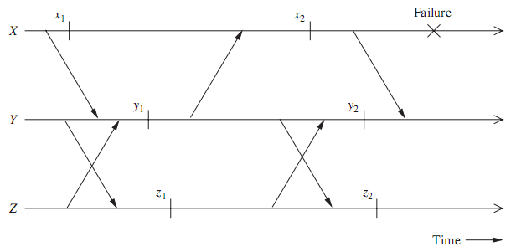
Koo-Toueg coordinated checkpointing algorithm(cont.)
Correctness: resume from a consistent state
Optimization: may not to recover all, since some of the processes did not change anything

Slide 32
Juang-Venkatesan algorithm for asynchronous checkpointing and recovery
Assumptions: communication channels are reliable, delivery messages in FIFO order, infinite buffers, message transmission delay is arbitrary but finite
Underlying computation/application is event-driven: process P is at state s, receives message m, processes the message, moves to state s’ and send messages out. So the triplet (s, m, msgs_sent) represents the state of P
Two type of log storage are maintained:
Volatile log: short time to access but lost if processor crash. Move to stable log periodically.
Stable log: longer time to access but remained if crashed

Slide 33
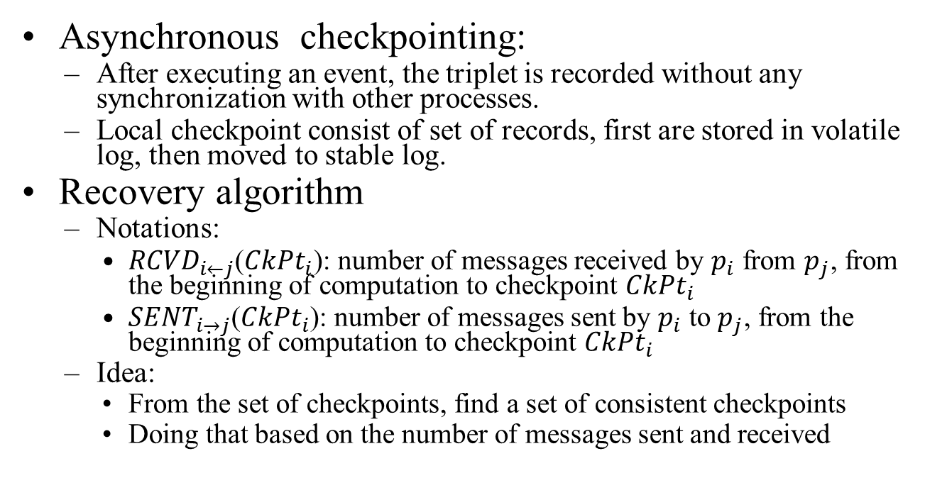
Juang-Venkatesan algorithm for asynchronous checkpointing and recovery(cont.)
Asynchronous checkpointing:
After executing an event, the triplet is recorded without any synchronization with other processes.
Local checkpoint consist of set of records, first are stored in volatile log, then moved to stable log.
Recovery algorithm
Notations:
${RCVD}_{i←j}$(${CkPt}_{i}$): number of messages received by $p_{i}$ from $p_{j}$, from the beginning of computation to checkpoint ${CkPt}_{i}$
${SENT}_{i→j}$(${CkPt}_{i}$): number of messages sent by $p_{i}$ to $p_{j}$, from the beginning of computation to checkpoint ${CkPt}_{i}$
Idea:
From the set of checkpoints, find a set of consistent checkpoints
Doing that based on the number of messages sent and received

Slide 34
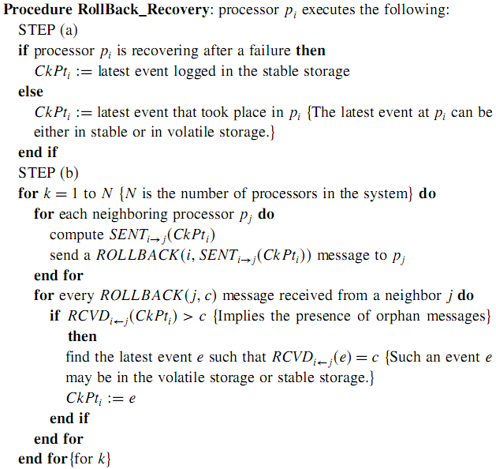
Juang-Venkatesan algorithm for asynchronous checkpointing and recovery(cont.)

Slide 35
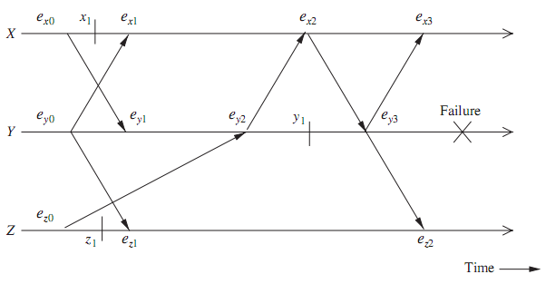
Juang-Venkatesan algorithm for asynchronous checkpointing and recovery(cont.)
Example

Slide 36
Manivannan-Singhal algorithm
Observation: there are some checkpoints useless (i.e. never included in any consistent global checkpoint), even none of them are useful
Combine the coordinated and uncoordinated checkpointing approaches
Take checkpoint asynchronously
Use communication-induced checkpointing to eliminates the useless checkpoint
Every checkpoint lies on a consistent checkpoint, determine the recovery line is easy and fast
Idea
Each checkpoint of a process has a unique sequence number – local number, increased periodically
When a process send out a message, its sequence number is piggybacked
When a process received a message, if the received sequence number > its sequence number, it is forced to take checkpoint, and any basic checkpointing with smaller sequence number is skipped

Slide 37
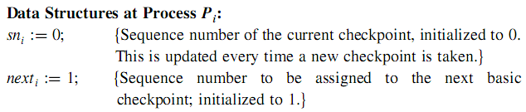
Manivannan-Singhal – Checkpointing Alg. (1)
Checkpointing algorithm
Checkpoints satisfy the following interesting properties
C_{i,m} of P_{i} is concurrent with C_{*, m} of all other processes
Checkpoints C_{*,m} of all processes form a consistent global checkpoint
Checkpoint C_{i,m} of P_{i} is concurrent with earliest checkpoint C_{j, n} with m ≤ n

Slide 38
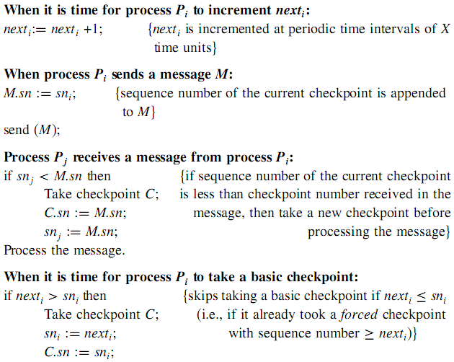
Manivannan-Singhal – Checkpointing Alg. (2)
For a forced
checkpoint
For a basic
checkpoint

Slide 39
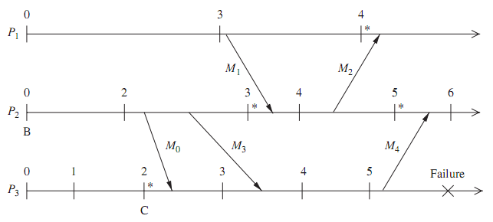
Manivannan-Singhal – Checkpointing Ex
M₁ forces P₂ to take a forced checkpoint with sequence number 3 before processing M₁ because M₁.sn> sn2

Slide 40
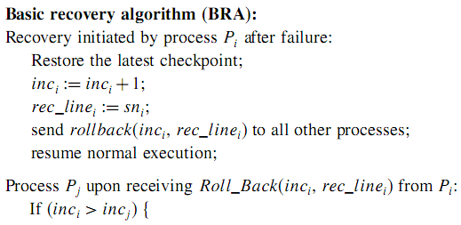
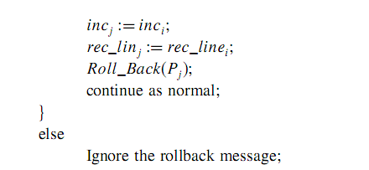
Manivannan-Singhal – Recovery Alg. (1)

Slide 41
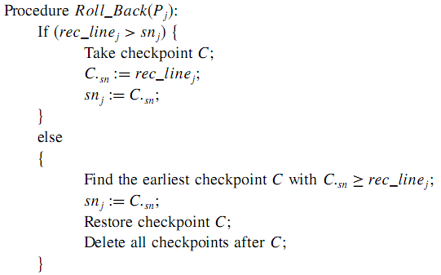
Manivannan-Singhal – Recovery Alg. (2)

Slide 42

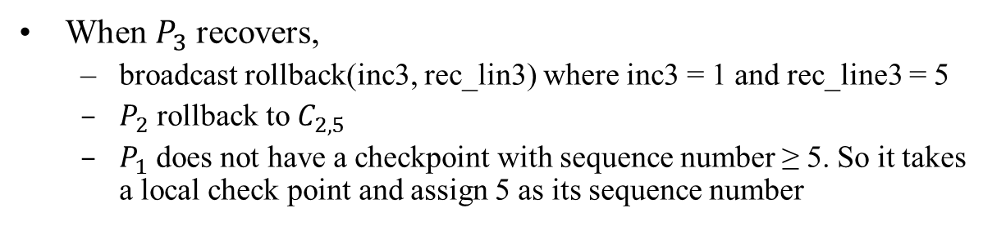
Manivannan-Singhal – Recovery Ex
$$C_{1,5}$$
When $P_{3}$recovers,
broadcast rollback(inc3, rec_lin3) where inc3 = 1 and rec_line3 = 5
$P_{2}$ rollback to $C_{2,5}$
$P_{1}$ does not have a checkpoint with sequence number ≥ 5. So it takes a local check point and assign 5 as its sequence number

Slide 43
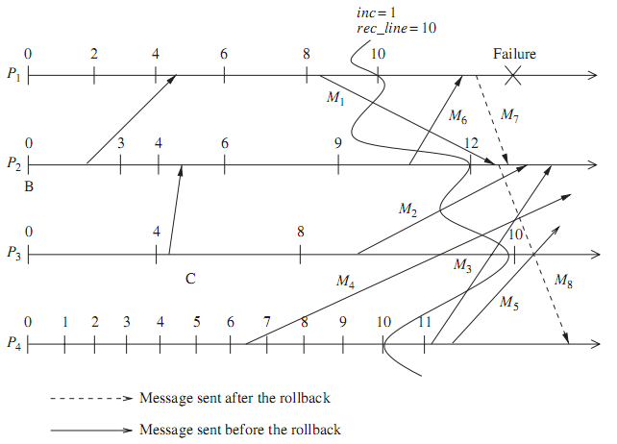
Manivannan-Singhal quasi-synchronous checkpointing algorithm(cont.)
Comprehensive handling messages during recovery
Handling the replay of messages
Handle of received messages

Slide 44
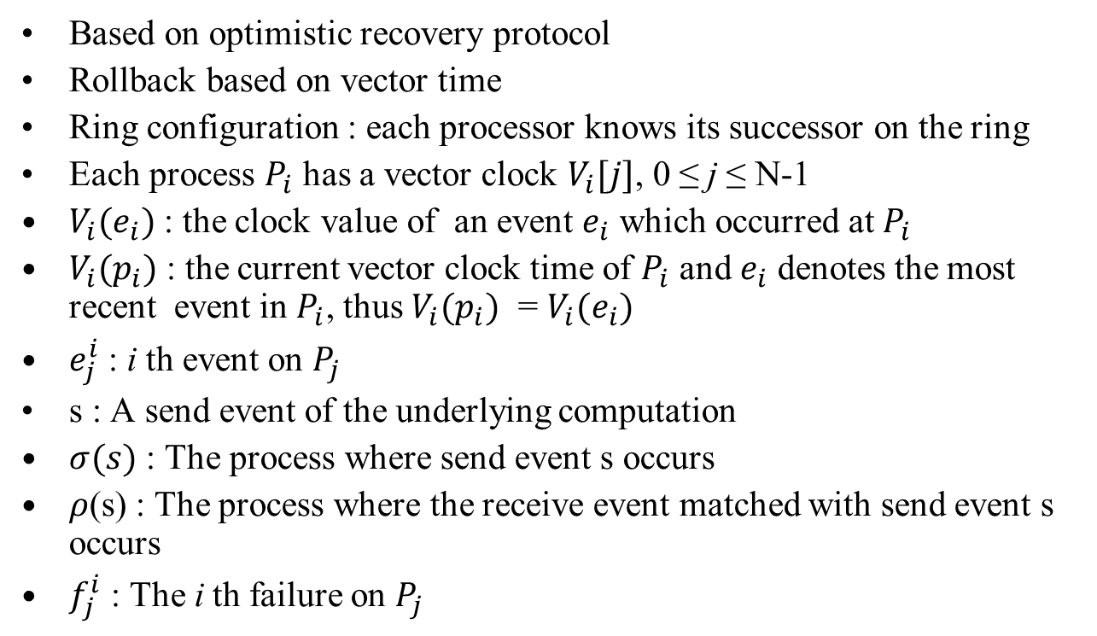
Peterson-Kearns algorithm – Definition (1)
Based on optimistic recovery protocol
Rollback based on vector time
Ring configuration : each processor knows its successor on the ring
Each process $P_{i}$ has a vector clock $V_{i}[j]$, 0 ≤ j ≤ N-1
$V_{i}(e_{i})$ : the clock value of an event $e_{i}$ which occurred at $P_{i}$
$V_{i}(p_{i})$ : the current vector clock time of $P_{i}$ and $e_{i}$ denotes the most recent event in $P_{i}$, thus $V_{i}(p_{i})$ = $V_{i}(e_{i})$
$e_{j}^{i}$ : i th event on $P_{j}$
s : A send event of the underlying computation
$σ(s)$ : The process where send event s occurs
$ρ$(s) : The process where the receive event matched with send event s occurs
$f_{j}^{i}$ : The i th failure on $P_{j}$

Slide 45
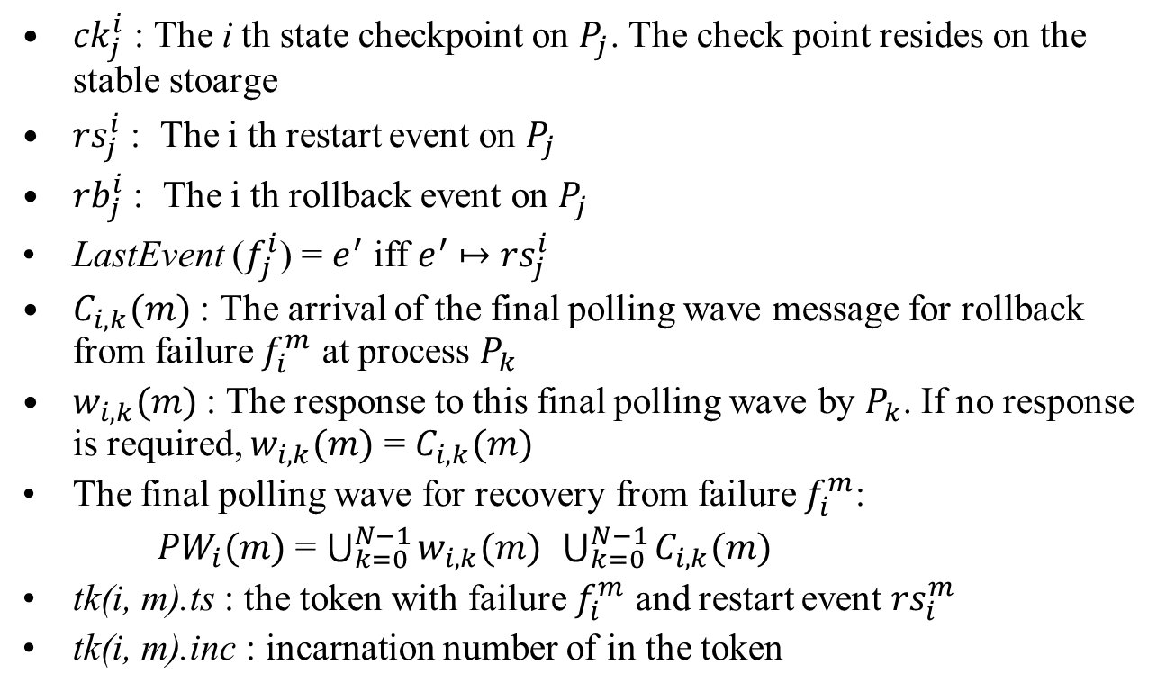
Peterson-Kearns algorithm – Definition (2)
${ck}_{j}^{i}$ : The i th state checkpoint on $P_{j}$. The check point resides on the stable stoarge
${rs}_{j}^{i}$ : The i th restart event on $P_{j}$
${rb}_{j}^{i}$ : The i th rollback event on $P_{j}$
LastEvent ($f_{j}^{i}$) = $e^{′}$ iff $e^{′}$ $↦$ ${rs}_{j}^{i}$
$C_{i,k}(m)$ : The arrival of the final polling wave message for rollback from failure $f_{i}^{m}$ at process $P_{k}$
$w_{i,k}(m)$ : The response to this final polling wave by $P_{k}$. If no response is required, $w_{i,k}(m)$ = $C_{i,k}(m)$
The final polling wave for recovery from failure $f_{i}^{m}$:
${PW}_{i}(m)$ = $\bigcup_{k=0}^{N−1}{w_{i,k}(m)}$ $\bigcup_{k=0}^{N−1}{C_{i,k}(m)}$
tk(i, m).ts : the token with failure $f_{i}^{m}$ and restart event ${rs}_{i}^{m}$
tk(i, m).inc : incarnation number of in the token

Slide 46
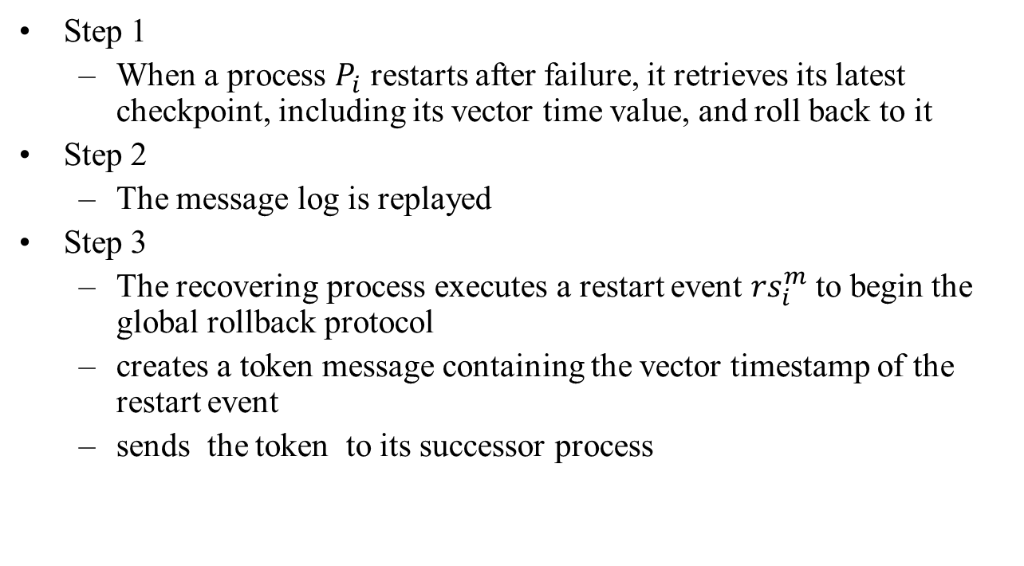
Peterson-Kearns Alg. – Informal Description (1)
Step 1
When a process $P_{i}$ restarts after failure, it retrieves its latest checkpoint, including its vector time value, and roll back to it
Step 2
The message log is replayed
Step 3
The recovering process executes a restart event ${rs}_{i}^{m}$to begin the global rollback protocol
creates a token message containing the vector timestamp of the restart event
sends the token to its successor process

Slide 47
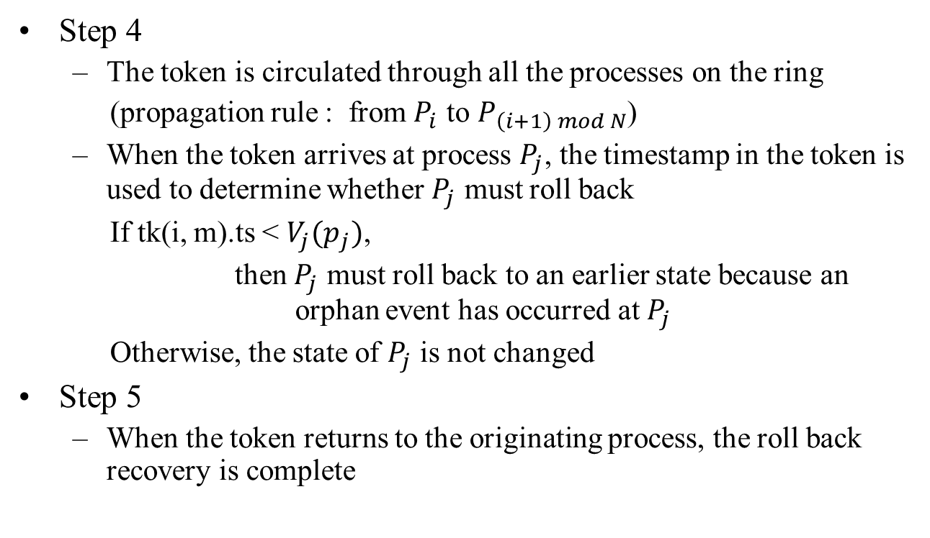
Peterson-Kearns Alg. – Informal Description (2)
Step 4
The token is circulated through all the processes on the ring
(propagation rule : from $P_{i}$ to $P_{\left(i+1\right) mod N}$)
When the token arrives at process $P_{j}$, the timestamp in the token is used to determine whether $P_{j}$ must roll back
If tk(i, m).ts < $V_{j}(p_{j})$,
then $P_{j}$ must roll back to an earlier state because an orphan event has occurred at $P_{j}$
Otherwise, the state of $P_{j}$ is not changed
Step 5
When the token returns to the originating process, the roll back recovery is complete

Slide 48
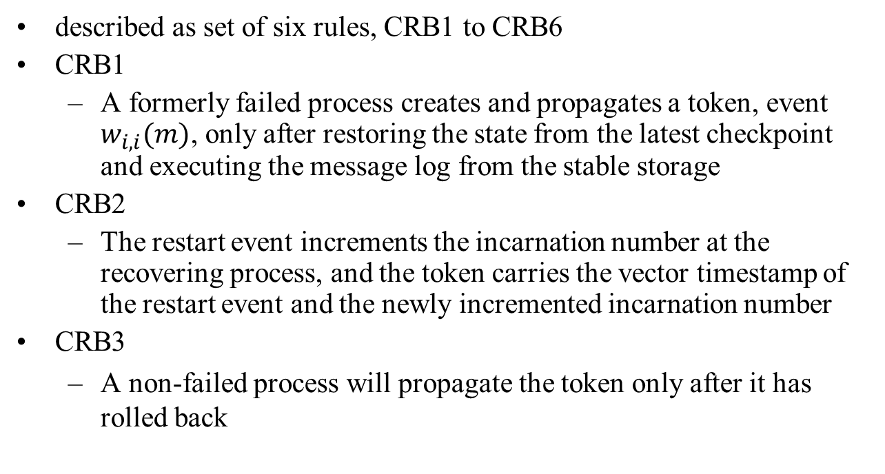
Peterson-Kearns Alg. – Formal Description (1)
described as set of six rules, CRB1 to CRB6
CRB1
A formerly failed process creates and propagates a token, event $w_{i,i}(m)$, only after restoring the state from the latest checkpoint and executing the message log from the stable storage
CRB2
The restart event increments the incarnation number at the recovering process, and the token carries the vector timestamp of the restart event and the newly incremented incarnation number
CRB3
A non-failed process will propagate the token only after it has rolled back

Slide 49
Peterson-Kearns Alg. – Formal Description (2)
CRB4
A non-failed process will propagate the token only after it has incremented its incarnation number and has stored the vector timestamp of the token and the incarnation number of the token in its OrVect set
CRB5
When the process that failed, recovered, and initiated the token, receives its token back, the rollback is complete
CRB6
Messages that were in transit and which were orphaned by the failure and subsequent restart and recovery must be discarded

Slide 50
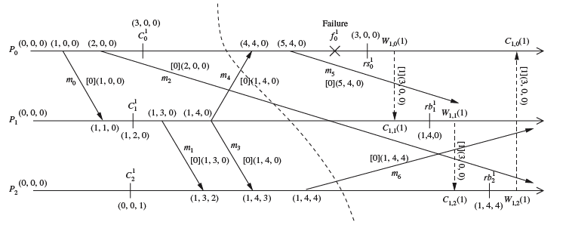
Peterson-Kearns - example

Slide 51
Helary-Mostefaoui-Netzer-Raynal protocol (1)
Communication-induced checking protocol
Some coordination is required in taking local checkpoints
Achieve the coordination by piggybacking control information on application messages
Basic checkpoints
Processes take local checkpoints independently
Forced checkpoints
The protocol directs processes to take additional local checkpoints
A process takes a forces checkpoint when it receives a message and its predicate becomes true
No local checkpoint is useless
Takes as few forced checkpoints as possible

Slide 52
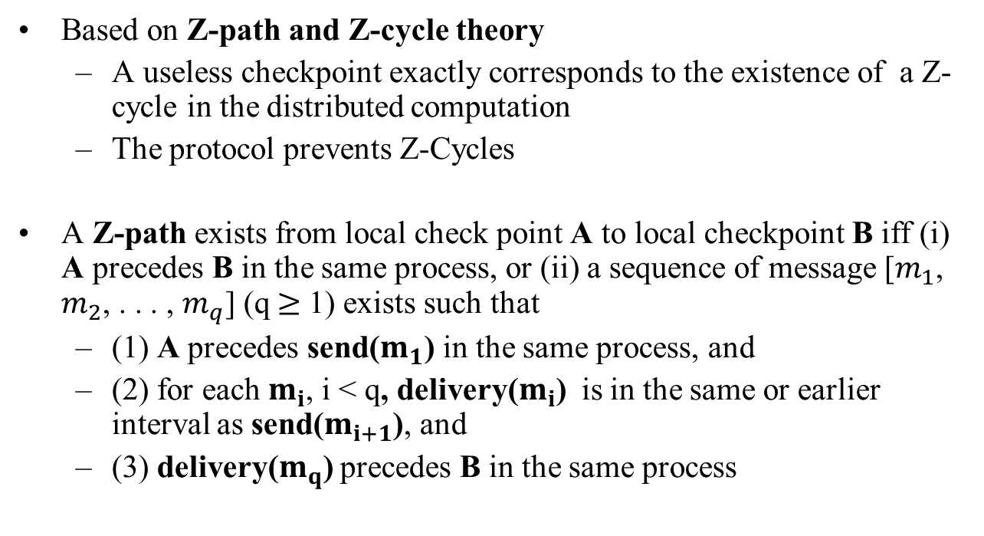
Helary-Mostefaoui-Netzer-Raynal protocol (2)
Based on Z-path and Z-cycle theory
A useless checkpoint exactly corresponds to the existence of a Z-cycle in the distributed computation
The protocol prevents Z-Cycles
A Z-path exists from local check point A to local checkpoint B iff (i) A precedes B in the same process, or (ii) a sequence of message [$m_{1}$, $m_{2}$, . . . , $m_{q}$] (q$≥$ 1) exists such that
(1) A precedes send($m_{1}$) in the same process, and
(2) for each $m_{i}$, i < q, delivery($m_{i}$) is in the same or earlier interval as send($m_{i+1}$), and
(3) delivery($m_{q}$) precedes B in the same process

Slide 53
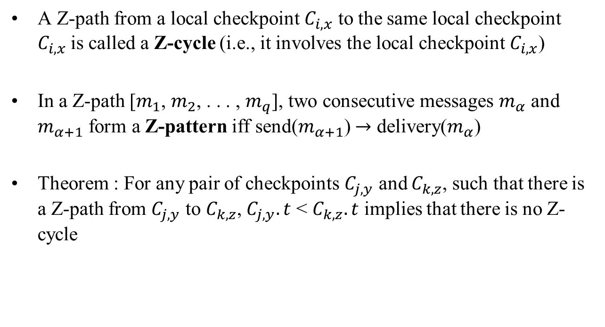
Helary-Mostefaoui-Netzer-Raynal protocol (3)
A Z-path from a local checkpoint $C_{i,x}$ to the same local checkpoint $C_{i,x}$is called a Z-cycle (i.e., it involves the local checkpoint $C_{i,x}$)
In a Z-path [$m_{1}$, $m_{2}$, . . . , $m_{q}$], two consecutive messages $m_{α}$ and $m_{α+1}$ form a Z-pattern iff send($m_{α+1}$) $→$ delivery($m_{α}$)
Theorem : For any pair of checkpoints $C_{j,y}$ and $C_{k,z}$, such that there is a Z-path from $C_{j,y}$ to $C_{k,z}$, $C_{j,y}.t$ < $C_{k,z}.t$ implies that there is no Z-cycle

Slide 54
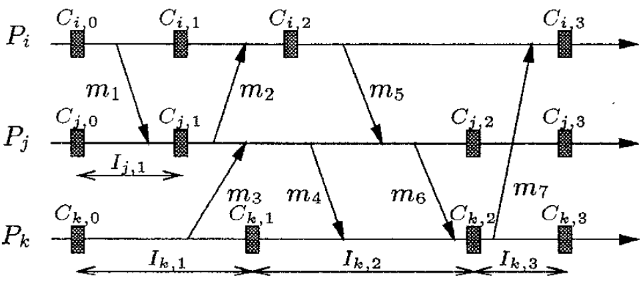
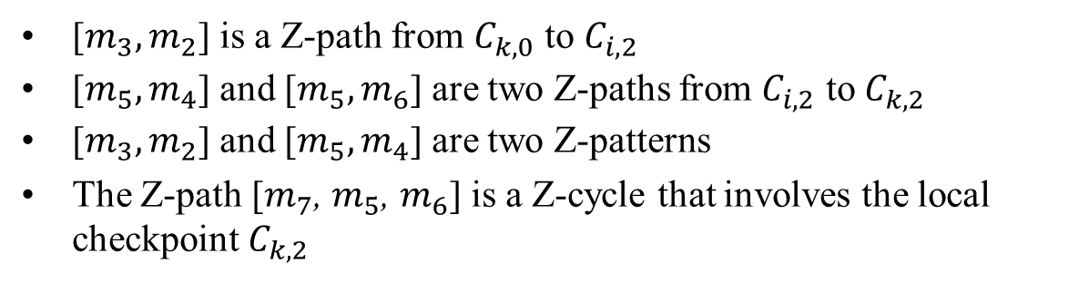
H-M-N-R protocol – Z-path & Z-cycle ex.
[$m_{3},m_{2}$] is a Z-path from $C_{k,0}$ to $C_{i,2}$
[$m_{5},m_{4}$] and [$m_{5},m_{6}$] are two Z-paths from $C_{i,2}$ to $C_{k,2}$
[$m_{3},m_{2}$] and [$m_{5},m_{4}$] are two Z-patterns
The Z-path [$m_{7}$, $m_{5}$, $m_{6}$] is a Z-cycle that involves the local checkpoint $C_{k,2}$

Slide 55
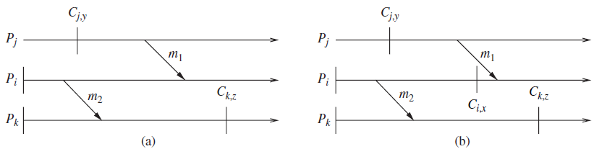
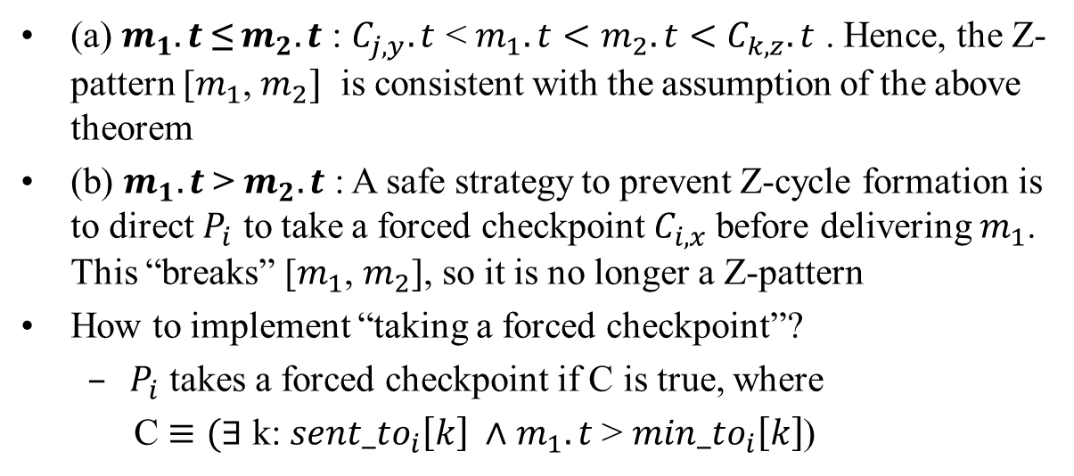
H-M-N-R protocol – forced checkpoints ex.
(a) $m_{1}.t$ ≤ $m_{2}.t$ : $C_{j,y}.t$ < $m_{1}.t<{m_{2}.t<C}_{k,z}.t$ . Hence, the Z-pattern [$m_{1}$, $m_{2}]$ is consistent with the assumption of the above theorem
(b) $m_{1}.t$ > $m_{2}.t$ : A safe strategy to prevent Z-cycle formation is to direct $P_{i}$ to take a forced checkpoint $C_{i,x}$before delivering $m_{1}$. This “breaks” [$m_{1}$, $m_{2}$], so it is no longer a Z-pattern
How to implement “taking a forced checkpoint”?
$P_{i}$ takes a forced checkpoint if C is true, where
C $≡(∃$ k: ${sent_to}_{i}\left[k\right] ∧$ $m_{1}.t$ > ${min_to}_{i}\left[k\right]$)

Slide 56
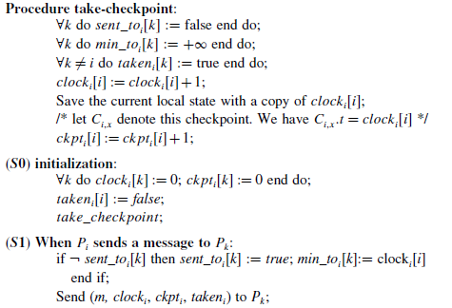
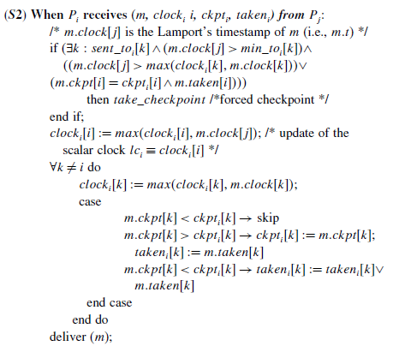
Helary-Mostefaoui-Netzer-Raynal protocol – Alg.
Notes:
Prevents useless checkpoints.

Slide 57
The End
Question portion

