Slide 1
Failure Detectors
Distributed Systems
Instructor: Ajay Kshemkalyani
Presented by,
Archana
Bharath
Lakshmi

Slide 2
Failure Detector
Failure detector is an application that is responsible for detection of node failures or crashes in a distributed system.
A failure detector is a distributed oracle that provides hints about the operational status of other processes

Slide 3
Why Failure Detectors
The design and verification of fault- tolerant distributed system is a difficult problem.
The detection of process failures is a crucial problem, system designers have to cope with in order to build fault tolerant distributed platforms

Slide 4
Synchronous Vs Asynchronous
A distributed system is synchronous if:
there is a known upper bound on the transmission delay of messages
there is a known upper bound on the processing time of a piece of code
A distributed system is asynchronous if:
there is no bound on the transmission delay of messages
there is no bound on the processing time of a piece of code

Slide 5
Why Failure Detectors cont…
To stop waiting or not to stop waiting?
Unfortunately, it is impossible to distinguish with certainty a crashed process from a very slow process in a purely asynchronous distributed system.
Look at two major problems
Consensus
Atomic Broadcast

Slide 6
Liveness & Safety
The problem can be defined with a safety and a liveness property.
The safety property stipulates that “nothing bad ever happens”
The liveness property stipulates that “something good eventually happens”

Slide 7
‘q’ not crashed
The message from q to p is only very slow.
Assuming that ‘q’ has crashed will violate the safety property
Slow
q
p

Slide 8
‘q’ has crashed
To prevent the bad previous scenario from occurring, p must wait until it gets q’s message.
It is easy to see that p will wait forever, and the liveness property of the application will never be satisfied
q
p

Slide 9
Characterizing Failure Detectors
Completeness
Suspect every process that actually crashes
Accuracy
Limit the number of correct processes that are suspected

Slide 10
Completeness
Strong Completeness
Eventually, every crashed process is permanently suspected by every correct process
Weak Completeness
Eventually, every crashed process is permanently suspected by some correct process

Slide 11
Strong Completeness

Slide 12
Weak Completeness

Slide 13
Accuracy
Strong Accuracy
A process is never suspected before it crashes by any correct process
Weak Accuracy
Some correct process never suspected by any correct process
Perpetual Accuracy!
As these properties hold all the times

Slide 14
Eventual Accuracy
Eventual Strong Accuracy
After a time, correct processes do not suspect correct processes
Eventual Weak Accuracy
After a time, some correct process is not suspected by any correct process

Slide 15
Failure Detector Classes
Completeness | Accuracy
 | Strong | Weak | Eventual Strong | Eventual Weak
Strong | Perfect P | Strong S | Eventually Perfect P | Eventually Strong S
Weak | v | Weak W | v | Eventually Weak W
0

Slide 16
Reducibility
A Failure detector D is reducible to another failure detector D’ if there exist a reduction algorithm T_{D -> D’} that transforms D to D’.
Then
D’ is Weaker than D (i.e) D D’
If D D’ and D’ D then D and D’ are equivalent (i.e) D ≡ D’
Suppose a given algorithm ‘A’ requires failure detector D’, but only D is available.

Slide 17
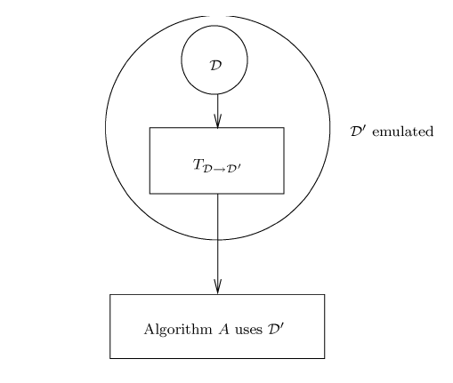
Example

Slide 18
Reducibility of FD
P v ; S W ; P v ; S W
v P ; W S ; v P ; W S
P ≡ v ; S ≡ W ; P ≡ v ; S ≡ W
Hence if we solve a problem for four failure detectors with strong completeness, the problem is automatically solved for the remaining four failure detectors.

Slide 19
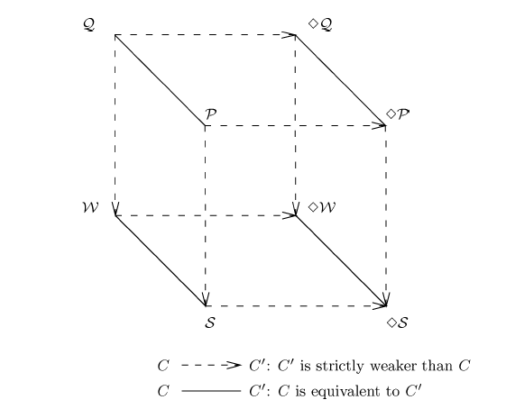
Comparing Failure detectors by Reducibility
v
v

Slide 20
Failure Detectors : Reducibility
Two failure detectors are equivalent if they are reducible to each other.
Failure detector with weak completeness is equivalent to corresponding failure detector with strong completeness.
P ≡ v ; P ≡ v ; S ≡ W ; S ≡ W
Solving a problem for the four failure detectors with strong completeness, automatically solves for the remaining four failure detectors.

Slide 21
Weak to Strong Completeness
Every process p executes the following:
Output _{p}← Null
cobegin
//Task 1: repeat forever
suspects _{p}←D _{p} {p queries its local failure detector module D _{p}}
send(p, suspects _{p}) to all other processes.
//Task 2: when receive (q, suspects _{q}) for a process q
output _{p}← output _{p} ∪ suspects _{q} − {q} {output _{p} emulates E _{p}}
coend

Slide 22
Weak to Strong Completeness
F,C
A
B
E
F
C
E
D
E,C

Slide 23
Weak to Strong Completeness
C,E
C,E
A
B
C,E
F
C
E,C
E
D

Slide 24
The consensus problem
Termination : Every correct process eventually decides some value.
Uniform integrity : Every process decides at most once.
Agreement : No two correct processes decide differently.
Uniform validity : If a process decides a value v, then some process proposed v.
It is widely known that the consensus cannot be solved in asynchronous systems in the presence of even a single crash failure

Slide 25
Solutions to the consensus problem
P ≡ v ; P ≡ v ; S ≡ W ; S ≡ W
Solving a problem for the four failure detectors with strong completeness, automatically solves for the remaining four failure detectors
Since P is reducible to S and P is reducible to S.
The algorithm for solving consensus using S also solve consensus using P.
The algorithm for solving consensus using S also solve consensus using P.

Slide 26
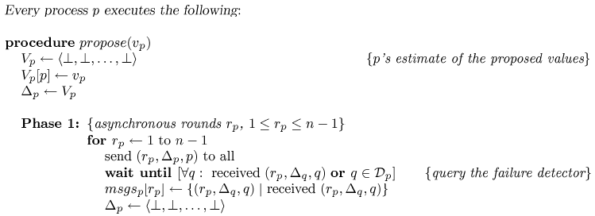
Consensus using S

Slide 27
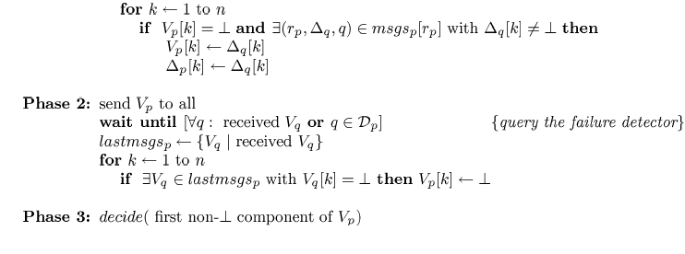

Slide 28
Solving Consensus using s :
Rotating Coordinator Algorithms
1
2
Work for up to f < n/2 crashes
3
Processes are numbered 1, 2, …, n
They execute asynchronous rounds
4
In round r , the coordinator is
process (r mod n) + 1
In round r , the coordinator:
- tries to impose its estimate as the consensus value
- succeeds if does not crash and it is not suspected by S

Slide 29
Consensus using S
The algorithm goes through
three Asynchronous stages
Each stage has several asynchronous rounds
Each round has 2 tasks
Task 1
Four asynchronous phases
Task 2
In the first stage, several decision values are proposed
In second stage, a value gets locked: no other decision value is possible
In the third and final stage, the processes decide on the locked value and consensus is reached.

Slide 30
Consensus using S
Task 1
Phase1
Every process ‘p’ sends
Current estimate to coordinator C_{p}
Round number ts_{p}
Phase 2
C_{p} gathers (n+1)/2 estimates
Selects one with largest time stamp estimate_{p}
Send the new estimate to all processes
Phase 3
Each process ‘p’
May receive estimate_{p}
Send an ack to C_{p}
May not receive estimate_{p}
Send an nack to C_{p} (suspecting C_{p} has crashed)
Phase 4
Waits for (n+1)/2 (acks or nacks)
If all are acks then estimate_{p} is locked
C_{p} broadcasts the decided value estimate_{p}
Task 2
If a process ‘p’ receives a broadcast on decided value and has not already decided
Accepts the value

Slide 31
Consensus using S
2,ts2
1
2
3,ts3
3
Let ts2 < ts1 < ts3

Slide 32
Consensus using S
Est_{p} =3
1
2
Est_{p} =3
3

Slide 33
Consensus using S
ack
1
2
ack
3

Slide 34
Consensus using S
3
3
2
3
3
Locks 3 and broad casts

Slide 35
Consensus using S
3
3
3
Locks 3 and broad casts

Slide 36
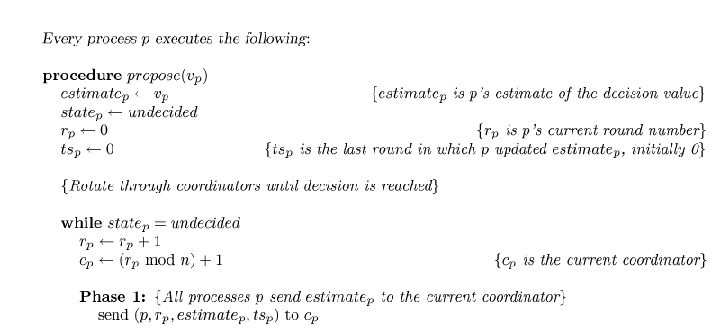
Consensus using S

Slide 37
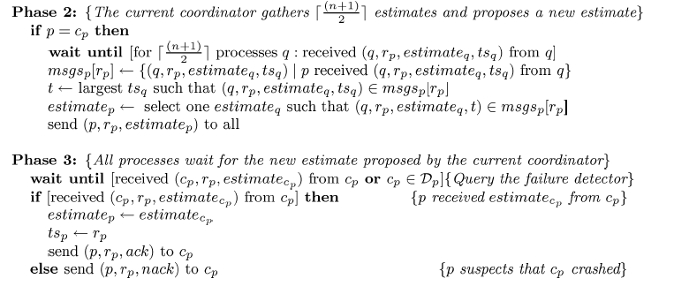
Consensus using S cont…

Slide 38
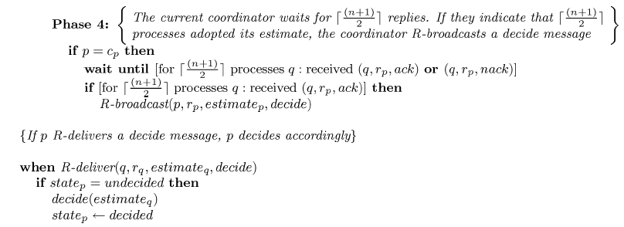
Consensus using S cont…

Slide 39
Atomic Broadcast
Informally, atomic broadcast requires that all correct processes deliver the same set of messages in the same order (i.e., deliver the same sequence of messages).
Formally atomic broadcast can be defined as a reliable broadcast with the total order property
Chandra and Toueg showed that the result of consensus can be used to solve the problem of atomic broad cast.

Slide 40
Reliable Broadcast
Validity : If the sender of a broadcast message m is non-faulty, then all correct processes eventually deliver m.
Agreement : If a correct process delivers a message m, then all correct processes deliver m.
Integrity : Each correct process delivers a message at most once.
Total Order
If two correct processes p and q deliver two messages m and m’ , then p delivers m before m’ if and only if q delivers m before m’ .

Slide 41
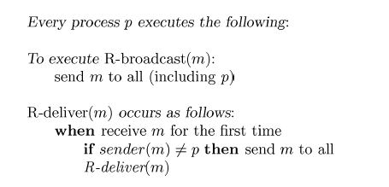
Reliable Broadcast

Slide 42
Atomic Broadcast
The algorithm consists of three tasks :
Task 1 :
when a process p wants to A-broadcast a message m, it R_broadcasts m.
Task 2 :
a message m is added to set R_deliveredp when process p R_delivers it.
Task 3 :
when a process p A_delivers a message m, it adds m to set A_deliveredp.
Process p periodically checks whether A_undeliveredp contains messages. If it contains messages, p enters its next execution of consensus, say the kth one, and proposes A_undeliveredp as the next batch of messages to be A_delivered.

Slide 43
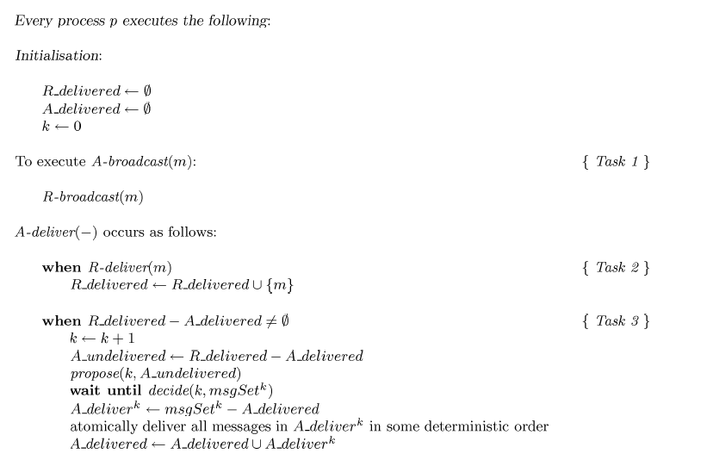
Atomic Broadcast

Slide 44
Implementation of failure detector
Task 1 : Each process p periodically sends a “p-is-alive” message to all other processes. This is like a heart-beat message that informs other processes that process p is alive.
Task 2 : If a process p does not receive a “q-is-alive” message from a process q within p(q) time units on its clock, then p adds q to its set of suspects if q is not already in the suspect list of p.
Task 3 : When a process delivers a message from a suspected process, it corrects its error about the suspected process and increases its timeout for that process.
If process p receives “q-is-alive” message from a process q that it currently suspects, p knows that its previous timeout on q was premature – p removes q from its set of suspects and increases its timeout period for process q, p(q).

Slide 45
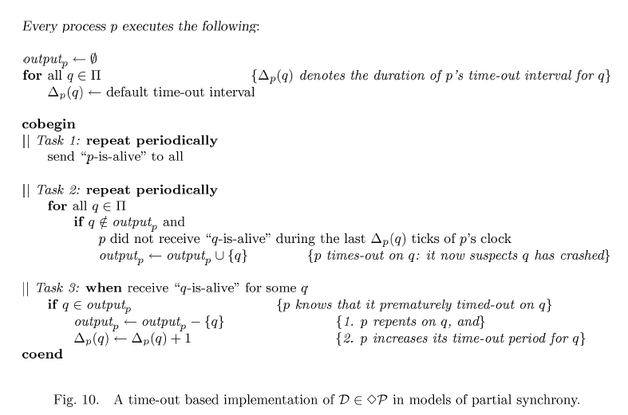
Implementation of failure detector

Slide 46
Lazy failure detection protocol
A relatively simple protocol that allows a process to “monitor” another process, and consequently to detect its crash.
This protocol enjoys the nice property to rely as much as possible on application messages to do this monitoring.
The cost associated with the implementation of a failure detector incurs only when the failure detector is used (hence, it is called a lazy failure detector).
Each process pi has a local hardware clock hc_{i} that strictly monotonically increases.
The local clocks are not required to be synchronized
Every pair of processes is connected by a channel and they communicate by sending and receiving messages through channels.
Channels are not required to be FIFO

Slide 47
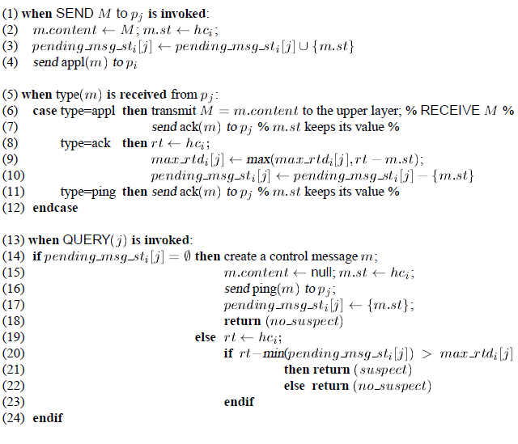
Lazy failure detection protocol

Slide 48
A short introduction to failure detectors for asynchronous Distributed Systems

Slide 49
Failure Detectors-Definition
Why use FD?
Based on well defined set of Abstract concepts
Not dependant on any particular implementation
Layered approach favors design, proof and portability of protocol
Helps to solve impossible time-free asynchronous distributed system problems like the Consensus problem.
Eventually accurate failure detectors helps in designing indulgent algorithms.

Slide 50
Asynchronous System Models
Process model
A process can fail by premature halting(crashing).
A process is correct if it does not crash else it is faulty
Computation models
FLP Crash-prone processes and reliable links
FLL Crash-prone processes and fair lossy links

Slide 51
Asynchronous System Models
Communication model
Processes communicate and synchronize by exchanging messages through links.
Reliable
Does not create or duplicate messages
Every message sent by Pi to Pj is eventually received by Pj
Fair lossy
Does not create or duplicate messages
Can lose message
Can send infinite number of messages from one process to another

Slide 52
Consensus

Slide 53
Consensus
All the processes, propose a initial value and they all have to agree upon some common value proposed
Solving consensus is key to solving many problems in distributed computing (e.g., total order broadcast, atomic commit, terminating reliable broadcast)

Slide 54
Consensus definition
C-Validity: Any value decided is a value proposed
C-Agreement: No two correct processes decide differently
C-Termination: Every correct process eventually decides
C-Integrity: No process decides twice
C- Uniform Agreement: No two (correct or not) processes decide differently

Slide 55
Consensus
propose(0)
decide(0)
p1
propose(1)
decide(1)
p2
crash
propose(0)
decide(0)
p3

Slide 56
Uniform Consensus
propose(0)
decide(0)
p1
propose(1)
decide(0)
p2
crash
propose(0)
decide(0)
p3

Slide 57
Eventually accurate failure detectors
Strong Completeness
Eventually, all processes that crash are suspected by every correct process
Eventually Weak Accuracy
There is a time after which some correct process is never suspected by the correct processes

Slide 58
S-based Consensus Protocol
FLP model
Indulgent
Never violates consensus safety
Terminates when the sets contain correct values during a long enough period
Requires majority of correct processes (t<n/2)
Proceeds in asynchronous consecutive rounds
Each round r is coordinated by process p_{c} such that, c=(r mod n) +1

Slide 59
Initialization
v_{i} = value initially proposed by p_{i}.
est_{i} = p_{i}’s estimate of the decision value.
In round r, its coordinator p_{c} tries to impose its current estimate as the decision value.
Algorithm runs in two phases.

Slide 60
Phase 1
p_{c} sends est_{c} to all the processes
process p_{i} waits until it receives p_{c}’s estimate or suspects it.
Based on result of waiting, either
aux_{i}= v(=est_{c})
or
aux_{i}= ⊥
Due to the completeness property of the underlying failure detector no process can block forever

Slide 61
Phase 2
All process exchange the values of their aux_{i} variables
Due to the “majority of correct processes” assumption, no process can block forever
Only two values can be exchanged: v = est_{c} or ⊥.
Therefore,
rec_{i} = {{v}, {v, ⊥}, or {⊥}}
Impossible for two sets rec_{i} and rec_{j} to be such that
rec_{i} = {v}
rec_{j} = {⊥}

Slide 62
Phase 2
rec_{i} = {v} ⇒ (∀ p_{j} : (rec_{j} = {v}) ∨ (rec_{j} = {v, ⊥}))
rec_{i} = {⊥} ⇒ (∀ p_{j} : (rec_{j} = {⊥}) ∨ (rec_{j} = {v, ⊥})).
rec_{i} = {v}
est_{i} = v.
To prevent possible deadlock situations, p_{i} broadcasts its decision value.
rec_{i} = {v, ⊥}
est_{i} = v.
proceeds to the next round.
rec_{i} = {⊥}
p_{i} proceeds to the next round without modifying est_{i}.

Slide 63
A Simple S-Based Consensus Protocol (t < n/2)
Function Consensus(v_{i})
Task T1:
(1) r_{i} ← 0; est_{i} ← v_{i};
(2) while true do
(3) c ← (r_{i} mod n) + 1; r_{i} ← r_{i} + 1; % 1 ≤ r_{i} < +∞ %
———————— Phase 1 of round r: from pc to all —————————
(4) if (i = c) then broadcast phase1(r_{i}, est_{i}) endif;
(5) wait until (phase1(ri, v) has been received from p_{c} ∨ c ∈ suspected_{i});
(6) if (phase1(r_{i}, v) received from p_{c}) then aux_{i} ← v else aux_{i} ←⊥ endif;
———————— Phase 2 of round r: from all to all —————————
(7) broadcast phase2(r_{i}, aux_{i});
(8) wait until (phase2 (r_{i}, aux) msgs have been received from a majority of proc.);
(9) let rec_{i} be the set of values received by p_{i} at line 8;
% We have rec_{i} = {v}, or rec_{i} = {v, ⊥}, or rec_{i} = {⊥} where v = est_{c} %
(10) case reci = {v} then est_{i} ← v; broadcast decision(est_{i}); stop T1
(11) rec_{i} = {v, ⊥} then est_{i} ← v
(12) rec_{i} = {⊥} then skip
(13) endcase
(14) endwhile
Task T2: when decision(est) is received: broadcast decision(est_{i}); return(est)

Slide 64
Findings
The strong completeness property is used to show that the protocol never blocks.
The eventual weak accuracy property is used to ensure termination.
The majority of correct processes is used to prove consensus agreement.

Slide 65
Interactive consistency
Harder than consensus problem
Process has to agree on a vector of values!
Termination
Every correct process eventually decides on a vector
Validity
Any decided vector D is such that D[i]∈{v_{i},⊥}, and is v_{i} if p_{i} does not crash
Agreement:
No two processes decide differently

Slide 66
Perfect failure detectors
Requires perfect failure detectors
Strong Completeness
Every process that crashes is eventually permanently suspected
Strong Accuracy
No process is suspected before it crashes

Slide 67
Perfect failure detector
init: suspected_{i} ← ∅; seq_{i} ← 0
task T1: while true do
seq_{i} ← seq_{i} + 1; % IC instance number %
D_{i} ← IC Protocol(seq_{i}, v_{i}); % v_{i} = ⊥ %
suspected_{i} ← {j | D_{i}[j] = ⊥}
enddo
task T2: when p_{i} issues QUERY: return(suspected_{i})

Slide 68

Non-Blocking Atomic Commit Problem (NBAC)
Yet another agreement problem in the world of distributed computing
Each process cast their votes (yes or no).
Non-crashed process decide on single value (commit or abort)

Slide 69
Properties
The problem is defined by following properties
NBAC -Termination
Every correct process eventually decides.
NBAC - Validity
A decided value is either commit or abort. Moreover:
NBAC - Justification
If process decides commit, all process have voted yes.
If all process vote yes and there is no crash, then the decision value is commit
NBAC - Obligation
NBAC - Obligation
No two process decide differently.

Slide 70
Continued
Justification property relates commit decision to yes.
Obligation property eliminates trivial solution of all process opting abort.
“good” run – all process wants to commit and the environment is free of crashes.
Process crashes are explicit in NBAC compared consensus.

Slide 71
Appropriate Failure Detector
Why appropriate failure detector?
To solve NBAC in the FLP model
Timeless failure detectors – No information ( sense of time ) when failure occurred.
Anonymously Perfect Failure Detectors
P and S - timeless failure detectors.
To address this problem, class ?P anonymous perfect failure detector introduced.
Anonymous completeness: If a crash occurs, eventually every correct process is permanently informed that some crash occurred.
Anonymous accuracy: No crash is detected unless some process crashed.
Class ?P + S - weakest class to solve NBAC, assuming a majority of correct process. The following protocol converts NBAC to consensus and subsequently uses subroutine consensus protocol.

Slide 72
Simple ?P + S-Based NBAC protocol (t < n/2)
Function Nbac( vote_{i} )
broadcast MY_VOTE(vote_{i});
wait until ( MY_VOTE(vote_{i}) has been received from each process ∨ ap_flag_{i});
if ( a vote yes has been received from each of the n processes)
then output_{i} ← Consensus(commit)
else output_{i} ← Consensus(abort)
endif;
return(output_{i})

Slide 73
Quiescence Problem
Consider processes p_{i} and p_{j} that do not crash connected by fair lossy link, a basic communication problem is to build a reliable link on top of fair lossy link.
Protocol used ( including TCP ) are quiescent - no message transfer after some time. ( communication ceases)
What if process p_{j} crashes?
How to solve quiescent communication problem?
Heartbeat failure detectors

Slide 74
Heartbeat Failure Detector
Failure detector outputs an array HB_{i} [1 ..n] – non decreasing counter at each process which satisfies……
HB-completeness: If p_{j} crashes, then HBi[j] stops increasing.
HB-accuracy: If p_{j} is correct, then HB_{i}[j] never stops increasing.
Easy implementation but it is not quiescent.
Allows the non-quiescent part of communication protocol to be isolated.
Favors design modularity and eases correctness proof.
“service” can be extended to upper layer applications.

Slide 75
Quiescent Implementation
Sender p_{i}:
when SEND(m) TO p_{j} is invoked:
seq_{i} ← seq_{i} + 1;
fork task repeat_send(m,seq_{i})
task repeat_send(m,seq_{i})
prev_hb ← 1;
repeat periodically hb ← HB_{i}[j];
if (prev_hb < hb) then send msg(m,seq) to p_{j};
prev_hb ← hb
endif
until (ack(m,seq) is received)
Receiver p_{j}:
when msg(m,seq) is received from p_{i}:
if (first reception of msg(m,seq)) then m is RECEIVED endif;
send ack(m,seq) to p_{i}

Slide 76
Failure Detectors in Synchronous Systems
Synchronous System Model
Synchronous systems – characterized by time bound to receive & send message.
Local computations take no time & transfer delays bounded by D.
Message sent at time ‘t’ is not received after t+D (D-timeliness)
Links are reliable ( no duplication, losses)
Process have access to common clock.
Consider p_{i} sends message to p_{j} & p_{k} , D-timeliness and no-loss properties gives rise to following scenarios…
P_{i} crashes at time t, no message sent
P_{i} crashes at time t, p_{j} receives while p_{k} doesn’t by t + D, vice versa.
P_{i} doesn’t crash, p_{j} & p_{k} receives message by t + D

Slide 77
Fast Failure Detectors
Fast failure detector provides processes with following properties (d < D)
d – Timely completeness: If a process p_{j} crashes at time t, then, by time t + d, every alive process suspects it permanently.
Strong accuracy: No process is suspected before it crashes.
Implemented with specialized hardware, also attains time complexity lower bounds << pure synchronous system.
Protocol described in the following slide illustrates early deciding property, reducing time complexity to D +fd ( f – actual number of process crashes)
Snapshot of the Synchronous Consensus with Fast Failure Detector implementation is illustrated as follows…

Slide 78
Fast Failure Detector Implementation
init est_{i} ← v_{i}; max_{i} ← 0
when (est,j) is received:
if ( j > max_{i} ) then est_{i} ← est; max_{i} ← j endif
at time (i-1)d do
if ( {p₁,p₂,…,p_{i-1}} ⊆ suspected_{i}) then broadcast (est_{i},i) endif
at time ( j-1)d + D for every 1 ≤ j ≤ n do
if ((p_{j} ∉ suspected_{i}) ∧ (p_{i} has not yet decided)) then return (est_{i}) endif

Slide 79
Thank You

