Slide 1
Hydra: Leveraging Functional Slicing for Efficient Distributed SDN Controllers
Yiyang Chang, Ashkan Rezaei, Balajee Vamanan, Jahangir Hasan, Sanjay Rao and T. N. Vijaykumar

Slide 2



SDN is becoming prevalent
Software defined Networking (SDN) becoming prevalent in datacenter and enterprise networks
  Centralized state → Fine-grained management
    high network utilization
  Wide adoption in industry WANs
    Google (B4, SIGCOMM ‘13)
    Microsoft (SWAN, SIGCOMM’13)
Consolidate state at a central controller
  Single physical controller for small networks
  Distributed implementation for large networks

Slide 3
Heterogeneity in SDN applications
SDN applications place varying demands on underlying machine
  Real-time: periodically refresh state
    e.g., heart-beats, link manager
    deadline driven, light load
  Latency-sensitive: invoked during flow setup
    e.g., path lookup, bandwidth reservation, QoS
    latency sensitive, medium load
  Computationally-intensive: triggered during failures
    e.g., shortest path calculation
    affect convergence, heavy load
Distributed controller must handle both
network size and application heterogeneity

Slide 4
Previous work: topological slicing
Conventional approach: topological slicing
  partition network topology: one physical controller for each network partition
    all network functions run in each partition
one-size-fits-all: all apps use same partition size
Topological slicing co-locates all applications
  Computationally-intensive apps susceptible to load spikes
  affects co-located real-time/latency-sensitive apps
Administrative constraints on partition sizing
topological slicing is agnostic of application heterogeneity and does not scale well

Slide 5
Hydra’s contributions
Functional slicing: split control plane applications across servers
  adds new dimension to partitioning, more freedom for placement
  Increase latency if critical paths span multiple servers
Communication-aware placement
  cast as optimization problem
    multi-constraint graph partitioning
Shields real-time apps from other apps
  uses thread prioritization
Hydra shows better performance for each app category and scales better than topological slicing

Slide 6
Outline
Introduction
Background
Hydra
  Goals
  Functional slicing
  Hybrid of functional and topological slicing
  Communication-aware placement
Key results
Conclusion

Slide 7
Topological slicing
Network is partitioned into multiple controller domains
Each controller instance hosts all control-plane apps
  but handles events only from switches in its partition
Server 2
f1() f2() f3() f4()
Server 1
Server 4
f1()
f2()
f3()
f4()
f1()
f2()
f3()
f4()
Partition 1
Partition 2
Partition 3
Partition 4
f1() f2() f3() f4()
Server 3

Slide 8
Shortcomings of topological slicing
Sustainable throughput limited
  compute/memory capacities of server must be sufficient to handle all apps
Possible solution: increase # of partitions
Increasing # of partitions causes other problems
  Worsens convergence
    time to recalculate paths during link/switch failure
  Slow updates → Write-heavy apps suffer
Topological slicing co-locates all apps → requires higher # of partitions → affects scalability

Slide 9
Outline
Introduction
Background
Hydra
  Goals
  Functional slicing
  Hybrid of functional and topological slicing
  Communication-aware placement
Key results
Conclusion

Slide 10
Hydra: goals and techniques
Partitioning must help scalability without worsening state convergence
  Functional slicing
Place applications without worsening latency
  Communication-aware placement
Isolate real-time applications from load spikes
  prioritize real-time apps over other apps

Slide 11
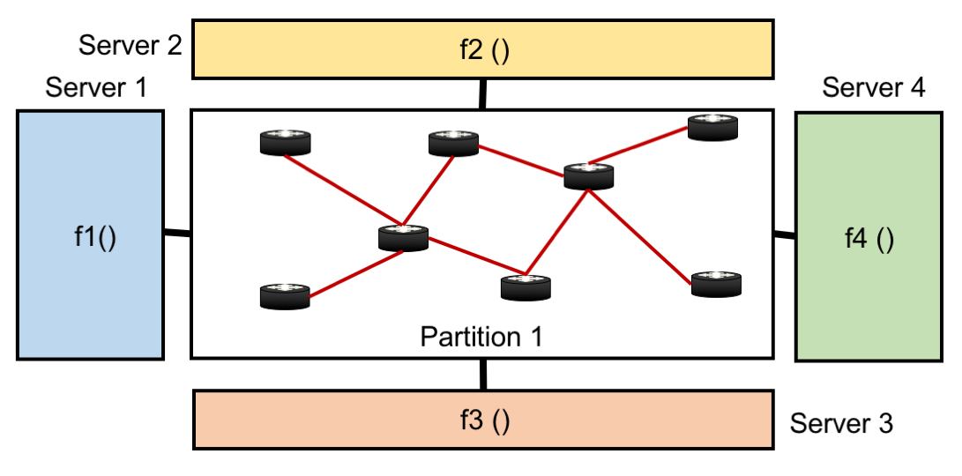
Functional slicing
Split control-plane apps among multiple servers
Better convergence (apps have complete network state)
Increases latency for events spanning >1 app
  e.g., handling a packet-in might could involve inter-controller communication
lkvnclkn

Slide 12
Communication-aware placement
Step-0: find partition size based on critical app(s)
  Typically, topology application is critical
Determine app slice <> server mapping
  Objective: minimize latency
  subject to capacity and communication constraints
Inputs
  applications’ CPU, memory demand
  aggregate server CPU and memory capacity
  communication graph
compute-intensive apps (e.g., topology app) placed in separate machines to avoid interference
Mathematical formulation in the paper

Slide 13
Communication-aware placement (cont.)
An instance of multi-constraint graph partitioning
  a known NP hard problem
  use existing heuristics to solve in reasonable time
f1
f3
f2
f4

Slide 14
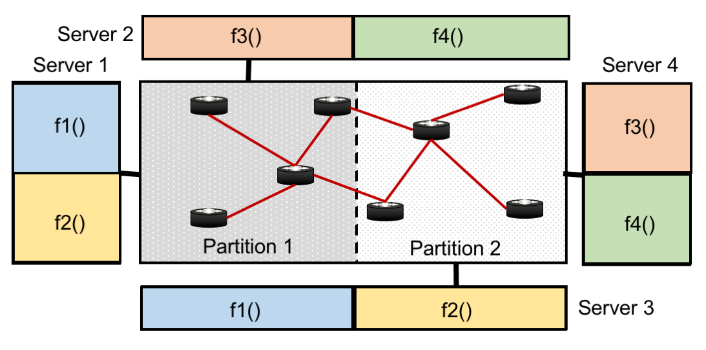
Hydra’s approach: hybrid of functional and topological slicing
hybrid of topological and functional slicing
Communication-aware placement achieves better convergence without increasing latency

Slide 15
Odds and ends
Our model can be extended to accommodate
  dynamic load changes
  replicated controllers (fault tolerance )
Details in the paper

Slide 16
Outline
Introduction
Background
Hydra
  Goals
  Functional slicing
  Hybrid of functional and topological slicing
  Communication-aware placement
Key results
Conclusion

Slide 17
Methodology
Floodlight controller
Apps
  Dijkstra's shortest path computation (DJ)
  Firewall (FW)
  Route lookup (RL)
  Heartbeat handler (HB)
  Modified CBench → load generation
    Mininet models control plane → doesn’t scale
Topology
  Datacenter network → fat-tree
    ~2500 switches

Slide 18
Convergence time
Func. slicing
Topo. slicing
Topological slicing requires higher # partitions → worsens convergence

Slide 19
CPU demand
DJ’s demand depends on # partitions;
other apps sensitive to network load (packet-in)

Slide 20
Placement results
Available capacity: 4 servers, 4 cores per server
Topological partitioning co-locates all apps → requires
>= 16 partitions
  16 partitions = 16 controller instances = one per core
Functional slicing reduces demand
→ Hydra requires fewer than 16 partitions (i.e., 8)
  each partition hosts two controller instances
    Packet-in pipeline: communication between RL and FW → one for DJ, one for {RL, FW, HB}
    HB is prioritized over other apps

Slide 21
Hydra’s scalability
Hydra scales better than topological slicing by isolating compute-intensive apps from other apps

Slide 22
Real-time performance
Hydra’s thread prioritization isolates
heart-beats from other apps

Slide 23
Conclusion
Hydra is framework for distributing SDN functions
Incorporates functional slicing
Communication-aware placement
Thread prioritization
Results show importance of Hydra’s key ideas
Future work
  Infer communication graph using program analysis
  Incorporate apps’ consistency requirements into model
Hydra’s gains potentially higher in large scale deployments

