Slide 1

Pulser: Fast Congestion Response Using Explicit Incast Notifications for Datacenter Networks
Hamidreza Almasi, Hamed Rezaei, Muhammad Usama Chaudhry, Balajee Vamanan

Slide 2





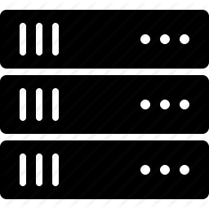



Datacenters host a mix of applications
High Bandwidth
Low Latency
Shallow Buffers
Large Scale

Slide 3



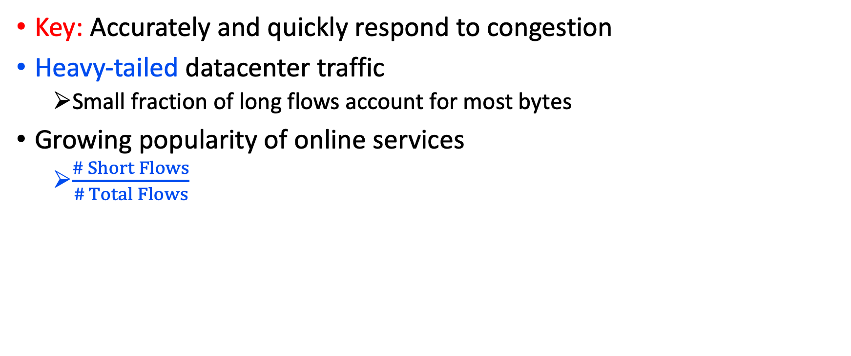
Goal: Joint optimization of short flows’ completion times and long flows’ throughput
Key: Accurately and quickly respond to congestion
Heavy-tailed datacenter traffic
  Small fraction of long flows account for most bytes
Growing popularity of online services
  $\frac{\# Short Flows}{\# Total Flows}$
Low tail latency
Problem: Incast, synchronized bursts of short flows
High throughput

Slide 4






Traditional TCP cannot infer congestion quickly
Congestion
Timeout
Cwnd = 1 MSS
High FCT
&
Low Throughput

Slide 5
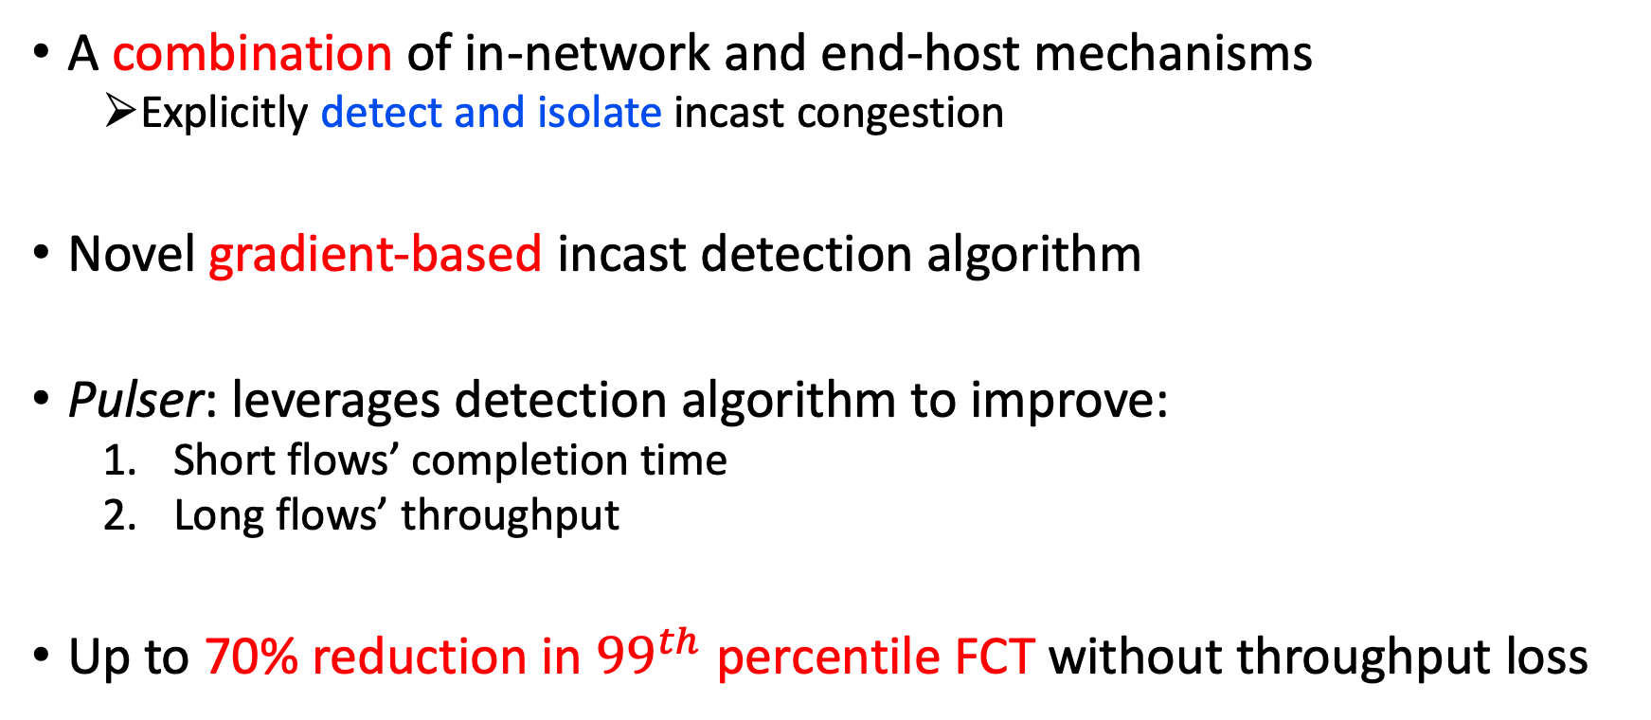
Contributions
A combination of in-network and end-host mechanisms
  Explicitly detect and isolate incast congestion
Novel gradient-based incast detection algorithm
Pulser: leverages detection algorithm to improve:
  Short flows’ completion time
  Long flows’ throughput
Up to 70% reduction in ${99}^{th}$ percentile FCT without throughput loss

Slide 6
Outline
Introduction
Background and existing solutions
Our proposal: Pulser
Methodology and key results
Conclusion

Slide 7
Related work
DCTCP: Infers the congestion faster than TCP
  Switches mark packets with ECN if their buffer builds up
    Instantaneous queue length > ECN Threshold → Mark
    Senders sending rate ∝ Number of marked packets
cwnd
Qlen
Mark packets
ECN Threshold
1 RTT
1 MSS
Time
Time
Sender 1
Switch
Sender 2
Receiver

Slide 8


DCTCP: iterative, gradual window adaptation
DCTCP responds to congestion faster than traditional TCP
BUT,
During severe incast, network queues build up at much faster rate…
DCTCP has iterative, gradual window adaptation → Packet drop
Sender 1
Insight:
It is necessary to drastically slow down all senders during incast in order to avoid packet loss
Sender 2
Receiver
Sender 3
Sender 4

Slide 9
Related work (cont’d)
ICTCP
Receiver side detection & no network support → Slow
RCP
Only observing intervening flows’ rates → No incast isolation
TIMELY
RTT-based, end-host implementation & Not customized for incast
DCQCN
Rate-based, leverages ECN for RDMA
QCN
Ethernet layer → Not applicable to large L3 routing datacenters
ExpressPass and NDP
Receiver-driven proposals

Slide 10
Outline
Introduction
Background and existing solutions
Our proposal: Pulser
Methodology and key results
Conclusion

Slide 11





Pulser: Explicitly detect and isolate incast congestion
hand-in-hand Incast detection and aggressive response
Without sacrificing the throughput

Slide 12


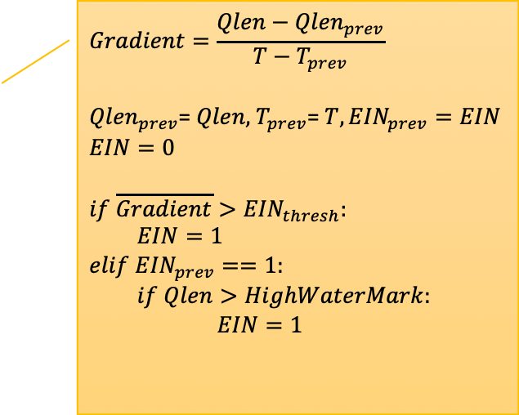
Pulser design: Fast and accurate incast detection
Explicit Incast Notification (EIN)
  Algorithm marks packets if gradient of queue length exceeds a threshold
  EIN requires:
    An additional bit in IP header
    Another bit in TCP header of ACKs to notify senders
$$Gradient=\frac{Qlen−{Qlen}_{prev}}{T−T_{prev}}$$
${Qlen}_{prev}$= $Qlen, { T}_{prev}$= $T, {EIN}_{prev}=EIN$
$$EIN=0$$
$$if \overline{Gradient}>{EIN}_{thresh}:$$
$EIN=1$
$$elif {EIN}_{prev}==1:$$
$if Qlen>HighWaterMark:$
$EIN=1$
Switch egress queue

Slide 13
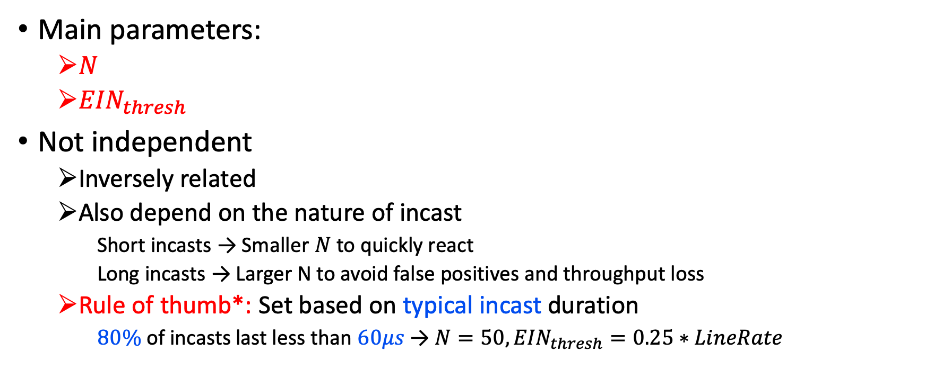
Pulser design: Fast and accurate incast detection
Main parameters:
  $N$
  ${EIN}_{thresh}$
Not independent
  Inversely related
  Also depend on the nature of incast
    Short incasts → Smaller $N$ to quickly react
    Long incasts → Larger N to avoid false positives and throughput loss
  Rule of thumb*: Set based on typical incast duration
    $80\%$of incasts last less than $60μs$ → $N=50, {EIN}_{thresh}=0.25∗LineRate$
* Zhang, Qiao, et al. "High-resolution measurement of data center microbursts." in IMC 2017

Slide 14

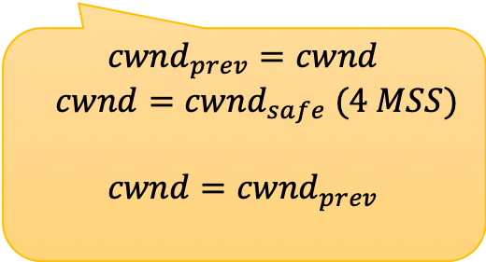
Pulser design: Congestion control
EIN
Pulser sender
$${cwnd}_{prev}=cwnd$$
$$cwnd={cwnd}_{safe} (4 MSS)$$
$$cwnd={cwnd}_{prev}$$
1
2

Slide 15
Outline
Introduction
Background and existing solutions
Our proposal: Pulser
Methodology and key results
Conclusion

Slide 16
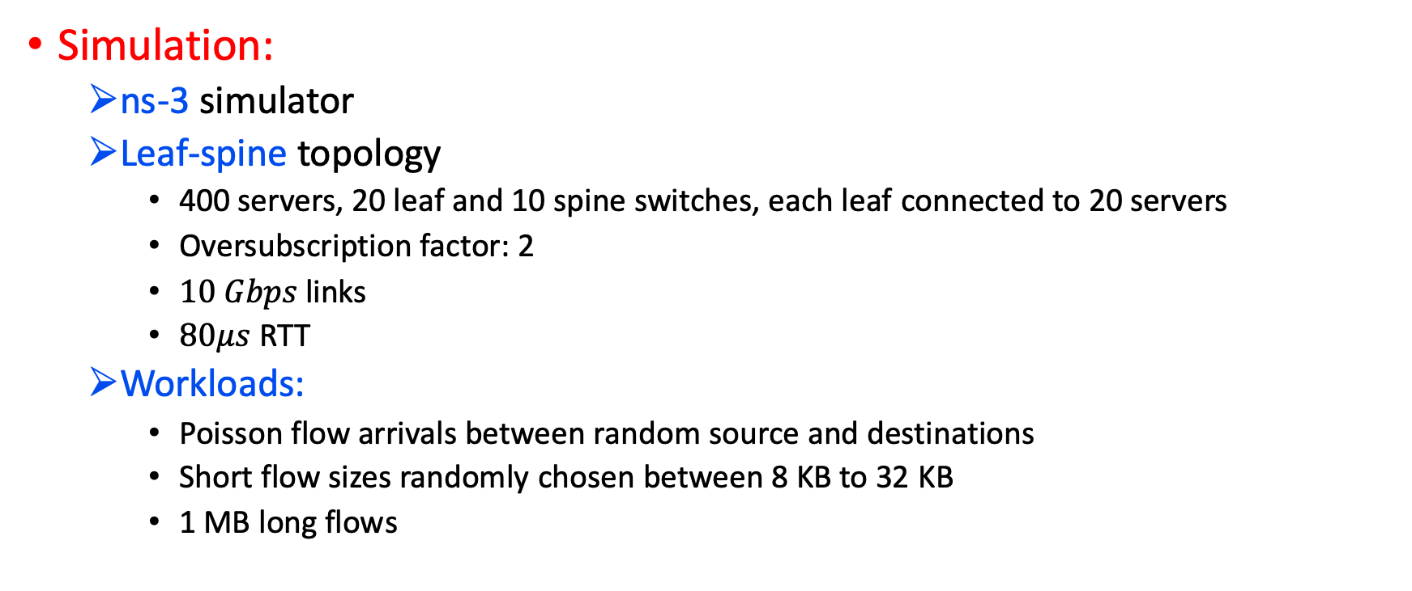
Experimental methodology
Simulation:
  ns-3 simulator
  Leaf-spine topology
    400 servers, 20 leaf and 10 spine switches, each leaf connected to 20 servers
    Oversubscription factor: 2
    $10 Gbps$links
    $80μs$ RTT
  Workloads:
    Poisson flow arrivals between random source and destinations
    Short flow sizes randomly chosen between 8 KB to 32 KB
    1 MB long flows

Slide 17
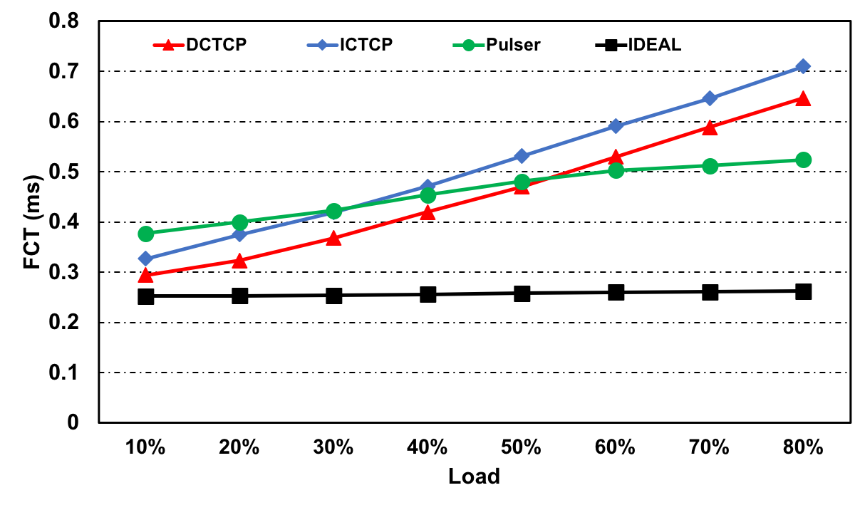
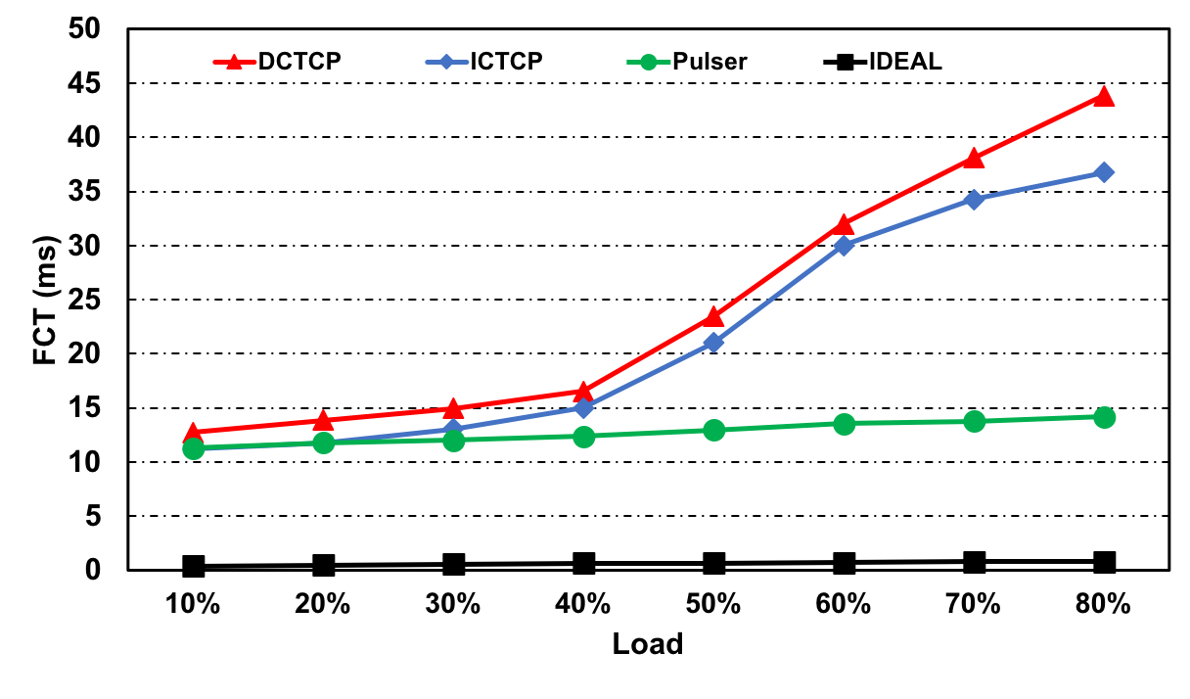
Results: Flow Completion Time (FCT)
Median FCT
Tail (99th %-ile) FCT
On average, compared to DCTCP and ICTCP
  Load > 20%:
    10% reduction
  Higher loads:
    Up to 25% reduction
On average, compared to DCTCP and ICTCP
  Load > 20%:
    50% reduction
  Higher loads:
    Up to 70% reduction
DC apps are more sensitive to tail FCT
& Pulser makes the right trade-off
Incast congestion is an issue at higher loads

Slide 18
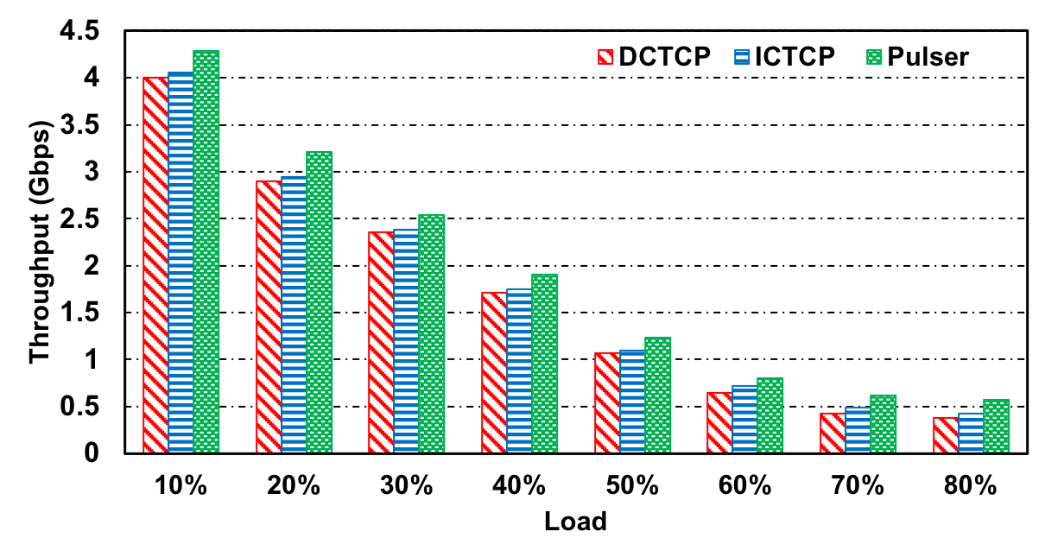
Results: Throughput
Long flow throughput decreases with load due to increased congestion
Pulser’s ON/OFF window modulation helps both at the beginning and the end of incast
16% and 22% higher throughput compared to ICTCP and DCTCP respectively

Slide 19
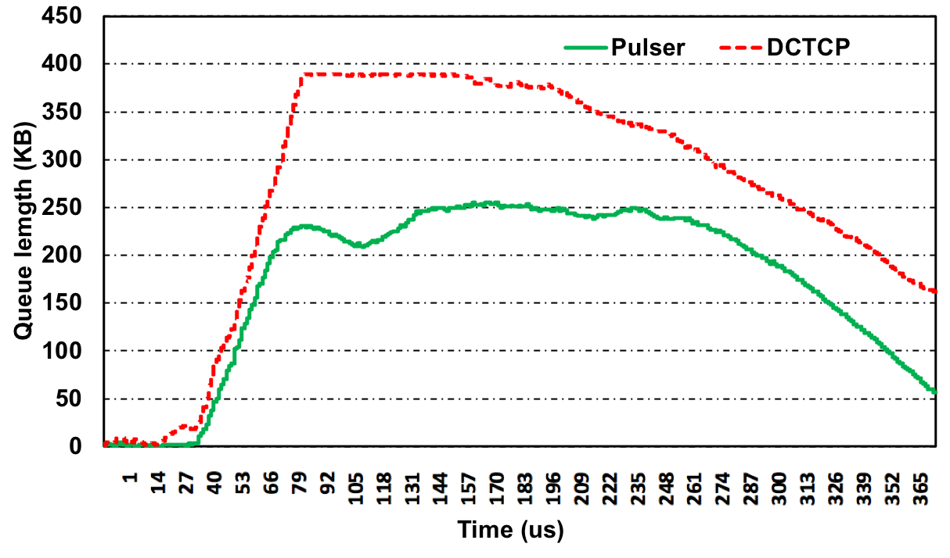
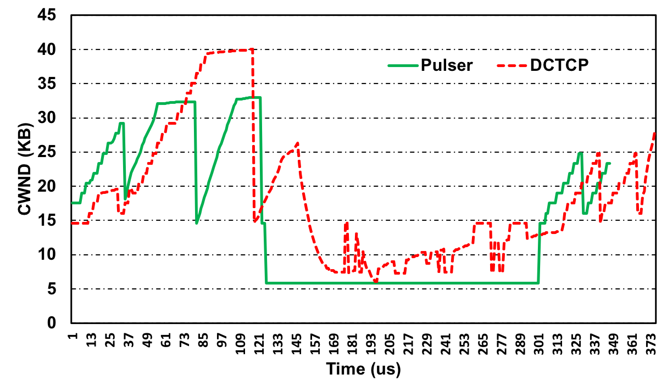

Results: Queue length and congestion window behavior
Load = 60%
Pulser reduces queue buildup by as much as 50%
Incast starts at t=120$μs$ and finishes at t=300$μs$
Pulser instantly backs off and recovers while DCTCP oscillates around

Slide 20
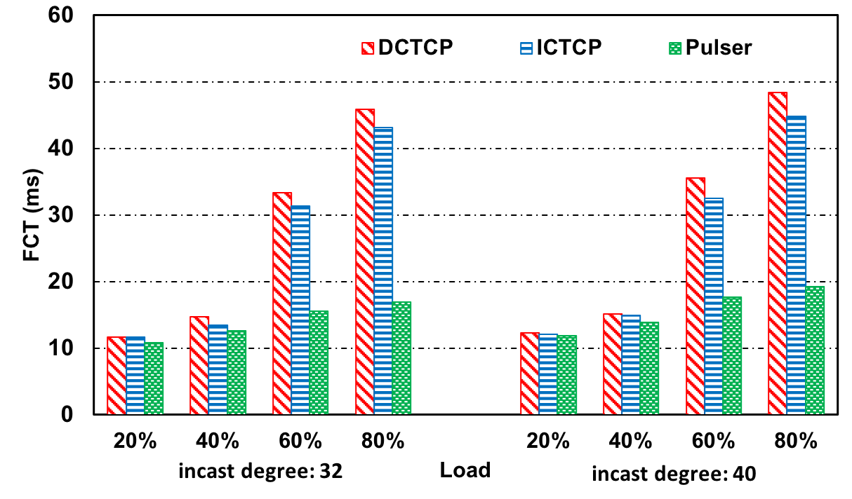
Results: Sensitivity of tail FCT to incast degree
Incast degree varied as 24 (default), 32 and 40
Results normalized to default case
At least 2x improvement over DCTCP and ICTCP for 60% and 80% loads
Performance improvement robust for a range of loads and incast degrees

Slide 21


Real implementation
Iperf3 to generate:
1 background 40MB long flow
15 synchronous bursts of short 100KB flows
Senders
8 VMs,
Each NIC rate limited to 50 Mbps
Physical switch
Rate limited to 50 Mbps
Aggregator
Linux switch
Senders
Metric | DCTCP | Pulser
Avg. flow completion time (s) | 1.99 | 1.59
99th percentile flow completion time (s) | 13.32 | 9.85
Throughput (Mbps) | 28 | 35

Slide 22
Outline
Introduction
Background and existing solutions
Our proposal: Pulser
Methodology and key results
Conclusion

Slide 23
Conclusion
Prior congestion control approaches do not explicitly detect and isolate incast
  Existing end-host mechanisms cannot aggressively respond without throughput loss
We propose:
  EIN: gradient-based incast detection at network switches which is fast and accurate
  Pulser: congestion control scheme which
    Quickly backs off during incast for short time intervals without hurting latency
    Restores the rate after the incast without losing throughput
Future work
  Learning the incast characteristics in different environments and adapting pulses accordingly (e.g. tailor pulse duration to the gradient extent)
  Evaluating Pulser on large production datacenter traces

