Slide 1


ResQueue: A Smarter Datacenter Flow Scheduler
Hamed Rezaei and Balajee Vamanan
hrezae2@uic.edu
University of Illinois at Chicago

Slide 2
Outline
Introduction to datacenter networks
Challenge: Incast problem in datacenter networks
ResQueue: Results
Our proposal: ResQueue
Conclusion
Idea and opportunity

Slide 3


Datacenter traffic characteristics
Datacenters host diverse applications; produce mixed traffic patterns
Foreground applications
Respond to user queries (e.g., Web search, social networks)
Short flows (e.g., < 10 KB)
Sensitive to higher percentiles of Flow Completion Times (FCT)
Produce most flows
Background applications
Update/backup/data replication (e.g., VM migration)
Long flows (e.g., > 10 MB)
Sensitive to throughput
Produce most load

Slide 4



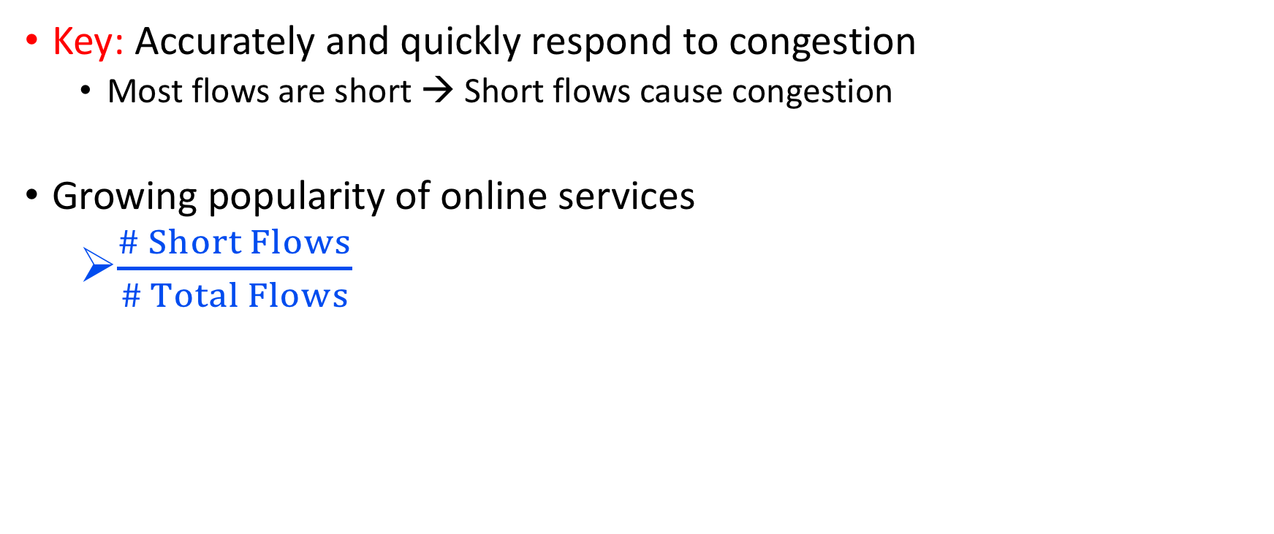
Goal: Joint optimization of short flows’ completion times and long flows’ throughput
Key: Accurately and quickly respond to congestion
Most flows are short → Short flows cause congestion
Growing popularity of online services
$\frac{\# Short Flows}{\# Total Flows}$
Low tail latency
High throughput
Problem: Incast of short flows!

Slide 5
Outline
Introduction to datacenter networks
Challenge: Incast problem in datacenter networks
ResQueue: Results
Our proposal: ResQueue
Conclusion
Idea and opportunity

Slide 6
What is incast?
Many-to-one traffic pattern
Multiple servers send their data to a single server simultaneously:
A server sends a query to multiple servers
Queried servers send their data chunk to the querying server concurrently
Common in modern datacenter networks
Social networking, real-time indexing, Web search
Mostly short flows (e.g., 2 KB)

Slide 7


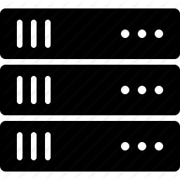
What is incast?
Incast aggregator
7

Slide 8


What is incast?
Q₁
Q₂
Port 1
Port 3
Q₃
Port 2
Incast aggregator
Incast + shallow buffers = packet drops
8

Slide 9
Incast
Many-to-one traffic pattern
Multiple servers send their data to a single server simultaneously:
A server sends a query to multiple servers
Queried servers send their reply to the querying server concurrently
Common in modern datacenter networks
Social networking, real-time indexing, Web search
Mostly short flows
Incast leads to
Long queues (long tails), packet loss

Slide 10
Incast
Many-to-one traffic pattern
Multiple servers send their data to a single server simultaneously:
A server sends a query to multiple servers
Queried servers send their reply to the querying server concurrently
Common in modern datacenter networks
Social networking, real-time indexing, Web search
Mostly short flows
Incast leads to
Long queues (long tails), packet loss
DCTCP performs poorly with incast of short flows (e.g., < 10 KB)
Both incast duration and incast inter-arrival times are short → no time for rate adjustment

Slide 11
Outline
Introduction to datacenter networks
Challenge: Incast problem in datacenter networks
ResQueue: Results
Our proposal: ResQueue
Conclusion
Idea and opportunity

Slide 12
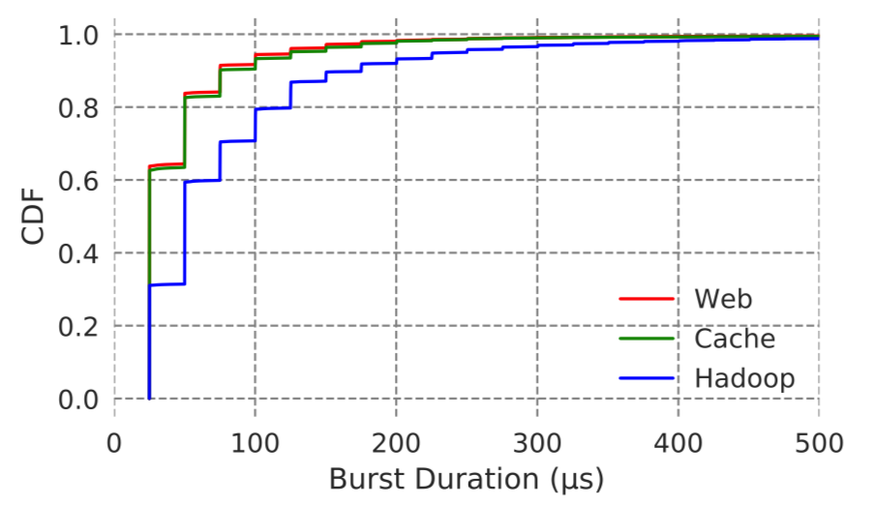
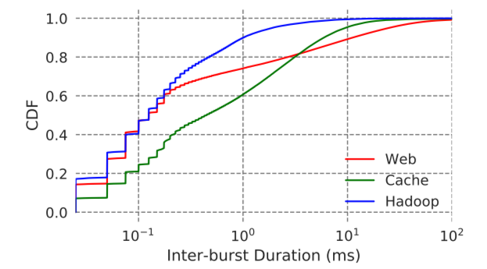
Idea and opportunity
Short incast duration, short incast inter-arrival time¹
Incasts are highly likely to collide
Packets are repeatedly dropped
S2
1 High-Resolution Measurement of Data Center Microbursts, [IMC’17]
12

Slide 13








Repeated drops!
Incast 1 happens!
Q₁
Q₂
Q₃
13
Notes:
Here how inter-arrival packets can give u notation about other users.

Slide 14
Repeated drops!
Incast 1 happens!
Incast 2 happens!
Q₁
Q₂
Q₃
14

Slide 15
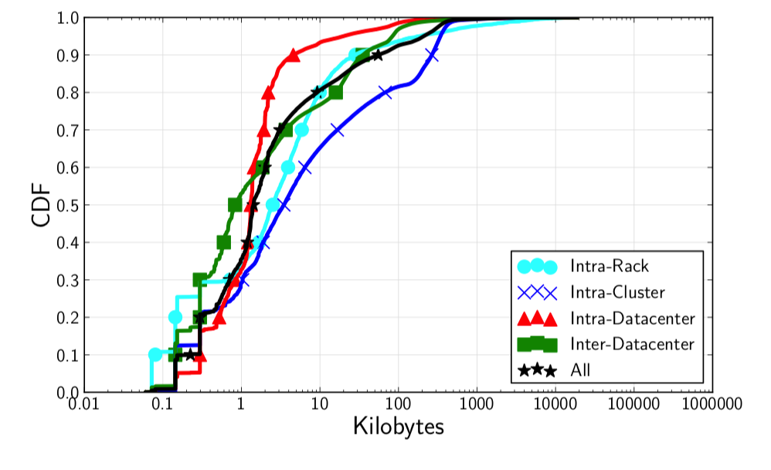
Idea and opportunity
A new study by Facebook¹:
Flows are smaller than what we thought
~75% of the flows have only 1 packet
If incast of 1 KB flows happens:
Size based flow schedulers will fail
Congestion control methods cannot help
If the packet is repeatedly dropped:
Tail FCT is significantly degraded
1 Inside the Social Network’s (Datacenter) Network [Sigcomm’15]
15

Slide 16
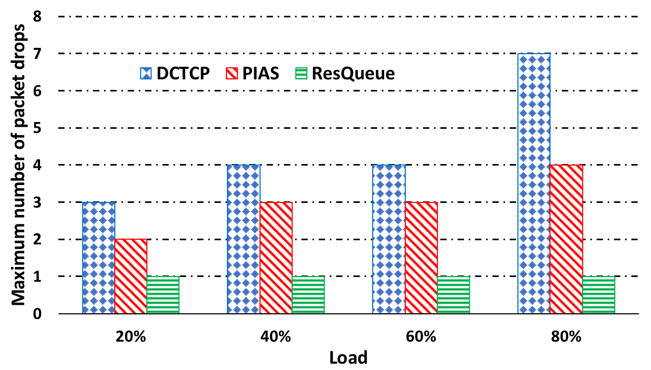
Idea and opportunity
Maximum drops for any packet in our experiments
S2
16

Slide 17
Existing solutions
DCTCP, ICTCP
Receiver side incast detection (slow)
PIAS
Priority based, does not perform well with same size flows
FastPass, ExpressPass
No flow prioritization (long tails)
Grant-based, wastes bandwidth in some scenarios
NDP
pFabric, PASE
Need apriori knowledge about flow sizes (difficult)
Do not perform well with same size flows
No flow prioritization (long tails)
No flow prioritization (long tails)
Arbiter based, increase latency for short messages

Slide 18
Outline
Introduction to datacenter networks
Challenge: Incast problem in datacenter networks
ResQueue: Results
Our proposal: ResQueue
Conclusion
Idea and opportunity

Slide 19
ResQueue: Design
ResQueue uses a mix of flow size¹ and drop history to prioritize packets during incast
Step I. ResQueue tags packets at the senders, based on number of bytes sent of the corresponding flow
An illustration of the mechanism:
If (first_window) -> priority = 1
If (second_window) -> priority = 2
If (third_window) -> priority = 3
If (fourth_window or higher) -> priority = 4
It uses multi-level queues at switches
Priority values are based on number of queues in switches
1 Information-Agnostic Flow Scheduling for Commodity Data Centers [NSDI’15]
19

Slide 20
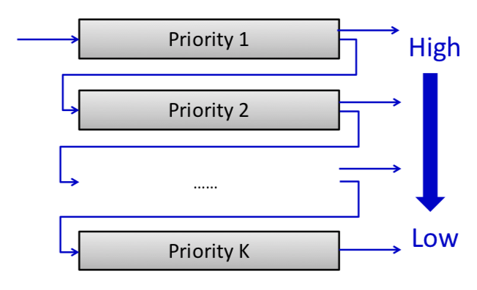
ResQueue: Design (cont.)
P1
P1
P1
P1
20

Slide 21
ResQueue: Design (cont.)
P2
P2
P2
P2
P1
21

Slide 22
ResQueue: Design (cont.)
But step I is not enough
Almost 75% of short flows have the same size!
Still a retransmitted packet and a fresh packet both go to priority-1 queue
Step II. Sender server subtracts one from the calculated priority, if and only if the packet is a retransmission
ResQueue reserves a queue (e.g., priority 0) for retransmitted packets that were part of the first window in previous round
The reserved queue has the highest priority
This queue is not shared with other non-dropped packets
Retransmitted packets belonging to other windows get promoted by one as well
22

Slide 23

ResQueue: Design
Endhost: priority tagging
Switch
Reserved (high priority-0)
Reserved (high priority-0)
Priority-1
I
N
P
U
T
P
O
R
T
O
U
T
P
U
T
P
O
R
T
Priority = $𝓕\left(Bytes_{sent}\right);$
If (Retransmitting)
Priority_increase
Priority-2
P1
Priority-3
Priority-4
23

Slide 24
ResQueue: Design
Endhost: priority tagging
Switch
Reserved (high priority-0)
Reserved (high priority-0)
Priority-1
I
N
P
U
T
P
O
R
T
O
U
T
P
U
T
P
O
R
T
Priority = $𝓕\left(Bytes_{sent}\right);$
If (Retransmitting)
Priority_increase
P0
P1
Priority-2
Priority-3
Priority-4
24

Slide 25
Outline
Introduction to datacenter networks
Challenge: Incast problem in datacenter networks
ResQueue: Results
Our proposal: ResQueue
Conclusion
Idea and opportunity

Slide 26
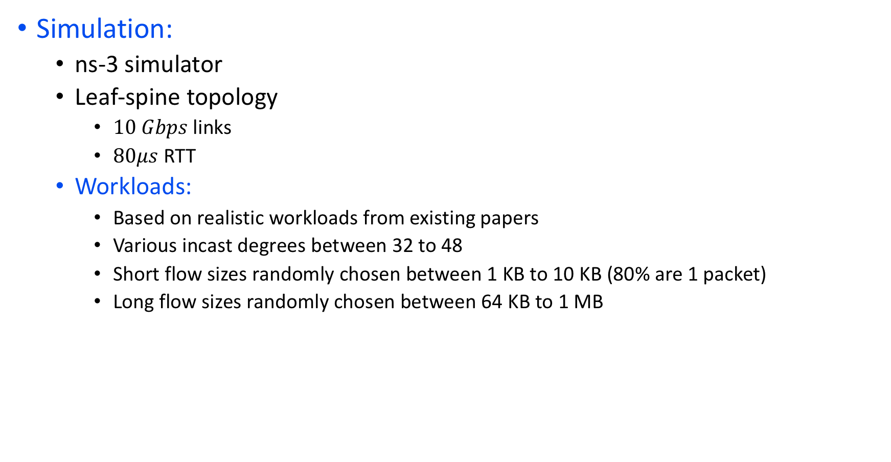
Experimental methodology
Simulation:
ns-3 simulator
Leaf-spine topology
$10 Gbps$links
$80μs$ RTT
Workloads:
Based on realistic workloads from existing papers
Various incast degrees between 32 to 48
Short flow sizes randomly chosen between 1 KB to 10 KB (80% are 1 packet)
Long flow sizes randomly chosen between 64 KB to 1 MB

Slide 27
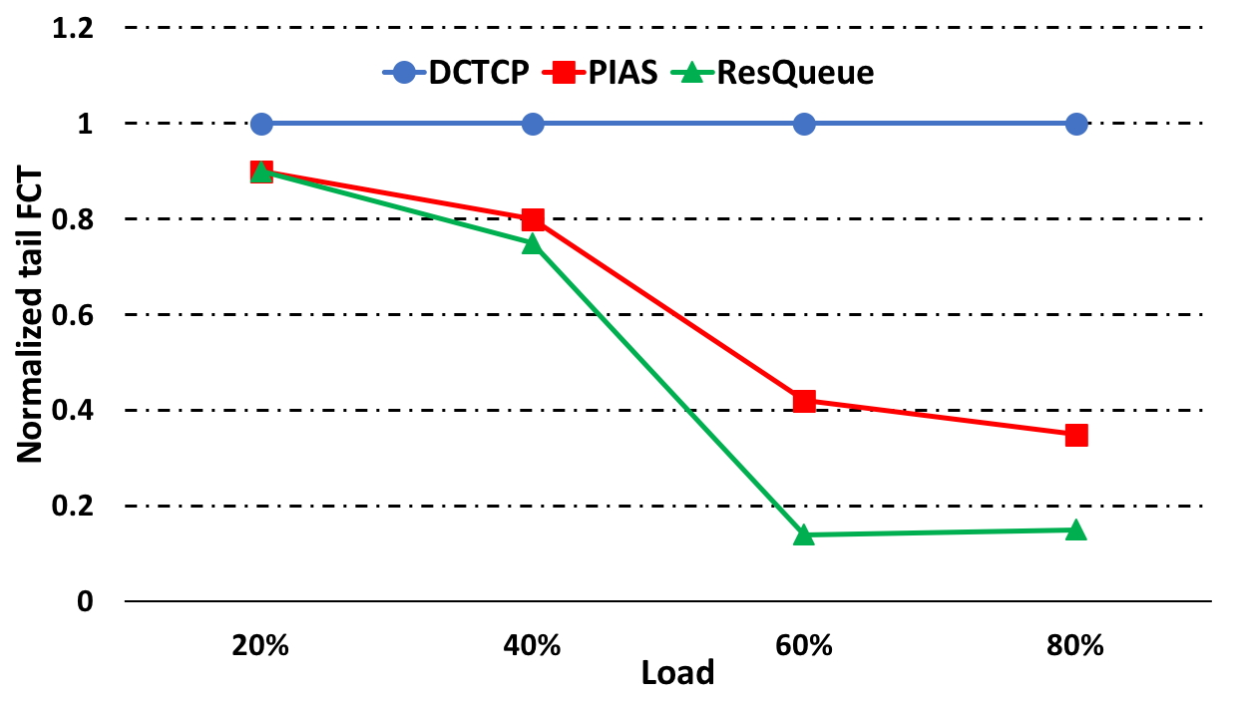
Results: Tail (99th %-ile) FCT
ResQueue achieves an average reduction in short flows’ tail FCT by a factor of 1.6x compared to PIAS (load > 60%)

Slide 28
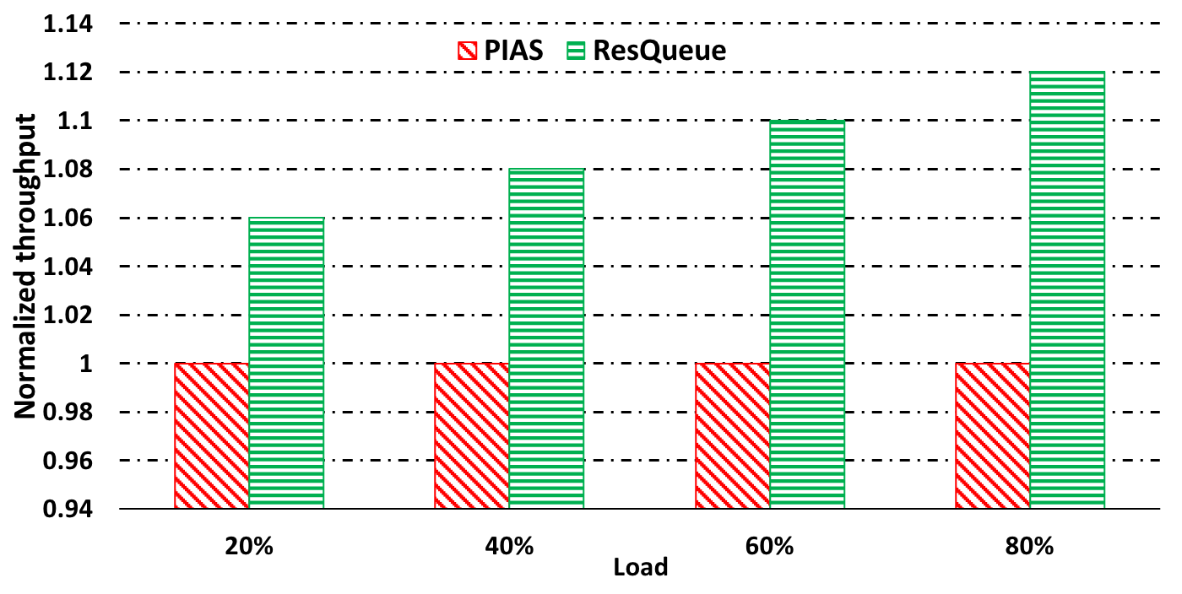
Results: Throughput
ResQueue achieves an average increase in long flows’ throughput by about 9%, compared to PIAS.

Slide 29
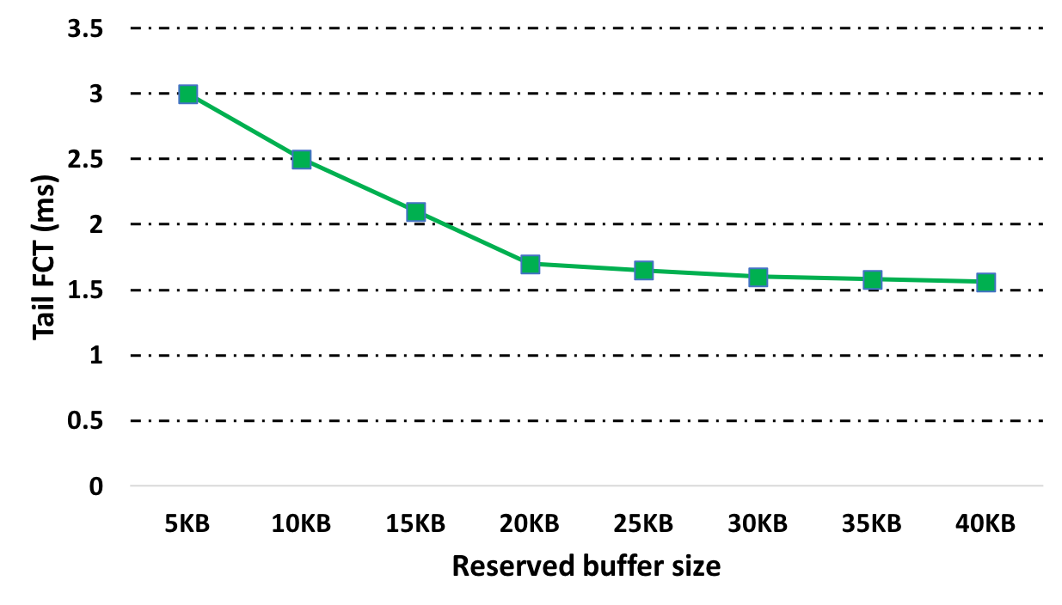
Results: Reserved buffer’s size
About 25 KB of reserved buffer is sufficient
Only a few packets are dropped but they are dropped repeatedly
Affects tail latency
It is implementable in super shallow buffers

Slide 30
Conclusion
ResQueue significantly improves short flows’ FCT
Short flows are scheduled in “priority-1” or “priority-0”
ResQueue improves long flows’ throughput
It schedules long flows’ retransmitted packets in a higher priority queue
ResQueue does not starve long flows
Only dropped packets of short flows get high priority
ResQueue compatible with existing congestion control mechanisms
Why ResQueue: increasing line rates → buffer pressure in switches will become acute
30

Slide 31
Thank you!

