Slide 1

Slytherin: Dynamic, Network-assisted Prioritization of Tail Packets in Datacenter Networks
Hamed Rezaei, Mojtaba Malekpourshahraki, Balajee Vamanan
Notes:
This project is carried on the bits system lab. And I worked with hamed rezai in this project. And its is supervised by Balajee Vamanan.
This is a join work with

Slide 2




Diverse datacenter applications
Datacenters host diverse applications
Foreground applications
Respond to user queries (e.g., Web search)
Short flows (e.g., < 32 KB)
Background applications
Update data for foreground applications (e.g., Web crawler)
Long flows
Substantial diversity in datacenter applications
Notes:
Some example for foreground applications are ….

Slide 3

Multiple Network Objectives
Requirements
Foreground applications
Sensitive to tail (e.g., 99th %-ile) flow completion times
Background applications
Sensitive to throughput
Foreground
Background
Tail flow completion
times
Differing
Objectives
Solution?
Throughput
Datacenter network must provide both low tail flow completion times for short flows and high throughput for long flows
Notes:
But Its important for a data center networks to be able to fulfil all requirements for these applications. But the challenge is that they have deferring objectives.

Slide 4
Existing state-of-the-art
Load balancing
Presto [SIGCOMM ’15], Hula [SOSR ’16]
Conga [SIGCOMM ’14]
Congestion control
DCTCP [SIGCOMM ’10], D2TCP [SIGCOMM ’12]
Packet scheduling
Information-aware
pFabric [SIGCOMM ’13]
PASE [SIGCOMM ’14]
Information-agnostic
PIAS [NSDI ‘15]
Problem exists even with perfect load balancing
Does not specifically target
short flows (tail latency)
Apriori knowledge
of flow sizes
Most relevant to our proposal
Packet scheduling plays a direct role in the flow completion times of short flows (our focus on this paper)
Notes:
1)There has been a lot of work on data center networks over the last several years broadly speaking, previous work can be categorized into …
2)To the best of our knowledge pias is the most recent info agnostic packet scheduling scheme and its most relevant to our proposal.
3)Congestion control: end to end mechanism, iterative ->slow!
doesn’t specifically target short flows

Slide 5



Shortest Job First (SJF)
PIAS aims to implement SJF Practically
Improves FCT
SJF per switch $≠$ SJF for network
Optimal for a single switch (PIAS [NSDI ‘15])
NOT optimal for the whole network (pFabric [Sigcomm ‘13])
High
Short flows
Low
Long flows
SJF
SJF
SJF
SJF
SJF
SJF
Optimal
Global vs. local
Not optimal
PIAS (SJF per switch) is locally but not globally optimal
Notes:
So basically pias tries to send shorter flows to queues with higher priority and longer flows to queues with lower priority.

Slide 6
Key question!
Is it possible to identify and prioritize tail packets, to improve the tail flow completion times beyond PIAS?
Slytherin
Notes:
We answer this question in the affirmative with our design called Slytherin

Slide 7
Our contributions
Key insight: Tail packets often incur congestion at multiple points in the network
Slytherin
Step I: Targets tail packets
Uses ECN marks to identify tail packets
Step II: Prioritizes tail packets
Uses multi-level queues
Drastically reduces network queuing
2x lower queue length
Slytherin achieves 19% lower tail flow completion times without losing throughput
Notes:
OVERAL
packets that are more likely to fall in the tail often incur congestion at multiple points in the network

Slide 8
Outline
Datacenter network objectives
Existing proposals
Our contributions
Idea and Opportunity
Slytherin Design
Methodology
Results
Closing remarks
Notes:
This is the outline of my talk
High level idea and contributions
Going to explain details
And then _> experimental methodology
And key results

Slide 9


Idea and opportunity
High-level idea
Packets that incur congestion at multiple points
Likely to fall in the tail
Worsen tail FCT
0
2
Num of slots required
before dequeue
0
S2
S4
Maximum time slot =
2
1
0
1
0
S1
S6
S3
S5

Slide 10
Idea and opportunity
High-level idea
Packets that incur congestion at multiple points
Likely to fall in the tail
Worsen tail FCT
0
0
2
1
Num of slots required
before dequeue
0
1
S2
S4
Maximum time slot =
2
1
1
0
1
0
S1
S6
S3
S5

Slide 11
Idea and opportunity (cont.)
Could packets marked at multiple points, influence tail?
What is the fraction of packets that
are marked at more than one switch AND
fall in the tail
Experimental analysis
Substantial opportunity at high loads!
Notes:
Explain the axis
We ran a typical datacenter workload and observed the fraction of packets that are marked at ….

Slide 12
Outline
Datacenter network objectives
Existing proposals
Our contributions
Idea and Opportunity
Slytherin Design
Methodology
Results
Closing remarks
Notes:
7 min
This is the outline of my talk
High level idea and contributions
Going to explain details
And then _> experimental methodology
And key results

Slide 13
High level overview
Policy intent
Mechanism
Step I
Identify packets
that fall in the tail
Leverages ECN mark to
identify tail packets
Step II
Prioritizes tail
packets
Multi-level
queue
Notes:
I will talk about steps in details
What we do how
policy intent , mechanism

Slide 14

Slytherin: Design
Slytherin has two steps:
Step I: Identify packets that previously incur congestion
Use ECN marked packets
B
C
✓ Mark packet
A
D
S1
S2
S3
S4
S5
S6

Slide 15
Slytherin: Design
Slytherin has two steps:
Step I: Identify packets that previously incur congestion
Use ECN marked packets
✓ This packet previously incured congestion
B
C
✓ Mark packet
A
D
S1
S2
S3
S4
S5
S6

Slide 16
Slytherin: Design
Slytherin has two steps:
Step II: Prioritize previously congested packets
Use Multi-level queue
Supported in today’s datacenter switches
Simple queue
Multi-level queue
High
Low
Low

Slide 17
Slytherin: Design
Slytherin has two steps:
Step II: Prioritize previously contented packets
Use Multi-level queue for all switches
Multi-level queue
Multi-level queue
High
High
Low
Low
B
C
Multi-level queue
Multi-level queue
High
High
Low
Low
A
D
S1
S2
S3
S4
S5
S6
Notes:
Going back to our original example …

Slide 18
Slytherin: Design
Slytherin has two steps:
Step II: Prioritize previously contented packets
Use Multi-level queue
High
High
Low
Low
B
C
High
High
Low
Low
A
D
S1
S2
S3
S4
S5
S6

Slide 19
Slytherin: Design
Slytherin has two steps:
Step II: Prioritize previously contented packets
Use Multi-level queue
High
High
Low
Low
B
C
High
High
Low
Low
A
D
S1
S2
S3
S4
S5
S6

Slide 20
Slytherin: Design
Slytherin has two steps:
Step II: Prioritize previously contented packets
Use Multi-level queue
High
High
Low
Low
B
C
High
High
Low
Low
A
D
S1
S2
S3
S4
S5
S6

Slide 21
Design Considerations
Ack prioritization
Ack packets have the highest priority
Promote all Ack packets to the queue with higher priority
Implementation
Most of the switches support multi-level queue
Implement Slytherin with some switch rules

Slide 22
Outline
Datacenter network objectives
Existing proposals
Our contributions
Idea and Opportunity
Slytherin Design
Methodology
Results
Closing remarks

Slide 23
Simulation Methodology
Network simulator (ns-3 v3.28)
Transport protocol
DCTCP as underlying congestion control
ECN threshold
Threshold 25% of total queue size
Workloads
Short flows (8 - 32 KB) (web search workload)
long flows (1 MB) (data mining)
Schemes compared
PIAS [NSDI ‘15]
DCTCP [SIGCOMM ’10]
Notes:
Mixed of sh and l flows

Slide 24

Topology
Two level, leaf-spine topology
400 hosts through 20 leaf switches
Connected to 10 spine switches in full mesh
10 Spine Switches
10 Gbps
20 Leaf Switches
10 Gbps
400 Hosts
Notes:
Typical in today dc

Slide 25
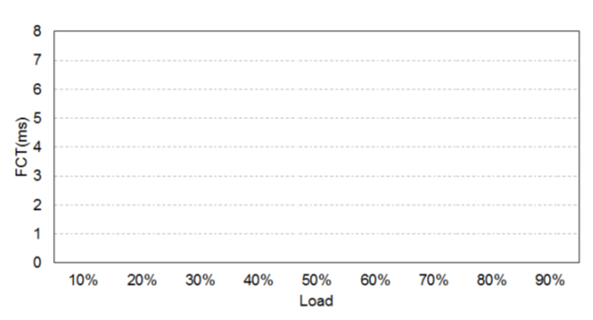
Tail (99th) percentile FCT
Tail FCT (ms)
Slytherin achieves 18.6% lower 99th percentile
flow completion times for short flows.
Notes:
Remember, the key metrics for DataCenter are tail FCT and Throughput
There are many results in the paper but I wanna show you three most important of them First result I wanna to show!
Axes
We show DCTCP with a yellow line, … PIAS with a….
As expected, FCT of all schemes increase with load
PIAS achieves lower FCT than DCTCT, matching their paper. Slytherin achieves EVEN lower FCT than PIAS.
Also, our improvements are larger at higher loads Gap between increases.

Slide 26
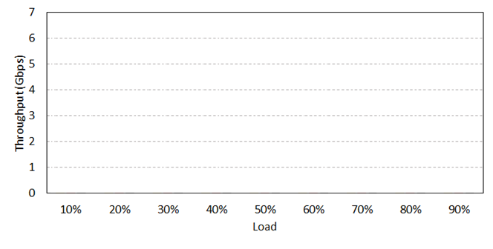
Average throughput (long flows)
Slytherin achieves an average increase in long flows
throughput by about 32%.
Notes:
Better Throughput
At high loads there is more congestion and queuing therefor, long flows achieve lower throughout at high loads.
The more the load is the lower the throughput, as there are more packets and more queuing delay.
Slytherin just target some packets while PIAS is prioritizing all packets and it should prioritize some useless ones

Slide 27
CDF of queue length in switches
Load =40%
Load =60%
Slytherin significantly reduces 99th percentile queue
length in switches by about a factor of 2x on average
Notes:
Axes
Tor switch + load 40 60%
SJF
We have lower queue length

Slide 28
Conclusion
Prior approaches
Leverage SJF to minimize average flow completion times
We proposed Slytherin
Identifies tail packets and prioritizes them in the network switches
Optimizes tail flow completion times
Tail flow completion time → most appropriate for many applications
Future work:
Improve Slytherin’s accuracy in identifying tail packets
Efficient switch hardware implementations
As data continues to grow at a rapid rate, schemes such as Slytherin that minimize network tail latency will become important

Slide 29
Thanks for the attention
mmalek3@uic.edu

Slide 30
BACKUP SLIDES

Slide 31
Index
Graphs
Response time
Reordering
Sensitivity to threshold
Sensitivity to incast
Definitions:
Tail FCT
Ack prioritize

Slide 32
Response time distribution
DCTCP takes 6 RTTs (480 μs) to converge to fair share whereas Slytherin converges in 4 RTTs (320 μs)

Slide 33
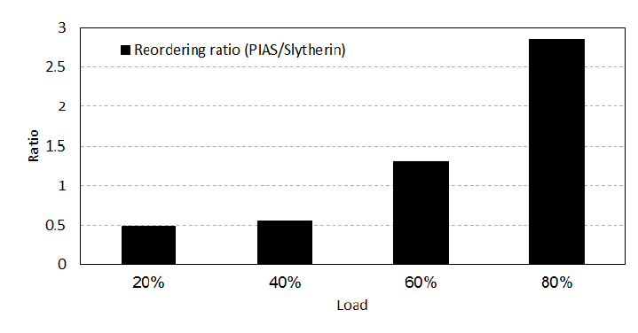
Reordering
PIAS with limited buffer for each port
Reordering PIAS/Slytherin

Slide 34
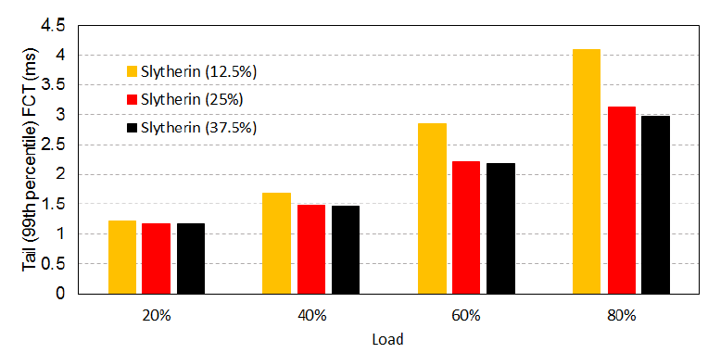
Sensitivity to threshold

Slide 35
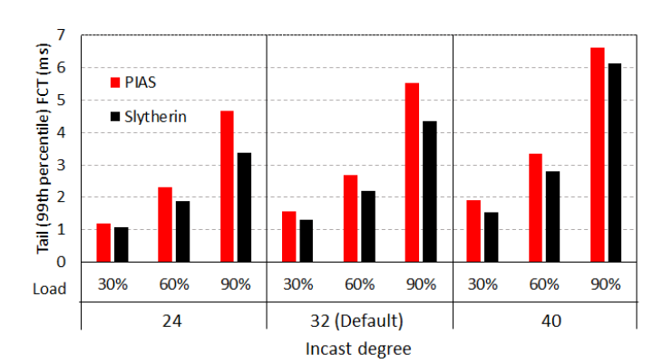
Sensitivity to incast

Slide 36
Slytherin: Design - ACK
Prioritize ACK packets
Packets will follow Slytherin rules
High
High
Low
Low
B
C
High
High
Low
Low
A
D
S1
S2
S3
S1
S2
S3

Slide 37


Tail flow completion time
Scenario I: Assume we have 5 short flows as follow
Scenario II:
which is better?
Flow ID | Duration
10 | 1ms
20 | 5ms
30 | 2ms
40 | 2ms
50 | 4ms
Average FCT = $\frac{\left(1+2+2+5+4\right)}{5}$
Tail FCT = $5$
Flow ID | Duration | Duration
10 | 2 | 1
20 | 2 | 6
30 | 2 | 1
40 | 2 | 1
50 | 2 | 1

