Slide 1


Superways: A datacenter topology for incast-heavy workloads
Hamed Rezaei and Balajee Vamanan
hrezae2@uic.edu
University of Illinois at Chicago

Slide 2
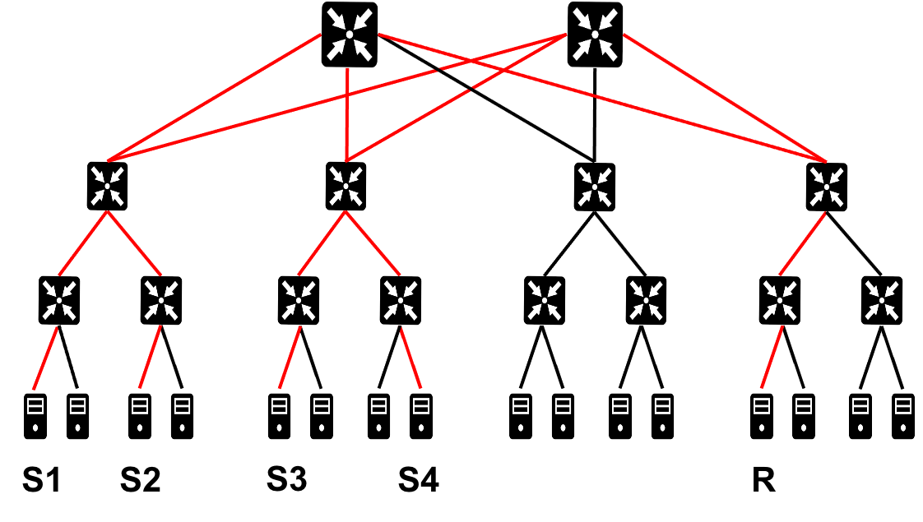
Incast in datacenter networks
Many-to-one traffic pattern
Multiple servers send their data to a single server simultaneously:
A server sends a query to multiple servers
Queried servers send their reply to the querying server simultaneously
Common in modern datacenter networks
Google search, Microsoft Bing
Mostly short flows
Incast leads to
Long queues (long tails)→ packet loss

Slide 3
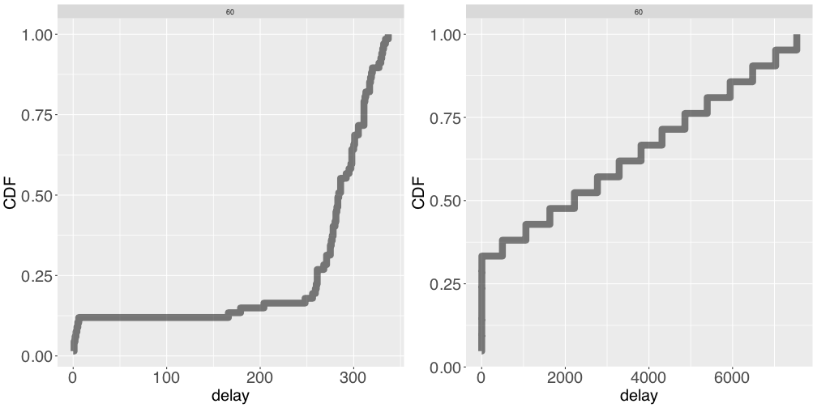
Incast inter-arrival time AND flow size distribution
About 50% of incasts arrive within 100 us from the previous incast¹
Accurate + timely incast detection HARD → congestion control (CC) unlikely to address incast
Incast leads to excessive packet drops
Flows are extremely small²:
~70% of the flows have only 1 packet
State-of-the-art reactive CC (Homa) insufficient
Packet prioritization does not work
S2
Solution: create a heterogeneous topology: co-locate incast aggregators and provide more links (bandwidth) for incast servers
1 High-Resolution Measurement of Data Center Microbursts, [IMC’17]
2 Inside the Social Network’s (Datacenter) Network (SIGCOMM’18)
3

Slide 4
Superways
Key insight:
# aggregators << # workers
Incast aggregators are network bound, not CPU bound
What about memory and storage?
Incast aggregators collect small (e.g., 1KB) replies; no memory and storage contention

Slide 5
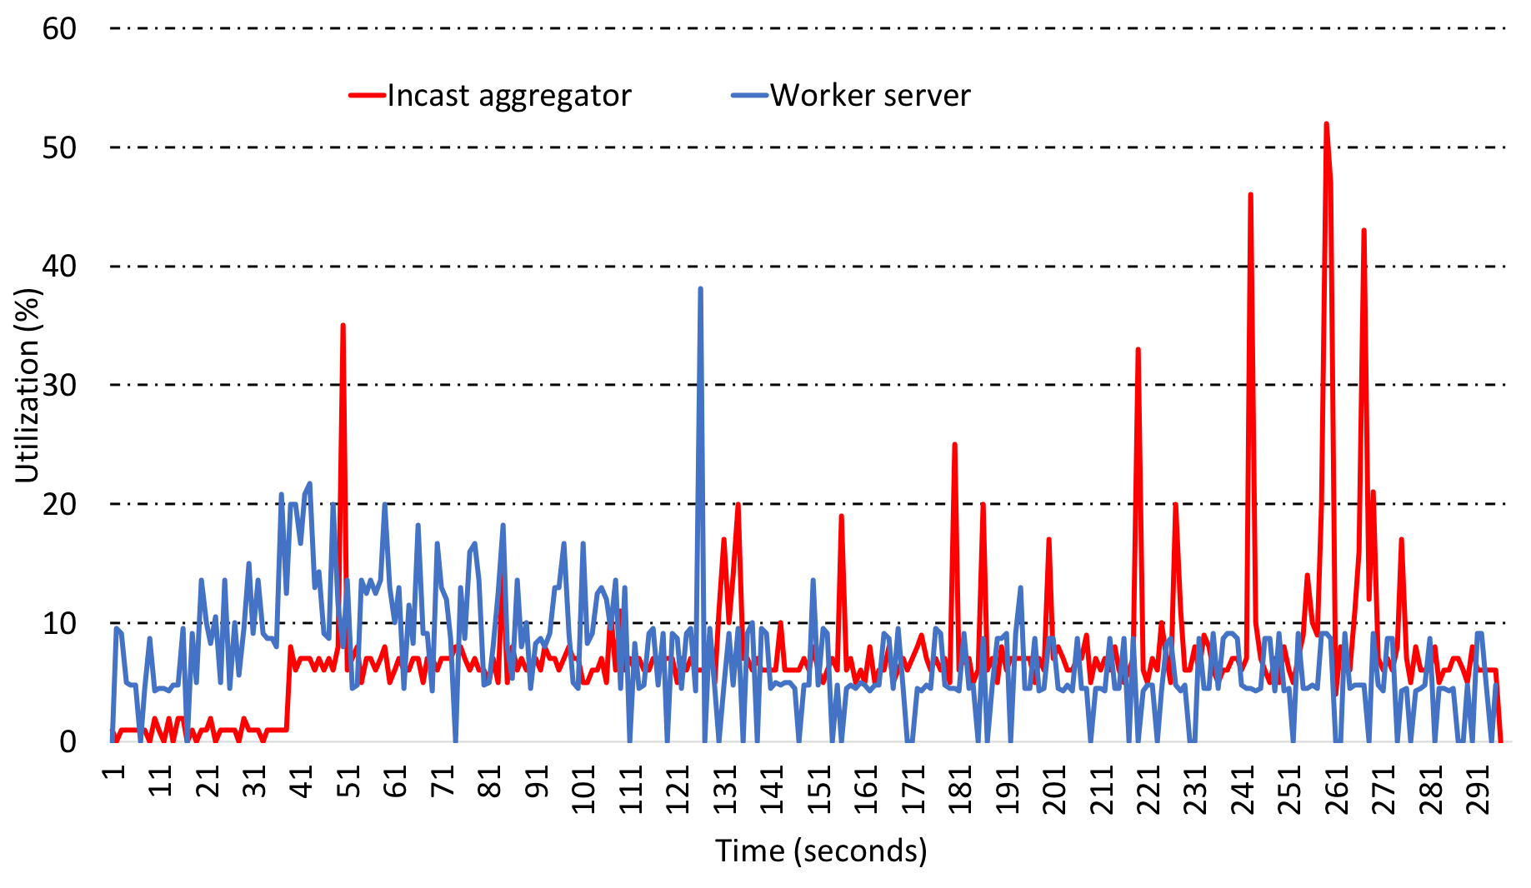
CPU utilization
Incast applications do not overload the CPU (Apache solr setup in Cloudlab)
Average CPU utilization for
A non-incast application: 7.08%
An incast application: 8.19%

Slide 6
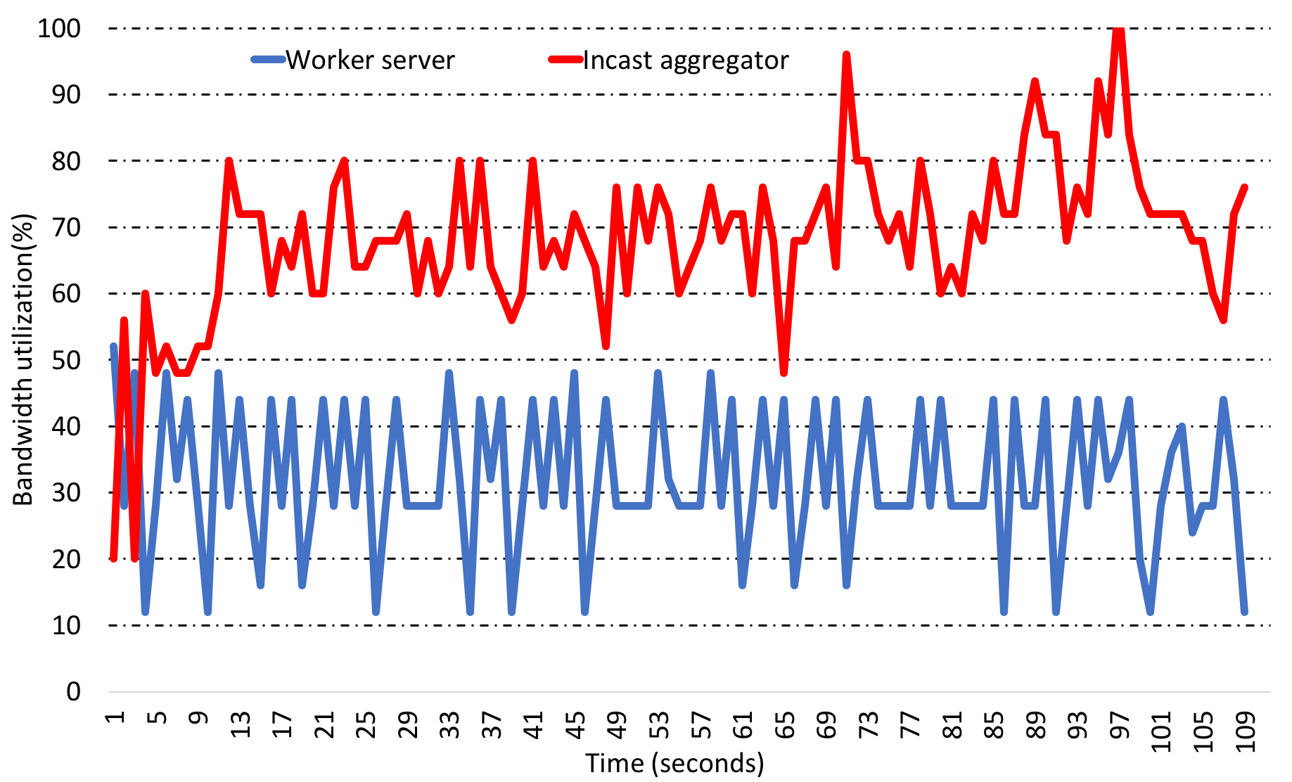
Network I/O utilization
Incast applications put stress on network bandwidth (Apache solr setup in Cloudlab)
Average bandwidth utilization for
A non-incast (worker) application: 22%
An incast application: 68%

Slide 7
Superways - Design
IDEA: create a heterogeneous topology by bin-packing incast aggregators on some specific servers and provide more bandwidth (links) for those servers
How to add links?
Sort aggregators based on their incast degree
Start installing the aggregator with highest incast degree on one of the servers
Use the leftover capacity optimally for other incast aggregators
Classic knapsack problem

Slide 8


Superways – Design – Scenario 1
App-1
Deg: 5
App-2
Deg: 4
App-3
Deg: 2
BW usage = 0
Leftover capacity = C

Slide 9
Superways – Design – Scenario 1
Deg: 5
App-2
Deg: 4
App-3
Deg: 2
BW usage = b1
App-1
Leftover capacity = C-b1
leftover capacity enough for next app

Slide 10
Superways – Design – Scenario 1
Deg: 5
Deg: 4
App-3
Deg: 2
BW usage = b1+b2
App-1
Leftover capacity = C-b1-b2
leftover capacity enough for next app
App-2

Slide 11
Superways – Design – Scenario 1
Deg: 5
Deg: 4
App-3
Deg: 2
BW usage = b1+b2
App-1
Leftover capacity = C-b1-b2
leftover capacity enough for next app
App-2

Slide 12
Superways – Design – Scenario 1
Deg: 5
Deg: 4
Deg: 2
BW usage = b1+b2+b3
App-1
Leftover capacity = C-b1-b2-b3
leftover capacity enough for next app
App-2
App-3

Slide 13
Superways – Design – Scenario 2
App-1
Deg: 5
App-2
Deg: 4
App-3
Deg: 2
BW usage = 0
Leftover capacity = C

Slide 14
Superways – Design – Scenario 2
Deg: 5
App-2
Deg: 4
App-3
Deg: 2
BW usage = b1
App-1
Leftover capacity = C-b1 (= 𝝴)
leftover capacity NOT enough for next app

Slide 15
Superways – Design – Scenario 2
Deg: 5
App-2
Deg: 4
App-3
Deg: 2
BW usage = b1
App-1
Leftover capacity = C-b1

Slide 16
Superways – Design – Scenario 2
Deg: 5
Deg: 4
App-3
Deg: 2
BW usage = b1+b2
App-1
Leftover capacity = 2*C-b1-b2
App-2

Slide 17
Superways – Design – Scenario 2
Deg: 5
Deg: 4
App-3
Deg: 2
BW usage = b1+b2
App-1
Leftover capacity = 2*C-b1-b2
leftover capacity NOT enough for next app
App-2

Slide 18
Superways – Design – Scenario 2
Deg: 5
Deg: 4
Deg: 2
BW usage = b3
App-1
App-3
Leftover capacity = C-b3
leftover capacity NOT enough for next app
App-2

Slide 19
Superways – Design – Scenario 2
Deg: 5
Deg: 4
App-3
Deg: 2
BW usage = b1+b2
App-1
Leftover capacity = 2*C-b1-b2
leftover capacity enough for next app
App-2

Slide 20
Superways – Design – Scenario 2
Deg: 5
Deg: 4
Deg: 2
BW usage = b1+b2+b3
App-1
Leftover capacity = 2*C-b1-b2-b3
App-2
App-3

Slide 21

Superways – Design
App-1
App-2
App-3
.
.
.

Slide 22
Superways - Discussion
Why Superways is implementable?
Number of incast aggregators is small
3% ~ 5% of all servers are incast aggregators
Modern datacenter applications are containerized
It is easy to relocate incast aggregators (applications)
Workload does not change frequently
No need to relocate applications frequently

Slide 23
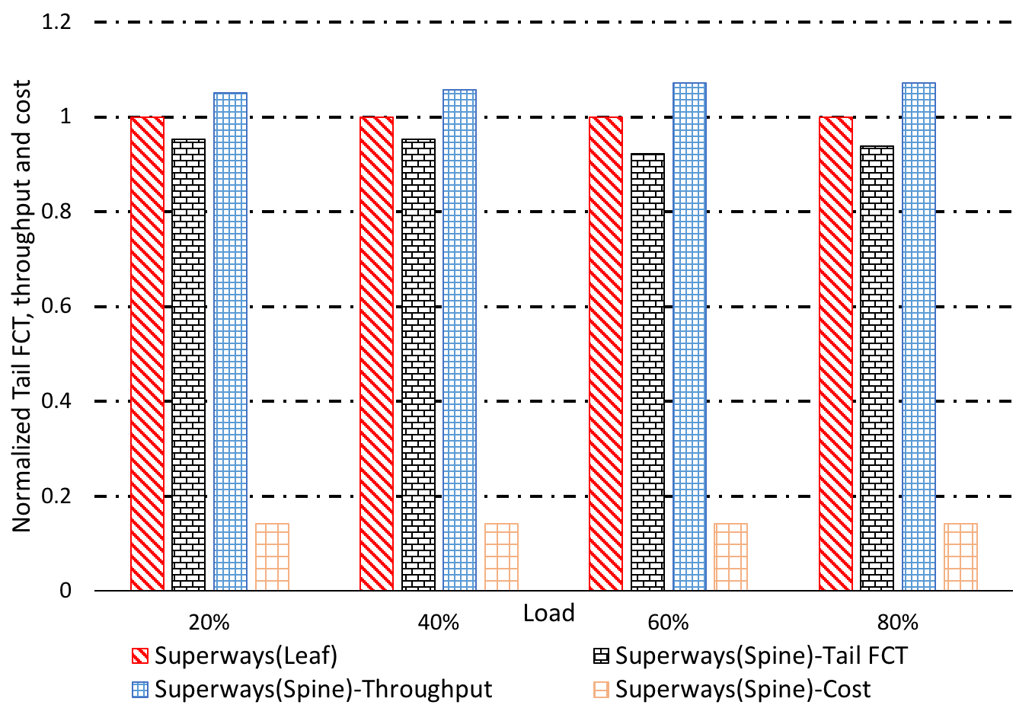
Why connect to spine switches?
Spine switches are more powerful (ports/speed)
Leads to lower tail FCT
Reduces the total cost of implementation
Separating long flows from short incast flows
No collision between incast flows and long flows (e.g., a live backup) → high throughput

Slide 24
Methodology
Simulations (ns3)
400 servers
10 spine switches
20 leaf switches
Real testbed (cloudlab)
16 servers
2 spine switches
4 leaf switches

Slide 25
Compared schemes
Jellyfish
Suggests a random graph topology rather than a tree topology
Bcube
Adds one extra link between all servers and spine switches
Subways
Adds extra links between all servers and leaf switches (inter/intra cluster)

Slide 26
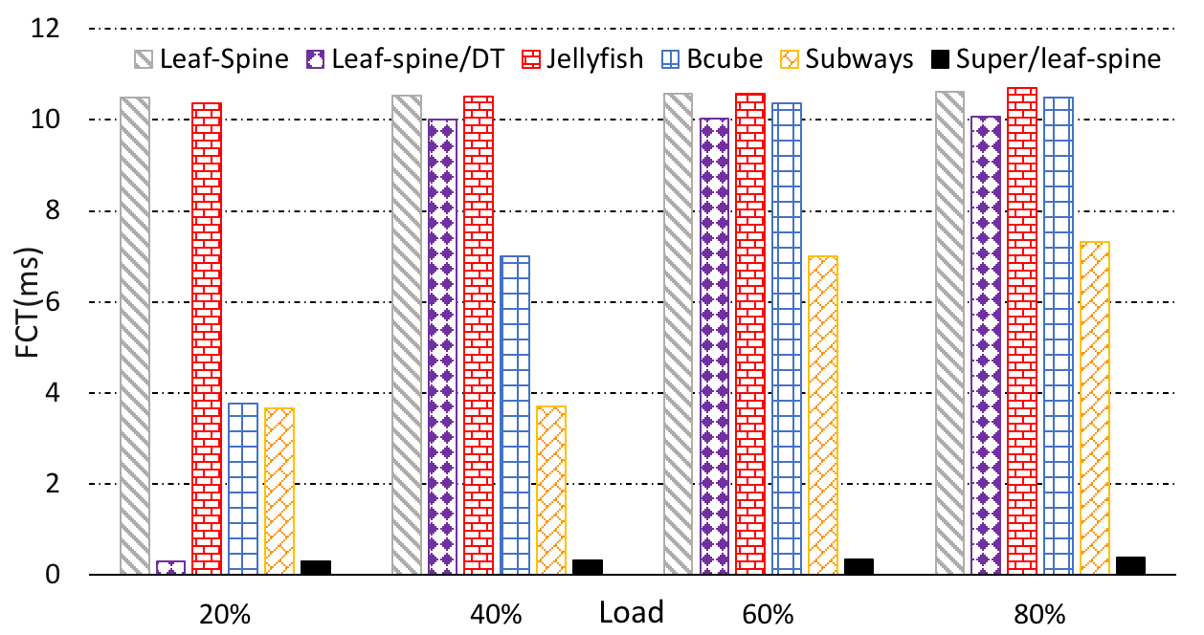
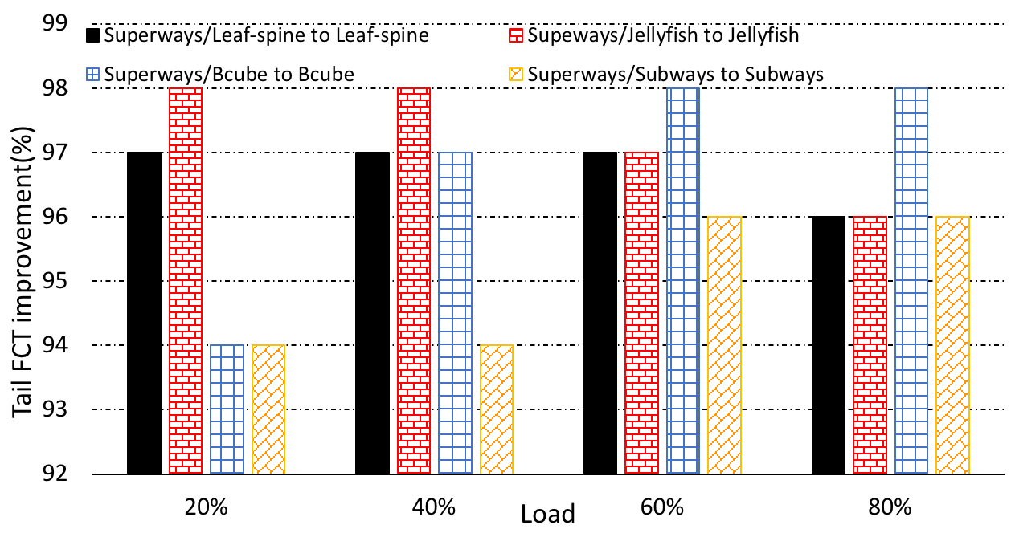
Superways – Results (Tail FCT)
95% reduction in tail FCT, on average, for all topologies

Slide 27
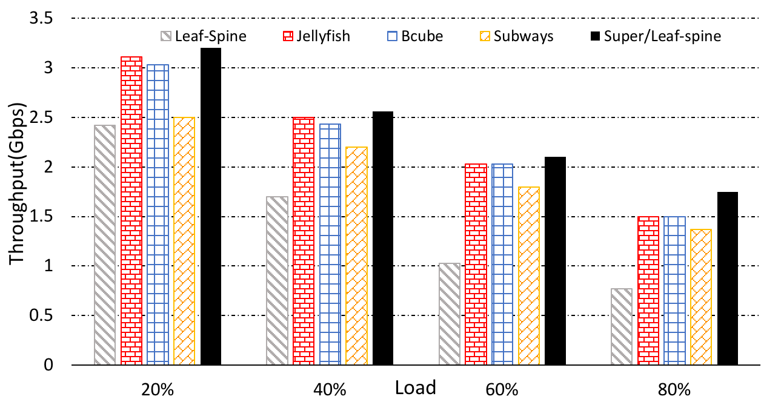
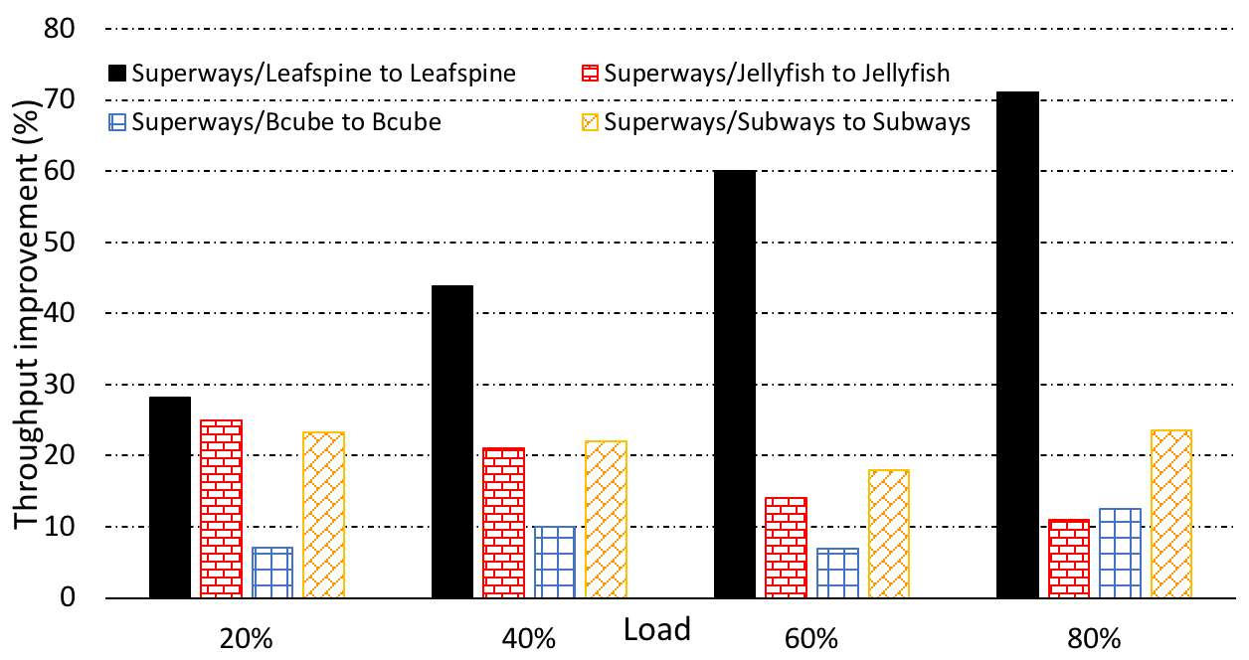
Superways – Results (throughput)
25% improvement in throughput, on average, for all topologies

Slide 28
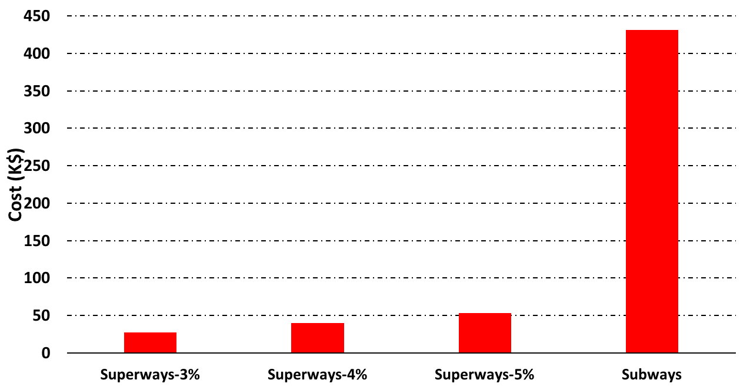
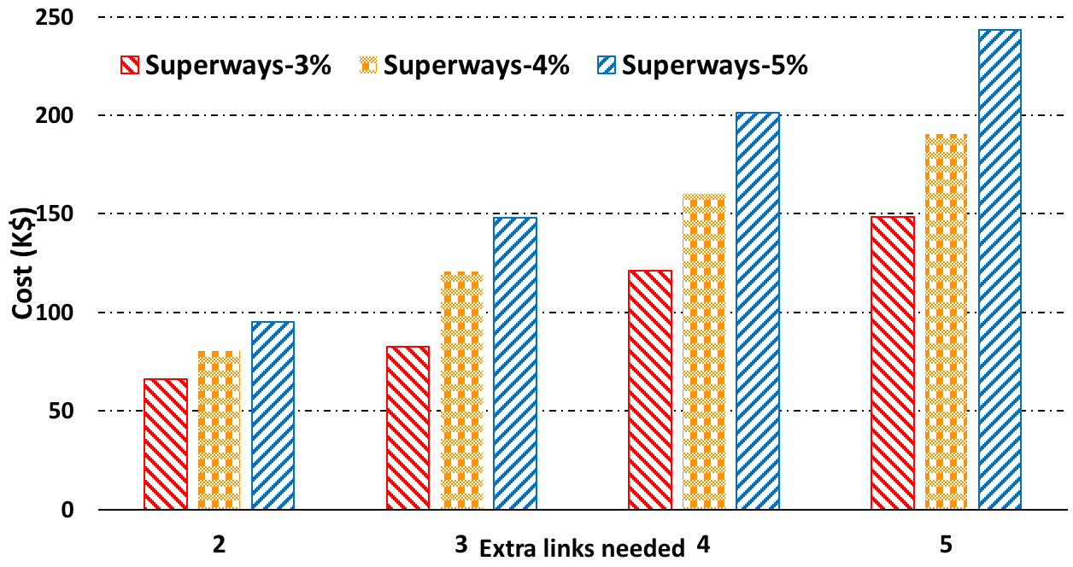
Superways – Results (cost)
Superways is 9x cheaper than Subways

Slide 29
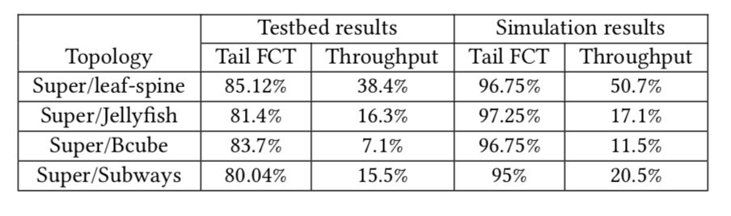
Superways – Results (Real testbed)
Superways will be the base topology for Web-search workloads
(incast-heavy workloads)

Slide 30
Thank you!

