Slide 1
TimeTrader: Exploiting Latency Tail to Save Datacenter Energy for Online Search
Balajee Vamanan, Hamza Bin Sohail, Jahangir Hasan, and T. N. Vijaykumar

Slide 2
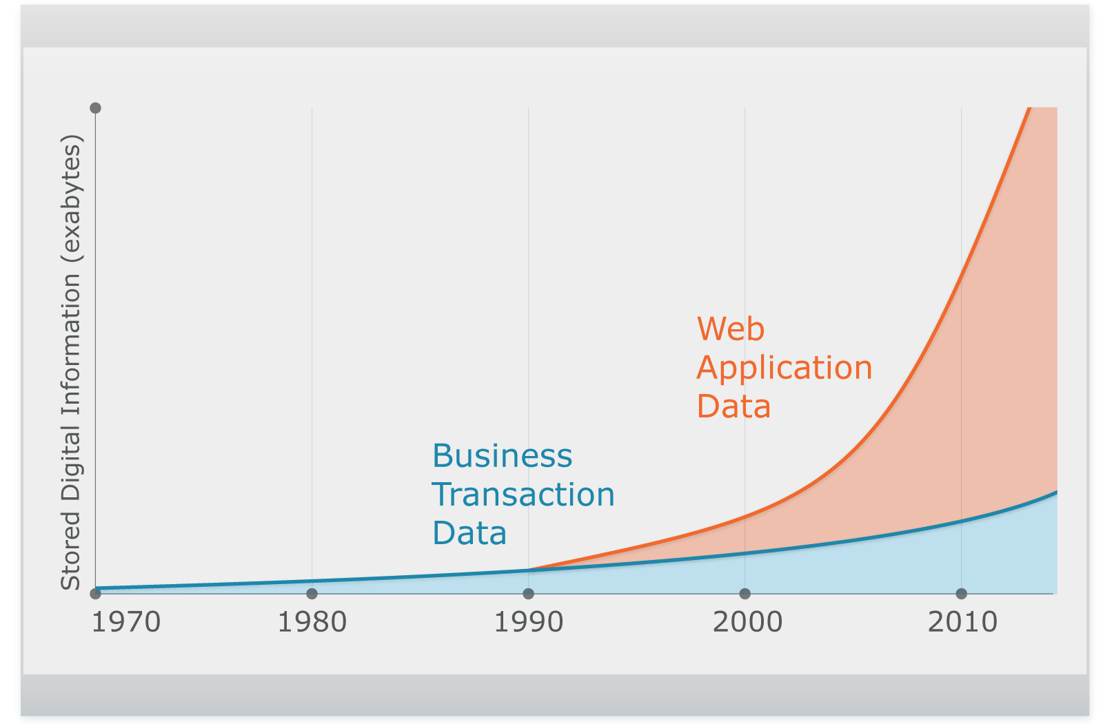
Searching large data is becoming prevalent
Data is growing exponentially
Online Search (OLS): Interactively query and access data
Key component of many web applications, not only Web Search (e.g., Facebook, Twitter, advertisements)
Complex, Unstructured
Relational

Slide 3
Energy management for OLS is hard
Traditional energy management does not work
Interactive, strict service-level agreements (SLAs)
Cannot batch
Short response times and inter-arrival times (e.g., 200 ms and ≈ 1 ms for Web Search)
Low-power modes (e.g., p-states) not applicable
Shard data over 1000s of servers → each query searches all servers
Cannot consolidate workload to fewer servers
Carefully slow down (not turn off) servers
without violating SLAs

Slide 4
Previous work
Pegasus [ISCA’14]: Achieves load-proportional energy
Uses (global) datacenter-wide response times
Shifts latency distribution at low loads
Saves energy at low loads
Does not save much at high loads
Saves 0% at peak load
Datacenters operate at moderate-peak during the day (diurnal pattern) → savings desired at high loads
Pegasus saves energy at low loads but limited savings at high loads

Slide 5
TimeTrader: contributions
Each query leads to 1000s of sub-queries
Each query’s budget set to accommodate 99th %-ile sub-query
In both network and compute parts
Key observation: 80% sub-queries complete in 20% of budget
TimeTrader exploits both network and compute slack to save energy

Slide 6
TimeTrader: contributions (cont.)
Uses (local) per-sub-query latencies → reshapes sub-query response time distribution at all loads
Baseline peak load
Pegasus (low load)
Baseline low load
TimeTrader (all load)
Fraction of sub-queries
Deadline (99% at peak)
A
B
Latency
Pegasus’s opportunity
TimeTrader’s opportunity
A: median baseline at low load B: 99% baseline at low load

Slide 7
TimeTrader: contributions (cont.)
Leverages network signals to determine slack
Does not need fine-grained clock synchronization
Employs Earliest Deadline First (EDF) scheduling
Slowing down a sub-query affects other queued sub-queries
Critical sub-queries affected the most
Allows critical sub-queries to bypass others
TimeTrader is the first to explore cross-layer optimization between network and architecture layers; saves 15% - 40% energy at peak - 30% loads

Slide 8
Outline
Introduction
Background
OLS architecture
Tail latencies and SLA budgets
TimeTrader’s design
Methodology
Results

Slide 9
Background: OLS architecture
Query
Query result
Partition-aggregate (tree)
Request-compute-reply
Request: root → leaf
Compute: leaf node
Reply: leaf → root
Root waits until deadline to generate overall response
Some replies may take longer in network or compute
Collisions in network → TCP retransmit
Imperfect sharding → disproportionately large compute
Long tails → tail latency problem
Root
Request
Response
Agg 1
Agg m
Leaf 1
Leaf n
Leaf 1
Leaf n

Slide 10
OLS tail latencies and SLA budgets
Missed replies due to tail latency affect quality
e.g., SLA of 1% missed deadlines
Time budgets based on 99th %-ile latency of sub-queries
To optimize network and compute separately
Split budget into network and compute
e.g., total = 250 ms → flow deadlines 25 ms
250
50
25 25
25
25 25
75
80% of sub-queries complete within 20% of budget → slack

Slide 11
Outline
Introduction
Background
TimeTrader’s design
Key ideas
Determining slack
Slowing down based on slack
EDF
Methodology
Results

Slide 12
TimeTrader: design
TimeTrader exploits per-sub-query slack
Sources of slack
Network
Request
Reply (after compute, unpredictable)
Compute
Actual compute (query dependent)
Queuing (due to local load variations)
Determine (a) request slack and (b) compute slack
Slow down based on slack and load
Shield critical sub-queries from slowed down sub-queries
EDF implementation
Intel’s Running Avg. Power Limit (RAPL) to set power states

Slide 13
1(a): Determine request slack
Requests traverse network from root to leaf
Timestamp at parent and leaf?
Clock skew ≈ slack
Estimate based on already-available network signals
e.g., Explicit Congestion Notification (ECN) marks, TCP timeouts
If a leaf doesn’t see either ECN or Timeouts
Request Slack = Network Budget – Median Latency
Else
Request Slack = 0

Slide 14
1(b): Determine compute-queuing slack
Exploit local load variations in each leaf server
Slack calculation
Details in the paper
Total Slack = Request Slack + Compute-Queuing Slack

Slide 15
2: Slow down based on slack
Given the slack, calculate slow down factor
As a fraction of compute budget
But not all of the slack can be used
Slack calculation assumes no queuing
Need to scale slack based on load
Slowdown factor = Total Slack * Scale / Compute Budget
Scale depends on load
Feedback controller (details in the paper)

Slide 16
3: Shield critical sub-queries
Earliest Deadline First (EDF)
Implementation details in the paper

Slide 17
Outline
Introduction
Background
TimeTrader’s design
Methodology
Results

Slide 18
Methodology
Compute
Real measurements for service time, power
Network
Real measurements at a small scale
Tails effects only in large clusters → simulate with ns-3
Workload: Web Search (Search) from CloudSuite 2.0
Search index from Wikipedia
3000 queries/s at peak load → 90% load
Deadline budget: Overall 125 ms
Network (request/reply): 25 ms
Compute: 75 ms
SLA of 1% missed deadlines

Slide 19
Idle and Active Energy Savings
TimeTrader saves 15% - 40% energy over baseline (17% over Pegasus at 30% load)

Slide 20
Response time distribution

Slide 21
Response time distribution

Slide 22
Response time distribution
TimeTrader reshapes distribution at all loads; Slows ~80% of requests at all loads

Slide 23
Conclusion
TimeTrader…
Exploits sub-query slack
Reshapes response time distribution at all loads
Saves 15% energy at peak, 40% energy at 30% load
Leverages network signals to estimate slack
Employs EDF to decouple critical sub-queries from sub-critical sub-queries
TimeTrader converts the performance disadvantage of latency tail into an energy advantage!

