Slide 1


Loom: Flexible and Efficient NIC Packet Scheduling
NSDI 2019
Brent Stephens
Aditya Akella, Mike Swift
Notes:
In this talk, we will be continuing on from our previous talk with more scheduling.
This work comes from a design philosophy that any time there are competing accesses contending for a shared resource, we need scheduling
In this case, packets from competing applications are contending for the network inside the NIC, so I am here to argue that we need flexible and efficient packet scheduling inside the NIC

Slide 2

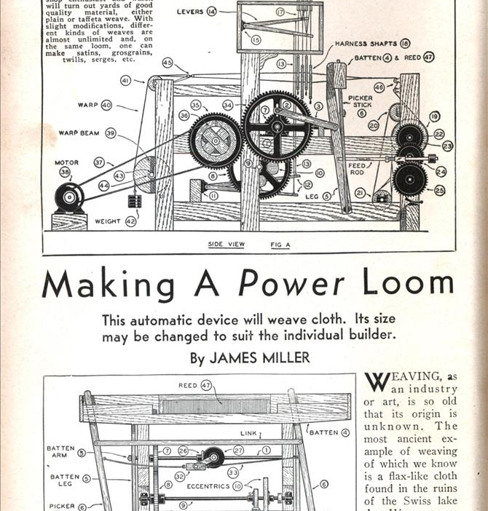
Loom is a new Network Interface Card (NIC) design that offloads all per-flow scheduling decisions out of the OS and into the NIC
Why is packet scheduling important?
What is wrong with current NICs?
Why should all packet scheduling be offloaded to the NIC?

Slide 3
Why is packet scheduling important?

Slide 4


Collocation (Application and Tenant) is Important for Infrastructure Efficiency
Tenant 1
Tenant 2
CPU Isolation Policy:
Tenant 1:
Memcached: 3 cores
Spark: 1 core
Tenant 2:
Spark: 4 cores

Slide 5
Network Performance Goals
Different applications have differing network performance goals
Low Latency
High Throughput
Notes:
Start off with existing hiearchy. Then bring in DAG nodes to show more power -- explain what you want, then bring in nodes and show how they help.
Description of shaping vs ordering too complicated. Perhaps start with a simple example with two endpoints and one node.
So: build this up from simple mem/spark by adding new pieces
This should be 4-5 slides, not one

Slide 6
Network Policies
VM1
VM1
VM2
Pseudocode
Tenant_1.Memcached -> Pri_1:high
Tenant_1.Spark -> Pri_1:low
Pri_1 -> RL_WAN(Dst == WAN: 15Gbps)
Pri_1 -> RL_None(Dst != WAN: No Limit)
RL_WAN -> FIFO_1; RL_None -> FIFO_1
FIFO_1-> Fair_1:w1
Tenants_2.Spark -> Fair_1:w1
Fair_1 -> Wire
Pri_1
RL_WAN
RL_None
FIFO_1
Fair_1
Wire
Network operators must specify and enforce a network isolation policy
Enforcing a network isolation policy requires scheduling
Notes:
Start off with existing hiearchy. Then bring in DAG nodes to show more power -- explain what you want, then bring in nodes and show how they help.
Description of shaping vs ordering too complicated. Perhaps start with a simple example with two endpoints and one node.
So: build this up from simple mem/spark by adding new pieces
This should be 4-5 slides, not one

Slide 7
What is wrong with current NICs?

Slide 8


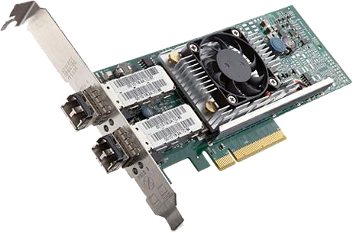
Single Queue Packet Scheduling Limitations
Single core throughput is limited (although high with Eiffel)
  Especially with very small packets
  Energy-efficient architectures may prioritize scalability over single-core performance
Software scheduling consumes CPU
Core-to-core communication increases latency
App 1
App 2
CPU
NIC
NIC
SQ struggles to drive line-rate
Wire

Slide 9
Multi Queue NIC Background and Limitations
App 1
App 2
Multi-queue NICs enable parallelism
  Throughput can be scaled across many tens of cores
Multi-queue NICs have packet scheduler that chose which queue to send packets from
The one-queue-per-core multi-queue model (MQ) attempts to enforces the policy at every core independently
  This is the best possible without inter-core coordination, but it is not effective
CPU
NIC
NIC
Wire
MQ struggles to enforce policies!

Slide 10
MQ Scheduler Problems
Naïve NIC packet scheduling prevents colocation!
It leads to:
High latency
Unfair and variable throughput
CPU
NIC (Network Interface Card)
Packet Scheduler
Time (t)

Slide 11
Why should all packet scheduling be offloaded to the NIC?

Slide 12
Where to divide labor between the OS and NIC?
CPU
Option 3: Loom
Every flow uses its own queue
All policy enforcement is offloaded to the NIC
Precise policy + low CPU
VM1
VM1
VM2
Pri_1
Option 2: Multi Queue (MQ)
Every core independently enforces policy on local traffic
Cannot ensure polices are enforced
RL_WAN
RL_None
FIFO_1
Option 1: Single Queue (SQ)
Enforce entire policy in software
Low Tput/High CPU Utilization
Fair_1
NIC
Wire
Notes:
Start off with existing hiearchy. Then bring in DAG nodes to show more power -- explain what you want, then bring in nodes and show how they help.
Description of shaping vs ordering too complicated. Perhaps start with a simple example with two endpoints and one node.
So: build this up from simple mem/spark by adding new pieces
This should be 4-5 slides, not one

Slide 13

Loom is a new NIC design that moves all per-flow scheduling decisions out of the OS and into the NIC
Loom uses a queue per flow and offloads all packet scheduling to the NIC

Slide 14
Core Problem:
It is not currently possible to offload all packet scheduling because NIC packet schedulers are inflexible and configuring them is inefficient
NIC packet schedulers are currently standing in the way of performance isolation!

Slide 15
Outline
Intro: Loom is a new NIC design that moves all per-flow scheduling decisions out of the OS and into the NIC
Contributions:
Specification: A new network policy abstraction: restricted directed acyclic graphs (DAGs)
Enforcement: A new programmable packet scheduling hierarchy designed for NICs
Updating: A new expressive and efficient OS/NIC interface
Implementation and Evaluation: BESS prototype and CloudLab

Slide 16
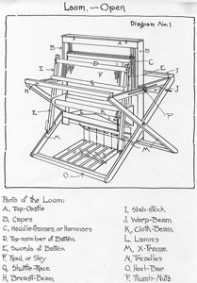
Outline
Contributions:
  Specification: A new network policy abstraction: restricted directed acyclic graphs (DAGs)
  Enforcement: A new programmable packet scheduling hierarchy designed for NICs
  Updating: A new expressive and efficient OS/NIC interface

Slide 17
What scheduling polices are needed for performance isolation?
How should policies be specified?

Slide 18
Solution: Loom Policy DAG
Two types of nodes:
Scheduling nodes: Work-conserving policies for sharing the local link bandwidth
Shaping nodes: Rate-limiting policies for sharing the network core (WAN and DCN)
Programmability: Every node is programmable with a custom enqueue and dequeue function
VM1
VM1
VM2
Pri_1
RL_WAN
RL_None
Loom can express policies that cannot be expressed with either Linux Traffic Control (Qdisc) or with Domino (PIFO)!
FIFO_1
Fair_1
Important systems like BwE (sharing the WAN) and EyeQ (sharing the DCN) require Loom’s policy DAG!
Wire

Slide 19


Types of Loom Scheduling Policies:
Group by source
Scheduling:
All of the flows from competing Spark jobs J1 and J2 in VM1 fairly share network bandwidth
Group by destination
Shaping:
All of the flows from VM1 to VM2 are rate limited to 50Gbps
Because Scheduling and Shaping polices may aggregate flows differently, they cannot be expressed as a tree!
Notes:
TODO: Link to a bunch of paper titles to motivate the need for shaping

Slide 20

Loom: Policy Abstraction
Policies are expressed as restricted acyclic graphs (DAGs)
DAG restriction: Scheduling nodes form a tree when the shaping nodes are removed
(b) And (d) are prevented because they allow parents to reorder packets that were already ordered by a child node.
Notes:
Start off with existing hiearchy. Then bring in DAG nodes to show more power -- explain what you want, then bring in nodes and show how they help.
Description of shaping vs ordering too complicated. Perhaps start with a simple example with two endpoints and one node.
So: build this up from simple mem/spark by adding new pieces
This should be 4-5 slides, not one

Slide 21
Outline
Contributions:
  Specification: A new network policy abstraction: restricted directed acyclic graphs (DAGs)
  Enforcement: A new programmable packet scheduling hierarchy designed for NICs
  Updating: A new expressive and efficient OS/NIC interface

Slide 22
How do we build a NIC that can enforce Loom’s new DAG abstraction?

Slide 23
Loom Enforcement Challenge
No existing hardware scheduler can efficiently enforce Loom Policy DAGs
Domino PIFO Block
New PIFO Block?
1 x
1 x
1 x
N x
Scheduling
Shaping
Scheduling
Shaping
Requiring separate shaping queues for every shaping traffic class would be prohibitive!

Slide 24
Insight: All shaping can be done with a single queue because all shaping can use wall clock time as a rank

Slide 25
Loom
Enforcement
F3
Mem – 25Gbps RL
F2
Mem – No RL
Pri
F1
Spark – No RL
In Loom, scheduling and shaping queues are separate
All traffic is first only placed in scheduling queues
If a packet is dequeued before its shaping time, it is placed in a global shaping queue
After shaping, the packet is placed back in scheduling queues
F1
F3
F1
F2
F1
Scheduling
Shaping

Slide 26
Outline
Contributions:
  Specification: A new network policy abstraction: restricted directed acyclic graphs (DAGs)
  Enforcement: A new programmable packet scheduling hierarchy designed for NICs
  Updating: A new expressive and efficient OS/NIC interface

Slide 27
PCIe Limitations:
NIC doorbell and update limitations:¹
Core
1
Latency Limitations:
120-900ns
App
PCIe
1
2
Throughput Limitations:
~3Mops (Intel XL710 40Gbps)
NIC
PCIe
Engine
DB1
DB2
DB3
DB4
…
DB_F
2
¹
Loom Goal: Less than 1Mops @ 100Gbps

Slide 28


Loom Efficient Interface Challenges
Too many PCIe writes:
In the worst case (every packet is from a new flow), the OS must generate 2 PCIe writes per-packet
2 writes per 1500B packet at 100Gbps = 16.6 Mops!
Insufficient data:
Before reading any packet data (headers), the NIC must schedule DMA reads for a queue

Slide 29

Loom Design
Loom introduces a new efficient OS/NIC interface that reduces the number of PCIe writes through batched updates and inline metadata

Slide 30
Batched Doorbells
Core
Using on-NIC Doorbell FIFOs allows for updates to different queues (flows) to be batched
App
PCIe
NIC
Per-core
Doorbell
FIFO
Per-core FIFOs still enable parallelism

Slide 31
Inline Metadata
Mem
Q2
Q3
Q1
Scheduling metadata (traffic class and scheduling updates) is inlined to reduce PCIe writes
Q5
Q_F
…
NIC
DMA Engine
Descriptor inlining allows for scheduling before reading packet data
PIFOs
Wire

Slide 32
Outline
Contributions:
  A new network policy abstraction: restricted directed acyclic graphs (DAGs)
  A new programmable packet scheduling hierarchy designed for NICs
  A new expressive and efficient OS/NIC interface
Evaluation:
  Implementation and Evaluation: BESS prototype and CloudLab

Slide 33

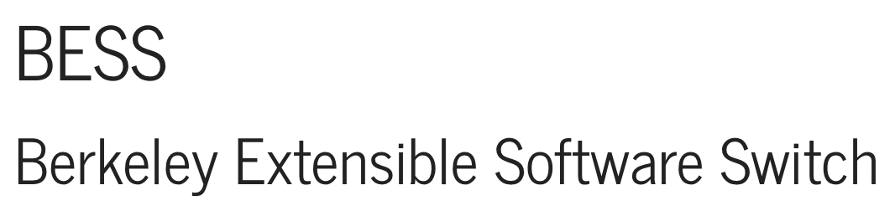
Loom Implementation
Software prototype of Loom in Linux on the Berkeley Extensible Software Switch (BESS)¹
C++ PIFO² implementation is used for scheduling
10Gbps and 40Gbps CloudLab evaluation
http://github.com/bestephe/loom
¹
²
Notes:
This holds even if every flow is new and if the scheduler is updated

Slide 34
Loom Evaluation
Can Loom drive line rate? Can Loom enforce network policies?
Experiment: Microbenchmarks with iPerf
Can Loom isolate real applications?
Experiment: CloudLab experiments with memcached and Spark
How effective is Loom’s efficient OS/NIC interface?
Experiment: Analysis of PCIe writes in Linux (QPF) versus Loom
Notes:
This holds even if every flow is new and if the scheduler is updated

Slide 35
Loom 40Gbps Evaluation
SQ
Policy: All tenants should receive an equal share.
T1
T2
T3
T4
MQ
Fair
Setup:
Every 2s a new tenant starts or stops
Each tenant i starts 4^{i} flows (4-256 total flows)
Loom
Loom can drive line-rate and isolate competing tenants and flows
35
Notes:
All data center applications are distributed. Network performance is a key aspect of overall application performance.
Take the text out if I’m going to say it
Reduce density of lines

Slide 36
Application Performance: Fairness
Linux
Loom
vs
Bandwidth
Hungry
Bandwidth
Hungry
Policy: Bandwidth is fairly shared between Spark jobs
Fair
Loom can ensure competing jobs share bandwidth even if they have different numbers of flows
Notes:
* Take out dotted lines. Smooth the data some more. Start the data at 0.

Slide 37
Application Performance: Latency
vs
Latency Sensitive
Bandwidth Hungry
Setup: Linux software packet scheduling (Qdisc) is configured to prioritize memcached traffic over Spark traffic
Pri
MQ cannot isolate latency-sensitive applications!
Notes:
All data center applications are distributed. Network performance is a key aspect of overall application performance.
Take the text out if I’m going to say it
Reduce density of lines

Slide 38
Loom Interface Evaluation
Worse case scenario:
Packets are sent in 64KB batches and each packet is from a different flow
Line-rate | Existing approaches: PCIe Writes per second | Loom: PCIe Writes per second
10 Gbps | 833K | 19K
40 Gbps | 3.3M | 76K
100 Gbps | 8.3M | 191K
Loom Goal: Less than 1Mops @ 100Gbps
Notes:
This holds even if every flow is new and if the scheduler is updated

Slide 39

Conclusion
Current NICs cannot ensure that competing applications are isolated
Loom is a new NIC design that completely offloads all packet scheduling to the NIC with low CPU overhead
Loom’s benefits translate into reductions in latency, increases in throughput, and improvements in fairness
Notes:
Add a slide (or perhaps say on the next slide) "My work addresses this at X layers of the network. Within a host, ..." Want a good preview, concise statement of what you have done

Slide 40

Related Work (Eiffel)
NIC Scheduling does not eliminate the need for software scheduling
Loom and Eiffel can be used together
Bucketed priority queues could be used to build efficient PIFOs
Eiffel

