Slide 1
Algorithms, games, and evolution
Erick Chastain, Adi Livnat, Christos Papadimitriou, and Umesh Vazirani
Nasim Mobasheri
Spring 2015

Slide 2
outline
Evolution
Population Genetics
Game Theory and Evolution
MWUA
Coordination Game
Optimization Interpretation of MWUA

Slide 3
Evolution
Change of heritable traits of biological populations over generations
Sexual reproduction
Genetic Recombination
Natural Selection
Traits that enhance survival and reproduction become more common in next generations
Fitness

Slide 4
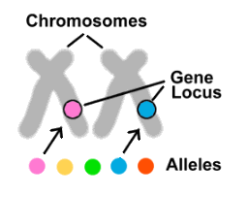
Genetic Dictionary
Locus: Specific location of a gene, DNA sequence, or position on chromosome.
Allele: a variant form of a gene. Some genes have variety of different forms, which are located at the same position on a chromosome.
Haplotype: a collection of specific alleles in a cluster of tightly-linked genes that are likely to be inherited together.

Slide 5
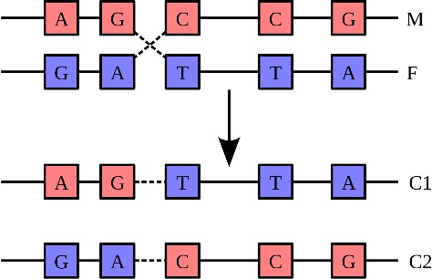
Genetic Recombination
The production of offspring with combination of traits that differ from those found in either parents.

Slide 6
Population Genetics
Study of distribution and changes of allele frequency in a population
Weak Selection Regime
Linkage Equilibrium
Linkage disequilibrium

Slide 7
Linkage Disequilibrium
Measures the degree to which alleles at two loci are associated.
The non-random association between alleles at two loci
Based on expectations relative to allele frequencies at two loci
Consider the haplotypes for two loci A and B with two alleles:
Haplotype | Frequency
AB
Ab
aB
ab
Allele | Frequency
A
a
B
b

Slide 8
Linkage Disequilibrium
The deviation of the observed frequency from the expected is a quantity called linkage disequilibrium :
If D≠0, then the two loci are in linkage disequilibrium
If D=0, then the two loci are in linkage equilibrium

Slide 9
Population genetics under recombination and selection
Assumptions:
Genotype population is infinite
Genotypes are haploid
There’s no overlap between generations
Genotypes are pair ij:
= genotype ij fitness value
= genotype ij frequency
= genotype ij frequency at generation t
How do the frequencies change from one generation to the next?

Slide 10
Population genetics under recombination and selection cont.
How do the frequencies change from one generation to the next?
Each pair of genotypes mates with a probability determined by the frequencies of those genotypes
recombines with probability
The expected frequency of genotype ij at generation t+1:

Slide 11
Population genetics under recombination and selection cont.
Linkage Equilibrium:
Probability of occurrence of a genotype is the product of the probabilities of each of its alleles.
Weak Selection:
Assumes differences in fitness between genotypes are small.
All the s lie within the interval [1-s 1+s] for
a very small s > 0.

Slide 12
Game theory and Evolution
Evolution in a regime of weak selection can be formulated as a repeated game:
Recombining loci are the players
Alleles in those loci are the possible actions
The expected payoff is the expected fitness of an organism across the genotypes in population.

Slide 13
Multiplicative Weights Update Algorithm (MWUA)
Very useful framework applicable to wide variety of learning and optimization problems.
Maintain a probability distribution/weights over a certain set that is updated iteratively via a multiplicative rule.
Example:
Receiving advice from n financial advisers
Following the advice of adviser i in day t has a net gain:

Slide 14
Multiplicative Weights Update Algorithm (MWUA) cont.
Cumulative gain:
Optimum expert ➔ Largest cumulative gain
A randomized algorithm for selecting an expert on each day so that the total gain is very close to largest cumulative gain ?

Slide 15
Multiplicative Weights Update Algorithm (MWUA) cont.
Using MWUA: assign each day t, probability
Initially all weights are equal ➔
Each day modify all weights as follows:
for
The total gain achieved by MWUA is at least

Slide 16
Coordination Game
Coordination game:
All players have the same utility function and their interest are perfectly matched.
Players have to agree on a mutually beneficial action
How do players choose and adjust their actions over repeated plays?
MWUA adjusts the random strategy for player i in the next round as follows:

Slide 17
Coordination games between genes
We can write the population genetics dynamics with respect to linkage equilibrium as:
Differential fitness landscape is a tensor where
We can write the population genetic dynamics as:

Slide 18
Coordination games between genes cont.
Theorem 1:
Under weak selection with selection strength s, the population genetic dynamics is precisely the multiplicative update dynamics of a coordination game whose payoff matrix is the differential fitness landscape and ε=s

Slide 19
Optimization Interpretation of MWUA
MWUA can be a multistep optimization algorithm which, at each step, strives to optimize a convex combination:
The expected cumulative gain
The entropy of distributions
In game formulation, define cumulative utility of player i choosing strategy j as:

Slide 20
Optimization Interpretation of MWUA cont.
Consider this quantity:
For optimizing this quantity we can apply Kuhn-Tucker condition which will result in obtaining game coordination equation (MWUA).
Theorem 1.

Slide 21
Optimization Interpretation of MWUA cont.
Corollary:
Under weak selection with selection strength s, the population genetics dynamics is tantamount to each gene optimizing at generation t a quantity equal to the cumulative expected fitness over all generation up to t, plus 1/s times the negative entropy of the allele distribution of the gene at time t.
Tradeoff between entropy and fitness maximization

Slide 22
References
1. Burger R (2000) The Mathematical Theory of Selection, Recombination, and Mutation
2. Nagylaki T (1993) The evolution of multi-locus systems under week selection. Genetics 134(2): 627-647
3. Nei M (2005) Selectionism and neutralism in molecular evolution. Mol Biol Evol 22(12): 2318-2342
4. Nagylaki t, Hofbauer J, Brunovsky P (1999) Convergence of multi-locus systems under weak epistasis or weak selection. J Math Biol 38(2): 103-133
5. Arora S, Hazan E, Kale S (2012) The multiplicative weights update method. Theory Compute 8: 212-164
6. Maynard-Smith J (1982) Evolution and the Theory of Games
7. Weilbull JW (1995) Evolutionary Game Theory
8. Boyd SP, Vanderberghe L (2004) Convex Optimization

Slide 23
Thank You

