Slide 1
Welcome to CS411 - Artificial Intelligence I

Slide 2
About me
My name: Bing Liu
Research interests:
Lifelong and continual learning
Continuous learning dialogue systems
Sentiment analysis
Natural language processing (NLP)
Artificial Intelligence (AI).
More about me:
See my homepage: https://www.cs.uic.edu/~liub/

Slide 3
General information
Teaching mode: Weeks 1 & 2, online. After that, in-class/person
Instructor: Bing Liu
Email: liub@uic.edu
Lectures
Tuesdays and Thursdays: 2:00pm - 3:15pm
Room: TBH 180F
Instructor office hours: 10:30am-12:30pm Tuesdays
TAs: (1) Jiangshu Du and (2) Sepideh Esmaeilpourcharandabi
Email: (1) jdu25@uic.edu (2) sesmae2@uic.edu;
Office hours: (1) 3:00 - 4:00 pm, Wed. (2) 11am-12pm, Wed.

Slide 4
Course structure
Course webpage:
https://www.cs.uic.edu/~liub/teach/cs411-spring-22/cs411.html
The course consists of three main parts:
Lectures – teach each topic
Homework and quizzes
No homework submission, but you will be tested on homework questions in quizzes
Programming assignments – assess your ability to solve problems
Designing and implementing algorithms
Done in groups of 2 students per group but you can do it alone
Graded based on demo results + code submissions.

Slide 5
Assessment and grading
Quizzes: 20%
Use the best N out of N+1 quizzes
Programming assignments: 20%
Midterm exam: 25%
Final exam: 35%
Conversion from final score to letter grade (subject to change)
A: 80 and above B: 70 ~ 79
C: 60 ~ 69 D: 50 ~ 59
F: 0 ~ 49

Slide 6
Prerequisites
Grade of C or better in CS 251.

Slide 7
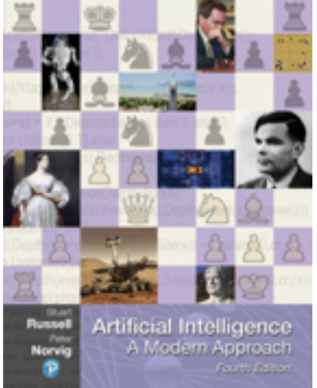
Teaching materials
Required text
Artificial Intelligence: A Modern Approach. Fourth edition,
by Stuart Russell and Peter Norvig, Pearson, 2020.
ISBN 978-0134610993.
References
Expert Systems: Principles and Programming. By Giarratano and Riley, ISBN 0-534-73744-6
Web Data Mining: Exploring Hyperlinks, Contents and Usage Data. Second Edition, by Bing Liu, Springer, ISBN 978-3-642-19459-7.
Lifelong Machine Learning. Second Edition, by Bing Liu, Morgan & Claypool Publishers, August 2018
Sentiment Analysis: mining sentiments, opinions, and emotions. Second Edition, by Bing Liu, Cambridge University Press, 2020

Slide 8
Course management tool
Blackboard
Slides can be downloaded from the Slides link
Source code submissions should be uploaded to Blackboard
Quizzes will be taken on Blackboard
Your grades for each assessment can be viewed on Blackboard
We will use Discussion Board for discussions and for asking and answering questions.
I will create a forum for each topic. Please subscribe to them
You are encouraged to introduce yourself in the Self-introduction forum.
I will use the Announcements tool to make course related announcements.

Slide 9
Rules and policies
Statute of limitations: No grading questions or complaints, no matter how justified, will only be listened to one week after the item in question has been returned.
Cheating: Cheating will not be tolerated.
All work you submitted must be entirely your own.
Any suspicious similarities between students' work (including program code) will be recorded and brought to the attention of the Dean.
The MINIMUM penalty for any student found cheating will be to receive a 0 for the item in question and drop your final course grade by one letter.
The MAXIMUM penalty will be expulsion from the University.
Late submission: Late submission of assignments will not be accepted unless it is due to some extraordinary circumstances. I must be informed at least one day before the deadline.

Slide 10
Introduction to the Course
Many slides are borrowed from Stuart Russell, an author of the textbook.

Slide 11
What is artificial intelligence?
What is artificial intelligence?
Past: how did the ideas in AI come about?
Present: what is the state of the art?
Future: will robots take over the world?

Slide 12
What is artificial intelligence (AI)?
AI aims to imitate human intelligence on computers.
Thinking and acting like humans
We often use an AI agent to refer to an AI system.
AI has focused on the study and building of agents that do the right thing.
Thinking rationally – right thinking.
Based on logic and probability.
Acting rationally: A rational agent acts so as to achieve the best outcome, or when there is uncertainty, the best expected outcome.
Recently, sentiment and emotion are also being considered.

Slide 13
Test of intelligence
One is suggested by Alan Turing (1950).
Can machine think?
Turing test:
A computer passes the test if a human interrogator, after posing some written questions, cannot tell whether the written responses come from a person or from a computer.
The annual Loebner Prize was for Turing tests (1991-2020).
But it is a controversial test because competition entrants do not aim at understanding or intelligence but resort to tricks.

Slide 14
Areas of study
Search
Knowledge representation and reasoning
Automated planning
Machine learning
Natural language processing
Computer vision
Robotics
Cognitive science
…

Slide 15
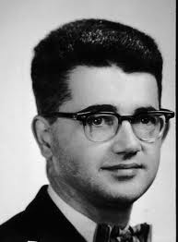
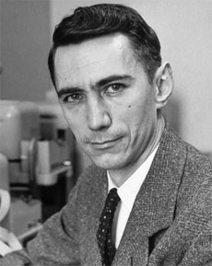
AI’s official birth: Dartmouth, 1956
“An attempt will be made to find how to make machines use language, form abstractions and concepts, solve kinds of problems now reserved for humans, and improve themselves. We think that a significant advance can be made if we work on it together for a summer.”
John McCarthy and Claude Shannon
Dartmouth Workshop Proposal

Slide 16
A brief history of AI
1940-1950: Early days
1943: McCulloch & Pitts: Boolean circuit model of brain – the birth of neural network
1950: Turing's “Computing Machinery and Intelligence” (introduced Turing test)
1950—70: Excitement
1950s: Early AI programs: chess, checkers, theorem proving
1956: Dartmouth meeting: “Artificial Intelligence” adopted
1965: Robinson's complete algorithm for logical reasoning
1970—90: Knowledge-based approaches
1969—79: Early development of knowledge-based systems
1980—88: Expert systems industry booms
1988—93: Expert systems industry busts: “AI Winter”
1990— 2012: Statistical approaches + subfield expertise
Resurgence of probability, focus on uncertainty
General increase in technical depth
Agents and learning systems… “AI Spring”?
2012 – present, Excitement again!
Big data, big compute, deep learning
AI used in many industries

Slide 17
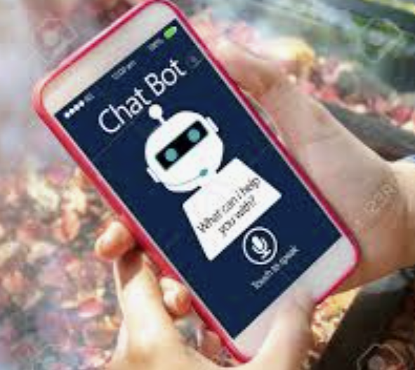
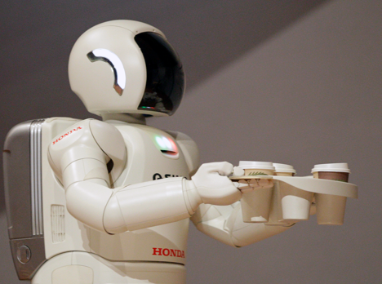
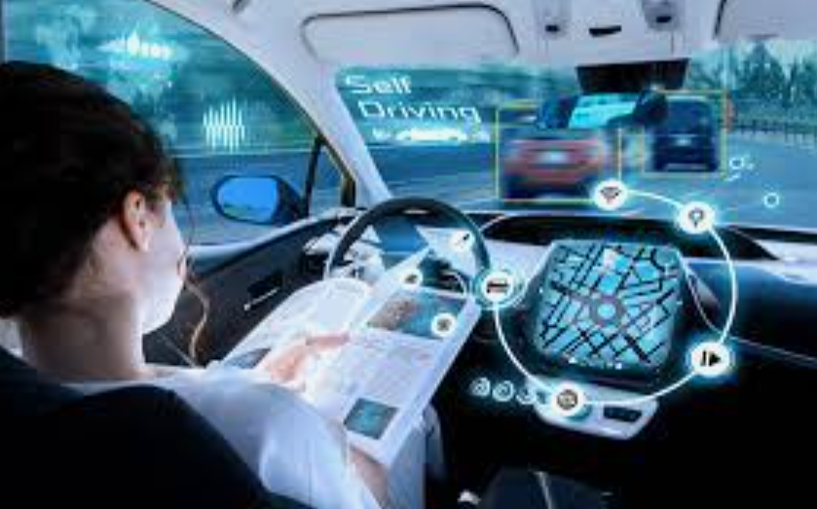
What is the state-of-the-art of AI now?
Big data, big compute, and deep learning.
We have seen a huge number of applications
Almost every country has one or more big programs for AI.

Slide 18


Slide 19
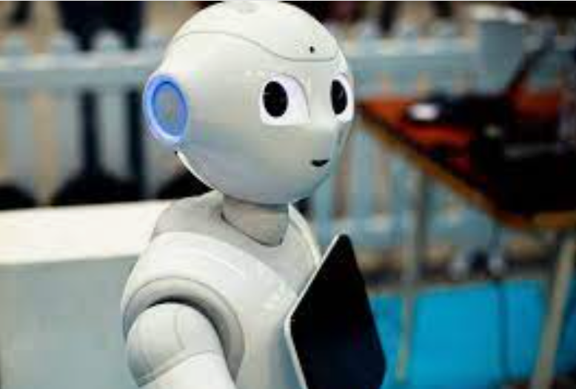
What can AI do?
Which of the following can be done at present?
Play a decent game of table tennis?
Play a decent game of Jeopardy, or any chess or card game?
Drive safely along a curving mountain road?
Drive safely along in the Michigan Avenue?
Buy a week's worth of groceries on the web?
Buy a week's worth of groceries at Costco?
Discover and prove a new mathematical theorem?
Converse successfully with another person for an hour?
Perform a surgical operation?
Translate spoken Chinese into spoken English in real time?
Fold the laundry and put away the dishes?
X Write an intentionally funny story?
Notes:
Mountain road example: https://www.wired.com/2010/11/audis-robotic-car-climbs-pikes-peak/

Slide 20
What can AI do? (cont.)
It often can do (can be made to do) what we human consider to be very difficulty tasks that require strong intelligence
E.g., play chess and GO
Require heavy computation in highly restricted environments
But it has great difficulty to do what we consider very easy
E.g., get a cup of water, change a lightbulb, etc.
Requires a lot of commonsense knowledge.

Slide 21
Future
We are doing AI…
To create intelligent systems
To improve our quality of life
The more intelligent, the better
To gain a better understanding of human intelligence
Unfortunately, the progress on this has been extremely slow.
To magnify those benefits that flow from it
Might help us avoid war and ecological catastrophes, achieve immortality and expand throughout the universe
What if we succeed?

Slide 22
It seems probable that once the machine thinking method had started, it would not take long to outstrip our feeble powers. … At some stage therefore we should have to expect the machines to take control

Slide 23
What’s bad about better AI?
AI that is incredibly good at achieving something other than what we really want.
AI, economics, statistics, operations research, control theory all assume utility to be fixed, known, and externally specified
Bad: Machines are intelligent to the extent that their actions can be expected to achieve their objectives.
Good: Machines are beneficial to the extent that their actions can be expected to achieve our objectives
???: What happens if machines become conscious?

Slide 24
A new model for AI
The machine’s only goal is to maximize the realization of human preferences.
The robot is initially uncertain about what those preferences are.
Human behaviors provides evidence about human preferences and the robot can learn from them.
Do we want AI to be emotional?

Slide 25
What topics are we going to study?
Solving problems by searching
Constraint satisfaction problem
Game playing
Propositional logic and reasoning
First-order logic and reasoning
Reasoning under uncertainty
Supervised learning: decision tree and naive Bayes
Supervised learning: linear regression and logistic regression
Supervised learning: neural networks and deep learning
Unsupervised learning
Advanced topic: Introduction to sentiment and emotion analysis
Advanced topic: Introduction to lifelong and continual learning

