Slide 1
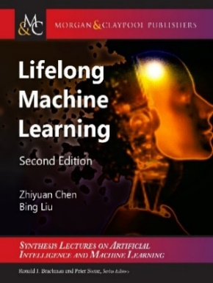
Lifelong and Continual Learning

Slide 2
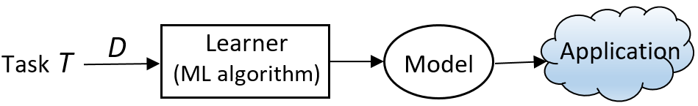
Introduction
Classic machine learning: Isolated single-task learning
Key weaknesses
Closed-world assumption: nothing new in testing / application
Model is fixed during application: no model revision/improvement in application
No knowledge accumulation: needs a large amount of labeled training data
Suitable for well-defined tasks in restricted environments
Chen and Liu. Lifelong machine learning. Morgan & Claypool. 2015, 2018

Slide 3
Outline
Lifelong or continual learning
Out-of-distribution detection
Continual learning
Learning on the job (after model deployment)
Continual learning dialogue systems
Summary

Slide 4

Classic definition of lifelong/continual learning (Thrun 1996, Silver et al 2013; Ruvolo and Eaton, 2013; Chen and Liu, 2014, 2018)
Learn a sequence of tasks, T₁, T₂, …, T_{N}, … incrementally. Each task t has a training dataset .
Goal: learn each new task T_{N+1} incrementally
without catastrophic forgetting: Learning of the new task T_{N+1} should not result in degradation of accuracy for any of previous N tasks.
with knowledge transfer: leveraging the knowledge learned from the previous tasks to learn the new task T_{N+1} better.
Assumption: Once a task is learned its data is no longer accessible, at least a majority of it, and both the task T_{N+1} and its training data D_{N+1} are given by the user, and

Slide 5
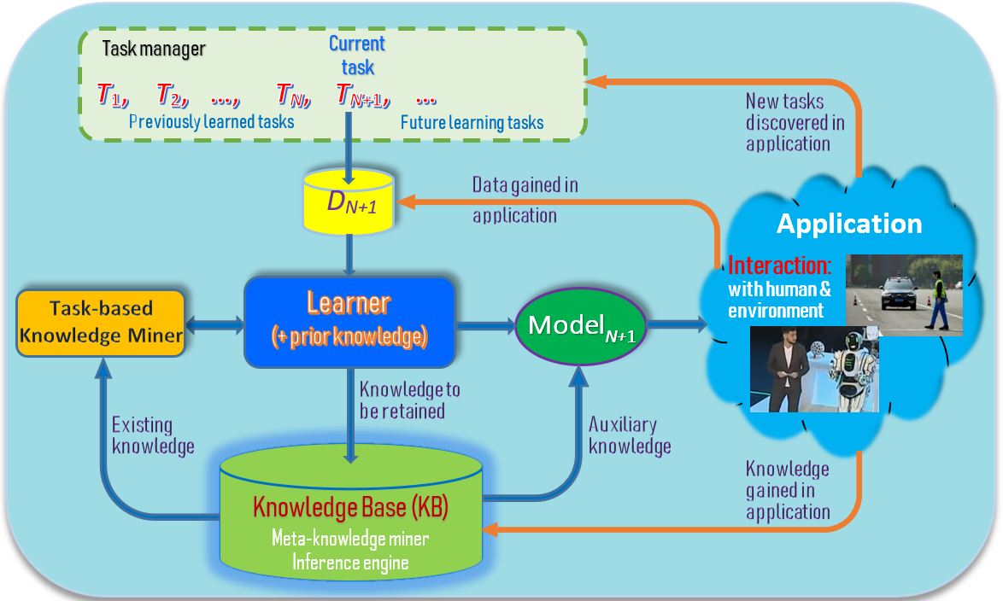
Lifelong/continual learning in the open world (Chen & Liu, 2018, Liu, 2020)
Liu. Learning on the Job: Online Lifelong and Continual Learning. AAAI-2020
Chen and Liu. Lifelong machine learning. Morgan & Claypool. 2015, 2018

Slide 6
Characteristics of open world continual learning (Chen and Liu, 2018, Liu, 2020)
Continuous and incremental learning process (no forgetting)
Knowledge transfer/adaptation (across tasks)
Knowledge accumulation in KB (long-term memory)
Learning on the job (after model deployment). Self-supervision using the accumulated knowledge and interaction with humans & environment.
Main steps:
Identify new tasks to learn (open-world learning or OOD detection)
Acquire ground-truth training data (collecting training data interactively)
Learn the tasks incrementally (continual learning)
Liu. Learning on the Job: Online Lifelong and Continual Learning. AAAI-2020
Liu and Mazumder. Lifelong and Continual Learning Dialogue Systems: Learning during Conversation. AAAI-2021
Notes:
These three characteristics make LML different from related learning tasks such as transfer learning, multi-task learning, online learning and so on.

Slide 7
Outline
Lifelong or continual learning
Out-of-distribution detection
Continual learning
Learning on the job (after model deployment)
Continual learning dialogue systems
Summary

Slide 8
Out-of-distribution (OOD) detection
There are many names, e.g.,
OOD detection
Open-world classification
Open set recognition
Novelty detection

Slide 9
Closed-world assumption and open-world (Fei et al, 2016; Shu et al., 2017)
Traditional machine learning:
Training data: D^{train} with class labels 𝑌^{train} = {𝑙₁, 𝑙₂, ..., 𝑙_{𝑡}}.
Test data: D^{test}, 𝑌^{test} ⊆ {𝑙₁, 𝑙₂, ..., 𝑙_{𝑡}}
Closed-world: 𝑌^{test} ⊆ 𝑌^{train}
Classes appeared in testing must have been seen in training, nothing new.
A system that is unable to identify anything new, it cannot learn by itself.
Open-world: 𝑌^{test} - 𝑌^{train} ≠ φ
There are unseen classes in the test data, out-of-distribution.
Fei, and Liu. Breaking the Closed World Assumption in Text Classification. NAACL-HLT 2016

Slide 10
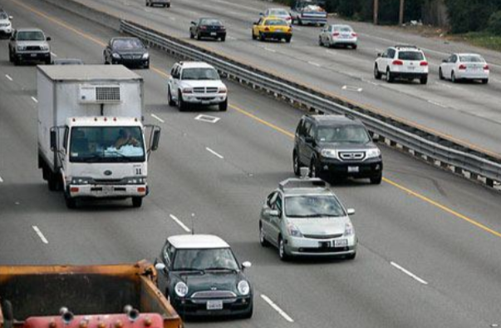
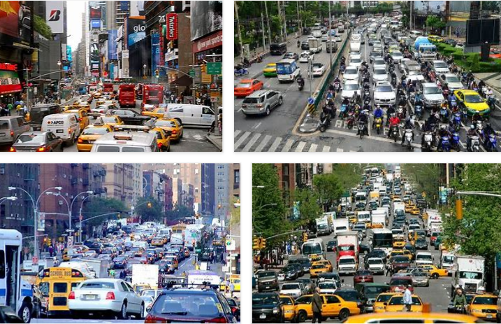
Self-driving cars need to learn continuously too
Self-driving cars cannot reach human-level of driving with only rules and off-line training.
Impossible to cover all corner cases
Real-world is full of unknowns.
Has to learn & adapt continuously in its interaction with humans and the environment by itself.
in the open world (changes & unknowns).
Chen and Liu. Lifelong machine learning. Morgan & Claypool. 2018

Slide 11
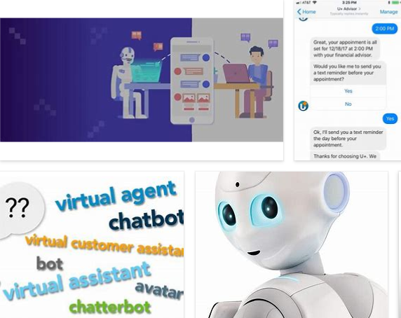
Chatbots need to learn continuously
A chatbot’s environment is highly dynamic & open.
What happens if the user says something that the chatbot cannot understand.
Hard to train the chatbot by its engineers forever.
Chatbot must learn during chatting
(learn from other sources)
Liu. Learning on the Job: Online Lifelong and Continual Learning. AAAI-2020

Slide 12
Outline
Lifelong or continual learning
Out-of-distribution detection
Continual learning
Learning on the job (after model deployment)
Continual learning dialogue systems
Summary

Slide 13
Continual learning (of a sequence of tasks)
All tasks are learned in a single neural network
Each task consists of a set of classes to be learned
Challenges: catastrophic forgetting and knowledge transfer
Class continual learning (Class-CL)
produce a single model from all tasks
classify all classes during testing
Task continual learning (Task-CL)
train a “separate” model for each task
task-id is provided during testing

Slide 14
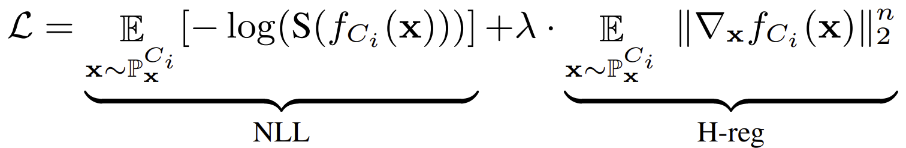
Class-continual learning (e.g., Hu et al. AAAI-2021)
Main cause of catastrophic forgetting (CF):
discriminative features for an early task may not be discriminative for a new task
to learn the new task well, features learned need to be updated, causing CF
PCL (Per class Continual Learning)
Each task can have one or more classes
PCL enables the learning algorithm to holistically consider the features of each class
Proposed a new regularization - holistic regularization (h-reg).
Hu, et al. Continual Learning by Using Information of Each Class Holistically. AAAI-2021

Slide 15
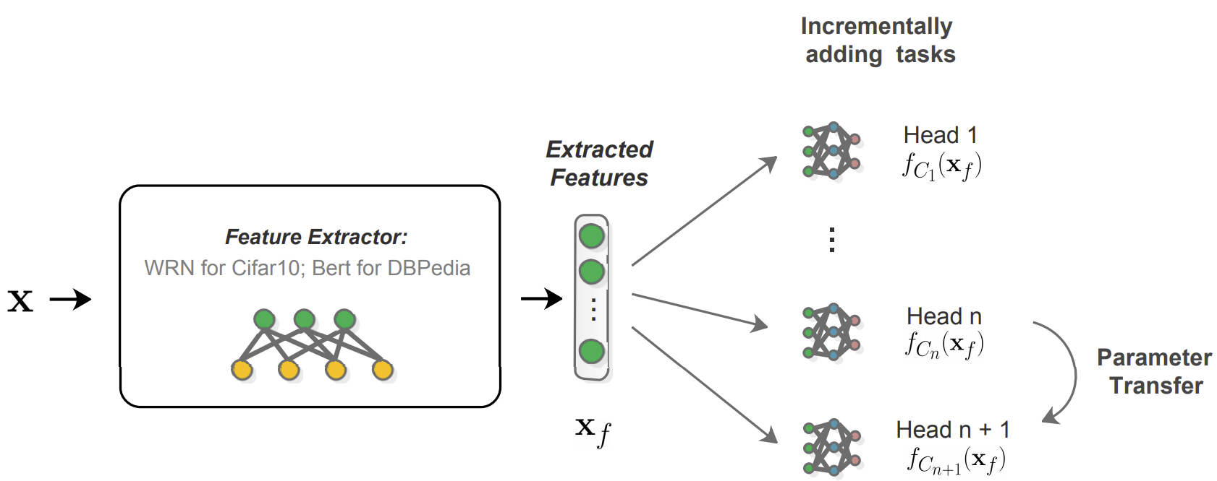
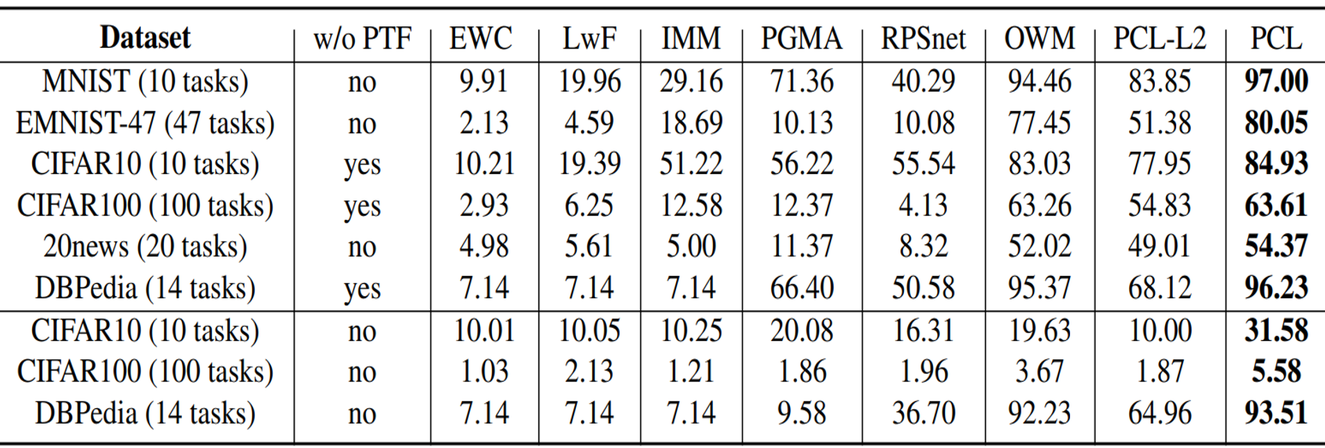
PCL architecture and results

Slide 16
Task continual learning (e.g., Ke, Liu and Huang, 2020)
Existing research mainly focused on overcoming CF.
Some works also addressed knowledge transfer
Leveraged the past knowledge to help learn the new task when tasks are similar and have shared knowledge.
Our goal: Achieve both Forgetting Avoidance and Knowledge Transfer at the same time
CAT (Continual learning with forgetting Avoidance and knowledge Transfer)
learn a mixed sequence of similar and dissimilar tasks
achieve both objectives.
Ke, Liu, and Huang. Continual Learning of a Mixed Sequence of Similar and Dissimilar Tasks. NeurIPS-2020

Slide 17
Main idea of CAT
For dissimilar tasks, Task Masks are trained to block all used/important neurons of the tasks
Encourage knowledge transfer among similar tasks by training attention.
Forward knowledge transfer (past knowledge helps new task)
Backward knowledge transfer (new data helps improve old tasks)
Automatically detect task similarity

Slide 18
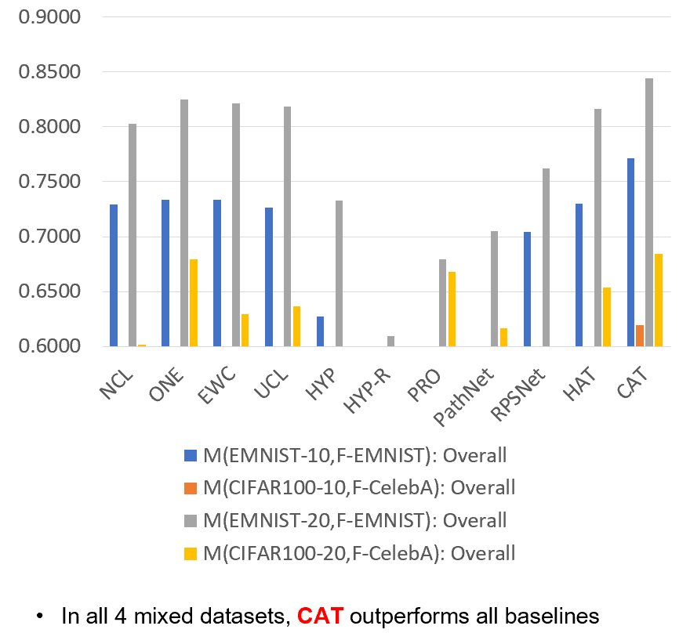
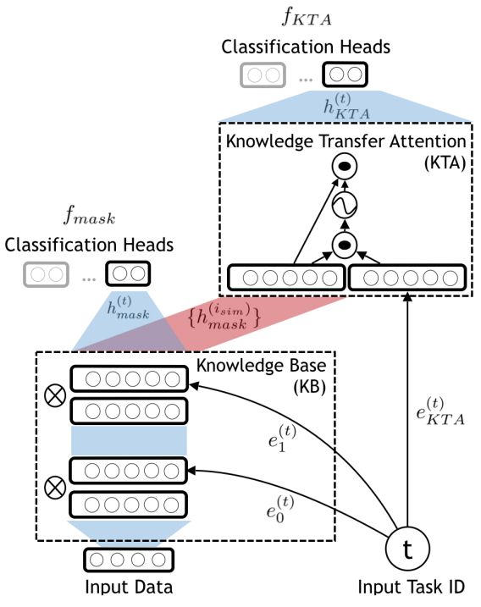
Model and results

Slide 19
Outline
Lifelong or continual learning
Out-of-distribution detection
Continual learning
Learning on the job (after model deployment)
Continual learning dialogue systems
Summary

Slide 20
Learning on the job (Liu, 2020, Chen and Liu, 2018)
It is known in learning science that about 70% of our human knowledge comes from ‘on-the-job’ learning.
Only about 10% through formal education or training
About 70% from on-the-job learning
The rest 20% through observation of others
AI agents should also learn on the job or during applications
the world is too complex and constantly changing.
Impossible to learn everything offline using manually labeled data
(1) Chen and Liu Lifelong machine learning, 2015, 2018. (2) Liu. Learning on the Job: Online Lifelong and Continual Learning. AAAI-2020

Slide 21
Learning on the job in the open-world (Fei et al, 2016; Shu et al., 2017)
Steps:
Discover novel instances: e.g., classify instances in D^{test} to 𝑌^{train} and detect novel instances D^{novel} ⊆ D^{test} belonging to L₀ – new tasks
Identify the unseen/new classes in D^{novel}, L₀ = {l_{t+1}, l_{t+2}, …} and gather training data
Interactive self-supervision: interaction with humans and the environment
Continual learning: Incrementally learn the new classes {l_{t+1}, l_{t+2}, …} (the new task)
Note: this does not include how the system should respond or react to novelty.
Fei, Wang, and Liu. Learning Cumulatively to Become More Knowledgeable. KDD-2016

Slide 22
Interactive self-supervision (Liu, 2020)
Identify new classes and training data by interacting with
Humans: through natural language, e.g.,
Self-drive cars: asking the passenger
What is that object? How do I drive now? Where should I stop?
Chatbots: learn new knowledge and learn language during chatting.
Environment: get feedback & use tools (e.g., search engines)
Need an internal evaluation system
to evaluate environmental feedback
To gather knowledge, and supervisory or reward information.
Liu. Learning on the Job: Online Lifelong and Continual Learning. AAAI-2020

Slide 23
Example - a greeting bot in a hotel (Chen and Liu, 2018; Liu et al., 2021)
See an existing guest.
Bot: “Hello John, how are you today?”
See a new guest - recognize he/she is new (OOD and create a new task)
Bot: “Welcome to our hotel! What is your name, sir?” (get class label)
Guest: “David” (got class label: David)
Bot learns to recognize David automatically
take pictures of David (get training data)
learn to recognize David (continual learning)
See David next time.
Bot: “Hello David, how are you today?” (use the new knowledge)
Liu, Robertson, Grigsby, and Mazumder. Self-Initiated Open World Learning for Autonomous AI Agents. arXiv:2110.11385, 2021.
Chen and Liu. Lifelong machine learning. Morgan & Claypool. 2015, 2018.

Slide 24
Example 2 – a chatbot system (Liu and Mazumder, 2021)
Session 1
User-1: Hey, I visited Stockholm last week. The place is awesome!
Chatbot: Where is Stockholm?
User-1: Stockholm is the capital of Sweden.
Session 2
User-2: I am planning to visit Europe next week.
Chatbot: Are you going Stockholm? I heard it is a very nice place.
Liu and Mazumder. Lifelong and Continual Learning Dialogue Systems: Learning during Conversation. AAAI-2021

Slide 25
Outline
Lifelong or continual learning
Out-of-distribution detection
Continual learning
Learning on the job (after model deployment)
Continual learning dialogue systems
Summary

Slide 26
Opportunities to learn in conversations
Extract knowledge directly from user utterances, e.g.,
User: Obama was born in Hawaii.
Agent extracts: (Obama, BornIn, Hawaii) – expressed in triples (h, r, t)
Actively ask user questions & expect correct answers, e.g.,
Agent: Where was Obama born?
User: Hawaii => (Obama, BornIn, Hawaii)
When the agent cannot understand a user utterance, it asks the user to rephrase or to select the right option.
When the agent cannot answer user questions, it asks the user for some supporting facts and then infers the answers.
We focus on this setting (which covers 1 and 2)
Liu and Mazumder. Lifelong and Continual Learning Dialogue Systems: Learning during Conversation. AAAI-2021

Slide 27
Example: natural language interface (NLI)
An application-independent approach to building task-oriented chatbots with interactive continual learning.
Based on natural language to natural language matching (NL2NL)
Our system CML builds NLIs for API-driven applications semi-automatically.
To build a new NLI (or add a new skill to an existing NLI),
The application developer only needs to write a set S_{i} of seed commands (SCs) in NL to represent each action i.
SCs in S_{i} are just like paraphrased NL commands from users to invoke i, but the objects to be acted upon in each SC are replaced with variables, the arguments of i.
An interactive learning mechanism to enable CML to continually learn new (paraphrased) SCs from users.
Mazumder, Liu, Wang, and Esmaeilpour. An Application-Independent Approach to Building Task-Oriented Chatbots with Interactive Continual Learning.
NeurIPS-2020 Workshop on Human in the Loop Dialogue Systems (HLDS-2020)

Slide 28
An example
Microsoft Paint tool: The API action
drawCircle(X1, X2)
drawing a circle having color X1 at coordinate X2 .
Let an SC be “draw an X1 circle at X2" for this API,
where X1 and X2 are variables representing the arguments of the API.
User command: “draw a blue circle at (20, 40)”
It can be matched or grounded to this SC, where the grounded API arguments are X1 = ‘blue’ and X2 = (20, 40).

Slide 29
CML has three components
SC (seed command) specification
to enable the application developer to specify a set of SCs for each of their APIs
Command grounding module
ground a user command C to an action SC by matching C with the correct SC (whose associated action API is then executed)
Interactive learner
It interacts with end-users to learn new SCs and paraphrases of API argument values.

Slide 30
Continual interactive learning
If CML does not understand a user commend C.
CML learns a new SC from the user command C through interactive dialogue
It also learns new paraphrased argument values from in C to improve repheaser R over time.

Slide 31
Outline
Lifelong or continual learning
Out-of-distribution detection
Continual learning
Learning on the job (after model deployment)
Continual learning dialogue systems
Summary

Slide 32
Summary
Classic ML: isolated, closed-world, single-task learning
AI agents must learn continuously in the open world, i.e.,
Learning on the job (Chen and Liu, 2018; Liu, 2020)
Detect new things and learn them with
self-motivation & self-supervision
Interactive self-supervision: need to interact with humans and the environment
E.g., self-driving cars and chatbots need such capabilities.
Current techniques are still in their infancy.
Novel learning algorithms or paradigm shifts may be needed.

