Slide 1
Solving Problems by Searching
Many slides are borrowed from Vincent Conitzer and Qiangfu Zhao

Slide 2
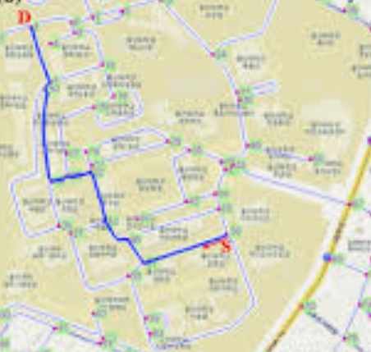
Application: route finding
Objective:
  shortest? fastest? most scenic?
Actions:
  go straight, turn left, turn right

Slide 3
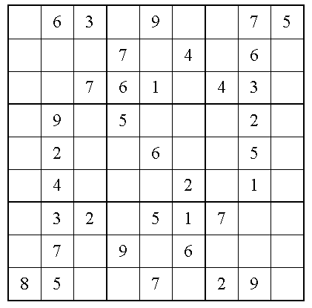
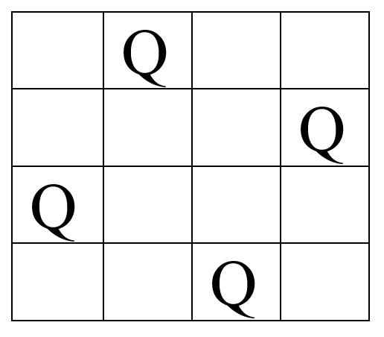
Application: solving puzzles
N-queens problem
Objective: reach a certain configuration
Sudoku

Slide 4
Outline
Search problem
Uninformed search without cost
Uninformed search with cost
Informed search
Summary

Slide 5
Search problem
State space: Set of states that we can be in
  Including an initial/start state…
  … and goal/end states (equivalently, a goal test)
For every state, a set of actions that we can take
  Each action results in a new state
  Typically defined by a successor function
    Given a state, produces all states that can be reached from it (aka., state expansion)
Cost function: determines the cost of each action (or path = sequence of actions)
Solution: path from initial state to a goal state
  Optimal solution: solution with minimal cost

Slide 6
A simple example: searching for a solution
We have the following state space graph
2
C
B
9
2
3
E
start state
A
3
D
goal state

Slide 7
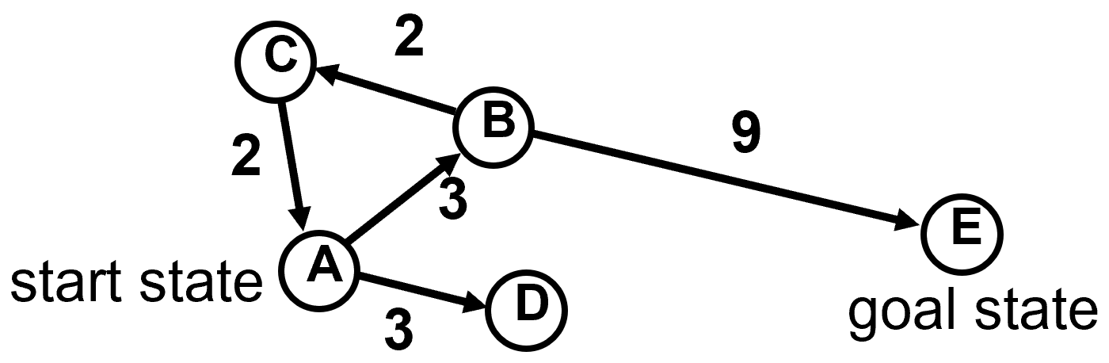
A possible search tree
Start state
state = A,
cost = 0
state = B,
cost = 3
state = D,
cost = 3
state = C,
cost = 5
state = E,
cost = 12
goal state!
state = A,
cost = 7

Slide 8
8-puzzle
1 |  | 2
4 | 5 | 3
7 | 8 | 6
1 | 2 | 3
4 | 5 | 6
7 | 8
Initial state
goal state

Slide 9
8-puzzle
1 |  | 2
4 | 5 | 3
7 | 8 | 6
1 | 2
4 | 5 | 3
7 | 8 | 6
 | 1 | 2
4 | 5 | 3
7 | 8 | 6
1 | 5 | 2
4 |  | 3
7 | 8 | 6
What is below each node?
Expand the tree.

Slide 10
Generic search algorithm
Fringe (frontier) = set of nodes generated but not expanded
fringe := {initial state}
loop:
  if fringe empty, declare failure
  choose and remove a node v from fringe
  check if v’s state s is a goal state; if so, declare success
  if not, expand v, insert resulting nodes into fringe
Key question in search: Which of the generated nodes/states do we expand next?

Slide 11
Outline
Search problem
Uninformed search without cost
Uninformed search with cost
Informed search
Summary

Slide 12
Uninformed search
Given a state, we only know whether it is a goal state or not
Cannot say one non-goal state looks better than another non-goal state
Can only traverse state space blindly in hope of somehow hitting a goal state at some point
  Also called blind search
  Blind does not imply unsystematic!

Slide 13
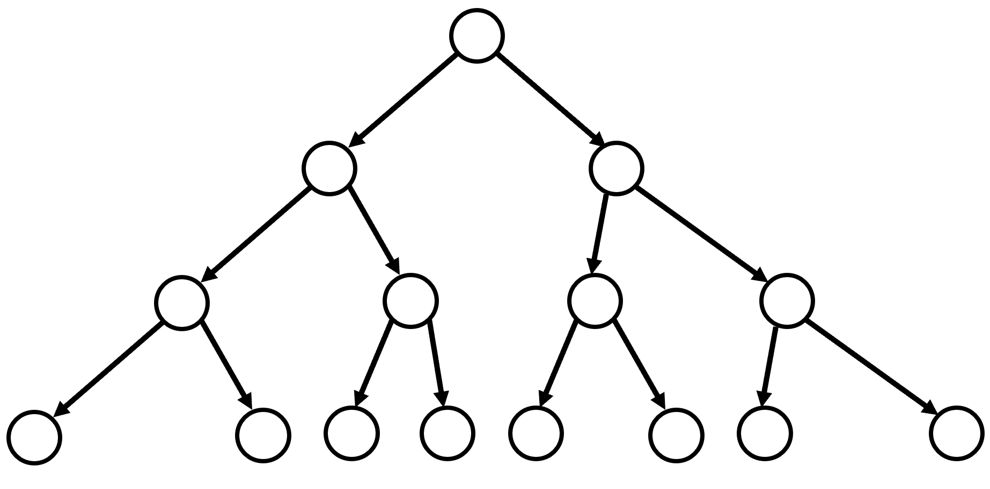


Breadth-first search (BFS)
Idea: explore all nodes in order of increasing depth.

Slide 14
Properties of breadth-first search
Nodes are expanded in the same order in which they are generated
  Fringe can be maintained as a First-In-First-Out (FIFO) queue
  BFS is complete: if a solution exists, one will be found
BFS finds a shallowest solution
  Not necessarily an optimal solution
If every node has b successors (the branching factor), first solution is at depth d, then fringe size will be at least b^{d} at some point
  Space: O(b^{d})
  Time: O(b^{d})

Slide 15
Breath-first search: First-In-First-Out (FIFO)
let Q be a queue and s be the start node // Q is our frontier
mark s as explored
Q.enqueue(s)
while Q is not empty do
v := Q.dequeue()
if IsGoal(v) then
return v
for each edge from v to w in Descendent(v) do
if w is not mark as explored then
mark w as explored
Q.enqueue(w)

Slide 16

Depth-first search (DFS) (Backtrack Search)
Idea: go as deep as possible and then backtrack + stop when find the first goal state.

Slide 17
Implementing depth-first search
Fringe can be maintained as a Last-In-First-Out (LIFO) queue (aka. a stack)
Also, easy to implement recursively:
DFS(v)
If IsGoal(v) then return solution(v)
mark v as explored
for each edge from v to w in Descendants(v) do
if w is not marked as explored then DFS(w)
return failure

Slide 18
Properties of depth-first search
If solution found, generally not optimal/shallowest
If b successors (or actions, or the branching factor) per state, maximum depth is d actions:
  Space: still O(d)
  Time: still O(b^{d}) worst case, but could be much better if solutions are easy to find
    b^{d} + b^{d-1} + … + 1 (for b >1, O(b^{D}))
  Inevitable for uninformed search methods

Slide 19
Combining good properties of BFS and DFS
Limited depth DFS: like DFS, except never go deeper than some depth d
Iterative deepening DFS:
  Call limited depth DFS with depth 0;
  If unsuccessful, call with depth 1;
  If unsuccessful, call with depth 2;
  Etc.
Complete, finds shallowest solution
Space requirements of DFS
May seem wasteful timewise due to duplicate effort
  Really not that wasteful because almost all effort at deepest level
  db + (d-1)b² + (d-2)b³ + ... + 1b^{d} is O(b^{d}) for b > 1

Slide 20
Outline
Search problem
Uninformed search without cost
Uninformed search with cost
Informed search
Summary

Slide 21
Let us consider cost – uniform-cost search
BFS finds shallowest solution because always works on shallowest nodes first
Similar idea: always work on the lowest-cost node first (uniform-cost search)
Will find optimal solution (assuming costs increase by at least constant amount along path)
Will often pursue lots of short steps first
Similar memory problems as BFS as we need to keep the whole frontier
  But depending on problems.

Slide 22
Dijkstra’s algorithm
Find a shortest path between two nodes
Add s_{start} to frontier (priority queue) // frontier is fringe (a.k.a, open-list)
Repeat until frontier is empty:
Remove s with smallest cost p from frontier
If IsGoal(s) then return solution
Add s to explored // explored: a.k.a, closed-list
For each action a ∈ Actions(s) do
Get successor s’ ← Succ(s, a)
If s’ already in explored then do-nothing
else Update frontier with s’ and cost p + Cost(s, a)

Slide 23
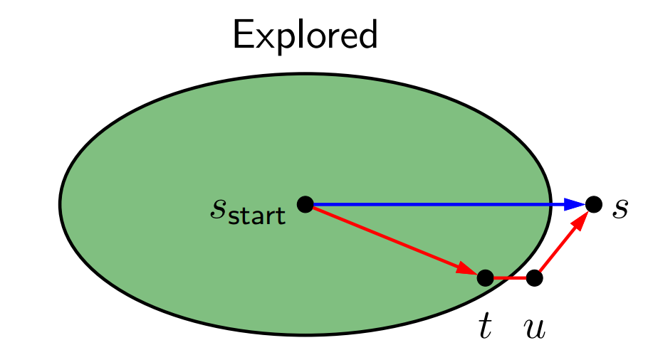
Correctness of Dijkstra’s algorithm
Theorem: correctness
  When a state s is popped from the frontier and moved to explored, its cost PastCost(s) is the minimum cost to s from s_{start}.
  It is assumed that all costs are non-negative.
Proof: (by contradiction)
  We assume that the statement is false..

Slide 24
Prove by contradiction
Let s be the first node that was added to explored and its cost PastCost(s) is greater than the cost of the shortest path to s.
  This implies that any node x added to explored before s has the short path, i.e., PastCost(x) is the lowest.
Let us look at the moment when s was popped from frontier but not yet added to explored.
  There must be a shortest path that passes a node t in explored to reach s and t’s descendent u that is in frontier with the cost PastCost(t) + Cost(t, u)
  Since both s and u are in frontier and s was popped instead of u, it means that PastCost(s) <= PastCost(t) + Cost(t, u): a contradiction.

Slide 25
What is Dijkstra’s algorithm doing?
S_{end}
S_{start}

Slide 26
Depth-first search with branch and bound (DFBB)
DFBB also called backtracking search with branch and bound
DFBB is DFS in which upon finding a solution, the algorithm updates current best solution.
DFBB does not explore paths that are guaranteed to lead to solutions worse than current best solution (bound).
On termination, the current best solution is a globally optimal solution.

Slide 27
An example: v₀ is the start and v₃ is the goal
v_{1,1}
₅
v_{2,1}
₁
₃
₄
₄
₃
₃
₁
v₀
v₀
v_{1,2}
v_{2,2}
v₃
₁
₁
₂
₂
₃
v_{1,3}
₁
v_{2,3}
v_{1,2}
v_{1,3}
₇
v_{1,1}
₅
₃
₄
₃
₁
₇
v_{2,1}
v_{2,3}
v_{2,1}
v_{2,2}
v_{2,2}
v_{2,3}
₄
₁
₄
₁
₁
₁
v₃
v₃
v₃
v₃
v₃
v₃

Slide 28
Solved by branch-and-bound (hill-climbing with bounds)
v₀
Notice the search order, which is hill-climbing
₁
₂
₃
v_{1,1}
v_{1,2}
v_{1,3}
₅
₃
₄
₃
₁
₇
v_{2,1}
v_{2,3}
v_{2,1}
v_{2,2}
v_{2,2}
v_{2,3}
_{X>6}
₁
_{X>7}
_{X>6}
₁
_{X>9}
v₃
v₃
_{Cost = 5}
a feasible solution found, which serves as an upper bound of the optimal solution!
_{Cost = 4*}
_{a better solution}

Slide 29
Searching backwards from the goal
Because predecessor branching factor can be smaller than successor branching factor, if finding predecessors is possible.
Stacking blocks:
  only action is to add something to the stack
A
B
A
B
C
C
In hand: A, B, C
In hand: nothing
Start state
Goal state

Slide 30
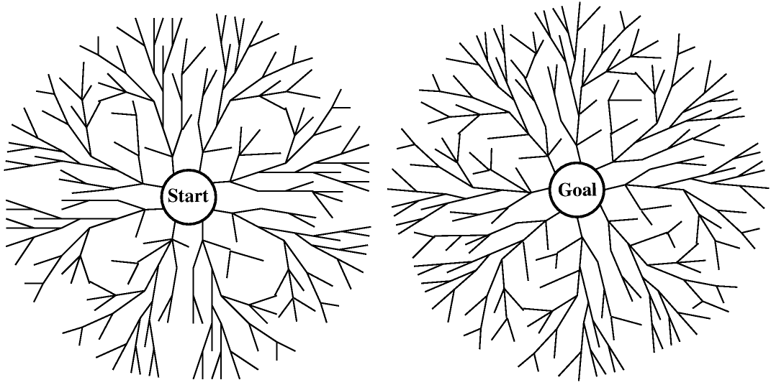
Bidirectional search
Even better: search from both the start and the goal, in parallel.
If the shallowest solution has depth d and branching factor is b on both sides, requires only O(b^{d/2}) nodes to be explored!

Slide 31
Making bidirectional search work
Need to be able to figure out whether the fringes intersect
Other than that, can do various kinds of search on either tree, and get the corresponding optimality etc. guarantees.
Not possible (feasible) if backwards search not possible (feasible)
  Hard to compute predecessors
  High predecessor branching factor
  Too many goal states

Slide 32
Outline
Search problem
Uninformed search without cost
Uninformed search with cost
Informed search
Summary

Slide 33
Informed search
So far, we have assumed that no non-goal state looks better than another
Unrealistic
  Even without knowing the road structure, some locations seem closer to the goal than others
  Some states of the 8-puzzle seem closer to the goal than others
Makes sense to expand closer-seeming nodes first.

Slide 34
Best-first search
This is a very general approach, in which we choose a node, n, with minimum value of some evaluation function f(n), which is usually a heuristic function.
Depending on f(n), we can have different best search algorithms.

Slide 35
A best-first search algorithm
Step 1: Put the start node s and its heuristic value f(s) to frontier.
Step 2: Take the node n (with best f(n)) from the top of the frontier list. If frontier is empty, stop with failure. If n is a goal node, stop with success.
Step 3: Expand n and get a set S of child nodes. Add n to explored.
Step 4: For each n’ in S but not in the explored list, estimate its heuristic value f(n’). If n’ is not in frontier, put n’ along with the edge (n,n’) and f(n’) into frontier; otherwise, if f(n’) is smaller than the old value f(n’), update n’ with the new edge and the new heuristic value.
Step 5: Sort nodes in frontier according to the heuristic values of the nodes and return to Step 2.

Slide 36
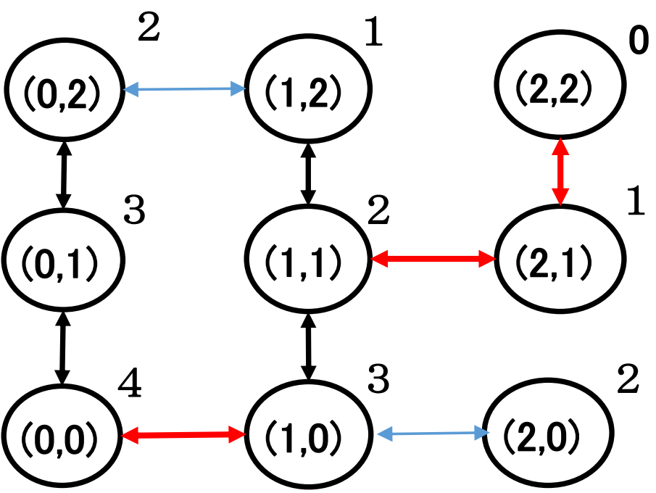
An example
Start node= (0,0) and goal node = (2,2)
 | Frontier | Explored
0 | {(0,0),4} | --
1 | {(1,0),3} {(0,1),3} | (0,0)
2 | {(2,0),2} {(1,1),2} {(0,1),3} | (0,0) (1,0)
3 | {(1,1),2} {(0,1),3} | (0,0) (1,0) (2,0)
4 | {(2,1),1} {(1,2),1} {(0,1),3} | (0,0) (1,0) (2,0) (1,1)
5 | {(2,2),0} {(1,2),1} {(0,1),3} | (0,0) (1,0) (2,0) (1,1) (2,1)
6 | (2,2) = goal node | (0,0) (1,0) (2,0) (1,1) (2,1)

Slide 37
Heuristics
Key notion: heuristic function h(n) gives an estimate of the distance from n to the goal
  h(n) = 0 for goal nodes
  E.g., straight-line distance for traveling problem
Say: h(A) = 9, h(B) = 8, h(C) = 9, h(D) = 6, h(E) = 3, h(F) = 0
  We’re adding something new to the problem!
We can use heuristic to decide which nodes to expand first
C
2
B
9
2
3
F
goal state
start state
A
E
4
3
D
4

Slide 38
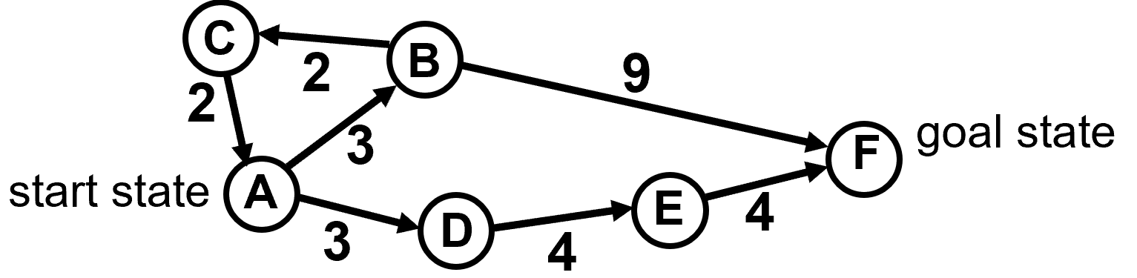
Greedy best-first search
Greedy best-first search: expand nodes with lowest h values first, e.g., f(n) = h(n).
  Recall: h(A) = 9, h(B) = 8, h(C) = 9, h(D) = 6, h(E) = 3, h(F) = 0
Rapidly finds the optimal solution!
Does it always?
start state
state = A,
cost = 0, h = 9
state = B,
cost = 3, h = 8
state = D,
cost = 3, h = 6
state = E,
cost = 7, h = 3
state = F,
cost = 11, h = 0
goal state!

Slide 39

A bad example of greedy best-first search
Say: h(A) = 9, h(B) = 5, h(D) = 6, h(E) = 3, h(F) = 0
Problem: greedy evaluates the promise of a node only by how far is left to go, i.e., h(n), but does not take the cost occurred already into account.
B
7
6
goal state
start state
F
A
D
E
4
3
4

Slide 40

A* search
Let g(n) be cost incurred already on path to n
Expand nodes with lowest f(n) = g(n) + h(n) first
Say: h(A) = 9, h(B) = 5, h(D) = 6, h(E) = 3, h(F) = 0
  Note: if h=0 everywhere, then just uniform cost search
But there is a condition!
B
7
6
goal state
start state
F
A
D
E
4
3
4

Slide 41
Admissibility
A heuristic h(n) is admissible if it never overestimates the distance/cost to the goal, i.e.,
  0 ≤ h(n) ≤ h*(n),
    where h*(n) is the optimal cost from node n to the goal.
  E.g., in route finding, straight-line distance is admissible because we cannot hope for anything better than a straight road to the goal.
Optimality of A*
  If the heuristic h(n) is admissible, A* is optimal (in the sense that it will never return a suboptimal solution).

Slide 42
A* algorithm
Step 1: Put the start node s and its heuristic value h(s) to frontier.
Step 2: Take the node n from the top of the frontier list. If frontier is empty, stop with failure. If n is the goal node, stop with success.
Step 3: Expand n and get a set S of child nodes. Add n to explored.
Step 4: For each n’ in S, find its cost
f(n’) = f(n) + c(n, n’) + [h(𝑥’) − h(n)] (or f(n’) = g(n) + c(n, n’) + h(n’)
  If n’ is in the explored list but the new cost f(n’) is smaller than the old one, move n’ to the frontier list and update the edge (n,n’) and the cost.
  Elseif n’ is in frontier, but the new cost f(n’) is smaller than the old one, update the edge (n,n’) and the cost.
  Else (if x’ is not in frontier nor in explored) put x’ along with the edge (n,n’) and the cost f(n’) to frontier.
Step 5: Sort nodes in frontier according to f(.) of the nodes and return to Step 2.

Slide 43
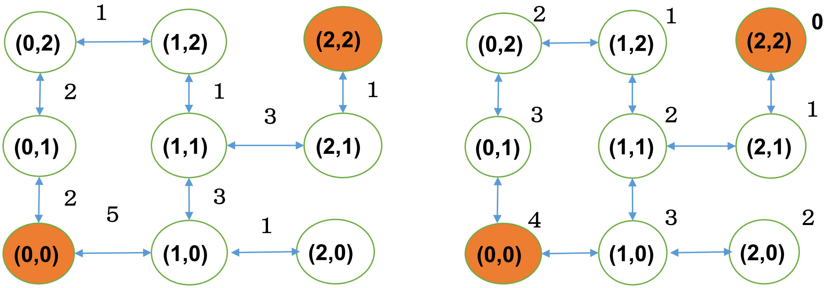
Example
True cost
Estimated cost
 | Frontier | Explored
0 | {(0,0), 4}
1 | {(0,1),5} {(1,0),8} | {(0,0),4}
2 | {(0,2),6} {(1,0),8} | {(0,0),4} {(0,1),5}
3 | {(1,2),6} {(1,0),8} | {(0,0),4} {(0,1),5} {(0,2),6}
4 | {(1,0),8} {(1,1),8} | {(0,0),4} {(0,1),5} {(0,2),6} {(1,2),6}}
5 | {(1,1),8} {(2,0),8} | {(0,0),4} {(0,1),5} {(0,2),6} {(1,2),6}} {(1,0),8}
6 | {(2,0),8} {(2,1),10} | {(0,0),4} {(0,1),5} {(0,2),6} {(1,2),6}} {(1,0),8} {(1,1),8}
7 | {(2,1),10} | {(0,0),4} {(0,1),5} {(0,2),6} {(1,2),6}} {(1,0),8} {(1,1),8} {(2,0),8}
8 | {(2,2),10} | {(0,0),4} {(0,1),5} {(0,2),6} {(1,2),6}} {(1,0),8} {(1,1),8} {(2,0),8} {(2,1),10}
9 | (2,2)=goal node | {(0,0),4} {(0,1),5} {(0,2),6} {(1,2),6}} {(1,0),8} {(1,1),8} {(2,0),8} {(2,1),10}

Slide 44
Compare Dijkstra’s algorithm and A*
Dijkstra’s algorithm is a special case of A* with f(n) = g(n) with h(n) = 0
A*
Dijkstra’s algo
S_{end}
S_{start}

Slide 45
Optimality of A*: Proof by contradiction
Suppose the optimal path has the cost of C*, but the algorithm returns a path with cost C > C*. Then, there must be some node n which is on the optimal path and is not expanded (because if all the nodes on the optimal path has been expanded, then we would have returned that optimal solution).
Let g*(n) be the cost of the optimal path from start to n and h*(n) the cost of optimal path from n to nearest goal, we have
  (1) f(n) > C* (otherwise n would have been expanded).
  (2) f(n) = g(n) + h(n) (by definition)
  (3) f(n) = g*(n) + h(n) (because n is on the optimal path)
  (4) f(n) ≤ g*(n) + h*(n) (because of admissibility, h(n) ≤ h*(n))
  (5) f(n) ≤ C* (by definition C* = g*(n) + h*(n))
(1) and (5) form a contradiction.

Slide 46
A* and repeated states – consistent heuristic
Suppose we try to avoid repeated states (in and out of frontier multiple times)
Ideally, the second (or third, …) time that we reach a state the cost is at least as high as the first time
  Otherwise, have to update everything that came after
This is guaranteed if the heuristic is consistent (or monotone):
  h(n) ≤ h(n’) + c(n, n’), where n’ is a child of n and c(n, n’) is the cost from n to n’. Similar to triangle inequality.
  Consistency implies admissibility (proof by induction of distance from the goal state).

Slide 47
Monotonicity property of consistent h
Theorem: If h(n) is consistent, f along any path is non-decreasing.
Let n’ be a child of n. If h is consistent, we have
f(n') = g(n') + h(n')
= g(n) + c(n, n') + h(n')
≥ g(n) + h(n)
= f(n)
We leave the proof of the following corollary to homework
  Corollary: the f values seen/expanded by A* are non-decreasing.
Theorem: A* guided by a consistent heuristic h finds optimal paths to all expanded nodes, i.e., g(n) = g*(n) for any explored n.

Slide 48
Proof
Suppose n and n’ correspond to same state, n’ is cheaper to reach, but n is expanded first. Then,
  n’ cannot have been in the frontier when n was expanded because g(n’) < g(n), so g(n’) + h(n’) < g(n) + h(n) (1) (because h(n’) = h(n))
So, n’ is generated (eventually) from some other node n’’ currently in the frontier, after n is expanded
  g(n) + h(n) ≤ g(n’’) + h(n’’) (2) (because n was expanded before n’’)
Combining (1) and (2), we get
  g(n’) + h(n’) < g(n’’) + h(n’’), which means f(n’) < f(n’’).
  It contradicts the monotonicity property: f(n’) ≥ f(n’’) (because n’ is after n’’)

Slide 49
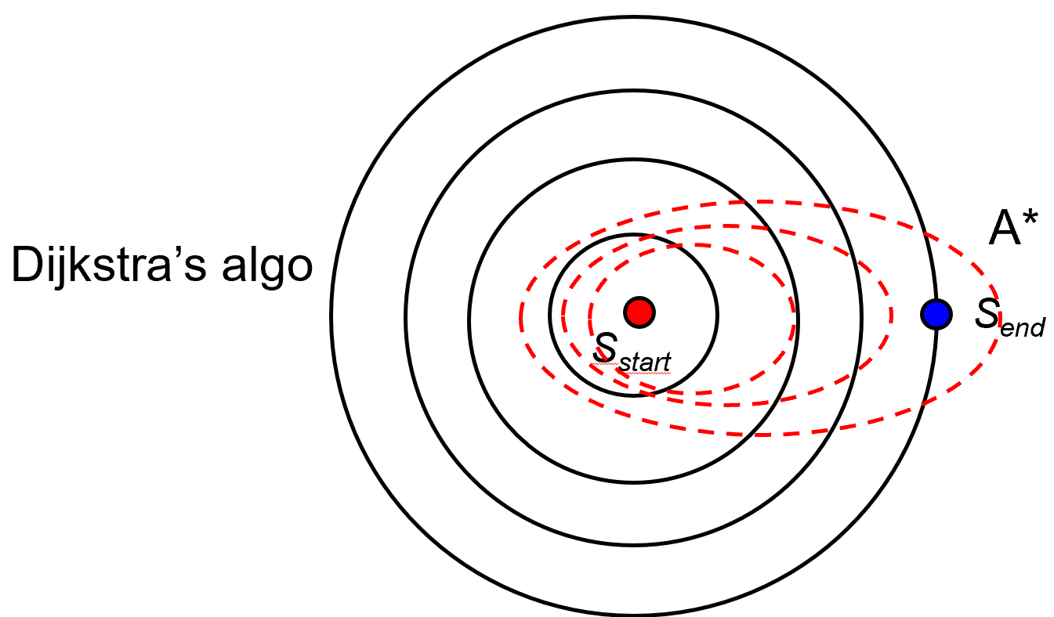
Iterative Deepening A*
One big drawback of A* is the space requirement: similar problems as uniform cost search, BFS
Limited-cost depth-first A*: some cost cutoff c, any node with g(n)+h(n) > c is not expanded, otherwise DFS
  IDA* gradually increases the cutoff (like iterative-deepening search to depth-first search)
    Cutoff for the next iteration is the min of those
    f values exceeded the current cutoff
Can require lots of iterations
  Trading off space and time

Slide 50
More about heuristics
1 |  | 2
4 | 5 | 3
7 | 8 | 6
One heuristic: number of misplaced tiles
Another: sum of Manhattan distances of tiles to their goal location
  Manhattan distance = number of moves required if no other tiles are in the way
Admissible? Which is better?
Admissible heuristic h1 dominates admissible heuristic h2 if h1(n) ≥ h2(n) for all n
  Will result in fewer node expansions
“Best” heuristic of all: solve the remainder of the problem optimally with search (not achievable normally)
  Need to worry about computation time of heuristics

Slide 51
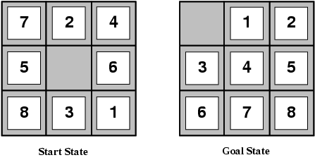
Comparing two heuristics for 8-puzzle
h₁(n) = number of misplaced tiles
h₂(n) = total Manhattan distance (i.e., no. of squares from desired location of each tile)
h1(S) = 8
h2(S) = 3+1+2+2+2+3+3+2 = 18
The true cost is 26.
Average cost for 8-puzzle is 22. Branching degree 3.

Slide 52
Designing heuristics
One strategy for designing heuristics: relax the problem (make it easier)
  “Number of misplaced tiles” heuristic corresponds to relaxed problem where tiles can jump to any location, even if something else is already there
  “Sum of Manhattan distances” corresponds to relaxed problem where multiple tiles can occupy the same spot
Another relaxed problem: only move 1, 2, 3, 4 into correct locations
The ideal relaxed problem is
  easy to solve,
  not much cheaper to solve than original problem

Slide 53
Outline
Search problem
Uninformed search without cost
Uninformed search with cost
Informed search
Summary

Slide 54
Summary
Uninformed search is seldomly used in practice, but it forms the base for informed search.
  One of the most well-known informed search algorithms is A*.
A* is cost-optimal given the admissible heuristic h(n)
  But A* can use lots of memory.
    In principle: O(number of states)
Dijkstra’s algorithm is a special case of A* with
  f(n) = g(n) + h(n) with h(n) = 0.
Next, we consider constraints because most practical search problems have constraints that must be satisfied.

