Slide 1
Adversarial Search and Games

Slide 2
Outline
History and overview
Minimax for zero-sum games
Alpha-Beta pruning
Monte Carlo tree search
Summary

Slide 3
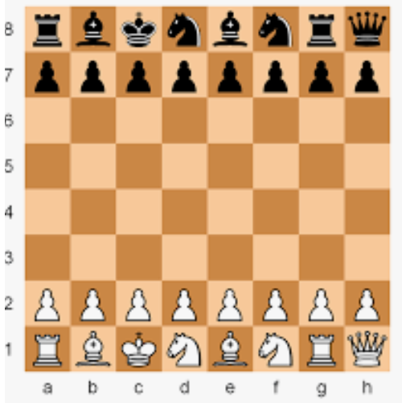
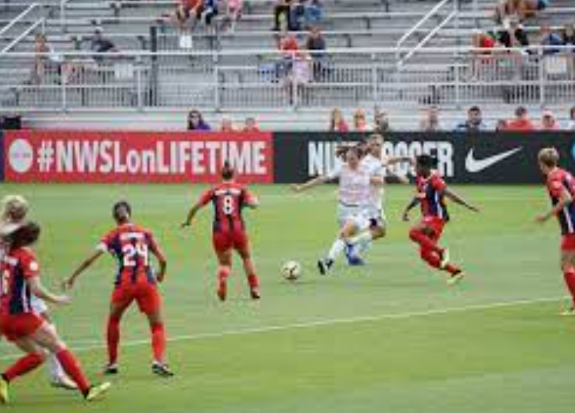
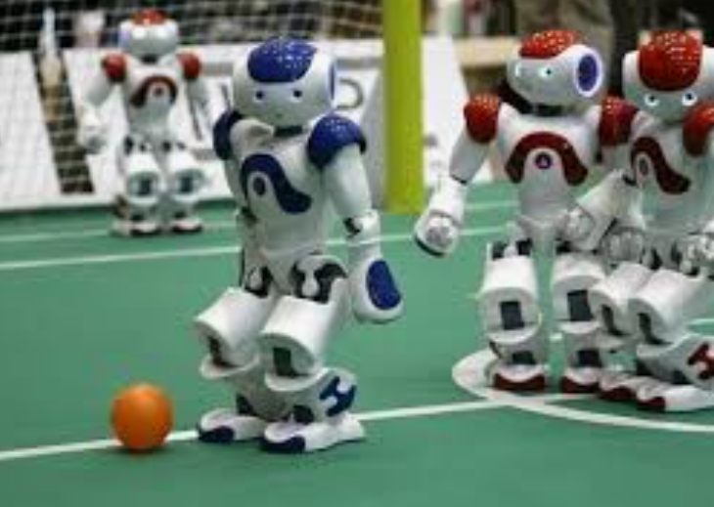
AI’s interest in games
We often regard those people who can play board or card games well as highly intelligent.
Such games have clear rules:
The state of a game is easy to represent
There are usually only a few actions
Computers have beaten humans!
Those physical games (e.g., soccer) are chaotic.
Their rules are hard to describe, and they have many actions
They often require more than one type of intelligence, e.g., vision, reasoning, performing physical actions, etc.,
Computers are still very far behind humans

Slide 4
A brief history
Computer programs have become “trainers” of human players!
Checkers:
1950: First computer player.
1959: Samuel’s self-taught program.
1994: First computer world champion: Chinook defeats Tinsley
2007: Checkers solved! Endgame database of 39 trillion states
Chess:
1945-1960: Zuse, Wiener, Shannon, Turing, Newell & Simon, McCarthy.
1960s onward: gradual improvement under “standard model”
1997: Deep Blue defeats human champion Gary Kasparov
2021: Stockfish rating 3551 (vs 2870 for Magnus Carlsen).
Go:
1968: Zobrist’s program plays legal Go, barely (b>300!)
1968-2005: various ad hoc approaches tried, novice level
2005-2014: Monte Carlo tree search -> strong amateur
2016-2017: AlphaGo defeats human world champions

Slide 5
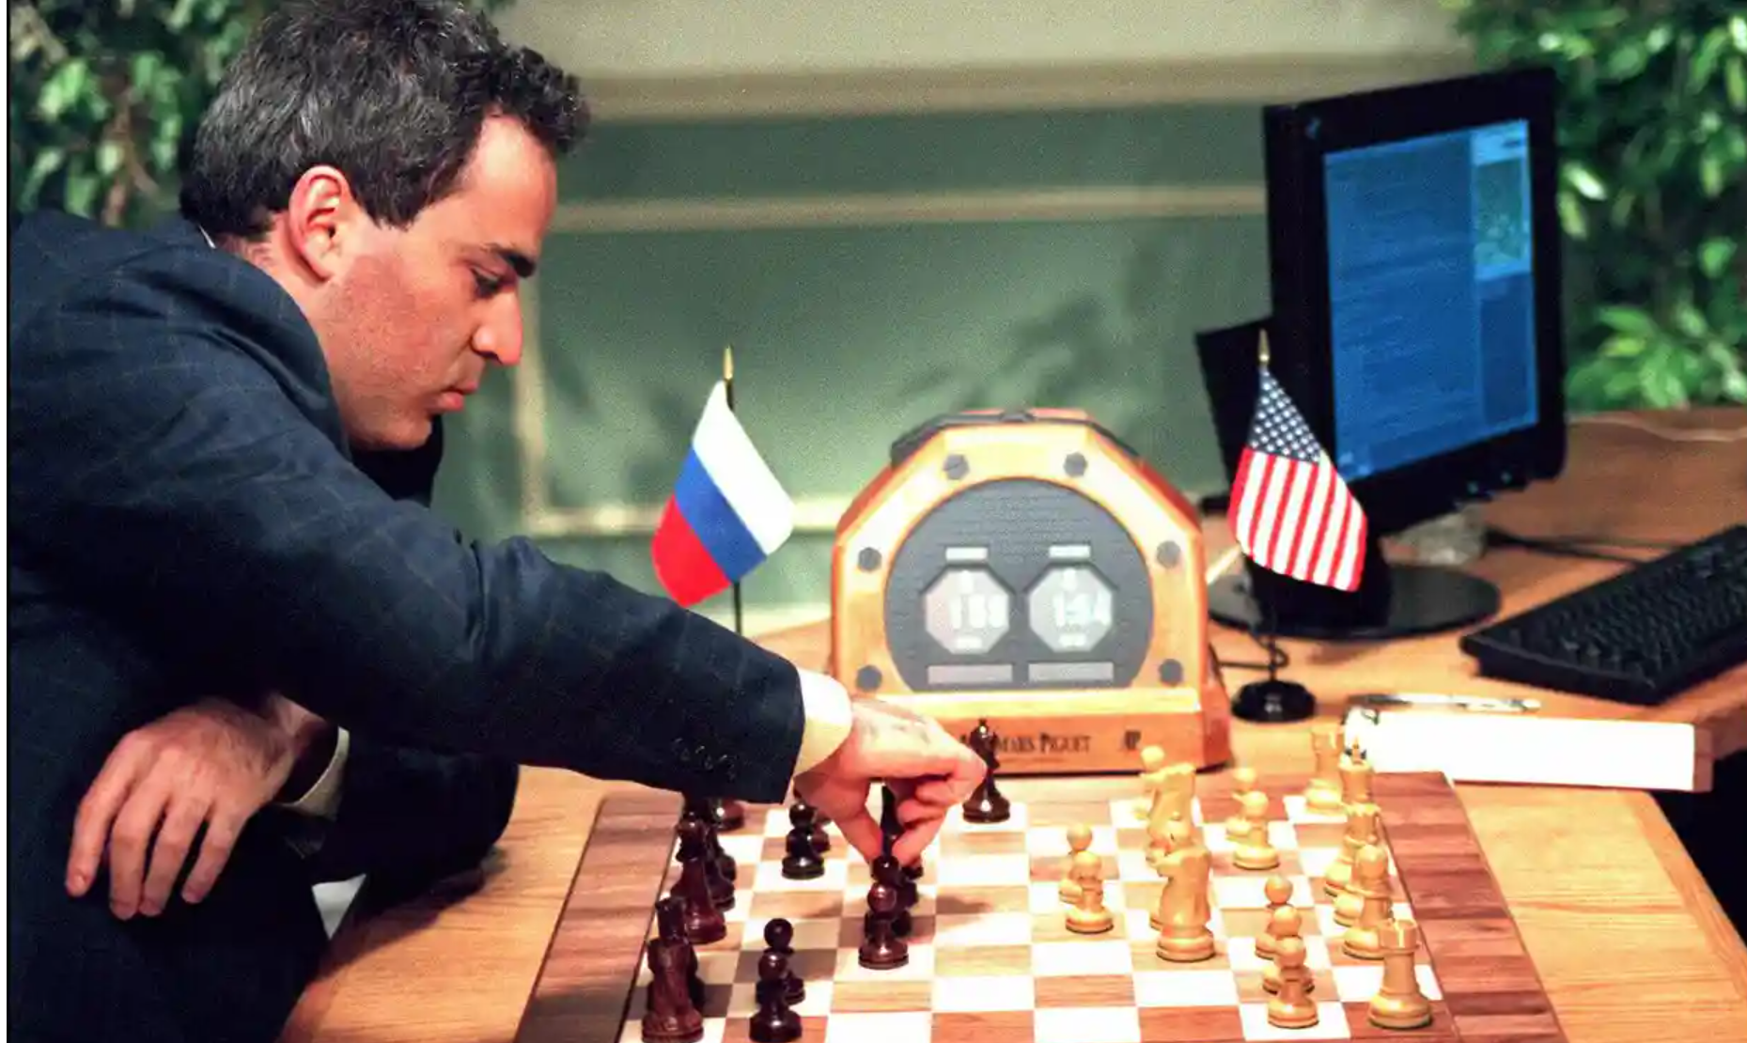
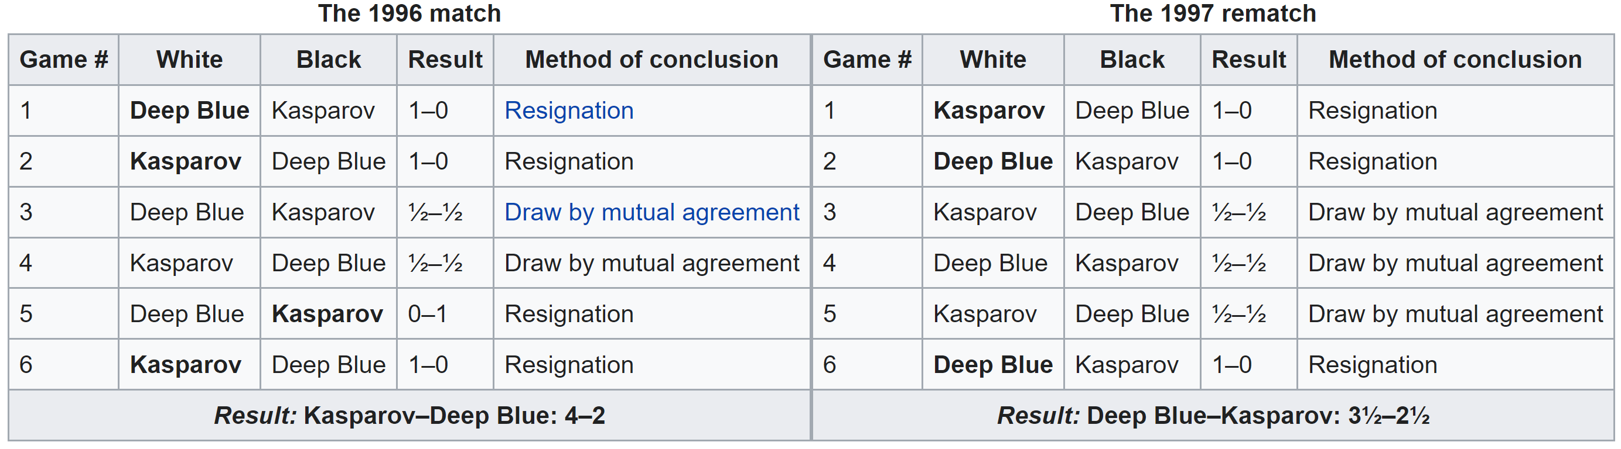
IBM Deep Blue vs Garry Kasparov
Deep Blue had two games with the world chess champion Garry Kasparov in 1996 and 1997.
Garry Kasparov was beaten in 1997.

Slide 6
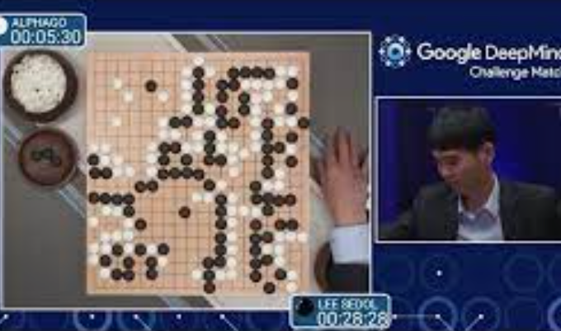
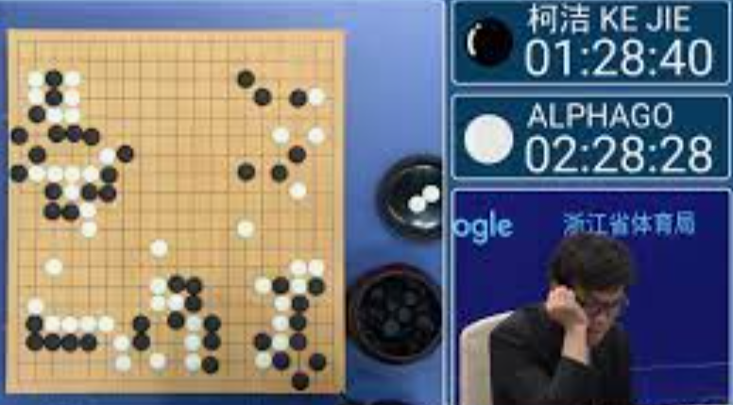
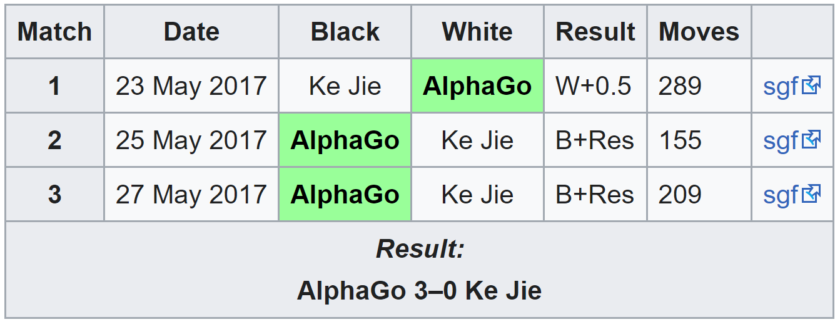
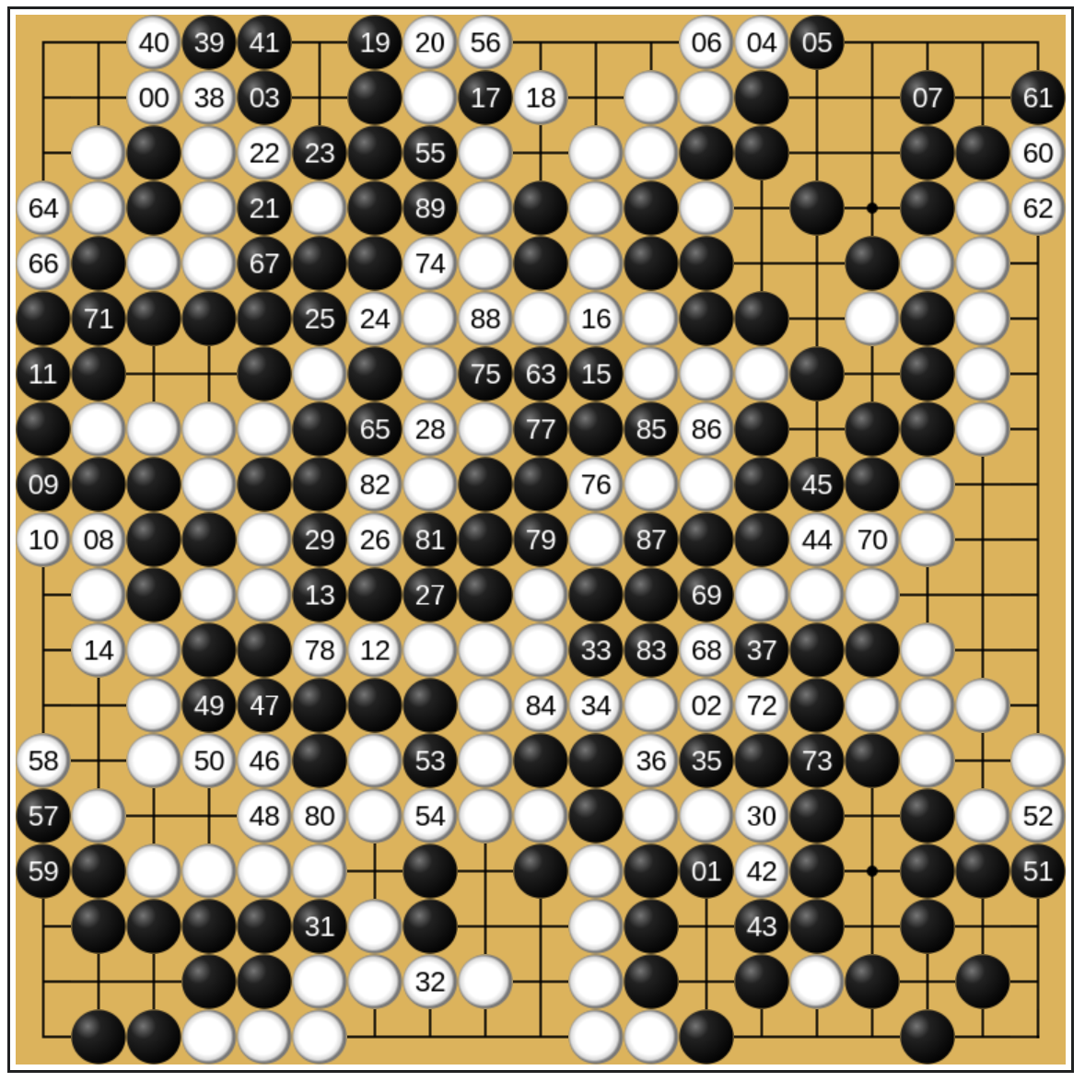
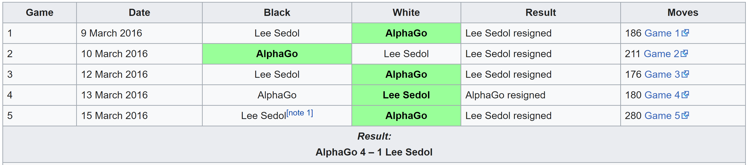
AlphaGo vs Lee Sedol/Ke Jie
AlphaGo beat Lee Sedol in 2016
18-time world champion
AlphaGo beat Ke Jie in 2017
At the time, Ke Jie was ranked 1st among all human players worldwide (since 2014).
Lee Sedol, 2016 Ke Jie, 2017

Slide 7
Types of Games
Game = task environment with > 1 agent
Involving contest/competition and adversarial
Different dimensions
Deterministic or stochastic?
Perfect information (fully observable)?
One, two, or more players?
Turn-taking or simultaneous?
Zero sum?
Want algorithms for calculating a contingent plan (a.k.a. strategy or policy) which recommends a move for every possible eventuality

Slide 8
Zero-Sum Games
Zero-Sum Games
One player wins and the other loses
Agents have opposite utilities
Pure competition
One maximizes, the other minimizes
General Games
Agents/players have independent utilities
Cooperation, indifference, competition, shifting alliances, and more are all possible
We focus on zero-sum games

Slide 9
Common game formulation
Standard games are deterministic, observable, two-player, turn-taking, zero-sum
Game formulation:
Initial state: s₀
Players: Player(s) indicates whose move it is
Actions: Actions(s) for player on move
Transition model: Result(s, a)
Terminal test: Terminal-Test(s)
Terminal values: Utility(s, p) for player p
Or just Utility(s) for player making the decision at root

Slide 10
Outline
History and overview
Minimax for zero-sum games
Alpha-Beta pruning
Monte Carlo tree search
Summary

Slide 11
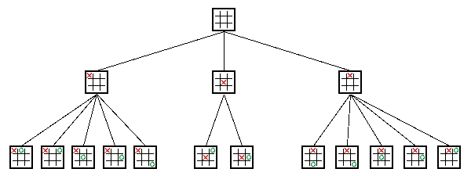
Minmax setup
Search tree
Nodes (squares here) represent decision states (i.e., after a move)
Branches are decisions, i.e., moves
Start at root
Nodes at end are leaf nodes
E.g., Tic-Tac-Toe (symmetrical positions removed)
Levels usually called plies (a ply is one level)
Each ply represents a "turn" switch to other player

Slide 12
Minmax setup (cont.)
Assign point value to the outcome of a game
Ex: Tic-Tac-Toe: X wins, value of 1. O wins, value -1.
Two players: one called Max and the other called Min
Max (X) tries to maximize point value,
while Min (O) tries to minimize point value
Assume both players play to best of their ability
Always make a move to minimize or maximize points
Decision: Max will choose the best move to get the highest point, assuming Min will choose the best move to get the lowest point

Slide 13
Minmax: first example
Max’s turn (with the complete tree)
Would like the “9” points (the maximum)
But if choose left branch, Min will choose move to get 3
→ left branch has a value of 3
If choose right, Min can choose any one of 5, 6 or 7 (will choose 5, the minimum)
→ right branch has a value of 5
Right branch is largest (the maximum) so choose that move
5
Max
3
4
5
Min
3
9
4
5
6
7
Max

Slide 14
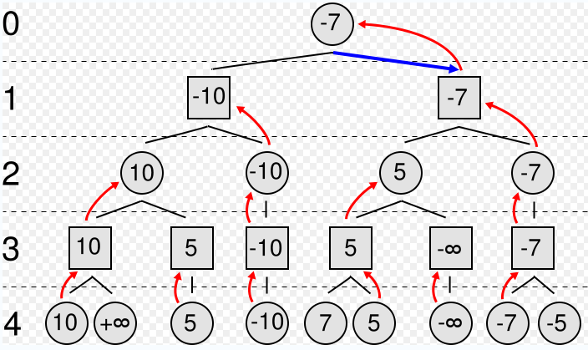
Minmax: second example
Max’s turn
Circles represent Max; Squares represent Min
Values inside represent the values of MinMax algorithm
Red arrows represent the chosen back up move
Numbers on left represent tree depth
Blue arrow is the chosen final move of Max
Max
Min
Max
Min

Slide 15
MinMax and Chess
With full tree, can determine best possible move
However, full tree impossible for some games! E.g., Chess
At a given time, chess has ~35 legal moves. Exponential growth:
35 at one ply, 35² = 1225 at two plies … 35⁶ = 2 billion and 35¹⁰ = 2 quadrillion
Games can last 40 moves (or more), so 35⁴⁰ … Stars in universe: ~ 2²⁸
For large games (Chess) can’t see end of the game. Must estimate winning or losing from top portion
Evaluate() function to guess end given board
A numeric value, much smaller than victory (i.e., Checkmate for Max will be one million, for Min minus one million)

Slide 16
Evaluation function
Checkmate – worth more than rest combined
Typical, use weighted function:
c1*material + c2*mobility + c3*king safety + c4*center control + ...
Simplest is point value for material
pawn 1, knight 3, bishop 3, castle 3, queen 9
All other stuff worth 1.5 pawns (i.e., can ignore most everything else)
What about a draw?
Can be good (i.e., if opponent is strong)
Can be bad (i.e., if opponent is weak)
Adjust with contempt factor
Makes a draw (0) slightly lower (play to win)

Slide 17
MinMax – Pseudo Code
Algorithm minimax(node, depth, maximizingPlayer) is
if depth = 0 or node is a terminal node then
return the heuristic value of node // evaluation()
if maximizingPlayer then // TRUE - Player Max
value := −∞
for each child of node do
value := max(value, minimax(child, depth − 1, FALSE))
return value
else (* minimizing player *) // FALSE - player Min
value := +∞
for each child of node do
value := min(value, minimax(child, depth − 1, TRUE))
return value
(* Initial call *)
minimax(origin, depth, TRUE) // depth – how deep to go
From Wikipedia

Slide 18
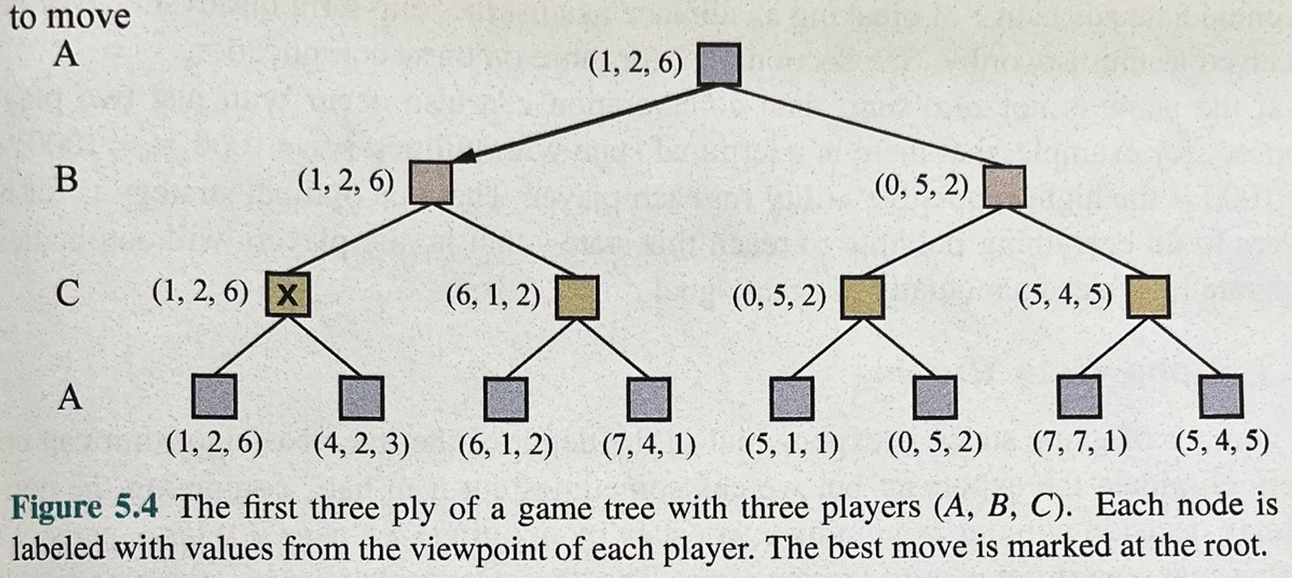
Generalized minimax
What if the game is not zero-sum, or has multiple players?
Generalization of minimax:
Terminals have utility tuples
Node values are also utility tuples
Each player maximizes its own component
Can give rise to cooperation and
competition dynamically…

Slide 19
Outline
History and overview
Minimax for zero-sum games
Alpha-Beta pruning
Monte Carlo tree search
Summary

Slide 20
MinMax – Alpha-Beta Pruning
MinMax searches entire tree, even if in some cases the rest can be ignored
In general, stop evaluating move when find worse than previously examined move
Does not benefit the player to play that move, it need not be evaluated any further.
Save processing time without affecting final result
The particular technique is called alpha-beta pruning. It still works in the context of MinMax tree.

Slide 21
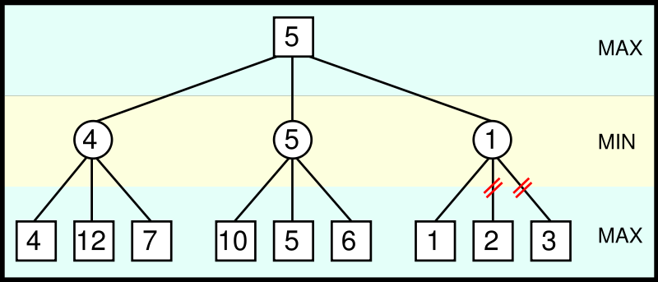
Alpha-Beta pruning example
From Max point of view, 1 is already lower than 4 or 5, so no need to evaluate 2 and 3 (bottom right) → Prune

Slide 22
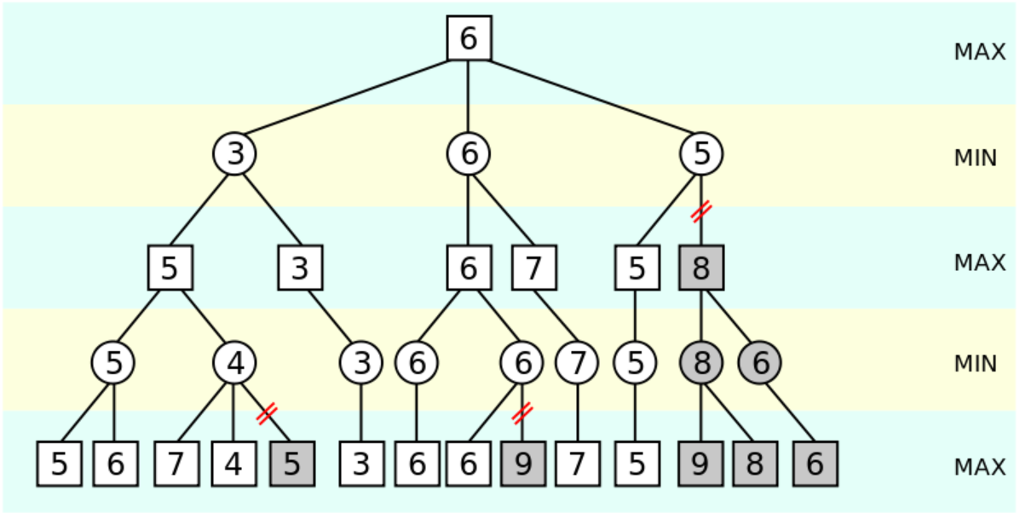
A more complex example
The grayed-out subtrees don't need to be explored (when moves are evaluated from left to right),
since it is known that the group of subtrees as a whole yields the value of an equivalent subtree or worse, and as such cannot influence the final result.

Slide 23
Basic idea of alpha-beta pruning
Two scores passed around in search
Alpha for Max– minimum score that Max is assured of
Anything less than this is no use (can be pruned) since we can already get alpha
Minimum score Max will get
Initially, negative infinity
Beta for Min – worst-case scenario for opponent (maximum score that Min is assured of)
Anything higher than this won’t be used by opponent
Maximum score Min will get
Initially, positive infinity
If beta < alpha, Max need not consider the other children of this node, as they will never be reached in the actual play.

Slide 24
Alpha-beta pruning algorithm
Alphabeta(node, alpha, beta) // initially, alpha = negative infinity
If node is terminal, return its value // beta = positive infinity
If (player(node) = Max)
v := -infinity
For each child of node
v := max(v, Alphabeta(child, alpha, beta))
If v >= beta, return v // beta cutoff
alpha := max(alpha, v)
Return v
Else
v := infinity
For each child of node
v := min(v, Alphabeta(child, alpha, beta))
If v <= alpha, return v // alpha cutoff
beta := min(beta, v)
Return v

Slide 25
Properties of alpha-beta pruning
Theorem: This pruning has no effect on minimax value computed for the root!
Good child ordering improves effectiveness of pruning
Try to first examine the children that are likely to be best
With “perfect ordering”:
Time complexity drops to O(b^{m/2})
Can effectively look twice as deep!
Difference between reasonable and expert play

Slide 26
Resource limits
Problem: In realistic games, cannot search to leaves!
Solution: Bounded lookahead
Search only to a preset depth limit or horizon
Use an evaluation function for non-terminal positions
Guarantee of optimal play is gone
More plies make a BIG difference
Example:
Suppose we have 100 seconds, can explore 10K nodes / sec
So can check 1M nodes per move
Chess with alpha-beta, 35^{(8/2)} =~ 1M; depth 8 is good

Slide 27
Outline
History and overview
Minimax for zero-sum games
Alpha-Beta pruning
Monte Carlo tree search
Summary

Slide 28
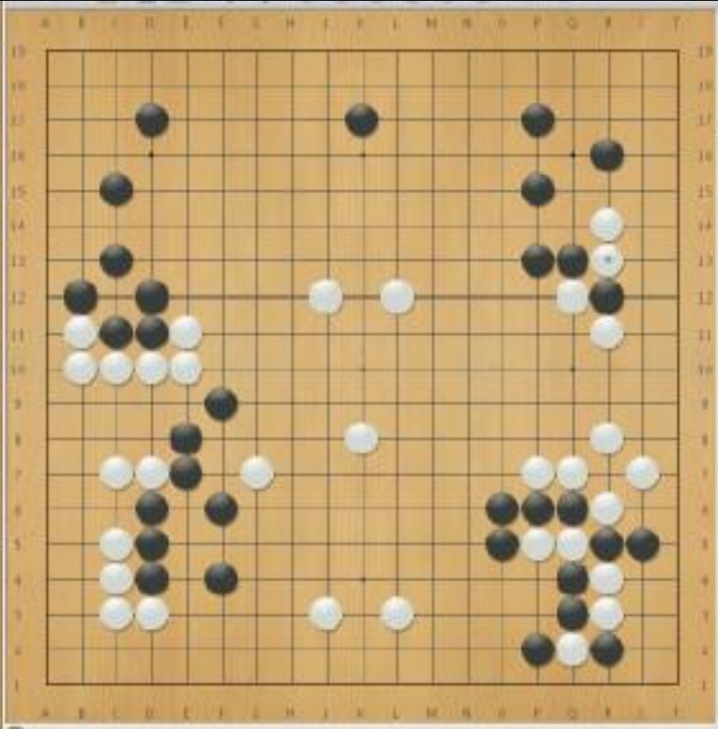
GO game (围棋)
A very old game invented in China more than 2,500 years ago.
围棋 (Weiqi) – encirclement chess.
The aim to surround more territory than your opponent
Much tougher for computers
High branching factor (b > 300, chess b ≈ 35)
No good heuristic value function
“Although progress has been steady, it will take many
decades of research and development before
world-championship– caliber GO programs exist”.
Jonathan Schaeffer, 2001

Slide 29
Monte Carlo Tree Search (MCTS)
Methods based on alpha-beta search assume a fixed horizon
Pretty hopeless for Go, with branching factor b > 300
Alpha-eta search would be limited to ony 4 or 5 ply.
Hard to evaluate.
MCTS combines two important ideas:
Evaluation by rollouts – play multiple games to termination from a state s (using a simple, fast rollout policy) and count wins and losses
Selective search – explore parts of the tree that will help improve the decision at the root, regardless of depth.

Slide 30
Monte Carlo tree search (MCTS)
MCTS revolutionized the world of computer GO
Best GGP (General Game Playing) players (2008, 2009) use MCTS
More CPU cycles leads to smarter play – each doubling of CPU time adds a constant to playing strength
Uses statistics of deep look-ahead from randomized rollouts
Anytime algorithm - an algorithm that can return a valid solution to a problem even if it is interrupted before it ends.

Slide 31
Rollouts
Build and search a game tree to make each move
Phases are:
Tree search: select node to expand using tree policy
Perform random rollout based on a fast rollout policy to end of game when true value is known
Record the result
Back the value up the tree

Slide 32
Basic Monte Carlo tree search
Play lots of random games (rollouts)
Start with each possible legal move
Keep winning statistics
Separately for each starting move
Keep going as long as you have time, then…
Play move with best winning percentage
Fraction of wins correlates with the true value of the position!
Having a “better” rollout policy helps

Slide 33
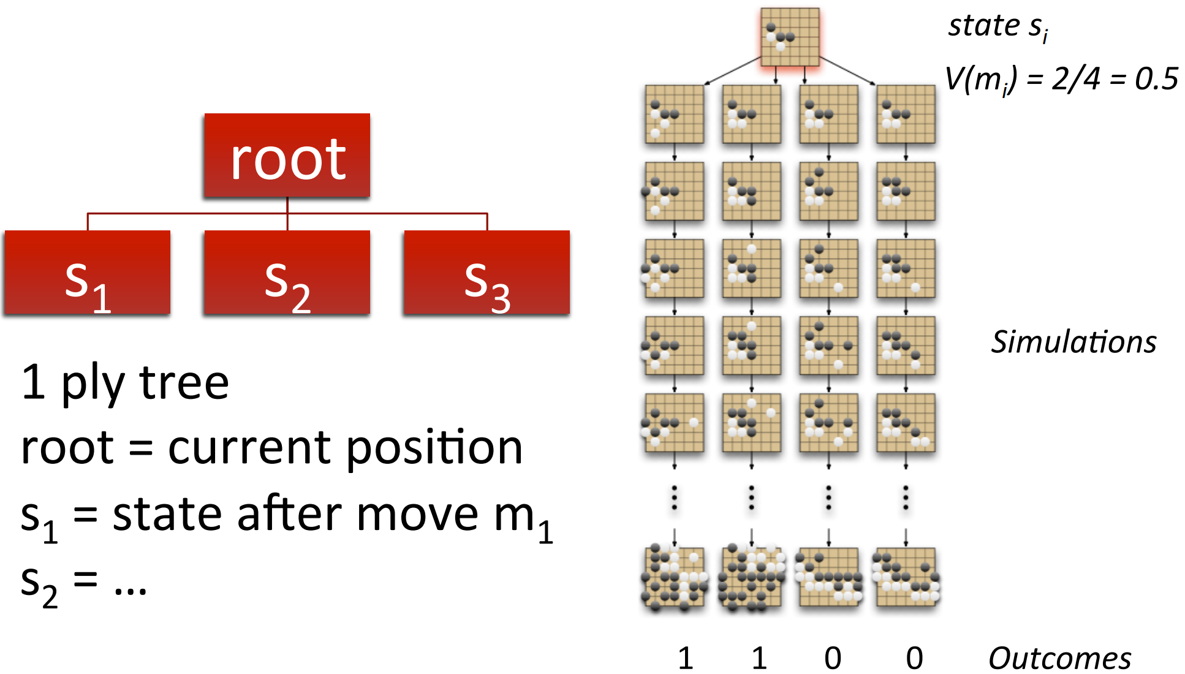
Example – basic Monte Carlo tree search

Slide 34
Monte Carlo tree search – a better version
We need a selection policy to selectively focus the computational resources on the important parts of the game tree. It balances two factors:
Exploitation: Allocate rollouts to more promising nodes
To get a more accurate estimate for those states that have done well so far in the rollouts (playouts)
Exploration: Allocate rollouts to more uncertain nodes
Try more rollouts for states that have had few rollouts or
One very effective selection policy is called “upper confidence bounds applied to trees” or UCT.

Slide 35
UCT and UCB1 heuristic
UCT policy ranks each possible move based on upper confidence bound (UCB1), which combines “promising” (exploitation) and “uncertain” (exploration):
N(n) = number of rollouts from node n
U(n) = total utility of rollouts from n (e.g., # wins)
PARENT(n) is the parent node of n
C is a parameter balancing the “promising” and “uncertain”

Slide 36
Algorithm - Monte Carlo tree search
Repeat until out of time:
Given the current search tree, recursively apply UCB to choose a path down to a leaf (not fully expanded) node n //select
Add a new child c to n // expand
Run a rollout from c // simulate
Update the win counts from c back up to the root // back-propagate
Choose the action/move leading to the child with highest N

Slide 37
An example
White has just moved, and it won 37 of 100 rollouts
37/100
37/100
37/101
60/79
1/10
2/11
60/79
1/10
2/11
61/80
1/10
2/11
3/26
16/53
6/6
3/4
3/26
16/53
6/6
3/4
3/26
16/54
6/6
3/4
27/35
10/18
0/3
0/3
27/35
10/18
0/3
0/3
28/36
10/18
0/3
0/3
0/0
0/1
(a) Selection (b) Expansion (c) Back-propagation
and simulation
Black win

Slide 38
Outline
History and overview
Minimax for zero-sum games
Alpha-Beta pruning
Monte Carlo tree search
Summary

Slide 39
Summary
Games require decisions when optimality is impossible
Bounded-depth search and approximate evaluation functions
Games force efficient use of computation
Alpha-beta pruning
Game playing has produced important research ideas
Reinforcement learning (checkers)
Iterative deepening (chess)
Monte Carlo tree search (Go)
Solution methods for partial-information games in economics (poker)

