Slide 1
Propositional Logic and Theorem Proving
Many slides are borrowed from Chelsea Finn & Nima Anari

Slide 2
Logic
Logic is a language for reasoning.
It is a collection of rules that we use when doing logical reasoning or inferencing.
Human reasoning has been observed over centuries from at least the times of Greeks.
Patterns appearing in reasoning have been extracted, abstracted, and streamlined.

Slide 3
Ingredients of a logic
Syntax: defines a set of valid formulas.
Example: Sunny ∧ Hot
Semantics (meaning): for each formula, specify a set of models (possible worlds) (value assignments / configurations)
Inference rules: given f, what new formulas g can be added that are guaranteed to follow?
f
-----
g
Example: from Sunny ∧ Hot, derive Sunny

Slide 4
Propositional logic
Propositional logic is a logic about truth and falsity of sentences.
The smallest unit of propositional logic is thus a sentence.
No analysis will be done to the components of a sentence.
We are only interested in true or false sentences, but not both.
Sentences that are either true or false are called propositions (or statements).

Slide 5
Propositions
If a proposition is true, then we say it has a truth value of “true“ (T);
if a proposition is false, its truth value is "false“ (F).
E.g.: 1. Ten is less than seven
2. 10 > 5
3. Open the door.
4. how are you?
5. She is very talented
6. There are life forms on other planets
7. x is great than 3
(1) and (2) are propositions (or statements). (1) is false and (2) is true. (3) – (7) are not propositions

Slide 6
Outline
Syntax
Semantics
Model checking
Inference using forward chaining
Proof by resolution
Inference using inference rules and logical equivalence
Summary

Slide 7
Identifying logical forms
Make statements 1 and 2 have the same form.
1. If Jane is a math major or Jane is a computer major, then Jane will take Math 150.
Jane is a computer science major
Therefore, Jane will take Math 150
2. If logic is easy or ____, then _______
I will study hard
Therefore, I will get an A in this course
Logic form: if P or Q, then R
Q
Therefore, R

Slide 8
Logic Connectives
Simple sentences which are true or false are basic propositions.
Larger and more complex sentences are constructed from basic propositions by combining them using connectives.
Thus, propositions and connectives are the basic elements of propositional logic.
English word Connective Symbol
Not Negation ¬ (∼)
And Conjunction ∧
Or Disjunction ∨
If then Implication → (=>)
if and only if Equivalence ↔ (<=>)

Slide 9
Syntax: construction of complex propositions
Let X and Y represent arbitrary propositions. Then (¬X), (X ∧ Y), (X ∨ Y), (X → Y), and (X ↔ Y),
are propositions.
E.g., (¬A) → (B ∨ C) is a proposition.
It is obtained by first constructing
(¬A) by applying (¬X),
(B V C) by applying (X ∨ Y) to propositions B and C, and then by applying (X → Y) to the two propositions (¬A) → (B ∨ C) considering them as X and Y, respectively.
A well-formed formula (wff): A legitimate string
yes: (¬A) → (B ∨ C) no: ((A ∨ BC((

Slide 10
Outline
Syntax
Semantics
Model checking
Inference using forward chaining
Proof by resolution
Inference using inference rules and logical equivalence
Summary

Slide 11
Truth table
We want to discuss properties/relations common to all propositions. We use propositional variables, e.g., A, B, P to stand for propositions.
A proposition in general contains a number of variables. E.g., (P ∧ Q)
Thus, a proposition takes different values depending on the values of the constituent variables.
The truth values of a proposition and its constituent variables can be represented by a table, called a truth table. P Q (P ∧ Q)
F F F
F T F
T F F
T T T

Slide 12
Truth Table for all Connectives
A | B | A ∧ B | A ∨ B | A → B | ¬A ∨ B | A ↔ B | ¬A
T | T | T | T | T | T | T | F
T | F | F | T | F | F | F | F
F | T | F | T | T | T | F | T
F | F | F | F | T | T | T | T

Slide 13
Truth table of a complex proposition A ∨ ¬B → ¬(A ∨ B)
A | B | ¬B | A ∨ ¬B | A ∨ B | ¬(A ∨ B) | A ∨ ¬B → ¬(A ∨ B)
T | T | F | T | T | F | F
T | F | T | T | T | F | F
F | T | F | F | T | F | T
F | F | T | T | F | T | T

Slide 14
Logical equivalence
Two statements P and Q are logically equivalent, if and only if, they have identical truth values for each possible substitution of statements for their variables, written as P ≡ Q. (used for two sentences/statements)
Double negation: ¬(¬P) ≡ P
P | ¬P | ¬(¬P)
T | F | T
F | T | F

Slide 15
Converse and inverse of conditional proposition
For the proposition A → B, the proposition B → A is called its converse.
proposition ¬A → ¬B is called its inverse.
For example, “If it rains, then I get wet”
Converse: If I get wet, then it rains.
The converse (inverse) of a proposition is not logically equivalent to the original proposition.
The converse and the inverse of a conditional statement are logically equivalent to each other. Why?

Slide 16
Contrapositive of proposition
For the proposition A → B, the proposition ¬B → ¬A is called its contrapositive.
For example, If it rains, then I get wet
Contrapositive: If I don't get wet, then it does not rain.
The contrapositive of a proposition is always logically equivalent to the proposition.
That is, they take the same truth value.

Slide 17
Truth table of contrapositive
A | B | A → B | ¬B | ¬A | ¬B → ¬A
T | T | T | F | F | T
T | F | F | T | F | F
F | T | T | F | T | T
F | F | T | T | T | T
Notes:
A sufficient condition guarantees the truth of another condition, but is not necessary for that other condition to happen.
A necessary condition is required for something else to happen, but it does not guarantee that the something else happens.

Slide 18
From English to propositions
"I will go to the beach if it is not snowing" or "If it is not snowing, I will go to the beach".
Let P be the proposition "It is snowing", Q be the proposition "I will go to the beach",
Then symbols P and Q are substituted for the respective sentences
¬ P → Q.
"If it is not snowing and I have time, then I will go to the beach",
Let R be the proposition "I have time"
The sentence can be converted to
(¬P ∧ R ) → Q.

Slide 19
Many ways to say, A → B
If A, then B.
A implies B.
A, therefore B.
A only if B.
B follows from A.
B whenever A
B if A
A is a sufficient condition for B
B is a necessary condition for A.

Slide 20
From English to propositions (cont.)
English sentences
“It is not hot but it is sunny”
“It is neither hot nor sunny”
Let P be the proposition "It is hot", Q be the proposition "It is sunny",
(1) ¬P ∧ Q (2) ¬P ∧ ¬Q
Suppose x is a number. Let P, Q, and R be “0 < x”, “x < 3” and “x = 3” respectively
1. x ≤ 3 2. 0 < x < 3 3. 0 < x ≤ 3
Q ∨ R P ∧ Q P ∧ (Q ∨ R)

Slide 21
Model
A model (possible world) w in propositional logic is an assignment of truth values to propositional symbols.
E.g., 2 propositional symbols: A, B
Have 2² = 4 possible models w because each symbol can be T or F.
A | B
T | T
T | F
F | T
F | F

Slide 22
Interpretation
Let f be a formula. Let w be a model. An interpretation function I(f, w) returns:
true (T or 1) (say that w satisfies f)
false (F or 0) (say that w does not satisfy f)
E.g.,
formula f = A → B
Model: w = {A : T, B : F}
model | A | B | I(A → B, w_{i})
w₁ | T | T | T
w₂ | T | F | F
w₃ | F | T | T
w₄ | F | F | T

Slide 23
Model and interpretation
Let M(f) be the set of models w for which I(f, w) = T (or 1).
E.g.,
formula f = A → B
M(f) = {w₁, w₃, w₄}
A formula compactly represents a set of models
model | A | B | I(A → B, w_{i})
w₁ | T | T | T
w₂ | T | F | F
w₃ | F | T | T
w₄ | F | F | T

Slide 24

Knowledge base and its models
A knowledge base KB is a set of formulas representing their conjunction / intersection.
$M(KB)=\bigcap_{f∈KB}{M(f)}$
E.g., Let KB = {Sunny, Sunny → Hot}
M(Sunny) M(KB) M(Sunny → Hot)

Slide 25
An illustration
model | A | B | I(A → B, w_{i})
w₁ | T | T | T
w₂ | T | F | F
w₃ | F | T | T
w₄ | F | F | T
Let KB = {Sunny, Sunny → Hot}
M(Sunny) M(Sunny → Hot) M(KB)
F T F T F T
Hot
Hot
Hot
F
T
F
T
F
T
Sunny
Sunny
Sunny

Slide 26
Adding to the knowledge base
Adding more formulas f to the knowledge base (KB):
KB KB ∪ {f}
Shrinks the set of models:
M(KB) M(KB) ∩ M(f)

Slide 27
Entailment
KB entails f (written as KB |= f) iff M(KB) ⊆ M(f) (i.e., in every model where KB is true, f is also true)
M(KB) M(f)
Idea: a sentence follows logically from another sentence
Example: Sunny ∧ Hot |= Hot

Slide 28
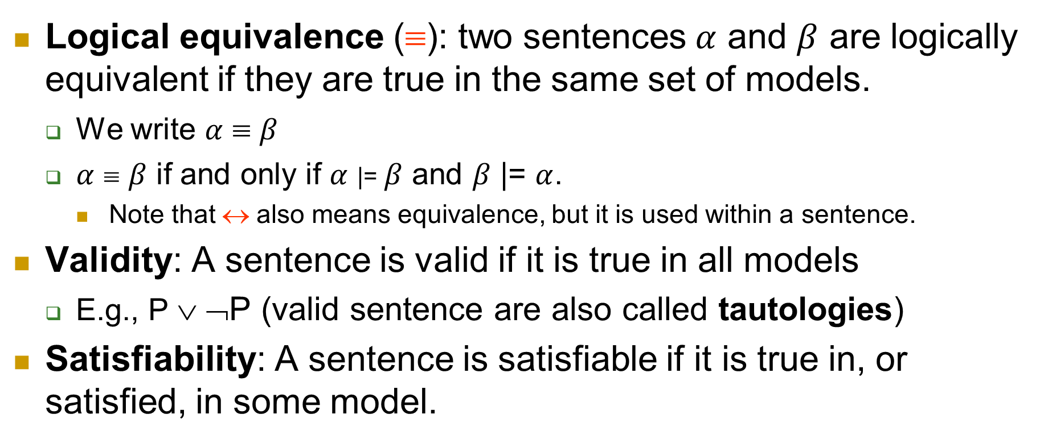
Logical equivalence, Validity, Satisfiability
Logical equivalence (≡): two sentences $α$ and $β$ are logically equivalent if they are true in the same set of models.
We write $α$ ≡ $β$
$α$ ≡ $β$ if and only if $α$ |= $β$ and $β$ |= $α$.
Note that ↔ also means equivalence, but it is used within a sentence.
Validity: A sentence is valid if it is true in all models
E.g., P ∨ ¬P (valid sentence are also called tautologies)
Satisfiability: A sentence is satisfiable if it is true in, or satisfied, in some model.

Slide 29
Contradiction and Contingency
KB contradicts f iff
M(KB) ∩ M(f) = ∅
E.g., Sunny ∧ Hot contradicts ¬Hot
KB contradicts f iff KB entails ¬f.
Contingency
f adds non-trivial information to KB
∅ ⊆ M(KB) ∩ M(f) ⊆ M(KB)
Neither tautology nor contradiction
M(KB) M(f)
M(KB) M(f)

Slide 30
Tell and ask
Tell operation
Tell[f] ----> KB -----> ?
Tell: it is sunny.
Tell[Sunny]
Possible responses:
Already knew that: entailment (KB |= f)
Don’t believe that: contradiction (KB |= ¬f)
Learned something new (update KB): contingent.
Ask operation
Ask[f] ----> KB -----> ?
Ask: is it sunny?
Ask[Sunny]
Possible responses:
Yes: entailment (KB |= f)
No: contradiction (KB |= ¬f)
I don’t know: contingent

Slide 31
Outline
Syntax
Semantics
Model checking
Inference using forward chaining
Proof by resolution
Inference using inference rules and logical equivalence
Summary

Slide 32
Model checking
Model checking: Given knowledge base KB, check whether there exists a satisfying model (M(KB) ≠ ∅)?
Checking satisfiability (SAT) in propositional logic is a special case of solving CSPs!
Propositional symbol = variable
Formular = constraint
Domain = {T, F}
Model = value assignment
There are dedicated SAT solvers
E.g., KB = {A ∨ B, B ↔ ¬C}
Satisfying model (consistent assignment): {A: T, B: F, C: T}

Slide 33
Outline
Syntax
Semantics
Model checking
Inference using forward chaining
Proof by resolution
Inference using inference rules and logical equivalence
Summary

Slide 34
A simple inference to prove entailment
To decide whether KB |= f.
We can use a model-checking approach that is a direct implementation of the definition of entailment:
Enumerate the models and check that f is true in every model in which KB is true.
Example
KB ={A, A → B} |= B
model | A | B | I(A → B, w_{i})
w₁ | T | T | T
w₂ | T | F | F
w₃ | F | T | T
w₄ | F | F | T

Slide 35
Using modus ponens inference rule
Modus ponens inference rule
For any propositional symbols p and q: p, p → q
q
Example:
It is raining. (Rain)
If it is raining, then it is wet. (Rain → Wet)
Therefore, it is wet. (Wet)
Rain, Rain → Wet (premises)
Wet (conclusion)

Slide 36
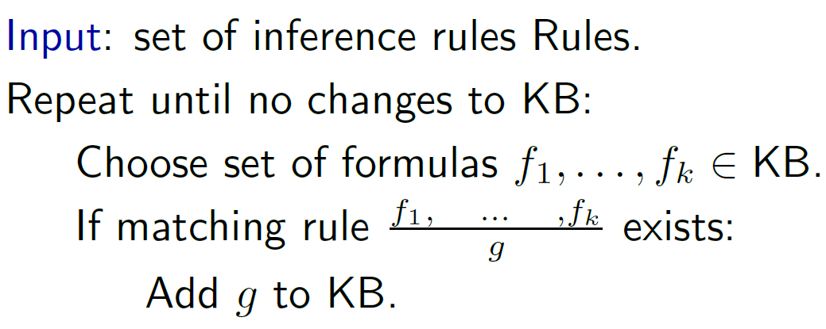
Forward inference

Slide 37
Derivation
KB derives/proves f (KB |- f) iff f eventually gets added to KB
Note: Inference rules operate directly on syntax, not on semantics.
Semantics:
Interpretation defines entailed/true formulas: KB |= f
Syntax:
Inference rules derive formulas: KB |- f
How does {f : KB |= f} relate to {f : KB |- f}?

Slide 38
Soundness and completeness of inference rules
Sound: everything it claims to prove is in fact entailed
A set of inference rules Rules is sound if:
{f : KB |- f} ⊆ {f : KB |= f}
Complete: everything that is entailed can be proven/derived
A set of inference rules Rules is complete if:
{f : KB |- f} ⊇ {f : KB |= f}
Sound and complete:
The truth, the whole truth, and nothing but the truth
Soundness: nothing but the truth
Completeness: whole truth

Slide 39
Soundness: example
model | A | B | I(A → B, w_{i})
w₁ | T | T | T
w₂ | T | F | F
w₃ | F | T | T
w₄ | F | F | T
Is Sunny, Sunny → Hot sound?
Hot
M(Sunny) ∩ M(Sunny → Hot) ⊆? M(Hot)
F T F T F T
sound!
Hot
Hot
Hot
F
T
F
T
F
T
Sunny
Sunny
Sunny

Slide 40
Soundness: example
model | A | B | I(A → B, w_{i})
w₁ | T | T | T
w₂ | T | F | F
w₃ | F | T | T
w₄ | F | F | T
Is Hot, Sunny → Hot sound?
Sunny
M(Hot) ∩ M(Sunny → Hot) ⊆? M(Sunny)
F T F T F T
Unsound!
Hot
Hot
Hot
F
T
F
T
F
T
Sunny
Sunny
Sunny

Slide 41
Completeness example
Recall completeness: inference rules derive all entailed formulas (f such that KB |= f)
Modus ponens is incomplete, e.g.
KB = {Rain, Rain ∨ Snow → Wet}
f = Wet
Rules = {f, f → g } (Modus ponens)
g
Semantically: KB |= f (f is entailed).
Syntactically: KB |-/ f (can’t derive f).
Incomplete! To fix it, use resolution

Slide 42
Definite clause
Definition: Definite clause
A definite clause has the following form:
(p₁ ∧ · · · ∧ p_{k}) → q
where p₁, . . . , p_{k}, q are propositional symbols.
An alternative definition: a disjunction of literals of which exactly one is positive.
¬p₁∨ · · · ∨ ¬p_{k} ∨ q (p₁ ∧ · · · ∧ p_{k}) → q same as ¬(p₁ ∧ · · · ∧ p_{k}) ∨ q)
Example: (Sun ∧ Snow) → Dry
Example: Dry (T → Dry)
Non-example: ¬Dry
Non-example: (Sun ∧ Snow) → (Dry ∨ Cold)

Slide 43
Horn clause
Definition: Horn clause (slightly more general than definite clause)
A Horn clause is either:
a definite clause (p₁ ∧ · · · ∧ p_{k} → q), or
a goal clause (p₁ ∧ · · · ∧ p_{k} → false)
Example (definite): (Rain ∧ Snow) → Traffic
Example (goal): Traffic ∧ Accident → false
equivalent: ¬Traffic ∨ ¬Accident (no positive iteral)
We use Horn clauses in resolution later.

Slide 44
Simple theorem proving: Forward chaining
Forward chaining applies Modus Ponens to generate new facts:
X₁, X₂, …, X_{n}, (X₁ ∧ X₂ ∧ … X_{n}) → Y
Y
Forward chaining keeps applying this rule, adding new facts, until nothing more can be added
Requires KB to contain only definite clauses (restriction)
(Conjunction of symbols) → symbol; or
A single symbol (note that X is equivalent to True → X)
Runs in linear time using two simple tricks:
Each symbol X_{i} knows which rules it appears in
Each rule keeps count of how many of its premises are not yet satisfied

Slide 45
Forward chaining algorithm: Details
c: clause
s: symbol
function PL-FC-ENTAILS?(KB, q) returns true or false count ← a table, where count[c] is the number of symbols in c’s premise
inferred ← a table, where inferred[s] is initially false for all s
agenda ← a queue of symbols, initially symbols known to be true in KB
while agenda is not empty do
p ← Pop(agenda) if p = q then return true
if inferred[p] = false then
inferred[p]←true for each clause c in KB where p is in c.premise do
decrement count[c]
if count[c] = 0 then add c.conclusion to agenda
return false

Slide 46
Properties of forward chaining
Theorem: FC is sound and complete for definite-clause KBs
Soundness: follows from soundness of Modus Ponens
Completeness proof:
1. FC reaches a fixed point where no new atomic sentences are derived
2. Consider the final set of known-to-be-true symbols as a model m (other ones false in inferred)
3. Every clause in the original KB is true in m
Proof: Suppose a clause X₁∧... ∧X_{k} → Y is false in m
Then X₁∧... ∧X_{k} is true in m and Y is false in m
Therefore, the algorithm has not reached a fixed point (contradict)!
4. Hence m is a model of KB
5. If KB |= f, f is true in every model (∈ M(KB)) of KB, including m

Slide 47
Outline
Syntax
Semantics
Model checking
Inference using forward chaining
Proof by resolution
Inference using inference rules and logical equivalence
Summary

Slide 48
Clause and disjunction
Written with implication Written with disjunction
A → C ¬A ∨ C
A ∧ B → C ¬A ∨ ¬B ∨ C
Literal: either p or ¬p, where p is a propositional symbol
Clause: disjunction of literals, e.g., ¬A ∨ B ∨ ¬C ∨ D ∨ ¬E ∨ F
Horn clause: at most one positive literal (definite or goal clause)
Modus ponens (rewritten): A, ¬A ∨ C
C
Intuition: cancel out A and ¬A
Modus ponens cannot operate on general clauses. Resolution does!

Slide 49
Resolution
Resolution inference rule
f₁ ∨ · · · ∨ f_{n} ∨ p, ¬p ∨ g₁ ∨ · · · ∨ g_{m}
f₁ ∨ · · · ∨ f_{n} ∨ g₁ ∨ · · · ∨ g_{m}
where f₁, · · · f_{n}, g₁, · · · , g_{m} are arbitrary literals
Example: Sun ∨ Rain, ¬Rain ∨ Cloud
Sun ∨ Cloud
Resolution is sound and complete for propositional logic
Exponential time in the worst case

Slide 50
Conjunctive normal form (CNF)
A CNF formula is a conjunction of clauses.
E.g., (Sun ∨ Rain) ∧ (¬Rain ∨ Cloud)
Equivalent: knowledge base where each formula is a clause!
Proposition: conversion to CNF
Every formula f in propositional logic can be converted into an equivalent CNF formula f’: M(f) = M(f’)

Slide 51
Conversion to CNF
Conversion rules:
Eliminate ↔: f ↔ g
(f → g) ∧ (g → f)
Eliminate →: f → g
¬f ∨ g
Move ¬ inwards: ¬(f ∧ g)
¬f ∨ ¬g
Move ¬ inwards: ¬(f ∨ g)
¬f ∧ ¬g
Eliminate double negation:
¬¬f
f
Distribute ∨ over ∧:
f ∨ (g ∧ h)
(f ∨ g) ∧ (f ∨ h)

Slide 52
A conversion example
Initial formula: (Sun → Rain) → Bizarre
Remove implication (→): ¬(¬Sun ∨ Rain) ∨ Bizarre
Push negation (¬ ) inwards (de Morgan):
(¬¬Sun ∧ ¬Rain) ∨ Bizarre
Remove double negation: (Sun ∧ ¬Rain) ∨ Bizarre
Distribute ∨ over ∧: (Sun ∨ Bizarre) ∧ (¬Rain ∨ Bizarre)

Slide 53
Resolution algorithm
Proof by contradiction
To show that KB |= f, we show KB ∪ {¬f} (or KB ∧ ¬f) is unsatisfiable.
Algorithm:
Convert KB ∧ ¬f to CNF
Repeatedly apply the resolution rule to the resulting clauses until one of the two things happens
no new clauses can be added, in which case KB does not entail f, or
Two clauses resolve to yield the empty clause, in which case KB entails f.
The empty clause - a disjunction of no disjuncts – is equivalent to False as it can only arise by resolving p and ¬p (two contradictory unit clauses)

Slide 54
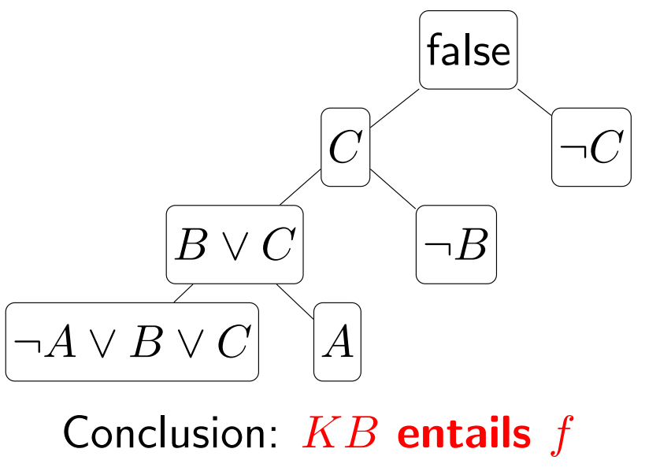
Resolution: example
KB = {A → (B ∨ C), A, ¬B}
Prove: KB |= C
1. KB’ = {A → (B ∨ C), A, ¬B, ¬C}
2. Convert to CNF:
KB’ = {¬A ∨ B ∨ C, A, ¬B, ¬C}
3. Repeatedly apply resolution rule

Slide 55
Note that satisfiability checking uses CNF
Recall satisfiability is defined as follows: A knowledge base KB is satisfiable if M(KB) ≠ ∅.
Check satisfiability using SAT solvers
Efficient SAT solvers operate on conjunctive normal form (CNF).
They can be used to prove entailment as well.

Slide 56
Outline
Syntax
Semantics
Model checking
Inference using forward chaining
Proof by resolution
Inference using inference rules and logical equivalence
Summary

Slide 57
Tautology and contradiction
A proposition that is always true is called a tautology.
E.g., (P ∨ ¬P) is always true regardless of the truth value of the proposition P.
A proposition that is always false called a contradiction.
E.g., (P ∧ ¬P).

Slide 58
Tautological or logical equivalences
Commutative properties
A ∨ B ≡ B ∨ A A ∧ B ≡ B ∧A
Associative properties
(A ∨ B) ∨ C ≡ A ∨ (B ∨ C) (A ∧B) ∧C ≡ A ∧(B ∧C)
Distributive properties
A∨(B∧C) ≡ (A∨B)∧(A∨C) A∧(B∨C) ≡ (A∧B)∨(A∧C)
Identity properties
A ∨ false ≡ A A ∧ true ≡ A
Complement properties
A ∨ ¬A ≡ True A ∧ ¬A ≡ False
De Morgan’s law
¬(A ∨ B) ≡ ¬ A ∧ ¬B ¬(A ∧ B) ≡ ¬ A ∨ ¬B

Slide 59
Tautological or logical equivalences (cont.)
Double negation
P ≡ ¬(¬P)
Implication elimination
(P → Q) ≡ (¬P ∨ Q)
Equivalence (biconditional elimination)
(P ↔ Q) ≡ [(P → Q) ∧ (Q → P)]
Exportation
[(P ∧ Q) → R] ≡ [P → (Q → R)]
Absurdity
[(P → Q) ∧ (P → ¬Q)] ≡ ¬P
Contrapositive
(P → Q) ≡ (¬Q → ¬P)

Slide 60
Prove logical equivalences
Using truth table
E.g., to prove De Morgan’s law
A | B | ¬B | ¬A | ¬(A ∨ B) | ¬A ∧ ¬B
T | T | F | F | F | F
T | F | T | F | F | F
F | T | F | T | F | F
F | F | T | T | T | T

Slide 61
A computer program example
If ((outflow > inflow) and not((outflow>inflow) and (pressure < 1000)))
We can write this as: A ∧ ¬(A ∧ B)
where A is outflow > inflow, and B is pressure < 1000
But A ∧ ¬(A ∧ B) ≡ A ∧ ¬B. Why?
A ∧ ¬(A ∧ B)
= A ∧ (¬A ∨ ¬B) De Morgan
= (A ∧ ¬A) ∨ (A ∧ ¬B)
= false ∨ (A ∧ ¬B)
= (A ∧ ¬B)

Slide 62
Logical reasoning (inferencing)
Logical reasoning is the process of drawing conclusions from premises using rules of inference
These inference rules are results of observations of human reasoning over centuries.
They have contributed significantly to the scientific and engineering progress of the mankind.
Today they are universally accepted as the rules of logical reasoning and they should be followed in our reasoning.

Slide 63
Valid and invalid arguments
An argument is a sequence of statements. All statements but the final one are called premises (assumptions or hypotheses). The final statement is called the conclusion. The symbol ∴, read “therefore” is normally placed just before the conclusion.
“An argument form is valid” means that no matter what statements are substituted for the statement variables in its premises, if the resulting premises are all true, then the conclusion is also true.
A fallacy is an error in reasoning that results in an invalid argument.

Slide 64
Reasoning with Propositions
The basic inference rule is modus ponens. It states that if both P → Q and P hold, then Q can be concluded, and it is written as P, P → Q ------------- ∴ Q
The line above the dotted line are premises and the line below is the conclusion drawn from the premises.

Slide 65
More inference rules
Modus tollens ¬Q, P → Q --------- ∴ ¬P
Conjunctive simplification
P ∧ Q -------- ∴ P
Conjunctive addition P, Q ------------- ∴ P ∧ Q
Rule of contradiction
¬P → c, where c is a contradiction --------- ∴ P
Disjunctive Addition
P ------------- ∴ P ∨ Q
Disjunctive syllogism P ∨ Q , ¬Q --------- ∴ P
Hypothetical syllogism
P → Q, Q → R ---------------------- ∴ P → R
Dilemma: proof by division into cases
P ∨ Q, P → R, Q → R ------------------------------ ∴ R

Slide 66
An example
If my glasses are on the kitchen table, then I saw them at breakfast.
I was reading the newspaper in the living room or I was reading the newspaper in the kitchen.
If I was reading the newspaper in the living room, then my glasses are on the coffee table.
I did not see my classes at breakfast.
If I was reading my book in bed, then my glasses are on the bed table.
If I was reading the newspaper in the kitchen, then my glasses are on the kitchen table.
Where are the glasses?

Slide 67
Translate them into symbols
P = my glasses are on the kitchen table,
Q = I saw my glasses at breakfast.
R = I was reading the newspaper in the living room
S = I was reading the newspaper in the kitchen.
T = my glasses are on the coffee table.
U = I was reading my book in bed.
V= my glasses are on the bed table.
Statements in the previous slide are translated as follows:
1. P → Q 2. R ∨ S
3. R → T 4. ¬Q
5. U → V 6. S → P

Slide 68
Deductions
a. P → Q by (1)
¬Q by (4)
∴ ¬P by modus tollens
b. S → P by (6)
¬P by the conclusion of (a)
∴ ¬S by modus tollens
c. R ∨ S by (2)
¬S by the conclusion of (b)
∴ R by disjunctive syllogism
d. R → T by (3)
R by the conclusion of (c)
∴ T by modus ponens

Slide 69
Outline
Syntax
Semantics
Model checking
Inference using forward chaining
Proof by resolution
Inference using inference rules and logical equivalence
Summary

Slide 70
Summary
Inference in propositional logic:
Inference algorithms determine whether KB |= f
Theorem provers apply inference rules to construct proofs
Model checkers enumerate models to establish entailment directly
Forward chaining is sound, complete, and linear-time for definite clauses
Resolution based on CNF is also sound and complete, but it requires exponential time in the worst case.
Main limitation of propositional logic: it does not consider the components of a proposition.

