Slide 1
Reasoning under Uncertainty

Slide 2
Uncertainty with the data
Most tasks requiring intelligent behavior have some degree of uncertainty associated with them.
The uncertainty may be caused by problems with the data.
Data might be missing or unavailable
Data might be unreliable or ambiguous due to measurement errors
The representation of the data may be imprecise or inconsistent.
Data may just be user’s best guess.
Data may be based on defaults and the defaults may have exceptions.

Slide 3
Uncertainty with the knowledge
The uncertainty may also be caused by the represented knowledge since it might
represent best guesses of the experts that are based on plausible or statistical associations they have observed.
not be appropriate in all situations (e.g., may have indeterminate applicability)

Slide 4
Uncertainty reasoning is needed
Given these numerous sources of errors, most knowledge-based systems require the incorporation of some form of uncertainty management.
When implementing some uncertainty scheme, we must be concerned with three issues:
How to represent uncertain data
How to combine two or more pieces of uncertain data
How to draw inference using uncertain data
We introduce only probabilistic reasoning and certainty factor. There are also others.

Slide 5
Probabilistic Reasoning

Slide 6
Outline
Review of classic probability
Hypothetical reasoning and backward induction
Bayes’ rule and knowledge-based systems
Propagation of Belief
Advantages and disadvantages of Bayesian methods

Slide 7
Classic probability
The oldest and best-defined technique for managing uncertainty is based on classical probability theory.
Let us start to review it by introducing some terminologies.
Sample space
Consider an experiment whose outcome is not predictable with certainty in advance.
Although the outcome of the experiment is not known in advance, let us suppose that the set of all possible outcomes is known.
This set of all possible outcomes of an experiment is known as the sample space of the experiment and denoted by S.

Slide 8
Sample space examples
If the outcome of an experiment consists in the determination of the sex of a newborn child, then
S = {g, b}
where the outcome g means that the child is a girl and b that it is a boy.
If the experiment consists of flipping two coins, then the sample space consists of the following four points / outcomes:
S = {(H, H), (H, T), (T, H), (T, T)}

Slide 9
More terminologies
Event
any subset E of the sample space is known as an event.
That is, an event is a set consisting of some possible outcomes of the experiment. If the outcome of the experiment is contained in E, then we say that E has occurred.
E.g., if E = {(H, H), {H, T)}, then E is the event that a head appears on the first coin.
For any event E, we define the new event E’, referred to as the complement of E, to consist of all points in the sample space S that are not in E.

Slide 10
More terminologies (cont.)
Mutually exclusive events:
A set of events E₁, E₂, ..., E_{n} in a sample space S, are called mutually exclusive events if E_{i} ∩ E_{j} = ∅, i ≠ j, 1≤ i, j ≤ n.

Slide 11
Axioms of probability
A theory of probability can be made using three axioms:
1. 0 ≤ P(E) ≤ 1.
2. ∑ P(E_{i}) = 1 (or P(S) = 1)
I
This axiom states that the sum of all events which do not affect each other, called mutually exclusive events, is 1.
As a corollary of this axiom: P(E_{i}) + P(E_{i}’) = 1, where E_{i}’ is the complement of event E_{i}.
3. P(E₁ ∪ E₂) = P(E₁) + P(E₂),
where E₁ and E₂ are mutually exclusive events. In general, this is also true.

Slide 12
Compound probability
Events that do not affect each other in any way are called independent events. For two independent events A and B,
P(A ∩ B) = P(A) P(B)
Independent events: The events E₁, E₂, ..., E_{n} in a sample space S, are independent if
P(E_{i1} ∩ ... ∩ E_{ik}) = P(E_{i1}) ...P(E_{ik})
for each subset {i₁, ...,i_{k}) ⊆{1, ..., n},1 ≤ k ≤ n, n ≥ 1.
If events A and B are mutually exclusive, then
P(A ∪ B) = P(A) + P(B)
Addition law: If events A and B are not mutually exclusive, then
P(A ∪ B) = P(A) + P(B) - P(A ∩ B)

Slide 13
Conditional probability
The probability of an event A, given B occurred, is called a conditional probability and denoted by
P(A | B)
The conditional probability is defined as
P(A ∩ B)
P(A | B) = ------------------, for P(B) ≠ 0.
P(B)

Slide 14
Multiplicative law
Multiplicative Law of probability for two events is then defined as
P(A ∩ B) = P(A | B) P(B)
which is equivalent to the following
P(A ∩ B) = P(B | A) P(A)
Generalized Multiplicative Law
P(A₁ ∩ A₂ ∩ ... ∩ A_{n}) = P(A₁ | A₂ ∩ ... ∩ A_{n}) P(A₂ | A₃ ∩ ... ∩ A_{n})
... P(A_{n-1} | A_{n}) P(A_{n})

Slide 15
An example
Table below shows hypothetical probabilities of a disk crash using a Brand X drive within one year.
Brand X Brand X’ Total of Rows
Crash C 0.6 0.1 0.7
No crash C’ 0.2 0.1 0.3
Total of columns 0.8 0.2 1.0
Hypothetical probabilities of a disk crash
X X’ Total of rows
C P(C ∩ X) P(C ∩ X’) P(C)
C’ P(C’∩ X) P(C’ ∩ X’) P(C’)
Total of columns P(X) P(X’) 1

Slide 16
An example (cont.)
Using above tables, the probabilities of all events can be calculated. Some probabilities are
(1) P(C) = 0.7
(2) P(C’) = 0.3
(3) P(X) = 0.8
(4) P(X’) = 0.2
(5) P(C ∩ X) = 0.6
(the probability of a crash and using Brand X)

Slide 17
An example (cont.)
(6) The probability of a crash, given that Brand X is used, is
P(C ∩ X) 0.6
P(C | X) = ------------- = ------- = 0.75
P(X) 0.8
(7) The probability of a crash, given that Brand X is not used, is
P(C ∩ X’) 0.1
P(C | X’) = ------------- = ------- = 0.50
P(X’) 0.2

Slide 18
An example (cont.)
Probabilities (5) and (6) may appear to have similar meanings when you read their descriptions. (5) is the intersection of two events, while (6) is a conditional probability. The meaning of (5) is the following:
IF a disk drive is picked randomly, then 0.6 of the time it will be Brand x and have crashed.
In other words, we are just picking samples from the population of disk drives.
Some of those drives are Brand X and have crashed (0.6),
some are not Brand X and have crashed (0.1),
some are Brand X and have not crashed (0.2), and
some are not Brand X and have not crashed (0.1).

Slide 19
An example (cont.)
In contrast, the meaning of the conditional probability (6) is very different
IF a Brand X disk drive is picked, then 0.75 of the time it will have crashed.
Note also that if any of the following equation is true, then events A and B are independent.
P(A | B) = P(A) or
P(B | A) = P(B) or
P(A ∩ B) = P(A) P(B).

Slide 20
Bayes’ Theorem
Note that conditional probability is defined as
P(H ∩ E)
P(H | E) = ------------------, for P(E) ≠ 0.
P(E)
i.e., the conditional probability of H given E.
In real-life practice, the probability P(H | E) cannot always be found in the literature or obtained from statistical analysis. The conditional probabilities
P(E | H)
However, often are easier to come by;
In medical textbooks, for example, a disease is described in terms of the signs likely to be found in a typical patient suffering from the disease.

Slide 21
Bayes’ Theorem (cont.)
Bayes’ theorem provides us with a method for computing the conditional probability P(H | E) from the probabilities P(E), P(H) and P(E | H); From conditional probability:
P(H ∩ E)
P(H | E) = ------------------,
P(E)
P(E ∩ H)
Furthermore, we have, P(E | H) = ---------------
P(H)
So, P(E | H)P(H) = P(H | E)P(E) = P(H ∩ E)
Bayes theorem: P(E | H) P(H)
P(H | E) = ---------------------
P(E)

Slide 22
Bayes’ Theorem (cont.)
The general form of Bayes’ Theorem can be written in terms of events, E, and hypotheses (assumptions), H, in the following alternative forms.
P(E ∩ H_{i})
P(H_{i} | E) = -------------------------
∑ P(E ∩ H_{j})
j
P(E | H_{i}) P(H_{i}) P(E | H_{i}) P(H_{i})
= ------------------------- = ---------------------
∑ P(E | H_{j}) P(H_{j}) P(E)
j

Slide 23
Outline
Review of classic probability
Hypothetical reasoning and backward induction
Bayes’ rule and knowledge-based systems
Propagation of Belief
Advantages and disadvantages of Bayesian methods

Slide 24
Hypothetical reasoning and backward induction
Bayes’ Theorem is commonly used for decision tree analysis of business and the social sciences.
The method of Bayesian decision making is also used in expert system PROSPECTOR.
We use oil exploration in PROSPECTOR as an example. Suppose the prospector believes that there is a better than 50-50 chance of finding oil and assumes the following.
P(O) = 0.6 and P(O’) = 0.4

Slide 25
PROSPECTOR (cont.)
Using the seismic survey technique, we obtain the following conditional probabilities, where + means a positive outcome and - is a negative outcome
P(+ | O) = 0.8 P(- | O) = 0.2 (false -)
P(+ | O’) = 0.1 (false +) P(- | O’) = 0.9

Slide 26
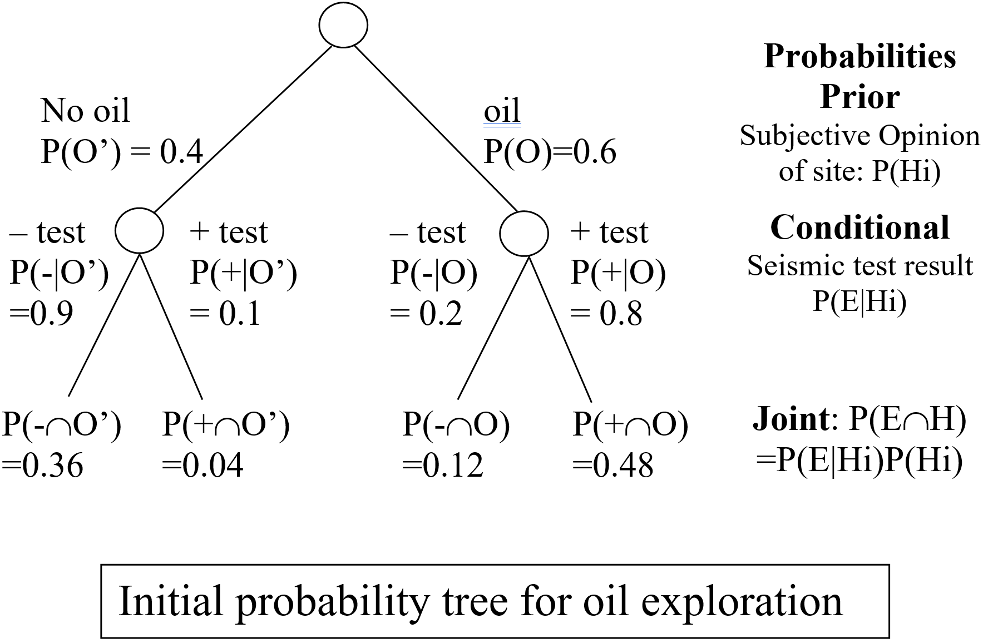
PROSPECTOR (cont.)
Using the prior and conditional probabilities, we can construct the initial probability tree as shown below.

Slide 27
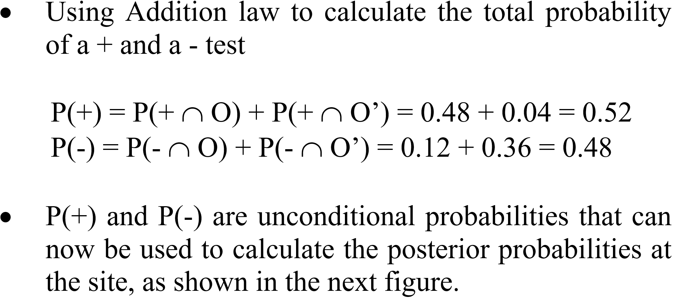
PROSPECTOR (cont.)

Slide 28
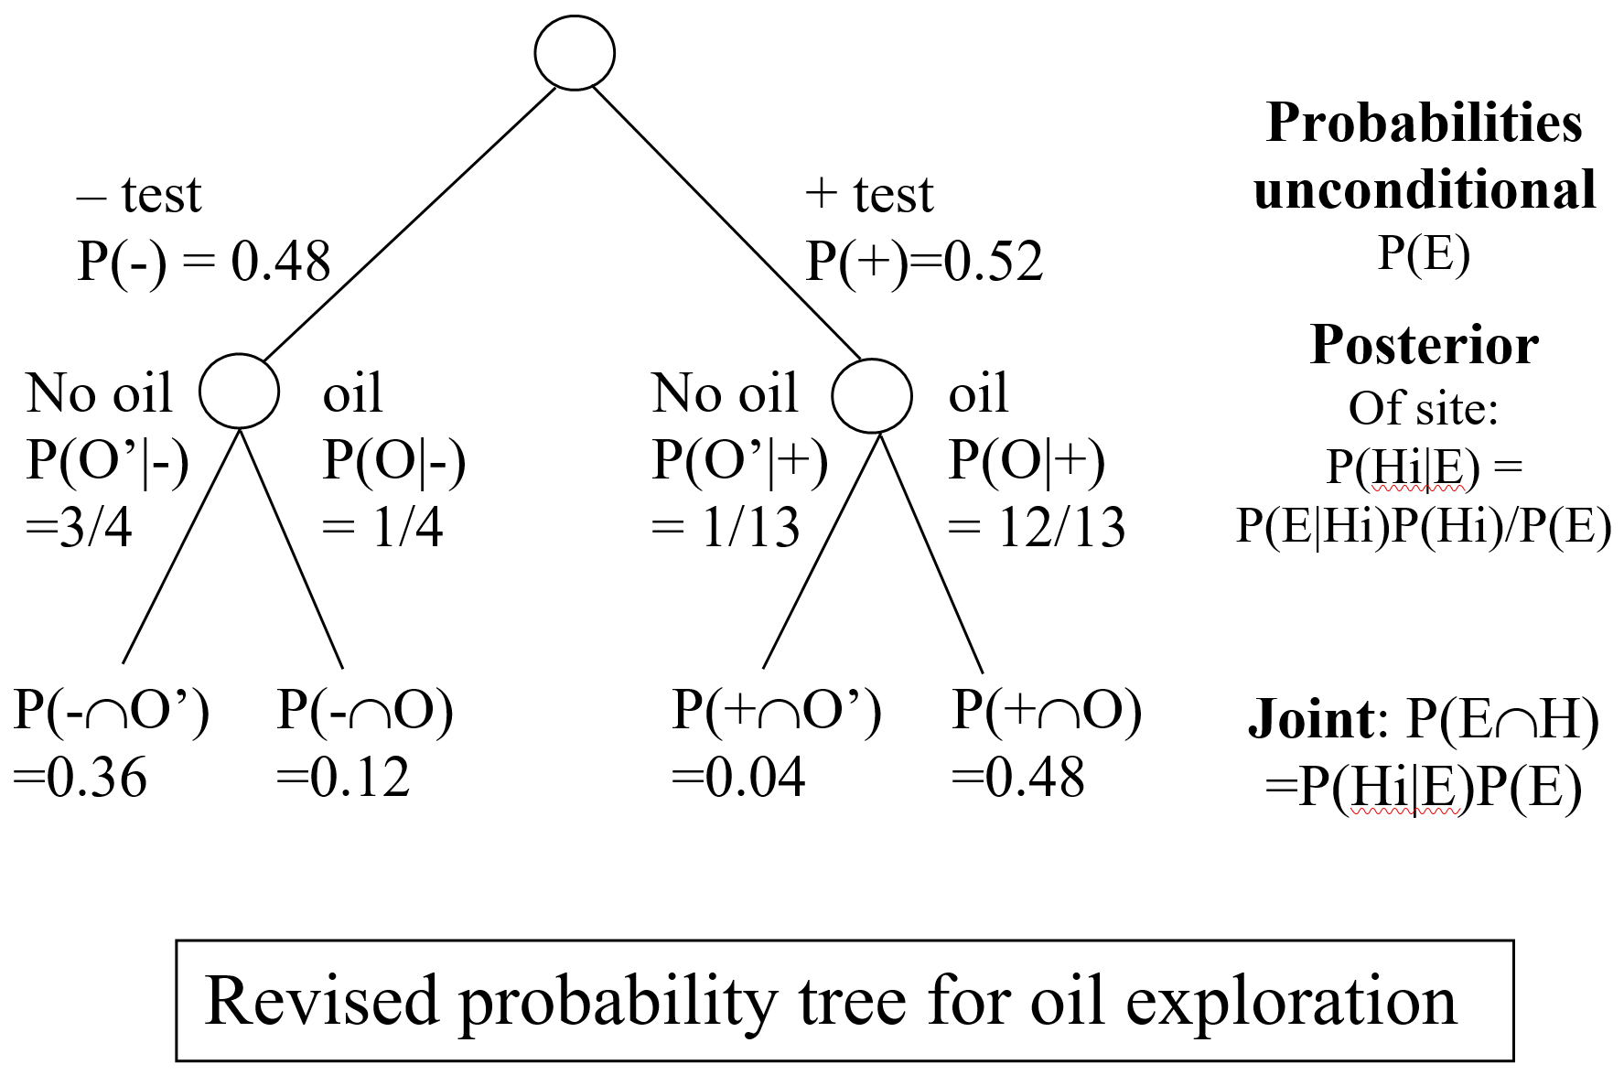
PROSPECTOR (cont.)

Slide 29
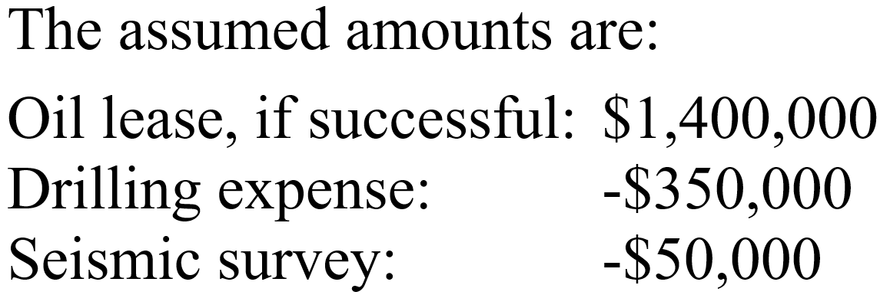
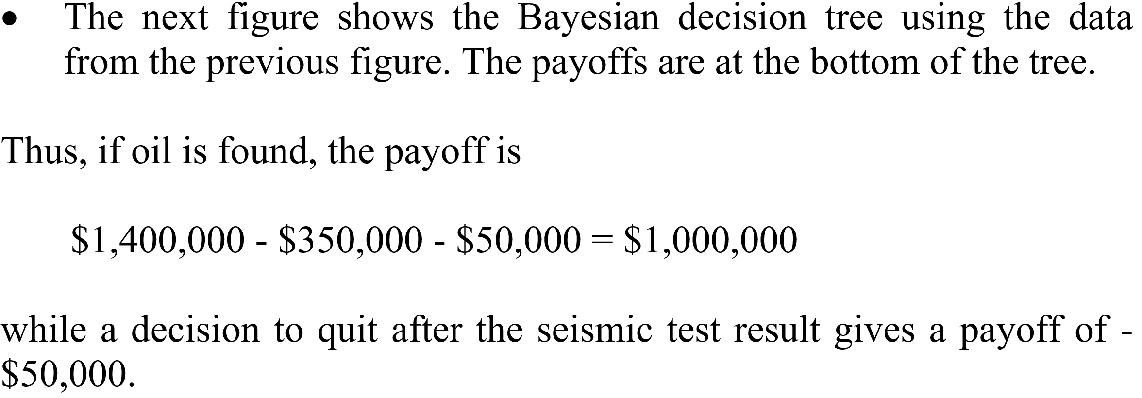
PROSPECTOR (cont.)

Slide 30
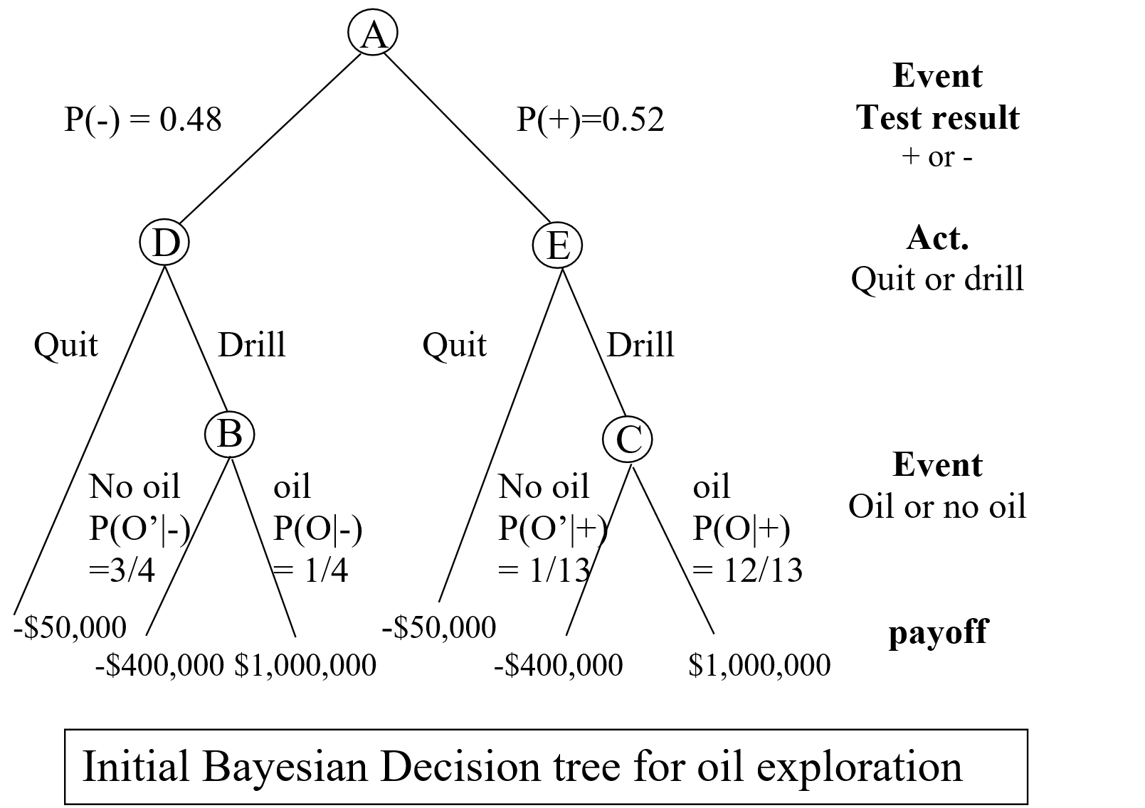
PROSPECTOR (cont.)

Slide 31
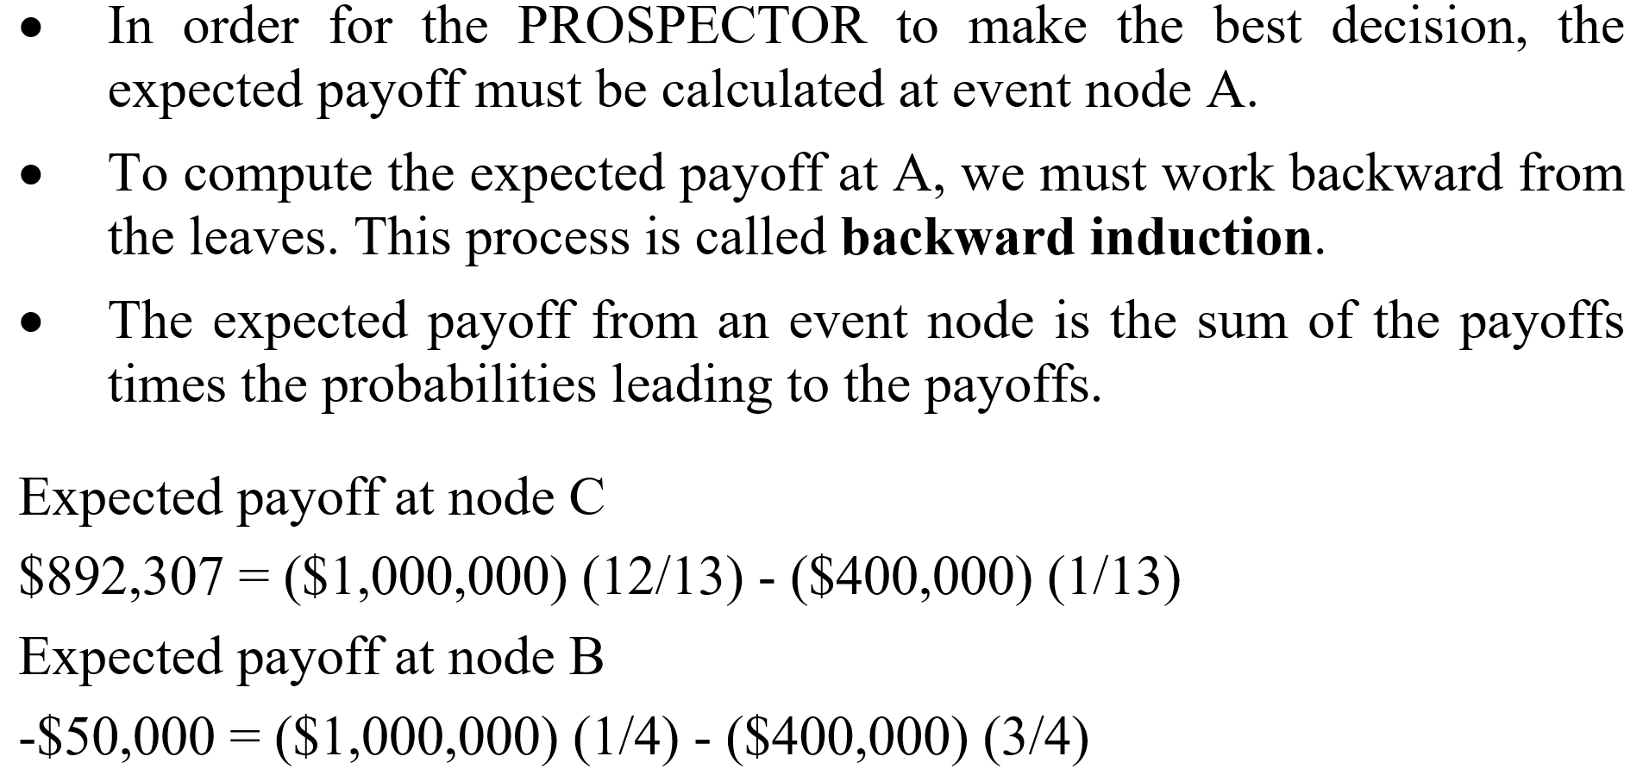
PROSPECTOR (cont.)

Slide 32
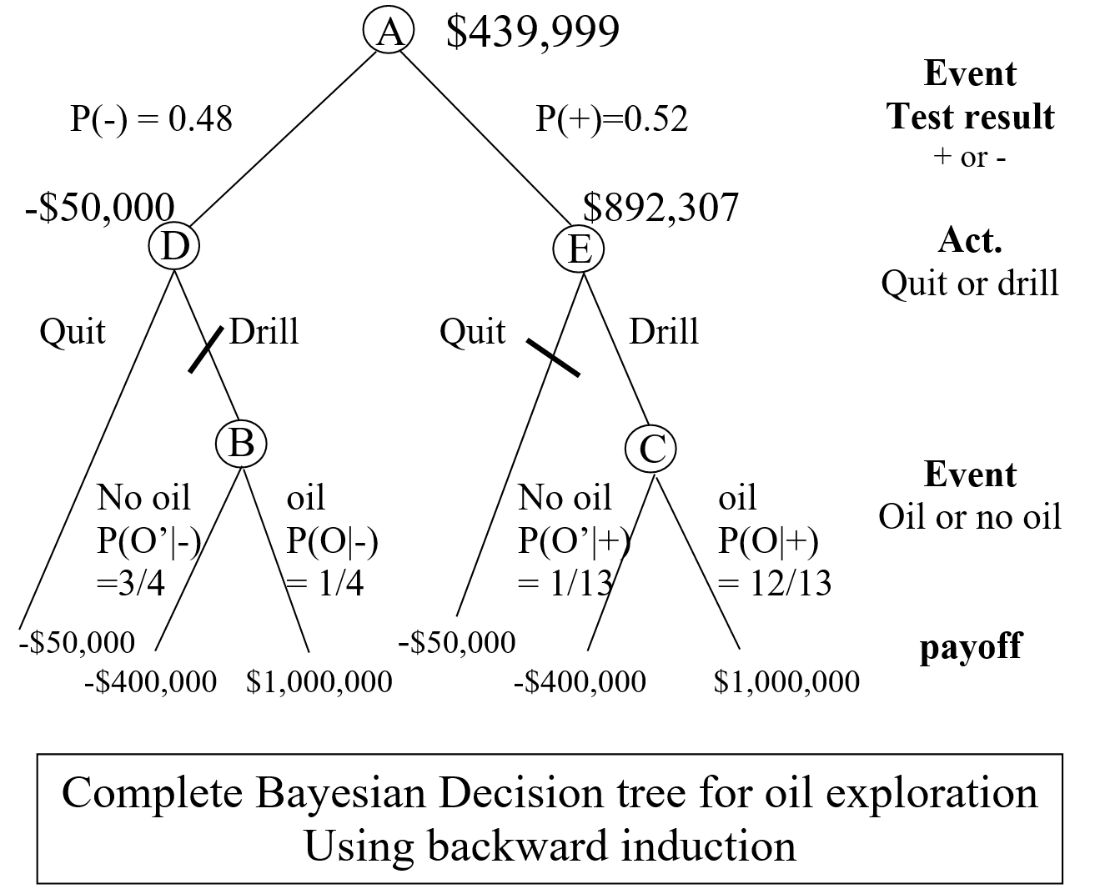
PROSPECTOR (cont.)

Slide 33
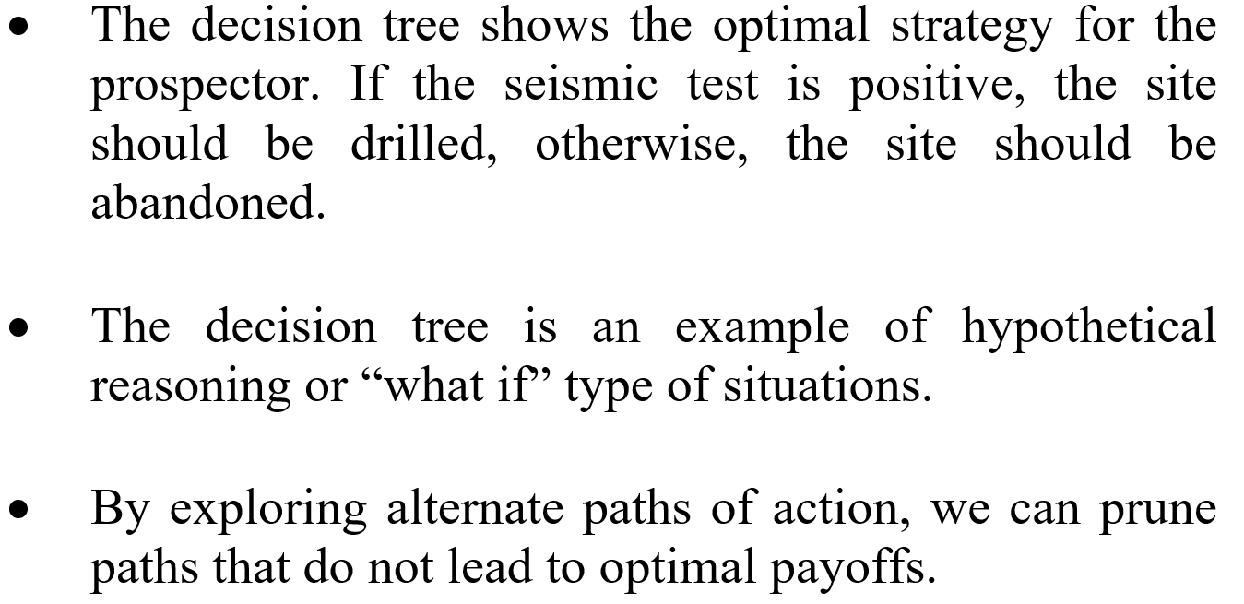
PROSPECTOR (cont.)

Slide 34
Outline
Review of classic probability
Hypothetical reasoning and backward induction
Bayes’ rule and knowledge-based systems
Propagation of Belief
Advantages and disadvantages of Bayesian methods

Slide 35
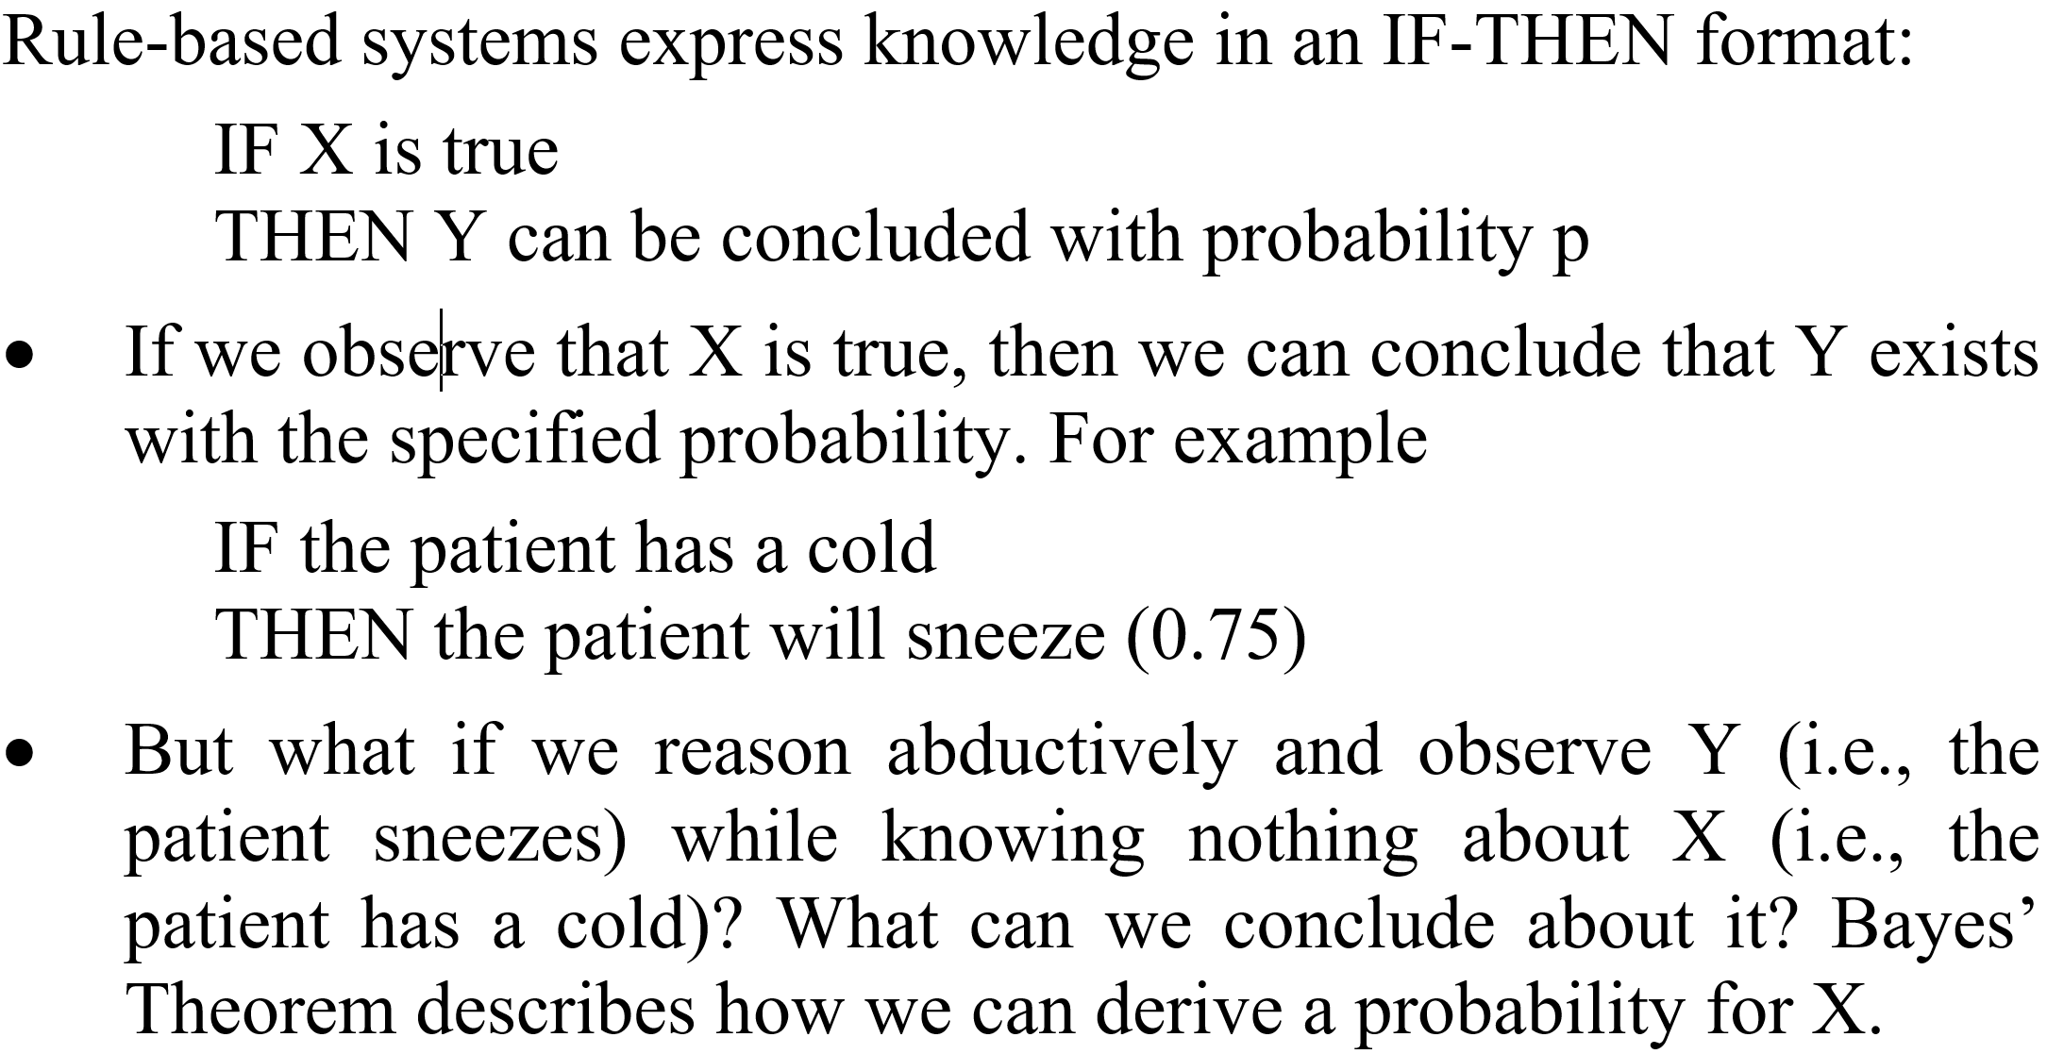
Bayes’ rule and knowledge-based systems

Slide 36
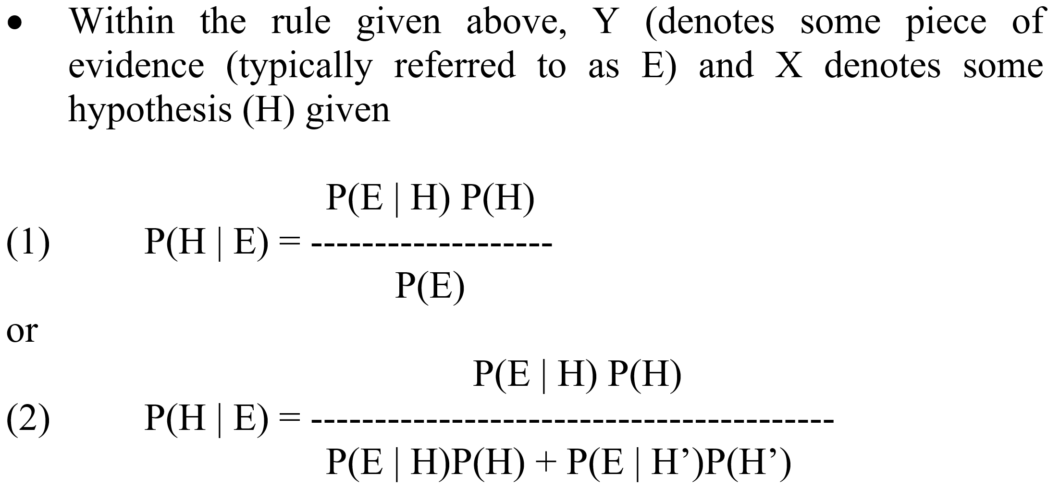
Apply Bayes’ rule

Slide 37
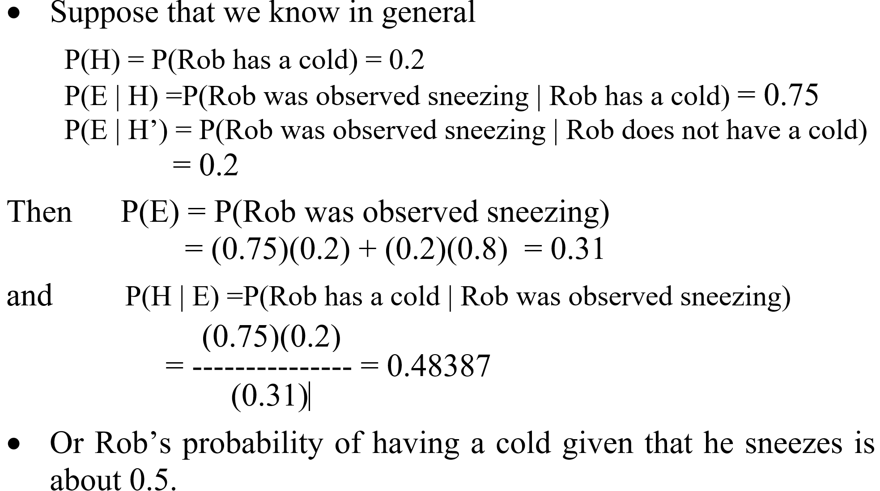
An example

Slide 38
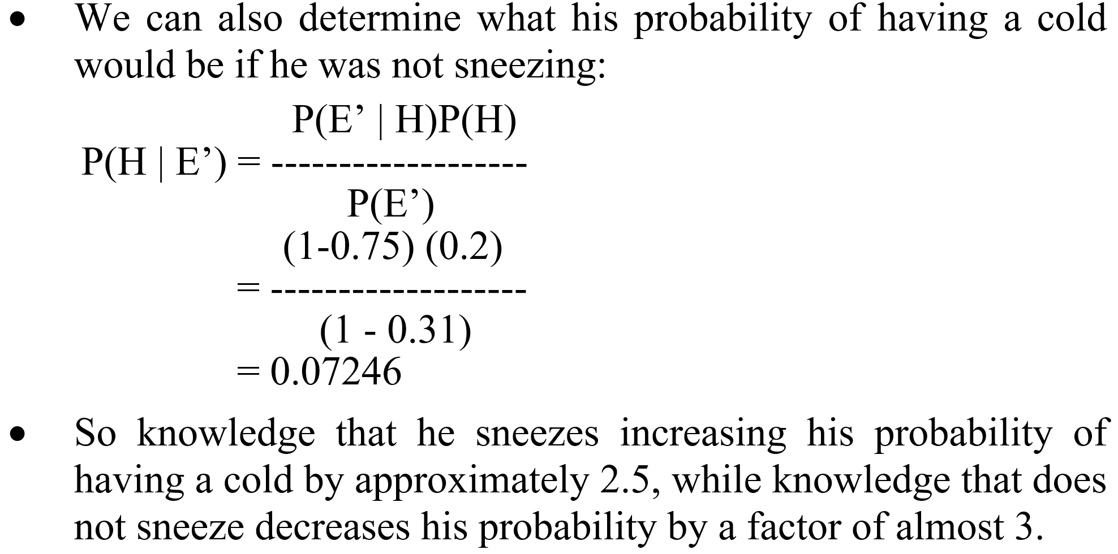
An example (cont.)

Slide 39
Outline
Review of classic probability
Hypothetical reasoning and backward induction
Bayes’ rule and knowledge-based systems
Propagation of Belief
Advantages and disadvantages of Bayesian methods

Slide 40
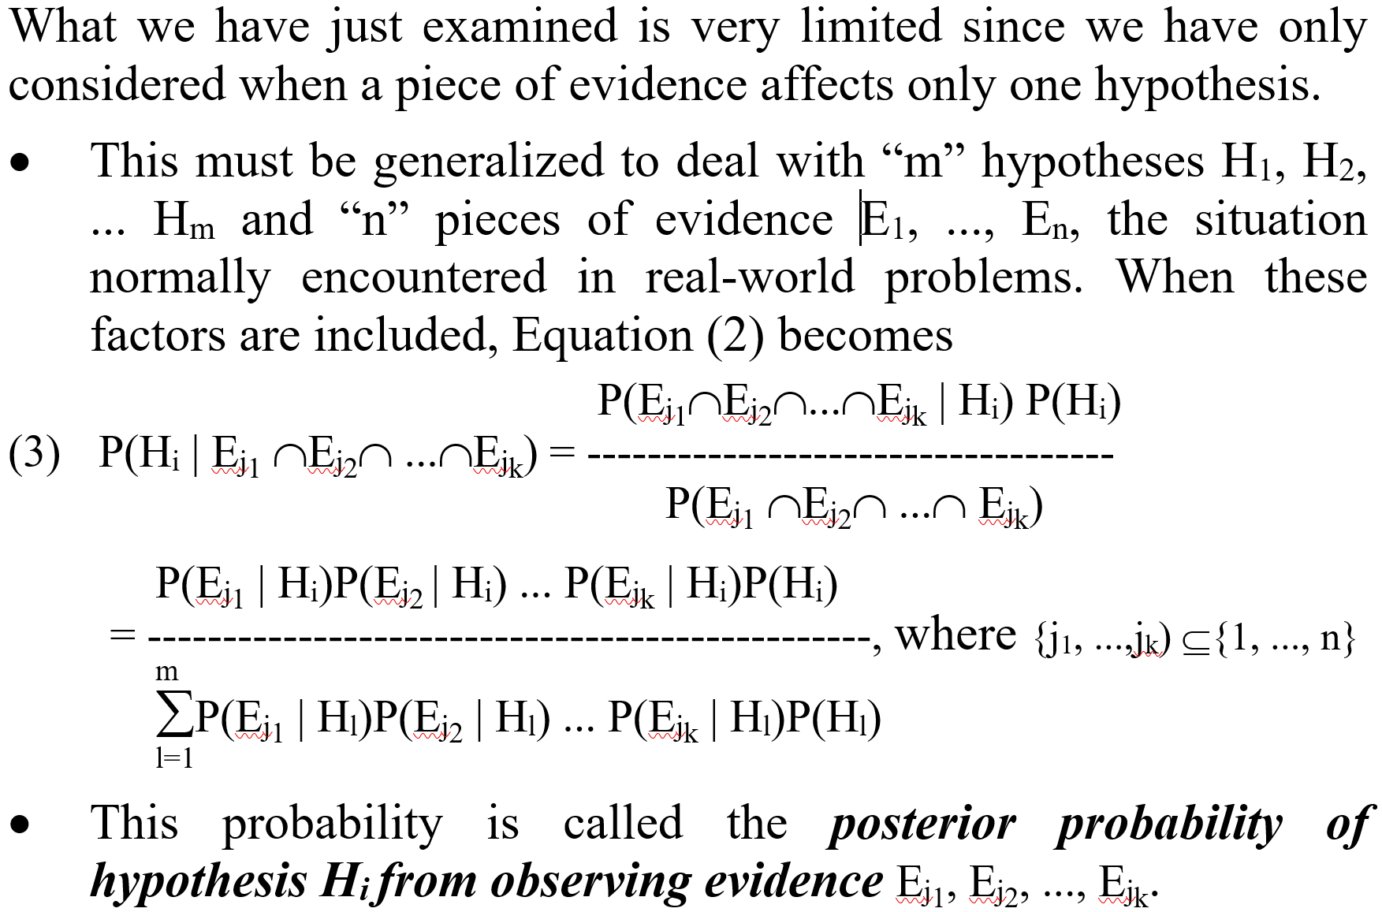
Propagation of beliefs

Slide 41
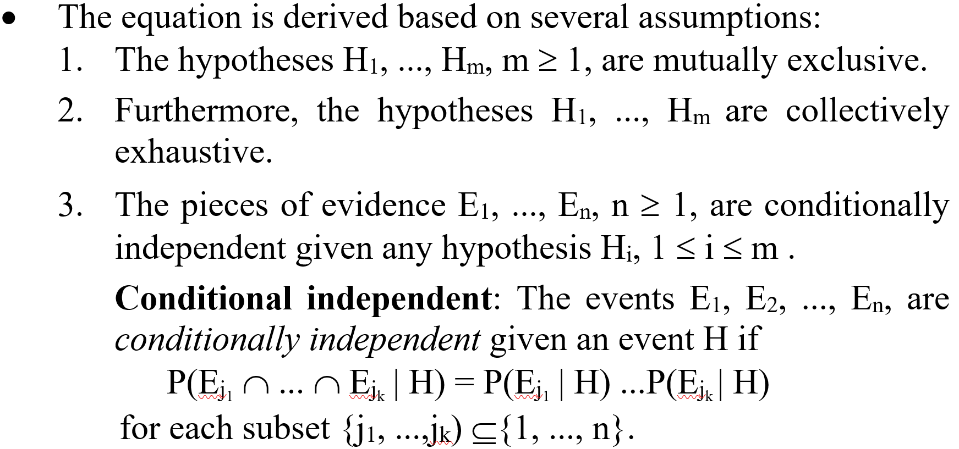
Assumptions of (3)

Slide 42
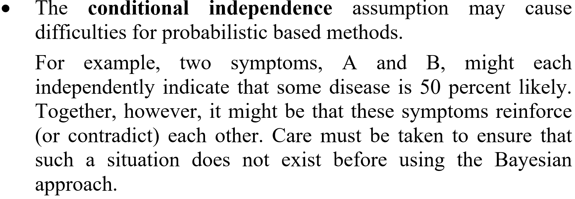
Issue with conditional independence assumption

Slide 43
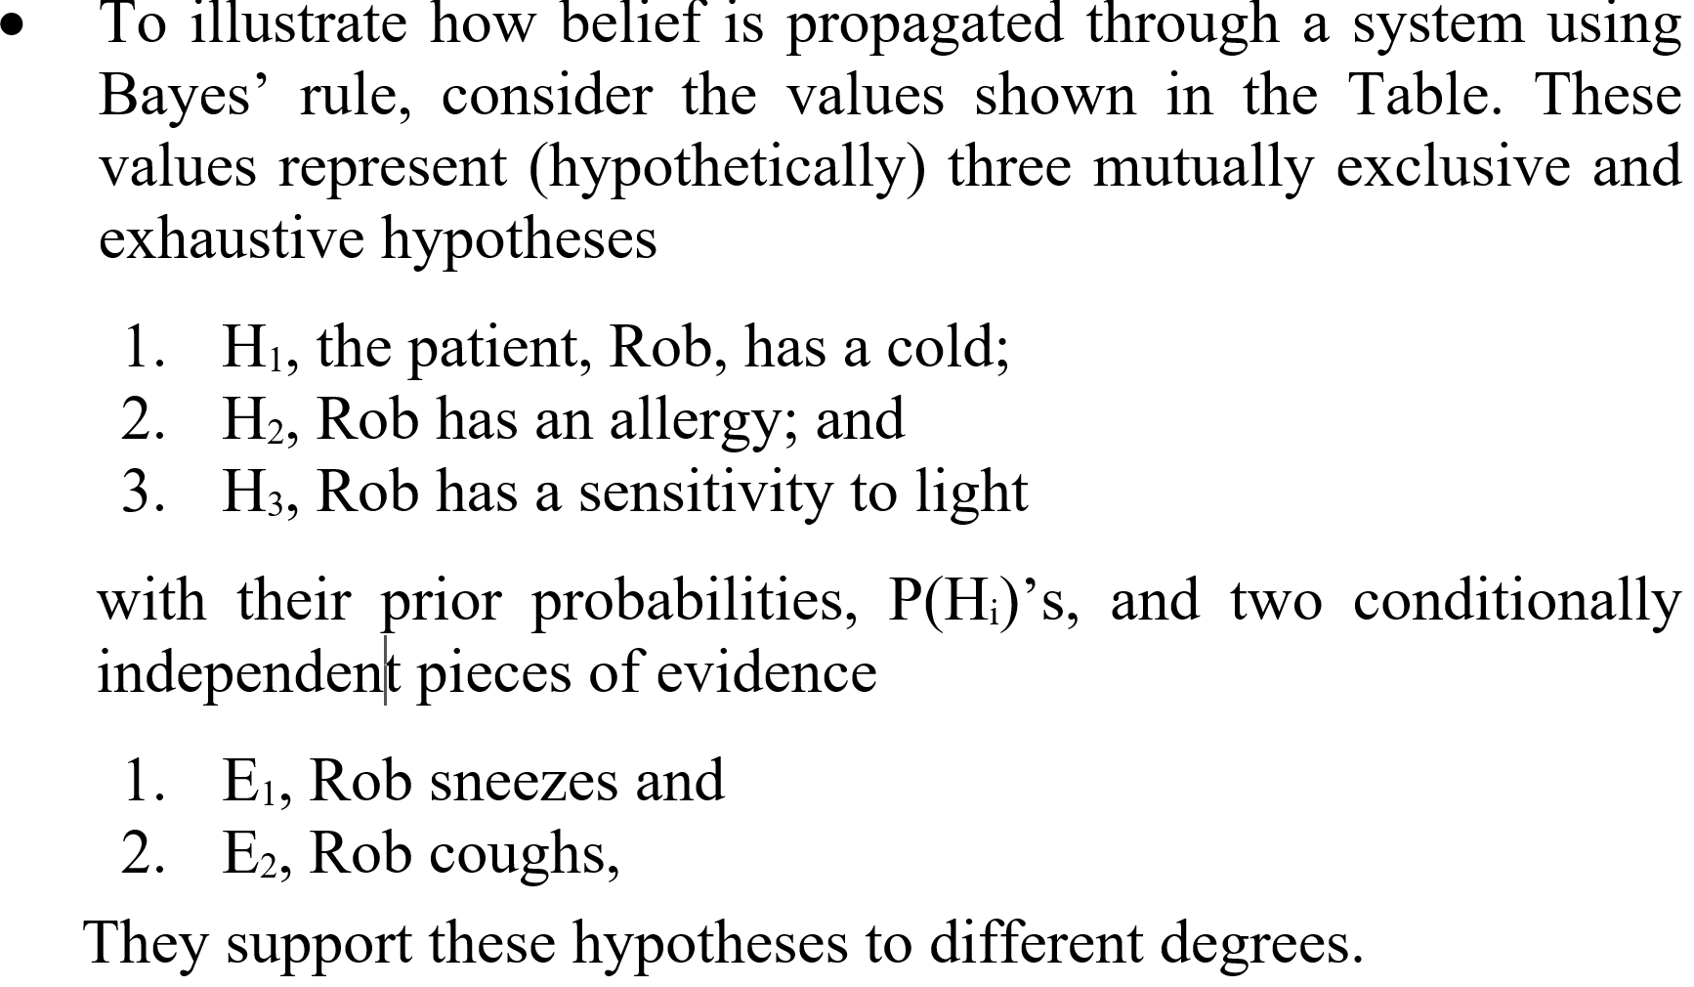
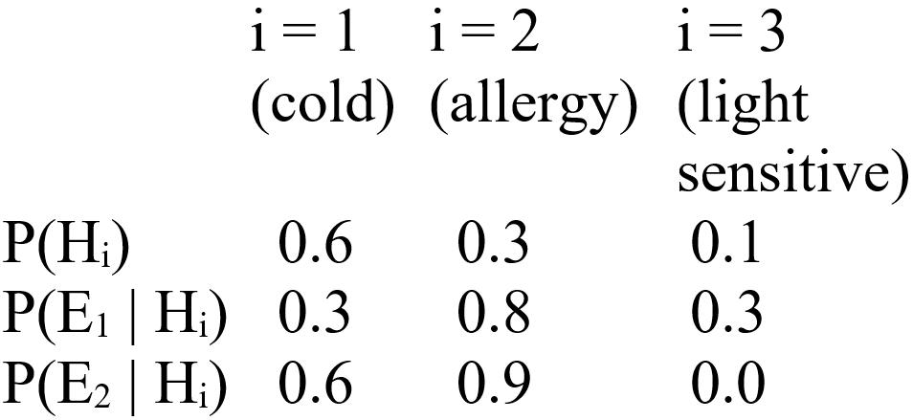
Illustration of belief propagation

Slide 44
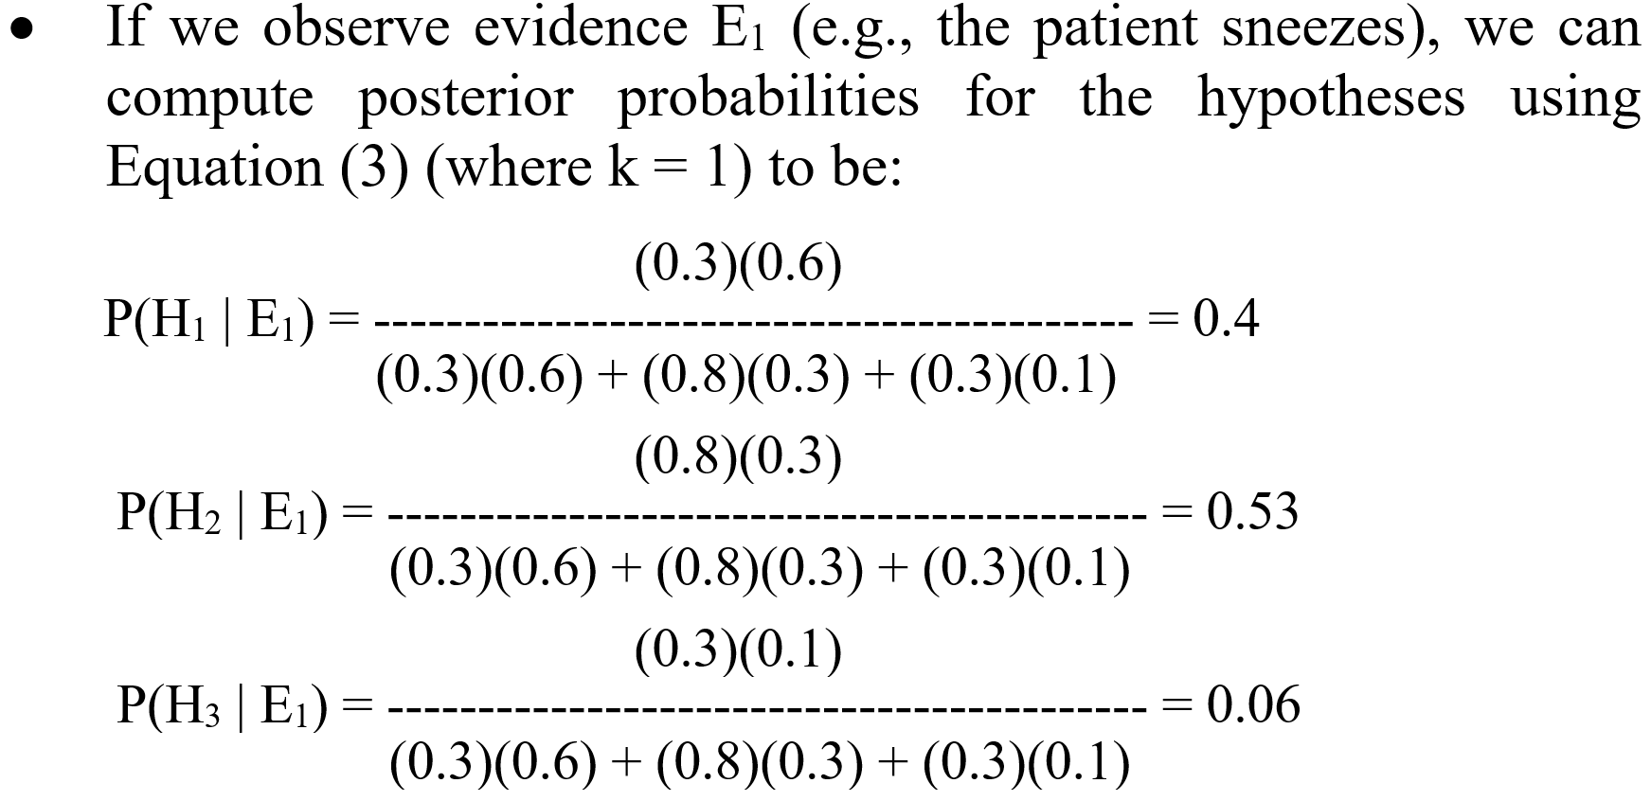
Illustration of belief propagation (cont.)

Slide 45
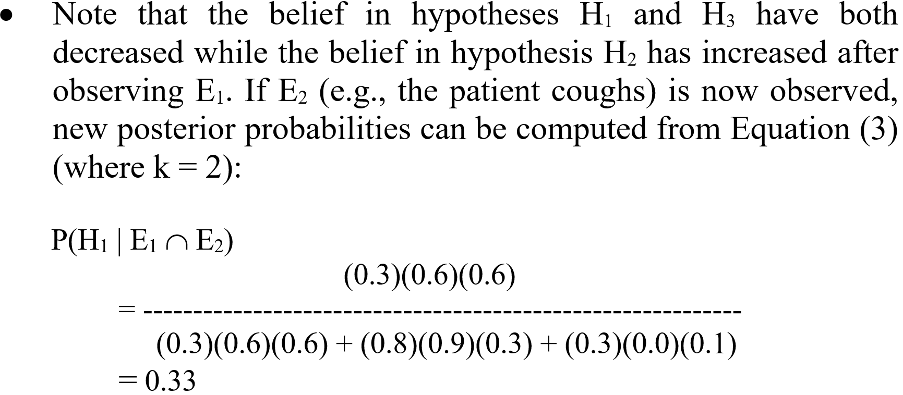
Illustration of belief propagation (cont.)

Slide 46
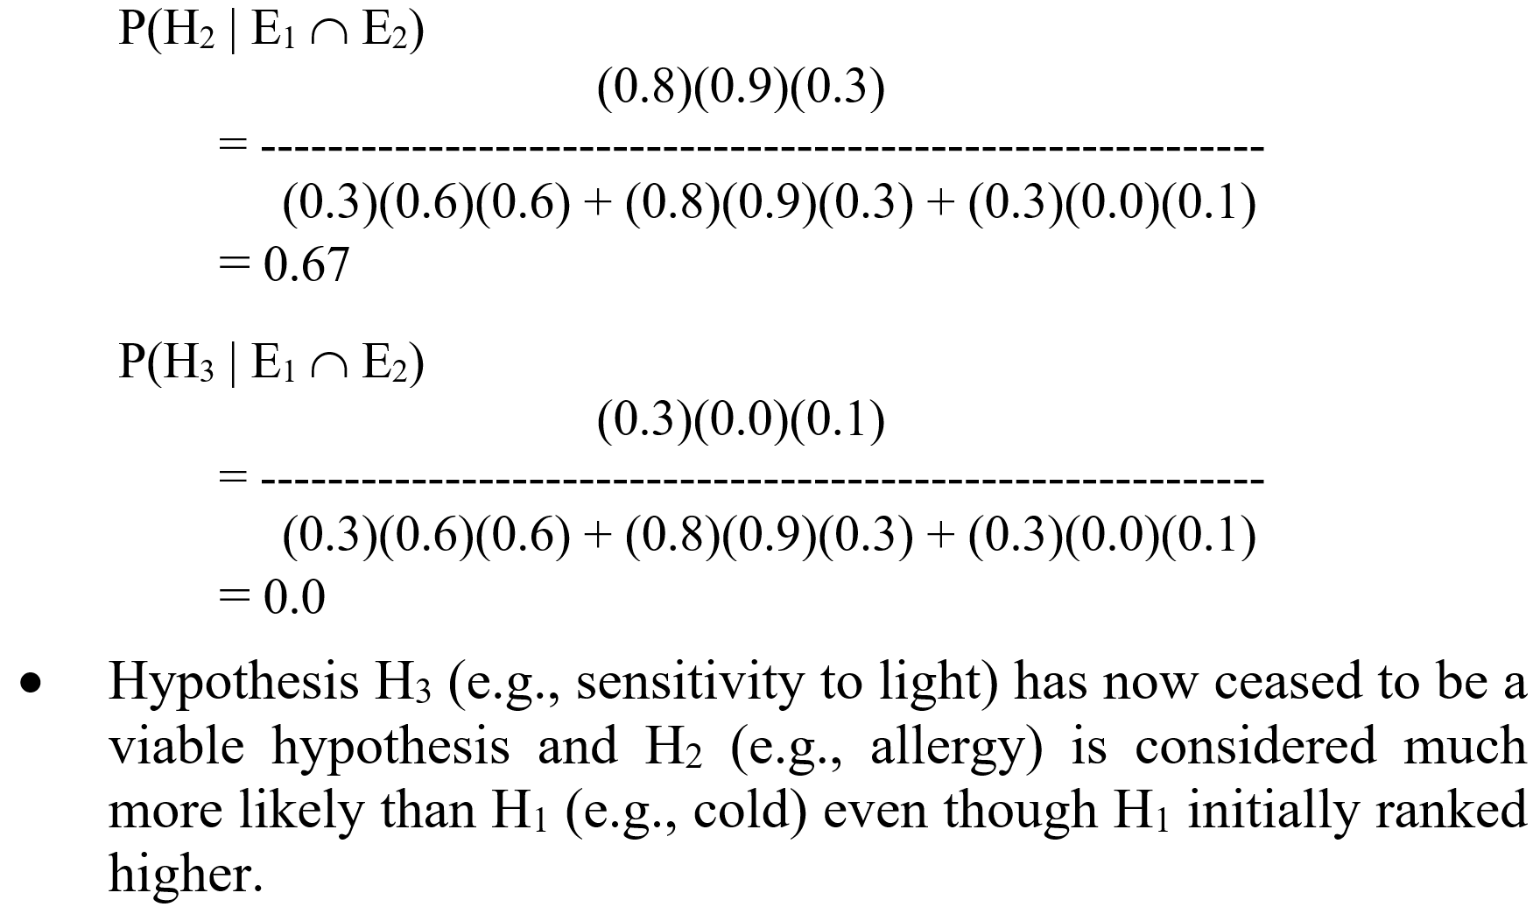
Illustration of belief propagation (cont.)

Slide 47
Outline
Review of classic probability
Hypothetical reasoning and backward induction
Bayes’ rule and knowledge-based systems
Propagation of Belief
Advantages and disadvantages of Bayesian methods

Slide 48
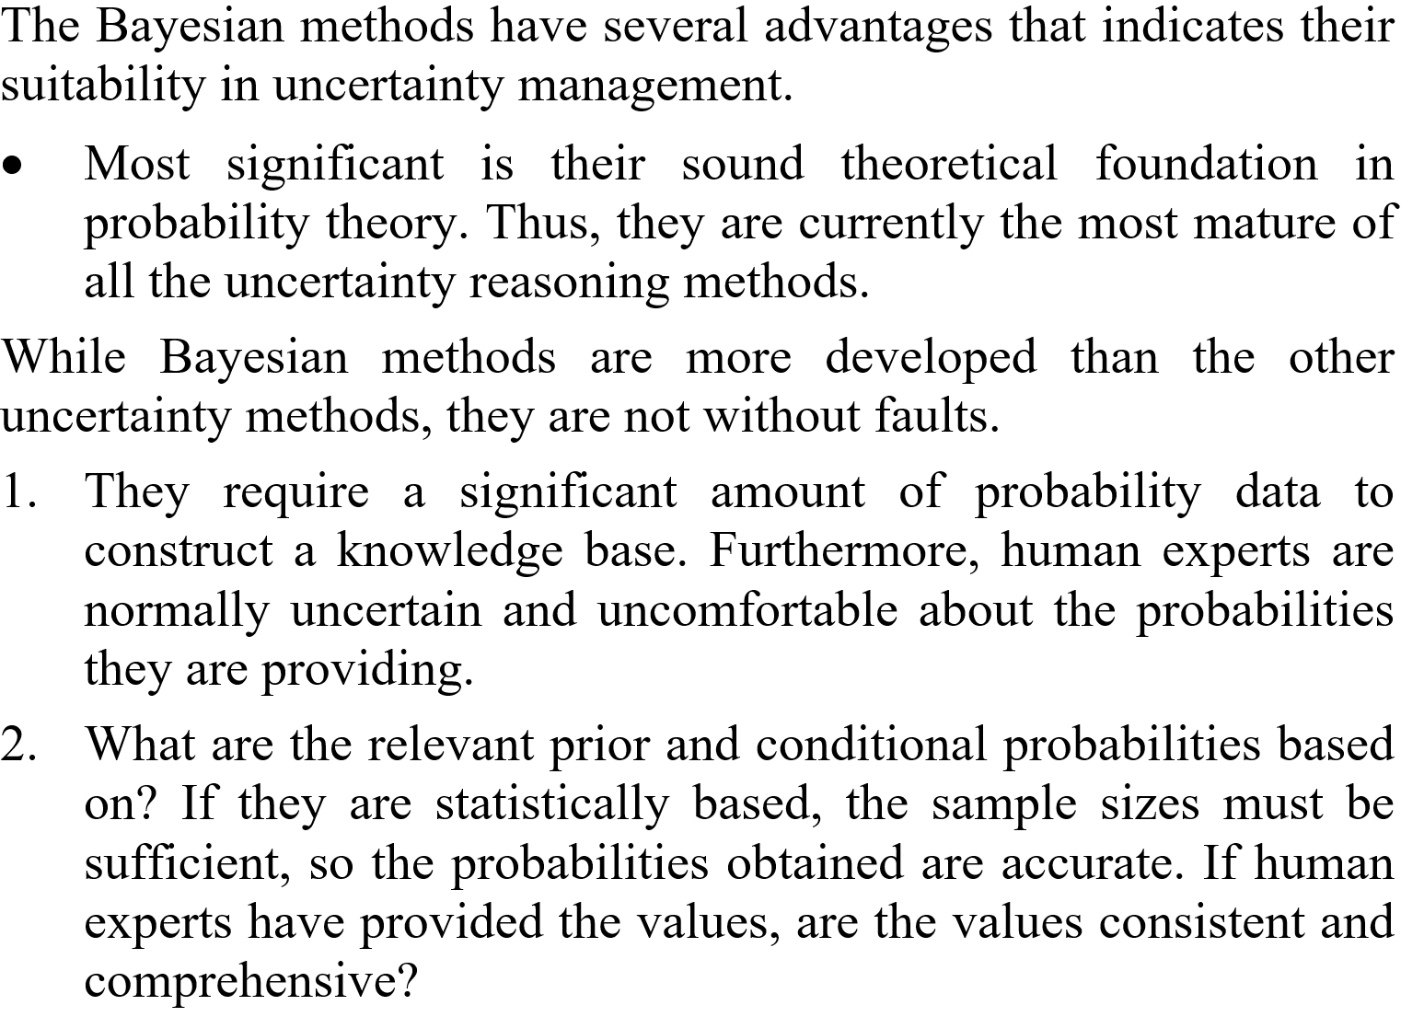
Pros and cons of Bayesian methods

Slide 49
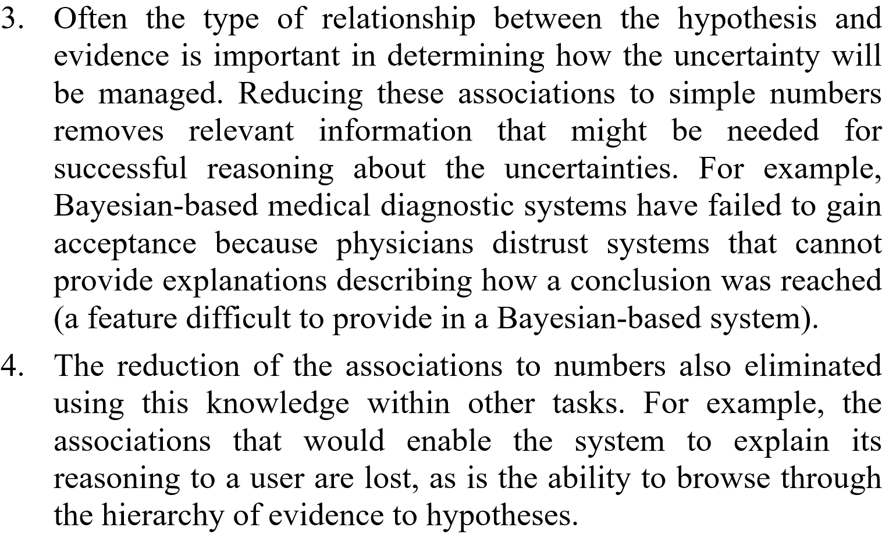
Pros and cons of Bayesian methods (cond.)

Slide 50
Certainty factor

Slide 51
Some difficulties of probabilistic reasoning
Certainty factor is another method of dealing with uncertainty. It was originally developed for the Expert System MYCIN.
One of the difficulties with Bayesian method is that there are too many probabilities required. Most could be unknown.
The problem gets very bad when there are many pieces of evidence.
Besides the problem of amassing all the conditional probabilities for the Bayesian method, another major problem that appeared with medical experts was the relationship of belief and disbelief.

Slide 52
Some difficulties of probabilistic reasoning (cont.)
At first sight, this may appear trivial since obviously disbelief is simply the opposite of belief. In fact, the theory of probability states that
P(H) + P(H’) = 1
and so
P(H) = 1 - P(H’)
For the case of a posterior hypothesis that relies on evidence, E
(1) P(H | E) = 1 - P(H’ | E)
However, when the MYCIN knowledge engineers began interviewing medical experts, they found that physicians were extremely reluctant to state their knowledge in the form of equation (1).

Slide 53
Some difficulties of probabilistic reasoning (cont.)
For example, consider a MYCIN rule such as the following.
IF 1) The stain of the organism is gram positive, and
2) The morphology of the organism is coccus, and
3) The growth conformation of the organism is chains
THEN There is suggestive evidence (0.7) that the
identity of the organism is streptococcus
This can be written in terms of posterior probability:
(2) P(H | E₁∩ E₂ ∩ E₃) = 0.7
where the E_{i} correspond to the three patterns of the antecedent.

Slide 54
Probability or belief
The MYCIN knowledge engineers found that while an expert would agree to equation (2), they became uneasy and refused to agree with the probability result
(3) P(H’ | E₁∩ E₂ ∩ E₃) = 1 - 0.7 = 0.3
This illustrates these numbers such as 0.7 and 0.3 are likelihoods of belief, not probabilities.

Slide 55
An example
Suppose this is your last course required for a degree. Assume your grade-point-average (GPA) has not been too good and you need an ‘A’ in this course to bring up your GPA.
The following formula may express your belief in the likelihood of graduation.
(4) P(graduating | ‘A’ in this course) = 0.70
Notice that this likelihood is not 100%. The reason it’s not 100% is that a final audit of your course and grades must be made by the school. There could be problem due to a number of reasons that would still prevent your graduation.

Slide 56
Example (cont.)
Assuming that you agree with (4) (or perhaps your own value for the likelihood) then by equation (1)
(5) P(not graduating | ‘A’ in this course) = 0.30
From a probabilistic point of view, (5) is correct. However,
it seems intuitively wrong.
It is just not right that if you really work hard and get an ‘A’ in this course, then there is a 30% chance that you won’t graduate.
(5) should make you uneasy.

Slide 57
Certainty factor
The fundamental problem is that while P(H | E) implies a cause of effect relationship between E and H, there may be no cause-and-effect relationship between E and H’.
These problems with the theory of probability led the researchers in MYCIN to investigate other ways of representing uncertainty.
The method that they used in MYCIN was based on certainty factors.

Slide 58
Measures of belief and disbelief
In MYCIN, the certainty factor (CF) was originally defined as the difference between belief and disbelief.
CF(H, E) = MB(H, E) - MD(H, E)
where
CF is the certainty factor in the hypothesis H due to evidence E
MB is the measure of increased belief in H due to E
MD is the measure of increased disbelief in H due to E

Slide 59
Measures of belief and disbelief (cont.)
The certainty factor is a way of combining belief and disbelief into a single number.
which has some interesting uses.
The certainty factor can be used to rank hypothesis in order of importance.
E.g., if a patient has certain symptoms which suggest several possible diseases, then the disease with the highest CF would be the one that is first investigated by ordering tests.

Slide 60
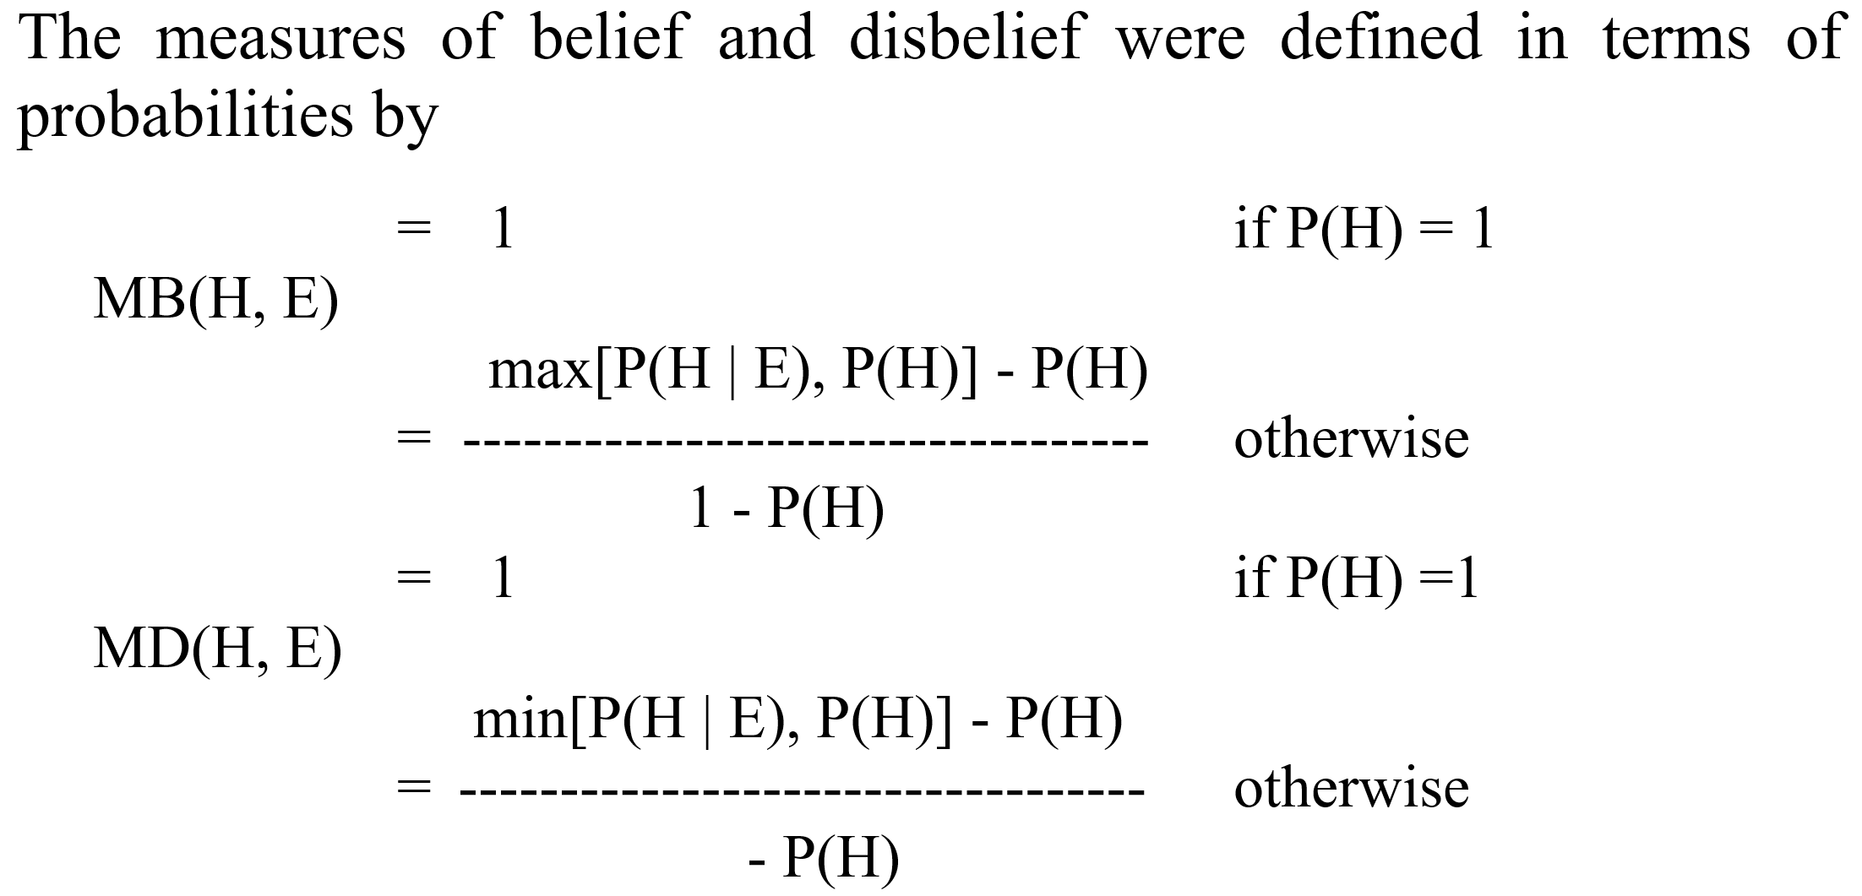
Measures of belief and disbelief (cont.)

Slide 61
Some characteristics of the definition

Slide 62
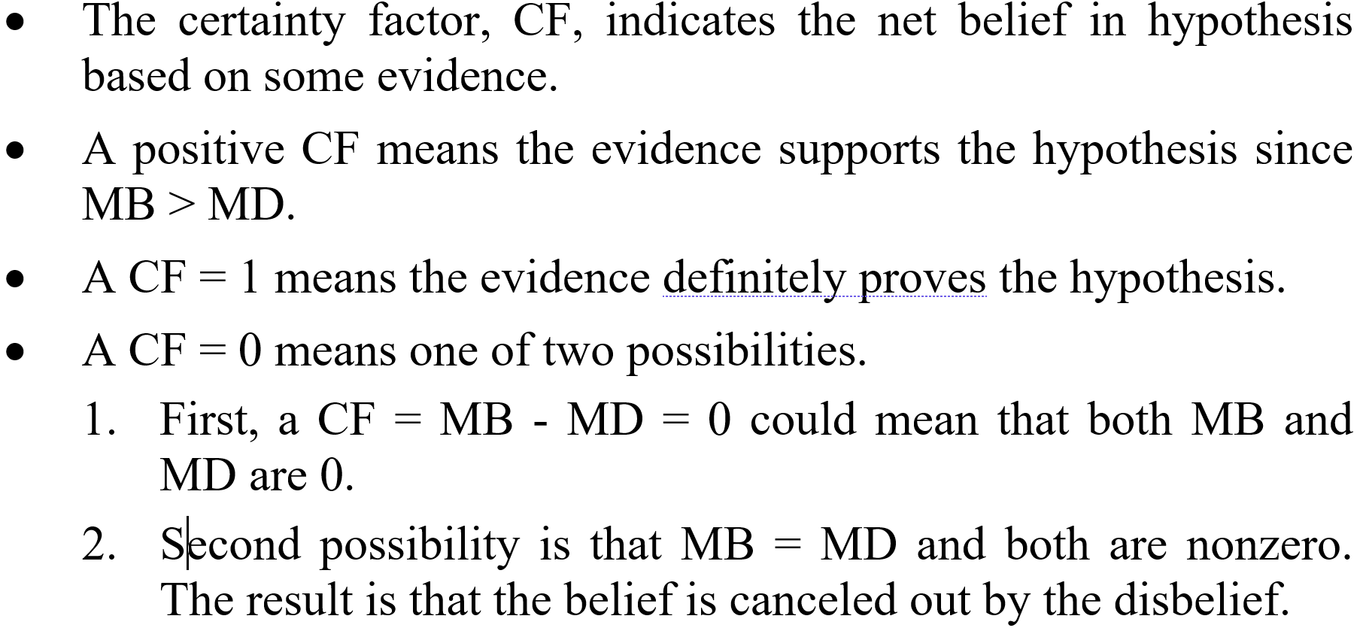
Certainty factor: Net belief in hypothesis

Slide 63
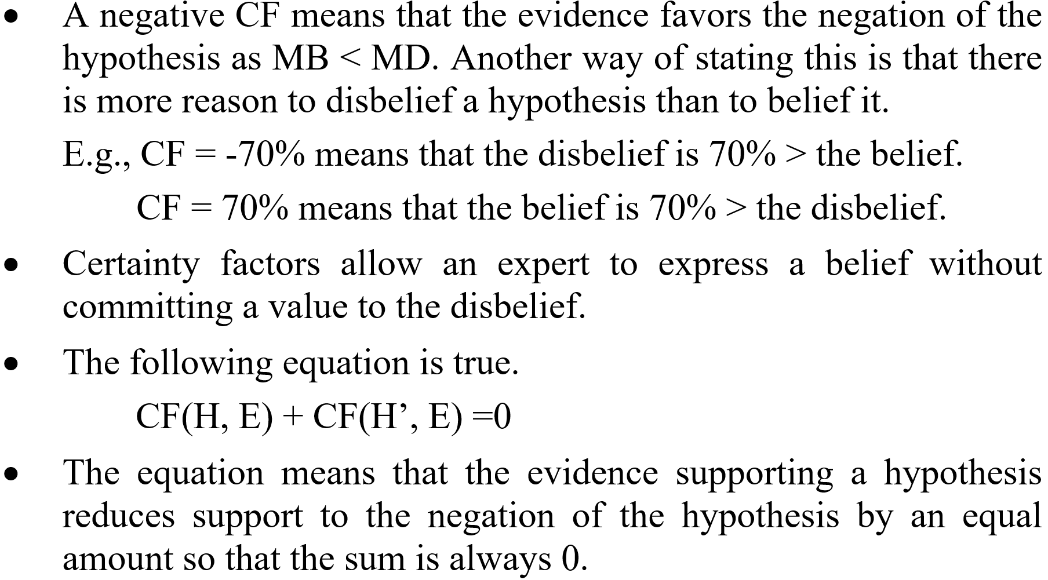
Certainty factor: Net belief in hypothesis (cont.)

Slide 64
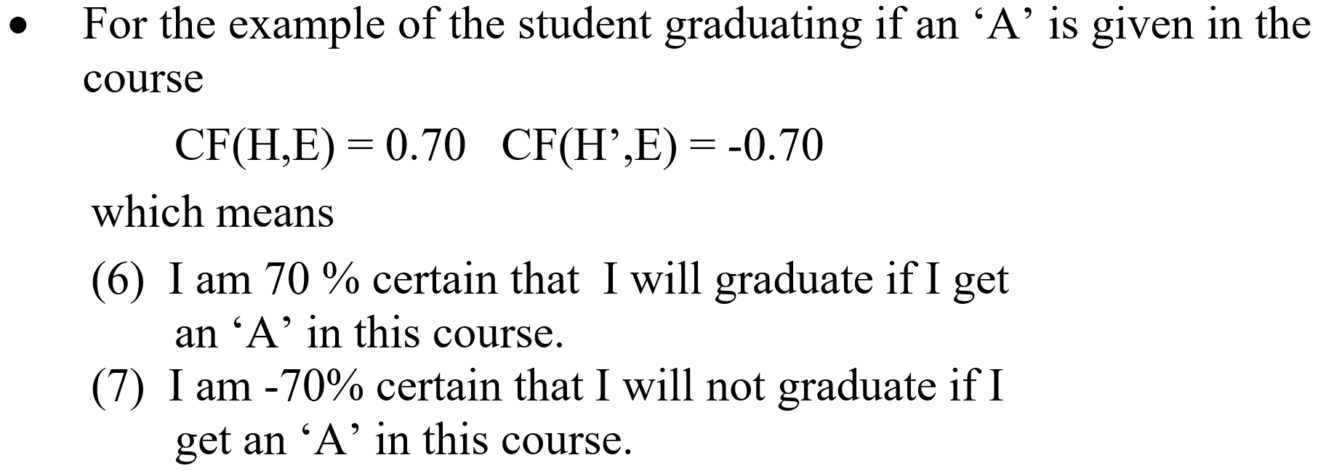
Example

Slide 65
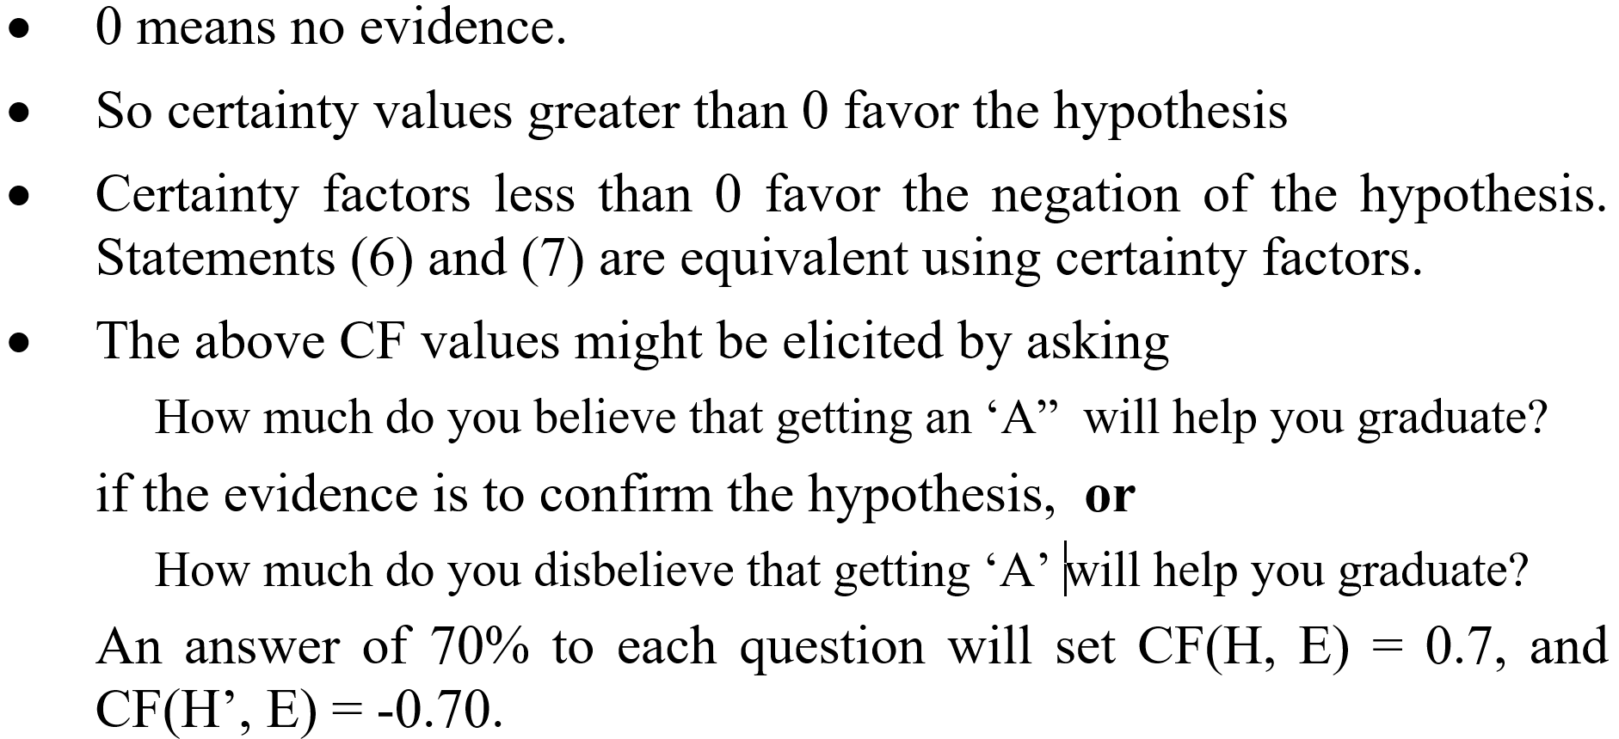
Example (cont.)

Slide 66
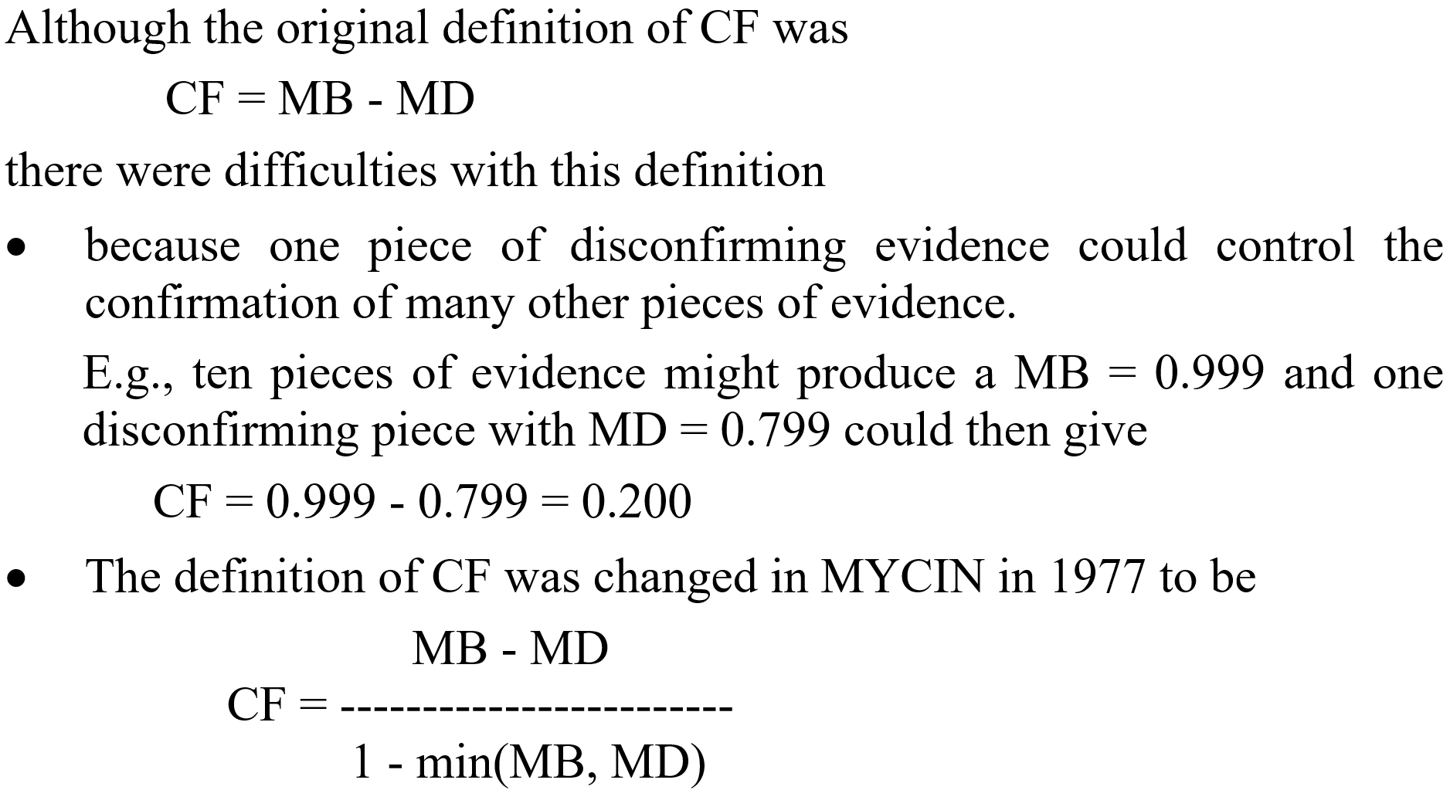
Calculation with Certainty Factors

Slide 67
Calculation with Certainty Factor (cont.)

Slide 68
Example

Slide 69
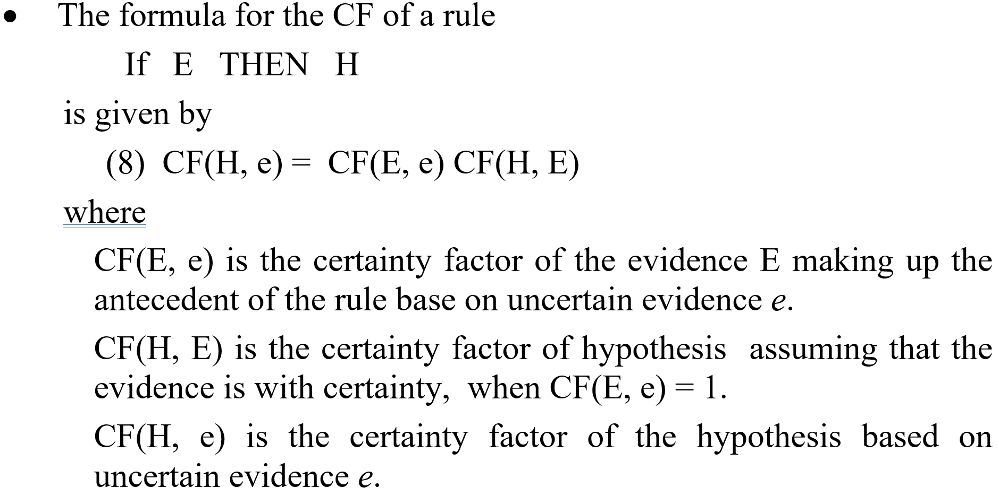
Calculation with Certainty Factor (cont.)

Slide 70
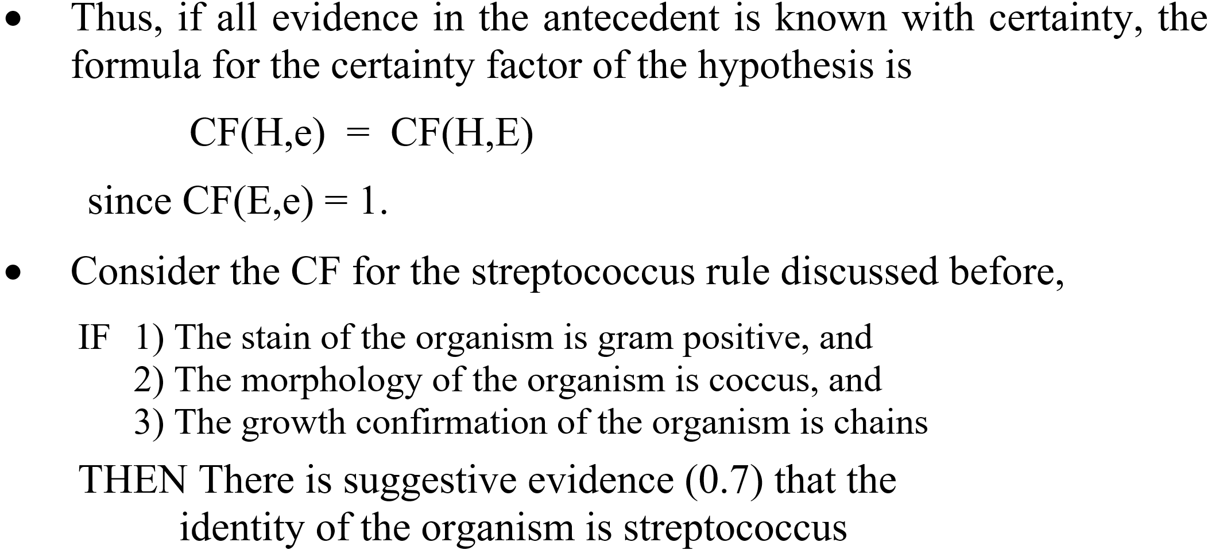
Calculation with Certainty Factor (cont.)

Slide 71
Calculation with Certainty Factor (cont.)

Slide 72
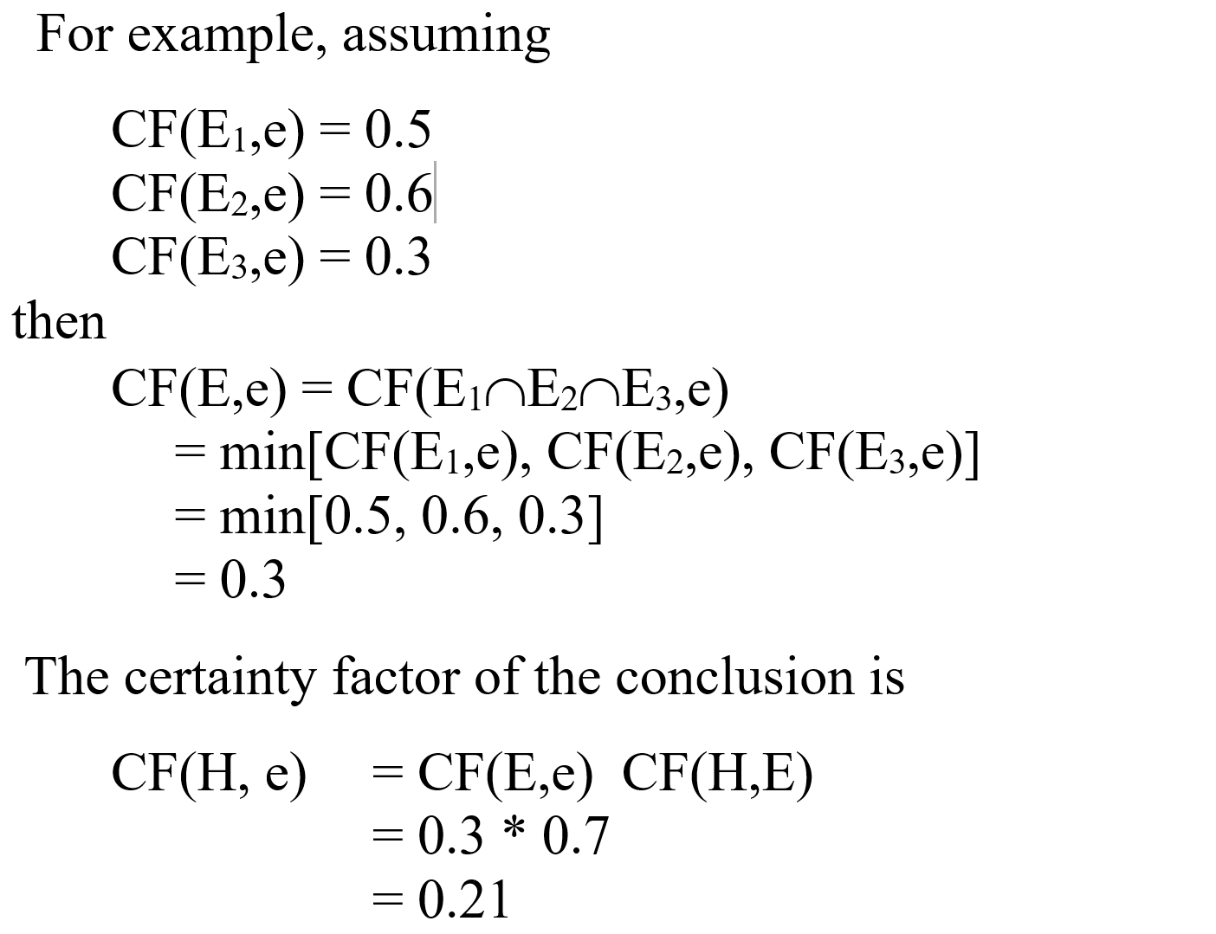
Example

Slide 73
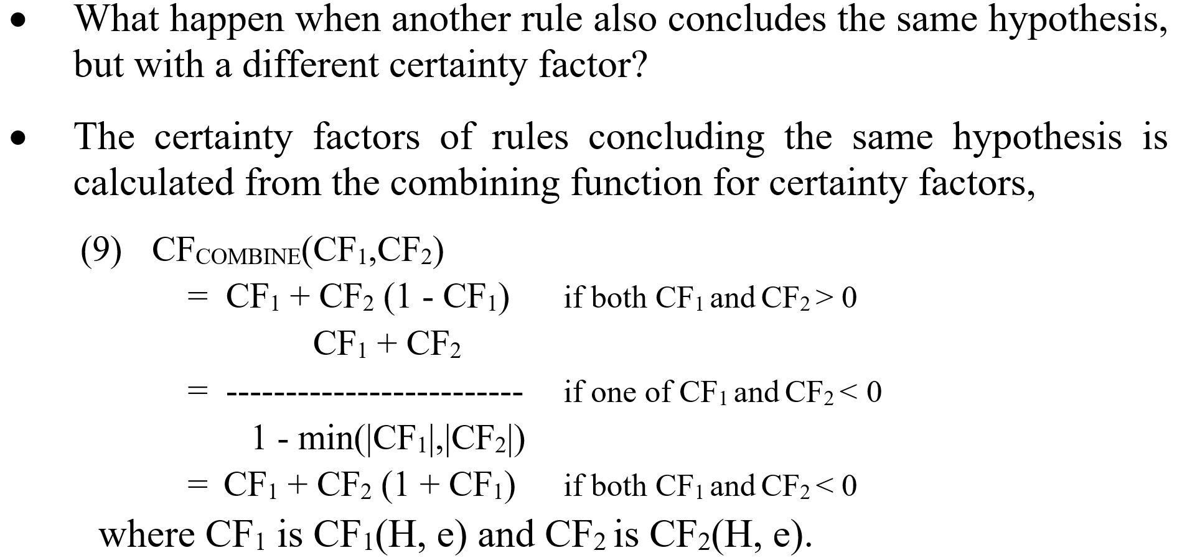
Combining certainties

Slide 74
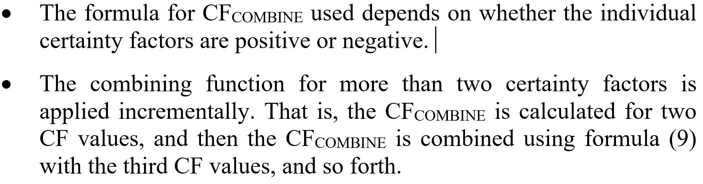
Combining certainties (cont.)

Slide 75
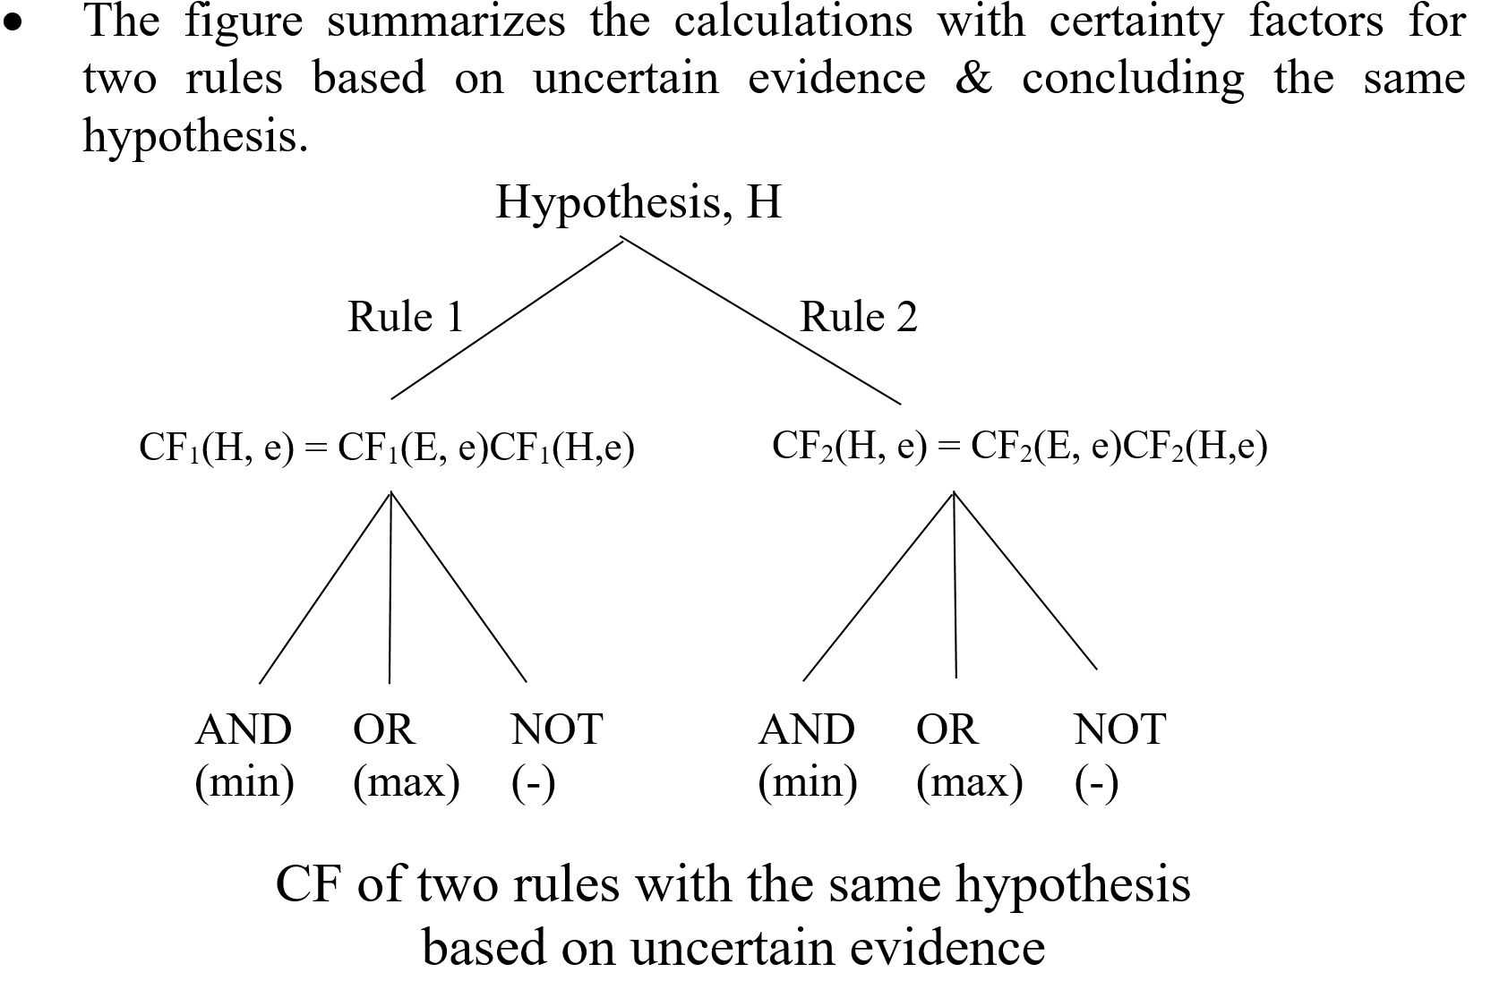
Put them together

Slide 76
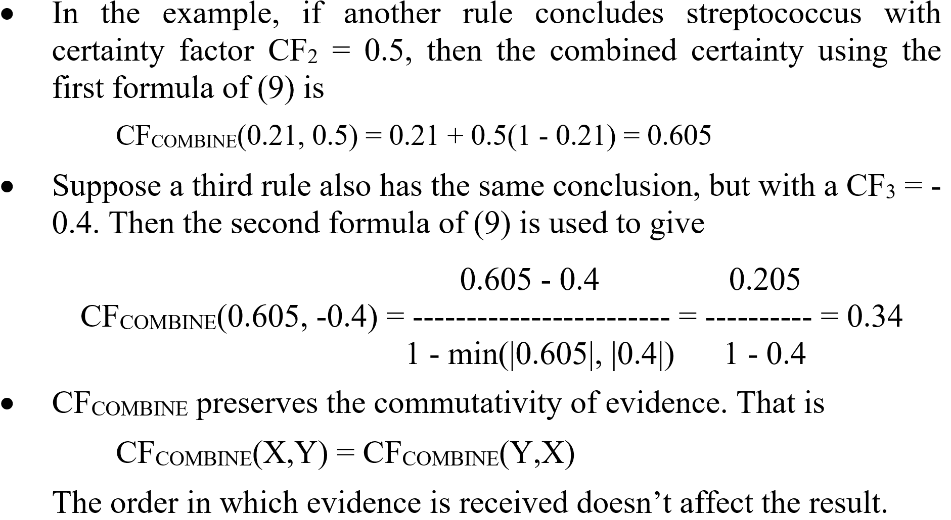
More combination

Slide 77
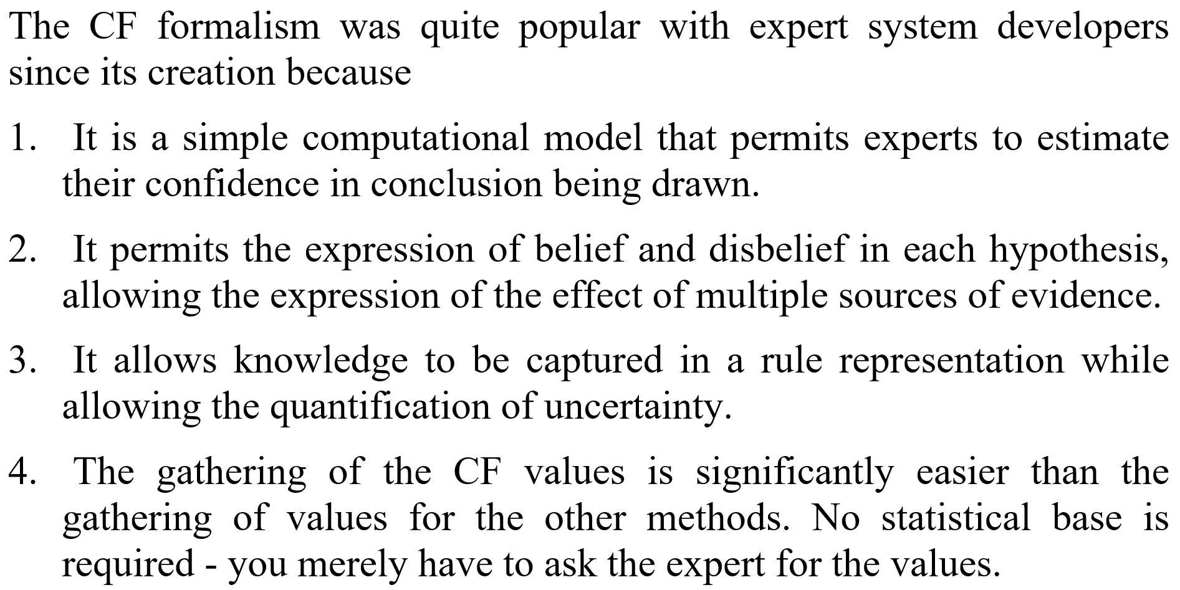
Pros and cons of certainty factors

Slide 78
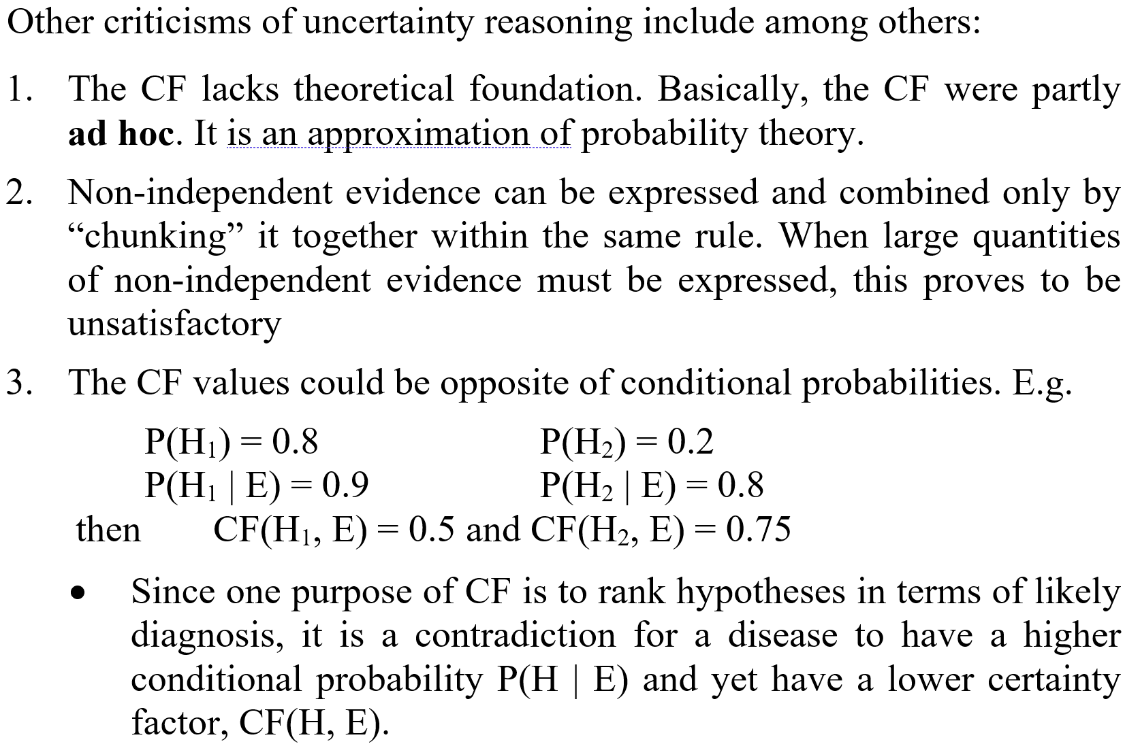
Pros and cons of certainty factors (cont.)

