Slide 1
Linear Regression and Logistic Regression
Many slides are borrowed from Jia-Bin Huang and Matt Gormley

Slide 2
Outline
Linear regression formulation
Gradient descent
Gradient descent for linear regression
Regularization
Logistic regression
Summary

Slide 3
Linear regression
Supervised learning has two main types
Classification: discrete predictive/output variable
Regression: continuous predictive/output variable
We first study linear regression, i.e., the predictive function h is a linear function.

Slide 4
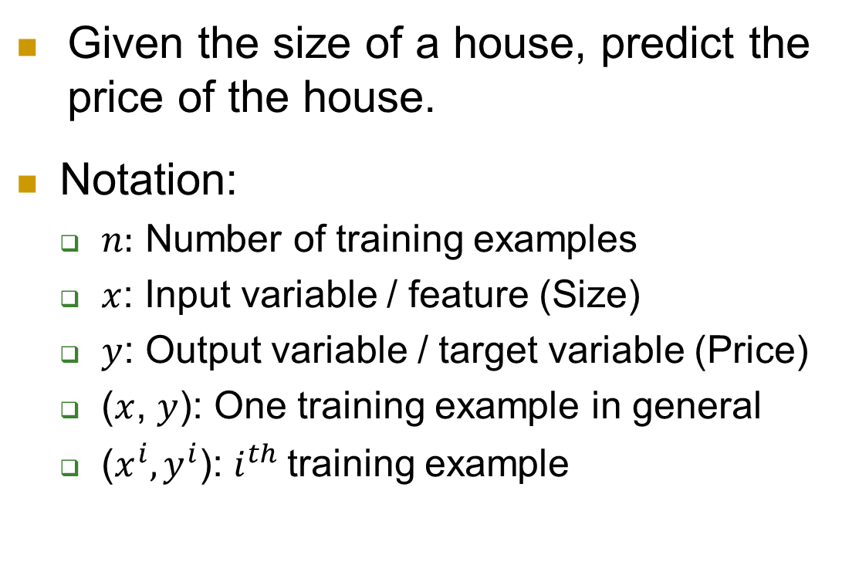
An example: housing price prediction
Given the size of a house, predict the price of the house.
Notation:
$n:$ Number of training examples
$x$: Input variable / feature (Size)
$y$: Output variable / target variable (Price)
($x$, $y$): One training example in general
($x^{i},y^{i}$): $i^{th}$training example
Training data
Size in feet^2 (x) | Price ($) in 1000’s (y)
2104 | 460
1416 | 232
1534 | 315
852 | 178
… | …

Slide 5
Training data and linear function
Price ($) (in 1000’s)
400
300
200
100
Size
(in feet²)
500
1000
1500
2000
2500

Slide 6
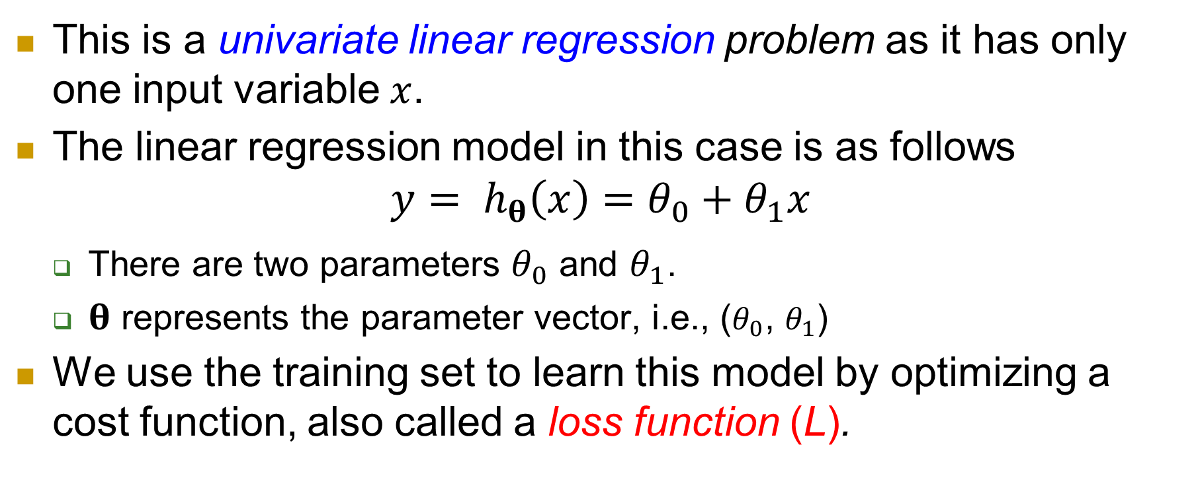
Model representation
This is a univariate linear regression problem as it has only one input variable $x$.
The linear regression model in this case is as follows
$$y= h_{θ}\left(x\right)=θ_{0}+θ_{1}x$$
There are two parameters $θ_{0}$ and $θ_{1}$.
$θ$ represents the parameter vector, i.e., ($θ_{0}$, $θ_{1}$)
We use the training set to learn this model by optimizing a cost function, also called a loss function (L).

Slide 7
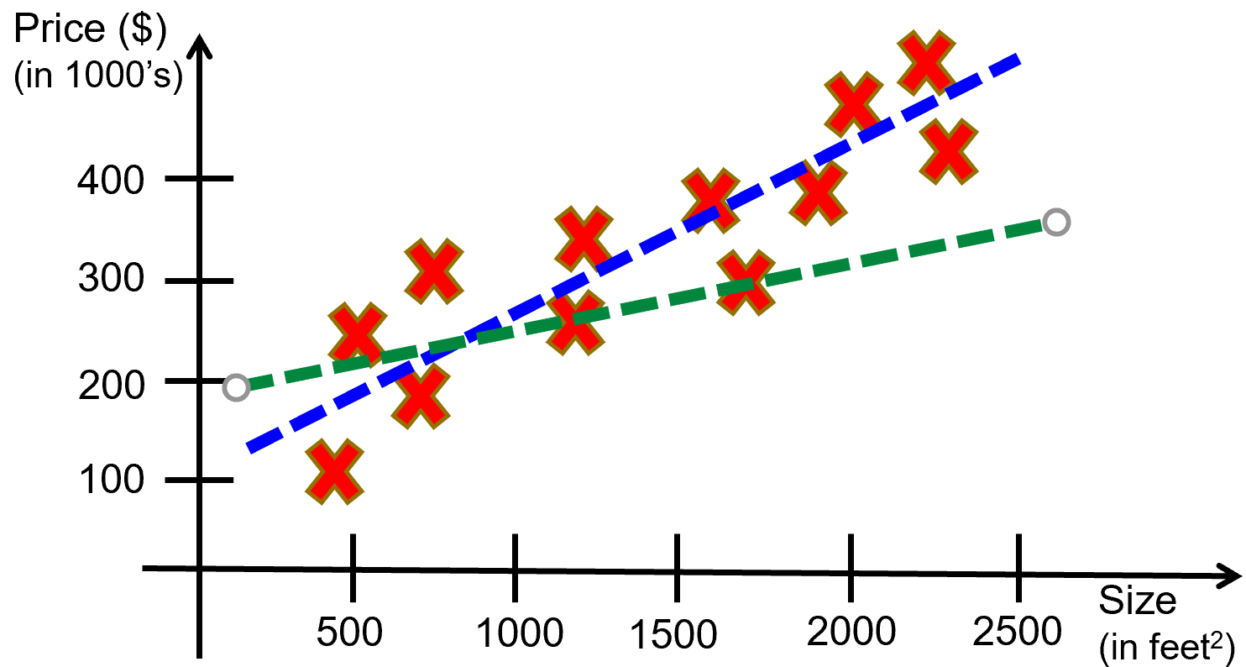
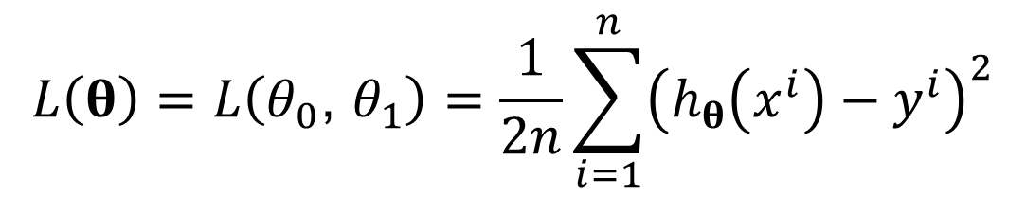



Loss function
Idea: select $θ_{0}\text{, }θ_{1}$ so that $h_{θ}\left(x\right)$ is close to $y$ for the training example $\left(x,y\right)$. This is expressed with a loss function.
Loss function (L) used by linear regression:
where $h_{θ}\left(x^{i}\right)=θ_{0}+θ_{1}x^{i}$
Learning goal:
$$L\left(θ\right)=L\left(θ_{0}\text{, }θ_{1}\right)=\frac{1}{2n}\sum_{i=1}^{n}{{\left(h_{θ}\left(x^{i}\right)−y^{i}\right)}^{2}}$$
Blue line is better than green line
$argmin$ $L\left(θ_{0}\text{, }θ_{1}\right)$
$$θ_{0}\text{, }θ_{1}$$

Slide 8
Solve the minimization problem
The learning is done using a general technique called
gradient descent

Slide 9
Outline
Linear regression formulation
Gradient descent
Gradient descent for linear regression
Regularization
Logistic regression
Summary

Slide 10

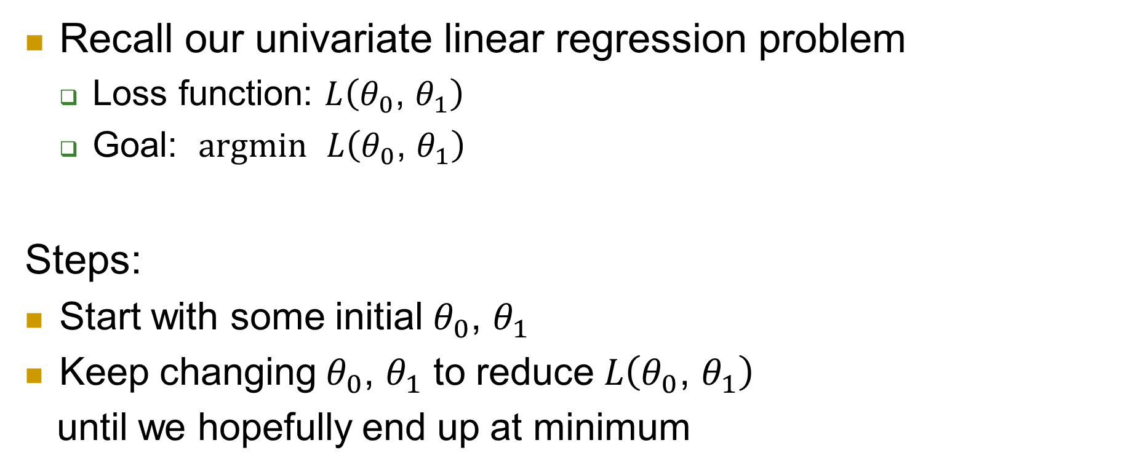
Gradient descent
Recall our univariate linear regression problem
Loss function: $L\left(θ_{0}\text{, }θ_{1}\right)$
Goal: $argmin$ $L\left(θ_{0}\text{, }θ_{1}\right)$
Steps:
Start with some initial $θ_{0}\text{, }θ_{1}$
Keep changing $θ_{0}\text{, }θ_{1}$ to reduce $L\left(θ_{0}\text{, }θ_{1}\right)$
until we hopefully end up at minimum
$$θ_{0}\text{, }θ_{1}$$

Slide 11
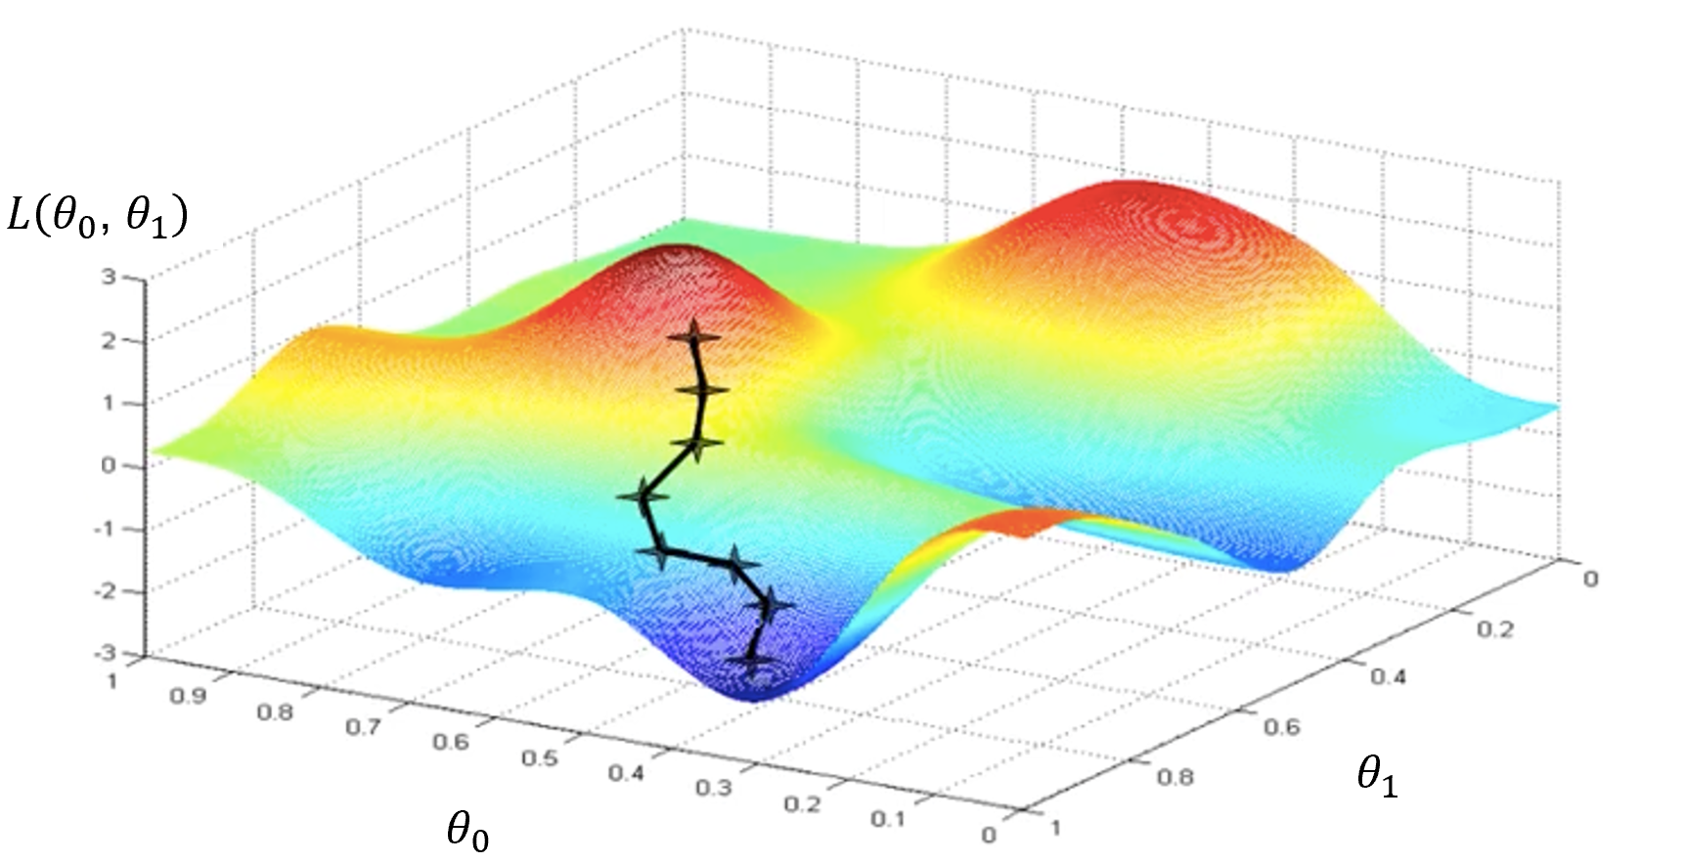
An illustration

Slide 12



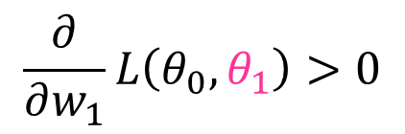

Keep going downhill
Learning rule: $θ_{1} ≔θ_{1}−α \frac{∂}{∂θ_{1}}L\left(θ_{0},θ_{1}\right)$
$$L\left(θ_{0},θ_{1}\right)$$
3
$$\frac{∂}{∂θ_{1}}L\left(θ_{0},θ_{1}\right)<0$$
2
$$\frac{∂}{∂w_{1}}L\left(θ_{0},θ_{1}\right)>0$$
1
$$θ_{1}$$
0
1
2
3

Slide 13
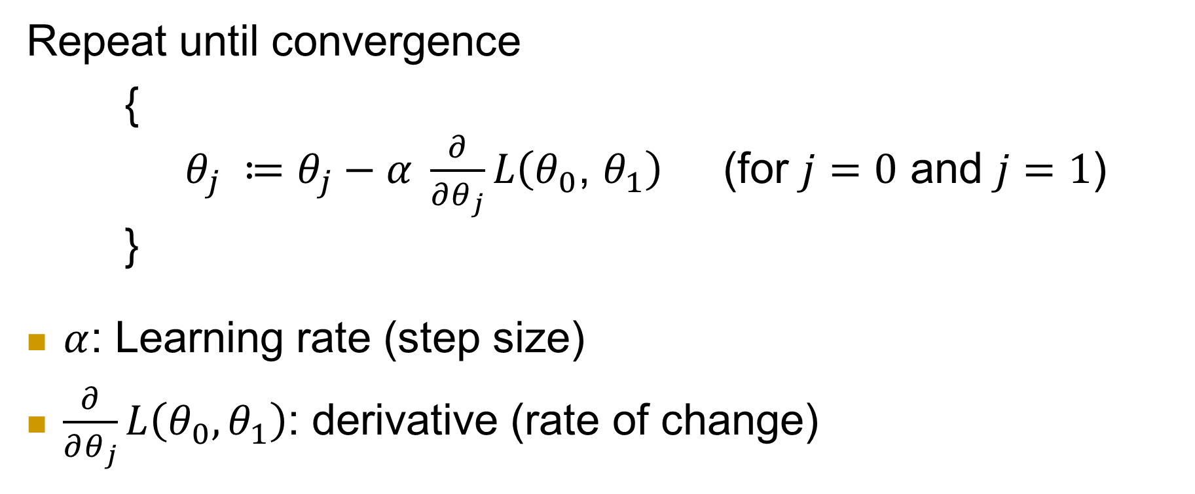
Gradient descent algorithm
Repeat until convergence
{
$θ_{j} ≔θ_{j}−α \frac{∂}{∂θ_{j}}L\left(θ_{0}\text{, }θ_{1}\right)$ (for $j=0$ and $j=1$)
}
$α$: Learning rate (step size)
$\frac{∂}{∂θ_{j}}L\left(θ_{0}, θ_{1}\right)$: derivative (rate of change)

Slide 14
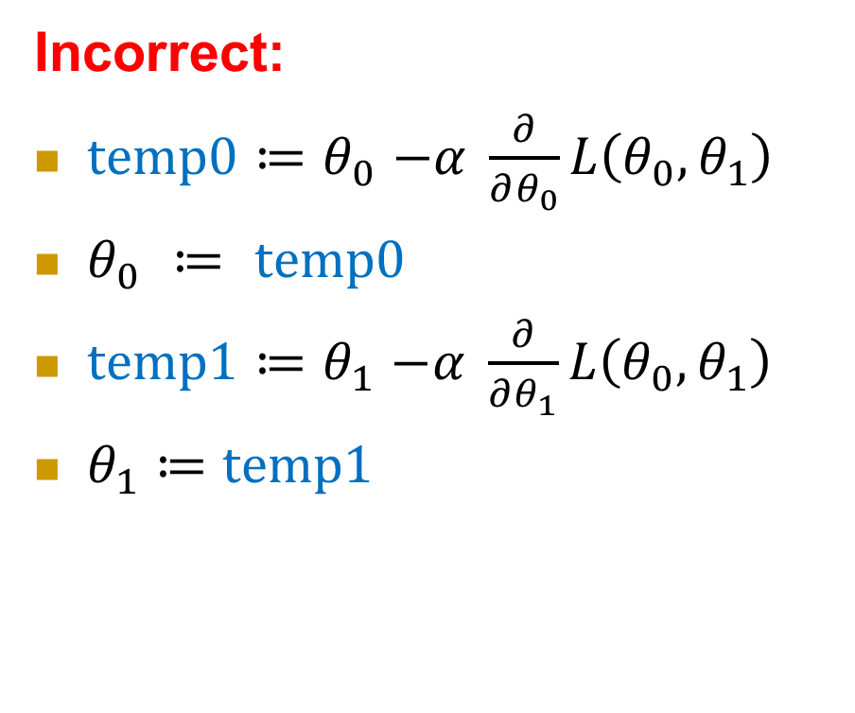
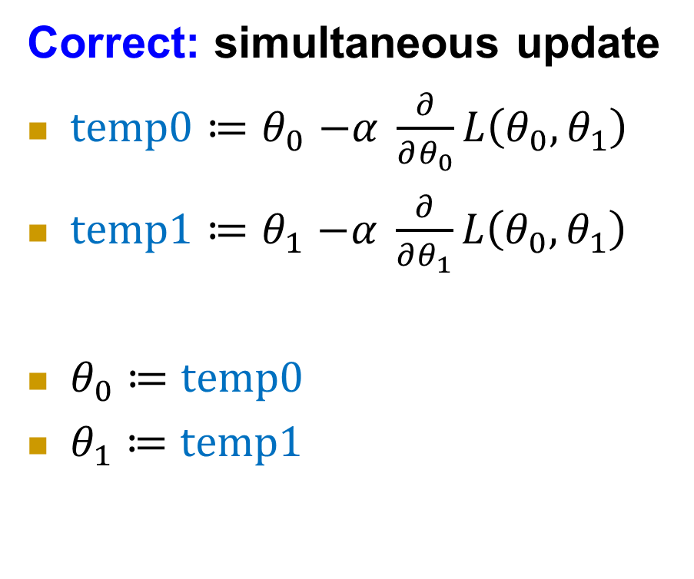
How to update
Correct: simultaneous update
$temp0{≔θ}_{0}−α \frac{∂}{∂θ_{0}}L\left(θ_{0}, θ_{1}\right)$
$temp1{≔θ}_{1}−α \frac{∂}{∂θ_{1}}L\left(θ_{0}, θ_{1}\right)$
$θ_{0}$ $≔$ $temp0$
$θ_{1}$ $≔$ $temp1$
Incorrect:
$temp0{≔θ}_{0}−α \frac{∂}{∂θ_{0}}L\left(θ_{0}, θ_{1}\right)$
$θ_{0} ≔ temp0$
$temp1{≔θ}_{1}−α \frac{∂}{∂θ_{1}}L\left(θ_{0}, θ_{1}\right)$
$θ_{1}$ $≔$ $temp1$

Slide 15
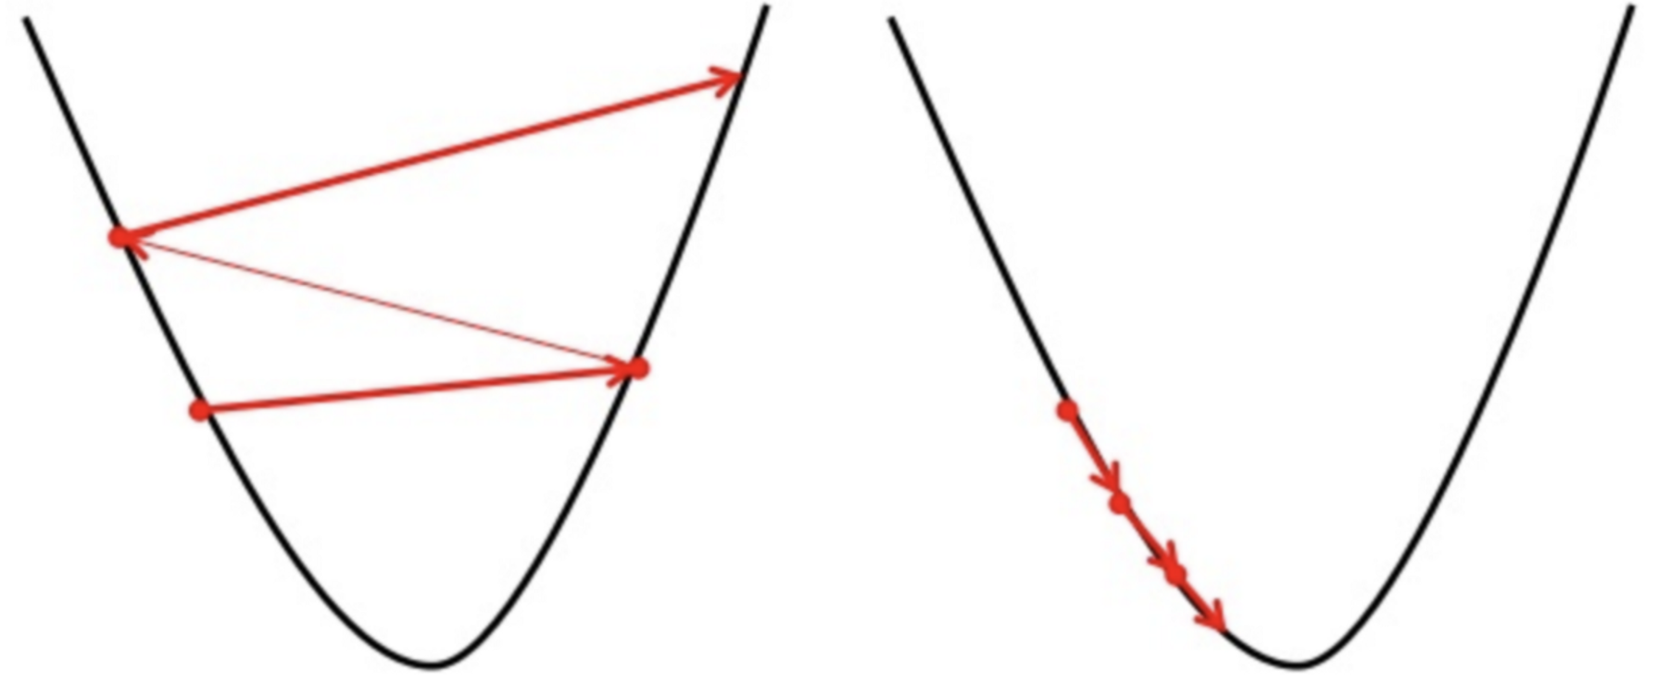
Learning rate
Too big learning rate Small learning rate

Slide 16
Outline
Linear regression formulation
Gradient descent
Gradient descent for linear regression
Regularization
Logistic regression
Summary

Slide 17
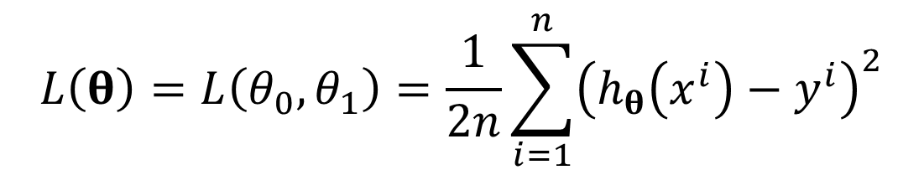



Recall: Loss function and learning goal
Recall: Loss function (L) used by linear regression is:
where $h_{θ}\left(x^{i}\right)=θ_{0}+θ_{1}x^{i}$
$h_{θ}\left(x^{i}\right)$ is an estimate of $y^{i}$
Learning goal:
$$L\left(θ\right)=L\left(θ_{0}, θ_{1}\right)=\frac{1}{2n}\sum_{i=1}^{n}{{\left(h_{θ}\left(x^{i}\right)−y^{i}\right)}^{2}}$$
Blue line is better than green line
$argmin$ $L\left(θ_{0}, θ_{1}\right)$
$$θ_{0},θ_{1}$$

Slide 18
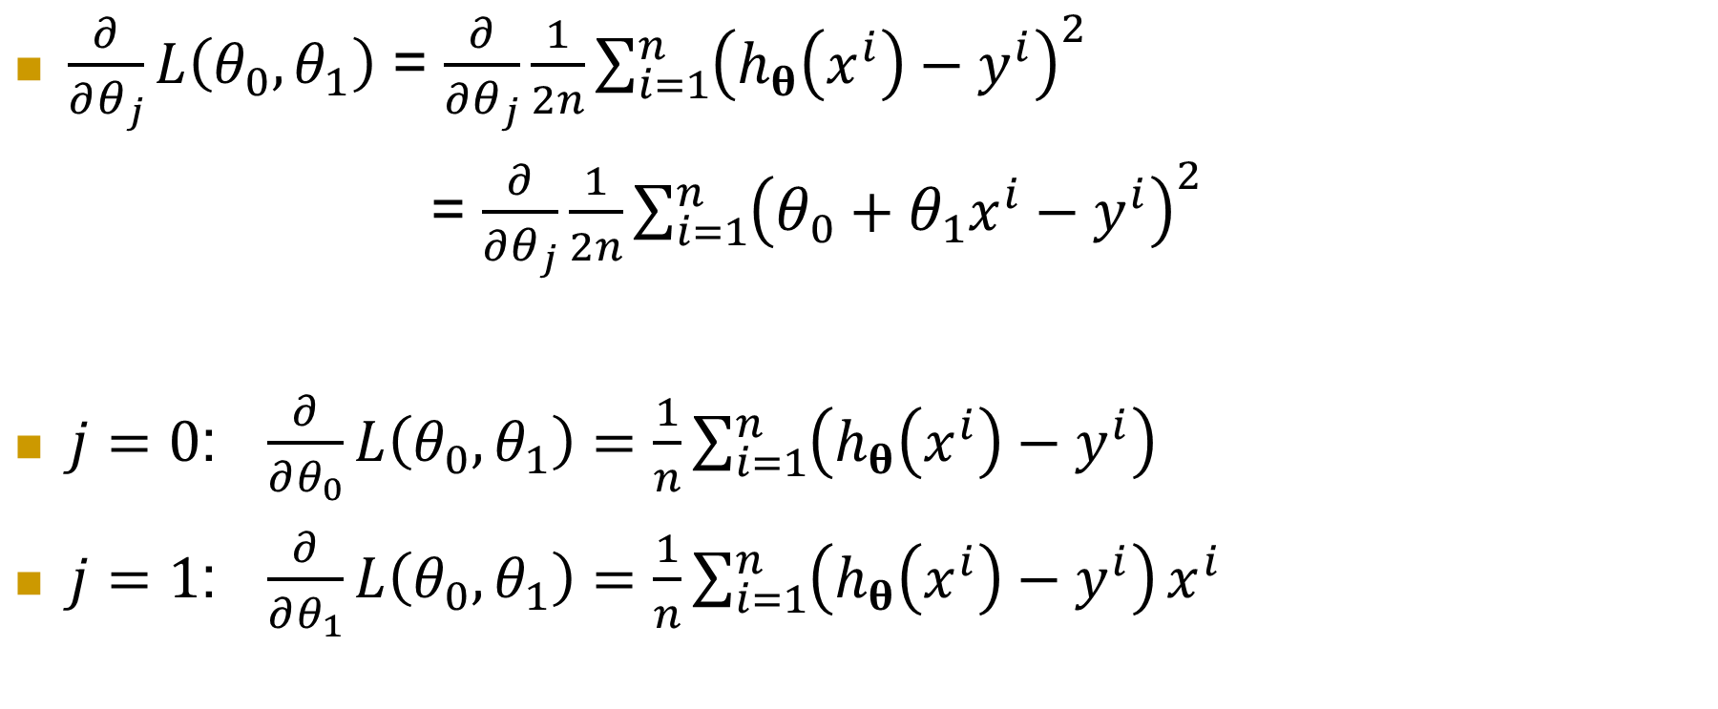
Computing partial derivative
$\frac{∂}{∂θ_{j}}L\left(θ_{0}, θ_{1}\right)$ = $\frac{∂}{∂θ_{j}}\frac{1}{2n}\sum_{i=1}^{n}{{\left(h_{θ}\left(x^{i}\right)−y^{i}\right)}^{2}}$
= $\frac{∂}{∂θ_{j}}\frac{1}{2n}\sum_{i=1}^{n}{{\left(θ_{0}+θ_{1}x^{i}−y^{i}\right)}^{2}}$
$j=0$: $\frac{∂}{∂θ_{0}}L\left(θ_{0}, θ_{1}\right)=\frac{1}{n}\sum_{i=1}^{n}{\left(h_{θ}\left(x^{i}\right)−y^{i}\right)}$
$j=1$: $\frac{∂}{∂θ_{1}}L\left(θ_{0}, θ_{1}\right)=\frac{1}{n}\sum_{i=1}^{n}{\left(h_{θ}\left(x^{i}\right)−y^{i}\right)}x^{i}$

Slide 19
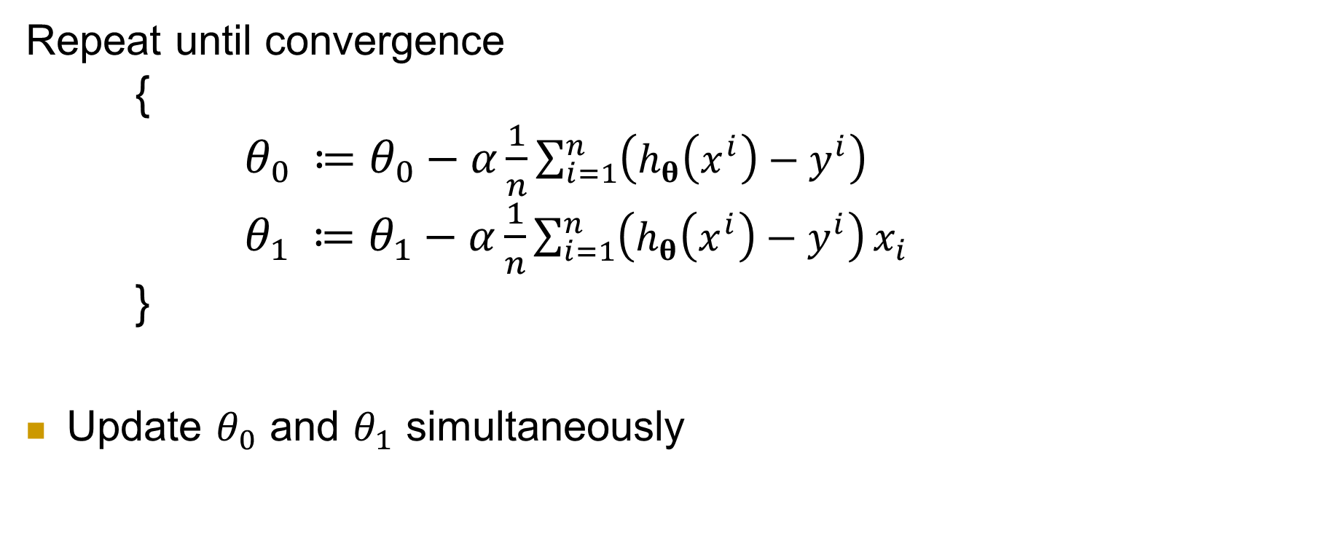
Gradient descent for linear regression
Repeat until convergence
{
$θ_{0} ≔θ_{0}−α\frac{1}{n}\sum_{i=1}^{n}{\left(h_{θ}\left(x^{i}\right)−y^{i}\right)}$ $θ_{1} ≔θ_{1}−α\frac{1}{n}\sum_{i=1}^{n}{\left(h_{θ}\left(x^{i}\right)−y^{i}\right)}x_{i}$
}
Update $θ_{0}$ and $θ_{1}$ simultaneously

Slide 20
Batch gradient descent
Each step or update of gradient descent uses all (n) the training examples.
Sum over all n training examples for each step – slow
It is also memory demanding if the training data is huge.
In a normally learning process, training needs many steps before convergence.
The training process that covers all the training examples once is called an epoch.
In batch gradient descent, each step is an epoch.

Slide 21
Stochastic gradient descent (SGD)
SGD with one example per step: In SGD each step uses a single training example. Before each epoch, the data should be shuffled.
SGD converges faster when the dataset is large as it causes updates to the parameters more frequently.
The loss may fluctuate as only one example is used in each step.
SGD with minibatch: each update/step uses a random minibatch of m out of n examples.
It is efficient, more stable, and more likely to jump out of a local minimum
Batch Gradient Descent is more suitable for convex loss functions as it can converge directly to minima.

Slide 22
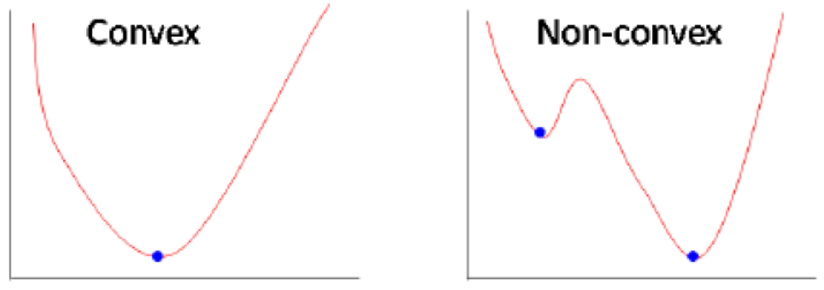
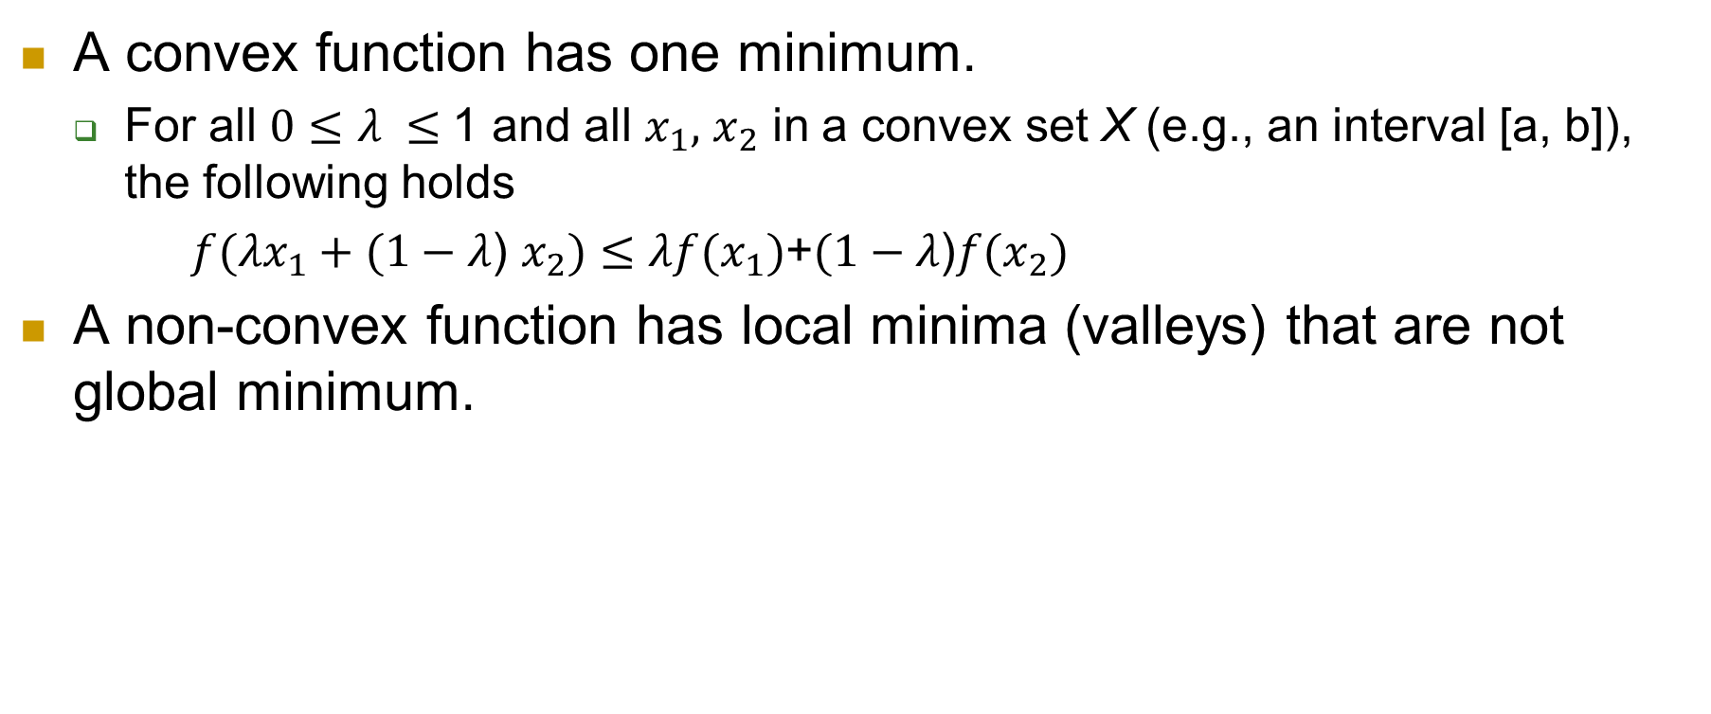
Convex and non-convex function
Convex set X: for all a and b in X, the line segment connecting a and b is included in X.
Convex function: a real-valued function is called convex if the line segment between any two points on the graph of the function does not lie below the graph between the two points.
A convex function has one minimum.
For all $0≤λ ≤$1 and all $x_{1},$ $x_{2}$ in a convex set X (e.g., an interval [a, b]), the following holds
$f(λx_{1}+(1−λ\text{) }x_{2})≤λf(x_{1})$+$(1−λ\text{)}f(x_{2})$
A non-convex function has local minima (valleys) that are not global minimum.

Slide 23
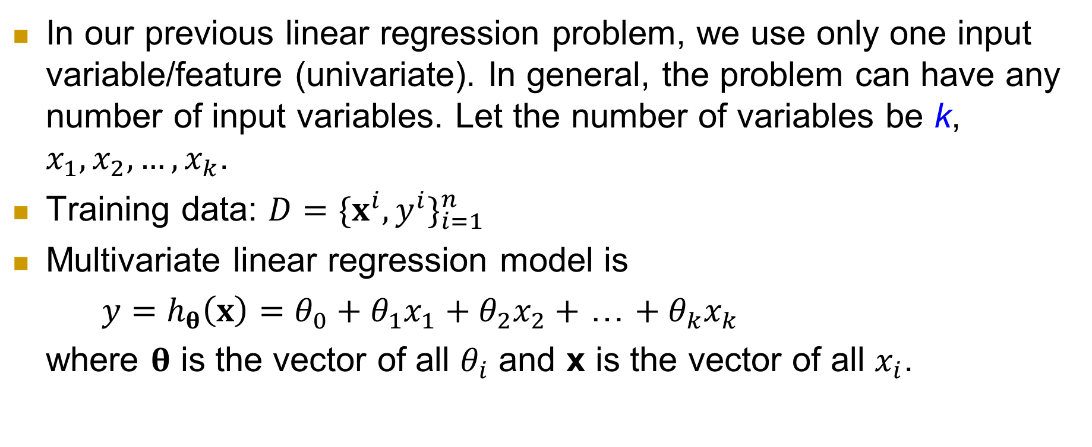
Multivariate linear regression
In our previous linear regression problem, we use only one input variable/feature (univariate). In general, the problem can have any number of input variables. Let the number of variables be k, $x_{1},x_{2},…,x_{k}$.
Training data: $D={\{x^{i},y^{i}\}}_{i=1}^{n}$
Multivariate linear regression model is
${y=h}_{θ}\left(x\right)=θ_{0}+θ_{1}x_{1}+θ_{2}x_{2}+$ … $+ θ_{k}x_{k}$
where $θ$ is the vector of all $θ_{i}$ and x is the vector of all $x_{i}$.

Slide 24
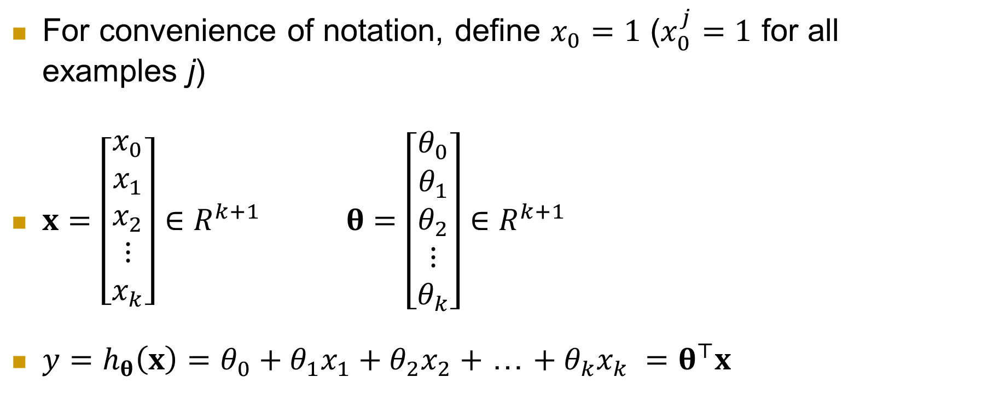
Multivariate linear regression (cont.)
For convenience of notation, define $x_{0}=1$ ($x_{0}^{j}=1$ for all examples j)
$x=\left[\begin{aligned}x_{0} \\ x_{1} \\ x_{2} \\ ⋮ \\ x_{k}\end{aligned}\right]∈R^{k+1} θ=\left[\begin{aligned}θ_{0} \\ θ_{1} \\ θ_{2} \\ ⋮ \\ θ_{k}\end{aligned}\right]∈R^{k+1}$
${y=h}_{θ}\left(x\right)=θ_{0}+θ_{1}x_{1}+θ_{2}x_{2}+$ … $+ θ_{k}x_{k} =θ^{⊤}x$

Slide 25
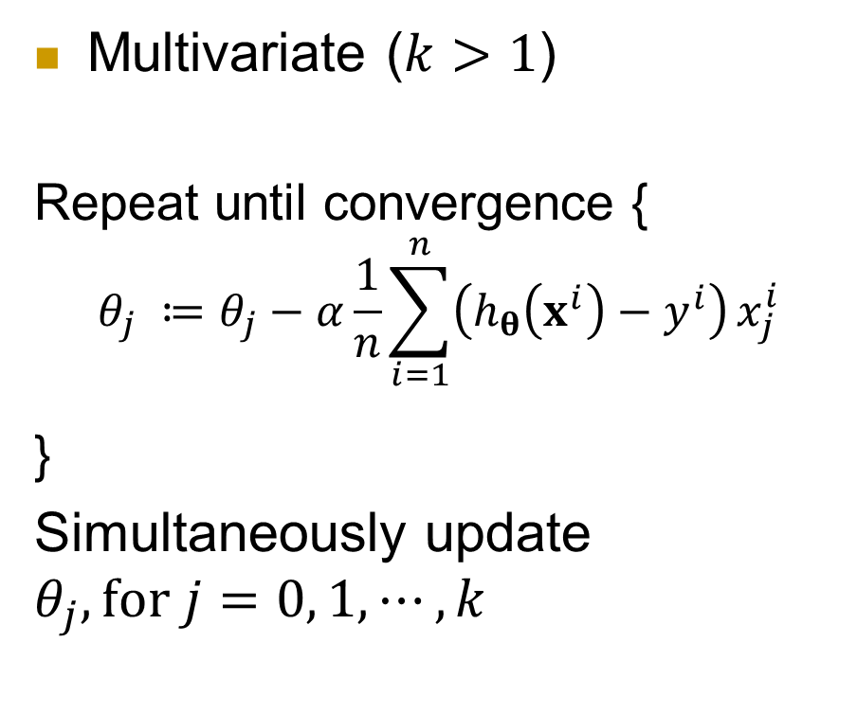
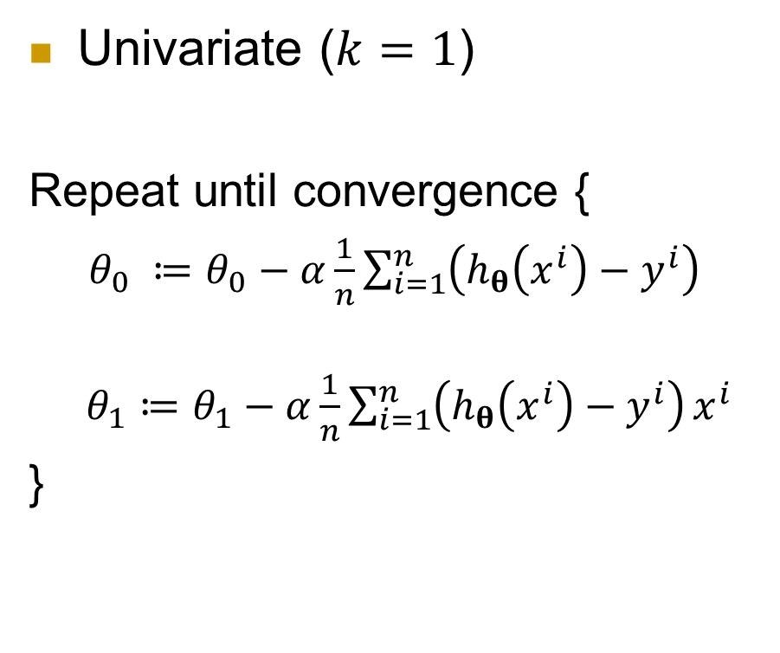
Univariate and multivariate gradient descent
Univariate ($k=1$)
Repeat until convergence {
$θ_{0} ≔θ_{0}−α\frac{1}{n}\sum_{i=1}^{n}{\left(h_{θ}\left(x^{i}\right)−y^{i}\right)}$
$θ_{1}≔θ_{1}−α\frac{1}{n}\sum_{i=1}^{n}{\left(h_{θ}\left(x^{i}\right)−y^{i}\right)}x^{i}$
}
Multivariate ($k>1$)
Repeat until convergence { $$θ_{j} ≔θ_{j}−α\frac{1}{n}\sum_{i=1}^{n}{\left(h_{θ}\left(x^{i}\right)−y^{i}\right)}x_{j}^{i}$$
}
Simultaneously update
$$θ_{j}, for j=0, 1, ⋯,k$$

Slide 26
Outline
Linear regression formulation
Gradient descent
Gradient descent for linear regression
Regularization
Logistic regression
Summary

Slide 27
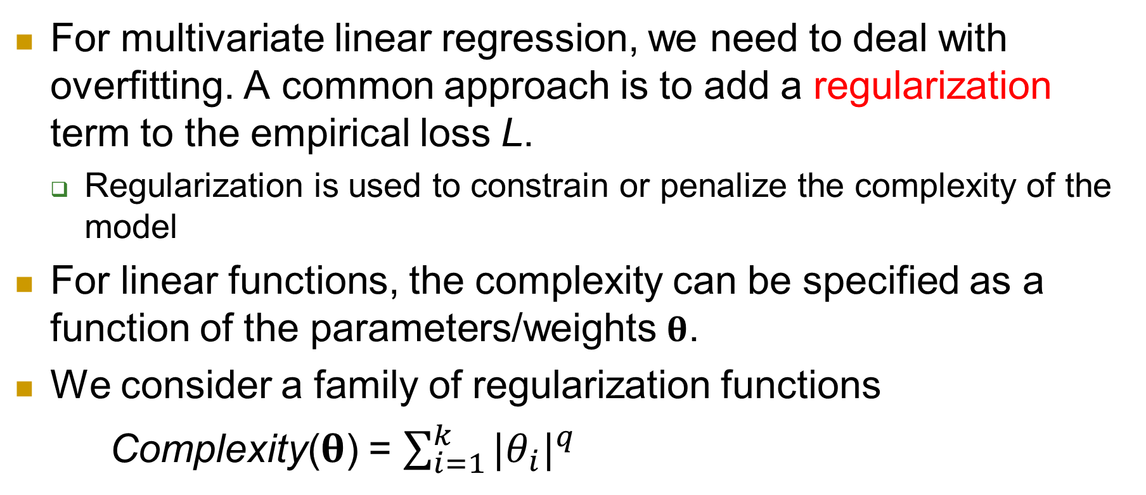
Dealing with overfitting
For multivariate linear regression, we need to deal with overfitting. A common approach is to add a regularization term to the empirical loss L.
Regularization is used to constrain or penalize the complexity of the model
For linear functions, the complexity can be specified as a function of the parameters/weights $θ$.
We consider a family of regularization functions
Complexity($θ$) = $\sum_{i=1}^{k}{{{|θ}_{i}|}^{q}}$

Slide 28
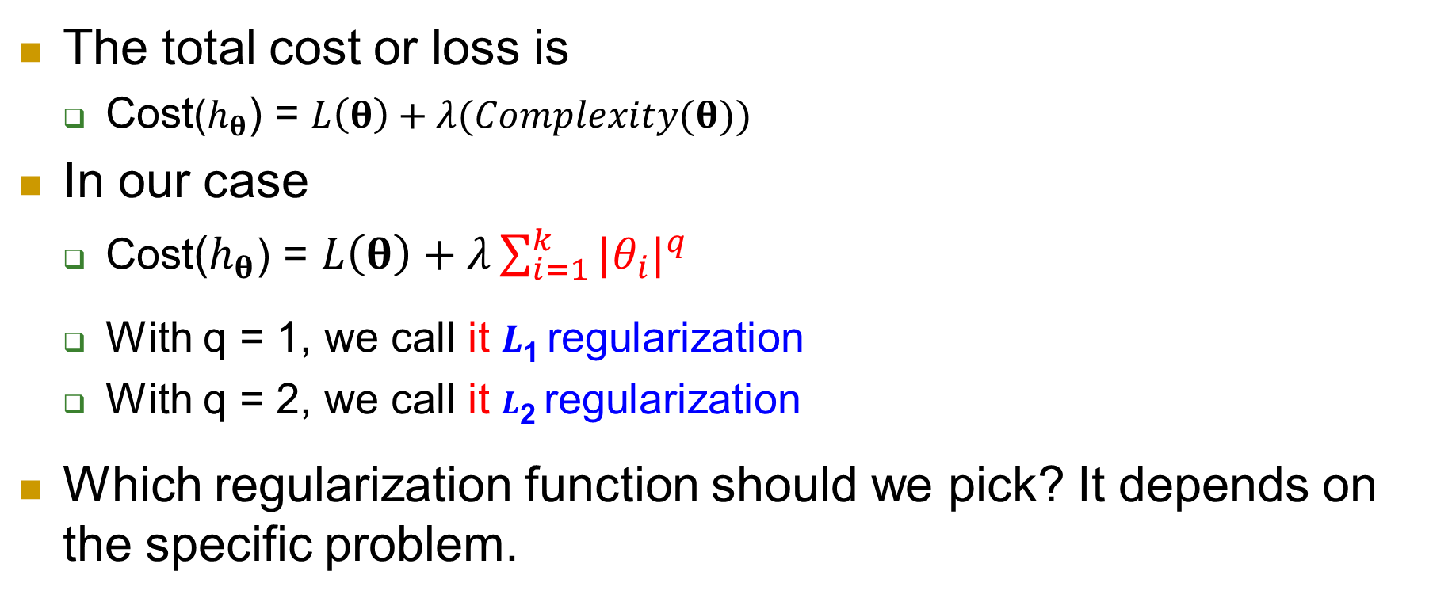
The total cost
The total cost or loss is
Cost($h_{θ}$) = $L\left(θ\right)+λ(Complexity(θ))$
In our case
Cost($h_{θ}$) = $L\left(θ\right)+λ\sum_{i=1}^{k}{{{|θ}_{i}|}^{q}}$
With q = 1, we call it $L$₁ regularization
With q = 2, we call it $L$₂ regularization
Which regularization function should we pick? It depends on the specific problem.

Slide 29
Outline
Linear regression formulation
Gradient descent
Gradient descent for linear regression
Regularization
Logistic regression
Summary

Slide 30
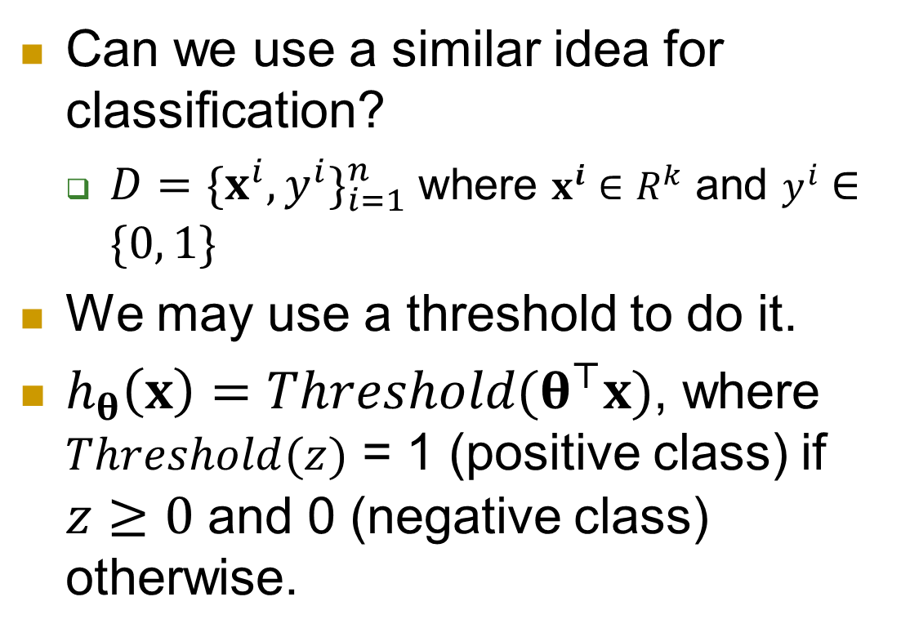
Classification with threshold
Can we use a similar idea for classification?
$D={\{x^{i},y^{i}\}}_{i=1}^{n}$where $x^{i}∈R^{k}$ and $y^{i}∈\{0, 1\}$
We may use a threshold to do it.
$h_{θ}\left(x\right)=Threshold(θ^{⊤}x)$, where $Threshold(z)$ = 1 (positive class) if $z≥0$ and 0 (negative class) otherwise.
1
0.5
-4
z
-2
0
-2
-4

Slide 31
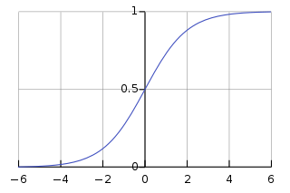
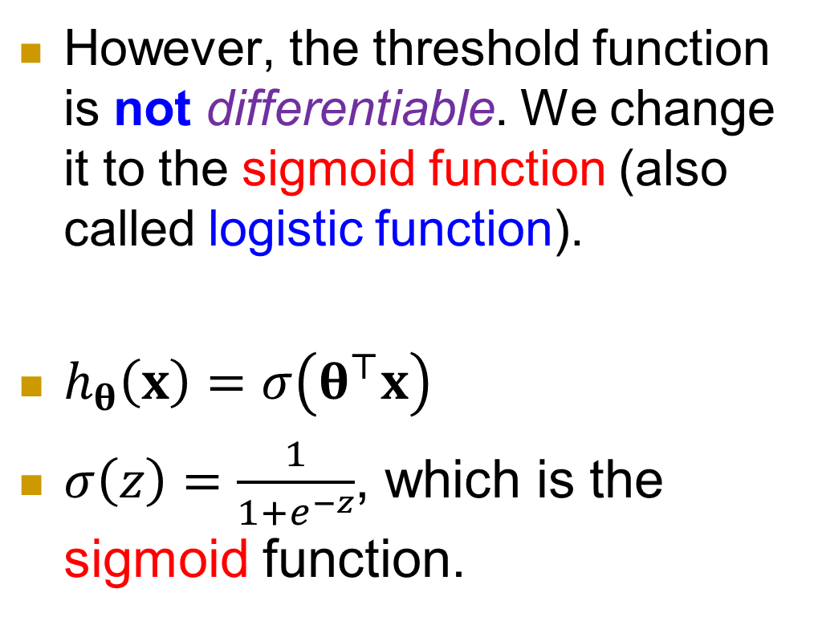


Replace Threshold with Sigmoid function
However, the threshold function is not differentiable. We change it to the sigmoid function (also called logistic function).
$h_{θ}\left(x\right)=σ\left(θ^{⊤}x\right)$
$σ\left(z\right)=\frac{1}{1+e^{−z}}$, which is the sigmoid function.
$$σ(z)$$
$$z=θ^{⊤}x$$

Slide 32
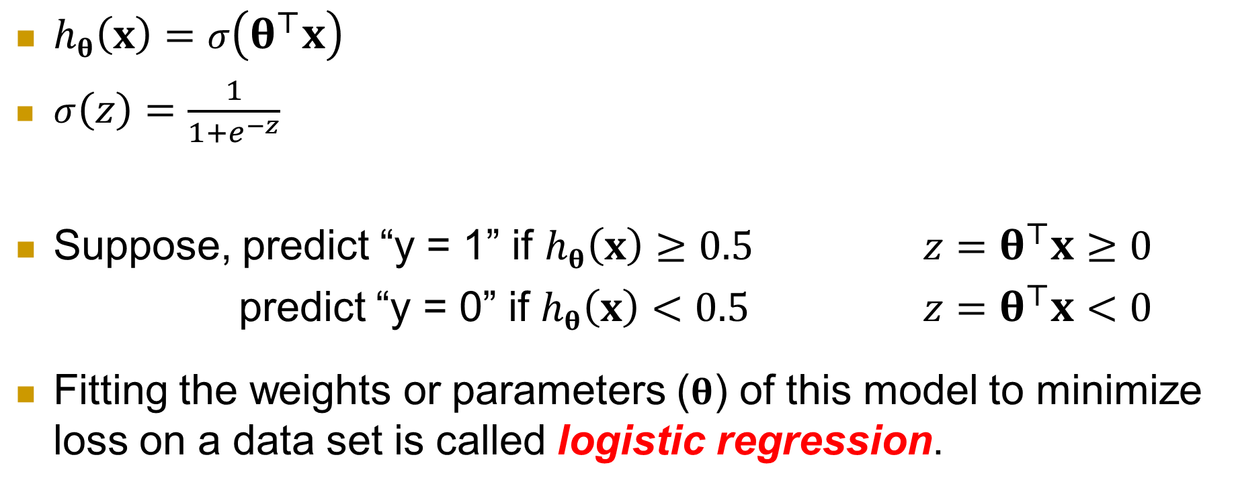
Logistic regression
$h_{θ}\left(x\right)=σ\left(θ^{⊤}x\right)$
$σ\left(z\right)=\frac{1}{1+e^{−z}}$
Suppose, predict “y = 1” if $h_{θ}\left(x\right)≥0.5$ $z=θ^{⊤}x≥0$
predict “y = 0” if $h_{θ}\left(x\right)<0.5$ $z=θ^{⊤}x<0$
Fitting the weights or parameters ($θ$) of this model to minimize loss on a data set is called logistic regression.

Slide 33
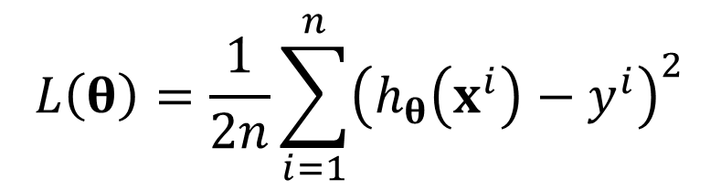
Solve the problem using gradient descent
Let us first use the same square loss (L) as in linear regression
We then discuss the loss commonly used in logistic regression implementations.
$$L\left(θ\right)=\frac{1}{2n}\sum_{i=1}^{n}{{\left(h_{θ}\left(x^{i}\right)−y^{i}\right)}^{2}}$$

Slide 34
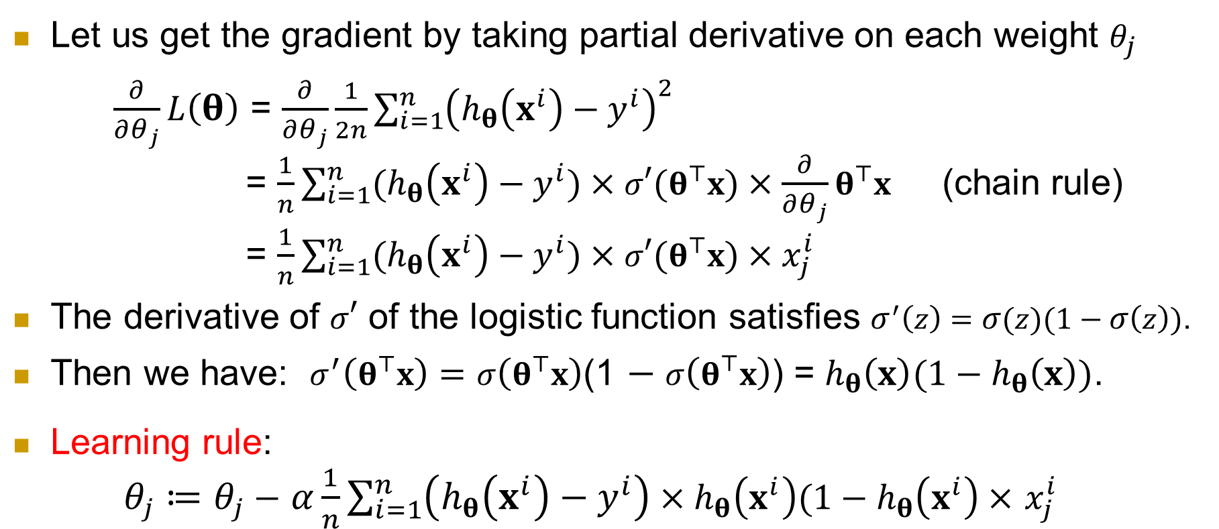
Take partial derivative
Let us get the gradient by taking partial derivative on each weight $θ_{j}$
$\frac{∂}{∂θ_{j}}L\left(θ\right)$ = $\frac{∂}{∂θ_{j}}\frac{1}{2n}\sum_{i=1}^{n}{{\left(h_{θ}\left(x^{i}\right)−y^{i}\right)}^{2}}$
= $\frac{1}{n}\sum_{i=1}^{n}{{(h}_{θ}\left(x^{i}\right)−y^{i})×σ′(θ^{⊤}x)×\frac{∂}{∂θ_{j}}θ^{⊤}x}$ (chain rule)
= $\frac{1}{n}\sum_{i=1}^{n}{{(h}_{θ}\left(x^{i}\right)−y^{i})×σ′(θ^{⊤}x)×x_{j}^{i}}$
The derivative of $σ′$ of the logistic function satisfies $σ^{′}\left(z\right)=σ(z)(1−σ\left(z\right))$.
Then we have: $σ^{′}\left(θ^{⊤}x\right)=σ\left(θ^{⊤}x\right)$(1 $− σ\left(θ^{⊤}x\right)$) = $h_{θ}\left(x\right)(1−h_{θ}\left(x\right))$.
Learning rule:
$θ_{j}≔θ_{j}−$ $α\frac{1}{n}\sum_{i=1}^{n}{\left(h_{θ}\left(x^{i}\right)−y^{i}\right)}×h_{θ}\left(x^{i}\right)(1−h_{θ}\left(x^{i}\right)×$ $x_{j}^{i}$

Slide 35

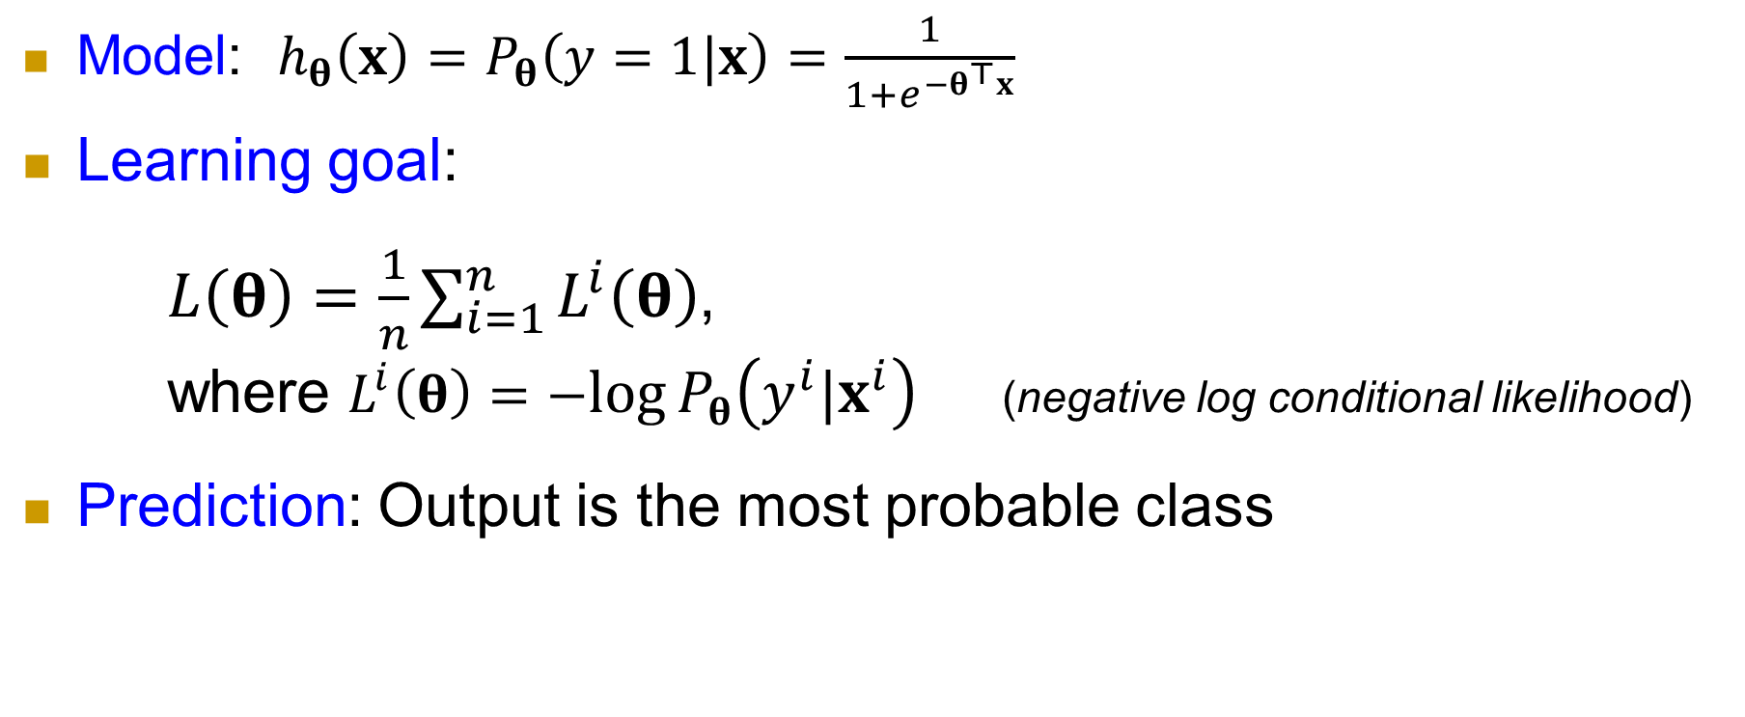



Alternative approach: probabilistic interpretation
Model: ${h_{θ}\left(x\right)=P}_{θ}\left(y=1|x\right)=\frac{1}{1+e^{−θ^{⊤}x}}$
Learning goal:
$L\left(θ\right)=\frac{1}{n}\sum_{i=1}^{n}{L^{i}\left(θ\right)}$,
where $L^{i}\left(θ\right)=−log{P_{θ}\left(y^{i}|x^{i}\right)}$ (negative log conditional likelihood)
Prediction: Output is the most probable class
$θ^{∗}=argmin$ $L\left(θ\right)$
$$θ$$
$$\hat{y}=argmax P_{θ}\left(y|x\right)$$
$$y∈(0, 1\}$$

Slide 36
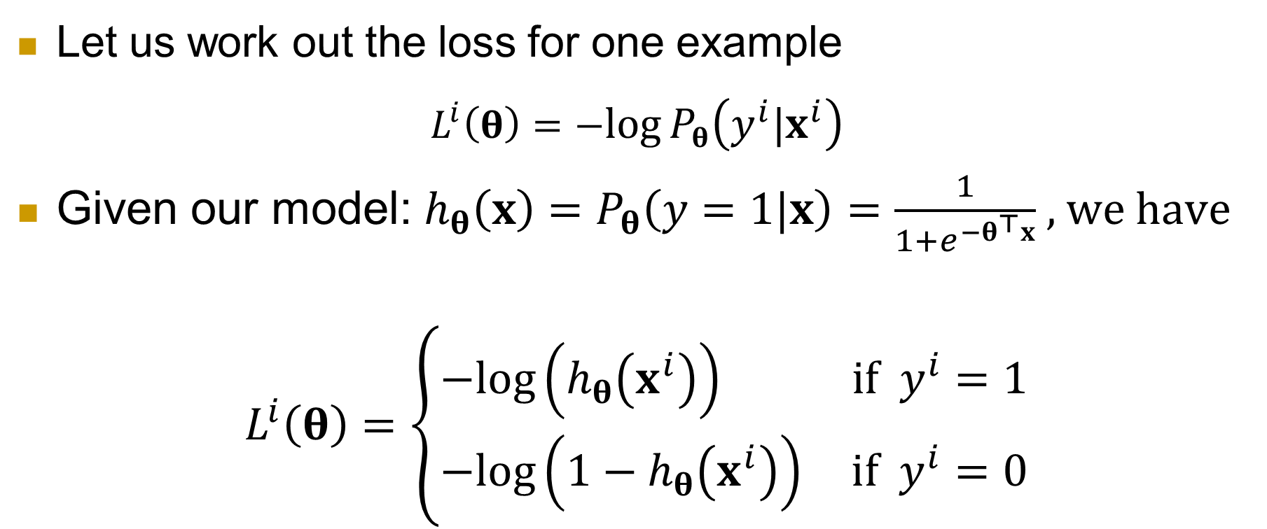
Loss for one example
Let us work out the loss for one example
$$L^{i}\left(θ\right)=−log{P_{θ}\left(y^{i}|x^{i}\right)}$$
Given our model: ${h_{θ}\left(x\right)=P}_{θ}\left(y=1|x\right)=\frac{1}{1+e^{−θ^{⊤}x}}$ , we have
$$L^{i}\left(θ\right)=\left\{\begin{aligned}−log\left(h_{θ}\left(x^{i}\right)\right) if { y}^{i}=1 \\ −log\left(1−h_{θ}\left(x^{i}\right)\right) if{ y}^{i}=0\end{aligned}\right.$$

Slide 37
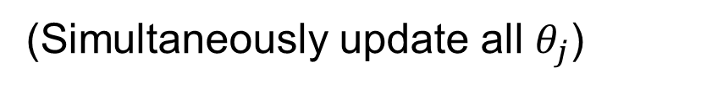

Gradient descent
$\frac{∂}{∂θ_{j}}(L^{i}\left(θ\right))=\left\{\begin{aligned}−(1−h_{θ}\left(x^{i}\right))x_{j}^{i} if { y}^{i}=1 \\ h_{θ}\left(x^{i}\right)x_{j}^{i} if{ y}^{i}=0\end{aligned}\right.$
$\frac{∂}{∂θ_{j}}L\left(θ\right)=\frac{1}{n}\sum_{i=1}^{n}{(h_{θ}\left(x^{i}\right)−y^{i})}x_{j}^{i}$
Repeat {
$θ_{j}≔θ_{j}−α\frac{1}{n}\sum_{i=1}^{n}{(h_{θ}\left(x^{i}\right)−y^{i})}x_{j}^{i}$
}
(Simultaneously update all $θ_{j}$)

Slide 38
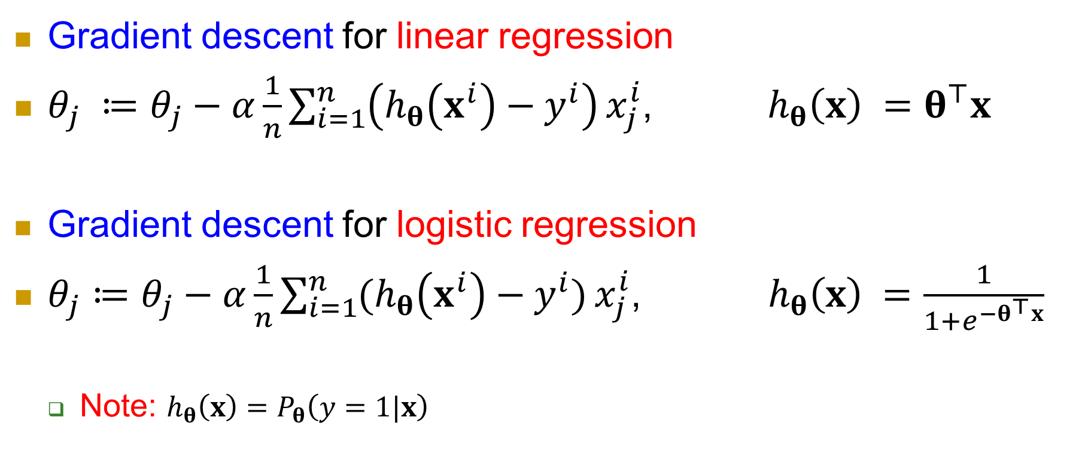
Comparing linear regression and logistic regression
Gradient descent for linear regression
$θ_{j} ≔θ_{j}−α\frac{1}{n}\sum_{i=1}^{n}{\left(h_{θ}\left(x^{i}\right)−y^{i}\right)}x_{j}^{i}$, $h_{θ}\left(x\right) =θ^{⊤}x$
Gradient descent for logistic regression
$θ_{j}≔θ_{j}−α\frac{1}{n}\sum_{i=1}^{n}{(h_{θ}\left(x^{i}\right)−y^{i})}x_{j}^{i}$, ${ h}_{θ}\left(x\right) =\frac{1}{1+e^{−θ^{⊤}x}}$
Note: ${h_{θ}\left(x\right)=P}_{θ}\left(y=1|x\right)$

Slide 39
Outline
Linear regression formulation
Gradient descent
Gradient descent for linear regression
Regularization
Logistic regression
Summary

Slide 40
Summary
In this part, we introduced two supervised learning models
Linear regression for supervised continuous variable prediction
Logistic regression for supervised discrete class prediction.
In both cases, we use gradient descent to learn, which is a general learning method. It has a wide range of applications in machine learning.
Our next topic is neural networks, which uses gradient descent as well, specifically, stochastic gradient descent (SGD).

