Slide 1
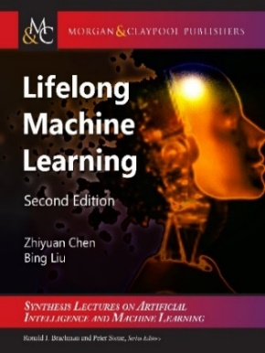
Lifelong and Continual Learning, and On-the-Job Learning
Bing Liu
Department of Computer Science,
University of Illinois at Chicago

Slide 2
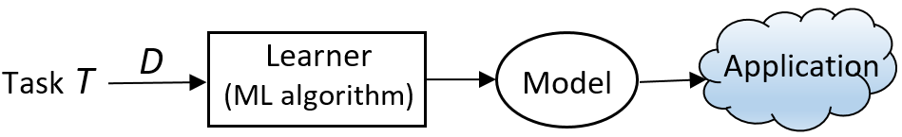
Introduction
Classic machine learning: Isolated single-task learning
  Key weaknesses
    Closed-world assumption: nothing new in testing / application
    Model is fixed during application: no model revision/improvement in application
    No knowledge accumulation: needs a large amount of labeled training data
  Suitable for well-defined tasks in restricted environments
Chen and Liu. Lifelong machine learning. Morgan & Claypool. 2015, 2018

Slide 3
Closed-world assumption and open-world
(Fei et al, 2016; Shu et al., 2017)
Traditional machine learning:
  Training data: D^{train} with class labels 𝑌^{train} = {𝑙₁, 𝑙₂, ..., 𝑙_{𝑡}}.
  Test data: D^{test}, 𝑌^{test} ⊆ {𝑙₁, 𝑙₂, ..., 𝑙_{𝑡}}
Closed-world: 𝑌^{test} ⊆ 𝑌^{train}
    Classes appeared in testing must have been seen in training, nothing new.
    A system that is unable to identify anything new, it cannot learn by itself.
Open-world: 𝑌^{test} - 𝑌^{train} ≠ φ
    There are unseen classes in the test data, out-of-distribution.
Fei, and Liu. Breaking the Closed World Assumption in Text Classification. NAACL-HLT 2016

Slide 4
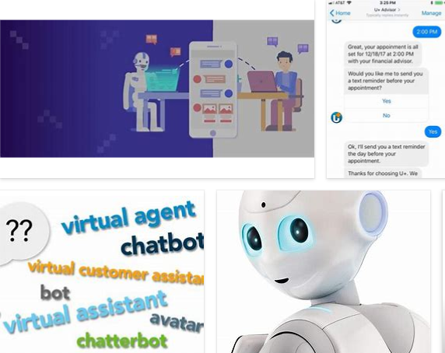
Chatbots need to learn continuously
A chatbot’s environment is highly dynamic & open.
  What happens if the user says something that the chatbot cannot understand.
  Hard to train the chatbot by its engineers forever.
    Chatbot must learn during chatting
    (learn from other sources)
Liu. Learning on the Job: Online Lifelong and Continual Learning. AAAI-2020

Slide 5
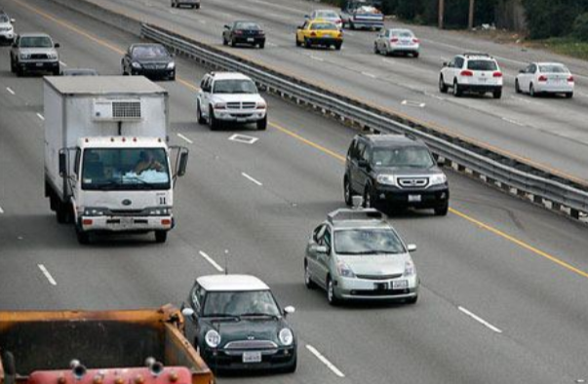
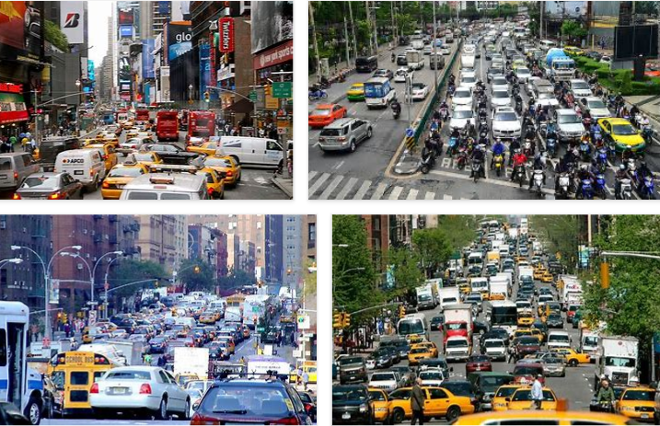
Self-driving cars need to learn continuously too
Self-driving cars cannot reach human-level of driving with only rules and off-line training.
    Impossible to cover all corner cases
    Real-world is full of unknowns.
Has to learn & adapt continuously in its interaction with humans and the environment by itself.
    in the open world (changes & unknowns).
Chen and Liu. Lifelong machine learning. Morgan & Claypool. 2018

Slide 6
Outline
Lifelong learning with learning on the job
Detecting novel instances
Continual learning with knowledge transfer
Continuous learning in dialogues
Summary

Slide 7
Old definition of lifelong learning
(Thrun 1996, Silver et al 2013; Ruvolo and Eaton, 2013; Chen and Liu, 2014, 2016)
At any point in time, the learner has learned a sequence of tasks, from 1 to N.
When faced with the (N+1)th task, it uses the knowledge gained from the N previous tasks to help learn the (N+1)th task.
Thrun. Is learning the n-th thing any easier than learning the first? NIPS, 1996.

Slide 8
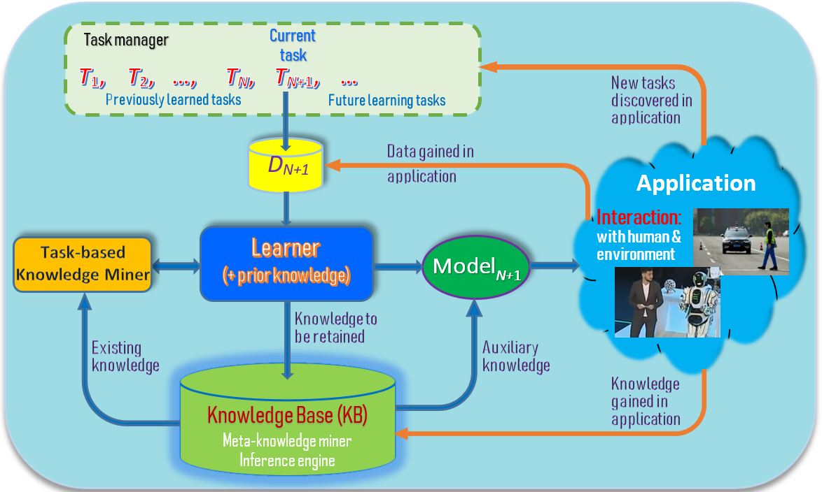
Lifelong/continual learning in the open world
(Chen & Liu, 2018, Liu, 2020)
Liu. Learning on the Job: Online Lifelong and Continual Learning. AAAI-2020

Slide 9
Key characteristics
(Chen and Liu, 2018-book)
Continuous learning process:
  Without forgetting: Learning a new task should not forget the past.
Knowledge accumulation in KB (long-term memory)
Using/adapting past knowledge to help learn new tasks
Learning on the job during model application in the open world in a self-supervised manner via interaction with humans and the environment.
  Discover new tasks and learn them incrementally/continually.
    Novel instances of existing/known classes – concept drifting.
    Novel/unknown classes or tasks
Liu. Learning on the Job: Online Lifelong and Continual Learning. AAAI-2020
Notes:
These three characteristics make LML different from related learning tasks such as transfer learning, multi-task learning, online learning and so on.

Slide 10
Learning on the job
(Liu, 2020, Chen and Liu, 2018)
It is known in learning science that about 70% of our human knowledge comes from ‘on-the-job’ learning.
    Only about 10% through formal education or training
    About 70% from on-the-job learning
    The rest 20% through observation of others
AI agents should also learn on the job or during applications
  the world is too complex and constantly changing.
    Impossible to learn everything offline using manually labeled data
(1) Chen and Liu Lifelong machine learning, 2015, 2018. (2) Liu. Learning on the Job: Online Lifelong and Continual Learning. AAAI-2020

Slide 11
Learning on the job in the open-world
(Fei et al, 2016; Shu et al., 2017)
Steps:
  Discover novel instances: e.g., classify instances in D^{test} to 𝑌^{train} and detect novel instances D^{novel} ⊆ D^{test} belonging to L₀ – new tasks
  Identify the unseen/new classes in D^{novel}, L₀ = {l_{t+1}, l_{t+2}, …} and gather training data
    Interactive self-supervision: interaction with humans and the environment
  Continual learning: Incrementally learn the new classes {l_{t+1}, l_{t+2}, …} (the new task)
Note: this does not include how the system should respond or react to novelty.
Fei, Wang, and Liu. Learning Cumulatively to Become More Knowledgeable. KDD-2016

Slide 12
Interactive self-supervision
(Liu, 2020)
Identify new classes and training data by interacting with
  Humans: through natural language, e.g.,
    Self-drive cars: asking the passenger
      What is that object? How do I drive now? Where should I stop?
    Chatbots: learn new knowledge and learn language during chatting.
  Environment: get feedback & use tools (e.g., search engines)
    Need an internal evaluation system
      to evaluate environmental feedback
  To gather knowledge, and supervisory or reward information.
Liu. Learning on the Job: Online Lifelong and Continual Learning. AAAI-2020

Slide 13
Example - a greeting bot in a hotel
(Chen and Liu 2018)
See an existing/known guest.
    Bot: “Hello John, how are you today?”
See a new guest. Bot must recognize the guest is new/novel.
    Bot: “Welcome to our hotel! What is your name, sir?”
    Guest: “I am David”
    Bot learns to recognize David automatically
      take pictures of David and incrementally learn to recognize him
See David next time.
    Bot: “Hello David, how are you today?”
Chen and Liu. Lifelong machine learning. Morgan & Claypool. 2015, 2018

Slide 14
Outline
Lifelong learning with learning on the job
Detecting novel instances
Continual learning with knowledge transfer
Continuous learning in dialogues
Summary

Slide 15
DOC - detecting novel instances (text classification)
(Shu et al. 2017)
To detect novel instances that do not belong to training classes.
Shu, Xu, Liu. DOC: Deep Open Classification of Text Documents. EMNLP-2017

Slide 16
Finding the rejection threshold

Slide 17
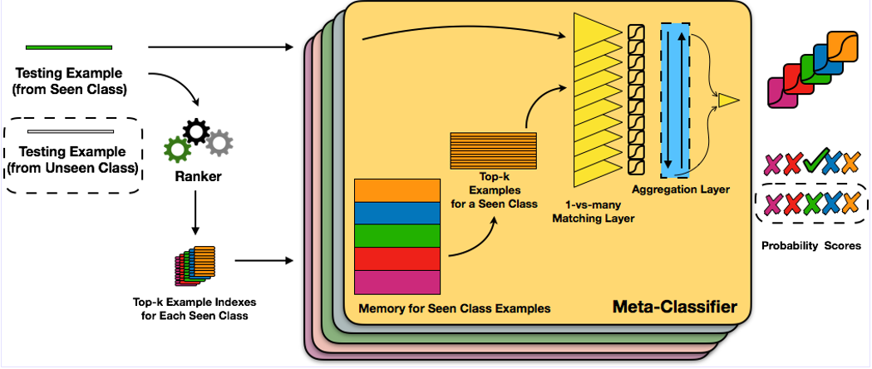
Open-world learning via meta-learning
(Xu et al. 2019)
L2AC–meta-learning
  It maintains a dynamic set S of seen classes that allows new classes to be added or deleted without re-training.
    Each class is represented by a small set of training examples.
  In testing, the meta-classifier uses only the examples of the seen classes on-the-fly for classification and rejection (novel)
Xu, Liu, Shu and Yu. Open-world Learning and Application to Product Classification. WWW-2019

Slide 18
Outline
Lifelong learning with learning on the job
Detecting novel instances
Continual learning with knowledge transfer
Continuous learning in dialogues
Summary

Slide 19
Continual learning
Continual learning (CL) learns a sequence of tasks.
CL has focused on dealing with catastrophic forgetting
  Catastrophic forgetting: In learning a new task, the learner should not forget what it has learned from previous tasks.
  Extensive research has been done
    See Chapter 4 in Lifelong Machine Learning. B. Liu, 2018
CL should also leverage the knowledge learned from previous tasks to learn the new task better.
    See Ke, Liu, and Huang. ”Continual Learning of a Mixed Sequence of Similar and Dissimilar Tasks.” NeurIPS 2020

Slide 20
Continual learning with knowledge transfer
(Ke and Liu, 2020)
Task-based continual learning (TCL)
  Each task is an independent classification problem.
Proposed system: KAN (knowledge accessibility network)
Application: continual sentiment classification
  Goal: learn a sequence of sentiment classification tasks.
  Each task – classify reviews of a category of products.
    Review: “I bought a cellphone a few days ago. It is such a nice phone. The touch screen is really cool. The voice quality is great too. ....”
    Class labels: positive or negative
Ke, Liu, Wang, and Shu. Continual Learning with Knowledge Transfer for Sentiment Classification. ECML-PKDD-2020

Slide 21
KAN architecture
Accessibility (AC) module
    decides accessible units in the KB by the current task t by learning a binary mask a_{t}.
Main continual learning (MCL)
    Knowledge base (KB-RNN).
    performs the main continual learning and testing.
    Uses mask a_{t} to block not-useful units in KB (avoid forgetting)
      Useful units transfer knowledge.

Slide 22
Outline
Lifelong learning with learning on the job
Detecting novel instances
Continual learning with knowledge transfer
Continuous learning in dialogues
Summary

Slide 23
Continuous knowledge learning in dialogues
(Mazumder et al. 2018, 2019)
Dialogue systems are increasingly using knowledge bases (KBs) storing real-world facts to help generate responses.
    KBs are inherently incomplete and remain fixed,
    which limit dialogue systems’ conversation capability
CILK: Continuous and Interactive Learning of Knowledge for dialogue systems
  to continuously and interactively learn and infer new knowledge during conversations
Liu and Mazumder. Lifelong and Continual Learning Dialogue Systems: Learning during Conversation. AAAI-2021

Slide 24

Human conversation is knowledge driven?
I watched ``The Dark Knight”
yesterday. It was awesome.
Grounding fact
USER1
Christian Bale Acted In
The Dark Knight
Did you like Christian
Bale’s acting?
USER2
Knowledge grounding makes conversation interesting and intelligent.

Slide 25
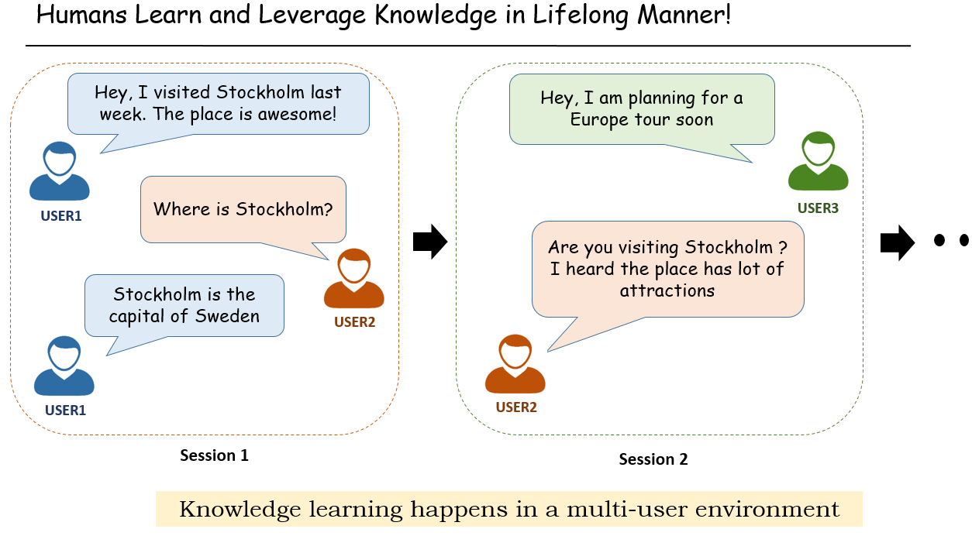
Knowledge learning in conversation
/ agent
/ agent

Slide 26
Opportunities to learn in conversations
Extract knowledge directly from user utterances, e.g.,
    User: Obama was born in Hawaii.
    Agent extracts: (Obama, BornIn, Hawaii) – expressed in triples (h, r, t)
Actively ask user questions & expect correct answers, e.g.,
    Agent: Where was Obama born?
    User: Hawaii => (Obama, BornIn, Hawaii)
When the agent cannot understand an user utterance, it asks the user to rephrase or to select the right option.
When the agent cannot answer user questions, it asks the user for some supporting facts and then infers the answers.
    We focus on this setting (which covers 1 and 2)
Liu and Mazumder. Lifelong and Continual Learning Dialogue Systems: Learning during Conversation. AAAI-2021

Slide 27
Problem formulation
Given a user query / question (h, r, ?) [or (?, r, t)], e.g., “who is the President of the US” (?, President-of, the US), our goal is two-fold:
  Answering the user query or rejecting the query to remain unanswered if the correct answer is believed to not exist in the KB
  learning / acquiring some knowledge (supporting facts) from the user to help the answering task.
We further distinguish two types of queries:
(1) Closed-world queries: h (or t) and r are known to the KB
(2) Open-world queries: Either one or both h (or t) and r are unknown
Proposed Soln.
an engine for Continuous and Interactive Learning of Knowledge (CILK)

Slide 28
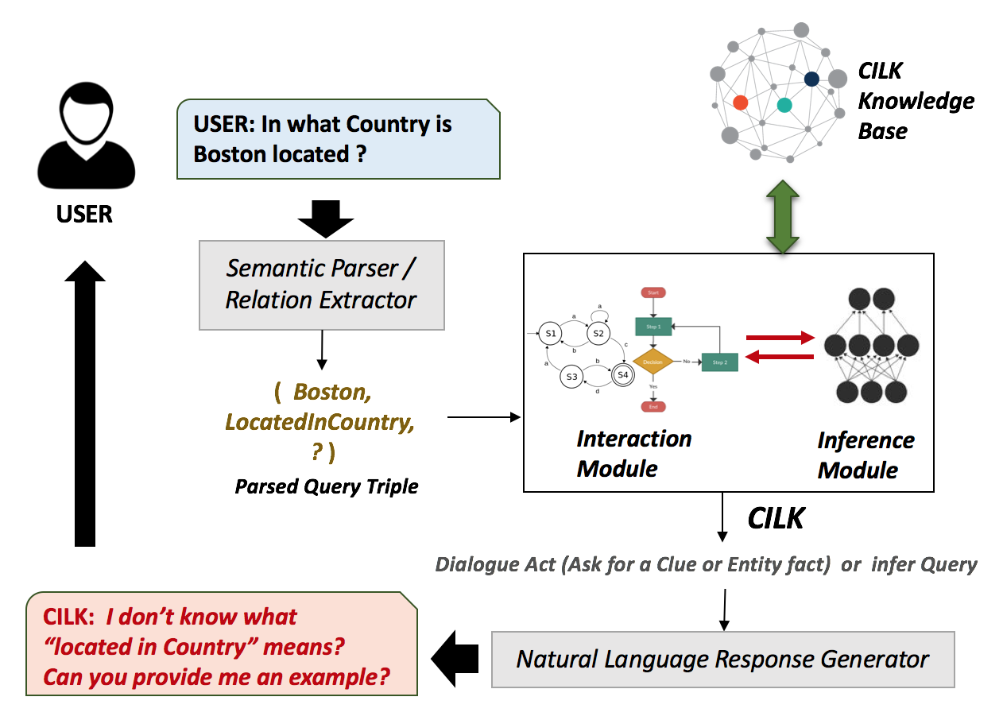
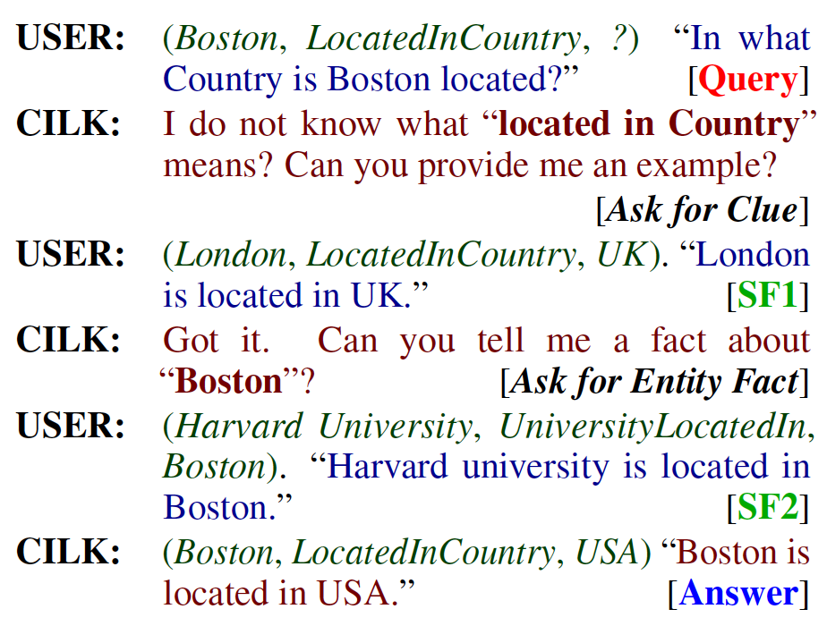
Interactive knowledge learning in dialogue: example
(Mazumder et al. 2019)
Mazumder, Liu, Wang, and Ma. Lifelong and Interactive Learning of Factual Knowledge in Dialogues. SIGDIAL-2019

Slide 29
Components of the system
Knowledge Base of triples
Interaction module: chatting with the user
  decides whether to ask or not and formulates questions to ask the user for supporting facts
  Updates KB with the acquired knowledge (used for training)
  Converts open-world queries to closed-world ones
    Using support facts to make h (or t) and r known to the KB (added to KB).
Inference module: using the acquired knowledge (supporting facts) and KB to answer the resulting closed-world query: (h, r, t).

Slide 30
Natural language interface and grounding
Motivation: when we were testing a self-driving car on the road, it suddenly stopped and refused to move.
    The road was completely clear, and we could not see anything wrong
      Debugging back in the lab found a small stone on the road.
    Why cannot the car tell us what the problem was in natural language (NL)?
    Why cannot we tell the car to go ahead in natural language?
      Our instruction is a piece of supervisory information.
To have this capability, the agent needs to continuously learn
    new natural language expressions that it does not understand, and
    to ground them to appropriate actions
Mazumder, Liu, Wang, Esmaeilpour. An Application-Independent Approach to Building Task-Oriented Chatbots with Interactive Continual Learning.
NeurIPS-2020 Workshop on Human in the Loop Dialogue Systems. 2020

Slide 31
Outline
Lifelong learning with learning on the job
Detecting novel instances
Continual learning with knowledge transfer
Continuous learning in dialogues
Summary

Slide 32
Summary
Classic ML: isolated, closed-world, single-task learning
AI agents must learn continuously in the open world, i.e.,
  Learning on the job (Chen and Liu, 2018; Liu, 2020)
    Detect new things and learn them with
      self-motivation & self-supervision
      Interactive self-supervision: need to interact with humans and the environment
  E.g., self-driving cars and chatbots need such capabilities.
Current techniques are still in their infancy.
  Novel learning algorithms or paradigm shifts may be needed.

