Slide 1
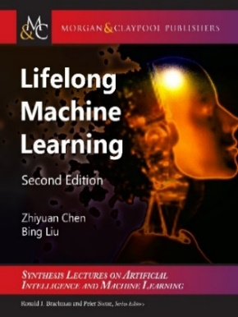
Continual Learning, OOD Detection & Open World Learning
Bing Liu
Department of Computer Science,
University of Illinois at Chicago

Slide 2
Introduction
Our human brains are hardwired to acquire knowledge. We are curious creatures who try to make sense of the world that confronts us. This natural inclination has helped our species evolve from early times (Brown & Dryden, 2004; Holt, 1983).
To build an AI agent, we must endow it the ability to
  learn continually in the open and dynamic world that is full of unknowns on its own initiative (by itself) with self-motivation and
  with interaction with humans, other agents and the environment.
Goal: Autonomy

Slide 3
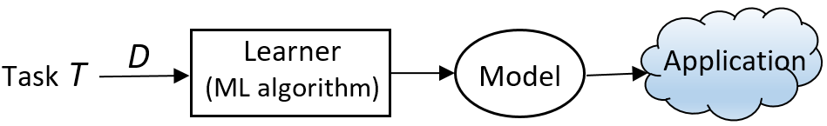
Introduction: classic paradigm
Classic machine learning: Isolated single-task learning
  Key weaknesses
    Closed-world assumption: nothing new in testing / application
    Model is fixed during application: no model revision/improvement in application
    No knowledge accumulation: needs a large amount of labeled training data
  Suitable for well-defined tasks in restricted environments
Chen and Liu. Lifelong machine learning. Morgan & Claypool. 2015, 2018

Slide 4
Introduction: open world continual learning
Closed-world: (test classes) 𝑌^{test} ⊆ 𝑌^{train} (training classes)
      Classes appeared in testing must have been seen in training, nothing new.
Open world: with unknowns or novelties, i.e., 𝑌^{test} - 𝑌^{train} ≠ φ
      A system unable to detect anything new cannot learn by itself.
Open-World (continual) Learning (OWL)
    Out-of-distribution (OOD) detection: novelty detection, anomaly/outlier detection
    Continual learning: learning detected/given new objects/tasks incrementally.
Autonomy: OWL is still insufficient. AI agents must learn by itself
  Self-initiated Open-world continual Learning and Adaptation (SOLA)
Liu, Mazumder, Robertson and Grigsby. AI Autonomy: Self-Initiated Open-World Continual Learning and Adaptation. AI Magazine, May 21, 2023
Chen and Liu. Lifelong machine learning. Morgan & Claypool. 2015, 2018.

Slide 5
Outline
Out-of-distribution detection
Lifelong or continual learning
Pre-deployment continual learning
    Batch continual learning
    Online continual learning
Post-deployment continual learning: autonomous learning
    Continual learning in the open-world
    Example 1: continual learning dialogue system
    Example 2: continual factual knowledge learning
Summary

Slide 6
Out-of-Distribution Detection
Detect instances from unseen classes. Fei and Liu (2016) proposed CBS learning:
  Center-based similarity (CBS) space learning.
It performs space transformation
  Each document vector d is transformed to a CBS space vector
    Compute centers c_{i} for the positive class
    Compute the similarities of each document to c_{i}.
    This gives us a new data set (in CBS space).

Slide 7
Traditional learning vs. CBS learning
Traditional learning (using SVM) CBS learning
Classification (testing)

Slide 8
DOC: OOD detection for text documents
(Shu et al. 2017)

Slide 9
Finding the rejection threshold

Slide 10
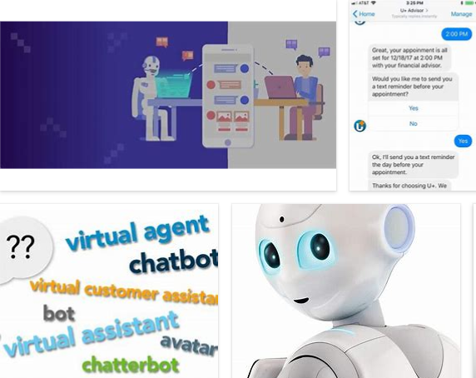
Chatbots need to learn continuously
A chatbot’s environment is highly dynamic & open.
  What happens if the user says something that the chatbot cannot understand.
  Hard to train the chatbot by its engineers forever.
    Chatbot must learn during chatting
    (learn from other sources)
Liu. Learning on the Job: Online Lifelong and Continual Learning. AAAI-2020

Slide 11
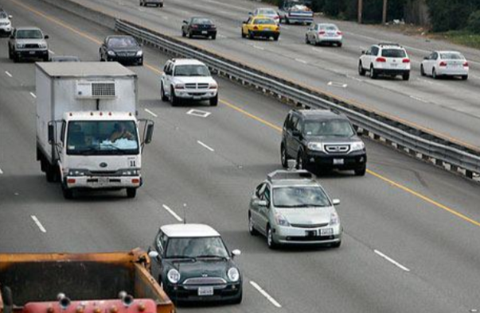
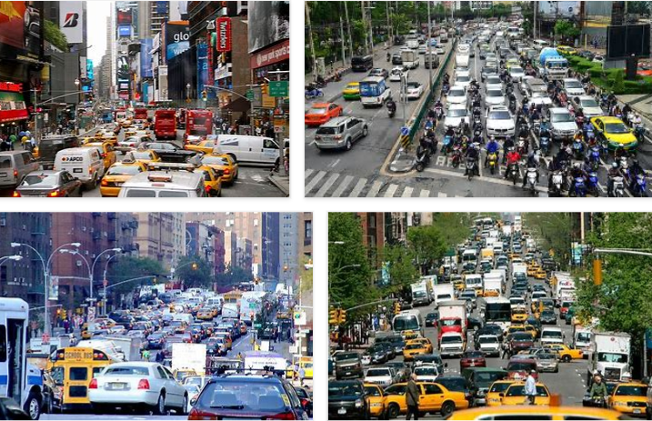
Self-driving cars need to learn continuously too
Self-driving cars cannot reach human-level of driving with only rules and off-line training.
    Impossible to cover all corner cases
    Real-world is full of unknowns.
Has to learn & adapt continuously in its interaction with humans and the environment by itself.
    in the open world (changes & unknowns).
Chen and Liu. Lifelong machine learning. Morgan & Claypool. 2018

Slide 12
Outline
Out-of-distribution detection
Lifelong or continual learning
Pre-deployment continual learning
    Batch continual learning
    Online continual learning
Post-deployment continual learning: autonomous learning
    Continual learning in the open-world
    Example 1: continual learning dialogue system
    Example 2: continual factual knowledge learning
Summary

Slide 13
Old definition of lifelong/continual learning
(Thrun 1996, Silver et al 2013; Ruvolo and Eaton, 2013; Chen and Liu, 2014, 2018)
Learn a sequence of tasks, T₁, T₂, …, T_{N}, … incrementally. Each task t has a training dataset D_{t} .
Assumptions:
  Once a task is learned its data is no longer accessible, at least a majority of it, and
  Both the task T_{N+1} and its training data D_{N+1} are given by the user.
Chen and Liu. Lifelong machine learning. Morgan & Claypool. 2018

Slide 14
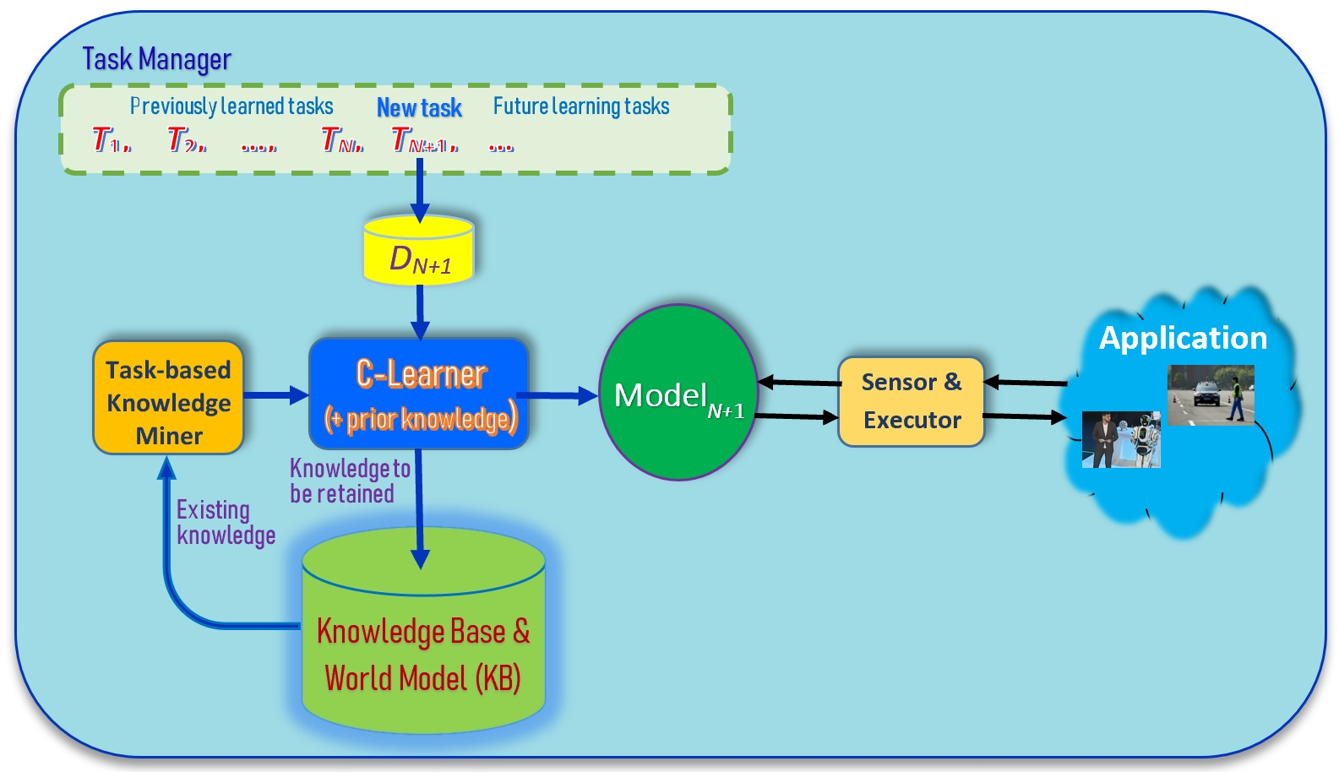
Traditional lifelong/continual learning
(Thrun 1996, Silver et al 2013; Ruvolo and Eaton, 2013; Chen and Liu, 2014, 2018)
Liu. Learning on the Job: Online Lifelong and Continual Learning. AAAI-2020
Chen and Liu. Lifelong machine learning. Morgan & Claypool. 2018

Slide 15
Goal of continual learning
Learn each new task T_{N+1} incrementally
  without catastrophic forgetting (CF): Learning of the new task T_{N+1} should not degrade the accuracy for any of the previous N tasks.
    In learning a new task, the system will need to change the network parameters, which may cause deterioration in performance of previous tasks.
  with knowledge transfer (KT): leveraging the knowledge learned from the previous tasks to learn the new task T_{N+1} better.
    Forward transfer: old task knowledge helps future task learning
    Backward transfer: future tasks improve the models of the previous tasks
Liu. Learning on the Job: Online Lifelong and Continual Learning. AAAI-2020
Chen and Liu. Lifelong machine learning. Morgan & Claypool. 2018

Slide 16
Batch and online continual learning
Batch continual learning
  When a new task arrives, all its training data are available
  Training can use any number of epochs
Online continual learning
  The data comes in a data stream.
  When a small batch of data is accumulated, it is learned in one iteration.
  Training is effectively done in one epoch.

Slide 17
Outline
Out-of-distribution detection
Lifelong or continual learning
Pre-deployment continual learning
    Batch continual learning
    Online continual learning
Post-deployment continual learning: autonomous learning
    Continual learning in the open-world
    Example 1: continual learning dialogue system
    Example 2: continual factual knowledge learning
Summary

Slide 18
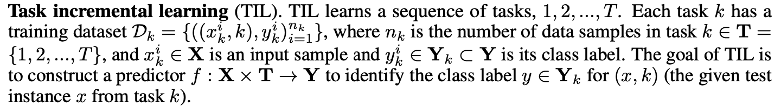
Two popular CL settings: TIL
Task incremental learning (TIL): train a “separate” model for each task and task-id is provided during testing
  Example: Task 1: learn to recognize different breeds of dogs. Task 2: learn to recognize different animals. Task 3: learn to recognize different types of fish.
  Testing needs task information (e.g., task id).

Slide 19
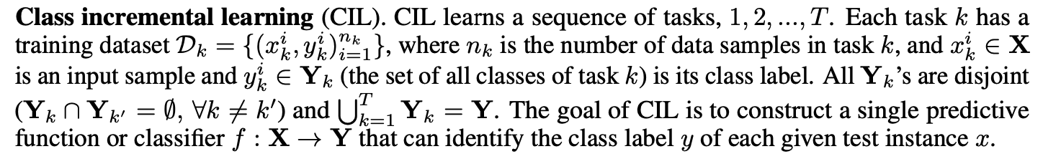
Two popular CL settings: CIL
Class incremental learning (CIL): produce a single model from all tasks and classify all classes during testing
  Example: Task 1: learn to recognize pig and cat. Task 2: sheep. Task 3: chicken and dog. Task 4: horse and cow
  Testing:
Kim, Xiao, Konishi, Ke and Liu. A Theoretical Study on Solving Continual Learning. NeurIPS-2022, Nov. 28 - Dec. 9, 2022
van de Ven and Tolias Three scenarios for continual learning, arXiv preprint arXiv:1904.07734, 2019.

Slide 20
Additional challenge of CIL
In addition to the challenges of catastrophic forgetting and knowledge transfer.
CIL has an additional challenge inter-task class separation (ICS), which is very hard to handle.
    Since after learning each task, its data is no longer accessible, then how to establish the decision boundaries between the classes of the new task and those of old tasks.
    Existing research has not dealt with this problem explicitly. Replay methods deal with this implicitly to a limited extent.
Question: What is the right way to solve CIL regardless what classification algorithm is used?
Kim, Xiao, Konishi, Ke and Liu. A Theoretical Study on Solving Continual Learning. NeurIPS-2022, Nov. 28 - Dec. 9, 2022.
Guo, Liu, Zhao. Cross-task class discrimination in online continual learning. CVPR-2023
.

Slide 21
Class incremental learning (CIL)
  Catastrophic forgetting

Slide 22
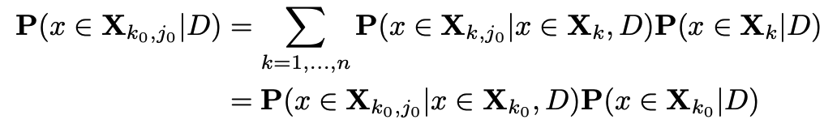
CIL decomposition and theoretical result
CIL problem can be decomposed into two subproblems: within-task prediction (WP) and task-id prediction (TP)
Theoretical result: Good WP and TP or (OOD) are necessary and sufficient for good CIL.
WP (i.e., TIL)
TP
Kim, Xiao, Konishi, Ke and Liu. A Theoretical Study on Solving Continual Learning. NeurIPS-2022, Nov. 28 - Dec. 9, 2022..

Slide 23
Upper Bound of CIL Loss
The loss of CIL is bounded by that of WP and TP
CIL improves with WP or TP
Kim, Xiao, Konishi, Ke and Liu. A Theoretical Study on Solving Continual Learning. NeurIPS-2022, Nov. 28 - Dec. 9, 2022..

Slide 24
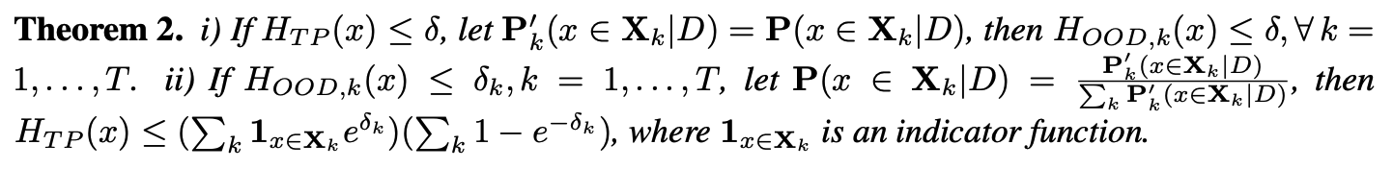
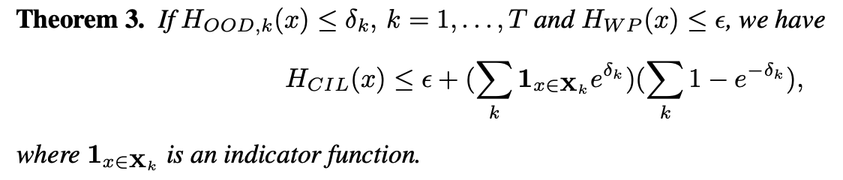
TP and OOD detection bound each other
TP and out-of-distribution (OOD) detection bound each other
The loss of CIL is bounded by that of WP and OOD
Kim, Xiao, Konishi, Ke and Liu. A Theoretical Study on Solving Continual Learning. NeurIPS-2022, Nov. 28 - Dec. 9, 2022..

Slide 25
Necessary Condition for CIL
Theorems 1, 2, and 3 shows that good performances of WP and TP or (OOD) are sufficient to guarantee a good CIL
Theorem 4 shows that good performances of WP and TP (or OOD) are necessary for a good CIL
Kim, Xiao, Konishi, Ke and Liu. A Theoretical Study on Solving Continual Learning. NeurIPS-2022, Nov. 28 - Dec. 9, 2022..

Slide 26
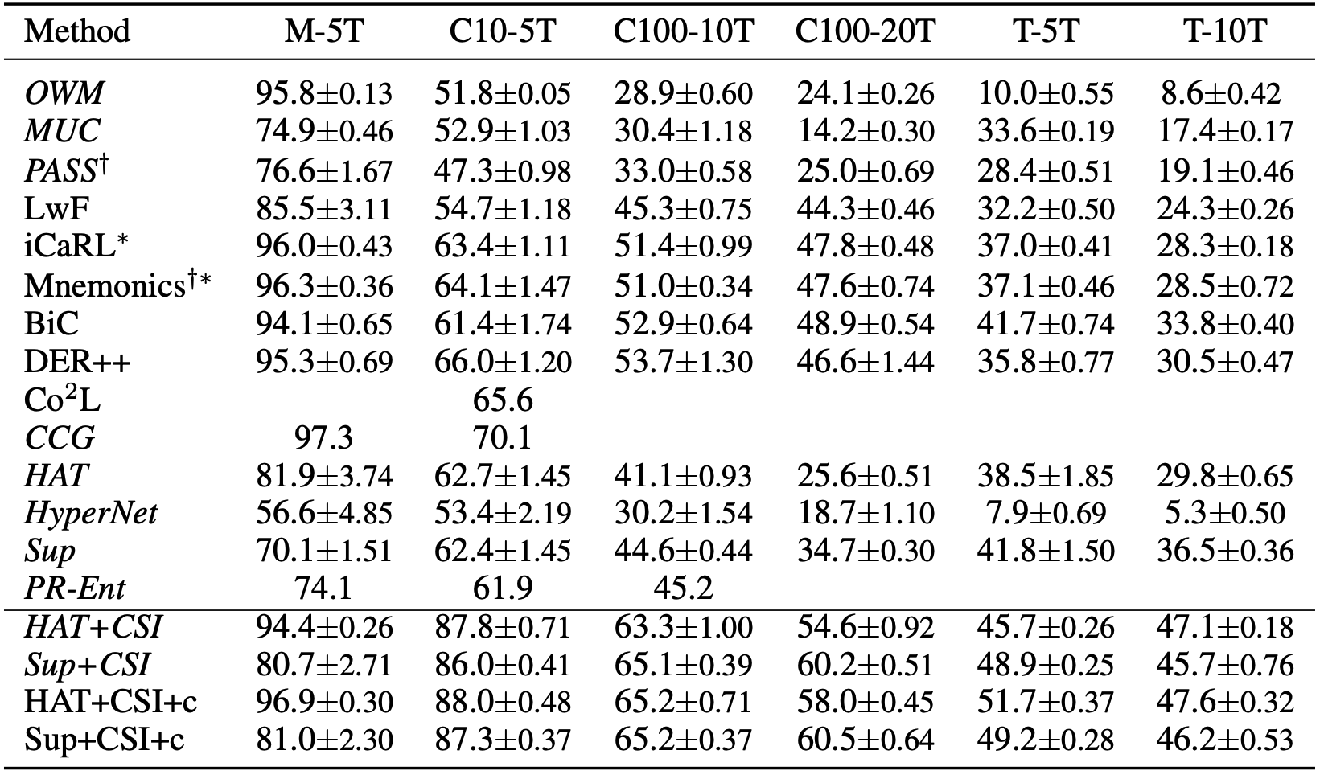
Proposed Methods - Comparison (CIL)
Theory-based methods outperform the baselines by large margins
Combination of
  a method to deal with CF
    E.g., HAT and SupSup
  a strong OOD detection
    E.g., CSI.
HAT+CSI and Sup+CSI
Kim, Xiao, Konishi, Ke and Liu. A Theoretical Study on Solving Continual Learning. NeurIPS-2022, Nov. 28 - Dec. 9, 2022..

Slide 27
Task incremental learning (TIL)
  Catastrophic forgetting
  Knowledge transfer

Slide 28
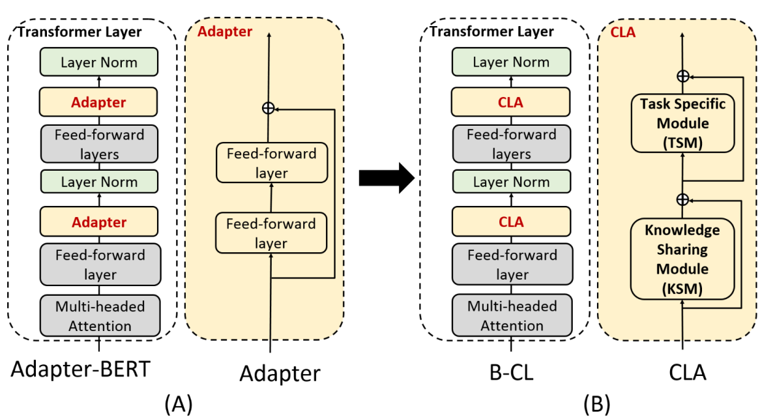
BERT-based Continual Learning (B-CL) for aspect sentiment classification (Ke, Xu and Liu, 2021)
Fine-tune BERT
  Perform poorly; capture highly task specific information, and difficult to transfer knowledge
Adapter-BERT
  Fix the pre-trained BERT parameters, only the adapter and normalization layers are trainable
We replace the adapter with Continual Learning Adapter (CLA)
Ke, Xu and Liu. Adapting BERT for Continual Learning of a Sequence of Aspect Sentiment Classification Tasks. NAACL-2021.
Notes:
Overview end

Slide 29
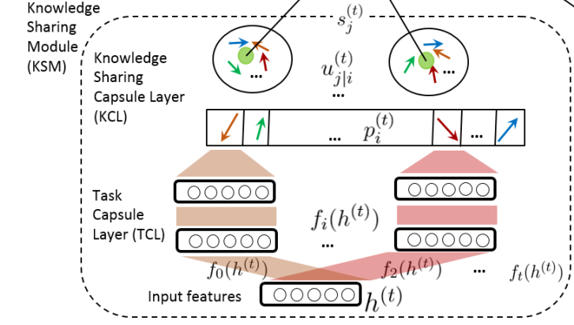
BERT-based Continual Learning (capsule network)
Knowledge Sharing Module (KSM)
Input: hidden state from the transformer layer
TCL: a capsule is added to TCL for every new task, preparing the low-level features from each task
Ke, Xu and Liu. Adapting BERT for Continual Learning of a Sequence of Aspect Sentiment Classification Tasks. NAACL-2021.
Notes:
Overview end

Slide 30
BERT-based Continual Learning
Knowledge Sharing Module (KSM)
KCL: capture those tasks with similar features or shared knowledge.
A key here is the dynamic routing, which encourages each low-level capsule (i.e., task capsule) to send its output to the similar higher-level capsule (i.e., Knowledge sharing capsule)
Ke, Xu and Liu. Adapting BERT for Continual Learning of a Sequence of Aspect Sentiment Classification Tasks. NAACL-2021.
Notes:
Overview end

Slide 31
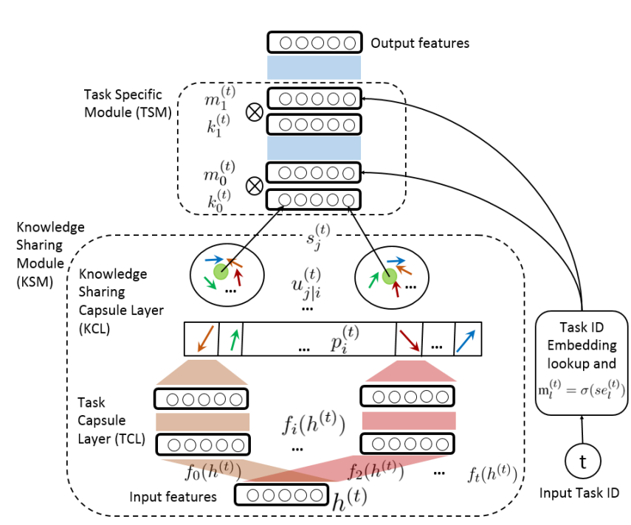
BERT-based Continual Learning
Task Specific Module (TSM)
  Input: the knowledge sharing capsule output and task id
  Task Masks
Ke, Xu and Liu. Adapting BERT for Continual Learning of a Sequence of Aspect Sentiment Classification Tasks. NAACL-2021.
Notes:
Overview end

Slide 32
Experimental results
Sentiment analysis tasks
  19 domains (opinions of 19 products)
Compared with 18 baseline systems.

Slide 33
Outline
Out-of-distribution detection
Lifelong or continual learning
Pre-deployment continual learning
    Batch continual learning
    Online continual learning
Post-deployment continual learning: autonomous learning
    Continual learning in the open-world
    Example 1: continual learning dialogue system
    Example 2: continual factual knowledge learning
Summary

Slide 34
Online CL: Mutual information (MI) maximization
OCM: Online Continual learning based on Mutual information (MI) maximization.
  Both batch CL and online CL have not used mutual information
  To learn features holistically.
Objective: deal with CF in the CIL setting
  Preventing information loss in feature learning
  Preserving the previously learned knowledge
Guo, Liu, and Zhao. Online Continual Learning through Mutual Information Maximization. ICML-2022

Slide 35
OCM architecture
A replay-based method: X^{new} (new data batch), X^{buf} (sampled data from replay buffer M)

Slide 36
Experiment results

Slide 37
Outline
Out-of-distribution detection
Lifelong or continual learning
Pre-deployment continual learning
    Batch continual learning
    Online continual learning
Post-deployment continual learning: autonomous learning
    Continual learning in the open-world
    Example 1: continual learning dialogue system
    Example 2: continual factual knowledge learning
Summary

Slide 38
Open-world continual learning
Open-World (continual) Learning (OWL)
  (1) detect novel/new objects (OOD detection) and
  (2) incrementally learn the new objects after they are labeled.
The theoretical result for CIL is also applicable here because
    (1) Theory says WP and OOD detection are necessary and sufficient conditions, and
    (2) an OOD detection system usually does both OOD detection and in-distribution (IND) classification, which is WP (within-task prediction).
Autonomous AI agents: SOLA = OWL + Adaptation
    Including getting training data by the AI agent itself.
Liu, Mazumder, Robertson and Grigsby. AI Autonomy: Self-Initiated Open-World Continual Learning and Adaptation. AI Magazine, May 21, 2023

Slide 39
An experience with self-driving
I consulted for a self-driving car company.
We took a self-driving car for a road test.
  At a T-junction, it stopped & refused to move.
    Every direction was clear, nothing on the road.
Our human driver had to take over.
  Debugging found that a sensor detected a pebble on the road.
  If the car had said ”I detected an unknown object here. What should I do?” we would have replied “It is safe. Go ahead.”
    The car can then learn the new object so that it will have no issue next time.
      Learning on the fly (on the job)

Slide 40
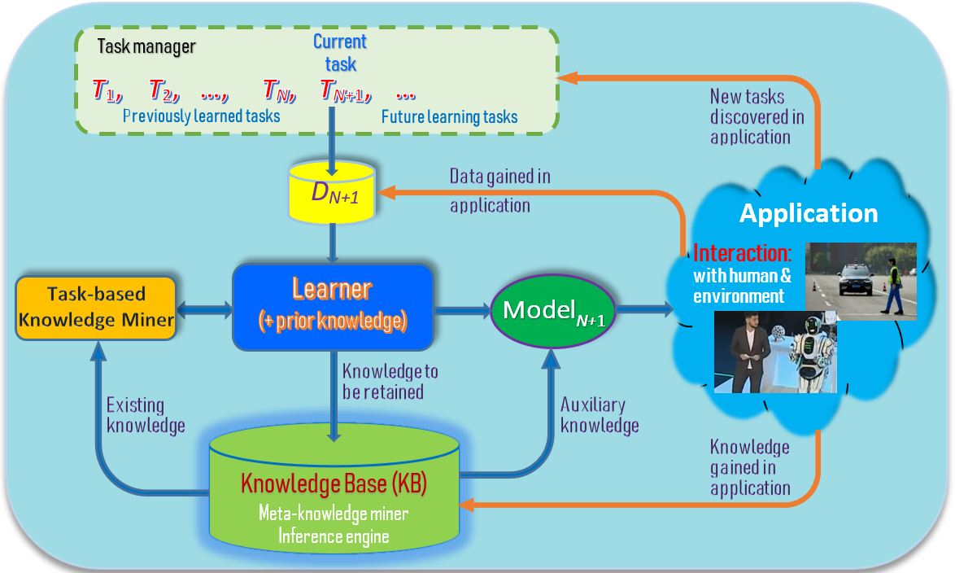
New: Lifelong/continual learning in the open world
(Chen & Liu, 2018, Liu, 2020)
Orange lines:
Learning after model deployment
- Learning on the job
Liu. Learning on the Job: Online Lifelong and Continual Learning. AAAI-2020
Chen and Liu. Lifelong machine learning. Morgan & Claypool. 2015, 2018

Slide 41
Key characteristics
(Chen and Liu, 2018-book)
Continuous learning process:
  Without forgetting: Learning a new task should not forget the past.
Knowledge accumulation in KB (long-term memory)
Using/adapting past knowledge to help learn new tasks
Learning on the job during model application in the open world in a self-supervised manner via interaction with humans and the environment.
  Discover new tasks and learn them incrementally/continually.
    Novel instances of existing/known classes – concept drifting.
    Novel/unknown classes or tasks
Liu. Learning on the Job: Online Lifelong and Continual Learning. AAAI-2020
Notes:
These three characteristics make LML different from related learning tasks such as transfer learning, multi-task learning, online learning and so on.

Slide 42
Learning on the job
(Liu, 2020, Chen and Liu, 2018)
It is known in learning science that about 70% of our human knowledge comes from ‘on-the-job’ learning.
    Only about 10% through formal education or training
    About 70% from on-the-job learning
    The rest 20% through observation of others
AI agents should also learn on the job or during applications
  the world is too complex and constantly changing.
    Impossible to learn everything offline using manually labeled data
(1) Chen and Liu Lifelong machine learning, 2015, 2018. (2) Liu. Learning on the Job: Online Lifelong and Continual Learning. AAAI-2020

Slide 43
Learning on the job in the open-world
(Fei et al, 2016; Shu et al., 2017)
Steps:
  Discover novel instances: e.g., classify instances in D^{test} to 𝑌^{train} and detect novel instances D^{novel} ⊆ D^{test} belonging to L₀ – new tasks
  Identify the unseen/new classes in D^{novel}, L₀ = {l_{t+1}, l_{t+2}, …} and gather training data
    Interactive self-supervision: interaction with humans and the environment
  Continual learning: Incrementally learn the new classes {l_{t+1}, l_{t+2}, …} (the new task)
Note: this does not include how the system should respond or react to novelty.
Fei, Wang, and Liu. Learning Cumulatively to Become More Knowledgeable. KDD-2016

Slide 44
Interactive self-supervision
(Liu, 2020)
Identify new classes and training data by interacting with
  Humans: through natural language, e.g.,
    Self-drive cars: asking the passenger
      What is that object? How do I drive now? Where should I stop?
    Chatbots: learn new knowledge and learn language during chatting.
  Environment: get feedback & use tools (e.g., search engines)
    Need an internal evaluation system
      to evaluate environmental feedback
  To gather knowledge, and supervisory or reward information.
Liu. Learning on the Job: Online Lifelong and Continual Learning. AAAI-2020

Slide 45
Example - a greeting bot in a hotel
(Chen and Liu, 2018; Liu et al., 2021)
Novelty detection = out-of-distribution (OOD) detection
See an existing guest.
    Bot: “Hello John, how are you today?”
See a new guest - recognize he/she is new (OOD and create a new task)
    Bot: “Welcome to our hotel! What is your name, sir?” (get class label)
    Guest: “David” (got class label: David)
    Bot learns to recognize David automatically
      take pictures of David (get training data)
      learn to recognize David (continual learning)
See David next time.
    Bot: “Hello David, how are you today?” (use the new knowledge)
Liu, Robertson, Grigsby, and Mazumder. Self-Initiated Open World Learning for Autonomous AI Agents. AAAI Spring Symposium, 2022 Chen and Liu. Lifelong machine learning. Morgan & Claypool. 2015, 2018.

Slide 46
Example (cont.)
In a real hotel, the situation is much more complex.
  How does the bot know that the novel object is a new guest?
    Is the object a person, an animal, or a piece of furniture?
      needs to use existing knowledge to characterize the novel object!
  Different characterizations require different responses (adaptation or accommodation strategies)? E.g.,
    If it looks like an animal, report to a hotel staff.
    If it looks like a policeman, do nothing
    If it looks like a hotel guest (with luggage), ask for his/her name: “Welcome to our hotel! What is your name, sir?” and learn to recognize him/her
Liu, Robertson, Grigsby, and Mazumder. Self-Initiated Open World Learning for Autonomous AI Agents. AAAI Spring Symposium, 2022 Chen and Liu. Lifelong machine learning. Morgan & Claypool. 2015, 2018.

Slide 47
Self-initiated Open-world Continual Learning (SOL)
An agent is represented as a pair (T, S),
    T is the primary task-performer (e.g., dialogue system of the greeting bot)
    S is a set of supporting functions (e.g., vision system and speech system) that supports the primary task-performer.
T or each S_{i} ∈ S has its own seven sub-systems (L, R, C, A, K, I, E),
    L: open-world continual learner (classification, novelty detection & continual learning)
    R: relevance module that decides if a detected novelty is relevant to agent’s task
    C: novelty characterizer that characterizes the novelty
    A: adaptor that adapts to novelty – characterizing novelty and formulating response
    K: risk assessment and management module
    I : interactive module to communicate with humans or other agents
    E: action executor
Liu, Mazumder, Robertson, Grigsby,: AI Autonomy: Self-Initiation, Adaptation and Continual Learning. submitted, 2022.
Chen and Liu. Lifelong machine learning. Morgan & Claypool. 2015, 2018.
Notes:
L (??)

Slide 48
Post-deployment continual learning (ML autonomy)
(Chen & Liu, 2018, Liu, 2020 Liu et al., 2022)
Blue lines: Existing continual learning
Orange lines:
Learning after model deployment
(Open-world continual learning)
Liu, Mazumder, Robertson, Grigsby,: AI Autonomy: Self-Initiation, Adaptation and Continual Learning. submitted, 2022.

Slide 49
Novelty characterization and adaptation
Characterization: a description of the novel object based on the agent's existing knowledge.
    Characterization at different levels of details => more or less precise responses.
      Similarity: e.g., it looks like an animal (general), or it looks like a dog (more specific).
      Attributes/properties: e.g., a moving object, speed and direction of moving.
Adapting to novelty: a pair (Characterization, Response)
    Response: According to characterization, formulate a specific course of actions to respond to the novelty, e.g.,
      If novel object looks like an animal (characterization), report to hotel staff (response).
      If cannot characterize, take default action (e.g., do nothing)
    Enable continual learning (see next slide)
Risk assessment: each decision carries risks
Liu, Mazumder, Robertson, Grigsby,: AI Autonomy: Self-Initiation, Adaptation and Continual Learning. submitted, 2022.

Slide 50
Adaptation enabled continual learning
Ask a human and learn
  E.g., for the greeting bot, ask the human using the interactive module I (in natural language) to get ground-truth data and incrementally learn.
Imitation learning.
  E.g., on seeing a novel object by a self-driving car, if the car in front drives through it with no issue, the car may choose the same course of action as well and learn it for future use.
Perform limited reinforcement learning.
  By interacting with the environment through trial-and-error exploration, the agent learns a good response policy for future use.
Liu, Mazumder, Robertson, Grigsby,: AI Autonomy: Self-Initiation, Adaptation and Continual Learning. submitted, 2022.

Slide 51
Outline
Out-of-distribution detection
Lifelong or continual learning
Pre-deployment continual learning
    Batch continual learning
    Online continual learning
Post-deployment continual learning: autonomous learning
    Continual learning in the open-world
    Example 1: continual learning dialogue system
    Example 2: continual factual knowledge learning
Summary

Slide 52
Example SOL: natural language interface (NLI)
Performance task: user asks the system (CML, like Siri and Alexa) to perform a task in NL, the system does it via API actions
    Approach: natural language to natural language matching (NL2NL)
CML builds NLIs for API-driven applications semi-automatically.
To build a new NLI (or add a new skill to an existing NLI),
    Application developer writes a set S_{i} of seed commands (SCs) in NL to represent each API action i.
      SCs in S_{i} are just like paraphrased NL commands from users to invoke i, but the objects to be acted upon in each SC are replaced with variables, the arguments of i.
    When the system does not understand a command (novelty), it adapts and learns new (paraphrased) SCs from users interactively and continually.
Mazumder, Liu, Wang, and Esmaeilpour. An Application-Independent Approach to Building Task-Oriented Chatbots with Interactive Continual Learning.
NeurIPS-2020 Workshop on Human in the Loop Dialogue Systems (HLDS-2020)

Slide 53
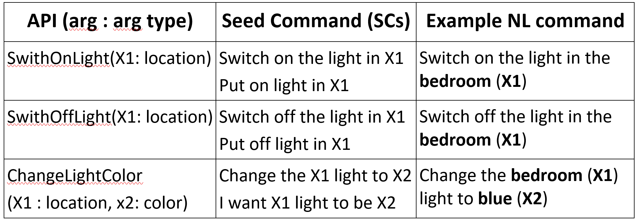
An example – Smart home
SmartHome: API action: SwitchOnLight(X1)
  Switching on a light at a given place X1
Let an SC be “put on light in X1" for this API,
    where X1 is a variable representing the argument of the API.
User command: “power on the light in the bedroom”
    It can be matched or grounded to this SC, where the grounded API arguments are {X1 = ‘bedroom’}.

Slide 54
CML has three components
SC (seed command) specification
  to enable application developer to specify a set of SCs for each of their APIs
Command grounding module
  ground a user command C to an action SC by matching C with the correct SC (whose associated action API is then executed)
Interactive continual learner
  It interacts with end-users to learn new SCs and paraphrases of API argument values.

Slide 55
Novelty detection, characterization, adaptation
Novelty detection: when CML cannot ground a user command, e.g., it cannot understand “turn off the light in the kitchen”
Novelty characterization: which part of the command it understands and which part it has difficulty based on similarity. E.g., it cannot ground “turn off”
Adaptation (or accommodation):
    Response: ask the user by providing some options (to collect ground-truth data)
Bot: Sorry, I didn’t get you. Do you mean to:
option-1. switch off the light in the kitchen,
option-2. switch on the light in the kitchen, or
option-3. change the color of the light in the kitchen?
    Continual learning: learn a new SC. No issue with related commands in future.

Slide 56
Risk consideration
CML manages risk in two ways
  Do not ask user too many questions in order not to annoy the user.
    Learning can be done to assess each user’s tolerance.
  When characterization is not confident, take the default action, i.e.,
    Ask the user to say his/her command in another way
      rather than providing a list of random options for user to choose from
        which can be annoying or make the user lose confidence in the system!
Notes:
Confident but wrong!! --- needs knowledge revision..

Slide 57
Outline
Out-of-distribution detection
Lifelong or continual learning
Pre-deployment continual learning
    Batch continual learning
    Online continual learning
Post-deployment continual learning: autonomous learning
    Continual learning in the open-world
    Example 1: continual learning dialogue system
    Example 2: continual factual knowledge learning
Summary

Slide 58
Continuous knowledge learning in dialogues
(Mazumder et al. 2018, 2019)
Dialogue systems are increasingly using knowledge bases (KBs) storing real-world facts to help generate responses.
    KBs are inherently incomplete and remain fixed,
    which limit dialogue systems’ conversation capability
CILK: Continuous and Interactive Learning of Knowledge for dialogue systems
  to continuously and interactively learn and infer new knowledge during conversations
Liu and Mazumder. Lifelong and Continual Learning Dialogue Systems: Learning during Conversation. AAAI-2021

Slide 59

Human conversation is knowledge driven?
I watched ``The Dark Knight”
yesterday. It was awesome.
Grounding fact
USER1
Christian Bale Acted In
The Dark Knight
Did you like Christian
Bale’s acting?
USER2
Knowledge grounding makes conversation interesting and intelligent.

Slide 60
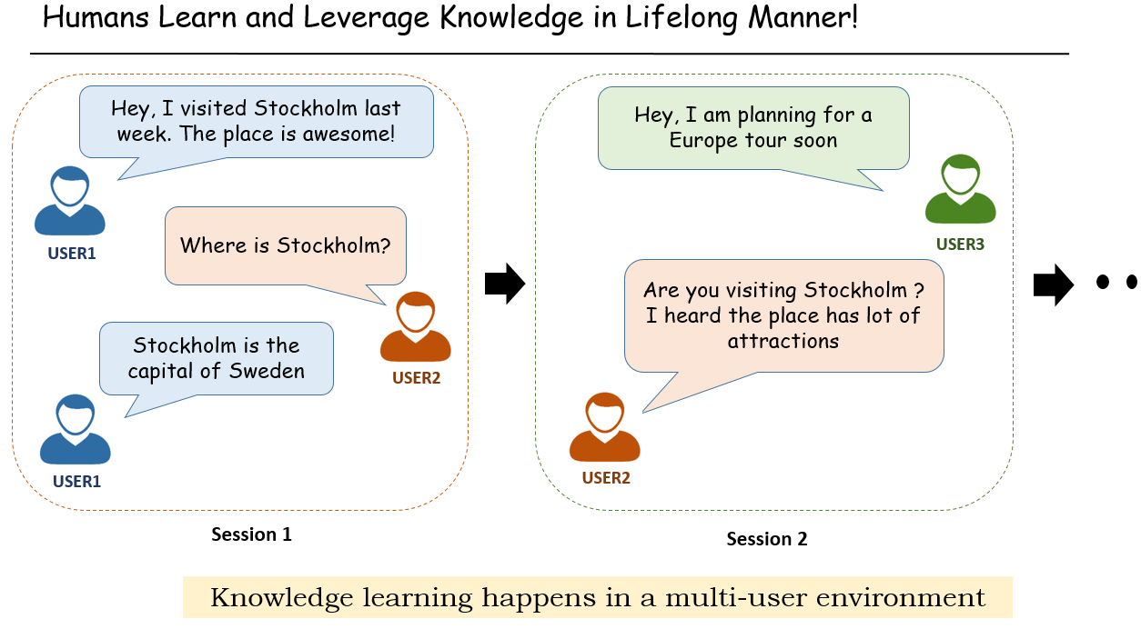
Knowledge learning in conversation
/ agent
/ agent

Slide 61
Opportunities to learn in conversations
Extract knowledge directly from user utterances, e.g.,
    User: Obama was born in Hawaii.
    Agent extracts: (Obama, BornIn, Hawaii) – expressed in triples (h, r, t)
Actively ask user questions & expect correct answers, e.g.,
    Agent: Where was Obama born?
    User: Hawaii => (Obama, BornIn, Hawaii)
When the agent cannot understand an user utterance, it asks the user to rephrase or to select the right option.
When the agent cannot answer user questions, it asks the user for some supporting facts and then infers the answers.
    We focus on this setting (which covers 1 and 2)
Liu and Mazumder. Lifelong and Continual Learning Dialogue Systems: Learning during Conversation. AAAI-2021

Slide 62
Problem formulation
Given a user query / question (h, r, ?) [or (?, r, t)], e.g., “who is the President of the US” (?, President-of, the US), our goal is two-fold:
  Answering the user query or rejecting the query to remain unanswered if the correct answer is believed to not exist in the KB
  learning / acquiring some knowledge (supporting facts) from the user to help the answering task.
We further distinguish two types of queries:
(1) Closed-world queries: h (or t) and r are known to the KB
(2) Open-world queries: Either one or both h (or t) and r are unknown
Proposed Soln.
an engine for Continuous and Interactive Learning of Knowledge (CILK)

Slide 63
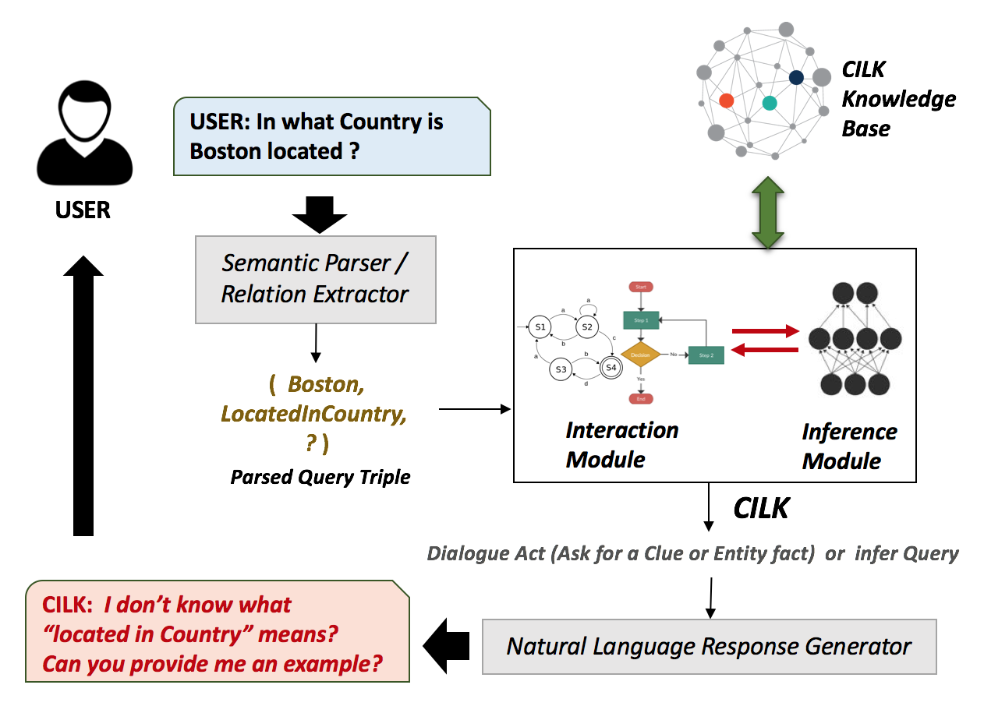
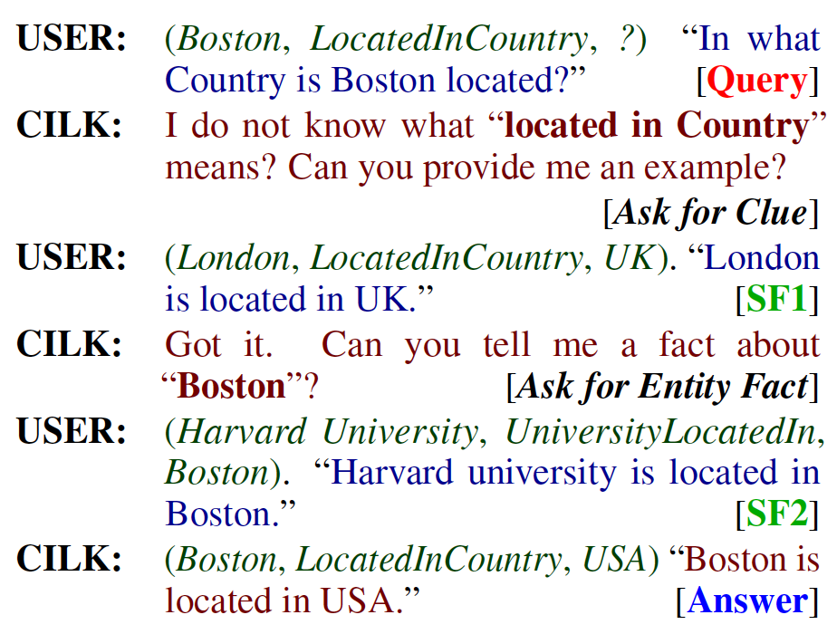
Interactive knowledge learning in dialogue: example
(Mazumder et al. 2019)
Mazumder, Liu, Wang, and Ma. Lifelong and Interactive Learning of Factual Knowledge in Dialogues. SIGDIAL-2019

Slide 64
Components of the system
Knowledge Base of triples
Interaction module: chatting with the user
  decides whether to ask or not and formulates questions to ask the user for supporting facts
  Updates KB with the acquired knowledge (used for training)
  Converts open-world queries to closed-world ones
    Using support facts to make h (or t) and r known to the KB (added to KB).
Inference module: using the acquired knowledge (supporting facts) and KB to answer the resulting closed-world query: (h, r, t).

Slide 65
Dealing with wrong knowledge from users
Learn from end-users comes with a major challenge:
  Acquiring intentional or unintentional wrong knowledge from users.
Since chatbots normally work in multi-user environments
  The issue may be addressed through cross-verification.
  After acquiring a piece of new knowledge, the agent can store it in an unverified knowledge buffer.
    Next, while chatting with some other users in future sessions to accomplish related tasks, the chatbot can ask them to verify the unverified knowledge
Liu and Mazumder. Lifelong and Continual Learning Dialogue Systems: Learning during Conversation. AAAI-2021

Slide 66
Outline
Out-of-distribution detection
Lifelong or continual learning
Pre-deployment continual learning
    Batch continual learning
    Online continual learning
Post-deployment continual learning: autonomous learning
    Continual learning in the open-world
    Example 1: continual learning dialogue system
    Example 2: continual factual knowledge learning
Summary

Slide 67
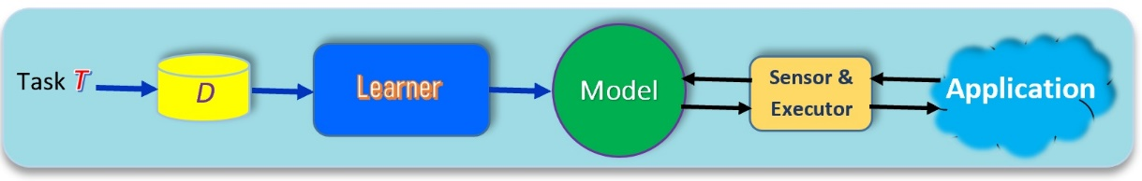
Summary
Traditional ML
    Isolated and closed-world learning
AI agents must learn continuously in the open world (post-deployment)
    Discover new learning tasks in applications
    Acquiring ground-truth training data on the fly via self-initiated interactions.
    Continual learning of new tasks incrementally
Current techniques are still in their infancy.
    But some techniques are ready for applications.
    A paradigm shift is needed in building AI agents
      Building modules to enable AI agents to learn by themselves.

