Slide 1
Continual Learning Dialogue Systems – Learning after Model Deployment
Bing Liu
Department of Computer Science
University of Illinois at Chicago

Slide 2
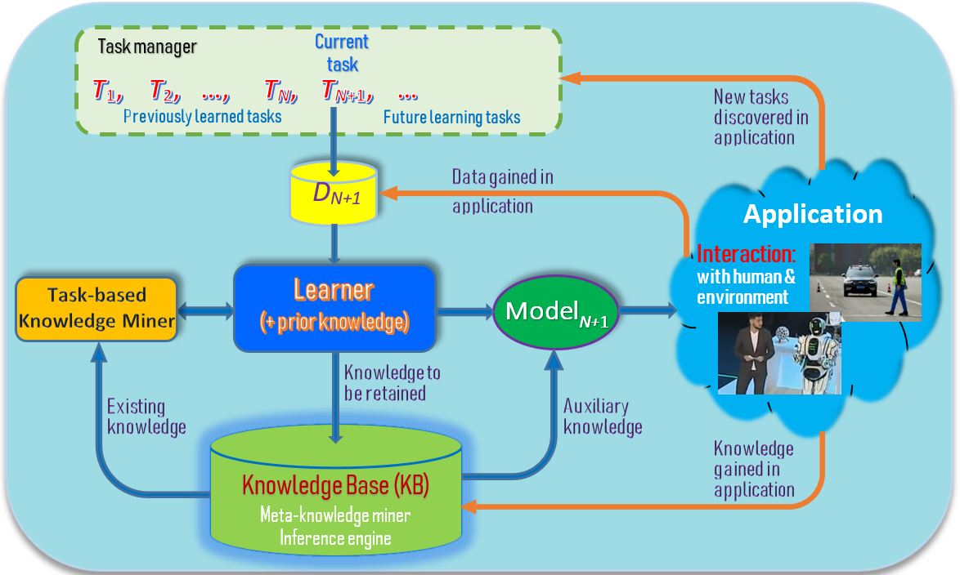
Continual learning with learning after deployment (Fei et al 2016, Shu et al 2017a, 2017, Chen & Liu, 2018, Liu, 2020)
Orange lines:
Learning after model deployment
- Learning on the job
Liu. Learning on the Job: Online Lifelong and Continual Learning. AAAI-2020

Slide 3
Characteristics of continual learning (Chen and Liu, 2018, Liu, 2020)
Continuous incremental learning process (no forgetting)
Knowledge accumulation in KB (long-term memory)
Knowledge transfer/adaptation (across tasks) (Ke, Liu, Huang, 2020)
Learning after deployment (on the job). Self-supervision using the accumulated knowledge and interaction with humans & environment.
Main steps:
Identify new tasks to learn (tasks not given)
Acquire ground-truth training data (training data not given)
Learn the tasks incrementally (one-shot or few-shot)
Liu. Learning on the Job: Online Lifelong and Continual Learning. AAAI-2020
Ke, Liu, and Huang. Continual Learning of a Mixed Sequence of Similar and Dissimilar Tasks. NeurIPS-2020
Notes:
These three characteristics make LML different from related learning tasks such as transfer learning, multi-task learning, online learning and so on.

Slide 4
Example 1 – a chatbot system (Liu and Mazumder, 2021)
Session 1
User-1: Hey, I visited Stockholm last week. The place is awesome!
Chatbot: Where is Stockholm?
User-1: Stockholm is the capital of Sweden.
Session 2
User-2: I am planning a tour to Europe next month.
Chatbot: Are you visiting Stockholm? I heard it is an awesome place.
Liu and Mazumder. Lifelong and Continual Learning Dialogue Systems: Learning during Conversation. AAAI-2021

Slide 5
Example 2 - a greeting bot in a hotel (Chen and Liu 2018)
See an existing guest.
Bot: “Hello John, how are you today?”
See a new guest. Bot recognizes the guest is new. (creat a new task)
Bot: “Welcome to our hotel! What is your name, sir?” (get class label)
Guest: “David” (got class label: David)
Bot learns to recognize David automatically
take pictures of David (get training data)
learn to recognize David (learn incrementally)
See David next time.
Bot: “Hello David, how are you today?” (use the new knowledge)
Chen and Liu. Lifelong machine learning. Morgan & Claypool. 2015, 2018

Slide 6
Learning new knowledge during dialogue
Learning to ground language expressions (Mazumder et al, 2020b)
Learning via multi-turn dialogues with the user
Learning via user demonstrations
Learning factual knowledge (Mazumder et al, 2019, 2020a)
Extracting new knowledge from user utterances via dialogues (Liu and Mei, 2020)
Asking and inferring new facts when the bot cannot answer a user query.
Asking questions to learn about unknown entities and concepts (Ono et al. 2017).
Learning conversation skills (Hancock et al. 2019; Shuster et al. 2020)
Learning user behaviors and preferences
Modeling situation-aware conversations
Learning the user’s emotion and mood state
Liu and Mazumder. Lifelong and Continual Learning Dialogue Systems: Learning during Conversation. AAAI-2021

Slide 7
Outline
Continual learning with learning after deployment
Continual learning to ground new language expressions
Continual learning of factual knowledge
Dealing with wrong knowledge from users
Summary

Slide 8
Learning to ground NL commands
Task-oriented chatbots like virtual assistants (e.g., Siri, Alexa, etc) are Natural Language (command) Interfaces (NLI)
allow users to issue natural language (NL) commands to be mapped to some actions for execution by the underlying application.
Existing approaches to building such chatbots:
Train an end-to-end deep learning model.
Semantic parsing -> logical forms -> translated to executable actions
We discuss CML (Command Matching and Learning)
Mazumder, Liu, Wang, and Esmaeilpour. An Application-Independent Approach to Building Task-Oriented Chatbots with Interactive Continual Learning.
NeurIPS-2020 Workshop on Human in the Loop Dialogue Systems (HLDS-2020)

Slide 9
Natural language to natural language matching
An application-independent approach to building task-oriented chatbots with interactive continual learning.
Based on natural language to natural language matching (NL2NL)
CML to automatically build NLIs for any API-driven applications.
To build a new NLI (or add a new skill to an existing NLI),
the application developer only needs to write a set S_{i} of seed commands (SCs) in NL to represent each action i.
SCs in S_{i} are just like paraphrased NL commands from users to invoke i, but the objects to be acted upon in each SC are replaced with variables, the arguments of i.
An interactive learning mechanism to enable CML to continually learn new (paraphrased) SCs from users.

Slide 10
An example
Microsoft Paint tool: The API action
drawCircle(X1, X2)
drawing a circle having color X1 at coordinate X2.
Let a SC be “draw a X1 circle at X2" for this API,
where X1 and X2 are variables representing the arguments of the API.
User command: “draw a blue circle at (20, 40)”
It can be matched or grounded to this SC, where the grounded API arguments are X1 = ‘blue’ and X2 = (20, 40).

Slide 11
CML has three components
SC (seed command) specification
to enable the application developer to specify a set of SCs for each of their APIs
Command grounding module
ground a user command C to an action SC by matching C with the correct SC (whose associated action API is then executed)
Interactive learner
It interacts with end-users to learn new SCs and paraphrases of API argument values.

Slide 12
SC Specification (blocks-world)

Slide 13
Command grounding module (CGM)
Rephraser and Tagger (R):
Given the user command C, R repharses C and tags each word or phrase in the rephrased C with either ‘O’ (i.e., not an argument type) or one of the possible argument types of the action SCs.
SC Matcher (M):
Given the rephrased and tagged command C and the set T of (action or utility) SCs, Matcher M computes a match score f(t, C) for each t in T and returns the top ranked SC.
This work uses an information retrieval (IR) based unsupervised matching model for M

Slide 14
Command grounding module (contd.)

Slide 15
Continual interactive learning
If CML does not understand a user commend C.
CML learns a new SC from the user commend C through interactive dialogue
It also learn new paraphrased argument values from in C to improve repheaser R over time.

Slide 16
Experiment results
BERT-JISF: joint intent detection and slot filling - fine-tunes a pre-trained BERT model to solve NLU (Chen et al, 2019).
A-acc: action intent prediction
Arg-F1: argument F1
Datasets
BW: blocks-world
WPD: Webpage design
FB: flight booking

Slide 17
Outline
Continual learning with learning after deployment
Continual learning to ground new language expressions
Continual learning of factual knowledge
Dealing with wrong knowledge from users
Summary

Slide 18
Continuous knowledge learning in dialogues (Mazumder et al. 2019)
Dialogue systems are increasingly using knowledge bases (KBs) storing factual knowledge to help generate responses.
KBs are inherently incomplete and remain fixed,
which limit dialogue systems’ conversation capability
CILK: Continuous and Interactive Learning of Knowledge for dialogue systems
to continuously and interactively learn and infer new knowledge during conversations
Mazumder, Ma, and Liu. Towards a Continuous Knowledge Learning Engine for Chatbots. arXiv:1802.06024 [cs.CL], 16 Feb. 2018
Mazumder, Liu, Wang, and Ma. Lifelong and Interactive Learning of Factual Knowledge in Dialogues. SIGDIAL-2019

Slide 19
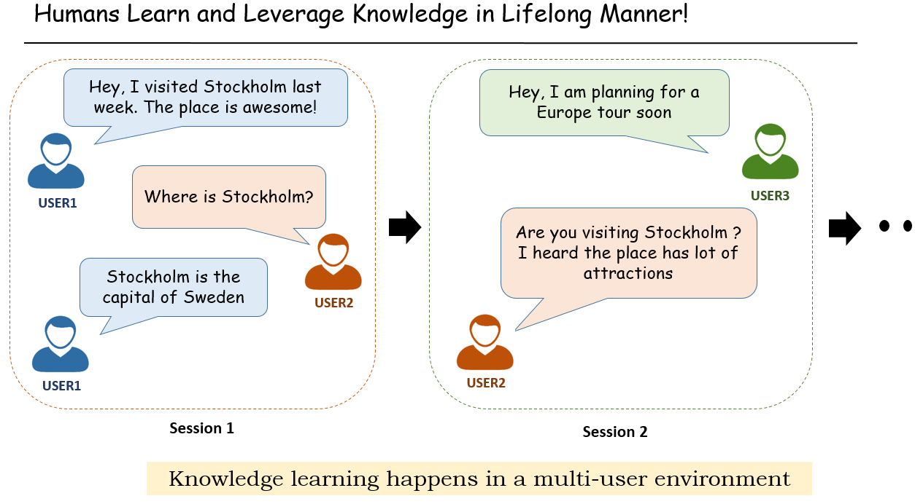
Knowledge learning in conversation
/ agent
/ agent

Slide 20
Opportunities to learn in conversations
Extracting knowledge directly from user utterances. E.g.,
User: Obama was born in Hawaii.
Agent extracts: (Obama, BornIn, Hawaii) – expressed in triples (h, r, t)
Asking user questions & expecting correct answers, e.g.,
Agent: Where was Obama born?
User: Hawaii => (Obama, BornIn, Hawaii)
When the agent cannot answer user questions, it asks the user for some supporting facts and then infers the answers.
We focus on this setting (which covers 1 and 2)

Slide 21
Two types of queries or questions
Wh-question
E.g., Where was Obama born?
(Obama, bornIn, s?)
Fact verification question
Was Obama born in Hawaii?
(Obama, bornIn? Hawaii)
Mazumder, Ma, and Liu. Towards a Continuous Knowledge Learning Engine for Chatbots. arXiv:1802.06024 [cs.CL], 16 Feb. 2018
Mazumder, Liu, Wang, and Ma. Lifelong and Interactive Learning of Factual Knowledge in Dialogues. SIGDIAL-2019

Slide 22
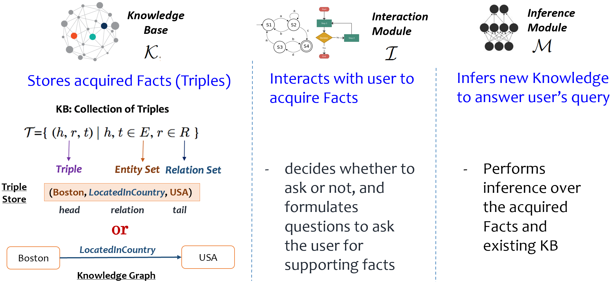
Components for knowledge learning
Mazumder, Ma, and Liu. Towards a Continuous Knowledge Learning Engine for Chatbots. arXiv:1802.06024 [cs.CL], 16 Feb. 2018
Mazumder, Liu, Wang, and Ma. Lifelong and Interactive Learning of Factual Knowledge in Dialogues. SIGDIAL-2019

Slide 23
Assumptions
Focus on developing the core interactive knowledge learning framework
Do not build all peripheral components (like fact or relation extraction, entity linking, etc.) which are assumed to be available for use.
We also assume that the user has good intentions
User answers questions with 100% conformity about the veracity of his/her facts (more discussion later)
User is NOT omniscient
We do not assume that the user can answer all questions as opposed to the teacher-student setup - the teacher is assumed to know everything.
Mazumder, Ma, and Liu. Towards a Continuous Knowledge Learning Engine for Chatbots. arXiv:1802.06024 [cs.CL], 16 Feb. 2018
Mazumder, Liu, Wang, and Ma. Lifelong and Interactive Learning of Factual Knowledge in Dialogues. SIGDIAL-2019

Slide 24
(1) When the user asks a Wh-question
Given a user query / question (h, r, ?) [or (?, r, t)], our goal is two-fold:
Answering the user query or rejecting the query to remain unanswered if the correct answer is believed to not exist in the KB
learning / acquiring some knowledge (supporting facts) from the user to help the answering task.
We further distinguish two types of queries:
(1) Closed-world Queries: h (or t) and r are known to the KB
(2) Open-world Queries: Either one or both h (or t) and r are unknown
Proposed Soln.
an engine for Continuous and Interactive Learning of Knowledge (CILK)
Mazumder, Liu, Wang, and Ma. Lifelong and Interactive Learning of Factual Knowledge in Dialogues. SIGDIAL-2019

Slide 25
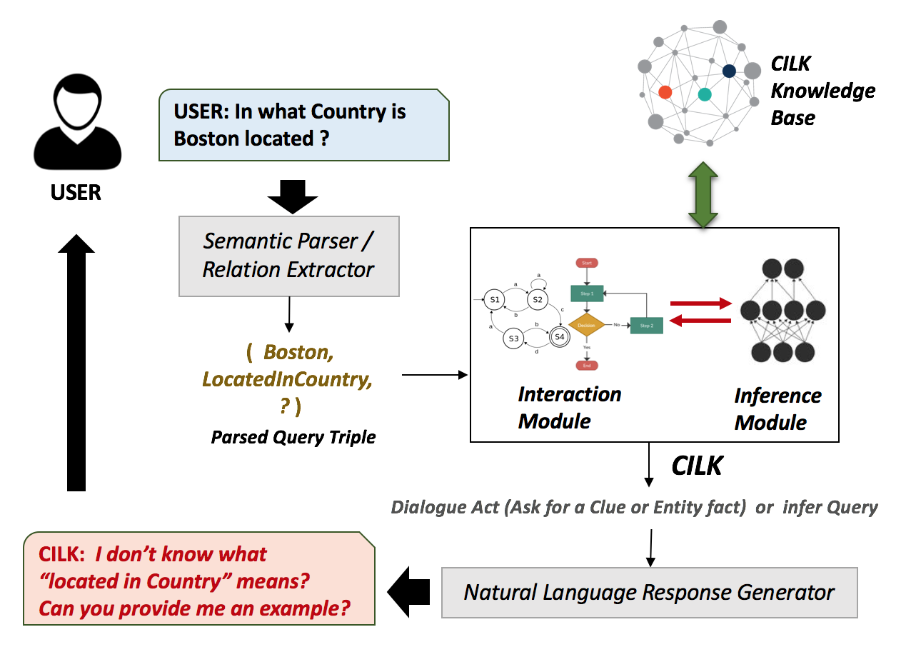
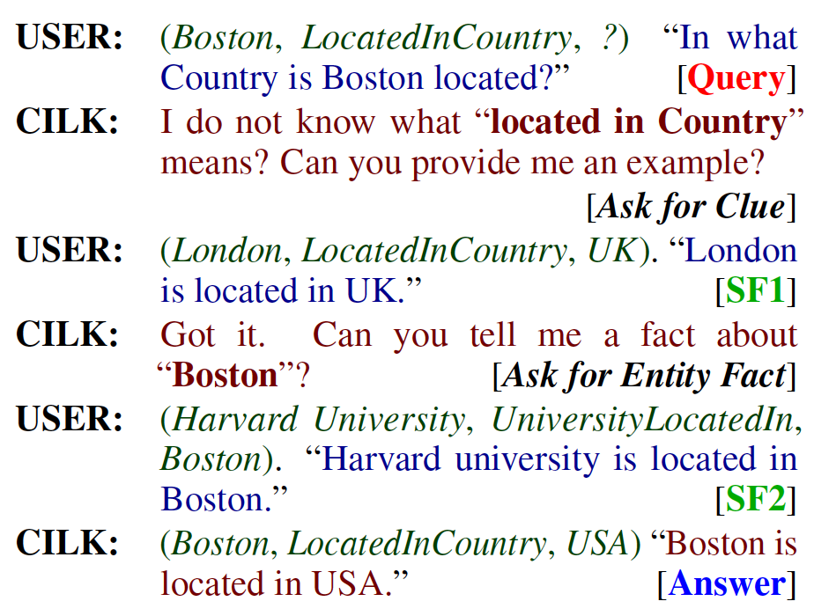
Interactive knowledge learning in dialogue: example (Mazumder et al. 2019)
Mazumder, Liu, Wang, and Ma. Lifelong and Interactive Learning of Factual Knowledge in Dialogues. SIGDIAL-2019

Slide 26
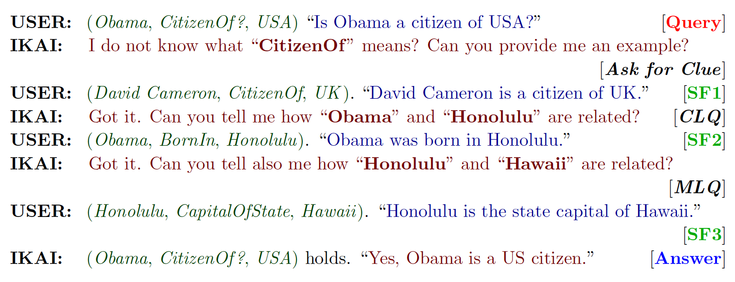
(2) When the user asks a fact-verification question
Learn new knowledge interactively from user when the system is unable to answer a user’s factual verification (yes/no) question.
Mazumder, Ma, and Liu. Towards a Continuous Knowledge Learning Engine for Chatbots. arXiv:1802.06024 [cs.CL], 16 Feb. 2018

Slide 27
The IKAI approach
User question (h, r? s)
Step 1 - Interactive acquisition of supporting facts:
If r is unknown, IKAI asks the user to provide a clue [an example triple r]
If s or t is unknown, IKAI asks the user to provide a link/relation to connect the unknown entity s or t with an automatically selected existing entity
Step 2 - Knowledge inference (Infer the query answer):
Uses a path-ranking algorithm C-PR (Mazumder and Liu 2017) to build a predictive model (Predictor) to predict whether (s, r?, t) is true.
Enumerate relation paths between two entities (s, t) in a KB (encoded as a multi-relation graph) and use those paths as features to train the predictor.
Mazumder, Liu, Ma and Wang, Continuous and Interactive Factual Knowledge Learning in Verification Dialogues. HAMLETS - NeurIPS-2020 Workshop, 2020.

Slide 28

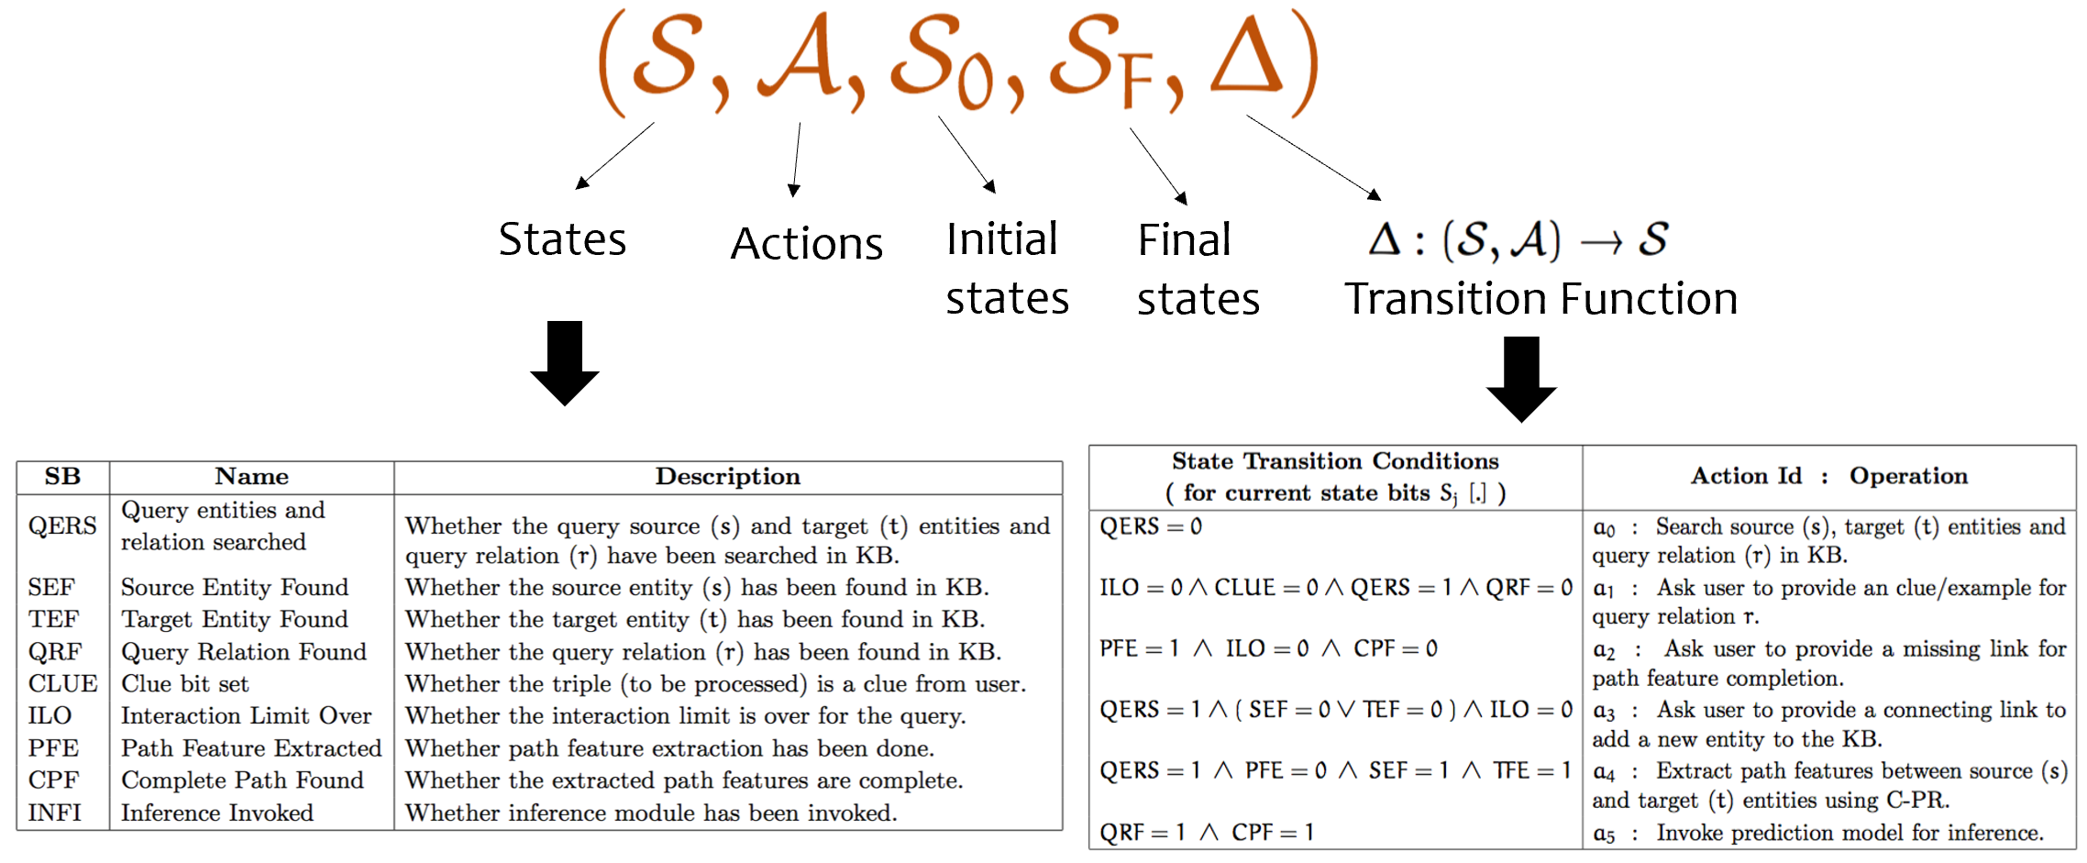
Finite State Machine : Interaction Module ( )
Mazumder, Liu, Ma and Wang, Continuous and Interactive Factual Knowledge Learning in Verification Dialogues. HAMLETS - NeurIPS-2020 Workshop, 2020.

Slide 29
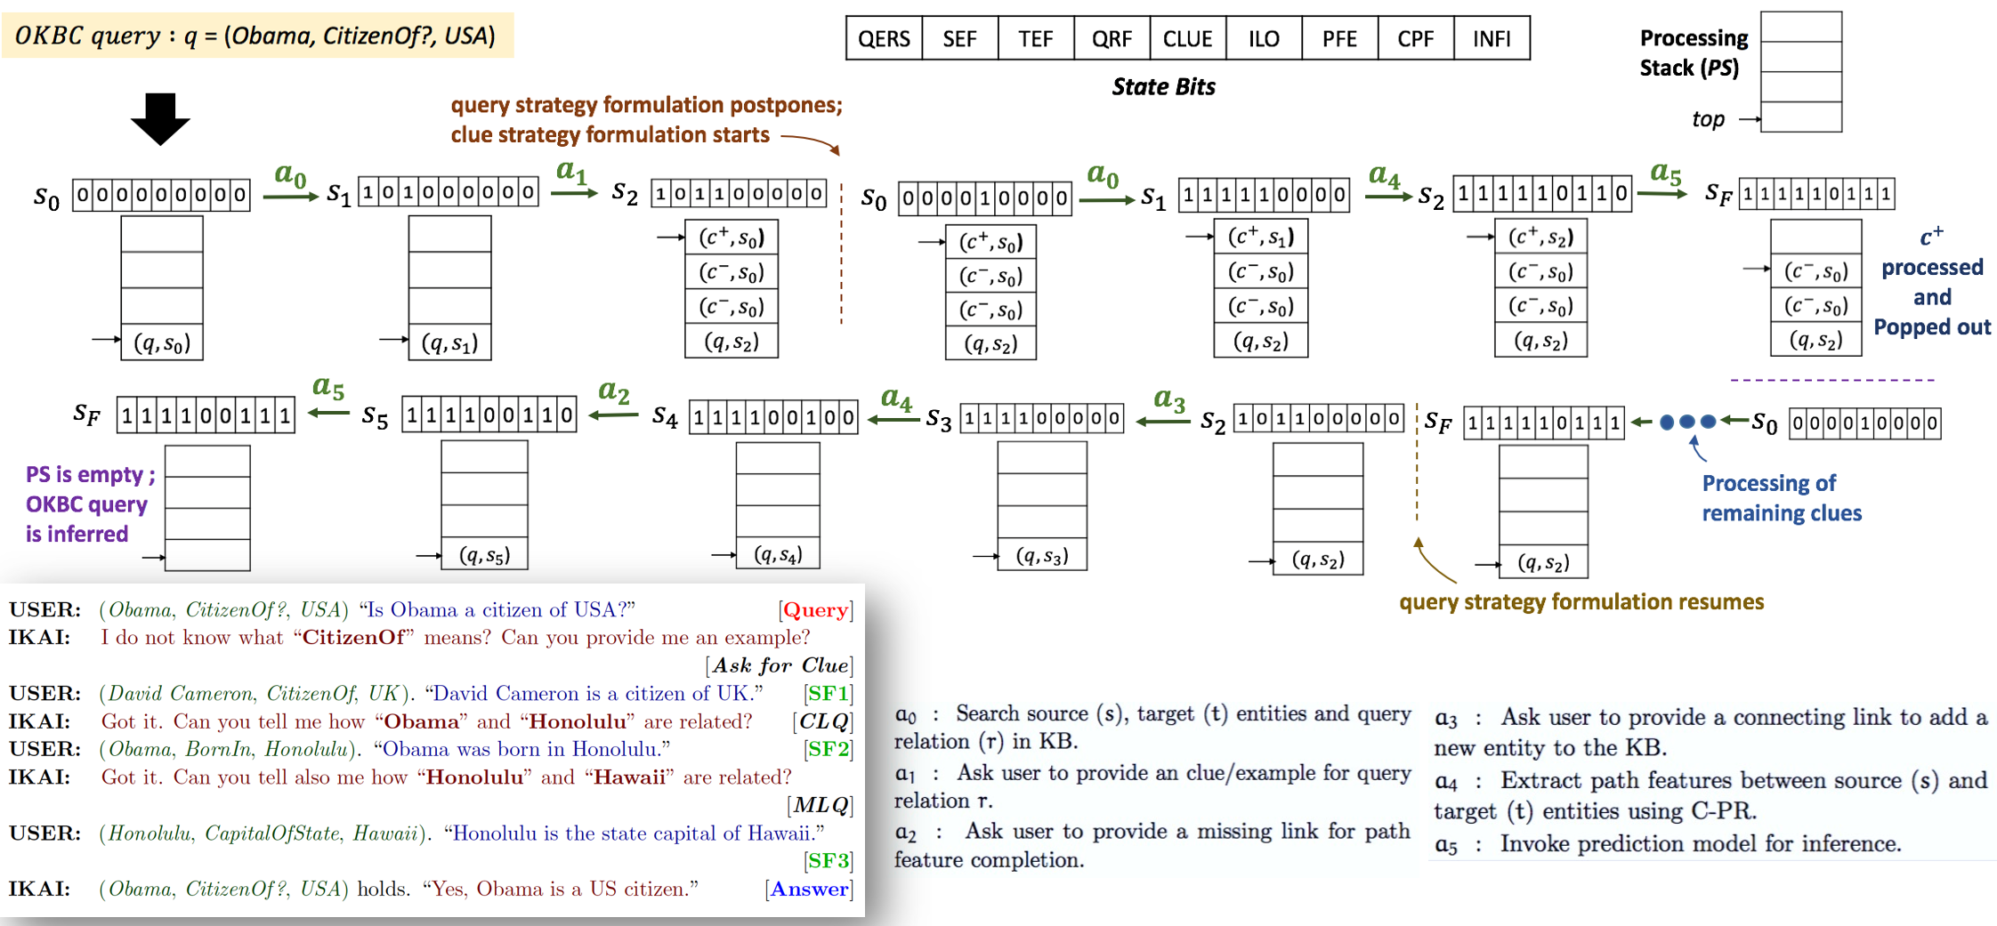
Working of IKAI’ FSM in a given Session
Mazumder, Liu, Ma and Wang, Continuous and Interactive Factual Knowledge Learning in Verification Dialogues. HAMLETS - NeurIPS-2020 Workshop, 2020.

Slide 30
(3) Knowledge acquisition in a rule-based system (Liu and Mei, 2020)
Many existing chatbots are written mainly with rules.
We learn with knowledge distillation pattern: (p, F, B),
where p: a dialogue pattern; F: implied facts; B: implied beliefs.
E.g., p: [* stayed in X at Y] F: {(X, is-a, hotel)} B: {(X, has-address, Y)}
If user says “I stayed in Hilton at 150 Pine Street,” the agent gets
a fact: (Hilton, is-a, hotel) & a belief: (Hilton, has-address, 150 Pine Street).
If user says “I stayed in Hilton,” the agent gets
A fact: (Hilton, is-a, hotel) and also
a question to ask the user: “What is the address of the hotel?”
With such patterns, a great deal of knowledge can be learned from end-users
Liu and Mei. Lifelong Knowledge Learning in Rule-based Dialogue Systems. arXiv:2011.09811, 2020.

Slide 31
Outline
Continual learning with learning after deployment
Continual learning to ground new language expressions
Continual learning of factual knowledge
Dealing with wrong knowledge from users
Summary

Slide 32
Dealing with wrong knowledge from users
Learn from end-users comes with a major challenge:
Acquiring intentional or unintentional wrong knowledge from users.
Since chatbots normally work in multi-user environments
The issue may be addressed through cross-verification.
After acquiring a piece of new knowledge, the agent can store it in an unverified knowledge buffer.
Next, while chatting with some other users in future sessions to accomplish related tasks, the chatbot can ask them to verify the unverified knowledge
Liu and Mazumder. Lifelong and Continual Learning Dialogue Systems: Learning during Conversation. AAAI-2021

Slide 33
Outline
Continual learning with learning after deployment
Continual learning to ground new language expressions
Continual learning of factual knowledge
Dealing with wrong knowledge from users
Summary

Slide 34
Summary
Classic ML: isolated and closed-world offline learning
No learning after deployment
Dialogue systems or any AI agent should continuously learn after deployment or on the job (Chen and Liu, 2018; Liu, 2020)
The agent becomes starter and smarter
Current techniques are still in their infancy, but
Some methods are ready for practical applications.
Liu and Mazumder. Lifelong and Continual Learning Dialogue Systems: Learning during Conversation. AAAI-2021

Slide 35
Thank You
Q&A

