Slide 1
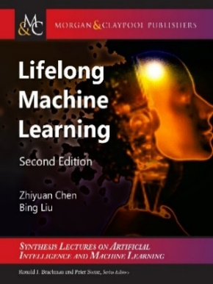
Lifelong and Continual Learning in the Open World
Bing Liu
Department of Computer Science
University of Illinois at Chicago

Slide 2
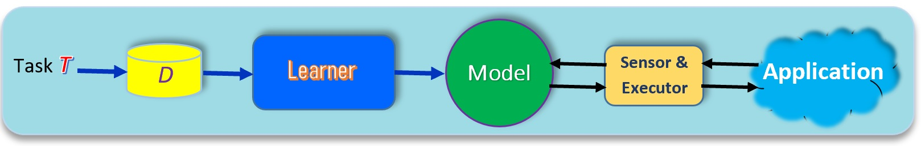
Introduction
Classical machine learning: Isolated single-task learning
Key weaknesses
  Closed-world assumption: nothing new/novel occurs
      Open world: with unknowns or novelties that are out-of-distribution (OOD)
  No continual learning: No knowledge accumulation or transfer
  No learning after deployment: model fixed after deployment
Chen and Liu. Lifelong machine learning. Morgan & Claypool. 2016, 2018
Liu. Learning on the Job: Online Lifelong and Continual Learning. AAAI-2020

Slide 3
Closed-world and open-world
(Fei et al, 2016; Shu et al., 2017)
Traditional machine learning:
  Training data: D^{train} with class labels 𝑌^{train} = {𝑙₁, 𝑙₂, ..., 𝑙_{𝑡}}.
  Test data: D^{test}, 𝑌^{test} ⊆ {𝑙₁, 𝑙₂, ..., 𝑙_{𝑡}}
Closed-world: 𝑌^{test} ⊆ 𝑌^{train}
    Classes appeared in testing must have been seen in training, nothing new.
    A system that is unable to identify anything new, it cannot learn by itself.
Open-world: 𝑌^{test} - 𝑌^{train} ≠ φ
    There are unseen classes in the test data, out-of-distribution.
    Out-of-distribution (OOD) detection: detect in test instances that does not belong to any training class.
Fei, and Liu. Breaking the Closed World Assumption in Text Classification. NAACL-HLT 2016

Slide 4
Open-world CL: a greeting bot in a hotel
(Chen and Liu, 2018; Liu et al., 2021)
Novelty detection = out-of-distribution (OOD) detection
See an existing guest.
    Bot: “Hello John, how are you today?”
See a new guest - recognize he/she is new (OOD and create a new task)
    Bot: “Welcome to our hotel! What is your name, sir?” (get class label)
    Guest: “David” (got class label: David)
    Bot learns to recognize David automatically
      take pictures of David (get training data)
      learn to recognize David (continual learning)
See David next time.
    Bot: “Hello David, how are you today?” (use the new knowledge)
Liu, Robertson, Grigsby, and Mazumder. Self-Initiated Open World Learning for Autonomous AI Agents. AAAI Spring Symposium, 2022 Chen and Liu. Lifelong machine learning. Morgan & Claypool. 2015, 2018.

Slide 5
An experience with self-driving
I consulted for a self-driving car company.
We took a self-driving car for a road test.
  At a T-junction, it stopped & refused to move.
    Every direction was clear, nothing on the road.
Our human driver had to take over.
  Debugging found that a sensor detected a pebble on the road.
  If the car had said ”I detected an unknown object here. What should I do?” we would have replied “It is safe. Go ahead.”
    The car can then learn the new object so that it will have no issue next time.
      Learning on the fly (on the job)

Slide 6
Outline
Definition of continual learning
Class incremental learning (CIL)
  Theoretical result and algorithms
Task incremental learning (TIL)
  Knowledge transfer
Open world continual learning
  A continuous learning chatbot
Summary

Slide 7


Continual or lifelong learning
(Thrun 1996, Silver et al 2013; Ruvolo and Eaton, 2013; Chen and Liu, 2014, 2018)
Learn a sequence of tasks, T₁, T₂, …, T_{N}, … incrementally. Each task t has a training dataset in a neural network.
  In supervised learning, a task is a set of classes to be learned.
Goal: learn each new task T_{N+1} incrementally
  without catastrophic forgetting (CF): Learning of the new task T_{N+1} should not result in accuracy degradation for any of the previous N tasks.
  with knowledge transfer (KT): leveraging the knowledge learned from the previous tasks to learn the new task T_{N+1} better.

Slide 8
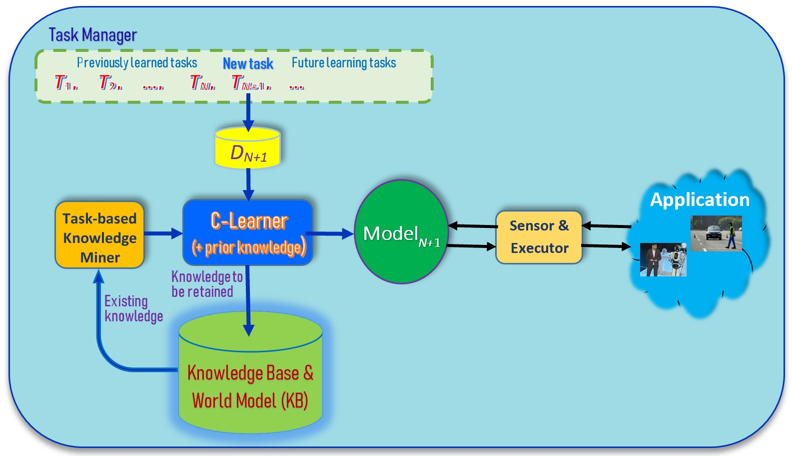
Traditional lifelong/continual learning
(Thrun 1996, Silver et al 2013; Ruvolo and Eaton, 2013; Chen and Liu, 2014, 2018)
In supervised ML,
a task is a set of classes to learn
Assumption:
Both the task T_{N+1} and its training data D_{N+1} are given.
Liu. Learning on the Job: Online Lifelong and Continual Learning. AAAI-2020
Chen and Liu. Lifelong machine learning. Morgan & Claypool. 2018

Slide 9
Assumptions
Once a task is learned its data is no longer accessible, at least a majority of it.
  In the replay approach, we can save a small amount of past data
Both the new task T_{N+1} and its training data D_{N+1} are given by the user.

Slide 10
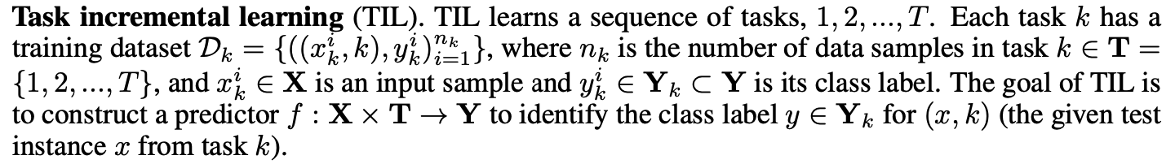
Two popular CL settings: TIL (Kim et al., 2022)
Task incremental learning (TIL): train a “separate” model for each task and task-id is provided during testing
Example: Task 1: learn to recognize different breeds of dog. Task 2: learn to recognize different animals. Task 3: learn to recognize different types of fish.
  Testing needs task information (e.g., task id).
Kim, Xiao, Konishi, Ke and Liu. A Theoretical Study on Solving Continual Learning. NeurIPS-2022.

Slide 11
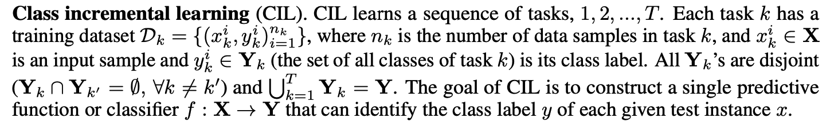
Two popular CL settings: CIL (Kim et al., 2022)
Class incremental learning (CIL): produce a single model from all tasks and classify all classes during testing
Example: Task 1: learn to recognize pig and cat. Task 2: sheep. Task 3: chicken and dog. Task 4: horse and cow
  Testing:
Kim, Xiao, Konishi, Ke and Liu. A Theoretical Study on Solving Continual Learning. NeurIPS-2022.

Slide 12
An additional challenge of CIL
In addition to the challenges of catastrophic forgetting and knowledge transfer.
CIL has an additional challenge inter-task class separation (ICS), which is very hard to handle.
  Since after learning each task, its data is no longer accessible, then how to establish the decision boundaries between the classes of the new task and the classes of the old tasks.
  Existing research has not dealt with this problem explicitly. Replay methods deal with this implicitly to some extent.

Slide 13
Outline
Definition of continual learning
Class incremental learning (CIL)
  Theoretical result and algorithms
Task incremental learning (TIL)
  Knowledge transfer
Open world continual learning
  A continuous learning chatbot
Summary

Slide 14
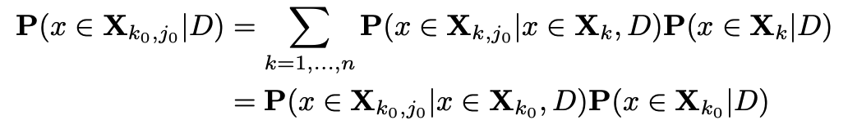
CIL decomposition and theoretical result
(Kim et al., 2022)
CIL problem can be decomposed into two subproblems: within-task prediction (WP) and task-id prediction (TP)
Theoretical result: Good WP and TP (or OOD) are necessary and sufficient for good CIL.
  Connect CIL and OOD (very important)
WP (i.e., TIL)
TP
Kim, Xiao, Konishi, Ke and Liu. A Theoretical Study on Solving Continual Learning. NeurIPS-2022.

Slide 15
Upper Bound of CIL Loss
The loss of CIL is bounded by that of WP and TP
CIL improves with WP or TP
Kim, Xiao, Konishi, Ke and Liu. A Theoretical Study on Solving Continual Learning. NeurIPS-2022.

Slide 16
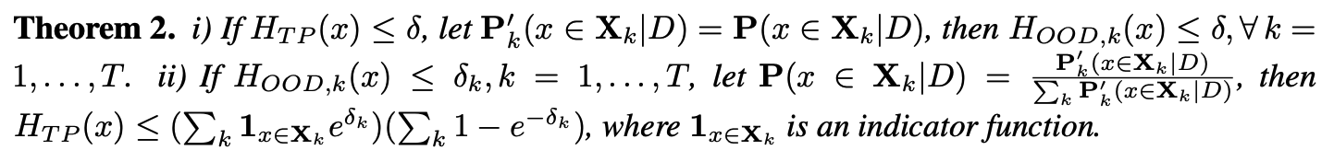
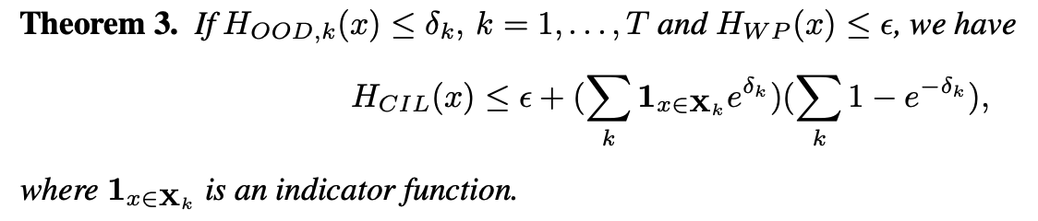
TP and OOD detection bound each other
TP and out-of-distribution (OOD) detection bound each other
The loss of CIL is bounded by that of WP and OOD
Kim, Xiao, Konishi, Ke and Liu. A Theoretical Study on Solving Continual Learning. NeurIPS-2022.

Slide 17
Necessary Condition for CIL
Theorems 1, 2, and 3 show that good performances of WP and TP or (OOD) are sufficient to guarantee a good CIL
Theorem 4 shows that good performances of WP and TP (or OOD) are necessary for a good CIL.
Most OOD methods can perform both WP and OOD detection.
  Good CIL requires a good OOD performance.
Kim, Xiao, Konishi, Ke and Liu. A Theoretical Study on Solving Continual Learning. NeurIPS-2022.

Slide 18
Intuition of the theory
If a CIL model is perfect at detecting OOD samples for each task, which solves the ICS problem, CIL is reduced to WP.
  WP is basically the in-distribution (IND) classification
Kim, Xiao, Konishi, Ke and Liu. A Theoretical Study on Solving Continual Learning. NeurIPS-2022.

Slide 19
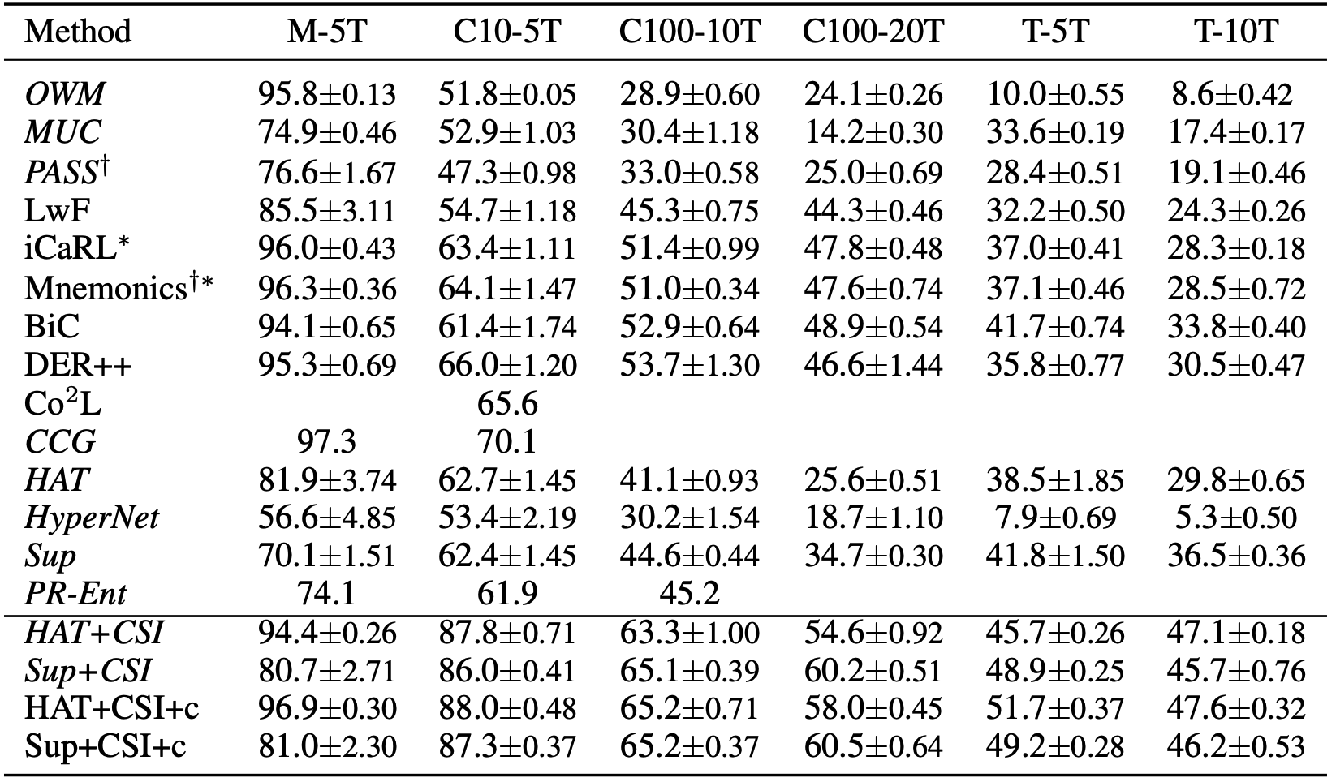
Proposed Methods - Comparison (CIL)
Theory-based methods outperform the baselines by large margins
Combination of
  a method to deal with CF
    E.g., HAT and SupSup
  a strong OOD detection
    E.g., CSI.
HAT+CSI and Sup+CSI
Kim, Xiao, Konishi, Ke and Liu. A Theoretical Study on Solving Continual Learning. NeurIPS-2022.

Slide 20
Outline
Definition of continual learning
Class incremental learning (CIL)
  Theoretical result and algorithms
Task incremental learning (TIL)
  Knowledge transfer
Open world continual learning
  A continuous learning chatbot
Summary

Slide 21
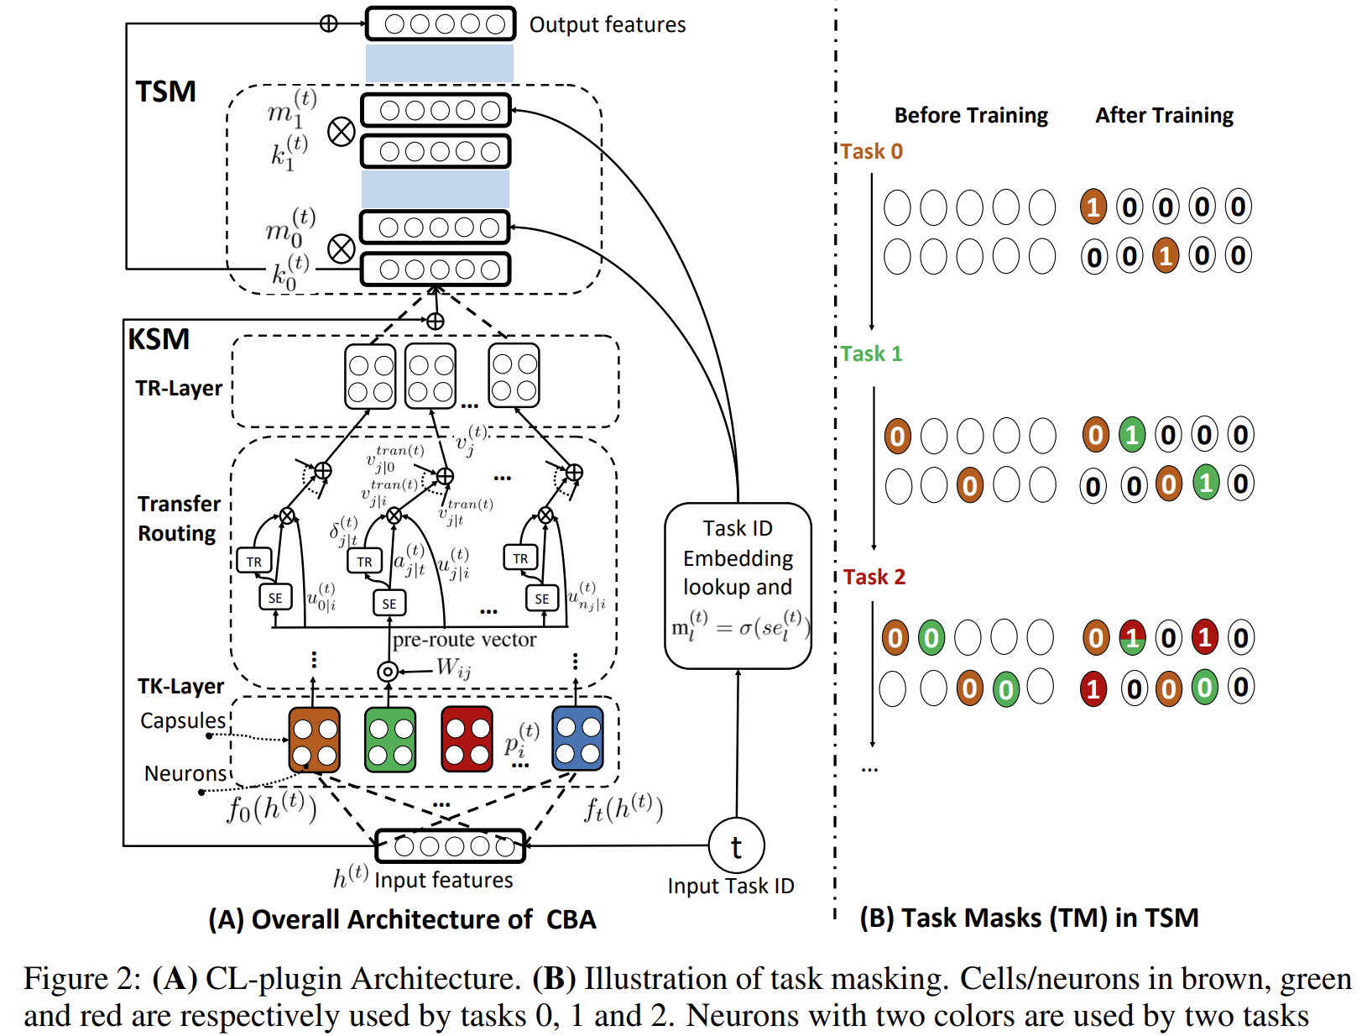
CTR: Capsule and Transfer Routing for CL
Knowledge Sharing Module
  Task capsule layer
    Input: hidden state from Transformer layer (in BERT)
  Knowledge sharing capsule layer
    Transfer routing: capture tasks with similar features or shared knowledge
Task Specific Module
  Input: the knowledge sharing capsule output and task id
  Task Masks (deal with forgetting)
Ke, Liu, Ma, Xu, Shu. Achieving Forgetting Prevention and Knowledge Transfer in Continual Learning. NeurIPS-2021.
Notes:
Overview end

Slide 22
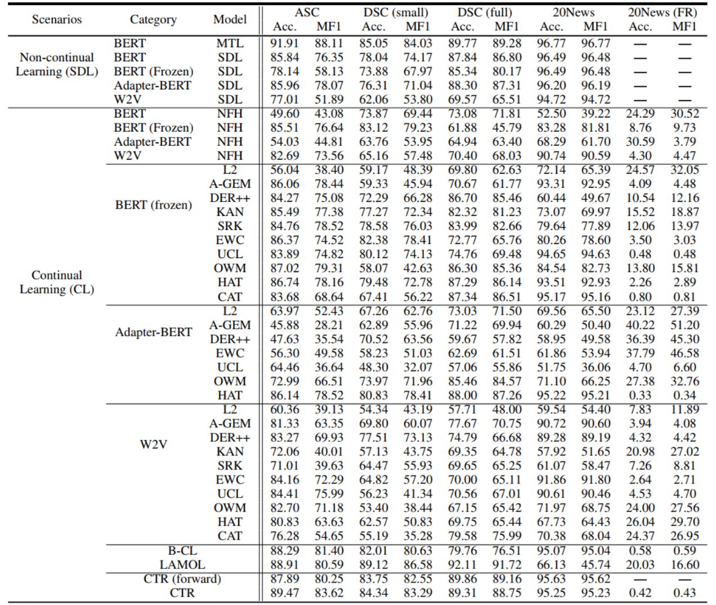
Experimental results
CTR outperforms ALL 37 considered baselines
  Yields the best Acc. and MF1 for similar tasks
  Yields least forgetting for dissimilar tasks
Ke, Liu, Ma, Xu, Shu. Achieving Forgetting Prevention and Knowledge Transfer in Continual Learning. NeurIPS-2021.

Slide 23
Outline
Definition of continual learning
Class incremental learning (CIL)
  Theoretical result and algorithms
Task incremental learning (TIL)
  Knowledge transfer
Open world continual learning
  A continuous learning chatbot
Summary

Slide 24
Theory for open-world continual learning
Open-World Continual Learning
  (1) detect novel/new objects (OOD detection) and
  (2) incrementally learn the new objects after they are labeled.
The theoretical result for CIL is also applicable here
    because (1) the theory say WP and OOD detection are necessary and sufficient conditions for good CIL, and
    (2) an OOD detection system usually does both OOD detection and in-distribution (IND) classification: IND = WP (within-task prediction).
We also want the AI agent to obtain the labels by itself.
Kim, Xiao, Konishi, Ke and Liu. A Theoretical Study on Solving Continual Learning. NeurIPS-2022, Nov. 28 - Dec. 9, 2022..

Slide 25
Open-world CL - a greeting bot in a hotel
(Chen and Liu, 2018; Liu et al., 2021)
Novelty detection = out-of-distribution (OOD) detection
See an existing guest.
    Bot: “Hello John, how are you today?”
See a new guest - recognize he/she is new (OOD and create a new task)
    Bot: “Welcome to our hotel! What is your name, sir?” (get class label)
    Guest: “David” (got class label: David)
    Bot learns to recognize David automatically
      take pictures of David (get training data)
      learn to recognize David (continual learning)
See David next time.
    Bot: “Hello David, how are you today?” (use the new knowledge)
Liu, Robertson, Grigsby, and Mazumder. Self-Initiated Open World Learning for Autonomous AI Agents. AAAI Spring Symposium, 2022 Chen and Liu. Lifelong machine learning. Morgan & Claypool. 2015, 2018.

Slide 26
Example (cont.)
In a real hotel, the situation is much more complex.
  How does the bot know that the novel object is a new guest?
    Is the object a person, an animal, or a piece of furniture?
      needs to use existing knowledge to characterize the novel object!
  Different characterizations require different responses (adaptation or accommodation strategies)? E.g.,
    If it looks like an animal, report to a hotel staff.
    If it looks like a policeman, do nothing
    If it looks like a hotel guest (with luggage), ask for his/her name: “Welcome to our hotel! What is your name, sir?” and learn to recognize him/her
Liu, Robertson, Grigsby, and Mazumder. Self-Initiated Open World Learning for Autonomous AI Agents. AAAI Spring Symposium, 2022 Chen and Liu. Lifelong machine learning. Morgan & Claypool. 2015, 2018.

Slide 27
Novelty characterization and adaptation
Characterization: a description of the novel object based on the agent's existing knowledge.
    Characterization at different levels of details => more or less precise responses.
      Often done based on similarity:
        E.g., it looks like an animal (general), or it looks like a dog (more specific).
      Attributes/properties: e.g., a moving object, speed and direction of moving.
Adapting to novelty: a pair (Characterization, Response)
    Response: According to characterization, formulate a specific course of actions to respond to the novelty, e.g.,
      If novel object looks like an animal (characterization), report to hotel staff (response).
      If cannot characterize, take default action (e.g., do nothing)
    Enable continual learning
Risk assessment: each decision carries risks
Liu, Robertson, Grigsby, and Mazumder. Self-Initiated Open World Learning for Autonomous AI Agents. AAAI Spring Symposium, 2022.

Slide 28
SOLA: Self-initiated Open-world continual Learning & Adaptation
(Chen & Liu, 2018, Liu, 2020 Liu et al., 2022)
Blue lines: Existing continual learning
Orange lines:
Learning after model deployment
(Open-world continual learning)
Liu, Robertson, Grigsby, and Mazumder. Self-Initiated Open World Learning for Autonomous AI Agents. AAAI Spring Symposium, 2022
Liu and Mazumder. Lifelong and Continual Learning Dialogue Systems: Learning during Conversation. AAAI-2021

Slide 29
Outline
Definition of continual learning
Class incremental learning (CIL)
  Theoretical result and algorithms
Task incremental learning (TIL)
  Knowledge transfer
Open world continual learning
  A continuous learning chatbot
Summary

Slide 30
SOLA example: natural language interface (NLI)
Performance task: user asks the system (CML, like Siri and Alexa) to perform a task in NL, the system does it via API actions
    Approach: natural language to natural language matching (NL2NL)
CML builds NLIs for API-driven applications semi-automatically.
To build a new NLI (or add a new skill to an existing NLI),
    Application developer writes a set S_{i} of seed commands (SCs) in NL to represent each API action i.
      SCs in S_{i} are just like paraphrased NL commands from users to invoke i, but the objects to be acted upon in each SC are replaced with variables, the arguments of i.
    When the system does not understand a command (novelty), it adapts and learns new (paraphrased) SCs from users interactively and continually.
Mazumder, Liu, Wang, and Esmaeilpour. An Application-Independent Approach to Building Task-Oriented Chatbots with Interactive Continual Learning.
NeurIPS-2020 Workshop on Human in the Loop Dialogue Systems (HLDS-2020)

Slide 31
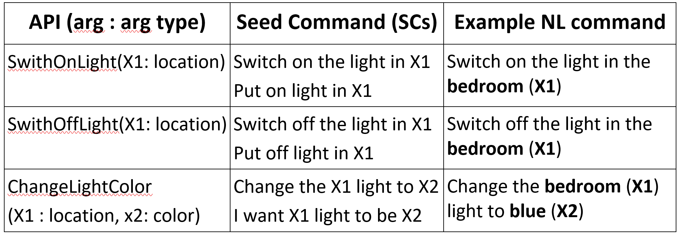
An example – Smart home
SmartHome: API action: SwitchOnLight(X1)
  Switching on a light at a given place X1
Let an SC be “put on light in X1" for this API,
    where X1 is a variable representing the argument of the API.
User command: “power on the light in the bedroom”
    It can be matched or grounded to this SC, where the grounded API arguments are {X1 = ‘bedroom’}.

Slide 32
Novelty detection, characterization, adaptation
Novelty detection: when CML cannot ground a user command, e.g., it cannot understand “turn off the light in the kitchen”
Novelty characterization: which part of the command it understands and which part it has difficulty based on similarity. E.g., it cannot ground “turn off”
Adaptation (or accommodation):
    Response: ask the user by providing some options (to collect ground-truth data)
Bot: Sorry, I didn’t get you. Do you mean to:
option-1. switch off the light in the kitchen,
option-2. switch on the light in the kitchen, or
option-3. change the color of the light in the kitchen?
    Continual learning: learn a new SC. No issue with related commands in future.

Slide 33
Risk consideration
CML manages risk in two ways
  Do not ask user too many questions in order not to annoy the user.
    Learning can be used to assess each user’s tolerance.
  When characterization is not confident, take the default action, i.e.,
    Ask the user to say his/her command in another way
      rather than providing a list of random options for user to choose from
        which can be annoying or make the user lose confidence in the system!
Notes:
Confident but wrong!! --- needs knowledge revision..

Slide 34
Outline
Definition of continual learning
Class incremental learning (CIL)
  Theoretical result and algorithms
Task incremental learning (TIL)
  Knowledge transfer
Open world continual learning
  A continuous learning chatbot
Summary

Slide 35
Summary
To make AI agents more intelligent and autonomous.
    They need to learn continuously in the open world on their own in a self-initiated manner
      Learning on the job (Liu, 2020; Liu et al, 2021)
        Self-initiated open world continual learning and adaptation (SOLA)
Current techniques are still in their infancy. Many challenges, e.g.,
    Novelty detection and new task formation
    Obtaining training data on the fly
    Novelty characterization and adaptation
      Learning task-related world model/knowledge
    Automated reasoning
But I believe SOL systems are possible in restricted domains.

Slide 36




Thank You
Q&A
Students: Zhiyuan Chen (ex), Sepideh Esmaeilpour, Zixuan Ke, Gyuhak Kim, Nianzu Ma, Sahisnu Mazumder (ex), Lei Shu (ex), Hu Xu (ex)
Collaborators: Wenpeng Hu, Scott Grigsby, Tatsuya Konishi, Eric Robertson
Funding:

