Slide 1
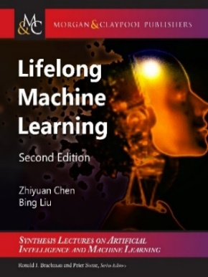
Autonomous AI: Open World Continual Learning
Bing Liu
Department of Computer Science
University of Illinois Chicago
Liu, Mazumder, Robertson, Grigsby, AI Autonomy: Self-Initiated Open-World Continual Learning and Adaptation. AI Magazine, May 21, 2023

Slide 2
Introduction
Our human brains are hardwired to acquire knowledge. We are curious creatures who try to make sense of the world that confronts us. This natural inclination has helped our species evolve from early times (Brown & Dryden, 2004; Holt, 1983).
To build an AI agent, we must endow it the ability to
learn continually in the open and dynamic world that is full of unknowns on its own initiative (by itself) with self-motivation and
with interaction with humans, other agents and the environment.

Slide 3
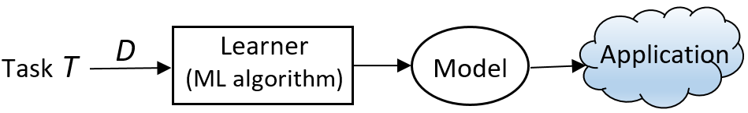
Introduction
Classic machine learning: Isolated single-task learning
Key weaknesses
Closed-world assumption: nothing new/novel occurs
Open world: with unknowns or novelties that are out-of-distribution (OOD)
No continual learning: No knowledge accumulation or transfer
No learning after deployment: model fixed after deployment
Chen and Liu. Lifelong machine learning. Morgan & Claypool. 2016, 2018
Liu. Learning on the Job: Online Lifelong and Continual Learning. AAAI-2020

Slide 4
Novelty detection & continual learning
Traditional ML makes the closed-world assumption
Closed-world assumption: (test classes) 𝑌^{test} ⊆ 𝑌^{train} (training classes)
Classes appeared in testing must have been seen in training, nothing new.
Open world: with unknowns or novelties, i.e., 𝑌^{test} - 𝑌^{train} ≠ φ
A system unable to detect anything new cannot learn by itself.
Two closely related research areas
Novelty detection: a.k.a., anomaly detection, open-world recognition, out-of-distribution (OOD) detection (Fei and Liu, EMNLP-2016, Hu et al, NeurIPS-2020, etc).
Continual/lifelong learning: learning a sequence of tasks incrementally.
Autonomy: we need to connect them
Self-initiated Open-world continual Learning and Adaptation (SOLA)
Liu, Mazumder, Robertson and Grigsby. AI Autonomy: Self-Initiated Open-World Continual Learning and Adaptation. AI Magazine, May 21, 2023
Chen and Liu. Lifelong machine learning. Morgan & Claypool. 2015, 2018.

Slide 5
Introduction – autonomous learning agent
AI agents are increasingly used in real world, full of unknowns
Need to be autonomous.
Also learn on the job (after deployment) autonomously and continually in a self-motivated and self-supervised manner to become better and better over time.
Not re-trained offline periodically on the initiation of human engineers using new or additional manually labeled training data.
Self-motivation: detect novel or unknown objects to learn.
Novelties or unknowns serve as an intrinsic motivation for human learning
Self-supervision: collect ground-truth training data by agent itself via
interaction or communication with humans and other AI agents
Perception, internal evaluation, and environmental feedback
Liu, Mazumder, Robertson and Grigsby. AI Autonomy: Self-Initiated Open-World Continual Learning and Adaptation. AI Magazine, May 21, 2023
Chen and Liu. Lifelong machine learning. Morgan & Claypool. 2015, 2018.

Slide 6
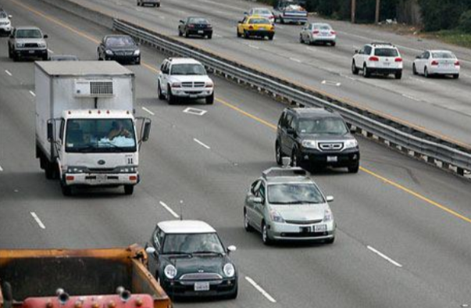
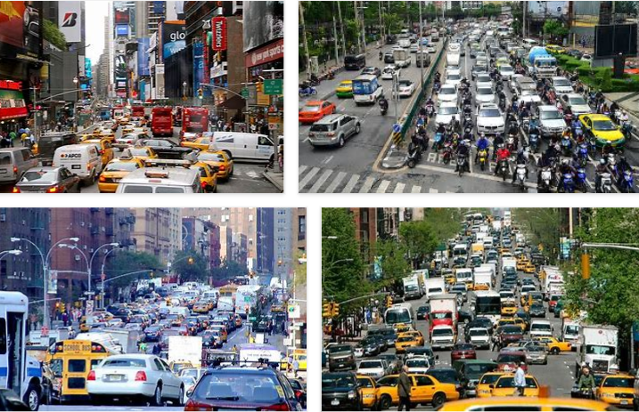
Self-driving cars need to learn continuously
Self-driving cars cannot reach human-level of driving with only rules and off-line training.
Impossible to cover all corner cases
Real-world is full of unknowns.
Have to learn & adapt continuously in its interaction with humans and the environment by itself.
in the open world with unknowns.
Chen and Liu. Lifelong machine learning. Morgan & Claypool. 2018

Slide 7
An experience with self-driving
I consulted for a self-driving car company.
We took a self-driving car for a road test.
At a T-junction, it stopped & refused to move.
Every direction was clear, nothing on the road.
Our human driver had to take over.
Debugging found that a sensor detected a pebble on the road.
If the car had said ”I detected an unknown object here. What should I do?” we would have replied “It is safe. Go ahead.”
The car can then learn the new object so that it will have no issue next time.
Learning on the fly (on the job)

Slide 8
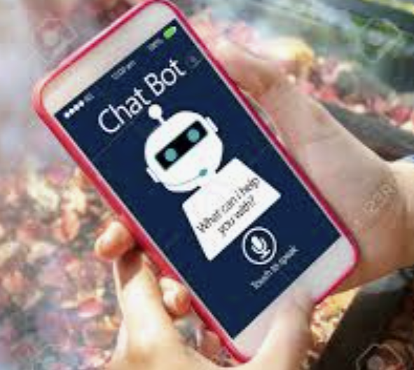
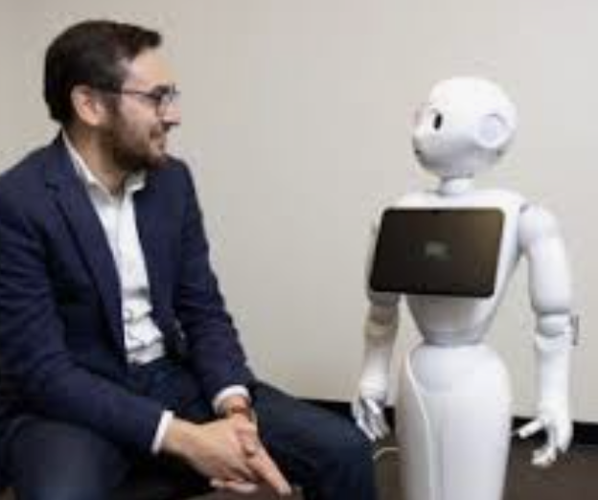
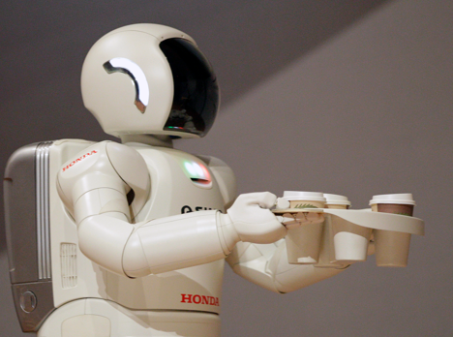
Chatbots should learn continually after deployment (Chen & Liu, 2018, Liu, 2020)
Chatbot: human users may say things a chatbot does not understand.
It should learn new knowledge and new language expressions during chatting.
E.g., asking the current or other users.
We humans learn a great deal in our daily conversations
Chatbots should not solely rely on offline training initiated by engineers.
Liu and Mazumder. Lifelong and Continual Learning Dialogue Systems: Learning during Conversation. AAAI-2021

Slide 9
Outline
Continual or lifelong learning
Class incremental learning (CIL)
Theoretical result and algorithms
Open world continual learning
A continuous learning chatbot
Continual pre-training of language models
Summary

Slide 10

Continual or lifelong learning (Thrun 1996, Silver et al 2013; Ruvolo and Eaton, 2013; Chen and Liu, 2014, 2018)
Learn a sequence of tasks, T₁, T₂, …, T_{N}, … incrementally. Each task t has a training dataset .
Goal: learn each new task T_{N+1} incrementally
without catastrophic forgetting (CF): Learning of the new task T_{N+1} should not result in accuracy degradation for any of the previous N tasks.
with knowledge transfer (KT): leveraging the knowledge learned from the previous tasks to learn the new task T_{N+1} better.
Assumption: Once a task is learned its data is no longer accessible, at least a majority of it.
Both the new task T_{N+1} and its training data D_{N+1} are given by the user.

Slide 11
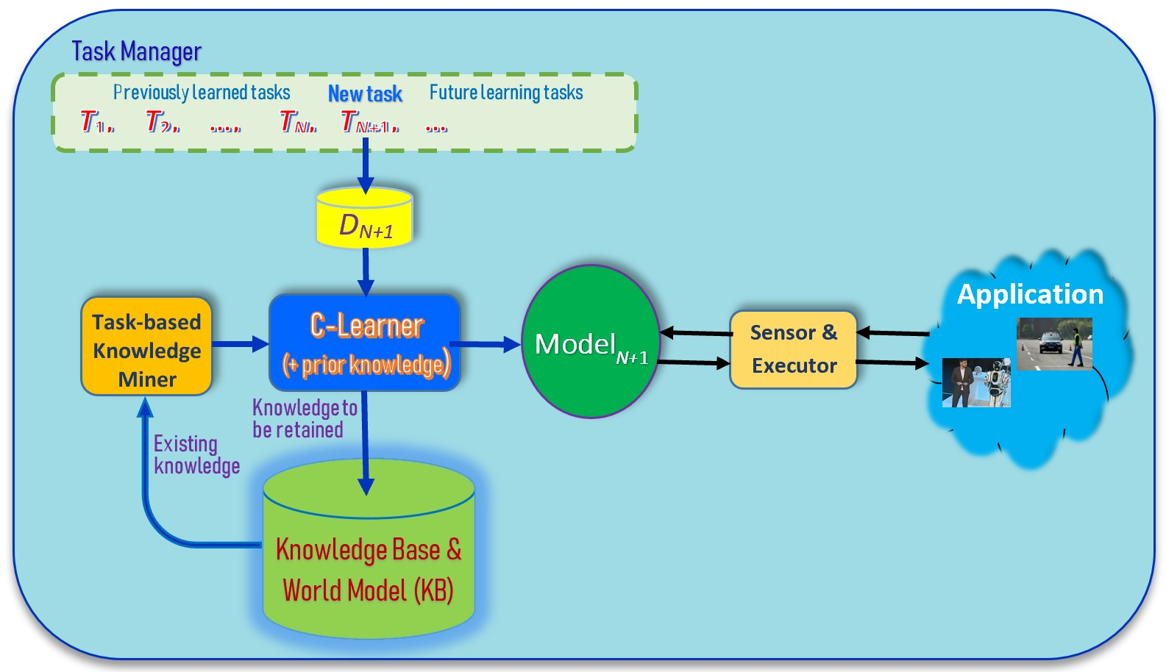
Traditional lifelong/continual learning (Thrun 1996, Silver et al 2013; Ruvolo and Eaton, 2013; Chen and Liu, 2014, 2018)
In supervised ML,
a task is a set of classes to learn
Assumption:
Both the task T_{N+1} and its training data D_{N+1} are given.
Liu. Learning on the Job: Online Lifelong and Continual Learning. AAAI-2020
Chen and Liu. Lifelong machine learning. Morgan & Claypool. 2018

Slide 12
Assumptions
Once a task is learned its data is no longer accessible, at least most of it.
In the replay approach, we can save a small amount of past data
Both the new task T_{N+1} and its training data D_{N+1} are given by the user.

Slide 13
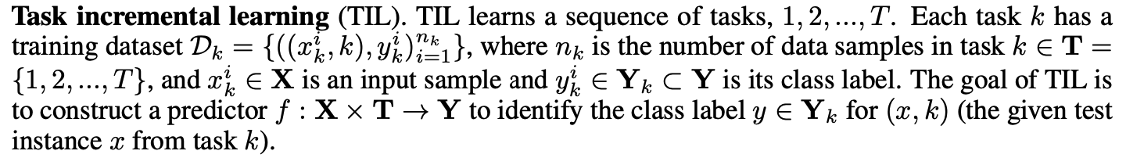
Two popular CL settings: TIL
Task incremental learning (TIL): train a “separate” model for each task and task-id is provided during testing
Example: Task 1: learn to recognize different breeds of dogs. Task 2: learn to recognize different animals. Task 3: learn to recognize different types of fish.
Testing needs task information (e.g., task id).

Slide 14
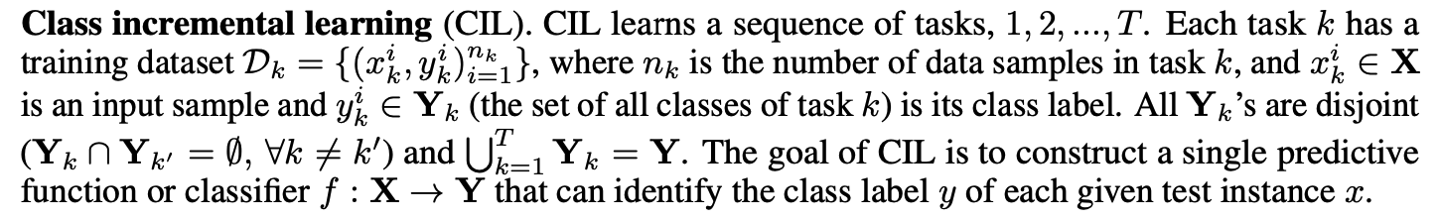
Two popular CL settings: CIL
Class incremental learning (CIL): produce a single model from all tasks and classify all classes during testing
Example: Task 1: learn to recognize pig and cat. Task 2: sheep. Task 3: chicken and dog. Task 4: horse and cow
Testing:
Kim, Xiao, Konishi, Ke and Liu. A Theoretical Study on Solving Continual Learning. NeurIPS-2022, Nov. 28 - Dec. 9, 2022
van de Ven and Tolias Three scenarios for continual learning, arXiv preprint arXiv:1904.07734, 2019.

Slide 15
Outline
Continual or lifelong learning
Class incremental learning (CIL)
Theoretical result and algorithms
Open world continual learning
A continuous learning chatbot
Continual pre-training of language models
Summary

Slide 16
Additional challenge of CIL
In addition to the challenges of catastrophic forgetting and knowledge transfer.
CIL has an additional challenge inter-task class separation (ICS), which is very hard to handle.
Since after learning each task, its data is no longer accessible, then how to establish the decision boundaries between the classes of the new task and those of old tasks.
Existing research has not dealt with this problem explicitly. Replay methods deal with this implicitly to a limited extent.
Question: What is the right way to solve CIL regardless what classification algorithm is used?
Kim, Xiao, Konishi, Ke and Liu. A Theoretical Study on Solving Continual Learning. NeurIPS-2022, Nov. 28 - Dec. 9, 2022.
Guo, Liu, Zhao. Cross-task class discrimination in online continual learning. CVPR-2023
.

Slide 17
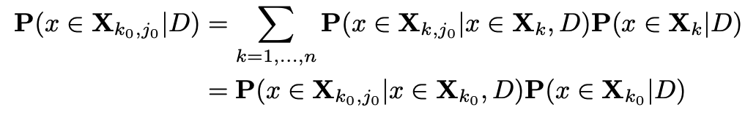
CIL decomposition and theoretical result
CIL problem can be decomposed into two subproblems: within-task prediction (WP) and task-id prediction (TP)
Theoretical result: Good WP and TP or (OOD) are necessary and sufficient for good CIL.
Connect CIL and OOD (very important)
WP (i.e., TIL)
TP
Kim, Xiao, Konishi, Ke and Liu. A Theoretical Study on Solving Continual Learning. NeurIPS-2022, Nov. 28 - Dec. 9, 2022..

Slide 18
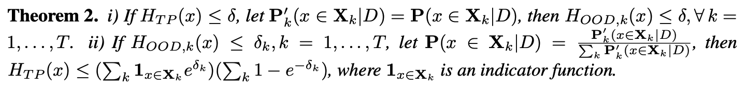
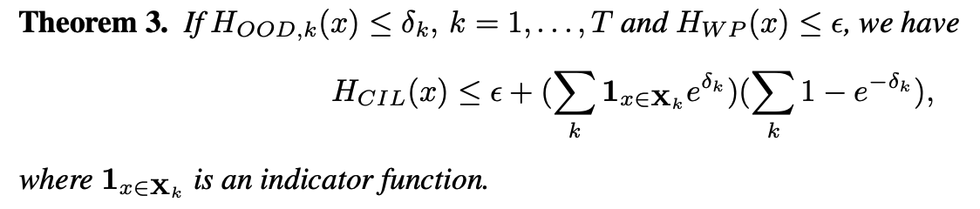
Results
The loss of CIL is bounded by that of WP and TP
CIL improves with WP or TP
TP and out-of-distribution (OOD) detection bound each other
The loss of CIL is bounded by that of WP and OOD
Kim, Xiao, Konishi, Ke and Liu. A Theoretical Study on Solving Continual Learning. NeurIPS-2022, Nov. 28 - Dec. 9, 2022..

Slide 19
Necessary Condition for CIL
Theorems 1, 2, and 3 shows that good performances of WP and TP or (OOD) are sufficient to guarantee a good CIL
Theorem 4 shows that good performances of WP and TP (or OOD) are necessary for a good CIL.
Most OOD methods can perform both WP and OOD detection.
Good CIL requires a good OOD performance.
Kim, Xiao, Konishi, Ke and Liu. A Theoretical Study on Solving Continual Learning. NeurIPS-2022, Nov. 28 - Dec. 9, 2022..

Slide 20
Intuition of the theory
To ensure that good decision boundaries between the classes learned so far and unknown future classes.
The model must achieve the OOD detection effect (?).
If a CIL model is perfect at detecting OOD samples for each task, the ICS problem is solved, and CIL is reduced to WP.
WP is basically the in-distribution (IND) classification.
What about CF? That can be solved with a TIL method.
Note: The theory says what a CIL system should achieve, but it does not say how to achieve it.

Slide 21
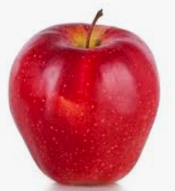
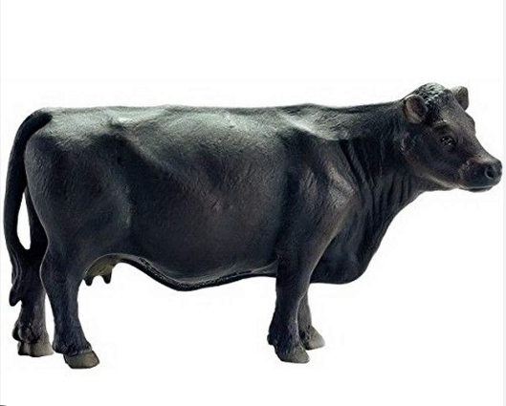
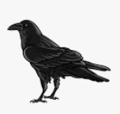
An implication
…
CIL needs to consider both the past and the future.
The algorithm must learn all the characteristics of the classes in each task;
i.e, learn holistic representations (Guo et al. 2022)
Otherwise, it will not be able to solve the ICS problem.
Are traditional principles or theories for machine learning (in the closed world) still “appropriate”?
E.g., Occam’s Razor: the simplest of competing models is preferred
But is it correct when we must consider the learning of future unknown classes?
Is cross-entropy the right loss function?
Guo, Liu and Zhao. Online Continual Learning through Mutual Information Maximization ICML-2022.

Slide 22
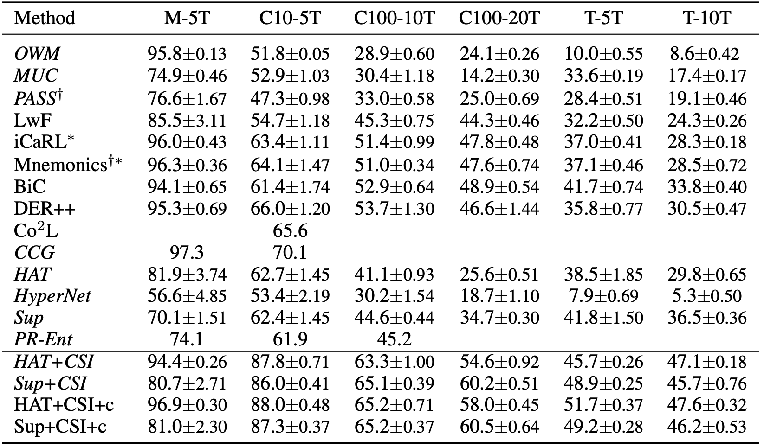
Proposed Methods - Comparison (CIL)
Theory-based methods outperform the baselines by large margins
Combination of
a method to deal with CF
E.g., HAT and SupSup
a strong OOD detection
E.g., CSI.
HAT+CSI and Sup+CSI
Kim, Xiao, Konishi, Ke and Liu. A Theoretical Study on Solving Continual Learning. NeurIPS-2022, Nov. 28 - Dec. 9, 2022..

Slide 23
Learnability of CIL
In (Kim et al. ICML-2023), we proved that CIL is learnable.
The intuitive ideas are the following:
We still follow the framework of using a TIL method to avoid forgetting or CF, and
An OOD detection method to build a model for each task.
Then we need OOD detection to be learnable, which fortunately was proven by several researchers in a paper in NeurIPS-2022.
We need a sequence of OOD models to be learnable, which can be recursively defined.
Kim, Xiao, Konishi, and Liu. Learnability and Algorithm for Continual Learning. ICML-2023.

Slide 24
Out-of-Distribution Replay
Existing methods in the replay approach
Single head; prone to forgetting as previous tasks must be modified with a limited number of saved/replay samples.
Proposed method, called MORE:
Multi-head; task-specific parameters do not interfere with each other; thus, it less or little forgetting.
Network is trained for OOD detection (using replay data as OOD data) and is naturally able to detect unseen classes.
Kim, Ke, and Liu. A Multi-Head Model for Continual Learning via Out-of-Distribution Replay. Proceedings of Conference on Lifelong Learning Agents. CoLLAs-2022...

Slide 25
Experiment results
Classification accuracy
Out-of-distribution detection (open-world)
Kim, Ke, and Liu. A Multi-Head Model for Continual Learning via Out-of-Distribution Replay. Proceedings of Conference on Lifelong Learning Agents. CoLLAs-2022...

Slide 26
Learning holistic representations for CIL
The theory says what a CIL system should achieve, but it does not say how to achieve it.
No theoretical study on what kind of features to learn.
We show that it is necessary to learn holistic feature representations, i.e., covering as many characteristics in the data as possible.
Our approach is based on mutual information maximization.
Intuition. If some features in the data are not learned and they are essential for discriminating some future classes, those features have to be learned in the future, which causes CF.
In a submitted paper, we study another necessary condition.
Guo, Liu and Zhao.. Online Continual Learning through Mutual Information Maximization ICML-2022.

Slide 27
Outline
Continual or lifelong learning
Class incremental learning (CIL)
Theoretical result and algorithms
Open world continual learning
A continuous learning chatbot
Continual pre-training of language models
Summary

Slide 28
Theory for open-world continual learning
Open-World Continual Learning
(1) detect novel/new objects (OOD detection) and
(2) incrementally learn the new objects after they are labeled.
The theoretical result for CIL is also applicable here
because (1) the theory say WP and OOD detection are necessary and sufficient conditions, and
(2) an OOD detection system usually does both OOD detection and in-distribution classification, which is WP (within-task prediction).
We also want the AI agent to obtain the labels by itself.
Kim, Xiao, Konishi, Ke and Liu. A Theoretical Study on Solving Continual Learning. NeurIPS-2022, Nov. 28 - Dec. 9, 2022..

Slide 29
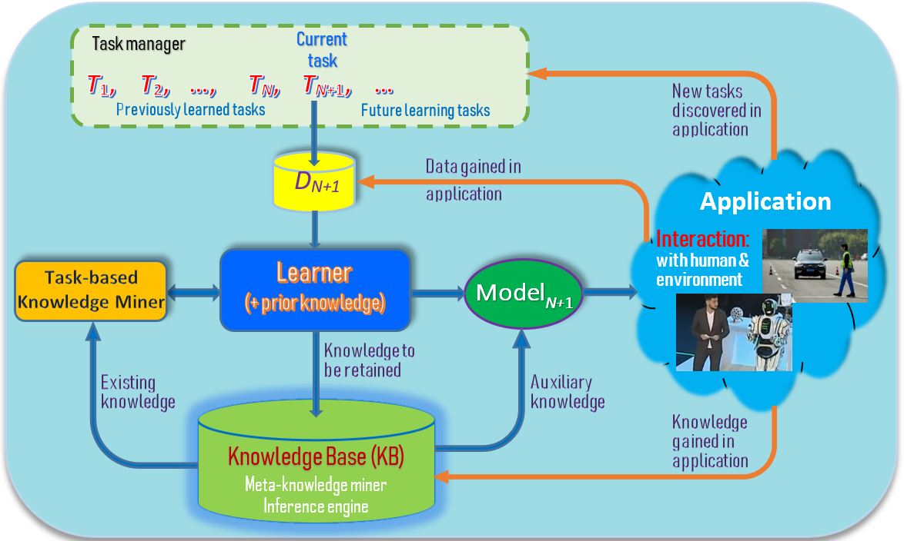
Simple version: Open-world continual learning (Chen & Liu, 2018, Liu, 2020)
Orange lines:
Learning after model deployment
- Learning on the job
Liu. Learning on the Job: Online Lifelong and Continual Learning. AAAI-2020
Chen and Liu. Lifelong machine learning. Morgan & Claypool. 2015, 2018

Slide 30
Characteristics of open world continual learning (Chen and Liu, 2018, Liu, 2020)
Continuous and incremental learning process
Knowledge accumulation in KB (no forgetting)
Knowledge transfer and adaptation (across tasks)
Learning on the job (after model deployment). Self-motivated and self-initiated learning with active interaction with humans & environment.
Main steps for learning:
Detect novel objects to learn (open-world learning or OOD detection)
Novelties as motivation and new task for learning
Acquire ground-truth training data (collect training data interactively, self-initiation)
Learn the task incrementally (continual learning)
Liu and Mazumder. Lifelong and Continual Learning Dialogue Systems: Learning during Conversation. AAAI-2021
Liu. Learning on the Job: Online Lifelong and Continual Learning. AAAI-2020
Notes:
These three characteristics make LML different from related learning tasks such as transfer learning, multi-task learning, online learning and so on.

Slide 31
Example - a greeting bot in a hotel (Chen and Liu, 2018; Liu et al., 2021)
Novelty detection = out-of-distribution (OOD) detection
See an existing guest.
Bot: “Hello John, how are you today?”
See a new guest - recognize he/she is new (OOD and create a new task)
Bot: “Welcome to our hotel! What is your name, sir?” (get class label)
Guest: “David” (got class label: David)
Bot learns to recognize David automatically
take pictures of David (get training data)
learn to recognize David (continual learning)
See David next time.
Bot: “Hello David, how are you today?” (use the new knowledge)
Liu, Mazumder, Robertson and Grigsby. AI Autonomy: Self-Initiated Open-World Continual Learning and Adaptation. AI Magazine, May 21, 2023
Chen and Liu. Lifelong machine learning. Morgan & Claypool. 2015, 2018.

Slide 32
Example (cont.)
In a real hotel, the situation is much more complex.
How does the bot know that the novel object is a new guest?
Is the object a person, an animal, or a piece of furniture?
needs to use existing knowledge to characterize the novel object!
Different characterizations require different responses (adaptation or accommodation strategies)? E.g.,
If it looks like an animal, report to a hotel staff.
If it looks like a policeman, do nothing
If it looks like a hotel guest (with luggage), ask for his/her name: “Welcome to our hotel! What is your name, sir?” and learn to recognize him/her
Chen and Liu. Lifelong machine learning. Morgan & Claypool. 2015, 2018.

Slide 33
Novelty characterization and adaptation
Characterization: a description of the novel object based on the agent's existing knowledge.
Characterization at different levels of details => more or less precise responses.
Often done based on similarity:
E.g., it looks like an animal (general), or it looks like a dog (more specific).
Attributes/properties: e.g., a moving object, speed and direction of moving.
Adapting to novelty: a pair (Characterization, Response)
Response: According to characterization, formulate a specific course of actions to respond to the novelty, e.g.,
If novel object looks like an animal (characterization), report to hotel staff (response).
If cannot characterize, take default action (e.g., do nothing)
Enable continual learning
Risk assessment: each decision carries risks
Liu, Mazumder, Robertson and Grigsby. AI Autonomy: Self-Initiated Open-World Continual Learning and Adaptation. AI Magazine, May 21, 2023

Slide 34
Adaptation enabled continual learning
Ask a human and learn
E.g., for the greeting bot, ask the human using the interactive module I (in natural language) to get ground-truth data and incrementally learn.
Imitation learning.
E.g., on seeing a novel object by a self-driving car, if the car in front drives through it with no issue, the car may choose the same course of action as well and learn it for future use.
Perform limited reinforcement learning.
By interacting with the environment through trial-and-error exploration, the agent learns a good response policy for future use.
Liu, Mazumder, Robertson and Grigsby. AI Autonomy: Self-Initiated Open-World Continual Learning and Adaptation. AI Magazine, May 21, 2023

Slide 35
SOLA: Self-initiated Open-world continual Learning & Adaptation
Our view from DARPA Sail-On Program.
Blue lines: Existing continual learning
Orange lines:
Learning after model deployment
(Open-world continual learning)
Liu, Mazumder, Robertson and Grigsby. AI Autonomy: Self-Initiated Open-World Continual Learning and Adaptation. AI Magazine, May 21, 2023

Slide 36
Outline
Continual or lifelong learning
Class incremental learning (CIL)
Theoretical result and algorithms
Open world continual learning
A continuous learning chatbot
Continual pre-training of language models
Summary

Slide 37
Example SOLA: natural language interface (NLI)
Performance task: user asks the system (CML, like Siri and Alexa) to perform a task in NL, the system does it via API actions
Approach: natural language to natural language matching (NL2NL)
CML builds NLIs for API-driven applications semi-automatically.
To build a new NLI (or add a new skill to an existing NLI),
Application developer writes a set S_{i} of seed commands (SCs) in NL to represent each API action i.
SCs in S_{i} are just like paraphrased NL commands from users to invoke i, but the objects to be acted upon in each SC are replaced with variables, the arguments of i.
When the system does not understand a command (novelty), it adapts and learns new (paraphrased) SCs from users interactively and continually.
Mazumder, Liu, Wang, and Esmaeilpour. An Application-Independent Approach to Building Task-Oriented Chatbots with Interactive Continual Learning.
NeurIPS-2020 Workshop on Human in the Loop Dialogue Systems (HLDS-2020)

Slide 38
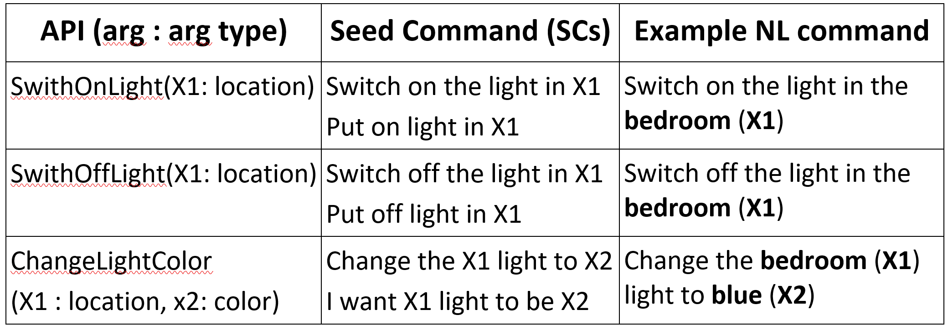
An example – Smart home
SmartHome: API action: SwitchOnLight(X1)
Switching on a light at a given place X1
Let an SC be “put on light in X1" for this API,
where X1 is a variable representing the argument of the API.
User command: “power on the light in the bedroom”
It can be matched or grounded to this SC, where the grounded API arguments are {X1 = ‘bedroom’}.

Slide 39
CML has three components
SC (seed command) specification
to enable application developer to specify a set of SCs for each of their APIs
Command grounding module
ground a user command C to an action SC by matching C with the correct SC (whose associated action API is then executed)
Interactive continual learner
It interacts with end-users to learn new SCs and paraphrases of API argument values.

Slide 40
Novelty detection, characterization, adaptation
Novelty detection: when CML cannot ground a user command, e.g., it cannot understand “turn off the light in the kitchen”
Novelty characterization: which part of the command it understands and which part it has difficulty based on similarity. E.g., it cannot ground “turn off”
Adaptation (or accommodation):
Response: ask the user by providing some options (to collect ground-truth data)
Bot: Sorry, I didn’t get you. Do you mean to:
option-1. switch off the light in the kitchen,
option-2. switch on the light in the kitchen, or
Continual learning: learn a new SC. No issue with related commands in future.

Slide 41
Risk consideration
CML manages risk in two ways
Do not ask user too many questions in order not to annoy the user.
Learning can be used to assess each user’s tolerance.
When characterization is not confident, take the default action, i.e.,
Ask the user to say his/her command in another way
rather than providing a list of random options for user to choose from
which can be annoying or make the user lose confidence in the system!
Notes:
Confident but wrong!! --- needs knowledge revision..

Slide 42
Continuous knowledge learning in dialogues (Mazumder et al. 2019)
Dialogue systems are increasingly using knowledge bases (KBs) storing factual knowledge to help generate responses.
KBs are inherently incomplete and remain fixed,
which limit dialogue systems’ conversation capability
CILK: Continuous and Interactive Learning of Knowledge
to continuously and interactively learn and infer new knowledge during conversations
Mazumder, Ma, and Liu. Towards a Continuous Knowledge Learning Engine for Chatbots. arXiv:1802.06024 [cs.CL], 16 Feb. 2018
Mazumder, Liu, Wang, and Ma. Lifelong and Interactive Learning of Factual Knowledge in Dialogues. SIGDIAL-2019

Slide 43
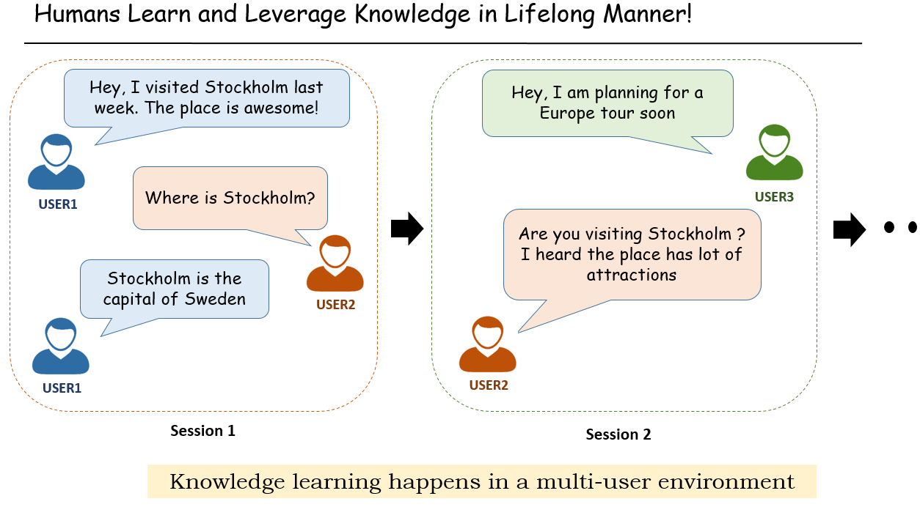
Knowledge learning in conversation
/ agent
/ agent

Slide 44
Opportunities to learn in conversations
Extracting knowledge directly from user utterances. E.g.,
User: Obama was born in Hawaii.
Agent extracts: (Obama, BornIn, Hawaii) – expressed in triples (h, r, t)
Asking user questions & expecting correct answers, e.g.,
Agent: Where was Obama born?
User: Hawaii => (Obama, BornIn, Hawaii)
When the agent cannot answer user questions, it asks the user for some supporting facts and then infers the answers.
We focus on this setting (which covers 1 and 2)

Slide 45
Two types of queries or questions
Wh-question
E.g., Where was Obama born?
(Obama, bornIn, s?)
Fact verification question
Was Obama born in Hawaii?
(Obama, bornIn? Hawaii)
Mazumder, Ma, and Liu. Towards a Continuous Knowledge Learning Engine for Chatbots. arXiv:1802.06024 [cs.CL], 16 Feb. 2018
Mazumder, Liu, Wang, and Ma. Lifelong and Interactive Learning of Factual Knowledge in Dialogues. SIGDIAL-2019

Slide 46
Assumptions
Focus on developing the core interactive knowledge learning
Do not build all peripheral components (like fact or relation extraction, entity linking, etc.) which are assumed to be available for use.
Assume that the user has good intentions
User answers questions with 100% conformity about the veracity of his/her facts
Cross-verification can be used to deal with wrong knowledge
Do not assume user can answer all questions
as opposed to the teacher-student setup - the teacher is assumed to know everything.
Mazumder, Ma, and Liu. Towards a Continuous Knowledge Learning Engine for Chatbots. arXiv:1802.06024 [cs.CL], 16 Feb. 2018
Mazumder, Liu, Wang, and Ma. Lifelong and Interactive Learning of Factual Knowledge in Dialogues. SIGDIAL-2019

Slide 47
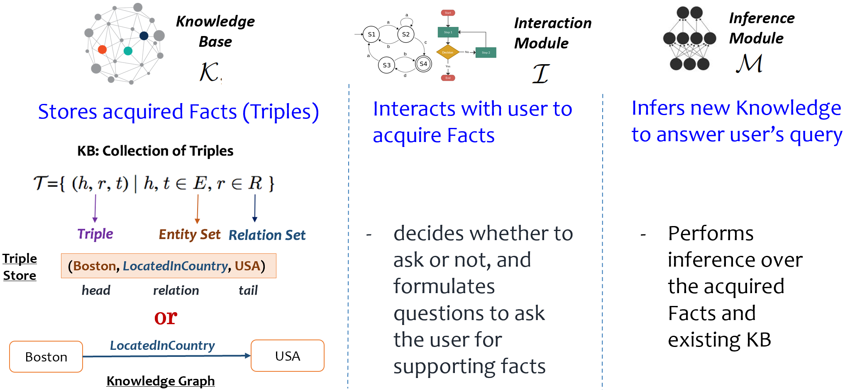
Components for knowledge learning
Mazumder, Ma, and Liu. Towards a Continuous Knowledge Learning Engine for Chatbots. arXiv:1802.06024 [cs.CL], 16 Feb. 2018
Mazumder, Liu, Wang, and Ma. Lifelong and Interactive Learning of Factual Knowledge in Dialogues. SIGDIAL-2019

Slide 48
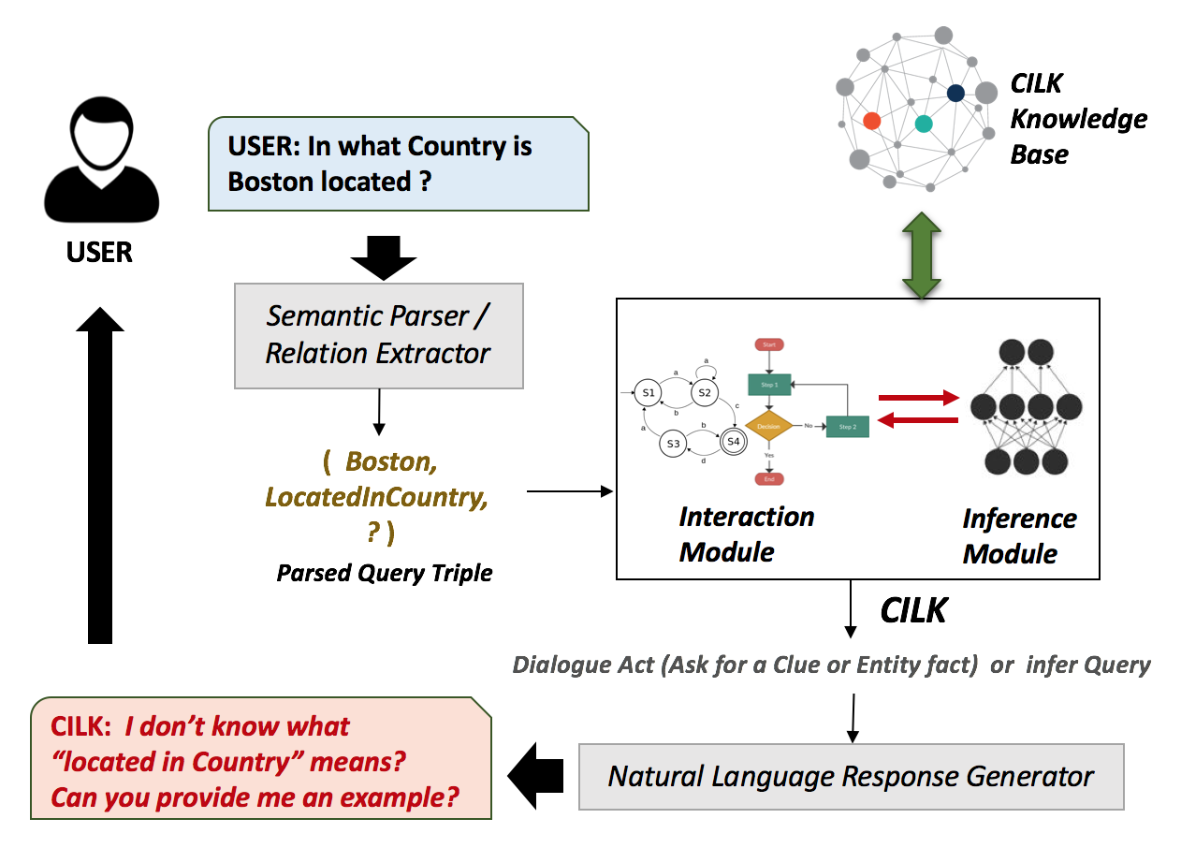
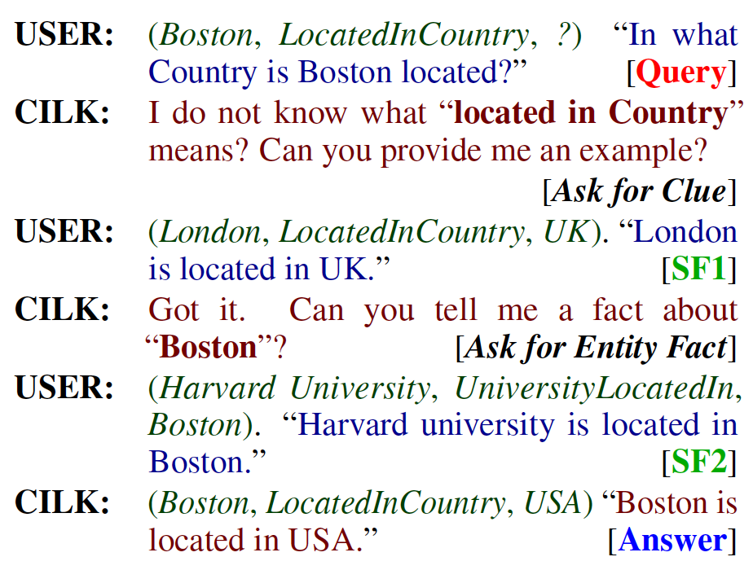
Interactive knowledge learning in dialogue: example (Mazumder et al. 2019)
Mazumder, Liu, Wang, and Ma. Lifelong and Interactive Learning of Factual Knowledge in Dialogues. SIGDIAL-2019

Slide 49
Outline
Continual or lifelong learning
Class incremental learning (CIL)
Theoretical result and algorithms
Open world continual learning
A continuous learning chatbot
Continual pre-training of language models
Summary

Slide 50
Continual pre-training of language models
Language models (LMs) once trained are hard to be changed.
But for a specific domain, fine-grained data may be available to make the language model do better.
Goal: (1) incrementally pre-train an LM with a sequence of domain corpora, and (2) achieve knowledge transfer across domains
key challenge: how to preserve the knowledge already in the LM (i.e., deal with forgetting/CF) and encourage KT.
We propose a method to do so based on LM robustness (making use of dropout masks) and network pruning to identify important parameters in the LM to be protected using soft masks.
Ke, Shao, Lin, Konishi, Kim and Liu. CONTINUALPRE-TRAININGOFLANGUAGEMODELS. ICLR-2023.

Slide 51
End-task evaluation results
Ke, Shao, Lin, Konishi, Kim and Liu. CONTINUALPRE-TRAININGOFLANGUAGEMODELS. ICLR-2023.

Slide 52
Outline
Continual or lifelong learning
Class incremental learning (CIL)
Theoretical result and algorithms
Open world continual learning
A continuous learning chatbot
Continual pre-training of language models
Summary

Slide 53
Summary
To make AI agents more intelligent and autonomous.
It needs to learn continuously in the open world by itself in a self-initiated manner
Learning on the job (Liu, 2020; Liu et al, 2021)
Self-initiated open world continual learning and adaptation (SOLA)
Current techniques are still in their infancy. Many challenges, e.g.,
Novelty detection and new task formulation
Obtaining training data on the fly
Novelty characterization and adaptation
Learning task-related world model
Automated reasoning
But I believe SOLA systems are possible in restricted domains.

Slide 54




Thank You
Q&A
Students: Zhiyuan Chen (ex), Sepideh Esmaeilpour, Zixuan Ke, Gyuhak Kim, Nianzu Ma, Sahisnu Mazumder (ex), Lei Shu (ex), Hu Xu (ex)
Collaborators: Wenpeng Hu, Scott Grigsby, Tatsuya Konishi, Eric Robertson
Funding:

