Slide 1
CS 472 – Provably Correct Programming
William Mansky

Slide 2
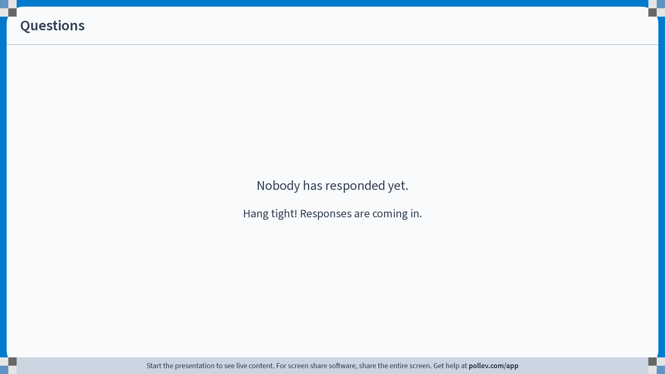
Notes:
Poll Title: Do not modify the notes in this section to avoid tampering with the Poll Everywhere activity.
More info at polleverywhere.com/support
Questions
https://www.polleverywhere.com/discourses/vWh3116qyAwpKecMPfY4Q

Slide 3

Practical Hoare Logic: Iris
Tool #2: Iris, a verification framework inside Coq
  Based on separation logic, a version of Hoare logic with support for memory and shared resources
  Default language is a simple functional language with memory
  Proofs combine symbolic execution of programs with tactics for using/proving facts about resources
Iris has lots of extensions, applications, and target languges. We’ll look at a few!

Slide 4
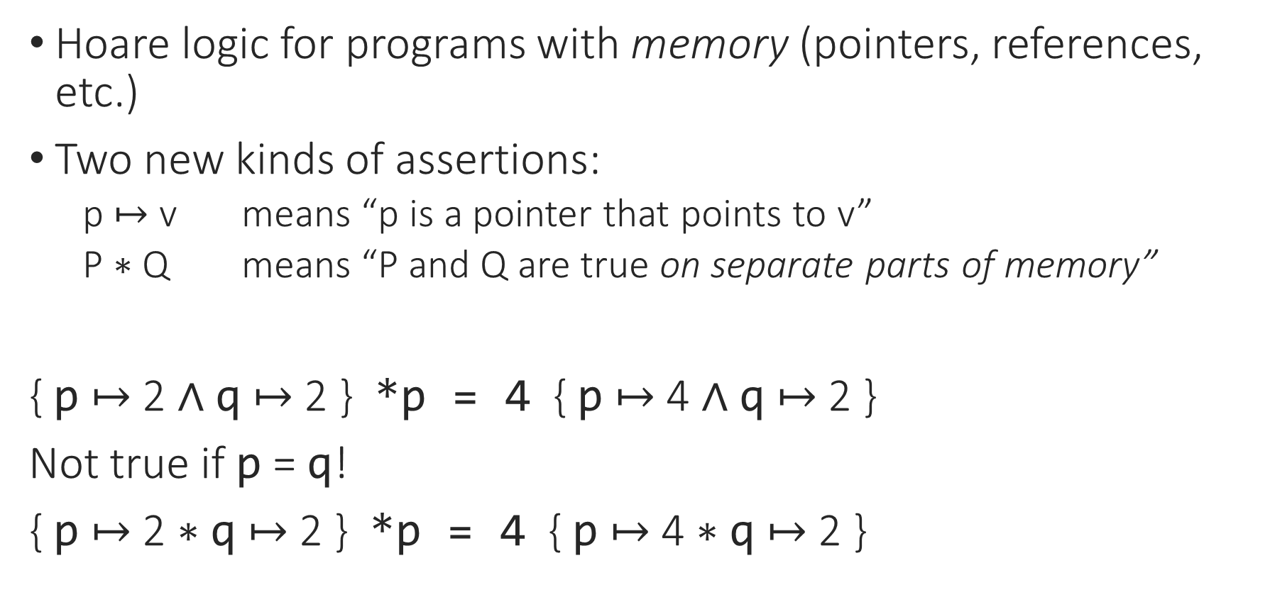
Separation Logic
Hoare logic for programs with memory (pointers, references, etc.)
Two new kinds of assertions:
  p $↦$ v means “p is a pointer that points to v”
  P $∗$ Q means “P and Q are true on separate parts of memory”
{ p $↦$ 2 $∧$ q $↦$ 2 } *p = 4 { p $↦$ 4 $∧$ q $↦$ 2 }
Not true if p = q!
{ p $↦$ 2 $∗$ q $↦$ 2 } *p = 4 { p $↦$ 4 $∗$ q $↦$ 2 }

Slide 5
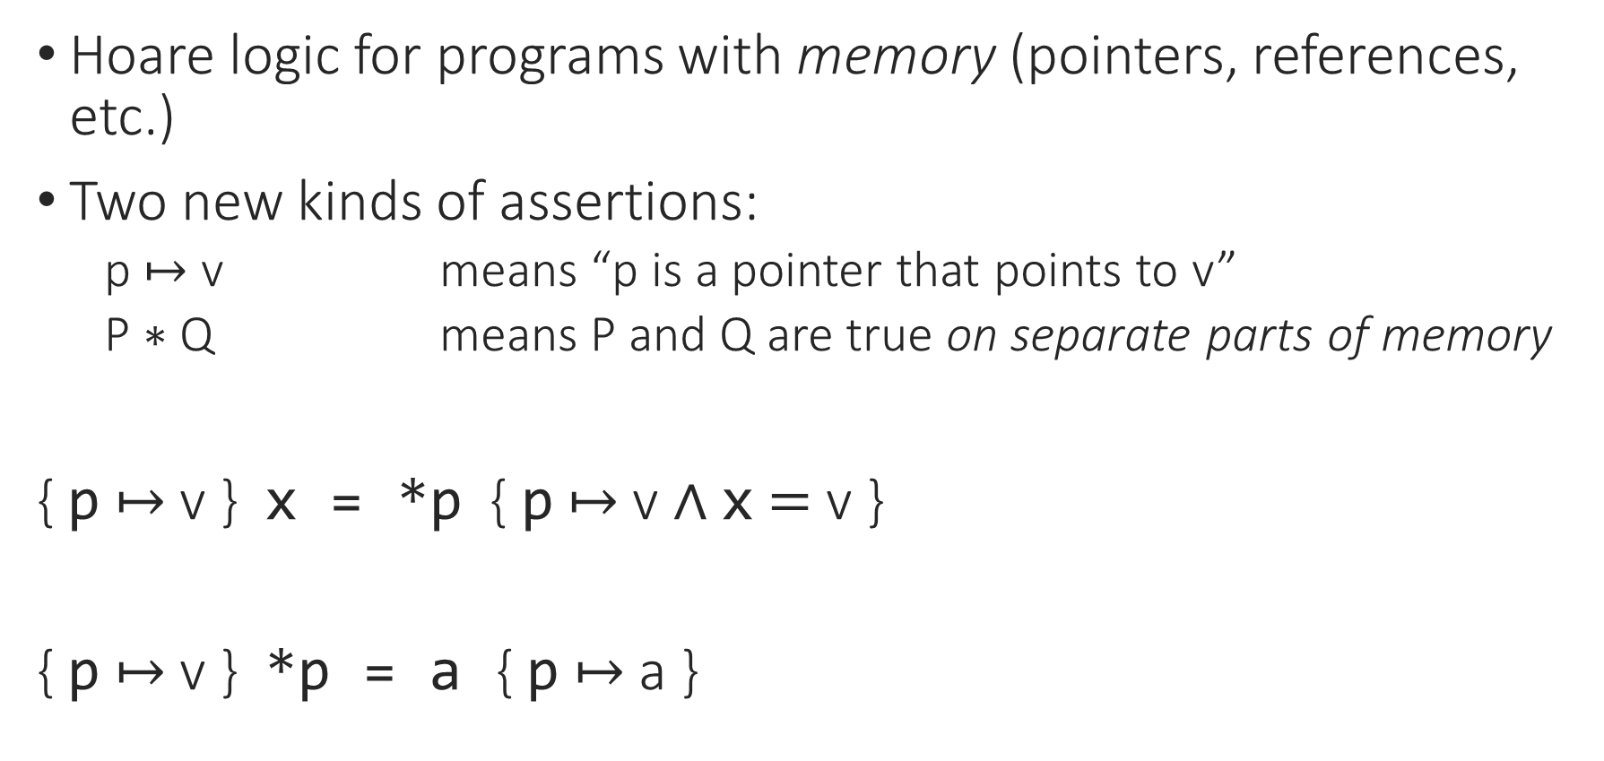
Separation Logic: Loads and Stores
Hoare logic for programs with memory (pointers, references, etc.)
Two new kinds of assertions:
  p $↦$ v means “p is a pointer that points to v”
  P $∗$ Q means P and Q are true on separate parts of memory
{ p $↦$ v } x = *p { p $↦$ v $∧$ x $=$ v }
{ p $↦$ v } *p = a { p $↦$ a }

Slide 6
Separation Logic: Resources
H : P
_________
P /\ P
split.
H : P H : P
_________ _________
P P
Notes:
In normal logic, facts/hypotheses don’t get used up when we use them to prove things.

Slide 7

Separation Logic: Resources
H : x $↦$ v
______________
x $↦$ v * x $↦$ v
Shouldn’t be provable!
If we could split:
H : x $↦$ v
___________ ___________
x $↦$ v x $↦$ v
Notes:
In normal logic, facts/hypotheses don’t get used up when we use them to prove things.

Slide 8
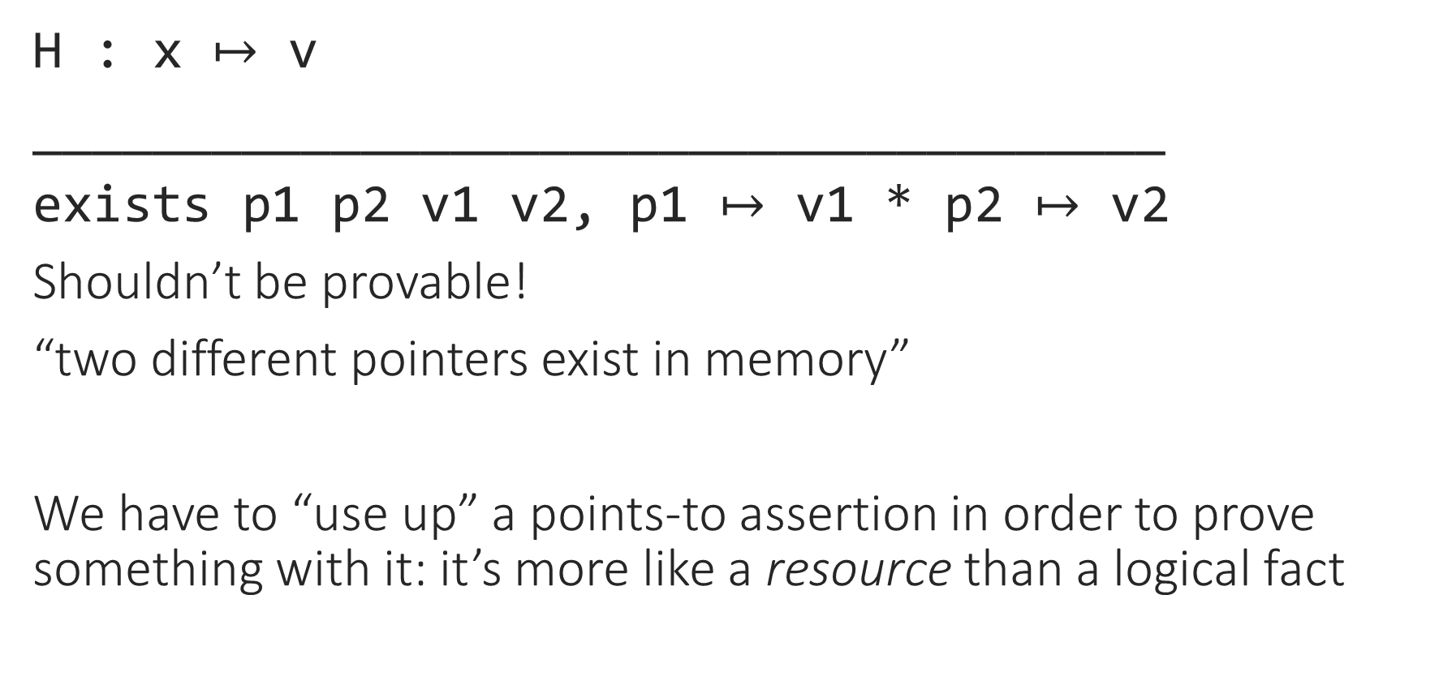
Separation Logic: Resources
H : x $↦$ v
______________________________________
exists p1 p2 v1 v2, p1 $↦$ v1 * p2 $↦$ v2
Shouldn’t be provable!
“two different pointers exist in memory”
We have to “use up” a points-to assertion in order to prove something with it: it’s more like a resource than a logical fact
Notes:
In normal logic, facts/hypotheses don’t get used up when we use them to prove things.

Slide 9
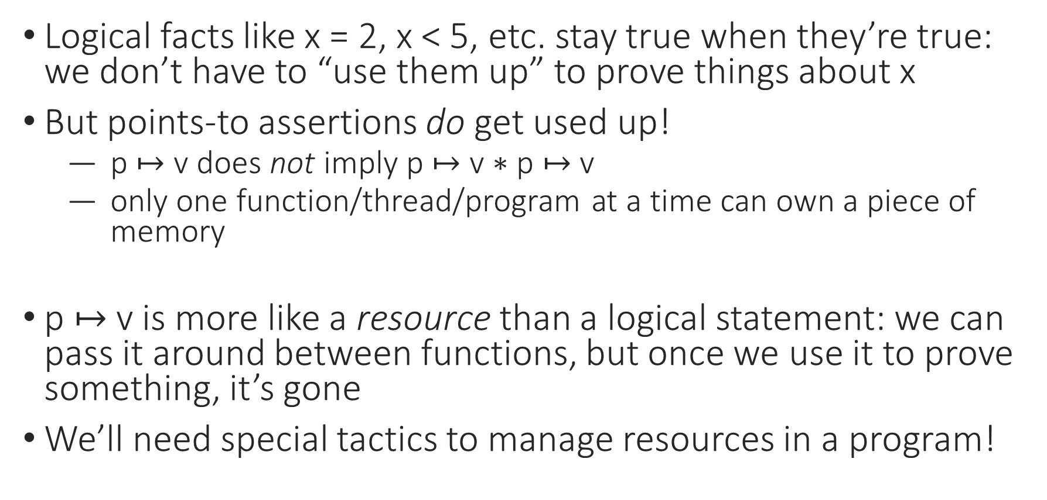
Separation Logic: Resources
Logical facts like x = 2, x < 5, etc. stay true when they’re true: we don’t have to “use them up” to prove things about x
But points-to assertions do get used up!
  p $↦$ v does not imply p $↦$ v $∗$ p $↦$ v
  only one function/thread/program at a time can own a piece of memory
p $↦$ v is more like a resource than a logical statement: we can pass it around between functions, but once we use it to prove something, it’s gone
We’ll need special tactics to manage resources in a program!

Slide 10
Notes:
Poll Title: Do not modify the notes in this section to avoid tampering with the Poll Everywhere activity.
More info at polleverywhere.com/support
Questions
https://www.polleverywhere.com/discourses/vWh3116qyAwpKecMPfY4Q

Slide 11
Setting Up Iris (version 4.0.0)
If you installed the Coq Platform, you probably have it already
If you installed Coq via OPAM, you can use OPAM to install Iris too (see instructions at https://gitlab.mpi-sws.org/iris/iris/-/tree/iris-4.0.0)
Otherwise, you’ll need to build it from source: clone the repo at https://gitlab.mpi-sws.org/iris/iris/-/tree/iris-4.0.0, and run make && make install in that folder
If it’s working, you should be able to run this line in your IDE: Require Import iris.heap_lang.proofmode.
For exercise 3/13, submit a screenshot of a working Iris file!

Slide 12
Setting Up Iris – Special Characters
There’s a lot of fancy notation and special characters in Iris!
My preferred font is DejaVu Sans Mono
You can find instructions for setting up your editor at https://gitlab.mpi-sws.org/iris/iris/-/blob/master/docs/editor.md
You can also do Require Import iris.bi.ascii. to enable ASCII notations (full list at https://gitlab.mpi-sws.org/iris/iris/-/blob/master/iris/bi/ascii.v)

Slide 13
Iris Resources
We will be working from a modified version of the Iris Tutorial (https://gitlab.mpi-sws.org/iris/tutorial-popl21) – please use the files from the course schedule page, not this link
A really good overview of the whole system from the ground up is available at https://arxiv.org/pdf/2105.12077.pdf
There are links to more tutorials and lecture notes at https://iris-project.org/#learning
A list of tactics is at https://gitlab.mpi-sws.org/iris/iris/-/blob/master/docs/proof_mode.md

Slide 14
Notes:
Poll Title: Do not modify the notes in this section to avoid tampering with the Poll Everywhere activity.
More info at polleverywhere.com/support
Questions
https://www.polleverywhere.com/discourses/vWh3116qyAwpKecMPfY4Q

