Slide 1
CS 472 – Provably Correct Programming
William Mansky

Slide 2

Notes:
Poll Title: Do not modify the notes in this section to avoid tampering with the Poll Everywhere activity.
More info at polleverywhere.com/support
Questions
https://www.polleverywhere.com/discourses/SRzwhp4zztmGWgIgz520A

Slide 3
Welcome to the Course!
This is CS 472, Provably Correct Programming
I’m glad you’re here!
Meets MW 2:00-3:15 PM in TBH 180F
My office hours: Tuesday 12-1 and Wednesday 10-11, and by appointment, in SEO 1331 and on Zoom via Blackboard
TA office hours: Monday 1-2 and Thursday 2-3
  Office hours are great for homework help, or just to say hi!

Slide 4
Course Information
Professor: William Mansky (he/him) (mansky1@uic.edu)
TA: Chao Ding (he/him) (cding22@uic.edu)
Prerequisites: CS 301 (logic and proofs)
Website: https://www.cs.uic.edu/~mansky/teaching/cs472/sp24/
Anonymous in-class questions: https://pollev.com/wmansky771
In-person lectures, recordings (probably incomplete) on Blackboard
Discussion board on Piazza, assignments via Gradescope (entry code VBPRNW)

Slide 5
Asking questions
In class: raise your hand anytime
You can ask questions anonymously with PollEverywhere (https://pollev.com/wmansky771)
On Piazza
  Can ask/answer anonymously
  Can post privately to instructors
  Can answer other students’ questions
In office hours
If you have a question, someone else probably has the same question!
Notes:
This class is going to be significantly different from any other CS class you’ve taken, so please, stop me and ask questions!

Slide 6
Notes:
Poll Title: Do not modify the notes in this section to avoid tampering with the Poll Everywhere activity.
More info at polleverywhere.com/support
Questions
https://www.polleverywhere.com/discourses/SRzwhp4zztmGWgIgz520A

Slide 7
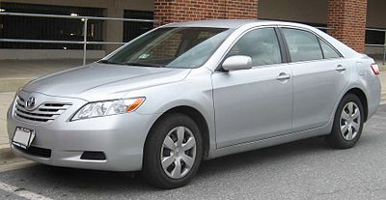
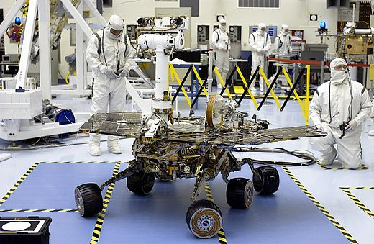
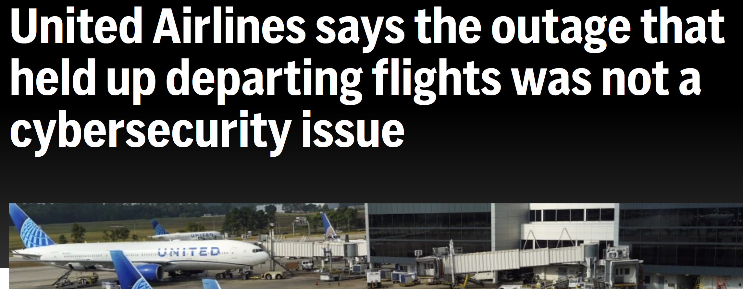
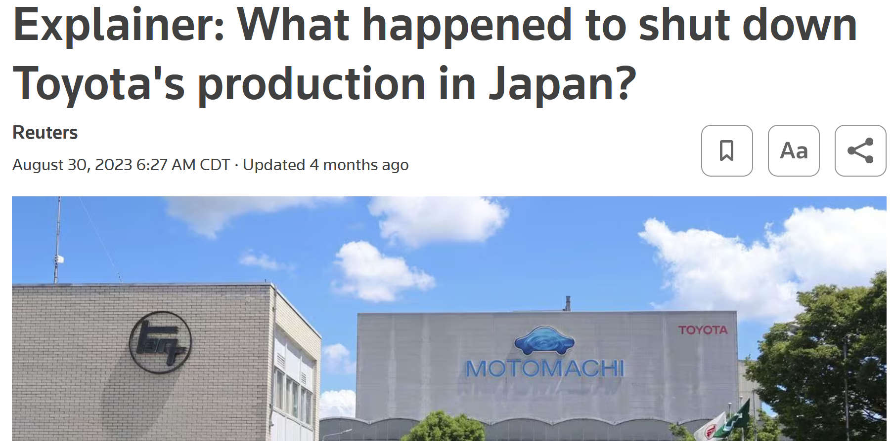
Software works badly
https://en.wikipedia.org/wiki/2009%E2%80%932011_Toyota_vehicle_recalls
https://en.wikipedia.org/wiki/Spirit_(rover)
https://dealbook.nytimes.com/2012/08/02/knight-capital-says-trading-mishap-cost-it-440-million/
Notes:
Spirit Mars Rover – stopped responding for 3 days in 2004 because there were too many files on the file system
Toyota – recalled millions of cars because they sometimes accelerated automatically
Knight Capital – accidentally activated a testing system in production that made tons of trades ignoring price
And it keeps happening – just last year, United cancelled all flights for 30 minutes because of a buggy software update, and every Toyota plant in Japan shut down for a day due to a bug in their parts ordering system.

Slide 8
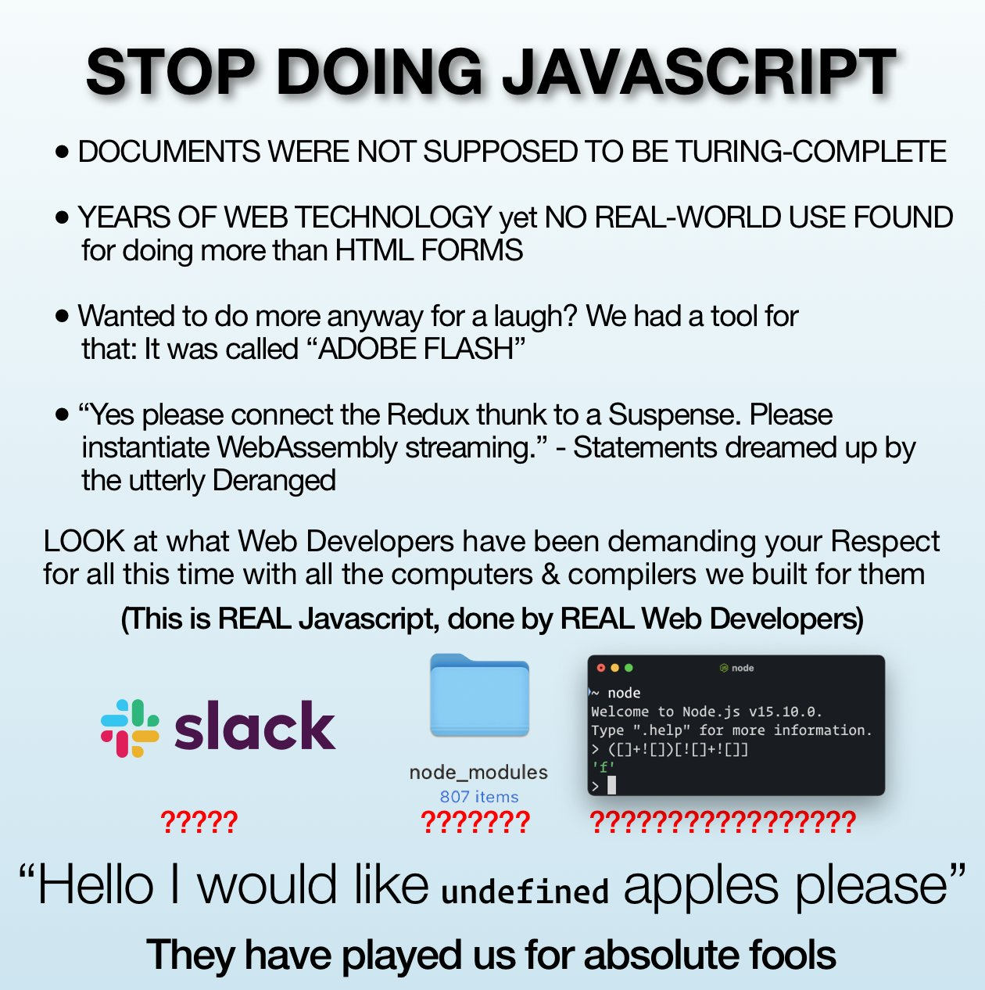
Can we change the way we program?
Notes:
There are a lot of reasons why software is so bad, but it’s worth asking, could we significantly reduce the number of bugs by changing the way we program?
https://www.reddit.com/r/ProgrammerHumor/comments/lxnmsq/stop_doing_javascript/
Languages like Javascript and Python make it easy to run code even if it makes no sense; C, on the other hand, makes it easy to mess up really fundamental things about the computer.

Slide 9
Can we change the way we program?
Programs in safer languages (Rust, OCaml, …) still have bugs
Most programmers don’t get to choose what language they write in!
  Need to maintain/interoperate with existing code
  We mostly write in the languages we know
Notes:
But there are limits to this: most programmers don’t get to choose what language they write in, and people still make mistakes even in nice languages like OCaml.

Slide 10

Can we change the way we program?
Prove programs correct!
This program will:
  never overflow its stack
  never dereference a null pointer
  never call a function without meeting its preconditions
  always return the right result!
i = 1;
while(i <= n){
r = r * i;
i++;
}
This course:
How can we write these proofs?
How can we write programs so they’re
easier to prove?

Slide 11
Notes:
Poll Title: Do not modify the notes in this section to avoid tampering with the Poll Everywhere activity.
More info at polleverywhere.com/support
Questions
https://www.polleverywhere.com/discourses/SRzwhp4zztmGWgIgz520A

Slide 12
Grading
In-class exercises: 25%
Assignments: 50%
Project: 25%

Slide 13
Exercises
In each class, we’ll work through some example problems/proofs
Submit via Gradescope
Due at the start of the next class
You get credit as long as you make some progress on the problem
Feel free to discuss with your neighbors, ask questions, suggest other approaches, etc.!
Notes:
This is the first time the class has been this big, so we’ll probably make adjustments as we go – please let me know if you think of anything that would help you!

Slide 14
Assignments
Programming/proving assignments
Submit via Gradescope
Due at 11:59 PM on the due date
You can discuss strategy with other students, but don’t look at each other’s code!
Cite your sources (websites, other students, StackOverflow, ChatGPT, etc.)
You’ll get most of the credit for attempting a problem, even if you don’t finish it – do what you can, and we’ll work through tricky ones in class after the deadline

Slide 15
Online Sources and ChatGPT
You can find solutions online, but:
Always cite your sources!
Please don’t make your solutions public (e.g. on GitHub)
There’s less theorem-prover code out there than other kinds of code, so what you find will often be outdated or unreliable
You can always run your proofs and see if they work! (and if they don’t, don’t submit them!)

Slide 16
Schedule Disruptions
Next week: I’ll be at POPL
  1/15 is MLK Day; for 1/17, I’ll ask you to watch some videos about proved-correct programming
Sometime mid-April: I’m expecting my second child
  We’ll probably have a few online classes – more details when we get closer

Slide 17
Notes:
Poll Title: Do not modify the notes in this section to avoid tampering with the Poll Everywhere activity.
More info at polleverywhere.com/support
Questions
https://www.polleverywhere.com/discourses/SRzwhp4zztmGWgIgz520A

Slide 18
Getting Started with Proofs
You already know how to write programs: languages, compilers, IDEs, etc.
How do we write proofs? The same way: with software tools!
Tool #1: The Coq proof assistant (https://coq.inria.fr/)
For the first ~4 weeks, we’ll learn how to use it to write guaranteed-correct mathematical proofs
After that, we’ll apply those techniques to programs!
And look at some complicated use cases, esp. concurrent programs (see also CS 454)

Slide 19
Interactive Theorem Provers
In the theorem prover, we can:
Write definitions, in a math-like programming language
Write proofs about those definitions, using logic “tactics”
See the proof state at each point in a proof (what do we know? what do we still need to show?)
Automatically check that each step of our proofs is valid
Notes:
demo.v

Slide 20
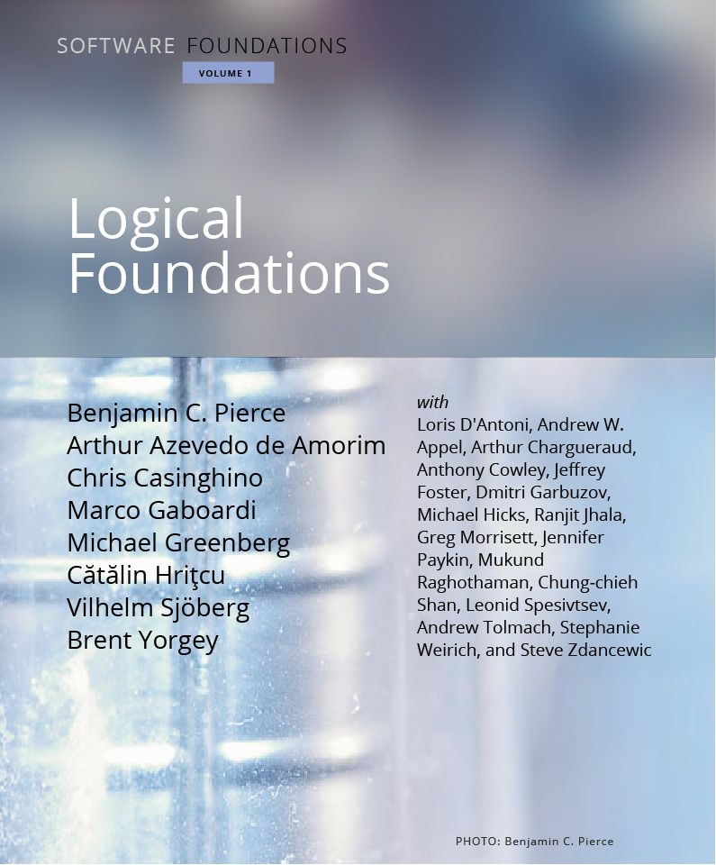
Logical Foundations
Online textbook, each chapter is a file that can be run in Coq
Contents:
  Introduction to Coq
  Basic logic and functional programming
  More advanced logic, mostly induction
  How to describe the behavior of programs
https://softwarefoundations.cis.upenn.edu/lf-current/index.html

Slide 21
Getting Started with Coq
Available online at https://coq.inria.fr/
You can download installers for Windows and Mac from the website
Coq file extension is .v
If it matters, we’ll use version 8.17.1
Two main IDEs: CoqIDE (ships with Coq) and Visual Studio Code (VSCoq extension)

Slide 22
Today’s Exercise
Download and install Coq (https://github.com/coq/platform/releases/tag/2023.03.0, or from the download links at https://coq.inria.fr/)
Download and unpack the textbook (https://softwarefoundations.cis.upenn.edu/lf-current/index.html)
  It’s a .tgz file, so you may need to install 7-zip (https://www.7-zip.org/) to unpack it
Run make in the textbook’s folder to compile the textbook. If you don’t have a command line with make, you’ll need to set one up: I use Cygwin (https://cygwin.com/install.html)
If you finish, run demo.v, then submit it for Exercise 1/8 on Gradescope. If you haven’t finished, submit a description of where you’re stuck instead.
If you get stuck, raise your hand, post on Piazza, or come by office hours
Notes:
Most of these links are also on the Welcome post on Piazza
Due at the start of the next class!

Slide 23
Notes:
Poll Title: Do not modify the notes in this section to avoid tampering with the Poll Everywhere activity.
More info at polleverywhere.com/support
Questions
https://www.polleverywhere.com/discourses/SRzwhp4zztmGWgIgz520A

