Slide 1
CS 472 – Provably Correct Programming
William Mansky

Slide 2
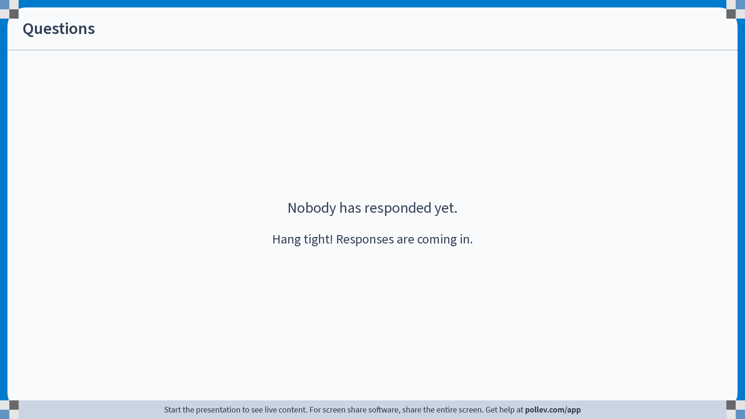
Notes:
Poll Title: Do not modify the notes in this section to avoid tampering with the Poll Everywhere activity.
More info at polleverywhere.com/support
Questions
https://www.polleverywhere.com/discourses/WCvhmKvzYppSkvlZISU4L

Slide 3
Interactive Theorem Provers
In the theorem prover, we can:
Write definitions, in a math-like programming language
Write proofs about those definitions, using logic “tactics”
See the proof state at each point in a proof (what do we know? what do we still need to show?)
Automatically check that each step of our proofs is valid
Notes:
We’re going to start by focusing on the first point: the language we use to write definitions.

Slide 4
Writing Definitions in Coq/Rocq
The definition language is an OCaml-like functional programming language, called Gallina
Key features: inductive types, pattern matching, and recursion
Purpose is to define mathematical objects, not to write programs (though the two are often the same!)
See Basics.v from the textbook

Slide 5
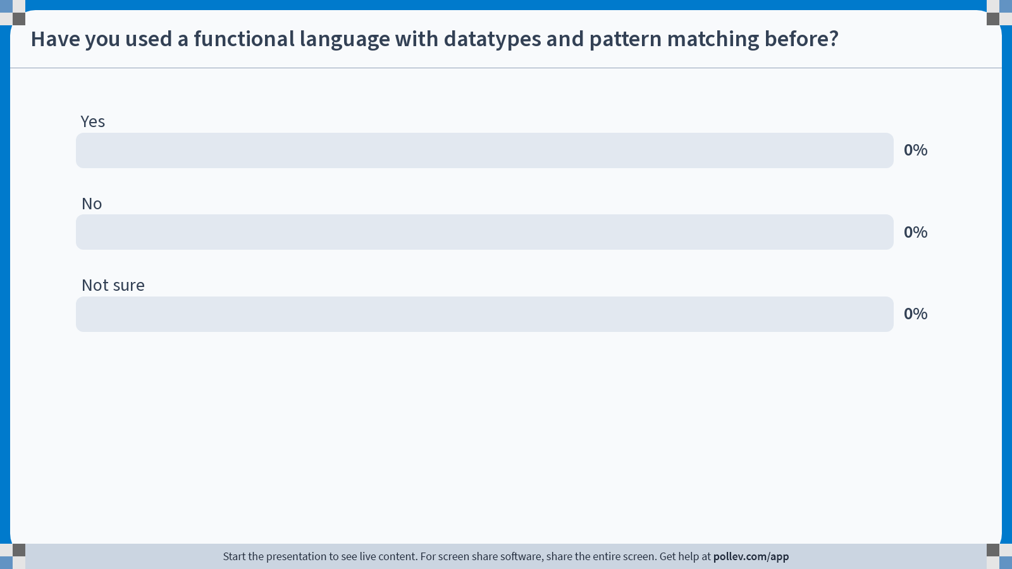
Notes:
Poll Title: Do not modify the notes in this section to avoid tampering with the Poll Everywhere activity.
More info at polleverywhere.com/support
Have you used a functional language with datatypes and pattern matching before?
https://www.polleverywhere.com/multiple_choice_polls/VFuuAQKcr19OQIKwVyMFf?state=opened&flow=Default&onscreen=persist

Slide 6

Inductive Definitions
Types are sets!
Inductive day :=
| monday
| tuesday
| wednesday
| thursday
| friday
| saturday
| sunday.
$$\left\{monday,tuesday,…, saturday,sunday\right\}$$
day is a type
monday : day
tuesday : day
…
saturday : day
sunday : day
day is a set
monday $∈$ day
tuesday $∈$ day
…
saturday $∈$ day
sunday $∈$ day
Notes:
What are we actually defining?

Slide 7
Exercise: nandb
Complete the exercise “nandb” in Basics.v: fill in the definition of nandb, and prove that the examples work
Submit your definition and example proofs for Exercise 1/16 on Gradescope
It may help to refer to the definitions of negb, andb, and orb earlier in the file
Notes:
What are we actually defining?

Slide 8
Inductive Definitions
How would you define the natural numbers?

Slide 9
Notes:
Poll Title: Do not modify the notes in this section to avoid tampering with the Poll Everywhere activity.
More info at polleverywhere.com/support
Questions
https://www.polleverywhere.com/discourses/WCvhmKvzYppSkvlZISU4L

Slide 10
HW1: Basics.v
Complete the listed exercises in Basics.v
Due Friday 1/24 at 11:59 PM
Submit via Gradescope (autograder coming soon)

