Slide 1
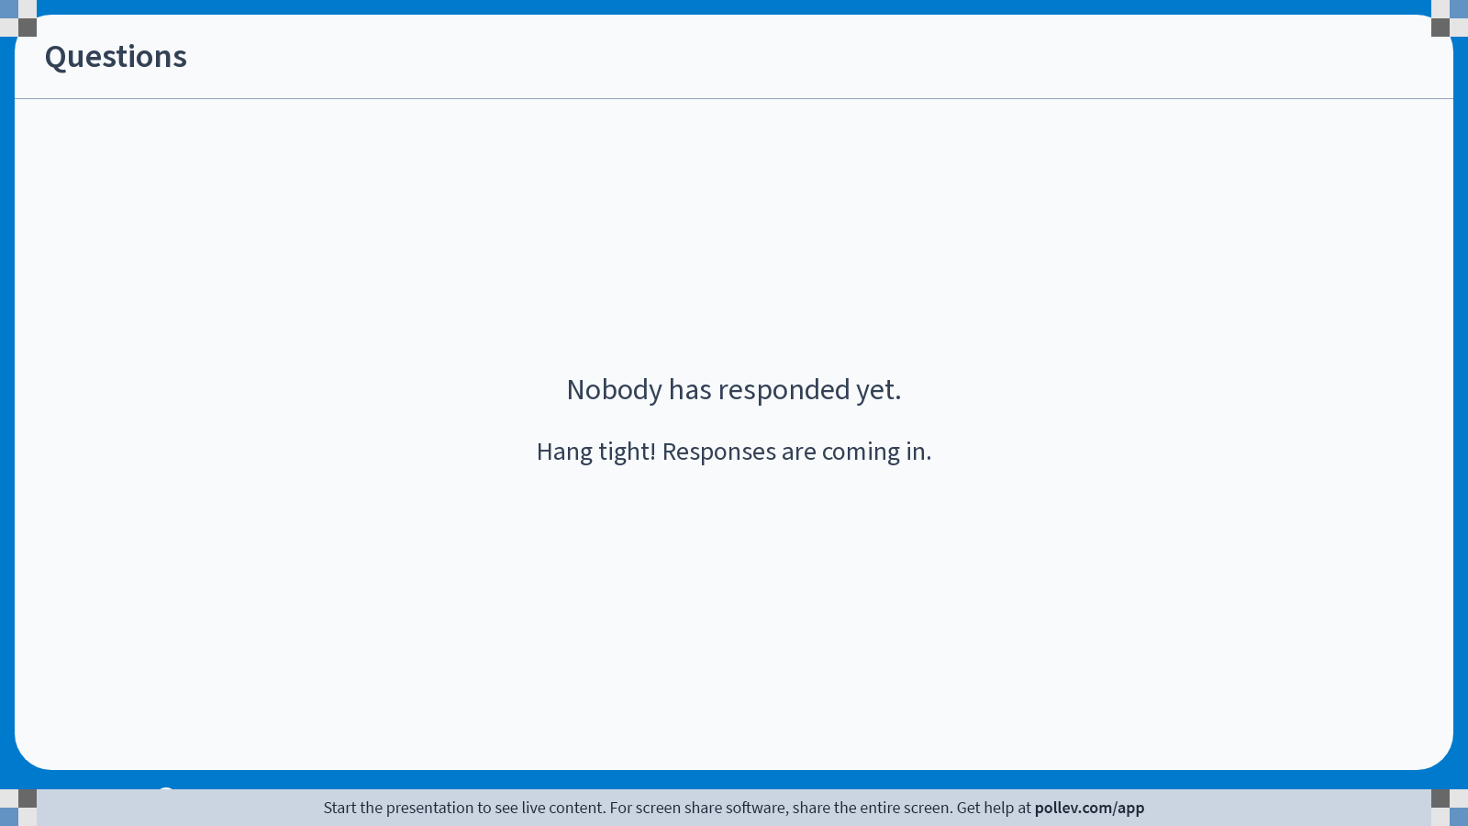
Notes:
Poll Title: Do not modify the notes in this section to avoid tampering with the Poll Everywhere activity.
More info at polleverywhere.com/support
Questions
https://www.polleverywhere.com/discourses/9lqXsklTQ5Mxj2gy9gGyX

Slide 2

Iris Projects
Logical atomicity
Weak memory (iGPS, iRC11)
Distributed systems (Aneris, Actris)
Later credits
Transfinite step-indexing
…
Rust (RustBelt)
Go (Perennial)
C (RefinedC)
WebAssembly (Iris-Wasm)
HeapLang + extensions
real languages
Notes:
Iris is a generic separation logic framework that starts from a very simple base logic and an idea of ghost state, and builds out in all sorts of different directions.

Slide 3
How do you verify a real program in Iris?
Translate the program into a model in Coq
  Could be a HeapLang-like language, or another kind of datatype
State a spec for each function
  Details can vary, but points-to, invariants, ghost state, etc. mostly the same in all languages
Prove the specs using wp tactics for that language
  iDestruct, iApply, etc. are universal, but wp_ are per-language
Exercise: What’s a feature of real languages that HeapLang doesn’t have?
Notes:
Let’s look at some examples.

Slide 4
How do you verify a real program in Iris?
Translate the program into a model in Coq
  Could be a HeapLang-like language, or another kind of datatype
State a spec for each function
  Details can vary, but points-to, invariants, ghost state, etc. mostly the same in all languages
Prove the specs using wp tactics for that language
  iDestruct, iApply, etc. are universal, but wp_ are per-language
Using the adequacy theorem, know that the verified program actually does the right thing!
Notes:
Let’s look at some examples.

Slide 5
Some Iris instances for real languages
lambda-rust (Rust): https://gitlab.mpi-sws.org/iris/lambda-rust
Perennial (Go): https://github.com/mit-pdos/perennial
Iris-Wasm (WebAssembly): https://github.com/logsem/iriswasm
RefinedC (C): https://gitlab.mpi-sws.org/iris/refinedc
Notes:
Let’s look at some examples.

Slide 6
What can we know about a verified program?
Program Logic (e.g., Iris)
Adequacy theorem
Semantics (abstract language model)
Verified compiler
Executable code (e.g., assembly)

Slide 7
Separation logics with verified compilers
Verified Software Toolchain (C): https://github.com/PrincetonUniversity/VST/, see also Software Foundations Volume 5
CakeML (SML): https://cakeml.org/index.html
Notes:
Let’s look at some examples.

