Slide 1
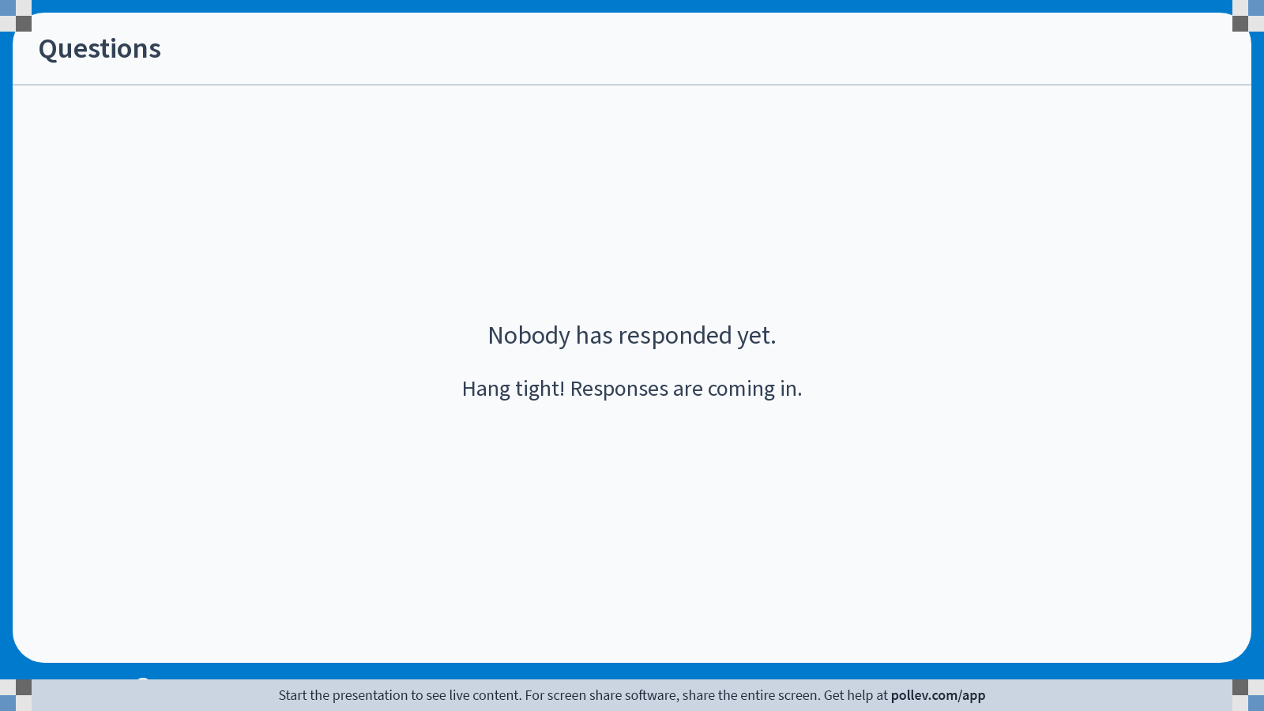
Notes:
Poll Title: Do not modify the notes in this section to avoid tampering with the Poll Everywhere activity.
More info at polleverywhere.com/support
Questions
https://www.polleverywhere.com/discourses/9lqXsklTQ5Mxj2gy9gGyX

Slide 2

Can we change the way we program?
Prove programs correct!
This program will:
  never overflow its stack
  never dereference a null pointer
  never call a function without meeting its preconditions
  always return the right result!
i = 1;
while(i <= n){
r = r * i;
i++;
}
This course:
How can we write these proofs?
How can we write programs so they’re
easier to prove?

Slide 3
What did we learn?
Introduction to theorem proving with Coq/Rocq
  Notation, pattern-matching and recursion, tactics, proof strategies
Separation logic with Iris
  Basic separation logic and tactics
  Specs for programs: pre- and postconditions
  Data structures
  Concurrency: invariants, threads, locks, ghost state
  Iris for real programming languages
Notes:
What didn’t we cover?

Slide 4
What should we prove correct?
Program verification is a lot of work!
Where is it worth the effort?
  Tradeoff: how bad would it be if something went wrong?
  Critical infrastructure – safety, security
  High-value code
  Widely-used code, e.g. libraries
Notes:
What didn’t we cover?

Slide 5
Can it be less work?
Program verification is a lot of work!
Just stating a specification is already an important step
  What does this function always do? What should be true in the caller before it’s called?
  Just writing this down in the code can help correctness!
Spectrum of tools between Coq proofs and just writing a spec:
  Lightweight formal methods: Dafny, Verifast, …
  Even lighter-weight formal methods: Infer, …
Notes:
I think it’s easiest to understand what these tools are actually doing, and why we’d want them, by starting on the most interactive end of the spectrum.
Even if you don’t verify programs in the future, I hope thinking about programs in this way will help you write more correct programs. Thank you!

Slide 6
Notes:
Poll Title: Do not modify the notes in this section to avoid tampering with the Poll Everywhere activity.
More info at polleverywhere.com/support
Questions
https://www.polleverywhere.com/discourses/9lqXsklTQ5Mxj2gy9gGyX

