Slide 1
CS 472 – Provably Correct Programming
William Mansky

Slide 2
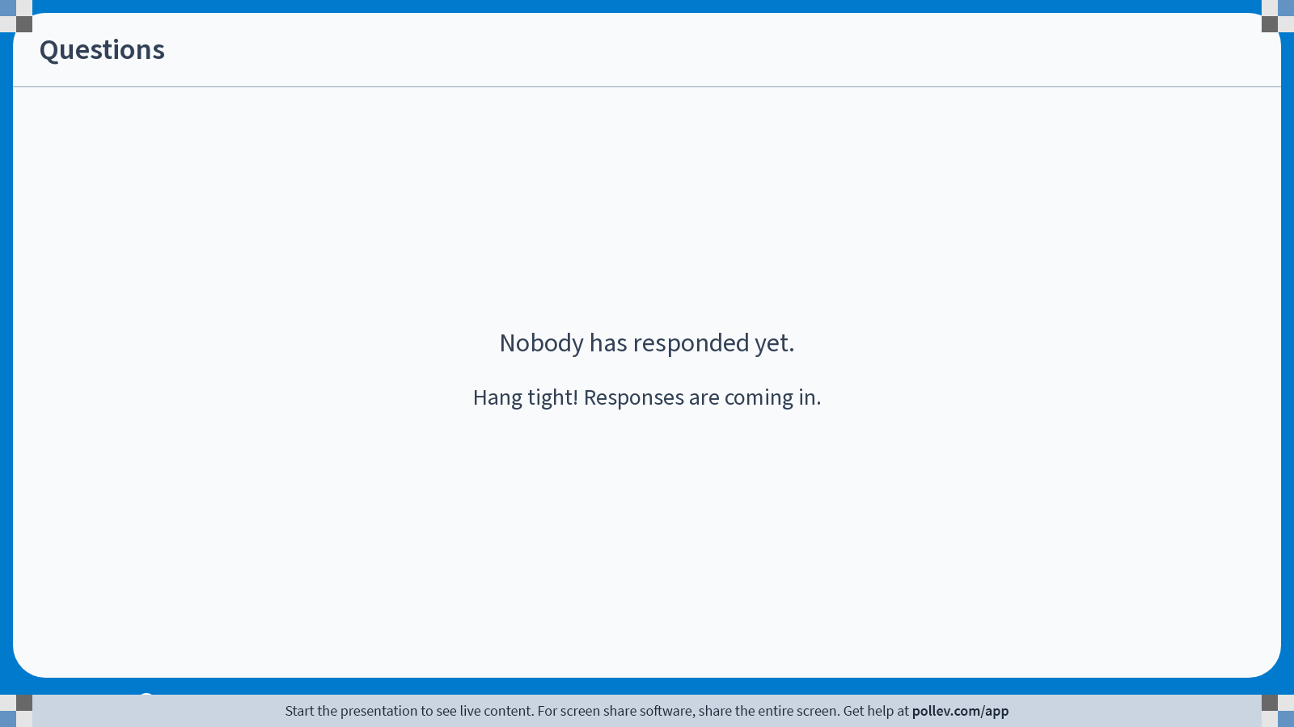
Notes:
Poll Title: Do not modify the notes in this section to avoid tampering with the Poll Everywhere activity.
More info at polleverywhere.com/support
Questions
https://www.polleverywhere.com/discourses/GIR7Q7npIoZWajmi0f3DR

Slide 3
How do we prove programs correct?
First: what’s our theorem statement?
// x should hold a number n
r = x;
while(x > 1){
x = x – 1;
r = r * x;
}
// r should be n!
Lemma fact_correct:
{ x = n }
fact_program
{ r = n! }
.

Slide 4
How do we prove programs correct?
Second: how do we prove it?
{ x = n }
r = x;
{ x = n /\ r = n }
while(x > 1){
{ x = a /\ r = n * n - 1 * … * a }
x = x – 1;
{x = a - 1 /\ r = n * n - 1 * … * a }
r = r * x;
}
Symbolic execution

Slide 5
How do we prove programs correct?
First: what’s our theorem statement?
Second: how do we prove it?
Third: what’s our logic?
Program logic works a bit differently than normal logic: we want to talk about owning and using resources

Slide 6
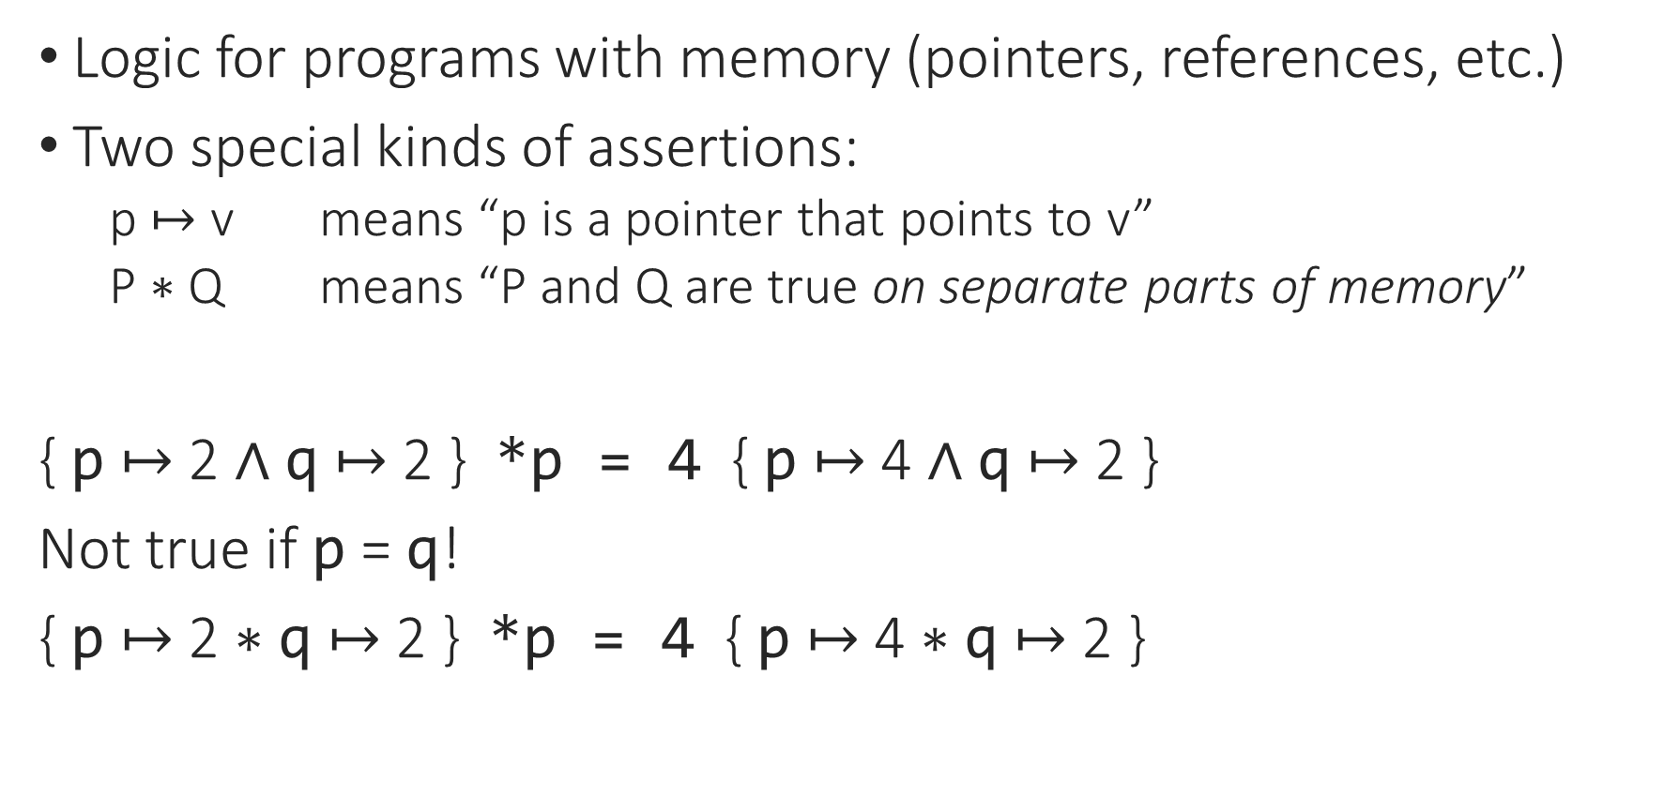
Separation Logic
Logic for programs with memory (pointers, references, etc.)
Two special kinds of assertions:
  p $↦$ v means “p is a pointer that points to v”
  P $∗$ Q means “P and Q are true on separate parts of memory”
{ p $↦$ 2 $∧$ q $↦$ 2 } *p = 4 { p $↦$ 4 $∧$ q $↦$ 2 }
Not true if p = q!
{ p $↦$ 2 $∗$ q $↦$ 2 } *p = 4 { p $↦$ 4 $∗$ q $↦$ 2 }

Slide 7
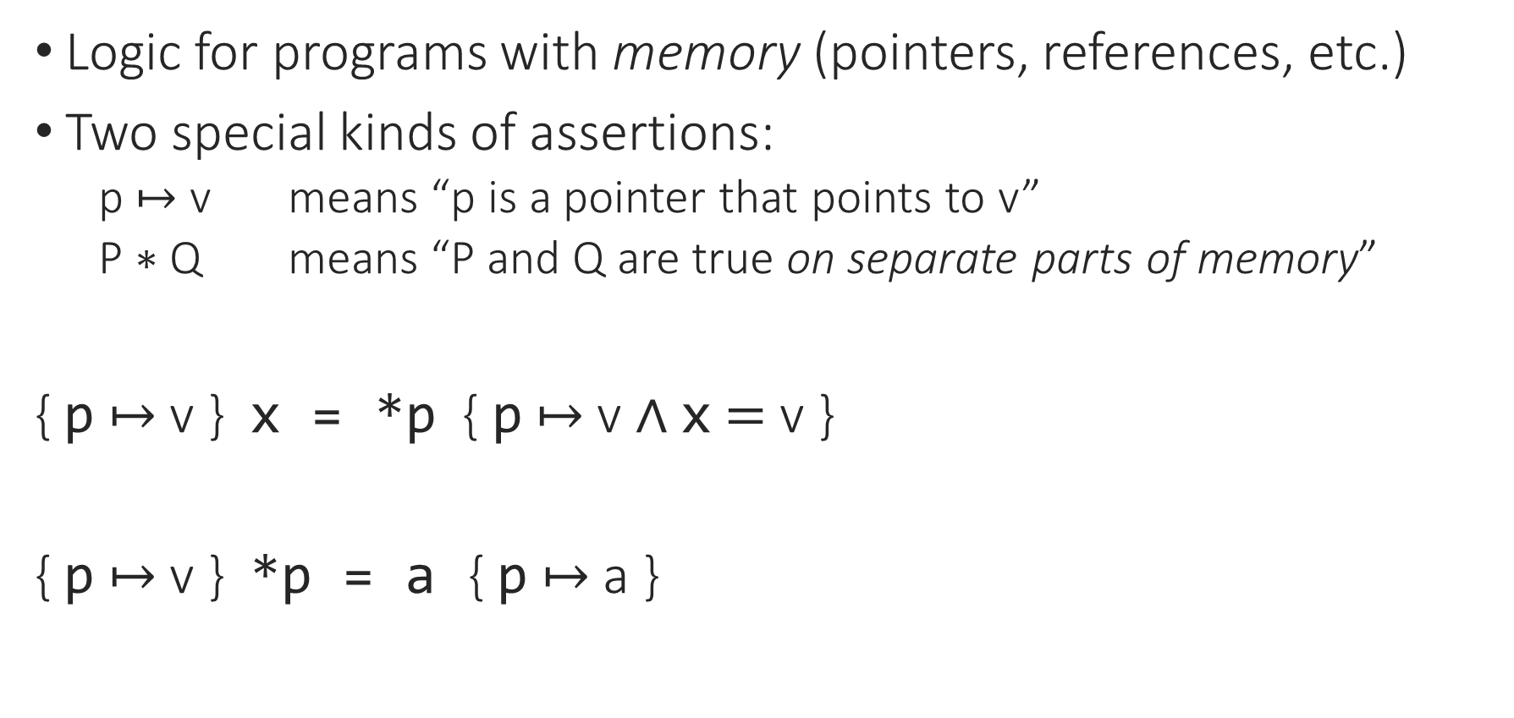
Separation Logic: Loads and Stores
Logic for programs with memory (pointers, references, etc.)
Two special kinds of assertions:
  p $↦$ v means “p is a pointer that points to v”
  P $∗$ Q means “P and Q are true on separate parts of memory”
{ p $↦$ v } x = *p { p $↦$ v $∧$ x $=$ v }
{ p $↦$ v } *p = a { p $↦$ a }

Slide 8
Separation Logic: Resources
HP : P
HPQ : P -> Q
…
HP : P
HPQ : P -> Q
HQ : Q
Notes:
In normal logic, facts/hypotheses don’t get used up when we use them to prove things.

Slide 9

Separation Logic: Resources
HP : x $↦$ 3
HPQ : x $↦$ 3 -* x $↦$ 5
…
HP : x $↦$ 3
HPQ : x $↦$ 3 -* x $↦$ 5
HQ : x $↦$ 5
Notes:
In normal logic, facts/hypotheses don’t get used up when we use them to prove things.

Slide 10
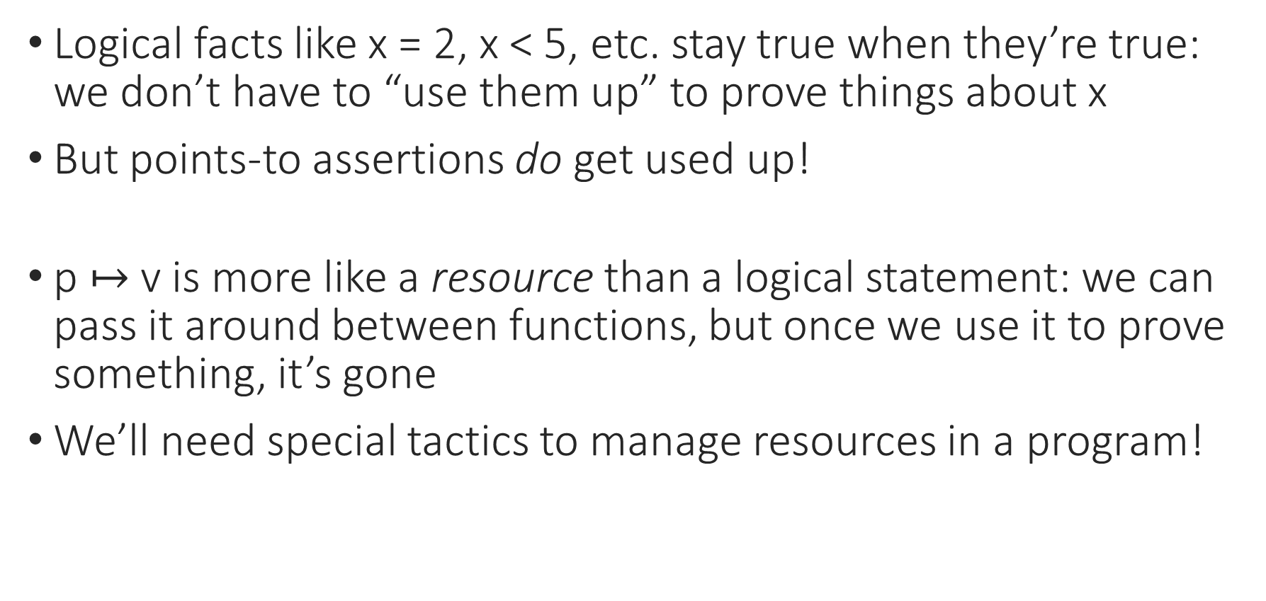
Separation Logic: Resources
Logical facts like x = 2, x < 5, etc. stay true when they’re true: we don’t have to “use them up” to prove things about x
But points-to assertions do get used up!
p $↦$ v is more like a resource than a logical statement: we can pass it around between functions, but once we use it to prove something, it’s gone
We’ll need special tactics to manage resources in a program!

Slide 11
Notes:
Poll Title: Do not modify the notes in this section to avoid tampering with the Poll Everywhere activity.
More info at polleverywhere.com/support
Questions
https://www.polleverywhere.com/discourses/9lqXsklTQ5Mxj2gy9gGyX

Slide 12

Practical Separation Logic: Iris
Tool #2: Iris, a separation logic framework inside Rocq
  Default language is a simple functional language with memory
  Proofs combine symbolic execution of programs with tactics for using/proving facts about resources
Iris has lots of extensions, applications, and target languges. We’ll look at a few!

Slide 13
Setting Up Iris (version 4.4.0)
Install via opam:
opam repo add rocq-released https://rocq-prover.github.io/opam/released/
opam install coq-iris-heap-lang
(more instructions at https://gitlab.mpi-sws.org/iris/iris/#working-with-iris)
If it’s working, you should be able to run this line in your IDE: Require Import iris.heap_lang.proofmode.

Slide 14
Setting Up Iris – Special Characters
There’s a lot of fancy notation and special characters in Iris!
My preferred font is DejaVu Sans Mono
You can find instructions for setting up your editor at https://gitlab.mpi-sws.org/iris/iris/-/blob/master/docs/editor.md
You can also do Require Import iris.bi.ascii. to enable ASCII notations (full list at https://gitlab.mpi-sws.org/iris/iris/-/blob/master/iris/bi/ascii.v)

Slide 15
Iris Resources
We will be working from my fork of the Iris Tutorial (https://github.com/mansky1/iris-tutorial/)
A really good overview of the whole system from the ground up is available at https://arxiv.org/pdf/2105.12077.pdf
There are links to more tutorials and lecture notes at https://iris-project.org/#learning
A list of tactics is at https://gitlab.mpi-sws.org/iris/iris/-/blob/master/docs/proof_mode.md

Slide 16
Notes:
Poll Title: Do not modify the notes in this section to avoid tampering with the Poll Everywhere activity.
More info at polleverywhere.com/support
Questions
https://www.polleverywhere.com/discourses/9lqXsklTQ5Mxj2gy9gGyX

