Slide 1
CS 472 – Provably Correct Programming
William Mansky

Slide 2
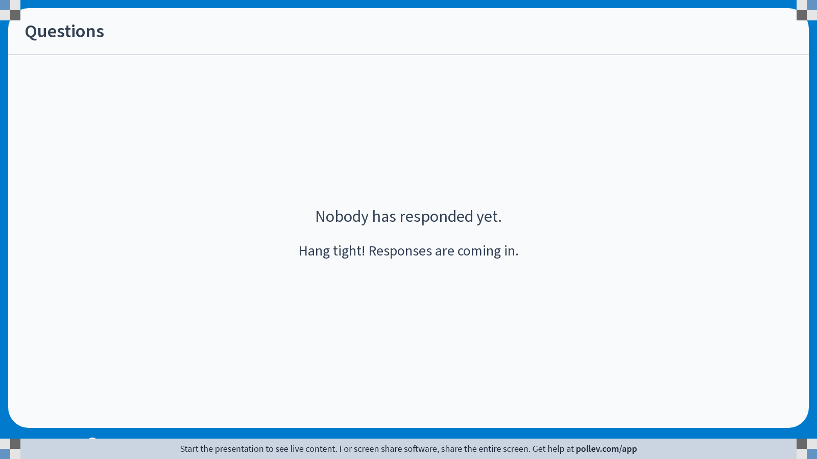
Notes:
Poll Title: Do not modify the notes in this section to avoid tampering with the Poll Everywhere activity.
More info at polleverywhere.com/support
Questions
https://www.polleverywhere.com/discourses/9lqXsklTQ5Mxj2gy9gGyX

Slide 3
Welcome to the Course!
This is CS 472, Provably Correct Programming
I’m glad you’re here!
Meets TR 11:00 AM – 12:15 PM in CDRLC 2406
My office hours: M 10-11 AM, R 2-3 PM, and by appointment, in CDRLC 4450 and on Zoom via Blackboard
TA office hours: TR 3-4 PM, location TBA and on Zoom
  Office hours are great for homework help, or just to say hi!

Slide 4
Course Information
Professor: William Mansky (he/him) (mansky1@uic.edu)
TA: Eli Whitehouse (ewhit37@uic.edu)
Prerequisites: CS 341 (functional programming)
Website: https://www.cs.uic.edu/~mansky/teaching/cs472/sp26/
Anonymous in-class questions: https://pollev.com/wmansky771
In-person lectures
Discussion board on Piazza, assignments via Gradescope (entry code X8GY8B)
Notes:
My research area is program verification, so in this class you’ll be learning the tools and techniques I use every day.

Slide 5
Asking questions
In class: raise your hand anytime
You can ask questions anonymously with PollEverywhere (https://pollev.com/wmansky771)
On Piazza
  Can ask/answer anonymously
  Can post privately to instructors
  Can answer other students’ questions
In office hours
If you have a question, someone else probably has the same question!
Notes:
This class is going to be significantly different from any other CS class you’ve taken, so please, stop me and ask questions!

Slide 6
Notes:
Poll Title: Do not modify the notes in this section to avoid tampering with the Poll Everywhere activity.
More info at polleverywhere.com/support
Questions
https://www.polleverywhere.com/discourses/9lqXsklTQ5Mxj2gy9gGyX

Slide 7
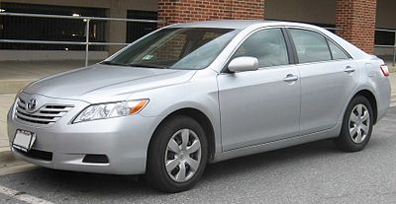
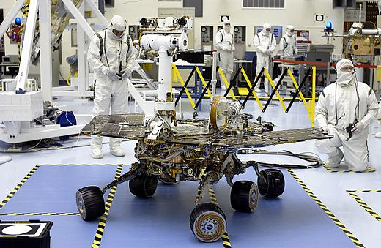
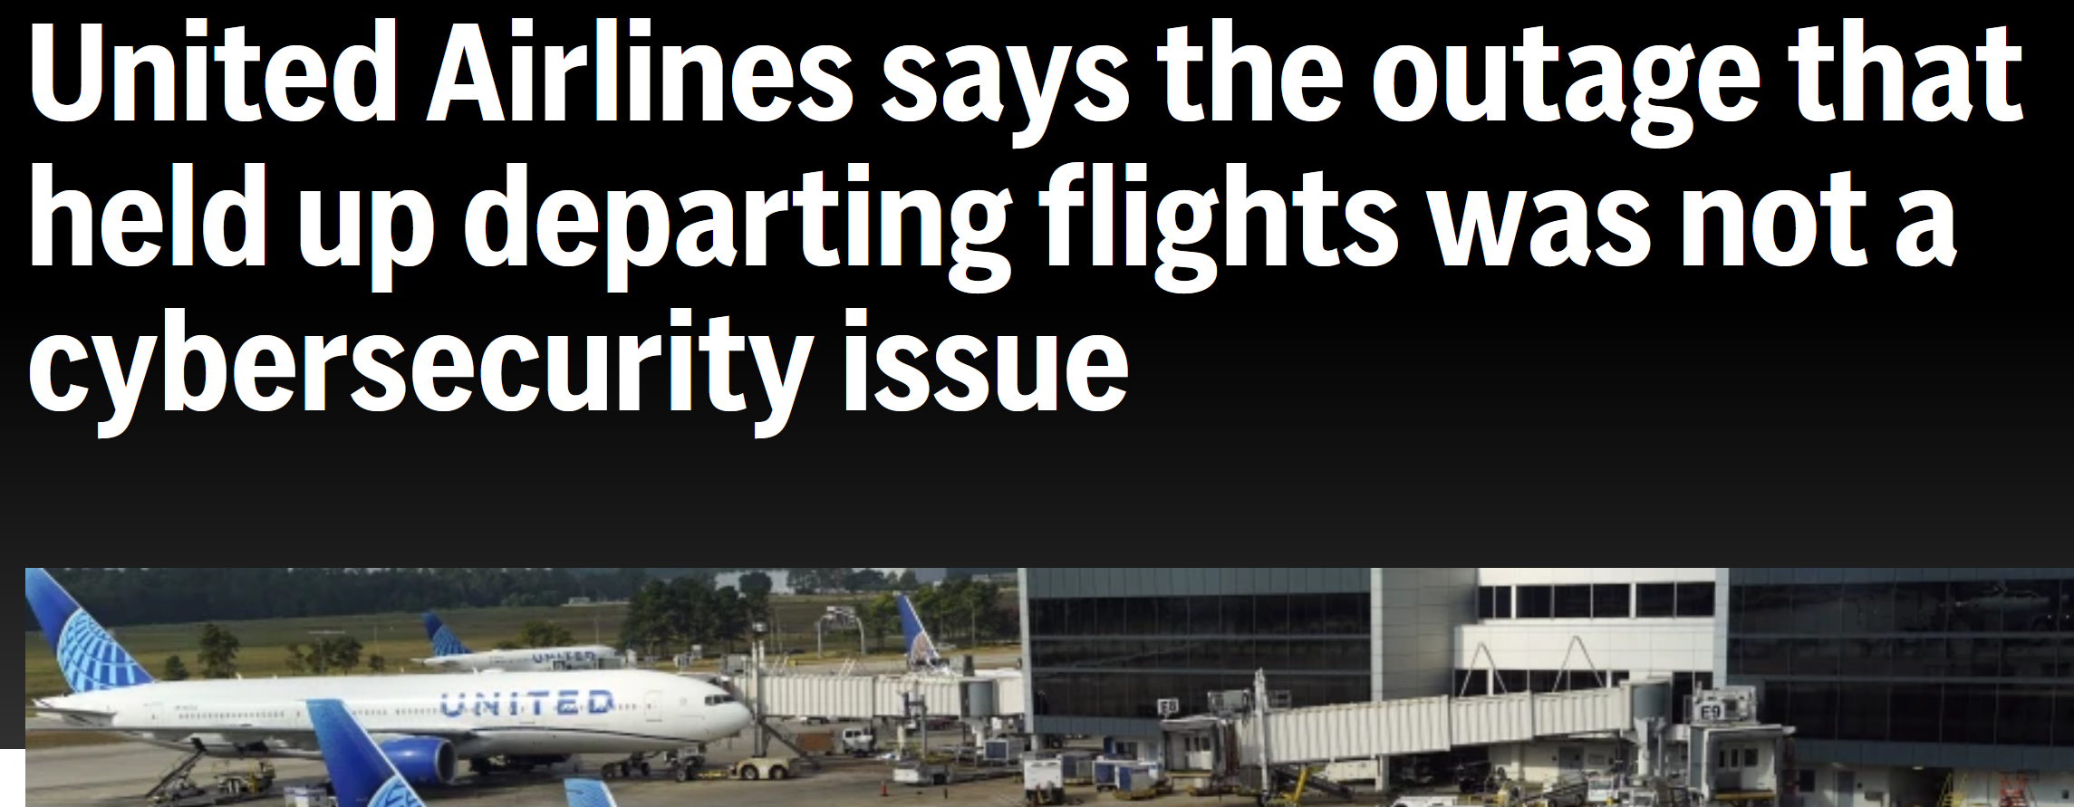
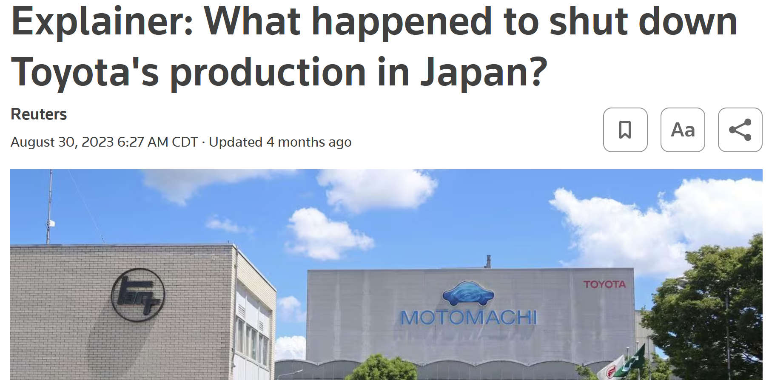
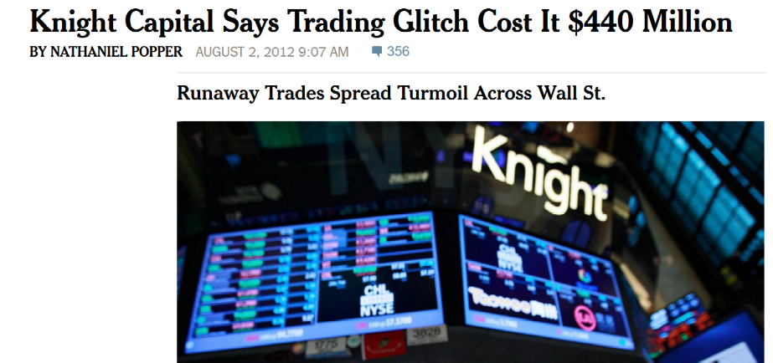
Software works badly
https://en.wikipedia.org/wiki/2009%E2%80%932011_Toyota_vehicle_recalls
https://en.wikipedia.org/wiki/Spirit_(rover)
https://dealbook.nytimes.com/2012/08/02/knight-capital-says-trading-mishap-cost-it-440-million/
Notes:
Spirit Mars Rover – stopped responding for 3 days in 2004 because there were too many files on the file system
Toyota – recalled millions of cars because they sometimes accelerated automatically
Knight Capital – accidentally activated a testing system in production that made tons of trades ignoring price
And it keeps happening – in 2023, United cancelled all flights for 30 minutes because of a buggy software update, and every Toyota plant in Japan shut down for a day due to a bug in their parts ordering system.

Slide 8
What goes wrong?
All these people tested their code!
Corner cases
Unexpected interactions
Language gotchas
Classic bugs: buffer overflows, use after free, …
Heisenbugs (test mostly succeeds, sometimes randomly fails)
Notes:
There are tools for checking for a lot of these, but those tools are incomplete! (and can’t be complete!)

Slide 9
Why can’t we find bugs automatically?
for(i = 0; i < bound; i++){
a[i] = get_val(i);
}
To prove it doesn’t overflow: show bound is <= length of a
Notes:
There are tools for checking for a lot of these, but those tools are incomplete! (and can’t be complete!)

Slide 10
Why can’t we find bugs automatically?
for(i = 0; i < bound; i++){
a[get_index(i)] = get_val(i);
}
To prove it doesn’t overflow: need to prove get_index always returns reasonable values!
Safety is entangled with functional correctness
Notes:
There are tools for checking for a lot of these, but those tools are incomplete! (and can’t be complete!)

Slide 11

Can we guarantee a program bug-free?
Prove programs correct!
This program will:
  never overflow its stack
  never dereference a null pointer
  never call a function without meeting its preconditions
  always return the right result!
i = 1;
while(i <= n){
r = r * i;
i++;
}
This course:
How can we write these proofs?
How can we write programs so they’re
easier to prove?

Slide 12
Notes:
Poll Title: Do not modify the notes in this section to avoid tampering with the Poll Everywhere activity.
More info at polleverywhere.com/support
Questions
https://www.polleverywhere.com/discourses/9lqXsklTQ5Mxj2gy9gGyX

Slide 13
Grading
In-class exercises: 25%
Assignments: 50%
Project: 25%

Slide 14
Exercises
In each class, we’ll work through some example problems/proofs
Submit via Gradescope
Due at the start of the next class
You get credit as long as you make some progress on the problem
Feel free to discuss with your neighbors, ask questions, suggest other approaches, etc.!
Notes:
This is the first time the class has been this big, so we’ll probably make adjustments as we go – please let me know if you think of anything that would help you!

Slide 15
Assignments
Programming/proving assignments
Submit via Gradescope
Due at 11:59 PM on the due date
You can discuss strategy with other students, but don’t look at each other’s code!
Always cite your sources (websites, other students, StackOverflow, ChatGPT, etc.)
You’ll get most of the credit for attempting a problem, even if you don’t finish it – do what you can, and we’ll work through tricky ones in class after the deadline

Slide 16
Online Sources and ChatGPT
You may be able to find solutions online/generate them, but:
It’ll make the class harder; the assignments are there to help you learn.
Always cite your sources! (websites, GPT, etc.)
Please don’t make your solutions public (e.g. on GitHub)
There’s less theorem-prover code out there than other kinds of code, so what you find will often be outdated or unreliable
  ChatGPT is a plagiarism machine, so google your code!
Always run your proofs and see if they work! (and if they don’t, don’t submit them!)

Slide 17
Notes:
Poll Title: Do not modify the notes in this section to avoid tampering with the Poll Everywhere activity.
More info at polleverywhere.com/support
Questions
https://www.polleverywhere.com/discourses/9lqXsklTQ5Mxj2gy9gGyX

Slide 18
Agenda
How do we prove things?
How do we prove things about programs?
What kinds of programs are interesting/tricky to prove?
Let’s prove some programs!
Notes:
demo.v

Slide 19
Getting Started with Proofs
You already know how to write programs: languages, compilers, IDEs, etc.
How do we write proofs? The same way: with software tools!
Tool #1: The Rocq proof assistant (https://rocq-prover.org/)
For the first ~5 weeks, we’ll learn how to use it to write guaranteed-correct mathematical proofs
After that, we’ll apply those techniques to programs!
And look at some complicated use cases, esp. concurrent programs (see also CS 454)
Notes:
Note: the prover was recently renamed from Coq to Rocq.

Slide 20
Interactive Theorem Provers
In the theorem prover, we can:
Write definitions, in a math-like programming language
Write proofs about those definitions, using logic “tactics”
See the proof state at each point in a proof (what do we know? what do we still need to show?)
Automatically check that each step of our proofs is valid
Notes:
demo.v

Slide 21
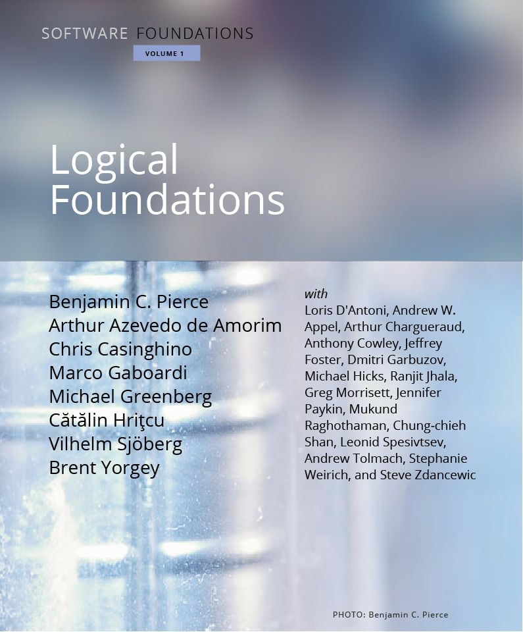
Logical Foundations
Online textbook, each chapter is a file that can be run in Rocq
Contents:
  Introduction to theorem proving
  Basic logic and functional programming
  More advanced logic, mostly induction
  How to describe the behavior of programs
https://softwarefoundations.cis.upenn.edu/lf-current/index.html

Slide 22
Getting Started with Rocq
Distributed via opam, the OCaml Package Manager
File extension is .v
If it matters, we’ll use version 9.0
Two main IDEs: Visual Studio Code (VSRocq extension) and RocqIDE (available on opam)

Slide 23
Today’s Exercise
Install opam: https://ocaml.org/install#linux_mac_bsd
  If you’re using Windows, I strongly recommend using WSL
Install Rocq: opam pin add rocq-prover (version)
Install VSRocq (or another IDE if you don’t like VSCode)
Download and unpack the textbook (https://softwarefoundations.cis.upenn.edu/lf-current/index.html)
Run make in the textbook’s folder to compile the textbook
If you finish, run demo.v, then submit a screenshot for Exercise 1/13 on Gradescope (the whole file should be processed). If you haven’t finished, submit a description of where you’re stuck instead.
If you get stuck, raise your hand, post on Piazza, or come by office hours
Notes:
Most of these links are also on the Welcome post on Piazza
Due at the start of the next class!

Slide 24
Notes:
Poll Title: Do not modify the notes in this section to avoid tampering with the Poll Everywhere activity.
More info at polleverywhere.com/support
Questions
https://www.polleverywhere.com/discourses/9lqXsklTQ5Mxj2gy9gGyX

