Slide 1
CS 476 – Programming Language Design
William Mansky

Slide 2

Notes:
Poll Title: Do not modify the notes in this section to avoid tampering with the Poll Everywhere activity.
More info at polleverywhere.com/support
Questions
https://www.polleverywhere.com/discourses/SRzwhp4zztmGWgIgz520A

Slide 3
Java-Like Language: Semantics
Values: ints, objects
How should we represent an object?
Name | Value
x | 3
y | 5
getx() | return x;
sety(n) | y := n;
Point(x = 3, y = 5)
Notes:
What do we need to record about an object? Its class, and the values of its fields.
It’s convenient for the values to use actual program syntax. This works only because we insisted that constructors don’t do anything.

Slide 4
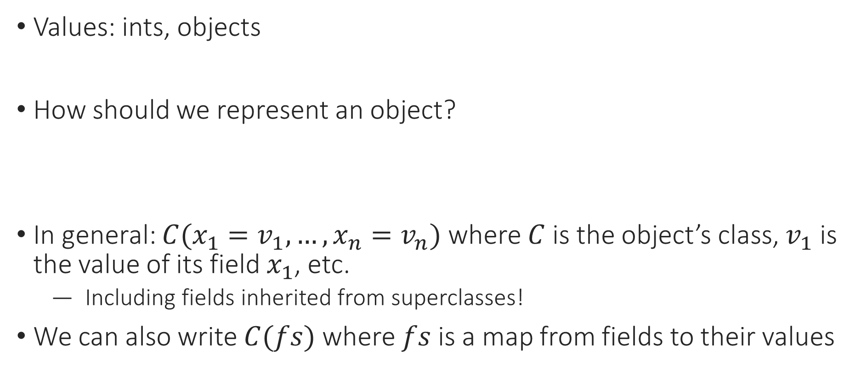
Java-Like Language: Semantics
Values: ints, objects
How should we represent an object?
In general: $C({x_{1}=v}_{1},…,x_{n}=v_{n})$ where $C$is the object’s class, $v_{1}$ is the value of its field $x_{1}$, etc.
  Including fields inherited from superclasses!
We can also write $C(fs)$ where $fs$ is a map from fields to their values
Point(x = 3, y = 5) Square(side = 4) Item(type = “book”, len = 200)
Notes:
What do we need to record about an object? Its class, and the values of its fields.
It’s convenient for the values to use actual program syntax. This works only because we insisted that constructors don’t do anything.

Slide 5

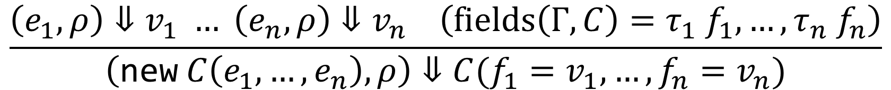
Java-Like Language: Semantics
Exercise: Fill in the rule to give semantics for field access.
$$\frac{\left(e_{1},ρ\right)⇓v_{1} … \left(e_{n},ρ\right)⇓v_{n} \left(fields\left(Γ,C\right)=τ_{1} f_{1},…,τ_{n} f_{n}\right)}{\left(\text{new} C\left(e_{1},…,e_{n}\right),ρ\right)⇓C({f_{1}=v}_{1},…,f_{n}=v_{n})}$$
$$\frac{}{\left(e.f,ρ\right)⇓ }$$
Notes:
How about method calls?

Slide 6
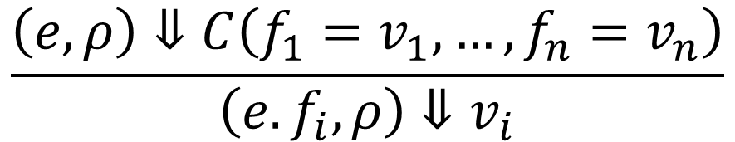
Java-Like Language: Semantics
$$\frac{\left(e_{1},ρ\right)⇓v_{1} … \left(e_{n},ρ\right)⇓v_{n} \left(fields\left(Γ,C\right)=τ_{1} f_{1},…,τ_{n} f_{n}\right)}{\left(\text{new} C\left(e_{1},…,e_{n}\right),ρ\right)⇓C({f_{1}=v}_{1},…,f_{n}=v_{n})}$$
$$\frac{\left(e,ρ\right)⇓C\left({f_{1}=v}_{1},…,f_{n}=v_{n}\right)}{\left(e.f_{i},ρ\right)⇓v_{i}}$$
Notes:
How about method calls?

Slide 7
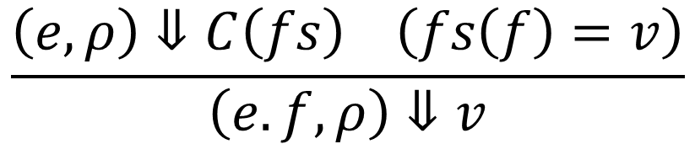
Java-Like Language: Semantics
$$\frac{\left(e_{1},ρ\right)⇓v_{1} … \left(e_{n},ρ\right)⇓v_{n} \left(fields\left(Γ,C\right)=τ_{1} f_{1},…,τ_{n} f_{n}\right)}{\left(\text{new} C\left(e_{1},…,e_{n}\right),ρ\right)⇓C({f_{1}=v}_{1},…,f_{n}=v_{n})}$$
$$\frac{\left(e,ρ\right)⇓C\left(fs\right) \left(fs\left(f\right)=v\right)}{\left(e.f,ρ\right)⇓v}$$
Notes:
How about method calls?

Slide 8

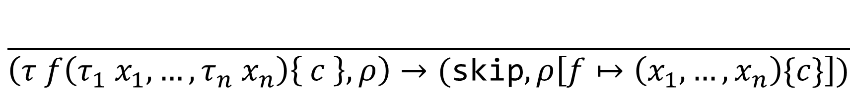
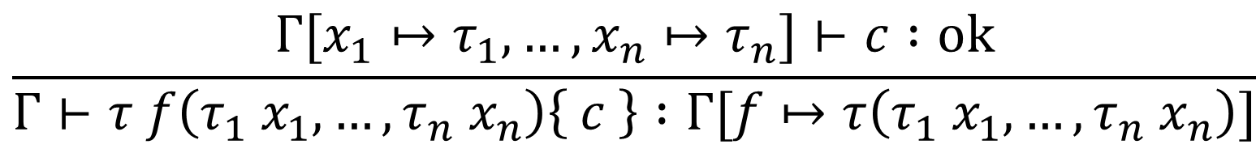
Java-Like Language: Contexts
In IMP, the type context $Γ$stored function signatures and the runtime environment $ρ$stored function definitions
In Java, both typing and semantics might need the whole class declaration
$$\frac{Γ[x_{1}↦τ_{1},…,x_{n}↦τ_{n}]⊢c :ok}{Γ⊢τ f\left(τ_{1} x_{1},…,τ_{n} x_{n}\right)\left\{ c \right\} :Γ[f↦τ\left(τ_{1} x_{1},…,τ_{n} x_{n}\right)]}$$
$$\frac{}{\left(τ f\left(τ_{1} x_{1},…,τ_{n} x_{n}\right)\left\{ c \right\},ρ\right)→(\text{skip}, ρ\left[f↦\left(x_{1},…,x_{n}\right)\{c\}\right])}$$

Slide 9
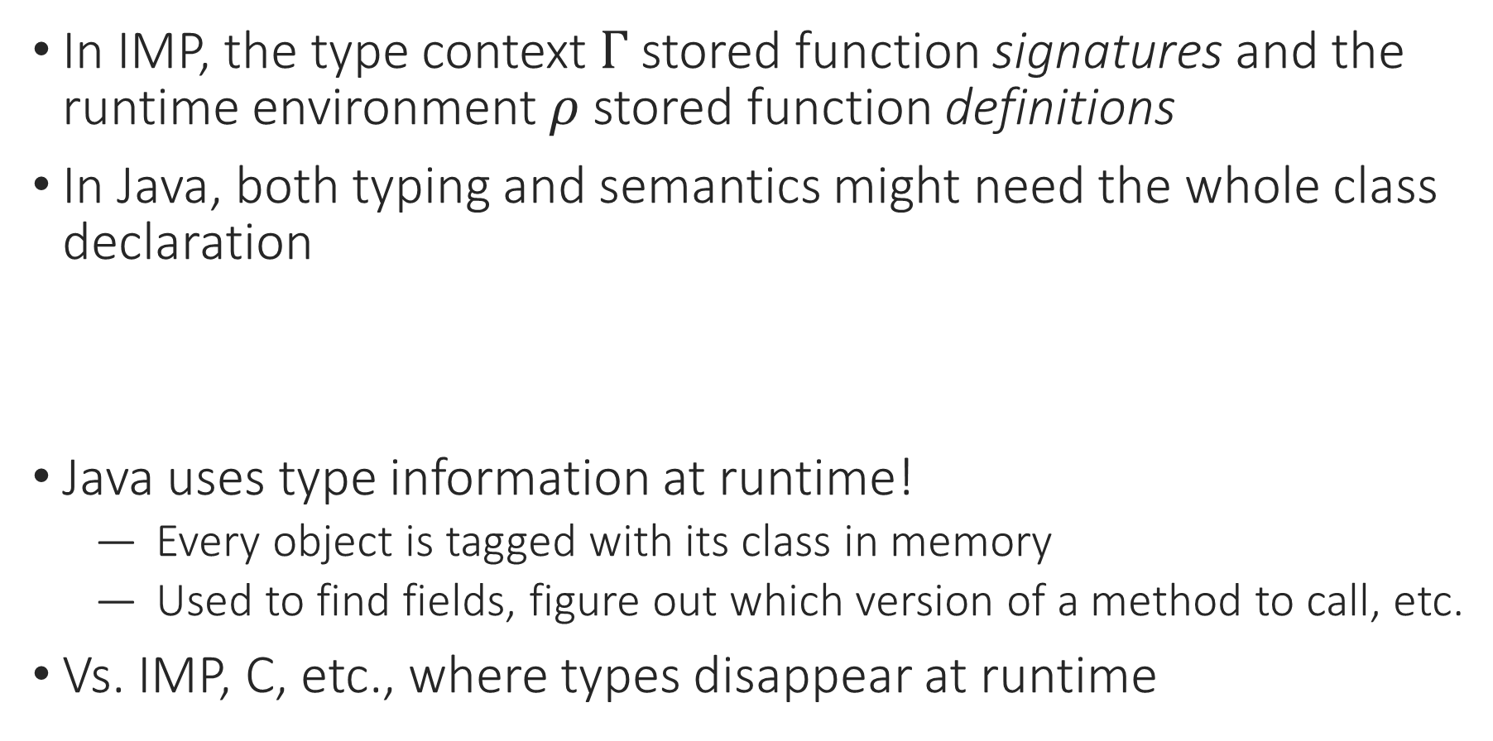
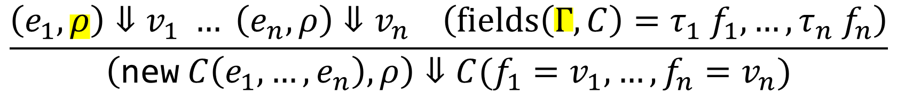
Java-Like Language: Contexts
In IMP, the type context $Γ$stored function signatures and the runtime environment $ρ$stored function definitions
In Java, both typing and semantics might need the whole class declaration
Java uses type information at runtime!
  Every object is tagged with its class in memory
  Used to find fields, figure out which version of a method to call, etc.
Vs. IMP, C, etc., where types disappear at runtime
$$\frac{\left(e_{1},ρ\right)⇓v_{1} … \left(e_{n},ρ\right)⇓v_{n} \left(fields\left(Γ,C\right)=τ_{1} f_{1},…,τ_{n} f_{n}\right)}{\left(\text{new} C\left(e_{1},…,e_{n}\right),ρ\right)⇓C({f_{1}=v}_{1},…,f_{n}=v_{n})}$$

Slide 10

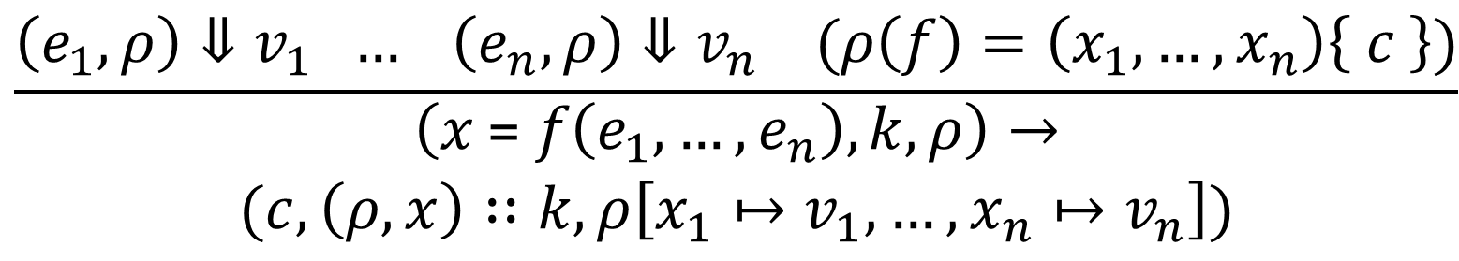
Functions: Semantics of Calls
Evaluate the arguments $e_{1},…,e_{n}$
Look up $f$ in $ρ$
Execute the body of $f$ and produce a return value
Assign the return value to $x$
$$\frac{\left(e_{1},ρ\right)⇓v_{1} … \left(e_{n},ρ\right)⇓v_{n} (ρ\left(f\right)=\left(x_{1},…,x_{n}\right)\left\{ c \right\})}{\begin{aligned}\left(x \text{=} f\left(e_{1},…, e_{n}\right),k,ρ\right)→ \\ (c,\left(ρ,x\right)∷k,ρ\left[x_{1}↦v_{1},…,x_{n}↦v_{n}\right])\end{aligned}}$$

Slide 11
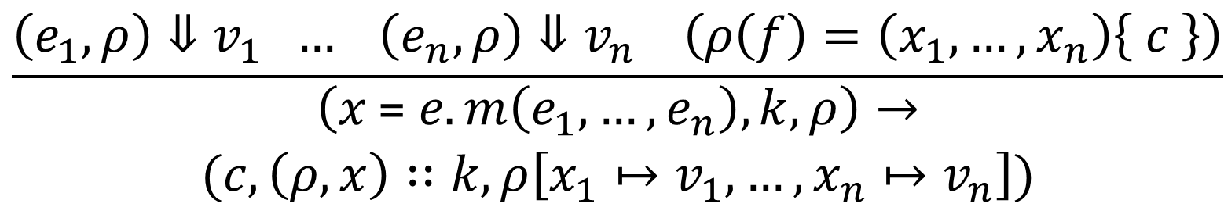
OO: Semantics of Methods
Evaluate the arguments $e_{1},…,e_{n}$
Look up $f$ in $ρ$
Execute the body of $f$ and produce a return value
Assign the return value to $x$
$$\frac{\left(e_{1},ρ\right)⇓v_{1} … \left(e_{n},ρ\right)⇓v_{n} \left(ρ\left(f\right)=\left(x_{1},…,x_{n}\right)\left\{ c \right\}\right)}{\begin{aligned}\left(x \text{=} e.m\left(e_{1},…, e_{n}\right),k,ρ\right)→ \\ (c,\left(ρ,x\right)∷k,ρ\left[x_{1}↦v_{1},…,x_{n}↦v_{n}\right])\end{aligned}}$$

Slide 12
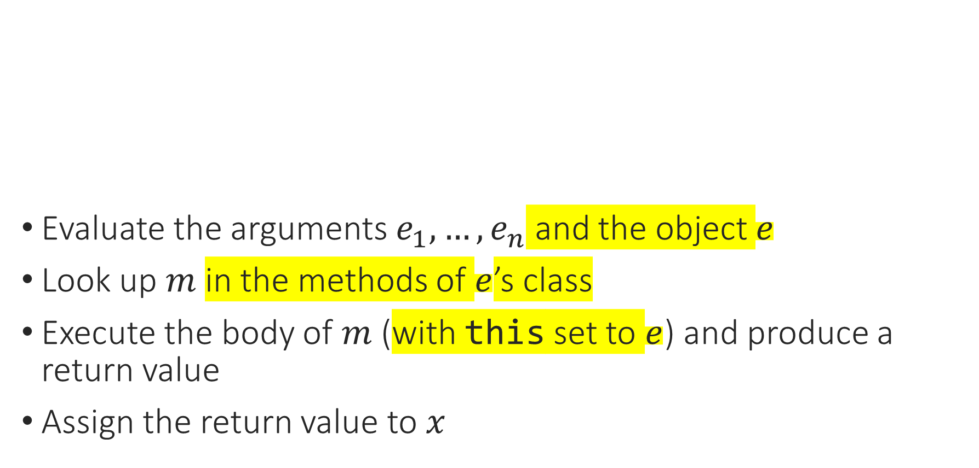
OO: Semantics of Methods
Evaluate the arguments $e_{1},…,e_{n}$ and the object $e$
Look up $m$ in the methods of $e$’s class
Execute the body of $m$ (with $\text{this}$ set to $e$) and produce a return value
Assign the return value to $x$
$$\frac{\left(e_{1},ρ\right)⇓v_{1} … \left(e_{n},ρ\right)⇓v_{n} \left(ρ\left(f\right)=\left(x_{1},…,x_{n}\right)\left\{ c \right\}\right)}{\begin{aligned}\left(x \text{=} e.m\left(e_{1},…, e_{n}\right),k,ρ\right)→ \\ (c,\left(ρ,x\right)∷k,ρ\left[x_{1}↦v_{1},…,x_{n}↦v_{n}\right])\end{aligned}}$$

Slide 13
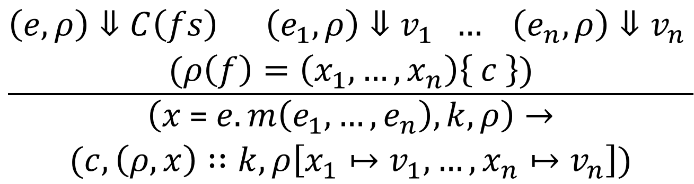
OO: Semantics of Methods
Evaluate the arguments $e_{1},…,e_{n}$ and the object $e$
Look up $m$ in the methods of $e$’s class
Execute the body of $m$ (with $\text{this}$ set to $e$) and produce a return value
Assign the return value to $x$
$$\frac{\begin{aligned}\left(e,ρ\right)⇓C\left(fs\right) \left(e_{1},ρ\right)⇓v_{1} … \left(e_{n},ρ\right)⇓v_{n} \\ (ρ\left(f\right)=\left(x_{1},…,x_{n}\right)\left\{ c \right\})\end{aligned}}{\begin{aligned}\left(x \text{=} e.m\left(e_{1},…, e_{n}\right),k,ρ\right)→ \\ (c,\left(ρ,x\right)∷k,ρ\left[x_{1}↦v_{1},…,x_{n}↦v_{n}\right])\end{aligned}}$$

Slide 14
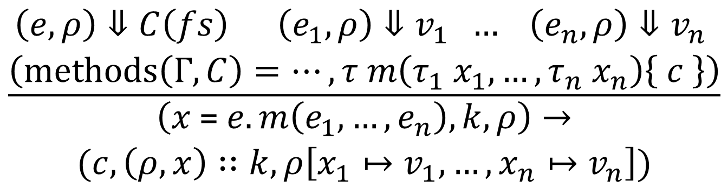
OO: Semantics of Methods
Evaluate the arguments $e_{1},…,e_{n}$ and the object $e$
Look up $m$ in the methods of $e$’s class
Execute the body of $m$ (with $\text{this}$ set to $e$) and produce a return value
Assign the return value to $x$
$$\frac{\begin{aligned}\left(e,ρ\right)⇓C\left(fs\right) \left(e_{1},ρ\right)⇓v_{1} … \left(e_{n},ρ\right)⇓v_{n} \\ \left(methods\left(Γ,C\right)=…,τ m\left(τ_{1} x_{1},…,τ_{n} x_{n}\right)\left\{ c \right\}\right)\end{aligned}}{\begin{aligned}\left(x \text{=} e.m\left(e_{1},…, e_{n}\right),k,ρ\right)→ \\ (c,\left(ρ,x\right)∷k,ρ\left[x_{1}↦v_{1},…,x_{n}↦v_{n}\right])\end{aligned}}$$

Slide 15
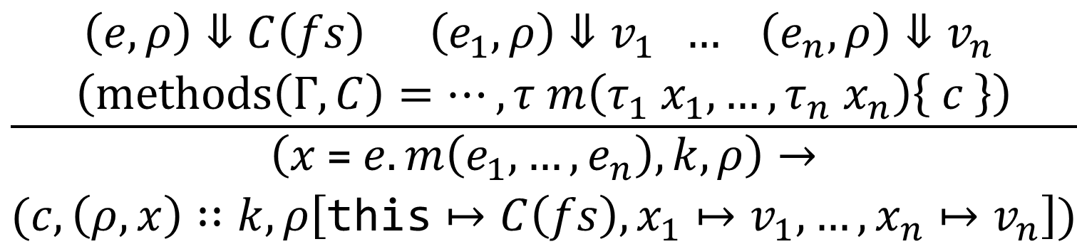
OO: Semantics of Methods
Evaluate the arguments $e_{1},…,e_{n}$ and the object $e$
Look up $m$ in the methods of $e$’s class
Execute the body of $m$ (with $\text{this}$ set to $e$) and produce a return value
Assign the return value to $x$
$$\frac{\begin{aligned}\left(e,ρ\right)⇓C\left(fs\right) \left(e_{1},ρ\right)⇓v_{1} … \left(e_{n},ρ\right)⇓v_{n} \\ \left(methods\left(Γ,C\right)=…,τ m\left(τ_{1} x_{1},…,τ_{n} x_{n}\right)\left\{ c \right\}\right)\end{aligned}}{\begin{aligned}\left(x \text{=} e.m\left(e_{1},…, e_{n}\right),k,ρ\right)→ \\ (c,\left(ρ,x\right)∷k,ρ\left[{\text{this}↦C\left(fs\right),x}_{1}↦v_{1},…,x_{n}↦v_{n}\right])\end{aligned}}$$

Slide 16
Notes:
Poll Title: Do not modify the notes in this section to avoid tampering with the Poll Everywhere activity.
More info at polleverywhere.com/support
Questions
https://www.polleverywhere.com/discourses/SRzwhp4zztmGWgIgz520A

Slide 17
Java-Like Language: Casts
Building build(Building model);
class School extends Building
School s = new School();
s2 = w.build((Building) s);
((School) s2).getCourse();
Exercise: When can we cast from one class to another?

Slide 18
Java-Like Language: Casts
Building build(Building model);
class School extends Building
School s = new School();
s2 = w.build((Building) s);
// upcast from School to Building
((School) s2).getCourse();
// downcast from Building to School

Slide 19
Java-Like Language: Casts
Upcast: always safe, doesn’t do anything
Downcast: safe only if object actually has the right type – we might not know until runtime
Other casts: ??
B b = new B();
A a = (A) b;
Notes:
In Java, this is actually a type error.

Slide 20
Java-Like Language: Casts
Upcast: always safe, doesn’t do anything
Downcast: safe only if object actually has the right type – we might not know until runtime
Other casts: ??
B b = new B();
A a = (A) ((Object) b);
Notes:
But that’s kind of inconsistent, since all objects are related – at the least, they’re all subclasses of Object.
In fact, this program will end up casting b to A regardless, and won’t give a compile-time type error.

Slide 21
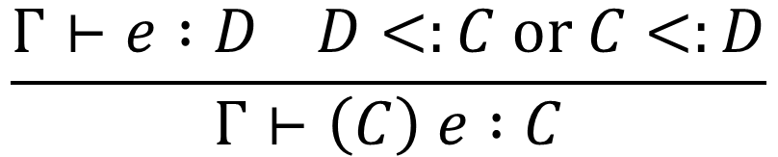
Java-Like Language: Casts
Upcast: always safe, doesn’t do anything
Downcast: safe only if object actually has the right type – we might not know until runtime
Other casts: never work, but users can write them anyway
B b = new B();
A a = (A) ((Object) b);
$$\frac{Γ⊢e :D D<:C or C<:D}{Γ⊢\left(C\right) e :C}$$
Notes:
But maybe this isn’t as much of a “type error” as the other rules.

Slide 22
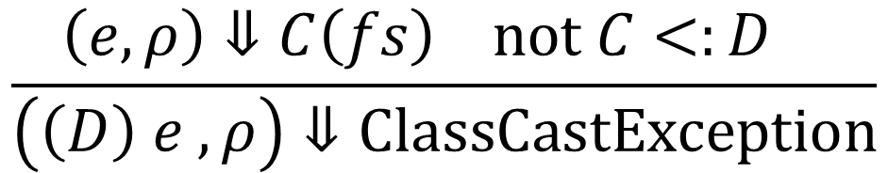
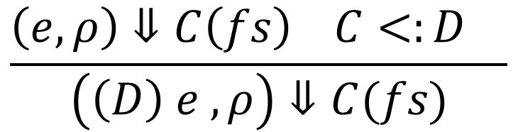
Java-Like Language: Casts
Upcast: always safe, doesn’t do anything
Downcast: safe only if object actually has the right type
At runtime, we know the object’s specific type!
$$\frac{\left(e,ρ\right)⇓C\left(fs\right) C<:D }{\left(\left(D\right) e ,ρ\right)⇓C(fs)}$$
$$\frac{\left(e,ρ\right)⇓C\left(fs\right) not C<:D }{\left(\left(D\right) e ,ρ\right)⇓ClassCastException}$$

Slide 23
Notes:
Poll Title: Do not modify the notes in this section to avoid tampering with the Poll Everywhere activity.
More info at polleverywhere.com/support
Questions
https://www.polleverywhere.com/discourses/SRzwhp4zztmGWgIgz520A

Slide 24
Java-Like Language: Syntax
CL ::= class <id> extends <id> { T <id>; …; T <id>; M … M }
M ::= T <id>(T <id>, …, T <id>){ C }
P ::= CL … CL
E ::= <#> | E + E | <id> | … | E.<id>
C ::= <id> = E | … | <id> = E.<id>(E, …, E)
| <id> = new <id>(E, …, E)
T ::= int | <id>

Slide 25
Java-Like Language: Syntax
CL ::= class <id> extends <id> { T <id>; …; T <id>; M … M }
M ::= T <id>(T <id>, …, T <id>){ C }
P ::= CL … CL
E ::= <#> | E + E | <id> | … | E.<id>
C ::= <id> = E | … | <id> = E.<id>(E, …, E)
| <id> = new <id>(E, …, E) | E.<id> = E
T ::= int | <id>

Slide 26
Objects vs. Values
We said “objects are values”
Objects: Values:
Point(x = 3, y = 5) 5, true, etc.
can be stored in variables can be stored in variables
have pieces that can change can’t change
different objects can have the if the value is the same,
same values in them they’re equal

Slide 27
Objects vs. Values
We said “objects are values”, but they’re also like variables!
Objects: Values:
Point(x = 3, y = 5) 5, true, etc.
can be stored in variables can be stored in variables
have pieces that can change can’t change
different objects can have the if the value is the same,
same values in them they’re equal

Slide 28
Java-Like Language: Mutable Objects
Our language so far has no field-set operation!
A a1 = new A(3, 5);
A a2 = a1;
a1.x = 4;
int result = a2.x;
Exercise: What should the value of result be?
Notes:
This is actually the same problem as with pointers in C: the problem known as “aliasing”.

Slide 29
Java-Like Language: Mutable Objects
Our language so far has no field-set operation!
A a1 = new A(3, 5);
A a2 = a1;
a1.x = 4;
int result = a2.x; // should be 4
Notes:
This is actually the same problem as with pointers in C: the problem known as “aliasing”.

Slide 30
Java-Like Language: Mutable Objects
Our language so far has no field-set operation!
A a1 = new A(3, 5); {a1 = A(x = 3, y = 5)}
A a2 = a1;
a1.x = 4;
int result = a2.x; // should be 4
Notes:
This is actually the same problem as with pointers in C: the problem known as “aliasing”.

Slide 31
Java-Like Language: Mutable Objects
Our language so far has no field-set operation!
A a1 = new A(3, 5); {a1 = A(x = 3, y = 5)}
A a2 = a1; {a1 = A(x = 3, y = 5), a2 = A(x = 3, y = 5))}
a1.x = 4;
int result = a2.x; // should be 4
Notes:
This is actually the same problem as with pointers in C: the problem known as “aliasing”.

Slide 32
Java-Like Language: Mutable Objects
Our language so far has no field-set operation!
A a1 = new A(3, 5); {a1 = A(x = 3, y = 5)}
A a2 = a1; {a1 = A(x = 3, y = 5), a2 = A(x = 3, y = 5)}
a1.x = 4; {a1 = A(x = 4, y = 5), a2 = A(x = 3, y = 5)}
int result = a2.x; // should be 4
Notes:
This is actually the same problem as with pointers in C: the problem known as “aliasing”.

Slide 33
Java-Like Language: Mutable Objects
Our language so far has no field-set operation!
A a1 = new A(3, 5); {a1 = r1, r1 -> A(x = 3, y = 5)}
A a2 = a1; {a1 = r1, a2 = r1, r1 -> A(x = 3, y = 5)}
a1.x = 4; {a1 = r1, a2 = r1, r1 -> A(x = 4, y = 5)}
int result = a2.x; // should be 4
a1 = new A(6, 7); {a1 = r2, a2 = r1, r1 -> A(x = 4, y = 5),
r2 -> A(x = 6, y = 7)}
Two-level model: variables hold references, references point to values
Notes:
This is actually the same problem as with pointers in C: the problem known as “aliasing”.

Slide 34
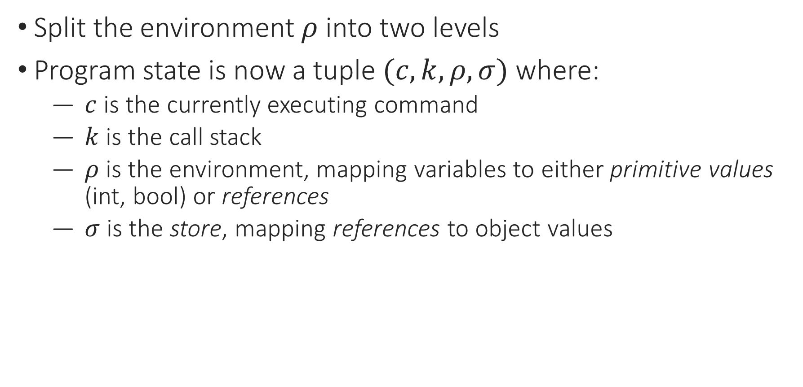
Java-Like Language: Mutable Objects
Split the environment $ρ$ into two levels
Program state is now a tuple $(c,k,ρ,σ)$ where:
  $c$ is the currently executing command
  $k$ is the call stack
  $ρ$ is the environment, mapping variables to either primitive values (int, bool) or references
  $σ$ is the store, mapping references to object values
Notes:
This is actually the same problem as with pointers in C: the problem known as “aliasing”.

Slide 35
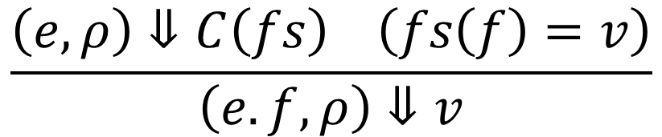
Java-Like Language: Semantics
$$\frac{\left(e,ρ\right)⇓C\left(fs\right) \left(fs\left(f\right)=v\right)}{\left(e.f,ρ\right)⇓v}$$

Slide 36

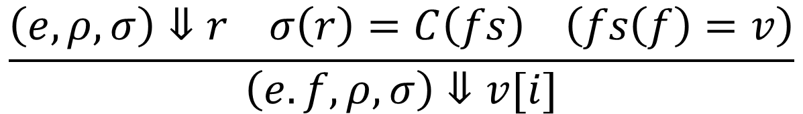
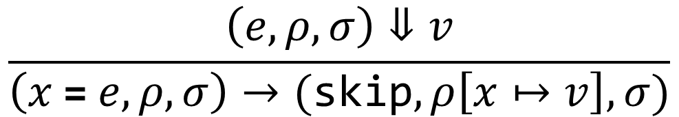
Java-Like Language: Semantics
$$\frac{\left(e,ρ,σ\right)⇓r σ\left(r\right)=C\left(fs\right) \left(fs\left(f\right)=v\right)}{\left(e.f,ρ,σ\right)⇓v[i]}$$
$$\frac{\left(ρ\left(x\right)=v\right)}{\left(x,ρ,σ\right)⇓v}$$
$$\frac{\left(e,ρ,σ\right)⇓v}{\left(x \text{=} e,ρ,σ\right)→(\text{skip},ρ\left[x↦v\right],σ)}$$

Slide 37
Java-Like Language: Semantics
$$\frac{\left(e_{1},ρ\right)⇓v_{1} … \left(e_{n},ρ\right)⇓v_{n} \left(fields\left(Γ,C\right)=τ_{1} f_{1},…,τ_{n} f_{n}\right)}{\left(\text{new} C\left(e_{1},…,e_{n}\right),ρ\right)⇓C(f_{1}=v_{1},…,f_{n}=v_{n})}$$

Slide 38
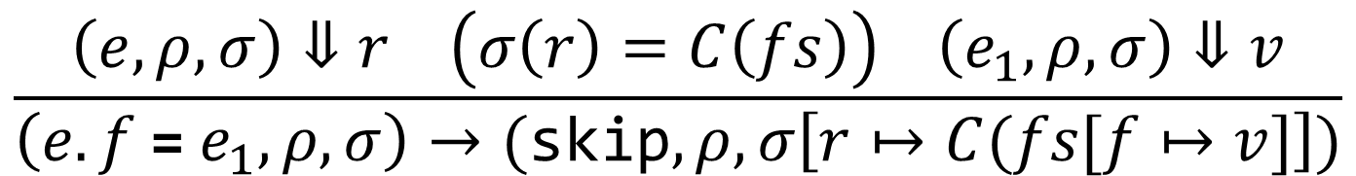
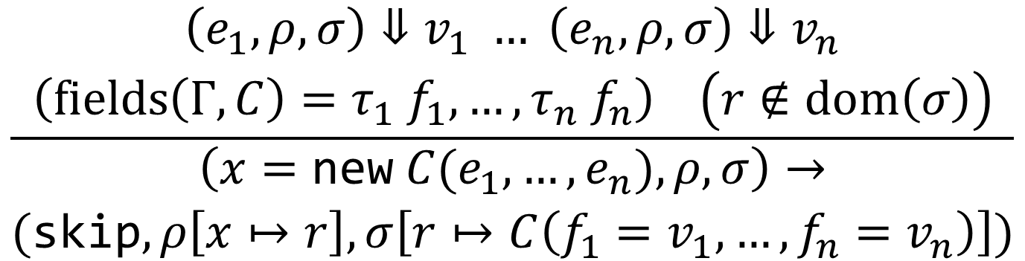
Java-Like Language: Semantics
$$\frac{\begin{aligned}\left(e_{1},ρ,σ\right)⇓v_{1} … \left(e_{n},ρ,σ\right)⇓v_{n} \\ \left(fields\left(Γ,C\right)=τ_{1} f_{1},…,τ_{n} f_{n}\right) \left(r∉dom\left(σ\right)\right)\end{aligned}}{\begin{aligned}\left(x=\text{new} C(e_{1},…,e_{n}),ρ,σ\right)→ \\ (\text{skip},ρ\left[x↦r\right],σ\left[r↦C\left({f_{1}=v}_{1},…,{f_{n}=v}_{n}\right)\right])\end{aligned}}$$
$$\frac{\left(e,ρ,σ\right)⇓r \left(σ\left(r\right)=C\left(fs\right)\right) \left(e_{1},ρ,σ\right)⇓v}{\left(e.f \text{=} e_{1},ρ,σ\right)→(\text{skip},ρ,σ\left[r↦C(fs[f↦v]\right])}$$

Slide 39
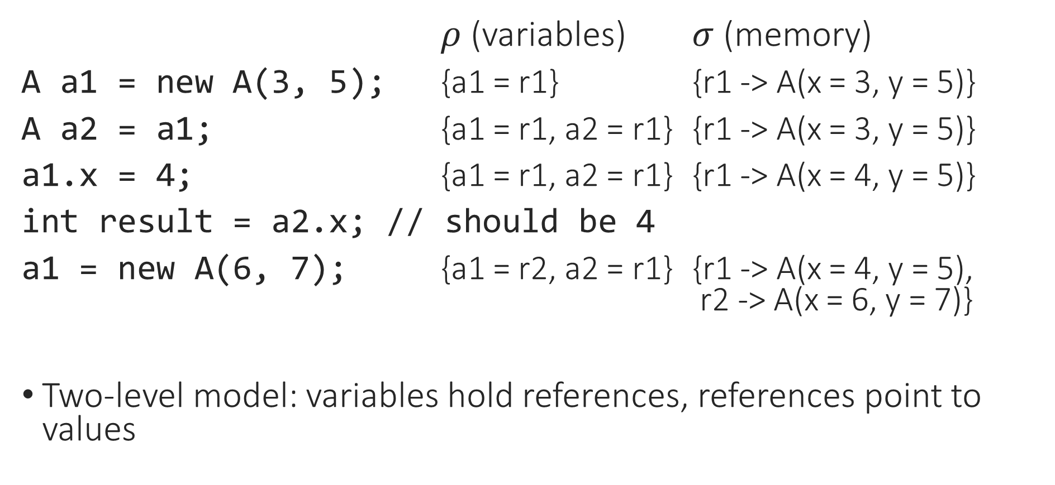
Java-Like Language: Mutable Objects
$ρ$ (variables) $σ$ (memory)
A a1 = new A(3, 5); {a1 = r1} {r1 -> A(x = 3, y = 5)}
A a2 = a1; {a1 = r1, a2 = r1} {r1 -> A(x = 3, y = 5)}
a1.x = 4; {a1 = r1, a2 = r1} {r1 -> A(x = 4, y = 5)}
int result = a2.x; // should be 4
a1 = new A(6, 7); {a1 = r2, a2 = r1} {r1 -> A(x = 4, y = 5),
r2 -> A(x = 6, y = 7)}
Two-level model: variables hold references, references point to values
Notes:
This is actually the same problem as with pointers in C: the problem known as “aliasing”.

Slide 40
Notes:
Poll Title: Do not modify the notes in this section to avoid tampering with the Poll Everywhere activity.
More info at polleverywhere.com/support
Questions
https://www.polleverywhere.com/discourses/SRzwhp4zztmGWgIgz520A

Slide 41
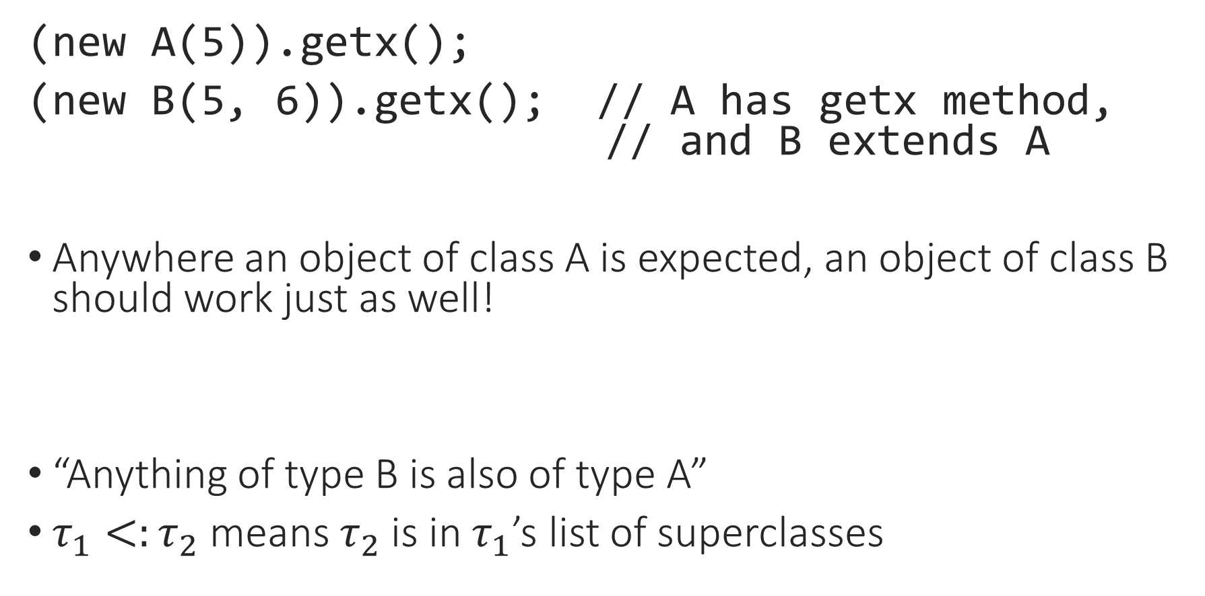
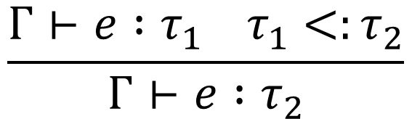
Subtyping and Assignment
(new A(5)).getx();
(new B(5, 6)).getx(); // A has getx method,
// and B extends A
Anywhere an object of class A is expected, an object of class B should work just as well!
“Anything of type B is also of type A”
$τ_{1}<:τ_{2}$ means $τ_{2}$ is in $τ_{1}$’s list of superclasses
$$\frac{Γ⊢e :τ_{1} τ_{1}<:τ_{2}}{Γ⊢e :τ_{2}}$$
Notes:
This is a contrast to our old type system, where we had two types, int and bool, that were totally unrelated (something could be an int or a bool but not both).

Slide 42
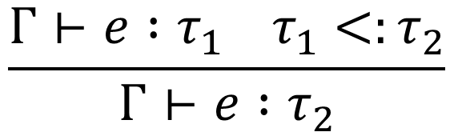
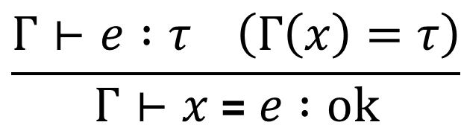
Subtyping and Assignment
Square a;
…
Shape b = a;
a’s most specific type is Square, but it also has type Shape
type_of gamma e : typ = … (* returns most specific type *)
typecheck gamma e typ : bool = … (* checks whether e : typ at all *)
$$\frac{Γ⊢e :τ \left(Γ\left(x\right)=τ\right)}{Γ⊢x \text{=} e :ok}$$
$$\frac{Γ⊢e :τ_{1} τ_{1}<:τ_{2}}{Γ⊢e :τ_{2}}$$
Notes:
Implement

Slide 43
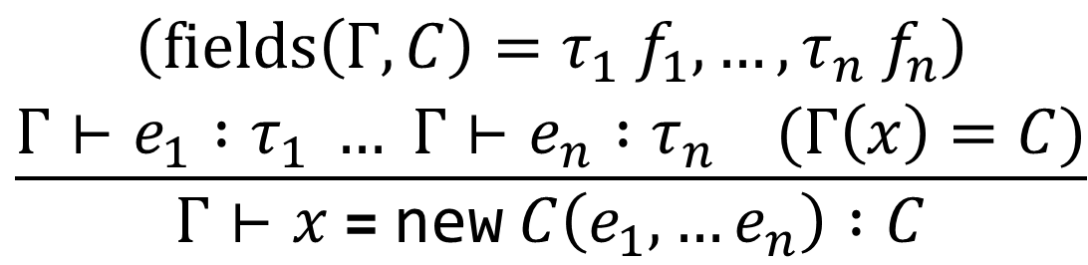
Subtyping and Assignment
Shape a = new Square();
$$\frac{Γ⊢e :τ \left(Γ\left(x\right)=τ\right)}{Γ⊢x \text{=} e :ok}$$
$$\frac{Γ⊢e :τ_{1} τ_{1}<:τ_{2}}{Γ⊢e :τ_{2}}$$
$$\frac{\begin{aligned}\left(fields\left(Γ,C\right)=τ_{1} f_{1},…,τ_{n} f_{n}\right) \\ Γ⊢e_{1} :τ_{1} … Γ⊢e_{n} :τ_{n} (Γ\left(x\right)=C)\end{aligned}}{Γ⊢x \text{=} \text{new} C\left(e_{1},…e_{n}\right) :C}$$

Slide 44
Subtyping and Assignment
Shape a = new Square();
$$\frac{Γ⊢e :τ \left(Γ\left(x\right)=τ\right)}{Γ⊢x \text{=} e :ok}$$
$$\frac{Γ⊢e :τ_{1} τ_{1}<:τ_{2}}{Γ⊢e :τ_{2}}$$
$$\frac{\begin{aligned}\left(fields\left(Γ,C\right)=τ_{1} f_{1},…,τ_{n} f_{n}\right) \\ Γ⊢e_{1} :τ_{1} … Γ⊢e_{n} :τ_{n} (Γ\left(x\right)=C)\end{aligned}}{Γ⊢x \text{=} \text{new} C\left(e_{1},…e_{n}\right) :C}$$

Slide 45
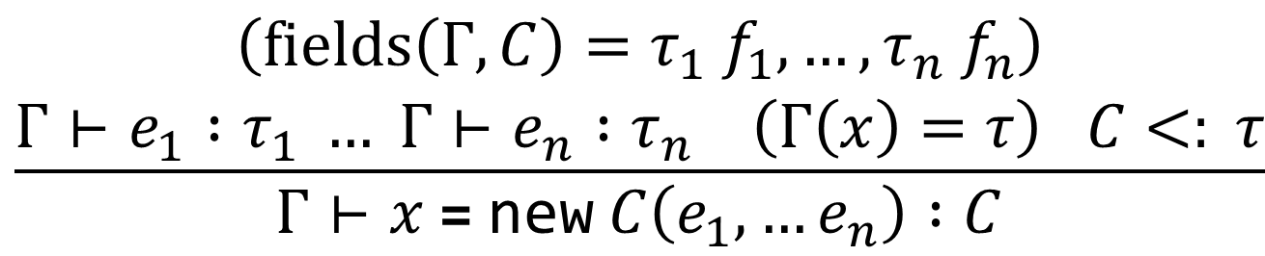
Subtyping and Assignment
Shape a = new Square();
$$\frac{Γ⊢e :τ \left(Γ\left(x\right)=τ\right)}{Γ⊢x \text{=} e :ok}$$
$$\frac{Γ⊢e :τ_{1} τ_{1}<:τ_{2}}{Γ⊢e :τ_{2}}$$
$$\frac{\begin{aligned}\left(fields\left(Γ,C\right)=τ_{1} f_{1},…,τ_{n} f_{n}\right) \\ Γ⊢e_{1} :τ_{1} … Γ⊢e_{n} :τ_{n} \left(Γ\left(x\right)=τ\right) C<: τ\end{aligned}}{Γ⊢x \text{=} \text{new} C\left(e_{1},…e_{n}\right) :C}$$

Slide 46
Notes:
Poll Title: Do not modify the notes in this section to avoid tampering with the Poll Everywhere activity.
More info at polleverywhere.com/support
Questions
https://www.polleverywhere.com/discourses/SRzwhp4zztmGWgIgz520A

Slide 47
Homework 5 Overview
Syntax: types, expressions, commands, declarations
Records in OCaml
Field and method lookup
type_of and typecheck_cmd

