Slide 1
CS 476 – Programming Language Design
William Mansky

Slide 2

Notes:
Poll Title: Do not modify the notes in this section to avoid tampering with the Poll Everywhere activity.
More info at polleverywhere.com/support
Questions
https://www.polleverywhere.com/discourses/SRzwhp4zztmGWgIgz520A

Slide 3
Imperative Languages
Arithmetic and boolean expressions
Variables and assignment
Control flow (conditionals, loops)
Variable declarations
Function declarations and calls

Slide 4
Object-Oriented Imperative Languages
Arithmetic and boolean expressions
Variables and assignment
Control flow (conditionals, loops)
Variable declarations
Function declarations and calls
Objects and classes
Exercise: What is an object in a programming language?
Notes:
Not all OO languages are imperative, but many of them are (Java most well known).

Slide 5
Object-Oriented Programming
An object is a kind of value
Objects have fields (object-specific variables) and methods (object-specific functions)
o ox := o.getx();
o.sety(ox);
Name | Value
x | 3
y | 5
getx() | return x;
sety(n) | y := n;
Notes:
I’m going to use Java-like syntax (but the principles apply to other OO languages too).

Slide 6
Object-Oriented Programming
An object is a kind of value
Objects have fields (object-specific variables) and methods (object-specific functions)
Different objects may provide the same method but have different code for it (dynamic dispatch)
o o2 o.getx();
o2.getx();
Name | Value
x | 3
y | 3
getx() | return x;
sety(n) | y := n;
Name | Value
r | 4
theta | pi/4
getx() | return r * cos(theta);
sety(n) | …
Notes:
I’m going to use Java-like syntax (but the principles apply to other OO languages too).

Slide 7
Object-Oriented Programming
An object is a kind of value
Objects have fields (object-specific variables) and methods (object-specific functions)
Different objects may provide the same method but have different code for it (dynamic dispatch)
We can only access a field/method by going through its object
An object may belong to a class, which describes a list of fields and methods the object contains
Classes may have subclasses, which extend them with more fields and methods
Notes:
Not all OO languages have classes, but most popular ones do.

Slide 8
Java-Like Language: Classes
class Square extends Shape {
int side;
int area(){
return this.side *
this.side;
}
}
Square s = new Square(3);
int x = s.area();
// x will be 9
Name | Value
side | 3

Slide 9
Java-Like Language: Syntax
CL ::= class <id> extends <id> { T <id>; …; T <id>; M … M }
M ::= T <id>(T <id>, …, T <id>){ C }
P ::= CL … CL
E ::= <#> | E + E | <id> | … | E.<id>
C ::= <id> = E | … | <id> = E.<id>(E, …, E)
| <id> = new <id>(E, …, E)
T ::= int | <id>

Slide 10
Java-Like Language: Syntax
CL ::= class <id> extends <id> { T <id>; …; T <id>; M … M }
M ::= T <id>(T <id>, …, T <id>){ C }
P ::= CL … CL
E ::= <#> | E + E | <id> | … | E.<id>
C ::= <id> = E | … | <id> = E.<id>(E, …, E)
| <id> = new <id>(E, …, E)
T ::= int | <id>

Slide 11
Notes:
Poll Title: Do not modify the notes in this section to avoid tampering with the Poll Everywhere activity.
More info at polleverywhere.com/support
Questions
https://www.polleverywhere.com/discourses/SRzwhp4zztmGWgIgz520A

Slide 12
Java-Like Language: Subtyping
class A extends Object {
int x;
int getx(){
return this.x;
}
}
class B extends A {
int y;
int gety(){
return this.y;
}
}

Slide 13
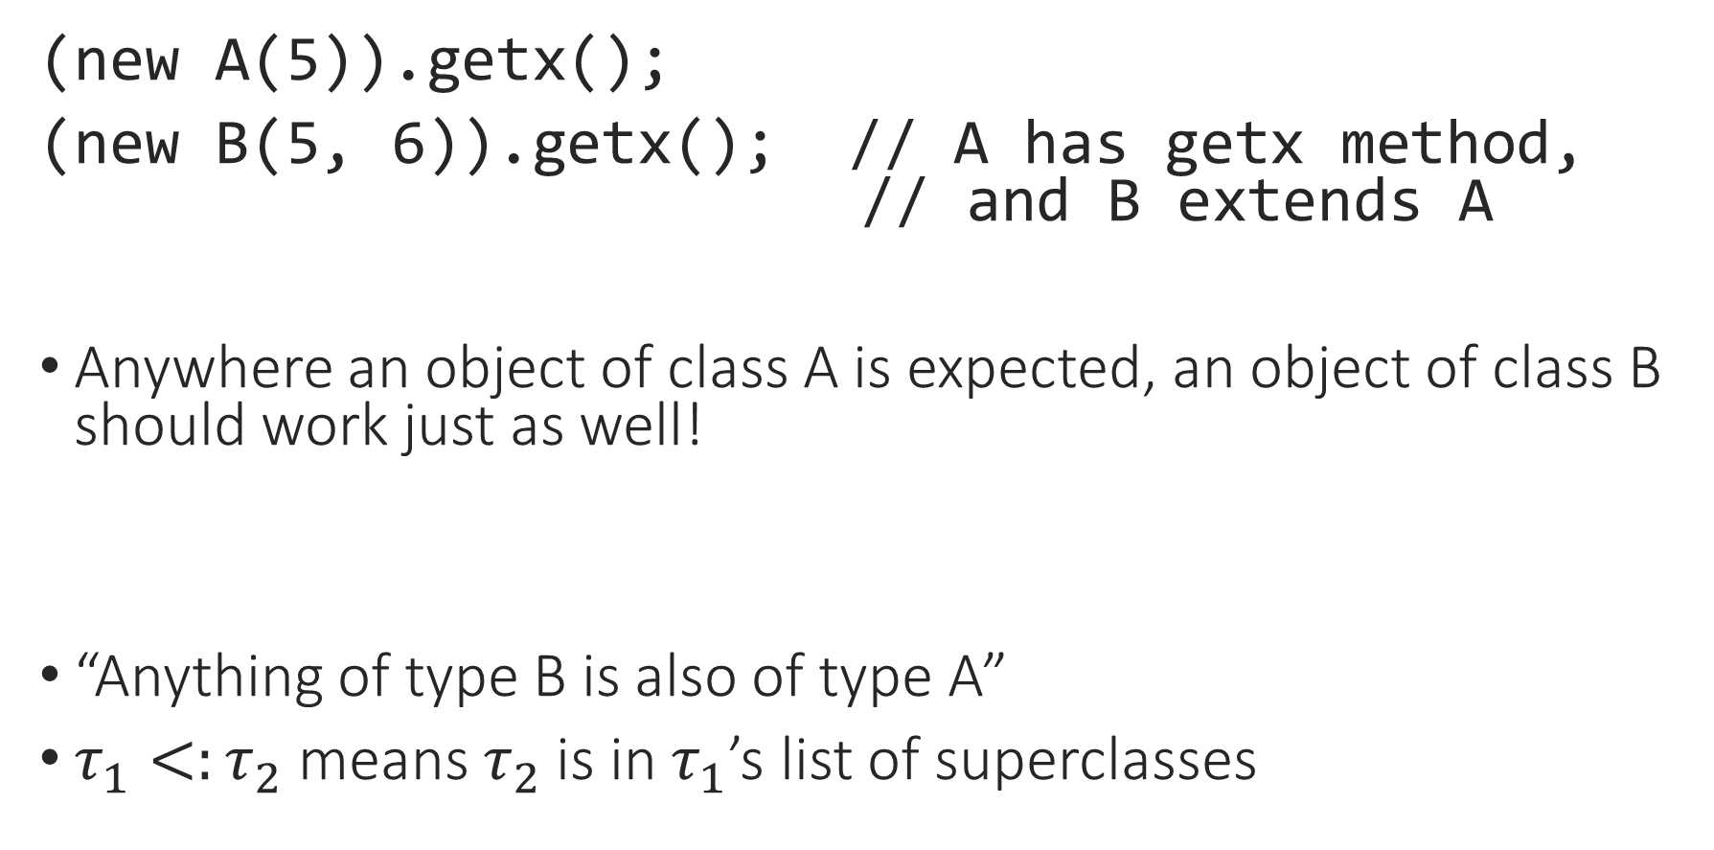
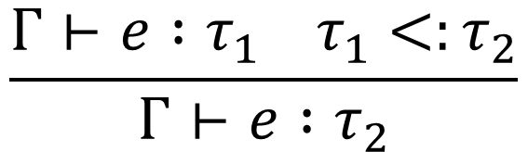
Java-Like Language: Subtyping
(new A(5)).getx();
(new B(5, 6)).getx(); // A has getx method,
// and B extends A
Anywhere an object of class A is expected, an object of class B should work just as well!
“Anything of type B is also of type A”
$τ_{1}<:τ_{2}$ means $τ_{2}$ is in $τ_{1}$’s list of superclasses
$$\frac{Γ⊢e :τ_{1} τ_{1}<:τ_{2}}{Γ⊢e :τ_{2}}$$
Notes:
This is a contrast to our old type system, where we had two types, int and bool, that were totally unrelated (something could be an int or a bool but not both).

Slide 14
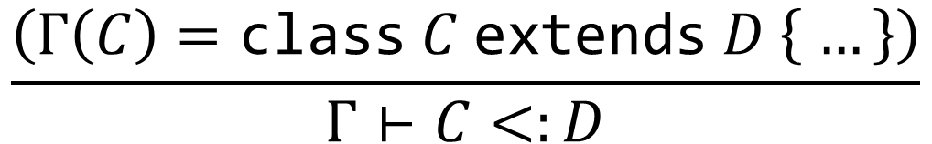

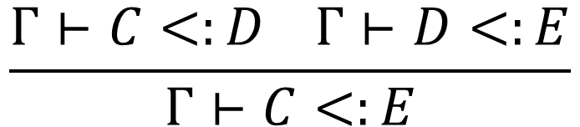
Java-Like Language: Subtyping
$$\frac{}{Γ⊢C<:C}$$
$$\frac{\left(Γ\left(C\right)=\text{class} C \text{extends} D \left\{ …\right\}\right)}{Γ⊢C<:D}$$
$$\frac{Γ⊢C<:D Γ⊢D<:E}{Γ⊢C<:E}$$
Notes:
Skip this, or present it as a list search?

Slide 15
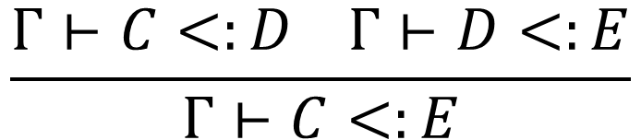
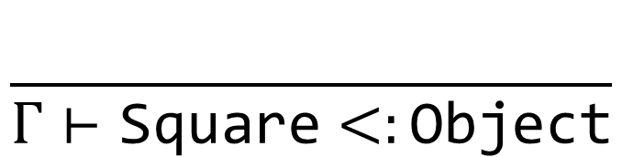
Java-Like Language: Subtyping
class Shape extends Object { … }
class Square extends Shape { … }
$$\frac{Γ⊢C<:D Γ⊢D<:E}{Γ⊢C<:E}$$
$$\frac{}{Γ⊢\text{Square}<:\text{Object}}$$

Slide 16
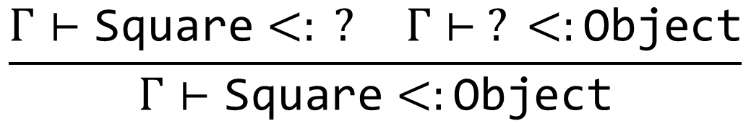
Java-Like Language: Subtyping
class Shape extends Object { … }
class Square extends Shape { … }
$$\frac{Γ⊢C<:D Γ⊢D<:E}{Γ⊢C<:E}$$
$$\frac{Γ⊢\text{Square}<: ? Γ⊢ ? <:\text{Object}}{Γ⊢\text{Square}<:\text{Object}}$$

Slide 17
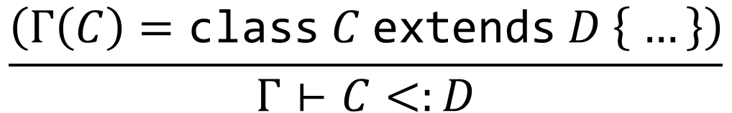
Java-Like Language: Subtyping
class Shape extends Object { … }
class Square extends Shape { … }
$$\frac{\left(Γ\left(C\right)=\text{class} C \text{extends} D \left\{ …\right\}\right)}{Γ⊢C<:D}$$
$$\frac{Γ⊢\text{Square}<: ? Γ⊢ ? <:\text{Object}}{Γ⊢\text{Square}<:\text{Object}}$$

Slide 18
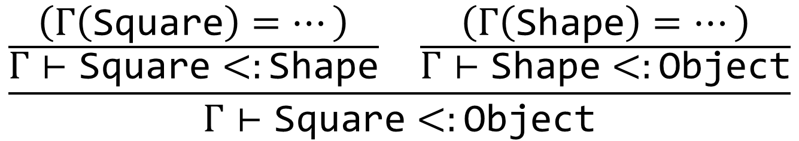
Java-Like Language: Subtyping
class Shape extends Object { … }
class Square extends Shape { … }
$$\frac{\left(Γ\left(C\right)=\text{class} C \text{extends} D \left\{ …\right\}\right)}{Γ⊢C<:D}$$
$$\frac{\frac{\left(Γ\left(\text{Square}\right)=…\right)}{Γ⊢\text{Square}<:\text{Shape}} \frac{\left(Γ\left(\text{Shape}\right)=…\right)}{Γ⊢\text{Shape}<:\text{Object}}}{Γ⊢\text{Square}<:\text{Object}}$$

Slide 19
Notes:
Poll Title: Do not modify the notes in this section to avoid tampering with the Poll Everywhere activity.
More info at polleverywhere.com/support
Questions
https://www.polleverywhere.com/discourses/SRzwhp4zztmGWgIgz520A

Slide 20

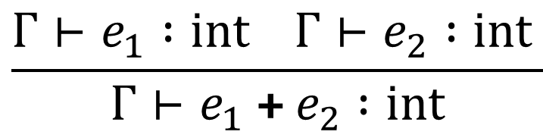
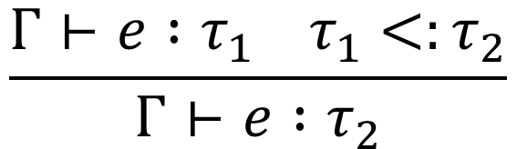
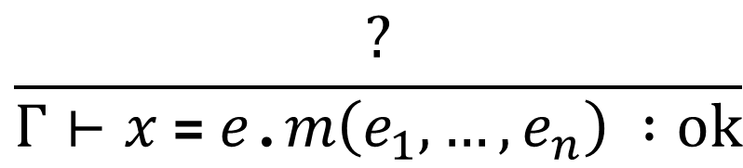
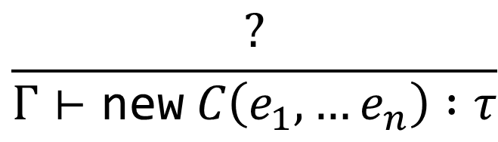
Java-Like Language: Types
Types: int, any class name
Rules:
$$\frac{{Γ⊢e}_{1} :int Γ⊢e_{2} :int }{{Γ⊢e}_{1} \text{+}{ e}_{2} :int}$$
$$\frac{Γ⊢e :τ_{1} τ_{1}<:τ_{2}}{Γ⊢e :τ_{2}}$$
$$\frac{?}{Γ⊢e\text{.}f :τ}$$
$$\frac{?}{Γ⊢\text{new} C\left(e_{1},…e_{n}\right) :τ}$$
$$\frac{?}{Γ⊢x \text{=} e\text{.}m\left(e_{1},…,e_{n}\right) :ok}$$

Slide 21

Java-Like Language: Types
Types: int, any class name
Exercise: When is a field access
type-correct?
$$\frac{?}{Γ⊢e\text{.}f :τ}$$
class A extends Object {
int x;
…
}
objA.x : int

Slide 22

Java-Like Language: Types
Types: int, any class name
$e$ is an object of a class $C$
$C$ has a field $f$ of type $τ$
$$\frac{?}{Γ⊢e\text{.}f :τ}$$
class A extends Object {
int x;
…
}
objA.x : int

Slide 23
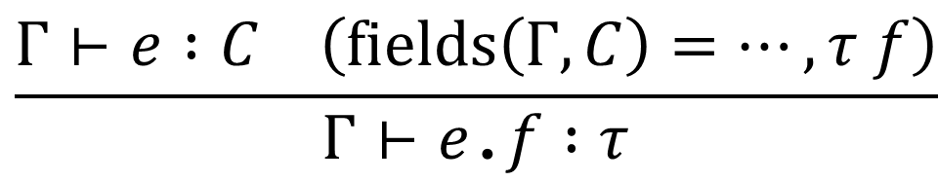
Java-Like Language: Types
Lists all the fields of C, its superclass, its superclass’s superclass, and so on up to Object
Types: int, any class name
$e$ is an object of a class $C$
$C$ has a field $f$ of type $τ$
$$\frac{Γ⊢e :C \left(fields\left(Γ,C\right)=…, τ f\right)}{Γ⊢e\text{.}f :τ}$$
class A extends Object {
int x;
…
}
objA.x : int

Slide 24
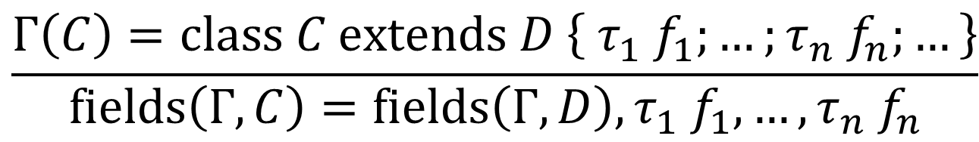
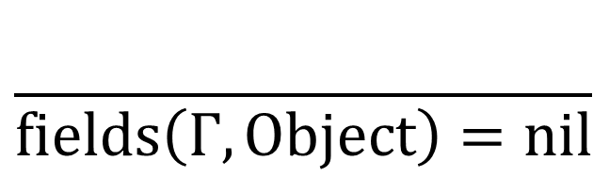
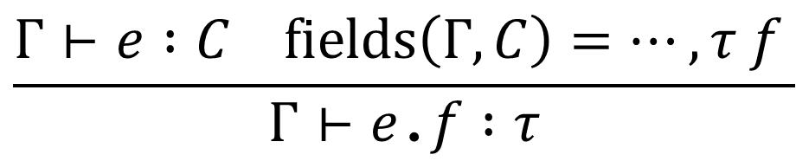
Java-Like Language: Fields
$$\frac{Γ⊢e :C fields\left(Γ,C\right)=…,τ f }{Γ⊢e\text{.}f :τ}$$
$$\frac{}{fields\left(Γ,Object\right)=nil}$$
$$\frac{Γ\left(C\right)=class C extends D \left\{ τ_{1} f_{1};…;τ_{n} f_{n};…\right\}}{fields\left(Γ,C\right)=fields\left(Γ, D\right), τ_{1} f_{1},…,τ_{n}{ f}_{n}}$$

Slide 25
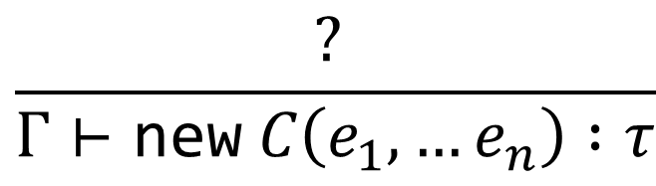
Java-Like Language: Types
Types: int, any class name
$$\frac{? }{Γ⊢\text{new} C\left(e_{1},…e_{n}\right) :τ}$$
class A extends Object {
int x;
}
new A(5) : ?

Slide 26
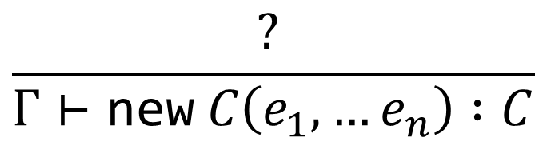
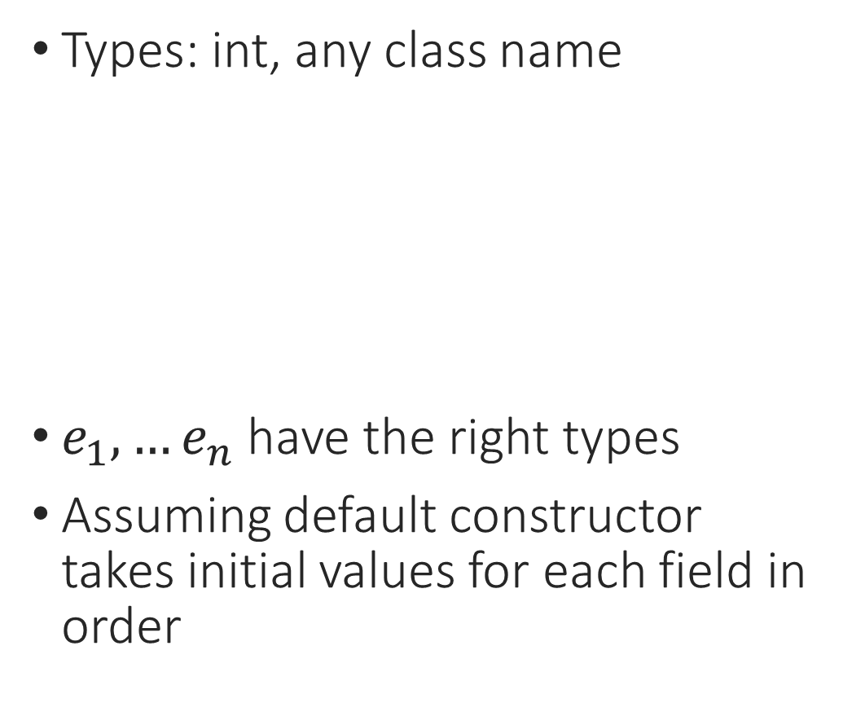
Java-Like Language: Types
Types: int, any class name
$e_{1},…e_{n}$ have the right types
Assuming default constructor takes initial values for each field in order
$$\frac{? }{Γ⊢\text{new} C\left(e_{1},…e_{n}\right) :C}$$
class A extends Object {
int x;
}
new A(5) : ?

Slide 27
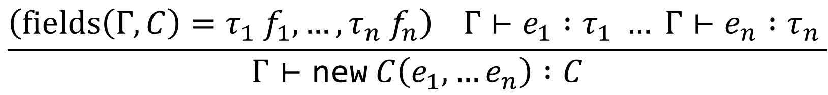

Java-Like Language: Types
Types: int, any class name
$e_{1},…e_{n}$ have the right types (the types of the fields of $C$, in order)
$$\frac{\left(fields\left(Γ,C\right)=τ_{1} f_{1},…,τ_{n} f_{n}\right) Γ⊢e_{1} :τ_{1} … Γ⊢e_{n} :τ_{n} }{Γ⊢\text{new} C\left(e_{1},…e_{n}\right) :C}$$
class A extends Object {
int x;
}
new A(5) : ?

Slide 28
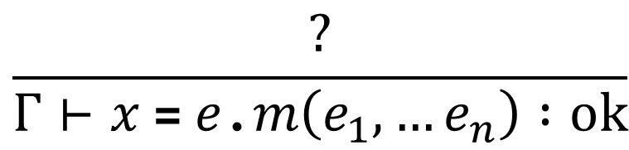

Java-Like Language: Types
Types: int, any class name
$e$ is an object of a class $C$
$C$ has a method $m$
args and return of $m$ are well typed
$$\frac{?}{Γ⊢x \text{=} e\text{.}m\left(e_{1},…e_{n}\right) :ok}$$
class A extends Object {
int x;
int getx(){
return this.x; }
}
y = objA.getx();

Slide 29
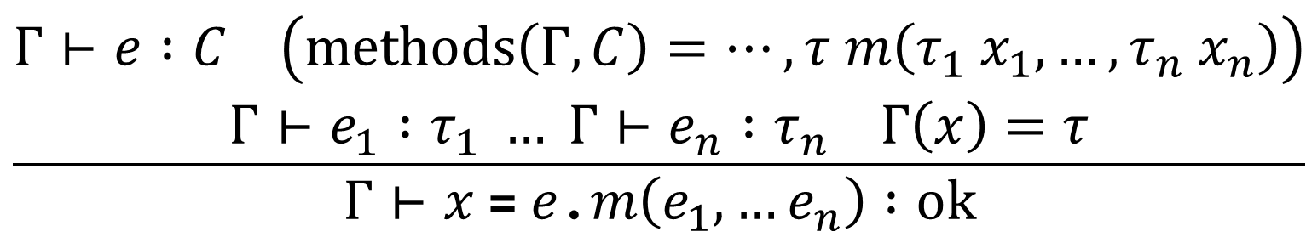
Java-Like Language: Types
Types: int, any class name
$e$ is an object of a class $C$
$C$ has a method $m$
args and return of $m$ are well typed
$$\frac{\begin{aligned}Γ⊢e :C \left(methods\left(Γ,C\right)=…, τ m\left(τ_{1} x_{1},…,τ_{n} x_{n}\right)\right) \\ Γ⊢e_{1} :τ_{1} … Γ⊢e_{n} :τ_{n} Γ\left(x\right)=τ\end{aligned}}{Γ⊢x \text{=} e\text{.}m\left(e_{1},…e_{n}\right) :ok}$$
class A extends Object {
int x;
int getx(){
return this.x; }
}
y = objA.getx();

Slide 30
Notes:
Poll Title: Do not modify the notes in this section to avoid tampering with the Poll Everywhere activity.
More info at polleverywhere.com/support
Questions
https://www.polleverywhere.com/discourses/SRzwhp4zztmGWgIgz520A

Slide 31

Java-Like Language: Declarations
In a Java-like language, all the code is in class declarations
CL ::= class <id> extends <id> { T <id>; …; T <id>; M … M }
We need to store all the class declarations in the context $Γ$, and then check that each method is type-correct

Slide 32
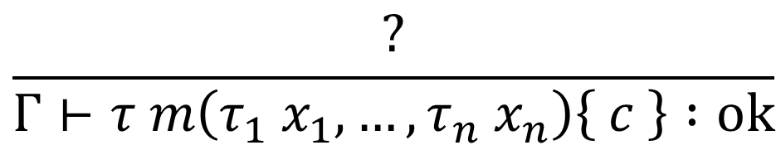
Java-Like Language: Declarations
class A extends Object {
int x;
int addx(int y){
return this.x + y;
}
}
$$\frac{?}{Γ⊢τ m\left(τ_{1} x_{1},…,τ_{n} x_{n}\right)\left\{ c \right\} :ok}$$

Slide 33
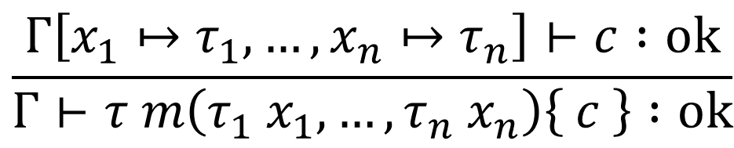
Java-Like Language: Declarations
class A extends Object {
int x;
int addx(int y){
return this.x + y;
}
}
A method declaration is typed like a function declaration: add the parameters to the context, then typecheck the body
$$\frac{Γ\left[x_{1}↦τ_{1},…,x_{n}↦τ_{n}\right]⊢c :ok}{Γ⊢τ m\left(τ_{1} x_{1},…,τ_{n} x_{n}\right)\left\{ c \right\} :ok}$$

Slide 34
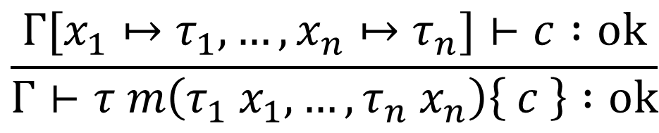
Java-Like Language: Declarations
class A extends Object {
int x;
int addx(int y){
return this.x + y;
}
}
A method declaration is typed like a function declaration: add the parameters to the context, then typecheck the body
$$\frac{Γ[x_{1}↦τ_{1},…,x_{n}↦τ_{n}]⊢c :ok}{Γ⊢τ m\left(τ_{1} x_{1},…,τ_{n} x_{n}\right)\left\{ c \right\} :ok}$$

Slide 35
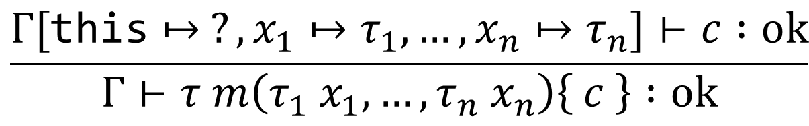
Java-Like Language: Declarations
class A extends Object {
int x;
int addx(int y){
return this.x + y;
}
}
A method declaration is typed like a function declaration: add the parameters to the context, then typecheck the body
Exercise: What is the type of “this”?
$$\frac{Γ[\text{this}↦ ?,x_{1}↦τ_{1},…,x_{n}↦τ_{n}]⊢c :ok}{Γ⊢τ m\left(τ_{1} x_{1},…,τ_{n} x_{n}\right)\left\{ c \right\} :ok}$$

Slide 36
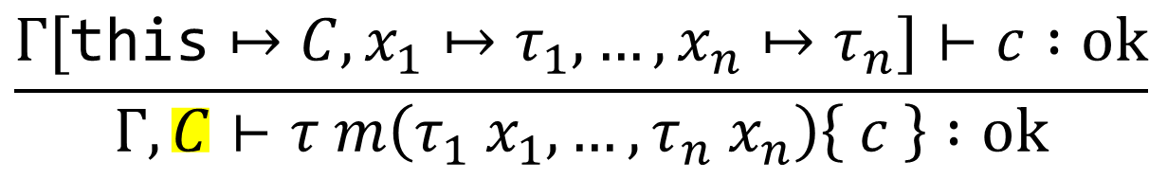
Java-Like Language: Declarations
class A extends Object {
int x;
int addx(int y){
return this.x + y;
}
}
A method declaration is typed like a function declaration
Except that it is called on an object
And it might be overriding a superclass’s method – some languages have additional restrictions in this case
$$\frac{Γ[\text{this}↦C,x_{1}↦τ_{1},…,x_{n}↦τ_{n}]⊢c :ok}{Γ,C⊢τ m\left(τ_{1} x_{1},…,τ_{n} x_{n}\right)\left\{ c \right\} :ok}$$
Notes:
“this” is a reference to the object that owns the method.

Slide 37
Java-Like Language: Overriding
class A extends Object {
int x;
int getval(){
return this.x;
}
}
class B extends A {
int y;
int getval(){
return this.x +
this.y;
}
}
Notes:
In some OO languages, this isn’t allowed.

Slide 38
Java-Like Language: Overriding
class A extends Object {
int x;
int getval(){
return this.x;
}
}
class B extends A {
int y;
int getval(int x){
return this.x +
this.y + z;
}
}
Notes:
In some OO languages, this isn’t allowed.

Slide 39
Java-Like Language: Overriding
class A extends Object {
int x;
int getval(A z){
return this.x;
}
}
class B extends A {
int y;
int getval(B z){
return this.x +
this.y + z;
}
}
Notes:
In some OO languages, this isn’t allowed.

Slide 40
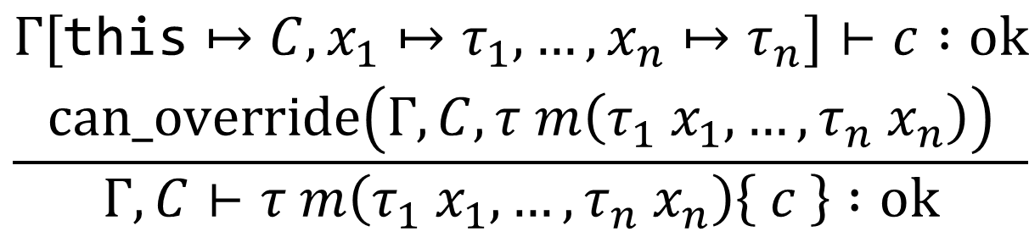
Java-Like Language: Declarations
A method declaration is typed like a function declaration
Except that it is called on an object
And it might be overriding a superclass’s method – some languages have additional restrictions in this case
$$\frac{\begin{aligned}Γ[\text{this}↦C,x_{1}↦τ_{1},…,x_{n}↦τ_{n}]⊢c :ok \\ can_override\left(Γ,C,τ m\left(τ_{1} x_{1},…,τ_{n} x_{n}\right)\right)\end{aligned}}{Γ,C⊢τ m\left(τ_{1} x_{1},…,τ_{n} x_{n}\right)\left\{ c \right\} :ok}$$
Notes:
“this” is a reference to the object that owns the method.

Slide 41
Notes:
Poll Title: Do not modify the notes in this section to avoid tampering with the Poll Everywhere activity.
More info at polleverywhere.com/support
Questions
https://www.polleverywhere.com/discourses/SRzwhp4zztmGWgIgz520A

Slide 42
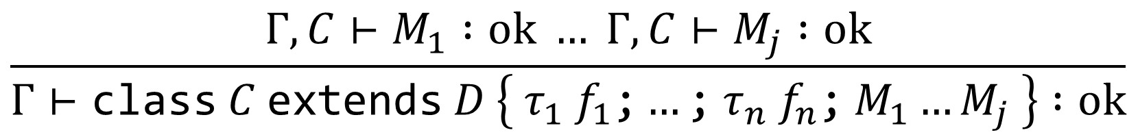
Java-Like Language: Declarations
A class declaration is well typed if all its methods are well typed
$$\frac{Γ,C⊢M_{1} :ok … Γ,C⊢M_{j} :ok}{Γ⊢\text{class} C \text{extends} D \left\{ τ_{1} f_{1}\text{;}…\text{;} τ_{n} f_{n}\text{;} M_{1}…M_{j} \right\} :ok}$$

Slide 43
Notes:
Poll Title: Do not modify the notes in this section to avoid tampering with the Poll Everywhere activity.
More info at polleverywhere.com/support
Questions
https://www.polleverywhere.com/discourses/SRzwhp4zztmGWgIgz520A

Slide 44
Object-Oriented Programming
An object is a kind of value
Objects have fields (object-specific variables) and methods (object-specific functions)
Different objects may provide the same method but have different code for it (dynamic dispatch)
We can only access a field/method by going through its object
An object may belong to a class, which describes a list of fields and methods the object contains
Classes may have subclasses, which extend them with more fields and methods
Notes:
Not all OO languages have classes, but most popular ones do.

Slide 45
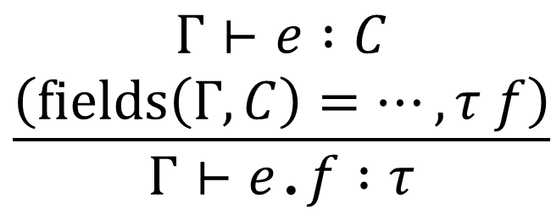
Java-Like Language: Access Modifiers
class B extends A {
private int y;
public int gety(){
return this.y;
}
public int addy(B b){
this.y = this.y + b.y;
}
}
$$\frac{\begin{aligned}Γ⊢e :C \\ \left(fields\left(Γ,C\right)=…, τ f\right)\end{aligned}}{Γ⊢e\text{.}f :τ}$$
B b1 = new B(1, 2);
b1.y = 5; // error

Slide 46
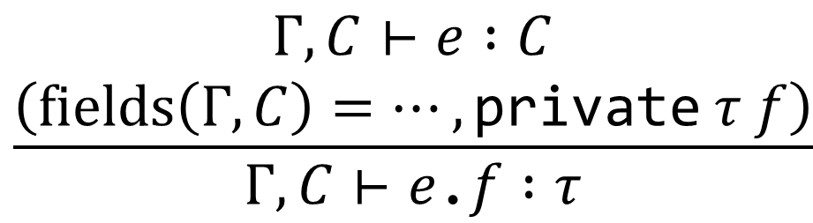
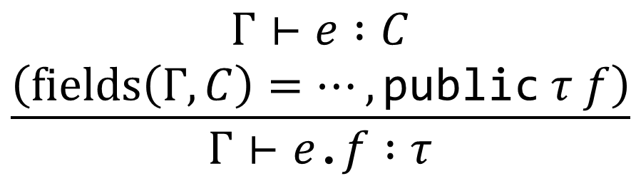
Java-Like Language: Access Modifiers
class B extends A {
private int y;
public int gety(){
return this.y;
}
public int addy(B b){
this.y = this.y + b.y;
}
}
$$\frac{\begin{aligned}Γ⊢e :C \\ \left(fields\left(Γ,C\right)=…, \text{public} τ f\right)\end{aligned}}{Γ⊢e\text{.}f :τ}$$
$$\frac{\begin{aligned}Γ,C⊢e :C \\ \left(fields\left(Γ,C\right)=…, \text{private} τ f\right)\end{aligned}}{Γ,C⊢e\text{.}f :τ}$$

Slide 47
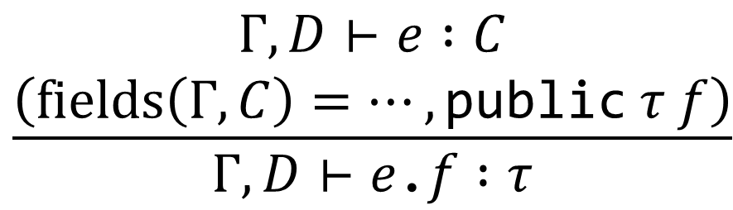
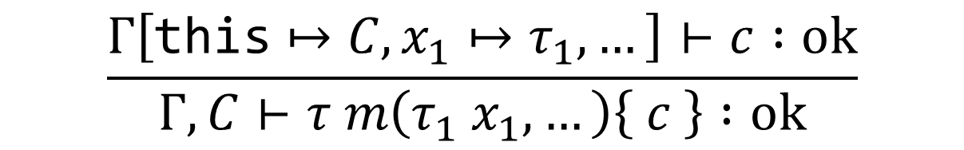
Java-Like Language: Access Modifiers
class B extends A {
private int y;
public int gety(){
return this.y;
}
public int addy(B b){
this.y = this.y + b.y;
}
}
$$\frac{\begin{aligned}Γ,D⊢e :C \\ \left(fields\left(Γ,C\right)=…, \text{public} τ f\right)\end{aligned}}{Γ,D⊢e\text{.}f :τ}$$
$$\frac{\begin{aligned}Γ,C⊢e :C \\ \left(fields\left(Γ,C\right)=…, \text{private} τ f\right)\end{aligned}}{Γ,C⊢e\text{.}f :τ}$$
$$\frac{Γ\left[\text{this}↦C,x_{1}↦τ_{1},…\right]⊢c :ok}{Γ,C⊢τ m\left(τ_{1} x_{1},…\right)\left\{ c \right\} :ok}$$

Slide 48
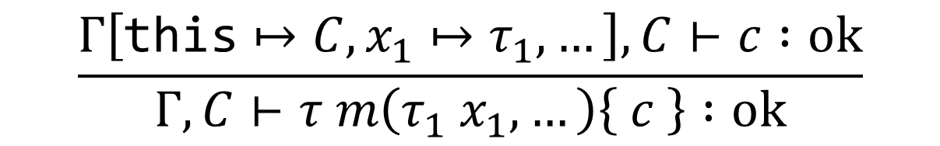
Java-Like Language: Access Modifiers
class B extends A {
private int y;
public int gety(){
return this.y;
}
public int addy(B b){
this.y = this.y + b.y;
}
}
$$\frac{\begin{aligned}Γ,D⊢e :C \\ \left(fields\left(Γ,C\right)=…, \text{public} τ f\right)\end{aligned}}{Γ,D⊢e\text{.}f :τ}$$
$$\frac{\begin{aligned}Γ,C⊢e :C \\ \left(fields\left(Γ,C\right)=…, \text{private} τ f\right)\end{aligned}}{Γ,C⊢e\text{.}f :τ}$$
$$\frac{Γ\left[\text{this}↦C,x_{1}↦τ_{1},…\right],C⊢c :ok}{Γ,C⊢τ m\left(τ_{1} x_{1},…\right)\left\{ c \right\} :ok}$$
Notes:
To do protected, we just do a slightly weaker check in the access rule.

Slide 49
Notes:
Poll Title: Do not modify the notes in this section to avoid tampering with the Poll Everywhere activity.
More info at polleverywhere.com/support
Questions
https://www.polleverywhere.com/discourses/SRzwhp4zztmGWgIgz520A

