Slide 1
CS 476 – Programming Language Design
William Mansky

Slide 2

Notes:
Poll Title: Do not modify the notes in this section to avoid tampering with the Poll Everywhere activity.
More info at polleverywhere.com/support
Questions
https://www.polleverywhere.com/discourses/SRzwhp4zztmGWgIgz520A

Slide 3
OCaml: Variants
Next step up from sum types: variants
inl “hi” : string + int inr 123 : string + int
Text “hi” : [Text : string; Num : int; …]
Can have any number of choices, and each one is named
Choice (“field”) names are like OCaml constructors!
Notes:
These are structural variant types.
Each choice has exactly one type; we can use tuples if we want more than one argument.

Slide 4
OCaml: Variants
L ::= … | <Ident> L
| (match L with
| <Ident> <ident> -> L
| …
| <Ident> <ident> -> L)
T ::= … | [ <Ident> of T; …; <Ident> of T ]
Notes:
These are structural variant types.

Slide 5
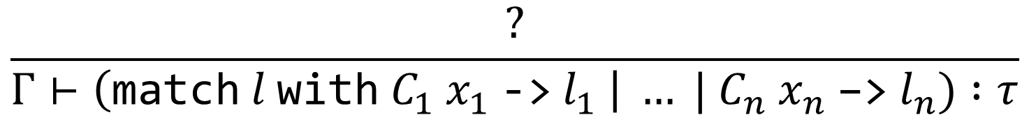
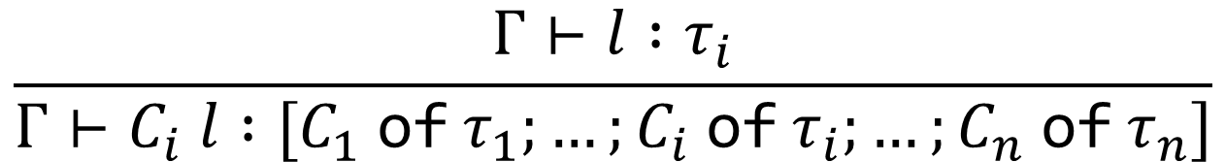
OCaml: Variants
$$\frac{Γ⊢l :τ_{i}}{Γ⊢C_{i} l :[C_{1} \text{of} τ_{1};…;C_{i} \text{of} τ_{i};…;C_{n} \text{of} τ_{n}]}$$
$$\frac{?}{Γ⊢\left(\text{match} l \text{with} C_{1} x_{1} \text{−>} l_{1} \right| … | C_{n} x_{n} \text{−>}{ l}_{n}) :τ}$$

Slide 6
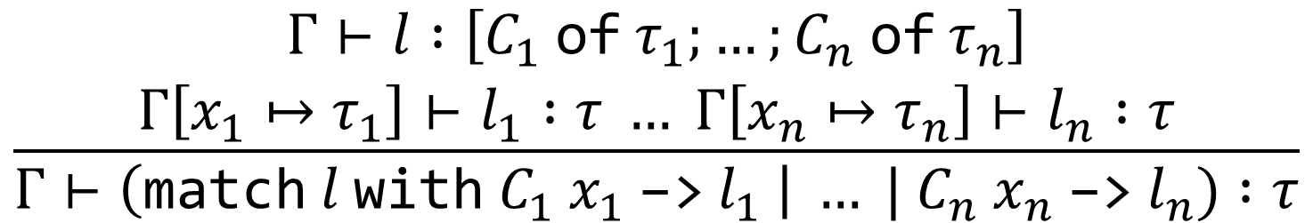
OCaml: Variants
$$\frac{Γ⊢l :τ_{i}}{Γ⊢C_{i} l :[C_{1} \text{of} τ_{1};…;C_{i} \text{of} τ_{i};…;C_{n} \text{of} τ_{n}]}$$
$$\frac{\begin{aligned}Γ⊢l :\left[C_{1} \text{of} τ_{1};…;C_{n} \text{of} τ_{n}\right] \\ Γ\left[x_{1}↦τ_{1}\right]⊢l_{1} :τ … Γ\left[x_{n}↦τ_{n}\right]⊢l_{n} :τ\end{aligned}}{Γ⊢\left(\text{match} l \text{with} C_{1} x_{1} \text{−>}{ l}_{1} \right| … | C_{n} x_{n} \text{−>}{ l}_{n}) :τ}$$

Slide 7
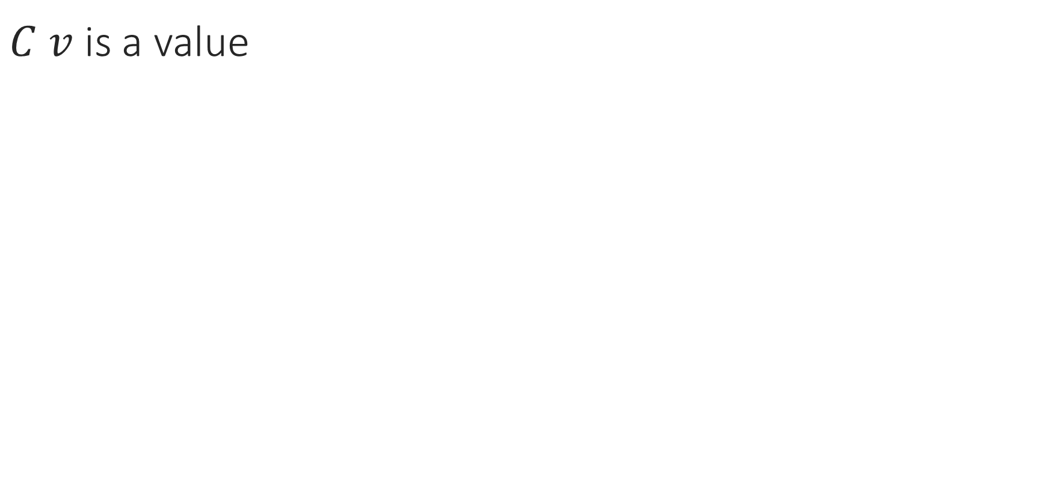
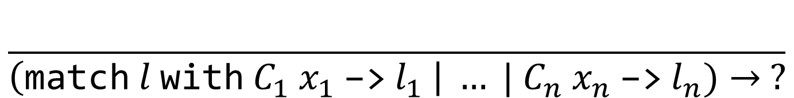

OCaml: Variants
$C v$ is a value
$$\frac{l→l′}{C l→C l′}$$
$$\frac{}{\left(\text{match} l \text{with} C_{1} x_{1} \text{−>}{ l}_{1} \right| … | C_{n} x_{n} \text{−>}{ l}_{n})→ ?}$$
Notes:
This is the main difference between constructors and functions: a function applied to a value steps by the application rule, but a constructor applied to a value is itself a value.

Slide 8
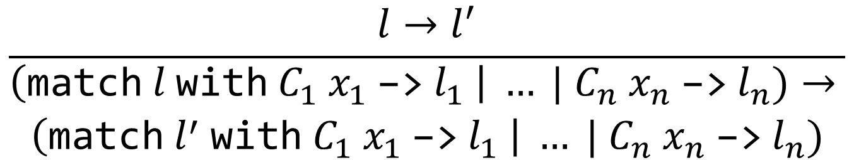
OCaml: Variants
$C v$ is a value
$$\frac{l→l′}{C l→C l′}$$
$$\frac{l→l^{′}}{\begin{aligned}\left(\text{match} l \text{with} C_{1} x_{1} \text{−>}{ l}_{1} \right| … | C_{n} x_{n} \text{−>}{ l}_{n})→ \\ \left(\text{match} l^{′} \text{with} C_{1} x_{1} \text{−>}{ l}_{1} \right| … | C_{n} x_{n} \text{−>}{ l}_{n})\end{aligned}}$$
$$\frac{}{\left(\text{match} C_{i} v \text{with} C_{1} x_{1} \text{−>}{ l}_{1} \right| … \left| C_{n} x_{n} \text{−>}{ l}_{n}\right)→\left[x_{i}↦v\right]l_{i}}$$
Notes:
This is the main difference between constructors and functions: a function applied to a value steps by the application rule, but a constructor applied to a value is itself a value.

Slide 9
OCaml: Variants
Exercise: If lookup gamma x returns Some IntTy, what steps will this program take?
match lookup gamma x with
| Some t -> subtype c t
| None -> false
$$\frac{l→l^{′}}{\begin{aligned}\left(\text{match} l \text{with} C_{1} x_{1} \text{−>}{ l}_{1} \right| … | C_{n} x_{n} \text{−>}{ l}_{n})→ \\ \left(\text{match} l^{′} \text{with} C_{1} x_{1} \text{−>}{ l}_{1} \right| … | C_{n} x_{n} \text{−>}{ l}_{n})\end{aligned}}$$
$$\frac{}{\left(\text{match} C_{i} v \text{with} C_{1} x_{1} \text{−>}{ l}_{1} \right| … \left| C_{n} x_{n} \text{−>}{ l}_{n}\right)→\left[x_{i}↦v\right]l_{i}}$$

Slide 10
OCaml: Variants
match … with
| Some t -> subtype c t
| None -> false
$$\frac{l→l^{′}}{\begin{aligned}\left(\text{match} l \text{with} C_{1} x_{1} \text{−>}{ l}_{1} \right| … | C_{n} x_{n} \text{−>}{ l}_{n})→ \\ \left(\text{match} l^{′} \text{with} C_{1} x_{1} \text{−>}{ l}_{1} \right| … | C_{n} x_{n} \text{−>}{ l}_{n})\end{aligned}}$$
$$\frac{}{\left(\text{match} C_{i} v \text{with} C_{1} x_{1} \text{−>}{ l}_{1} \right| … \left| C_{n} x_{n} \text{−>}{ l}_{n}\right)→\left[x_{i}↦v\right]l_{i}}$$

Slide 11
OCaml: Variants
match Some IntTy with
| Some t -> subtype c t
| None -> false
$$\frac{l→l^{′}}{\begin{aligned}\left(\text{match} l \text{with} C_{1} x_{1} \text{−>}{ l}_{1} \right| … | C_{n} x_{n} \text{−>}{ l}_{n})→ \\ \left(\text{match} l^{′} \text{with} C_{1} x_{1} \text{−>}{ l}_{1} \right| … | C_{n} x_{n} \text{−>}{ l}_{n})\end{aligned}}$$
$$\frac{}{\left(\text{match} C_{i} v \text{with} C_{1} x_{1} \text{−>}{ l}_{1} \right| … \left| C_{n} x_{n} \text{−>}{ l}_{n}\right)→\left[x_{i}↦v\right]l_{i}}$$

Slide 12
OCaml: Variants
match Some IntTy with
| Some t -> subtype c t
| None -> false
$$\frac{l→l^{′}}{\begin{aligned}\left(\text{match} l \text{with} C_{1} x_{1} \text{−>}{ l}_{1} \right| … | C_{n} x_{n} \text{−>}{ l}_{n})→ \\ \left(\text{match} l^{′} \text{with} C_{1} x_{1} \text{−>}{ l}_{1} \right| … | C_{n} x_{n} \text{−>}{ l}_{n})\end{aligned}}$$
$$\frac{}{\left(\text{match} C_{i} v \text{with} C_{1} x_{1} \text{−>}{ l}_{1} \right| … \left| C_{n} x_{n} \text{−>}{ l}_{n}\right)→\left[x_{i}↦v\right]l_{i}}$$

Slide 13
OCaml: Variants
match Some IntTy with
| Some t -> subtype c t
| None -> false
$$\frac{l→l^{′}}{\begin{aligned}\left(\text{match} l \text{with} C_{1} x_{1} \text{−>}{ l}_{1} \right| … | C_{n} x_{n} \text{−>}{ l}_{n})→ \\ \left(\text{match} l^{′} \text{with} C_{1} x_{1} \text{−>}{ l}_{1} \right| … | C_{n} x_{n} \text{−>}{ l}_{n})\end{aligned}}$$
$$\frac{}{\left(\text{match} C_{i} v \text{with} C_{1} x_{1} \text{−>}{ l}_{1} \right| … \left| C_{n} x_{n} \text{−>}{ l}_{n}\right)→\left[x_{i}↦v\right]l_{i}}$$

Slide 14

OCaml: Variants
match Some IntTy with
| Some t -> subtype c t $→$ [t $↦$ IntTy](subtype c t)
| None -> false
$$\frac{l→l^{′}}{\begin{aligned}\left(\text{match} l \text{with} C_{1} x_{1} \text{−>}{ l}_{1} \right| … | C_{n} x_{n} \text{−>}{ l}_{n})→ \\ \left(\text{match} l^{′} \text{with} C_{1} x_{1} \text{−>}{ l}_{1} \right| … | C_{n} x_{n} \text{−>}{ l}_{n})\end{aligned}}$$
$$\frac{}{\left(\text{match} C_{i} v \text{with} C_{1} x_{1} \text{−>}{ l}_{1} \right| … \left| C_{n} x_{n} \text{−>}{ l}_{n}\right)→\left[x_{i}↦v\right]l_{i}}$$

Slide 15

OCaml: Variants
match Some IntTy with
| Some t -> subtype c t $→$ subtype c IntTy
| None -> false
$$\frac{l→l^{′}}{\begin{aligned}\left(\text{match} l \text{with} C_{1} x_{1} \text{−>}{ l}_{1} \right| … | C_{n} x_{n} \text{−>}{ l}_{n})→ \\ \left(\text{match} l^{′} \text{with} C_{1} x_{1} \text{−>}{ l}_{1} \right| … | C_{n} x_{n} \text{−>}{ l}_{n})\end{aligned}}$$
$$\frac{}{\left(\text{match} C_{i} v \text{with} C_{1} x_{1} \text{−>}{ l}_{1} \right| … \left| C_{n} x_{n} \text{−>}{ l}_{n}\right)→\left[x_{i}↦v\right]l_{i}}$$

Slide 16
Notes:
Poll Title: Do not modify the notes in this section to avoid tampering with the Poll Everywhere activity.
More info at polleverywhere.com/support
Questions
https://www.polleverywhere.com/discourses/SRzwhp4zztmGWgIgz520A

Slide 17
OCaml: Variants
L ::= … | <Ident> L
| (match L with
| <Ident> <ident> -> L
| …
| <Ident> <ident> -> L)
T ::= … | [ <Ident> of T; …; <Ident> of T ]
Notes:
These are structural variant types.

Slide 18
OCaml: Inductive Datatypes
L ::= … | <Ident> L | match L with …
TD ::= (type <ident> = <Ident> of T | … | <Ident> of T)
T ::= … | <ident>
P ::= TD … TD L
type exp = Num of int | Add of exp * exp
Every inductive type has a name, so constructors can take the type being declared as an argument!
Notes:
Now we’ve switched to nominal types – every inductive datatype has a name.

Slide 19
OCaml: Inductive Datatypes
$C v$ is a value
$$\frac{l→l′}{C l→C l′}$$
$$\frac{l→l^{′}}{\begin{aligned}\left(\text{match} l \text{with} C_{1} x_{1} \text{−>}{ l}_{1} \right| … | C_{n} x_{n} \text{−>}{ l}_{n})→ \\ \left(\text{match} l^{′} \text{with} C_{1} x_{1} \text{−>}{ l}_{1} \right| … | C_{n} x_{n} \text{−>}{ l}_{n})\end{aligned}}$$
$$\frac{}{\left(\text{match} C_{i} v \text{with} C_{1} x_{1} \text{−>}{ l}_{1} \right| … \left| C_{n} x_{n} \text{−>}{ l}_{n}\right)→\left[x_{i}↦v\right]l_{i}}$$
Notes:
Exactly the same as with variants – evaluate the argument to a constructor, find the appropriate case.

Slide 20

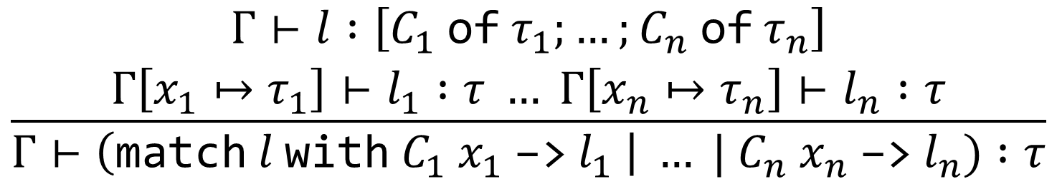
OCaml: Inductive Datatypes
We can store type definitions in the type context $Γ$
$Γ$maps variables to types, type names to definitions
$$\frac{lookup_constr\left(Γ, C\right)=(\text{type} t \text{=} C \text{of} τ \text{|} …) Γ⊢l :τ}{Γ⊢C l :t}$$
$$\frac{\begin{aligned}Γ⊢l :\left[C_{1} \text{of} τ_{1};…;C_{n} \text{of} τ_{n}\right] \\ Γ\left[x_{1}↦τ_{1}\right]⊢l_{1} :τ … Γ\left[x_{n}↦τ_{n}\right]⊢l_{n} :τ\end{aligned}}{Γ⊢\left(\text{match} l \text{with} C_{1} x_{1} \text{−>}{ l}_{1} \right| … | C_{n} x_{n} \text{−>}{ l}_{n}) :τ}$$
Notes:
“l has to be of a variant type, C1 through Cn have to be the cases of that type, and each of the cases has to return type tau.”

Slide 21

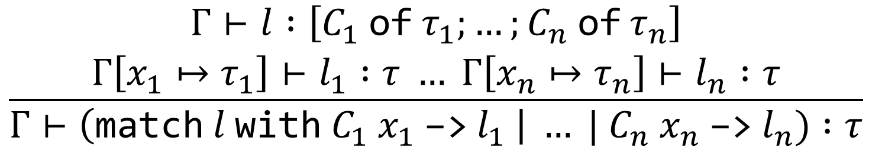
OCaml: Inductive Datatypes
$l$ has to be of a variant type
The cases of the match should be the cases of $l$’s type
Each case should return something of type $τ$
  where each case’s variable gets the type of the constructor
$$\frac{\begin{aligned}Γ⊢l :\left[C_{1} \text{of} τ_{1};…;C_{n} \text{of} τ_{n}\right] \\ Γ\left[x_{1}↦τ_{1}\right]⊢l_{1} :τ … Γ\left[x_{n}↦τ_{n}\right]⊢l_{n} :τ\end{aligned}}{Γ⊢\left(\text{match} l \text{with} C_{1} x_{1} \text{−>}{ l}_{1} \right| … | C_{n} x_{n} \text{−>}{ l}_{n}) :τ}$$
Notes:
“l has to be of a variant type, C1 through Cn have to be the cases of that type, and each of the cases has to return type tau.”

Slide 22

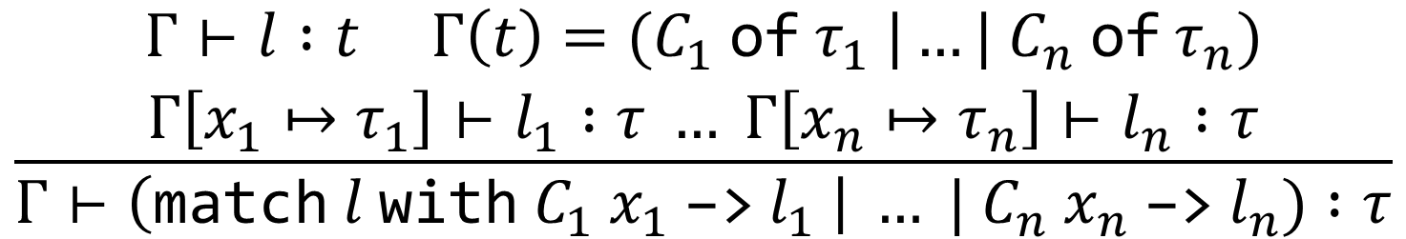
OCaml: Inductive Datatypes
$l$ has to be of an inductive type
The cases of the match should be the cases of $l$’s type
Each case should return something of type $τ$
  where each case’s variable gets the type of the constructor
$$\frac{\begin{aligned}Γ⊢l :t Γ\left(t\right)={(C}_{1} \text{of} τ_{1} \text{|}…| C_{n} \text{of} τ_{n}) \\ Γ\left[x_{1}↦τ_{1}\right]⊢l_{1} :τ … Γ\left[x_{n}↦τ_{n}\right]⊢l_{n} :τ\end{aligned}}{Γ⊢\left(\text{match} l \text{with} C_{1} x_{1} \text{−>}{ l}_{1} \right| … | C_{n} x_{n} \text{−>}{ l}_{n}) :τ}$$
Notes:
“l has to be of a variant type, C1 through Cn have to be the cases of that type, and each of the cases has to return type tau.”

Slide 23
Inductive Datatypes: Summary
In OCaml (and most other functional languages), we can define datatypes with cases, and match on those cases
Each datatype has a list of constructors, which build values of the type and are the patterns we match on
Sum types: two constructors
Variant types: any number of constructors, not recursive
Inductive types: any number of constructors, recursive!
  Because datatypes have names (nominal types), they can take instances of the same type as arguments

Slide 24
Notes:
Poll Title: Do not modify the notes in this section to avoid tampering with the Poll Everywhere activity.
More info at polleverywhere.com/support
Questions
https://www.polleverywhere.com/discourses/SRzwhp4zztmGWgIgz520A

Slide 25
PL Courses Next Semester
CS 472: Provably Correct Programming
  Logic, functional programming, proving programs correct
CS 473: Compiler Design
  Lexing and parsing, translation to assembly
CS 474: Object-Oriented Languages and Environments
  Much deeper study (without inference rules) of OO language features
CS 454: Principles of Concurrent Programming
Notes:
Like unions in C. The asterisk is because OCaml doesn’t actually have (unlabeled) sum types.

Slide 26
Notes:
Poll Title: Do not modify the notes in this section to avoid tampering with the Poll Everywhere activity.
More info at polleverywhere.com/support
Questions
https://www.polleverywhere.com/discourses/SRzwhp4zztmGWgIgz520A

