Slide 1
CS 476 – Programming Language Design
William Mansky

Slide 2

Notes:
Poll Title: Do not modify the notes in this section to avoid tampering with the Poll Everywhere activity.
More info at polleverywhere.com/support
Questions
https://www.polleverywhere.com/discourses/SRzwhp4zztmGWgIgz520A

Slide 3
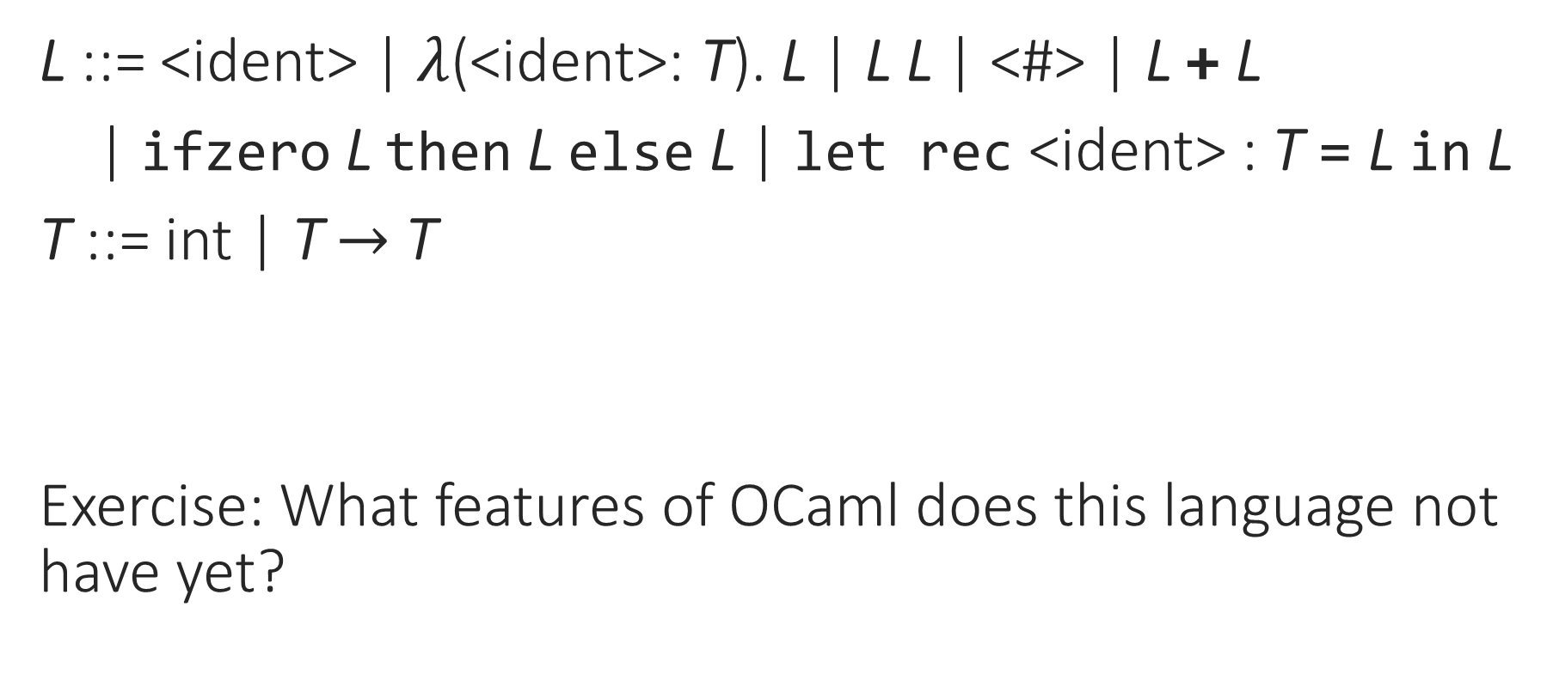
Typed Lambda Calculus with Recursion
L ::= <ident> | $λ$(<ident>: T). L | L L | <#> | L + L
| ifzero L then L else L | let rec <ident> : T = L in L
T ::= int | T $→$ T
Exercise: What features of OCaml does this language not have yet?
Notes:
What are we missing from OCaml?

Slide 4
From Typed Lambda Calculus to OCaml
User-friendly syntax
Basic types, tuples, records
Inductive datatypes and pattern-matching
Local declarations
References
Type inference
Generics/polymorphism

Slide 5

Typed Lambda Calculus with Recursion
L ::= <ident> | $λ$(<ident>: T). L | L L | <#> | L + L
| ifzero L then L else L | let rec <ident> : T = L in L
T ::= int | T $→$ T

Slide 6

Simple OCaml
L ::= <ident> | fun (<ident> : T) -> L | L L | <#> | L + L
| ifzero L then L else L | let rec <ident> : T = L in L
T ::= int | T $→$ T

Slide 7
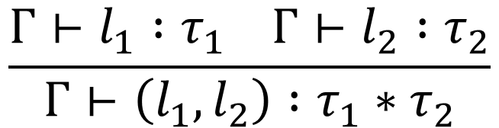


Simple OCaml: Tuples
L ::= … | (L, L) | fst L | snd L
T ::= … | T * T
$$\frac{Γ⊢l_{1} :τ_{1} Γ⊢l_{2} :τ_{2}}{Γ⊢\left(l_{1},l_{2}\right) :τ_{1}∗τ_{2}}$$
$$\frac{Γ⊢l :τ_{1}∗τ_{2}}{Γ⊢\text{fst} l :τ_{1}}$$
$$\frac{Γ⊢l :τ_{1}∗τ_{2}}{Γ⊢\text{snd} l :τ_{2}}$$

Slide 8





Simple OCaml: Tuples
L ::= … | (L, L) | fst L | snd L
T ::= … | T * T
$(v_{1}, v_{2})$ is a value
$$\frac{l_{1}→l_{1}^{′}}{\left(l_{1},l_{2}\right)→(l_{1}^{′},l_{2})}$$
$$\frac{l_{2}→l_{2}^{′}}{\left(l_{1},l_{2}\right)→(l_{1},l_{2}^{′})}$$
$$\frac{}{\text{fst} \left(v_{1},v_{2}\right)→v_{1}}$$
$$\frac{}{\text{snd} \left(v_{1},v_{2}\right)→v_{2}}$$

Slide 9
Notes:
Poll Title: Do not modify the notes in this section to avoid tampering with the Poll Everywhere activity.
More info at polleverywhere.com/support
Questions
https://www.polleverywhere.com/discourses/SRzwhp4zztmGWgIgz520A

Slide 10
Simple OCaml: Records
type person = { name : string; age : int; id : int };;
let a = { name = “Alice”; age = 22; id = 123456 };;
Nominal (“named”) type: the type of a is person
Structural type: the type of a is
{ name : string; age : int; id : int }
Notes:
Records are basically bigger tuples with named fields, so their syntax and semantics should be similar to tuples.
We have two choices for record types: either we could remember the names they’re declared with (like classes in OO), or we could just identify them by their signatures (like tuples). For now, we’ll do the latter, but we’ll see the named version in a future class.

Slide 11
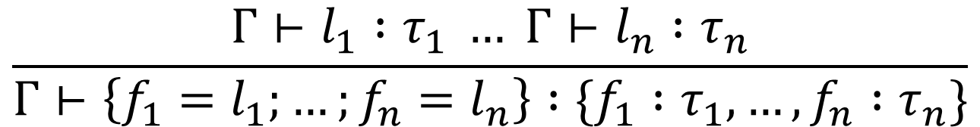
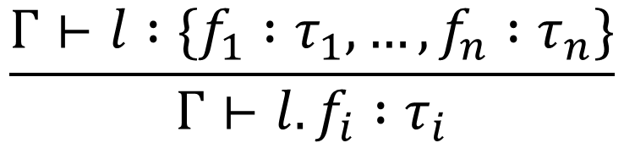
Simple OCaml: Records
L ::= … | { <ident> = L; …; <ident> = L } | L.<ident>
T ::= … | { <ident> : T; …; <ident> : T }
$$\frac{Γ⊢l_{1} :τ_{1} … Γ⊢l_{n} :τ_{n}}{Γ⊢\left\{f_{1}=l_{1};…;f_{n}=l_{n}\right\} :\{f_{1} :τ_{1},…,f_{n} :τ_{n}\}}$$
$$\frac{Γ⊢l :\{f_{1} :τ_{1},…,f_{n} :τ_{n}\}}{Γ⊢l.f_{i} :τ_{i}}$$
Notes:
You can also do subtyping with records!

Slide 12

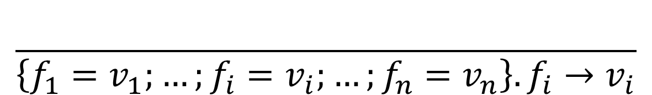
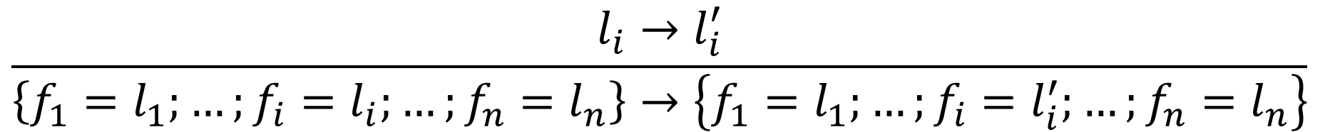
Simple OCaml: Records
L ::= … | { <ident> = L; …; <ident> = L } | L.<ident>
T ::= … | { <ident> : T; …; <ident> : T }
$\left\{f_{1}=v_{1};…;f_{n}=v_{n}\right\}$ is a value
$$\frac{l_{i}→l_{i}^{′}}{\left\{f_{1}=l_{1};…;f_{i}=l_{i};…;f_{n}=l_{n}\right\}→\left\{f_{1}=l_{1};…;f_{i}=l_{i}^{′};…;f_{n}=l_{n}\right\}}$$
$$\frac{}{\left\{f_{1}=v_{1};…;f_{i}=v_{i};…;f_{n}=v_{n}\right\}.f_{i}→v_{i}}$$

Slide 13
Notes:
Poll Title: Do not modify the notes in this section to avoid tampering with the Poll Everywhere activity.
More info at polleverywhere.com/support
Questions
https://www.polleverywhere.com/discourses/SRzwhp4zztmGWgIgz520A

Slide 14
From Typed Lambda Calculus to OCaml
User-friendly syntax
Basic types, tuples, records
Inductive datatypes and pattern-matching
Local declarations
References
Type inference
Generics/polymorphism

Slide 15
OCaml*: Sum Types
int + bool
(* like type int+bool = inl int | inr bool *)
inl 3 : int + bool
inr true : int + bool
match (a : int + bool) with
| inl i -> i + 1
| inr b -> if b then 1 else 0
Notes:
Like unions in C. The asterisk is because OCaml doesn’t actually have (unlabeled) sum types.

Slide 16
OCaml*: Sum Types
L ::= … | inl L | inr L
| (match L with inl <ident> -> L | inr <ident> -> L)
T ::= … | T + T

Slide 17
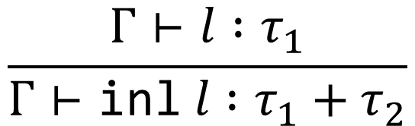
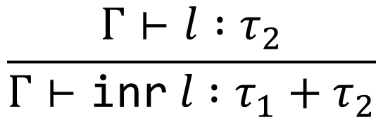
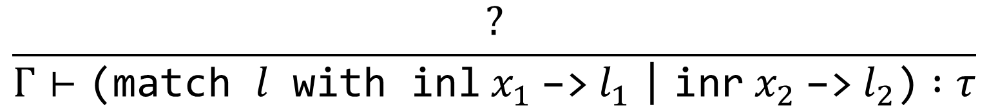
OCaml*: Sum Types
Exercise: How should we typecheck a match statement?
$$\frac{Γ⊢l :τ_{1}}{Γ⊢\text{inl} l :τ_{1}+τ_{2}}$$
$$\frac{Γ⊢l :τ_{2}}{Γ⊢\text{inr} l :τ_{1}+τ_{2}}$$
$$\frac{?}{Γ⊢\text{(}\text{match} l \text{with} \text{inl} x_{1} \text{−>} l_{1} \text{|} \text{inr} x_{2} \text{−>} l_{2}\text{)} :τ}$$

Slide 18
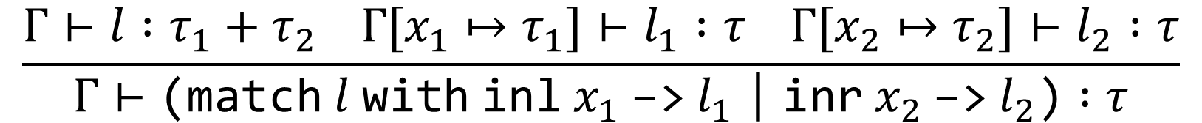
OCaml*: Sum Types
$$\frac{Γ⊢l :τ_{1}}{Γ⊢\text{inl} l :τ_{1}+τ_{2}}$$
$$\frac{Γ⊢l :τ_{2}}{Γ⊢\text{inr} l :τ_{1}+τ_{2}}$$
$$\frac{Γ⊢l :τ_{1}+τ_{2} Γ[x_{1}↦τ_{1}]⊢l_{1} :τ Γ[x_{2}↦τ_{2}]⊢l_{2} :τ}{Γ⊢\text{(}\text{match} l \text{with} \text{inl} x_{1} \text{−>}{ l}_{1} \text{|} \text{inr} x_{2} \text{−>}{ l}_{2}\text{)} :τ}$$

Slide 19
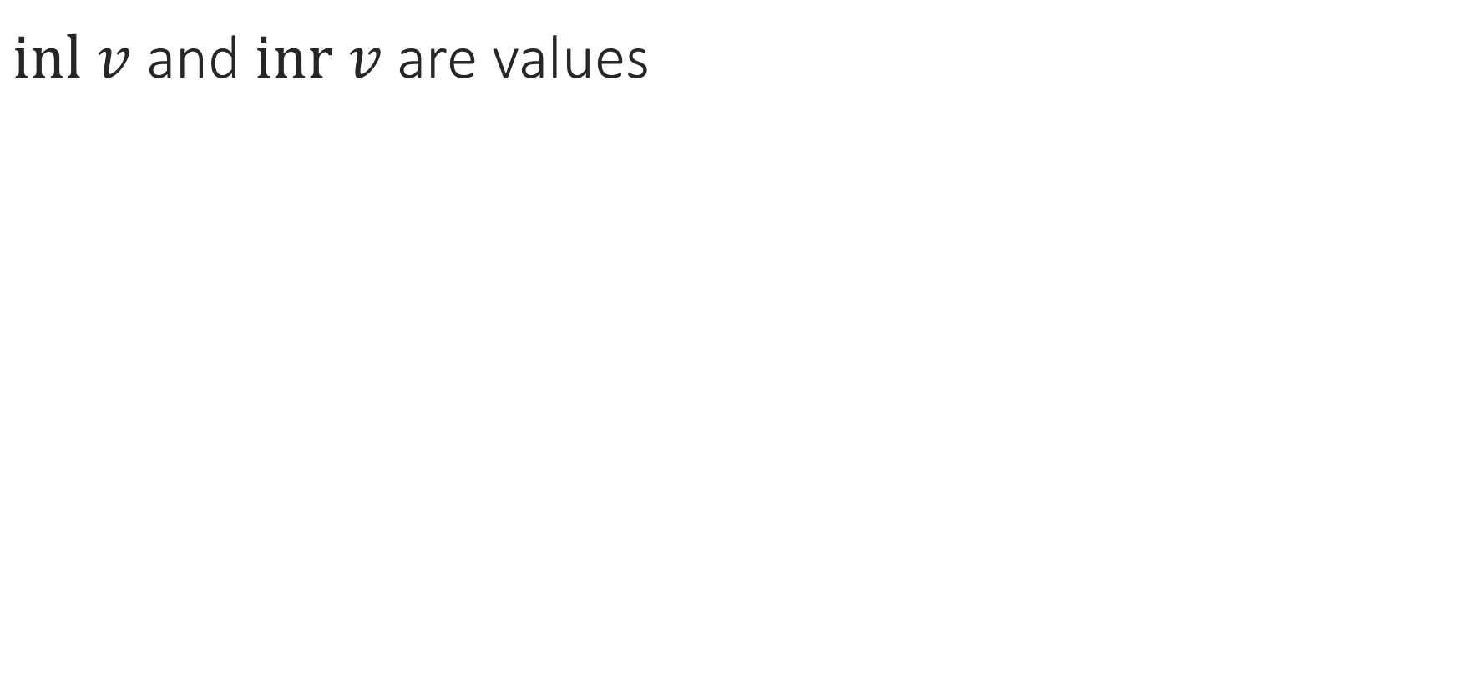

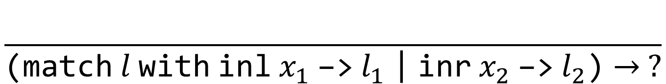

OCaml*: Sum Types
$inl v$ and $inr v$ are values
$$\frac{l→l′}{\text{inl} l→\text{inl} l′}$$
$$\frac{l→l′}{\text{in}\text{r} l→\text{in}\text{r} l′}$$
$$\frac{}{\text{(}\text{match} l \text{with} \text{inl} x_{1} \text{−>}{ l}_{1} \text{|} \text{inr} x_{2} \text{−>}{ l}_{2}\text{)}→ ?}$$

Slide 20
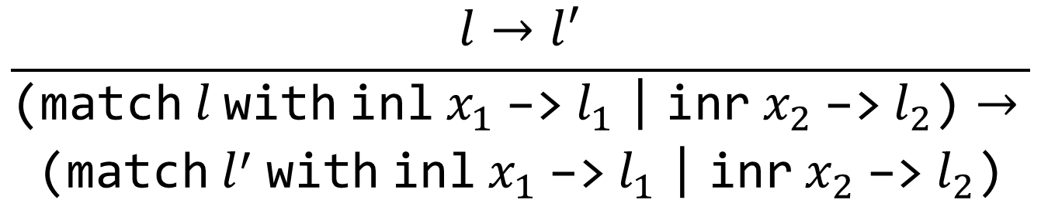
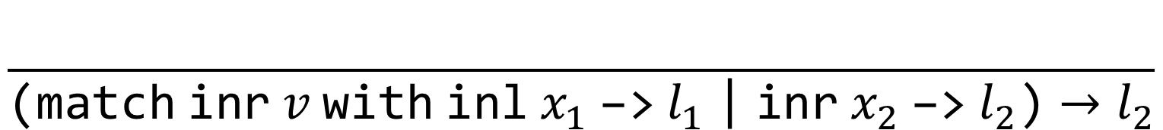
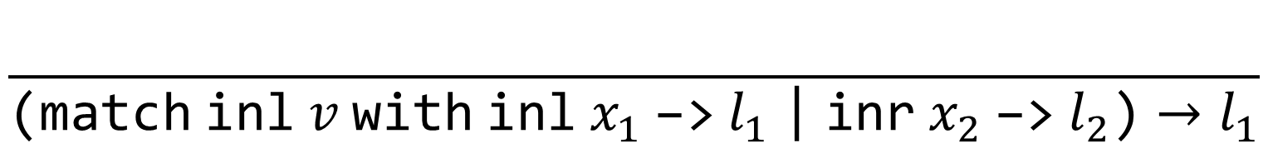
OCaml*: Sum Types
$$\frac{l→l^{′}}{\begin{aligned}\text{(}\text{match} l \text{with} \text{inl} x_{1} \text{−>}{ l}_{1} \text{|} \text{inr} x_{2} \text{−>}{ l}_{2}\text{)}→ \\ \text{(}\text{match} l^{′} \text{with} \text{inl} x_{1} \text{−>}{ l}_{1} \text{|} \text{inr} x_{2} \text{−>}{ l}_{2}\text{)}\end{aligned}}$$
$$\frac{}{\text{(}\text{match} \text{inl} v \text{with} \text{inl} x_{1} \text{−>}{ l}_{1} \text{|} \text{inr} x_{2} \text{−>}{ l}_{2}\text{)}→l_{1}}$$
$$\frac{}{\text{(}\text{match} \text{inr} v \text{with} \text{inl} x_{1} \text{−>}{ l}_{1} \text{|} \text{inr} x_{2} \text{−>}{ l}_{2}\text{)}→l_{2}}$$

Slide 21
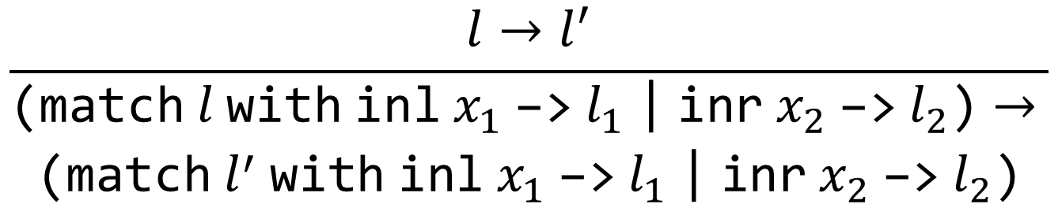
OCaml*: Sum Types
$$\frac{l→l^{′}}{\begin{aligned}\text{(}\text{match} l \text{with} \text{inl} x_{1} \text{−>}{ l}_{1} \text{|} \text{inr} x_{2} \text{−>}{ l}_{2}\text{)}→ \\ \text{(}\text{match} l^{′} \text{with} \text{inl} x_{1} \text{−>}{ l}_{1} \text{|} \text{inr} x_{2} \text{−>}{ l}_{2}\text{)}\end{aligned}}$$
$$\frac{}{\text{(}\text{match} \text{inl} v \text{with} \text{inl} x_{1} \text{−>}{ l}_{1} \text{|} \text{inr} x_{2} \text{−>}{ l}_{2}\text{)}→{\left[x_{1}↦v\right]l}_{1}}$$
$$\frac{}{\text{(}\text{match} \text{inr} v \text{with} \text{inl} x_{1} \text{−>}{ l}_{1} \text{|} \text{inr} x_{2} \text{−>}{ l}_{2}\text{)}→{\left[x_{2}↦v\right]l}_{2}}$$

Slide 22
Notes:
Poll Title: Do not modify the notes in this section to avoid tampering with the Poll Everywhere activity.
More info at polleverywhere.com/support
Questions
https://www.polleverywhere.com/discourses/SRzwhp4zztmGWgIgz520A

Slide 23
HW6 Overview
Interpreter for a simple functional language
Ignore the definition of substitution: it’s complicated, but for our purposes it just works

