Slide 1
CS 476 – Programming Language Design
William Mansky

Slide 2

Notes:
Poll Title: Do not modify the notes in this section to avoid tampering with the Poll Everywhere activity.
More info at polleverywhere.com/support
Questions
https://www.polleverywhere.com/discourses/SRzwhp4zztmGWgIgz520A

Slide 3
Adding Functions
With variables, assignment, declarations, and control flow, we have a simple imperative language
Last major feature of almost every imperative language: functions

Slide 4
Adding Functions
int add(int x, int y){
int r;
r := x + y;
return r
}
int main(){
int x = 5; int z;
z := add(1, 2);
return x
}
Declare function, then call it
Function declaration has argument and return types,
can return a value
Can declare local variables inside function body
Can call functions inside function body (even recursively!)

Slide 5
Functions: Syntax of Definitions
int add(int x, int y){
int r;
r := x + y;
return r
}
int main(){
int x; int z;
x := add(1, 2);
return x
}
E ::= … C ::= …
T ::= …
F ::=
Notes:
What are the pieces of a function definition?

Slide 6
Functions: Syntax of Definitions
int add(int x, int y){
int r;
r := x + y;
return r
}
int main(){
int x; int z;
x := add(1, 2);
return x
}
E ::= … C ::= …
T ::= …
F ::= type name (args)
{ body }
Notes:
What are the pieces of a function definition?

Slide 7
Functions: Syntax of Definitions
int add(int x, int y){
int r;
r := x + y;
return r
}
int main(){
int x; int z;
x := add(1, 2);
return x
}
E ::= … C ::= …
T ::= …
F ::= T name (args)
{ body }
Notes:
What are the pieces of a function definition?

Slide 8
Functions: Syntax of Definitions
int add(int x, int y){
int r;
r := x + y;
return r
}
int main(){
int x; int z;
x := add(1, 2);
return x
}
E ::= … C ::= …
T ::= …
F ::= T <id> (args)
{ body }
Notes:
What are the pieces of a function definition?

Slide 9
Functions: Syntax of Definitions
int add(int x, int y){
int r;
r := x + y;
return r
}
int main(){
int x; int z;
x := add(1, 2);
return x
}
E ::= … C ::= …
T ::= …
F ::= T <id> (T <id>, …, T <id>)
{ body }
Notes:
What are the pieces of a function definition?

Slide 10
Functions: Syntax of Definitions
int add(int x, int y){
int r;
r := x + y;
return r
}
int main(){
int x; int z;
x := add(1, 2);
return x
}
E ::= … C ::= …
T ::= …
F ::= T <id> (T <id>, …, T <id>)
{ D; C }
Notes:
What are the pieces of a function definition?

Slide 11
Functions: Syntax of Definitions
int add(int x, int y){
int r;
r := x + y;
return r
}
int main(){
int x; int z;
x := add(1, 2);
return x
}
E ::= … C ::= …
T ::= …
D ::= T <id>; …; T <id>
F ::= T <id> (T <id>, …, T <id>)
{ D; C }
Notes:
What are the pieces of a function definition?

Slide 12
Functions: Syntax of Definitions
int add(int x, int y){
int r;
r := x + y;
return r
}
int main(){
int x; int z;
x := add(1, 2);
return x
}
E ::= … C ::= …
T ::= …
D ::= T <id>; …; T <id>
F ::= T <id> (T <id>, …, T <id>)
{ D; C }
P ::= F … F
Notes:
What are the pieces of a function definition?

Slide 13
Notes:
Poll Title: Do not modify the notes in this section to avoid tampering with the Poll Everywhere activity.
More info at polleverywhere.com/support
Questions
https://www.polleverywhere.com/discourses/SRzwhp4zztmGWgIgz520A

Slide 14
Functions: Syntax of Calls
int add(int x, int y){
int r;
r := x + y;
return r
}
int main(){
int x; int z;
x := add(1, 2);
return x
}
E ::= … C ::= … | return E
T ::= …
D ::= T <id>; …; T <id>
F ::= T <id> (T <id>, …, T <id>)
{ D; C }
P ::= F … F
Exercise: should function calls be commands or expressions?
Notes:
If we made a bar chart, the results would be pretty close to 50-50!

Slide 15
Functions: Syntax of Calls
int add(int x, int y){
int r;
r := x + y;
return r
}
int main(){
int x; int z;
x := add(1, 2);
return x
}
E ::= … C ::= … | return E
| <id> (E, …, E)
D ::= T <id>; …; T <id>
F ::= T <id> (T <id>, …, T <id>)
{ D; C }
P ::= F … F
Exercise: should function calls be commands or expressions?
Notes:
If we made a bar chart, the results would be pretty close to 50-50!

Slide 16
Functions: Syntax of Calls
int add(int x, int y){
int r;
r := x + y;
return r
}
int main(){
int x; int z;
x := add(1, 2);
return x
}
E ::= … C ::= … | return E
| <id> := <id> (E, …, E)
D ::= T <id>; …; T <id>
F ::= T <id> (T <id>, …, T <id>)
{ D; C }
P ::= F … F
Exercise: should function calls be commands or expressions?
Notes:
If we made a bar chart, the results would be pretty close to 50-50!

Slide 17
Notes:
Poll Title: Do not modify the notes in this section to avoid tampering with the Poll Everywhere activity.
More info at polleverywhere.com/support
Questions
https://www.polleverywhere.com/discourses/SRzwhp4zztmGWgIgz520A

Slide 18
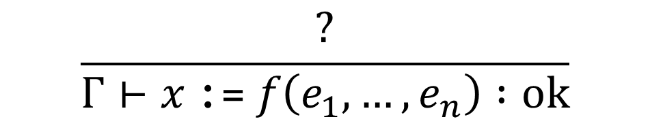
Functions: Types
Exercise: What do we need to check to make sure a function call is type-correct?
$$\frac{?}{Γ⊢x \text{:=} f\left(e_{1},…,e_{n}\right) :ok}$$
Notes:
What is a function call type-correct? What do we need to check?

Slide 19
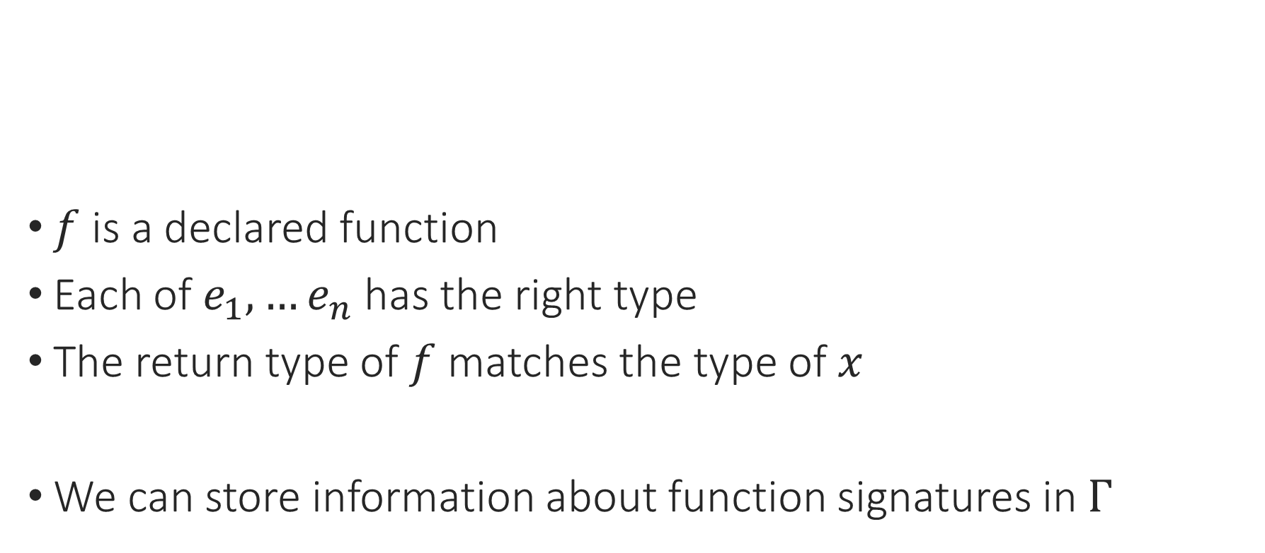
Functions: Types
$f$ is a declared function
Each of $e_{1},…e_{n}$ has the right type
The return type of $f$ matches the type of $x$
We can store information about function signatures in $Γ$
$$\frac{?}{Γ⊢x \text{:=} f\left(e_{1},…,e_{n}\right) :ok}$$
Notes:
What is a function call type-correct? What do we need to check?

Slide 20


Functions: Types
int f(int x, int y){ return x + y }
f is a function with return type int, arguments int x and int y
We can store this information in $Γ$
$$f :int\left(int x, int y\right)$$
Notes:
Should function calls be expressions or commands?

Slide 21
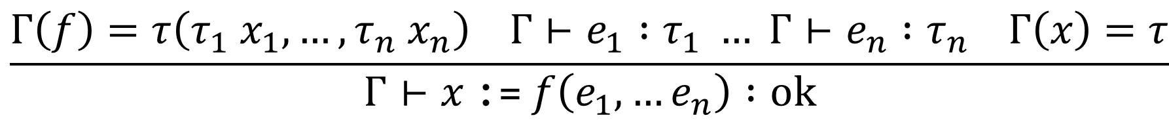

Functions: Types
$f$ is a declared function
Each of $e_{1},…e_{n}$ has the right type
The return type of $f$ matches the type of $x$
$$\frac{Γ\left(f\right)=τ\left(τ_{1} x_{1},…,τ_{n} x_{n}\right) Γ⊢e_{1} :τ_{1} … Γ⊢e_{n} :τ_{n} Γ\left(x\right)=τ}{Γ⊢x \text{:=} f\left(e_{1},…e_{n}\right) :ok}$$

Slide 22

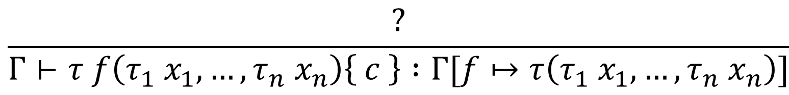
Processing Function Declarations
int f(int x, int y){ return x + y }
add $f :int\left(int x, int y\right)$ to $Γ$
$$\frac{?}{Γ⊢τ f\left(τ_{1} x_{1},…,τ_{n} x_{n}\right)\left\{ c \right\} :Γ[f↦τ\left(τ_{1} x_{1},…,τ_{n} x_{n}\right)]}$$
old context
function declaration
new context

Slide 23
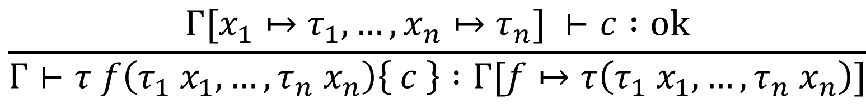
Processing Function Declarations
int f(int x, int y){ return x + y }
The function’s parameters should be available in the function body
And so should previously declared functions and global variables
(Mutually recursive functions would require an extra step)
$$\frac{Γ[x_{1}↦τ_{1},…,x_{n}↦τ_{n}] ⊢c :ok}{Γ⊢τ f\left(τ_{1} x_{1},…,τ_{n} x_{n}\right)\left\{ c \right\} :Γ[f↦τ\left(τ_{1} x_{1},…,τ_{n} x_{n}\right)]}$$

Slide 24
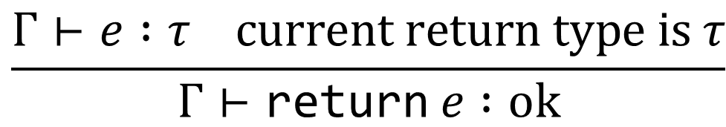
Functions: Return
int f(int x, int y){ return x + y }
$$\frac{Γ[x_{1}↦τ_{1},…,x_{n}↦τ_{n}] ⊢c :ok}{Γ⊢τ f\left(τ_{1} x_{1},…,τ_{n} x_{n}\right)\left\{ c \right\} :Γ[f↦τ\left(τ_{1} x_{1},…,τ_{n} x_{n}\right)]}$$
$$\frac{Γ⊢e :τ current return type is τ}{Γ⊢\text{return} e :ok}$$

Slide 25
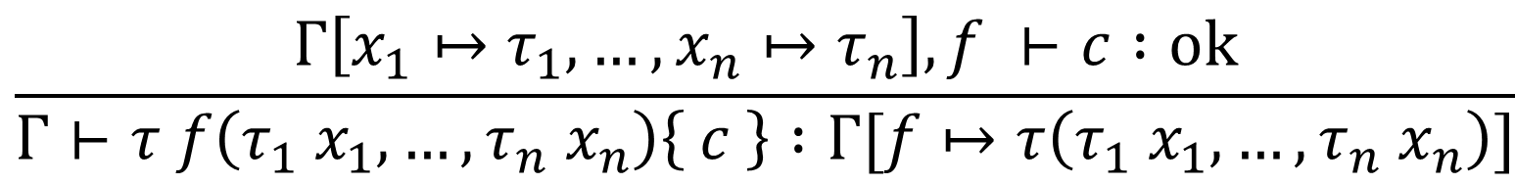
Functions: Return
int f(int x, int y){ return x + y }
$$\frac{Γ\left[x_{1}↦τ_{1},…,x_{n}↦τ_{n}\right], f ⊢c :ok}{Γ⊢τ f\left(τ_{1} x_{1},…,τ_{n} x_{n}\right)\left\{ c \right\} :Γ[f↦τ\left(τ_{1} x_{1},…,τ_{n} x_{n}\right)]}$$
$$\frac{Γ⊢e :τ current return type is τ}{Γ⊢\text{return} e :ok}$$

Slide 26
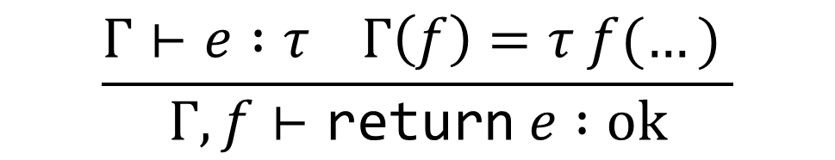
Functions: Return
int f(int x, int y){ return x + y }
Remember which function we’re in, so we know the return type
$$\frac{Γ\left[x_{1}↦τ_{1},…,x_{n}↦τ_{n}\right], f ⊢c :ok}{Γ⊢τ f\left(τ_{1} x_{1},…,τ_{n} x_{n}\right)\left\{ c \right\} :Γ[f↦τ\left(τ_{1} x_{1},…,τ_{n} x_{n}\right)]}$$
$$\frac{Γ⊢e :τ Γ\left(f\right)=τ f(…) }{Γ,f⊢\text{return} e :ok}$$

Slide 27
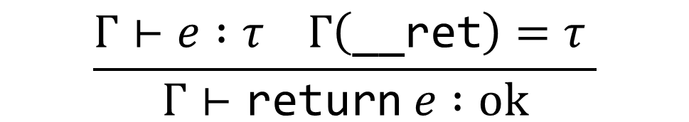
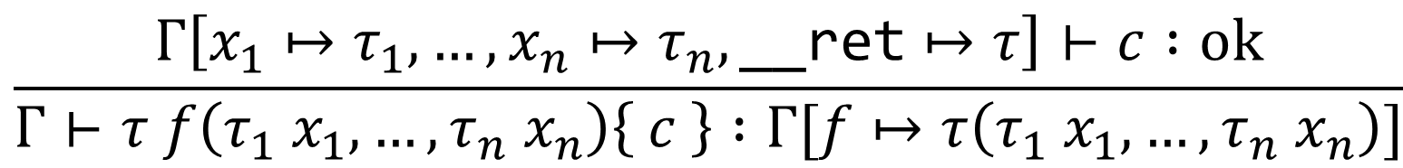
Functions: Return
int f(int x, int y){ return x + y }
Use a fake variable to remember the return type
$$\frac{Γ\left[x_{1}↦τ_{1},…,x_{n}↦τ_{n}, \text{__}\text{ret}↦τ\right]⊢c :ok}{Γ⊢τ f\left(τ_{1} x_{1},…,τ_{n} x_{n}\right)\left\{ c \right\} :Γ[f↦τ\left(τ_{1} x_{1},…,τ_{n} x_{n}\right)]}$$
$$\frac{Γ⊢e :τ Γ\left(\text{__}\text{ret}\right)=τ }{Γ⊢\text{return} e :ok}$$

Slide 28
Notes:
Poll Title: Do not modify the notes in this section to avoid tampering with the Poll Everywhere activity.
More info at polleverywhere.com/support
Questions
https://www.polleverywhere.com/discourses/SRzwhp4zztmGWgIgz520A

Slide 29
Functions: Syntax of Calls
int add(int x, int y){
int r;
r := x + y;
return r
}
int main(){
int x; int z;
x := add(1, 2);
return x
}
E ::= … C ::= … | return E
| <id> := <id> (E, …, E)
D ::= T <id>; …; T <id>
F ::= T <id> (T <id>, …, T <id>)
{ D; C }
P ::= F … F

Slide 30
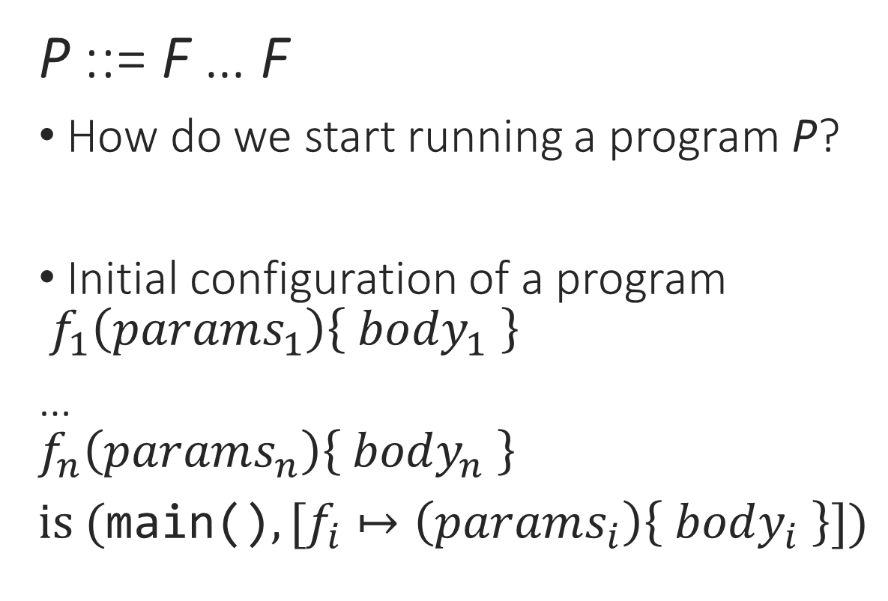
Functions: Initial Program State
int add(int x, int y){
int r;
r := x + y;
return r
}
int main(){
int x; int z;
x := add(1, 2);
return x
}
P ::= F … F
How do we start running a program P?
Initial configuration of a program $f_{1}\left(params_{1}\right)\left\{ body_{1} \right\}$
…
$$f_{n}\left(params_{n}\right)\left\{ body_{n} \right\}$$
is $(\text{main}\text{()}, [f_{i}↦\left(params_{i}\right)\left\{ body_{i} \right\}])$

Slide 31
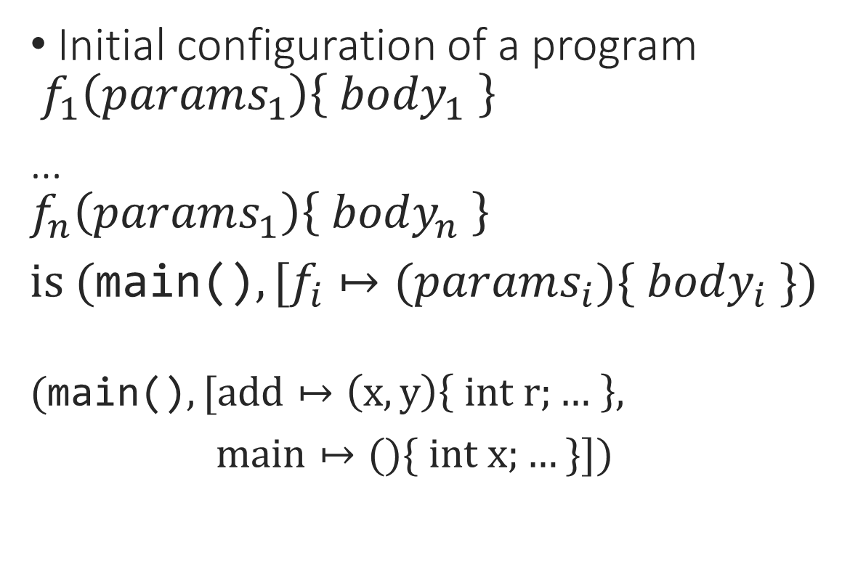
Functions: Initial Program State
int add(int x, int y){
int r;
r := x + y;
return r
}
int main(){
int x; int z;
x := add(1, 2);
return x
}
Initial configuration of a program $f_{1}\left(params_{1}\right)\left\{ body_{1} \right\}$
…
$$f_{n}\left(params_{1}\right)\left\{ body_{n} \right\}$$
is $(\text{main}\text{()}, [f_{i}↦(params_{i})\{ body_{i} \})$
$$(\text{main}\text{()}, [add↦\left(x,y\right)\left\{ int r;… \right\},$$
$main↦()\{ int x;…\}])$

Slide 32

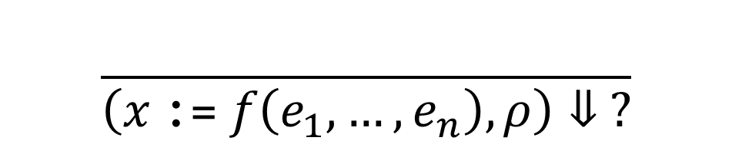
Functions: Semantics of Calls
Evaluate the arguments $e_{1},…,e_{n}$
Look up $f$ in $ρ$
Execute the body of $f$ and produce a return value
Assign the return value to $x$
$$\frac{}{\left(x \text{:=} f\left(e_{1},…,e_{n}\right),ρ\right)⇓ ?}$$
Notes:
What do we need to do to run a function call?

Slide 33
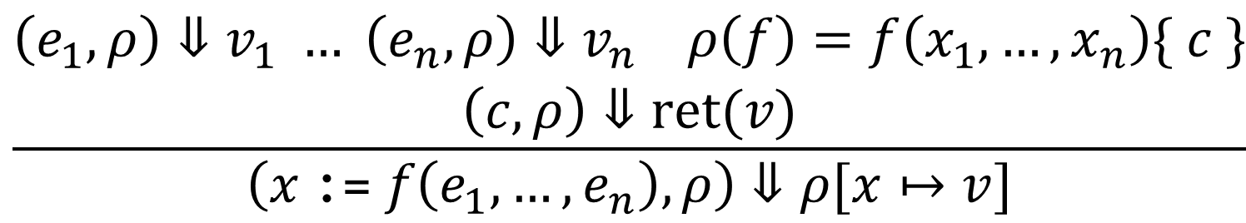
Functions: Semantics of Calls
Evaluate the arguments $e_{1},…,e_{n}$
Look up $f$ in $ρ$
Execute the body of $f$ and produce a return value
Assign the return value to $x$
$$\frac{\begin{aligned}\left(e_{1},ρ\right)⇓v_{1} … \left(e_{n},ρ\right)⇓v_{n} ρ\left(f\right)=f\left(x_{1},…,x_{n}\right)\{ c \} \\ \left(c,ρ\right)⇓ret(v)\end{aligned}}{\left(x \text{:=} f\left(e_{1},…,e_{n}\right),ρ\right)⇓ρ[x↦v]}$$

Slide 34

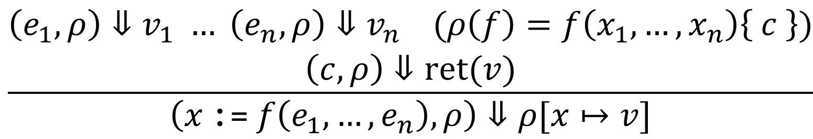
Functions: Semantics of Calls
Evaluate the arguments $e_{1},…,e_{n}$
Look up $f$ in $ρ$
Execute the body of $f$ and produce a return value
Assign the return value to $x$
$$\frac{\begin{aligned}\left(e_{1},ρ\right)⇓v_{1} … \left(e_{n},ρ\right)⇓v_{n} (ρ\left(f\right)=f\left(x_{1},…,x_{n}\right)\left\{ c \right\}) \\ \left(c,ρ\right)⇓ret(v)\end{aligned}}{\left(x \text{:=} f\left(e_{1},…,e_{n}\right),ρ\right)⇓ρ[x↦v]}$$
Notes:
We could also make a separate environment for functions.

Slide 35
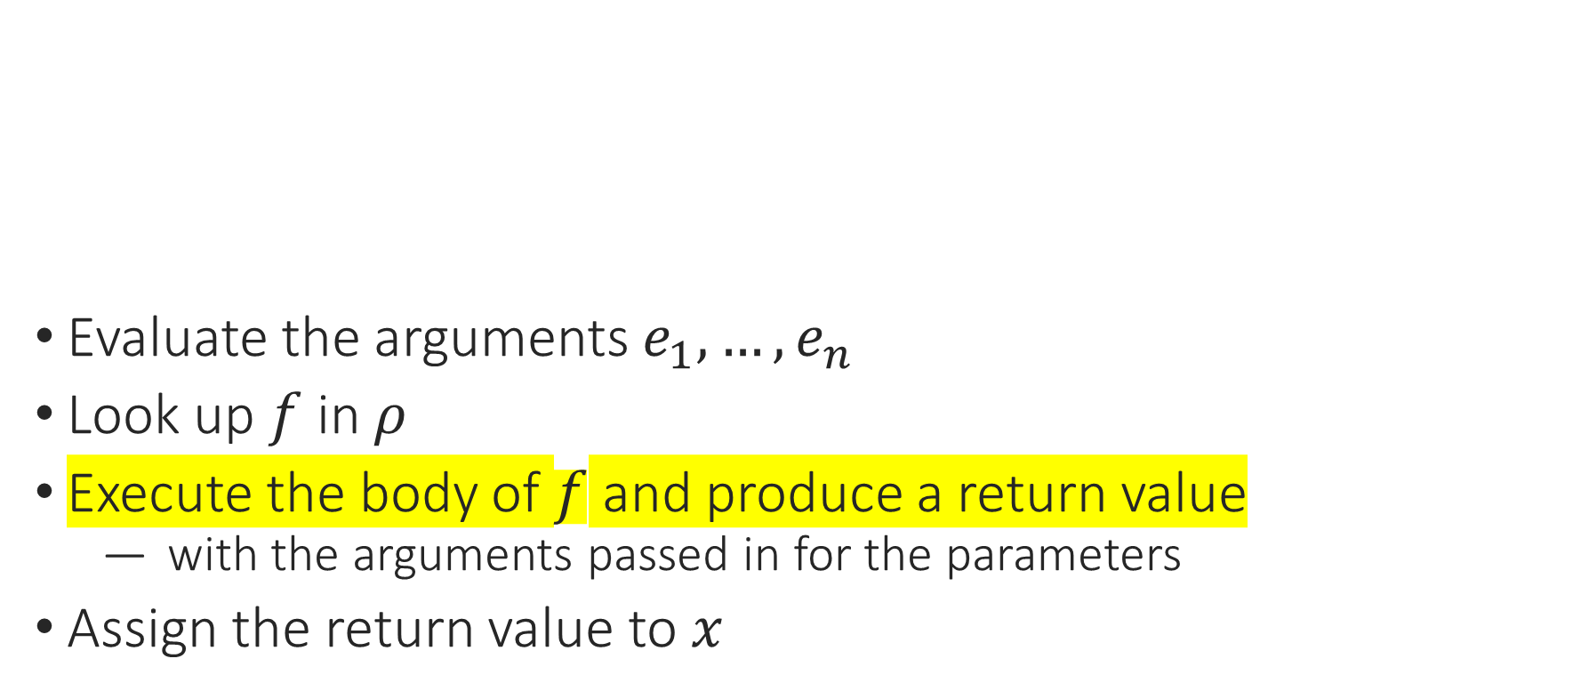
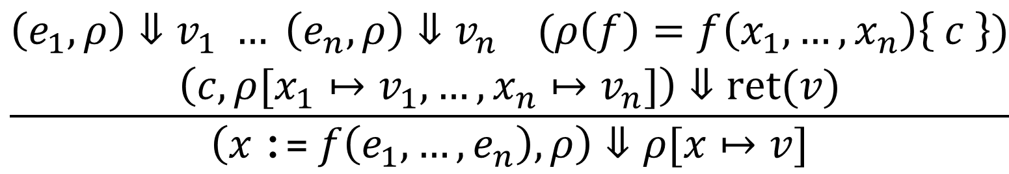
Functions: Semantics of Calls
Evaluate the arguments $e_{1},…,e_{n}$
Look up $f$ in $ρ$
Execute the body of $f$ and produce a return value
  with the arguments passed in for the parameters
Assign the return value to $x$
$$\frac{\begin{aligned}\left(e_{1},ρ\right)⇓v_{1} … \left(e_{n},ρ\right)⇓v_{n} (ρ\left(f\right)=f\left(x_{1},…,x_{n}\right)\left\{ c \right\}) \\ \left(c,ρ[x_{1}↦v_{1},…,x_{n}↦v_{n}]\right)⇓ret(v)\end{aligned}}{\left(x \text{:=} f\left(e_{1},…,e_{n}\right),ρ\right)⇓ρ[x↦v]}$$
Notes:
We could also make a separate environment for functions.

Slide 36
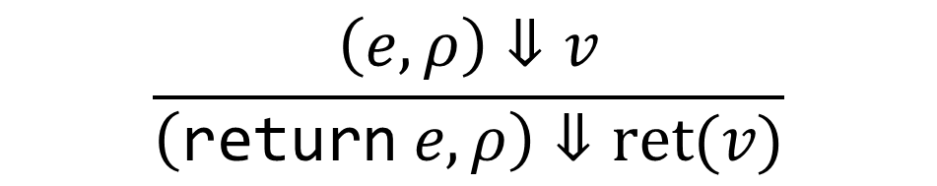
Functions: Semantics of Calls
$$\frac{\begin{aligned}\left(e_{1},ρ\right)⇓v_{1} … \left(e_{n},ρ\right)⇓v_{n} (ρ\left(f\right)=f\left(x_{1},…,x_{n}\right)\left\{ c \right\}) \\ \left(c,ρ[x_{1}↦v_{1},…,x_{n}↦v_{n}]\right)⇓ret(v)\end{aligned}}{\left(x \text{:=} f\left(e_{1},…,e_{n}\right),ρ\right)⇓ρ[x↦v]}$$
$$\frac{\left(e,ρ\right)⇓v}{\left(\text{return} e,ρ\right)⇓ret(v)}$$
Notes:
We could also make a separate environment for functions.

Slide 37
Notes:
Poll Title: Do not modify the notes in this section to avoid tampering with the Poll Everywhere activity.
More info at polleverywhere.com/support
Questions
https://www.polleverywhere.com/discourses/SRzwhp4zztmGWgIgz520A

Slide 38
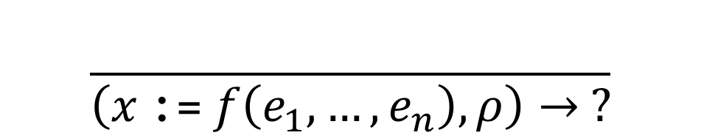
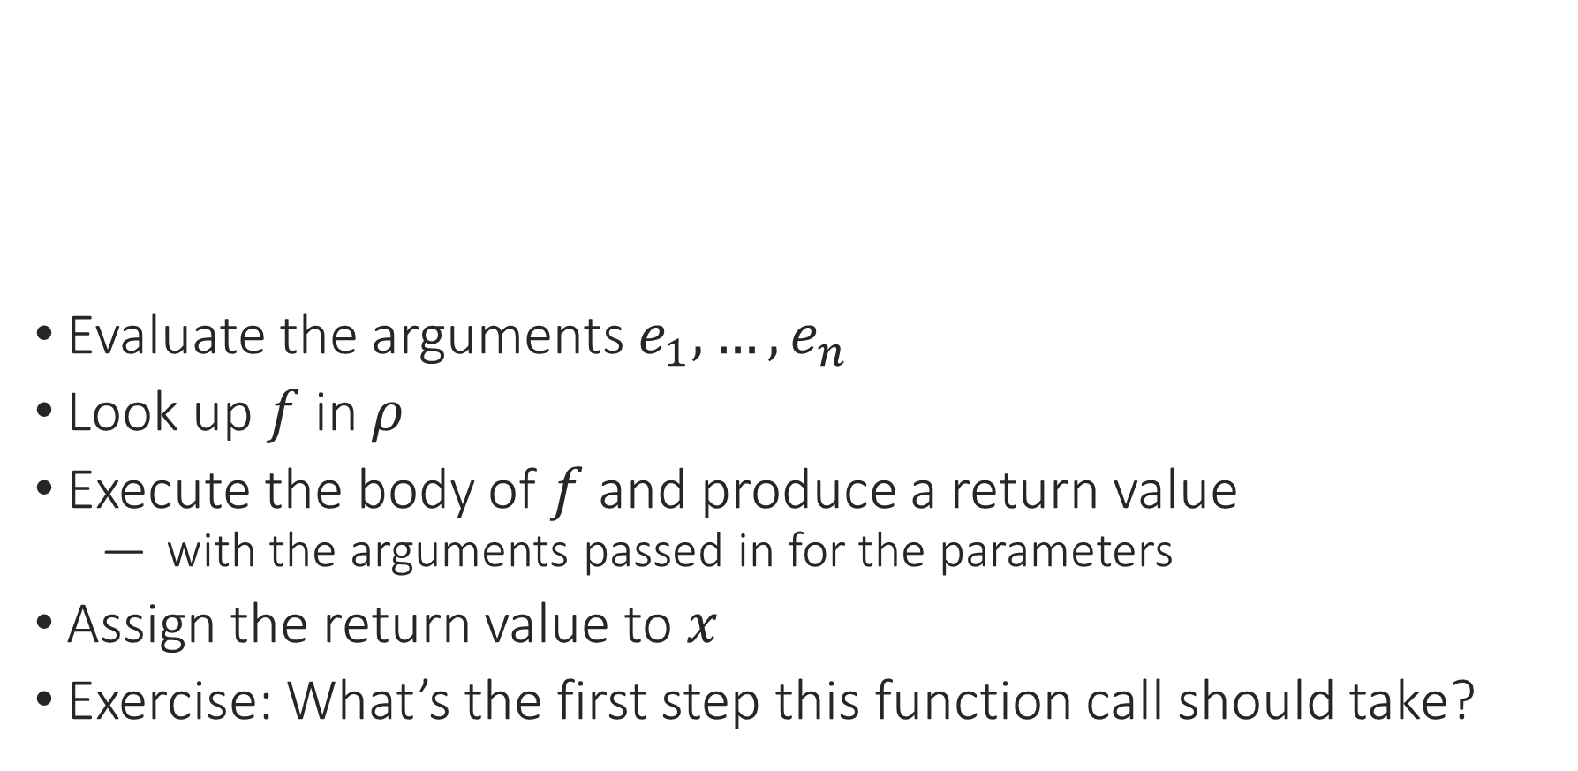
Functions: Small-Step Semantics of Calls
Evaluate the arguments $e_{1},…,e_{n}$
Look up $f$ in $ρ$
Execute the body of $f$ and produce a return value
  with the arguments passed in for the parameters
Assign the return value to $x$
Exercise: What’s the first step this function call should take?
$$\frac{}{\left(x \text{:=} f\left(e_{1},…,e_{n}\right),ρ\right)→ ?}$$

Slide 39

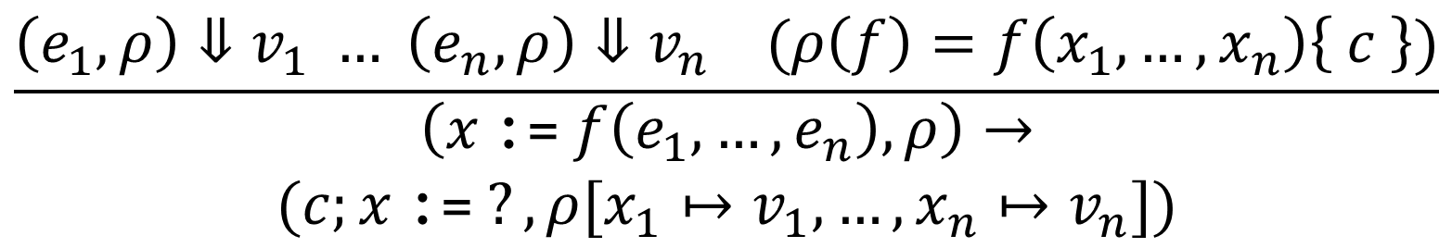
Functions: Semantics of Calls
Evaluate the arguments $e_{1},…,e_{n}$
Look up $f$ in $ρ$
Execute the body of $f$ and produce a return value
Assign the return value to $x$
$$\frac{\left(e_{1},ρ\right)⇓v_{1} … \left(e_{n},ρ\right)⇓v_{n} (ρ\left(f\right)=f\left(x_{1},…,x_{n}\right)\left\{ c \right\})}{\begin{aligned}\left(x \text{:=} f\left(e_{1},…,e_{n}\right),ρ\right)→ \\ (c;x \text{:=} ?,ρ[x_{1}↦v_{1},…,x_{n}↦v_{n}])\end{aligned}}$$
Notes:
But now we don’t know what the old environment was!

Slide 40
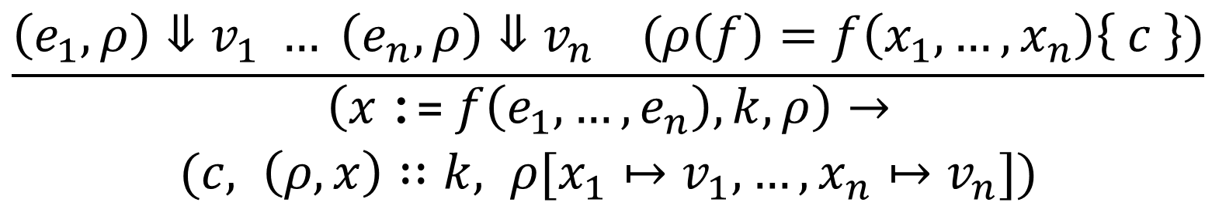
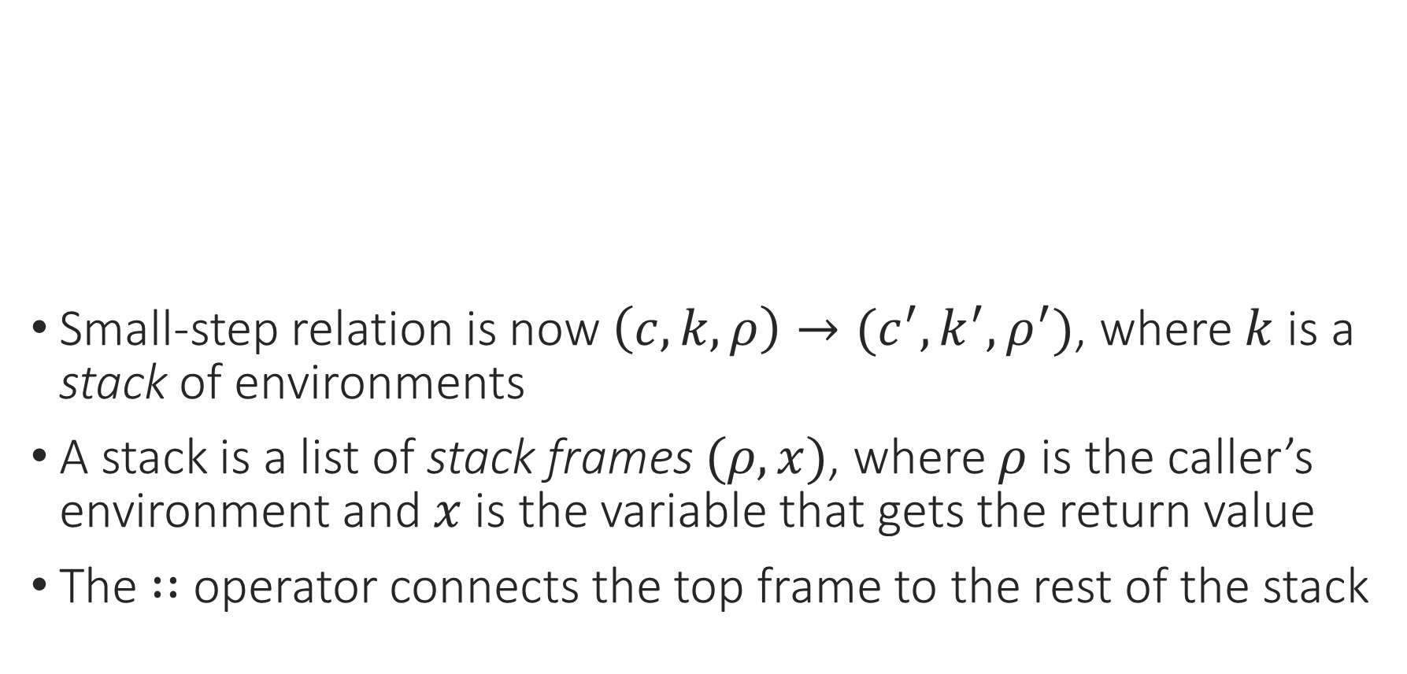
Functions: Semantics of Calls
Small-step relation is now $\left(c,k,ρ\right)→(c^{′},k^{′},ρ^{′})$, where $k$ is a stack of environments
A stack is a list of stack frames $(ρ,x)$, where $ρ$ is the caller’s environment and $x$ is the variable that gets the return value
The $∷$ operator connects the top frame to the rest of the stack
$$\frac{\left(e_{1},ρ\right)⇓v_{1} … \left(e_{n},ρ\right)⇓v_{n} (ρ\left(f\right)=f\left(x_{1},…,x_{n}\right)\left\{ c \right\})}{\begin{aligned}\left(x \text{:=} f\left(e_{1},…, e_{n}\right),k,ρ\right)→ \\ (c, \left(ρ,x\right)∷k, ρ[x_{1}↦v_{1},…,x_{n}↦v_{n}])\end{aligned}}$$

Slide 41

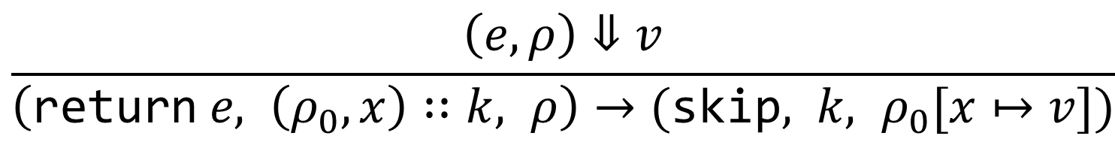
Functions: Semantics of Calls
Small-step relation is now $\left(c,k,ρ\right)→(c^{′},k^{′},ρ^{′})$, where $k$ is a stack of environments
$$\frac{\left(e_{1},ρ\right)⇓v_{1} … \left(e_{n},ρ\right)⇓v_{n} (ρ\left(f\right)=f\left(x_{1},…,x_{n}\right)\left\{ c \right\})}{\begin{aligned}\left(x \text{:=} f\left(e_{1},…, e_{n}\right),k,ρ\right)→ \\ (c, \left(ρ,x\right)∷k, ρ[x_{1}↦v_{1},…,x_{n}↦v_{n}])\end{aligned}}$$
$$\frac{\left(e,ρ\right)⇓v}{\left(\text{return} e, \left(ρ_{0},x\right)∷k, ρ\right)→(\text{skip}, k, ρ_{0}[x↦v])}$$

Slide 42
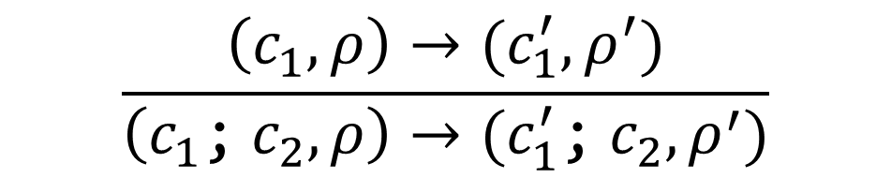
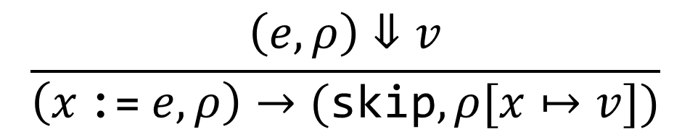
Functions: Semantics of Calls
$$\frac{\left(e,ρ\right)⇓v}{\left(x \text{:=} e,ρ\right)→(\text{skip},ρ[x↦v])}$$
Small-step relation is now $\left(c,k,ρ\right)→(c^{′},k^{′},ρ^{′})$, where $k$ is a stack of environments
$$\frac{\left(c_{1},ρ\right)→(c_{1}^{′}, ρ^{′})}{\left(c_{1}\text{;} c_{2},ρ\right)→(c_{1}^{′}\text{;} c_{2},ρ^{′})}$$

Slide 43
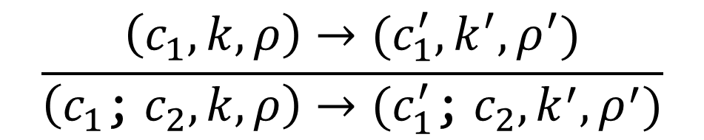
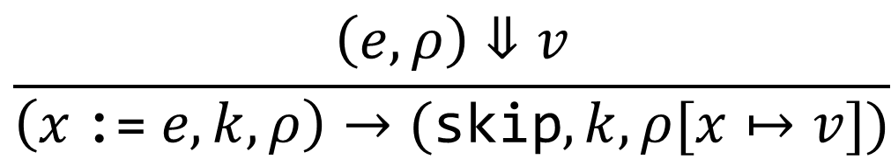
Functions: Semantics of Calls
$$\frac{\left(e,ρ\right)⇓v}{\left(x \text{:=} e,k,ρ\right)→(\text{skip},k,ρ[x↦v])}$$
Small-step relation is now $\left(c,k,ρ\right)→(c^{′},k^{′},ρ^{′})$, where $k$ is a stack of environments
$$\frac{\left(c_{1},k,ρ\right)→(c_{1}^{′},k^{′},ρ^{′})}{\left(c_{1}\text{;} c_{2},k,ρ\right)→(c_{1}^{′}\text{;} c_{2},{k^{′}, ρ}^{′})}$$

Slide 44

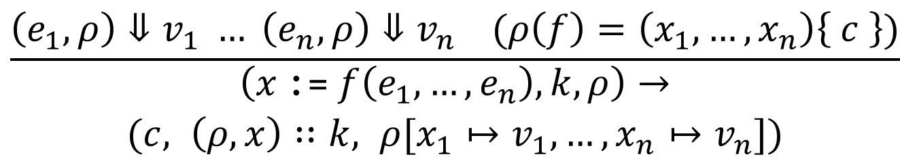
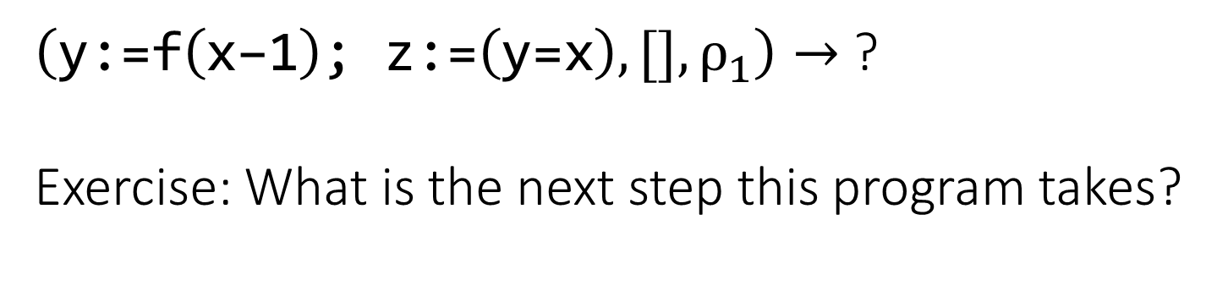
Functions: Semantics of Calls
where $ρ_{1}=\{\text{f}↦\left(\text{x}\right)\{ \text{return} \text{x}\text{+1} \}$, $\text{x}↦3\}$
$\left(\text{y}\text{:=}\text{f}\left(\text{x}\text{−1}\right)\text{; }\text{z}\text{:=}\left(\text{y}\text{=}\text{x}\right),[],ρ_{1}\right)→$ ?
Exercise: What is the next step this program takes?
$$\frac{\left(e_{1},ρ\right)⇓v_{1} … \left(e_{n},ρ\right)⇓v_{n} (ρ\left(f\right)=\left(x_{1},…,x_{n}\right)\left\{ c \right\})}{\begin{aligned}\left(x \text{:=} f\left(e_{1},…, e_{n}\right),k,ρ\right)→ \\ (c, \left(ρ,x\right)∷k, ρ[x_{1}↦v_{1},…,x_{n}↦v_{n}])\end{aligned}}$$
Notes:
So this works fine, as long as every function always executes a return statement.

Slide 45

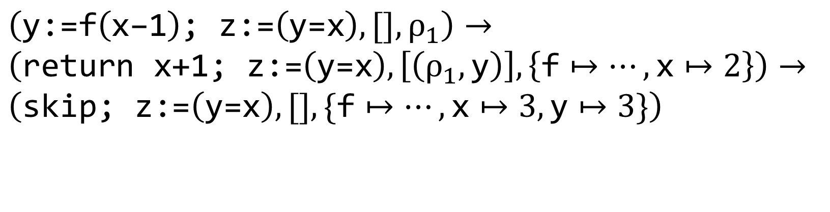
Functions: Semantics of Calls
where $σ=\{\text{f}↦\left(\text{x}\right)\{ \text{return} \text{x}\text{+1} \}$, $\text{x}↦3\}$
$$\left(\text{y}\text{:=}\text{f}\left(\text{x}\text{−1}\right)\text{; }\text{z}\text{:=}\left(\text{y}\text{=}\text{x}\right),[],ρ_{1}\right)→$$
$$\left(\text{return} \text{x}\text{+1; }\text{z}\text{:=}\left(\text{y}\text{=}\text{x}\right),\left[\left(ρ_{1},\text{y}\right)\right],\left\{\text{f}↦…,\text{x}↦2\right\}\right)→$$
$$\left(\text{skip}\text{;} \text{z}\text{:=}\left(\text{y}\text{=}\text{x}\right),[],\{\text{f}↦…,\text{x}↦3,\text{y}↦3\}\right)$$
$$\frac{\left(e_{1},ρ\right)⇓v_{1} … \left(e_{n},ρ\right)⇓v_{n} (ρ\left(f\right)=\left(x_{1},…,x_{n}\right)\left\{ c \right\})}{\begin{aligned}\left(x \text{:=} f\left(e_{1},…, e_{n}\right),k,ρ\right)→ \\ (c, \left(ρ,x\right)∷k, ρ[x_{1}↦v_{1},…,x_{n}↦v_{n}])\end{aligned}}$$
Notes:
So this works fine, as long as every function always executes a return statement.

Slide 46
Notes:
Poll Title: Do not modify the notes in this section to avoid tampering with the Poll Everywhere activity.
More info at polleverywhere.com/support
Questions
https://www.polleverywhere.com/discourses/SRzwhp4zztmGWgIgz520A

Slide 47
Homework 4 Overview
Lists in OCaml
Useful types: entry, env, stack, config
eval_exp and step_cmd
run_config and testing

Slide 48
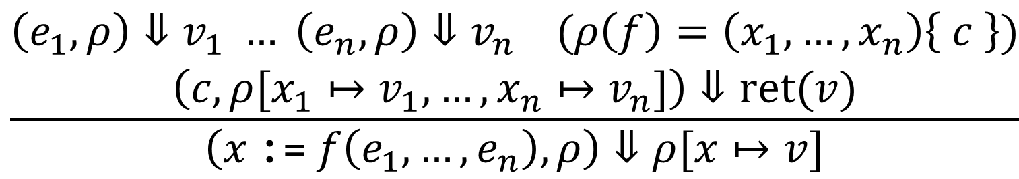
Functions: The Hidden Stack
Big-step and small-step describe the same behavior
Small-step semantics now need a whole extra piece of state
And that state corresponds to a feature of real language implementations!
$$\frac{\begin{aligned}\left(e_{1},ρ\right)⇓v_{1} … \left(e_{n},ρ\right)⇓v_{n} (ρ\left(f\right)=\left(x_{1},…,x_{n}\right)\left\{ c \right\}) \\ \left(c,ρ[x_{1}↦v_{1},…,x_{n}↦v_{n}]\right)⇓ret(v)\end{aligned}}{\left(x \text{:=} f\left(e_{1},…,e_{n}\right),ρ\right)⇓ρ[x↦v]}$$
Notes:
Does this mean we can write an interpreter without a call stack?

Slide 49
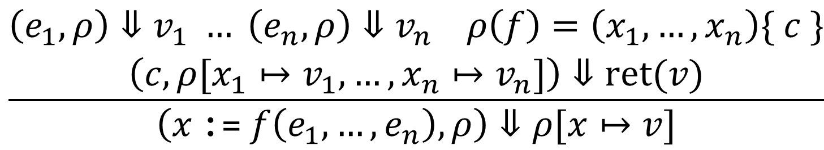
Functions: Interpreter vs. Compiled
$$\frac{\begin{aligned}\left(e_{1},ρ\right)⇓v_{1} … \left(e_{n},ρ\right)⇓v_{n} ρ\left(f\right)=\left(x_{1},…,x_{n}\right)\{ c \} \\ \left(c,ρ[x_{1}↦v_{1},…,x_{n}↦v_{n}]\right)⇓ret(v)\end{aligned}}{\left(x \text{:=} f\left(e_{1},…,e_{n}\right),ρ\right)⇓ρ[x↦v]}$$
let rec eval_cmd c r = match c with
| Call (x, f, es) ->

Slide 50
Functions: Interpreter vs. Compiled
$$\frac{\begin{aligned}\left(e_{1},ρ\right)⇓v_{1} … \left(e_{n},ρ\right)⇓v_{n} ρ\left(f\right)=\left(x_{1},…,x_{n}\right)\{ c \} \\ \left(c,ρ[x_{1}↦v_{1},…,x_{n}↦v_{n}]\right)⇓ret(v)\end{aligned}}{\left(x \text{:=} f\left(e_{1},…,e_{n}\right),ρ\right)⇓ρ[x↦v]}$$
let rec eval_cmd c r = match c with
| Call (x, f, es) -> match eval_exps es r with Some vs ->
match lookup r f with Some (Fun (xs, c)) ->
match eval_cmd c (add_args r xs vs) with
| Some (Ret v) -> Some (State (update r x v))
Notes:
Where is the old state stored in the interpreter? In the stack frame for eval_cmd!

Slide 51
Functions: Interpreter vs. Compiled
let rec eval_cmd c r = match c with
| Call (x, f, es) -> match eval_exps es r with Some vs ->
match lookup r f with Some (Fun (xs, c)) ->
match eval_cmd c (add_args r xs vs) with
| Some (Ret v) -> Some (State (update r x v))
push stackframe f:
store args <compiled code for c>
store ret addr pop stackframe
jmp f jmp ret addr
Notes:
Where is the old state stored in the interpreter? In the stack frame for eval_cmd!

Slide 52
Notes:
Poll Title: Do not modify the notes in this section to avoid tampering with the Poll Everywhere activity.
More info at polleverywhere.com/support
Questions
https://www.polleverywhere.com/discourses/SRzwhp4zztmGWgIgz520A

Slide 53
Imperative Languages
Arithmetic and boolean expressions
Variables and assignment
Control flow (conditionals, loops)
Variable declarations
Function declarations and calls
There’s more, but we’ve covered the essentials!
Next up: object-oriented languages

Slide 54
Notes:
Poll Title: Do not modify the notes in this section to avoid tampering with the Poll Everywhere activity.
More info at polleverywhere.com/support
Questions
https://www.polleverywhere.com/discourses/SRzwhp4zztmGWgIgz520A

