Slide 1
CS 476 – Programming Language Design
William Mansky

Slide 2

Notes:
Poll Title: Do not modify the notes in this section to avoid tampering with the Poll Everywhere activity.
More info at polleverywhere.com/support
Questions
https://www.polleverywhere.com/discourses/SRzwhp4zztmGWgIgz520A

Slide 3
Language Design: Outline
So far we’ve:
  started from an informal description of a language
  turned its syntax into a grammar and corresponding OCaml datatype
  written down typing rules and translated them into a typechecker
  written down semantic rules and translated them into an interpreter and debugger
These will be our main tools for the class!
For the rest of the class, we’ll apply these tools to a range of languages and language features
Notes:
If you think of something and we don’t cover it, that could be a good target for the course project!

Slide 4
Adding Variables
Next target language: expressions + variables
A variable has a name (usually alphanumeric), and holds a value
Examples: x + 5 if cond then 3 else z

Slide 5
Adding Variables: Syntax
E ::= <#>
| E + E | E – E | E * E
| <bool>
| E and E | E or E
| not E
| E = E
| if E then E else E

Slide 6
Adding Variables: Syntax
E ::= <#> | <ident>
| E + E | E – E | E * E
| <bool>
| E and E | E or E
| not E
| E = E
| if E then E else E
Example expressions:
x + 5
if y then 3 else z

Slide 7
Adding Variables
How do variables get their values?
Option 1: local binding
  fun x -> x + 5
  let x = 2 + 3 in if x = 5 then true else false
Option 2: assignment
  x = 3; y = x + 5;
  x = 4; z = x + 5; // y != z
Notes:
First of all, what are variables? Roughly speaking, they’re names that hold values we’ve already computed.

Slide 8
Adding Variables
Option 2: assignment
  x = 3; y = x + 5;
  x = 4; z = x + 5; // y != z
Some terms don’t just compute values: they have side effects that change the meaning of later terms
We call terms that compute values expressions, and terms with side effects commands

Slide 9
Adding Variables: Syntax
E ::= <#> | <ident>
| E + E | E – E | E * E
| <bool>
| E and E | E or E
| not E
| E = E
| if E then E else E
C ::= <ident> := E
| C; C
| skip
Example terms:
x := 3; y := x = 2; z := a && y
x := 0; x := x + 1; y := x
Notes:
Note that this isn’t C-like syntax; it’s modeled after Algol and Pascal.
Now that we’re doing assignments, a program is a whole series of commands.

Slide 10
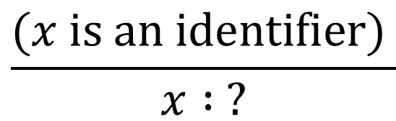
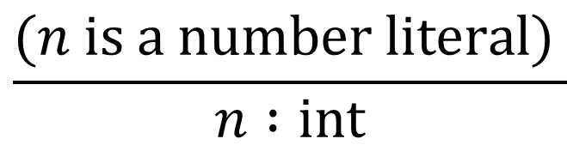

Adding Variables: Types
How do we typecheck variables?
Exercise: How do you figure out the type of a variable without running the program?
$$\frac{(n is a number literal) }{n :int}$$
$$\frac{e_{1} :int e_{2} :int }{e_{1} \text{+} e_{2} :int}$$
$$\frac{(x is an identifier) }{x : ?}$$

Slide 11
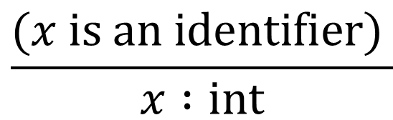
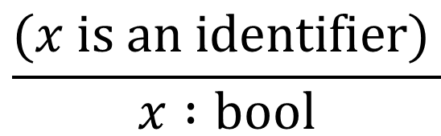
Typechecking Variables, Approach #1
How do we typecheck variables?
$$\frac{(n is a number literal) }{n :int}$$
$$\frac{e_{1} :int e_{2} :int }{e_{1} \text{+} e_{2} :int}$$
$$\frac{(x is an identifier) }{x :int}$$
$$\frac{(x is an identifier) }{x :bool}$$

Slide 12
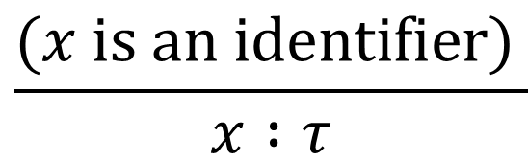

Typechecking Variables, Approach #1
How do we typecheck variables?
$$\frac{(n is a number literal) }{n :int}$$
$$\frac{e_{1} :int e_{2} :int }{e_{1} \text{+} e_{2} :int}$$
$$\frac{(x is an identifier) }{x :τ}$$
Notes:
This makes sense in a language where we can change the types of variables. It weakens typechecking significantly, though, because we have to assume every variable could have any type.

Slide 13


Typechecking Variables, Approach #2
How do we typecheck variables?
E ::= <#> | (<ident> : T)
| E + E | E – E | E * E
| <bool>
| E and E | E or E
| not E
| E = E
| if E then E else E
T ::= INT | BOOL
Each tag has its own namespace
add INT/BOOL tags in preprocessing
$$\frac{}{\left(x \text{:}\text{INT}\right) :int}$$
$$\frac{}{\left(x \text{:}\text{BOOL}\right) :bool}$$
Notes:
For instance, in BASIC, the names of string variables all ended in $.

Slide 14
Adding Variables: Syntax
E ::= <#> | <ident>
| E + E | E – E | E * E
| <bool>
| E and E | E or E
| not E
| E = E
| if E then E else E
C ::= <ident> := E
| C; C
| skip
Example terms:
x := 3; y := x = 2; z := a && y
x := 0; x := x + 1; y := x
Notes:
Note that this isn’t C-like syntax; it’s modeled after Algol and Pascal.
Now that we’re doing assignments, a program is a whole series of commands.

Slide 15
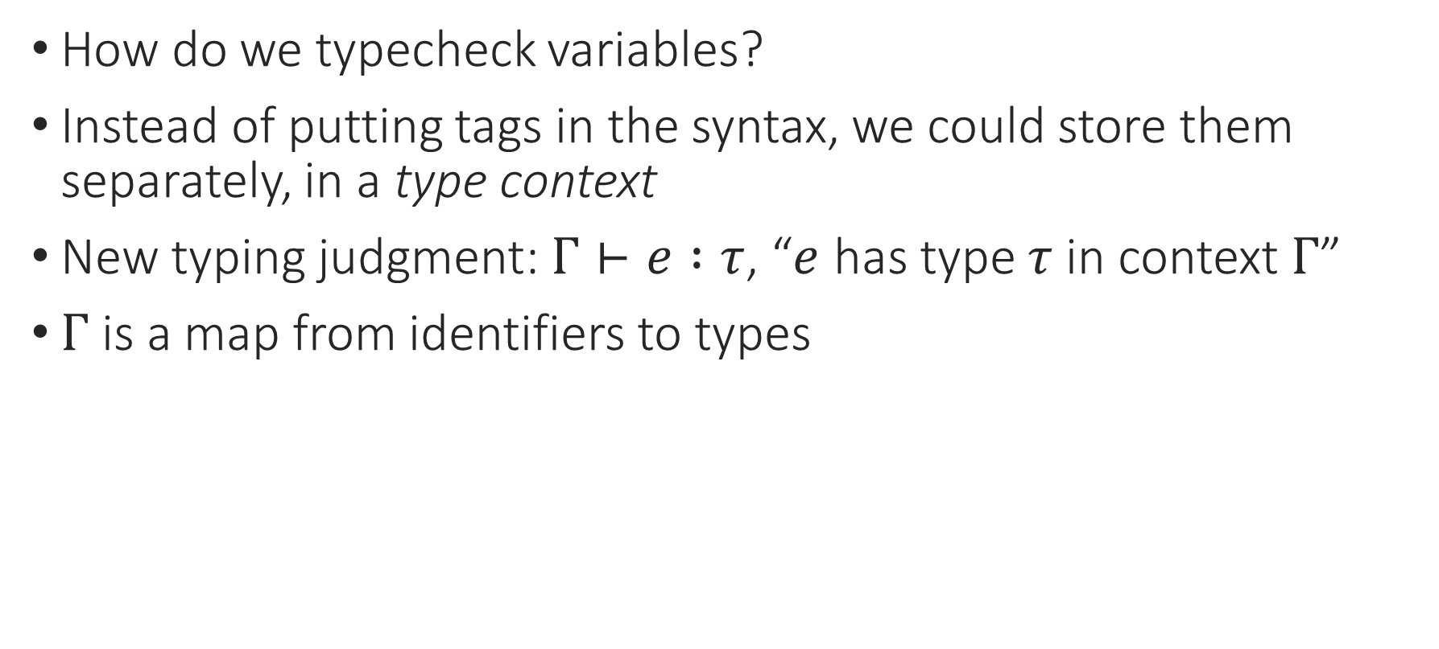
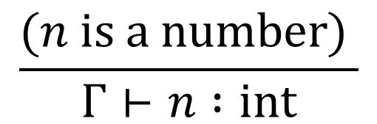
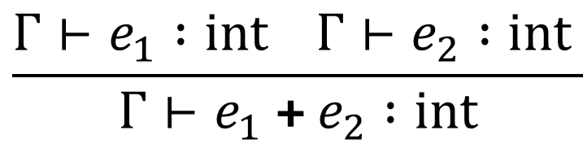

Typechecking Variables, Approach #3
How do we typecheck variables?
Instead of putting tags in the syntax, we could store them separately, in a type context
New typing judgment: $Γ⊢e :τ$, “$e$ has type $τ$ in context $Γ$”
$Γ$ is a map from identifiers to types
Greek letter “gamma”
$$\frac{Γ\left(x\right)=τ }{Γ⊢x :τ}$$
$$\frac{(n is a number) }{Γ⊢n :int}$$
$$\frac{Γ⊢e_{1} :int Γ⊢e_{2} :int }{Γ⊢e_{1} \text{+} e_{2} :int}$$

Slide 16
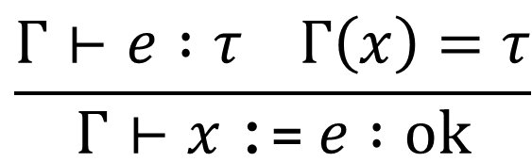

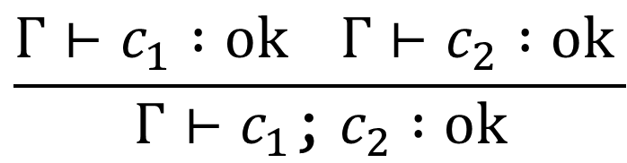
Adding Variables: Types for Commands
What types can a command have?
Only one: “correct”, or “ok”
$$\frac{Γ⊢e :τ Γ\left(x\right)=τ}{Γ⊢x \text{:=} e :ok}$$
$$\frac{Γ⊢c_{1} :ok Γ⊢c_{2} :ok }{Γ⊢c_{1}\text{;}{ c}_{2} :ok}$$
$$\frac{}{Γ⊢\text{skip} :ok}$$
Notes:
These can get a bit hard to read, so note that the parens are around whatever’s between the turnstile and the colon.

Slide 17
Notes:
Poll Title: Do not modify the notes in this section to avoid tampering with the Poll Everywhere activity.
More info at polleverywhere.com/support
Questions
https://www.polleverywhere.com/discourses/SRzwhp4zztmGWgIgz520A

Slide 18
Adding Variables: Syntax
E ::= <#> | <ident>
| E + E | E – E | E * E
| <bool>
| E and E | E or E
| not E
| E = E
| if E then E else E
C ::= <ident> := E
| C; C
| skip
Example terms:
x := 3; y := x = 2; z := a && y
x := 0; x := x + 1; y := x
Notes:
Note that this isn’t C-like syntax; it’s modeled after Algol and Pascal.
Now that we’re doing assignments, a program is a whole series of commands.

Slide 19
Adding Variables: Semantics
The behavior of programs now depends on the environment!
x := 3 + 4;
y := x + 5;
b := if y = 12 then true else false;
x := 2;
z := x + 5;
c := b && true
What are the values of the variables at this point?
{b = true, x = 2, y = 12}

Slide 20


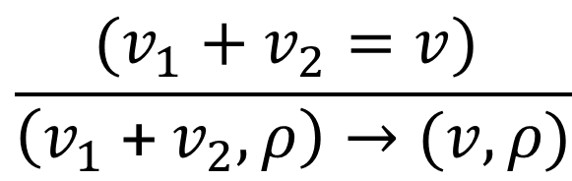
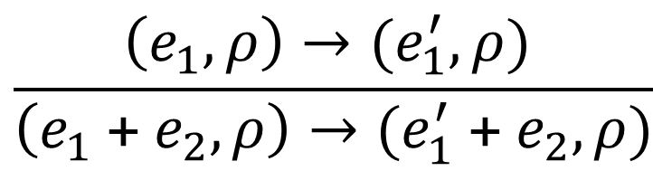

Adding Variables: Semantics
The behavior of programs now depends on the environment!
Small-step relation is $\left(t, ρ\right)→\left(t^{′}, ρ^{′}\right)$, where the environment $ρ$ is a map from variables to values
Greek letter “rho”
“when we look up $x$ in $ρ$, we find $v$”
$$\frac{ρ\left(x\right)=v }{\left(x, ρ\right)→(v,ρ)}$$
$$\frac{\left(e_{1}, ρ\right)→(e_{1}^{′},ρ) }{\left(e_{1} \text{+} e_{2},ρ\right)→(e_{1}^{′} \text{+} e_{2},ρ)}$$
$$\frac{(v_{1}+v_{2}=v) }{\left(v_{1} \text{+} v_{2},ρ\right)→(v,ρ)}$$
Notes:
A configuration of a program while it’s running now has both a program and a state.

Slide 21
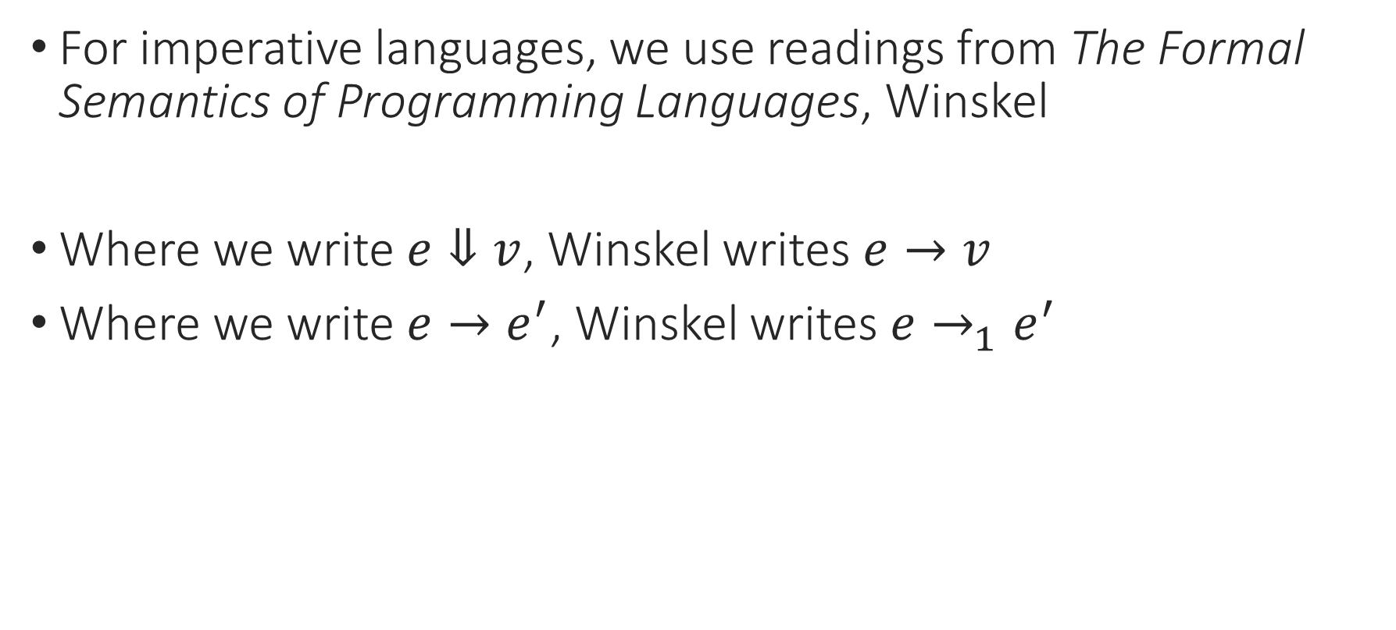
Textbook Notation Warning
For imperative languages, we use readings from The Formal Semantics of Programming Languages, Winskel
Where we write $e⇓v$, Winskel writes $e→v$
Where we write $e→e^{′}$, Winskel writes $e→_{1}e^{′}$

Slide 22


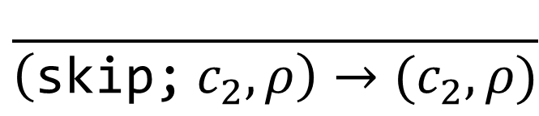
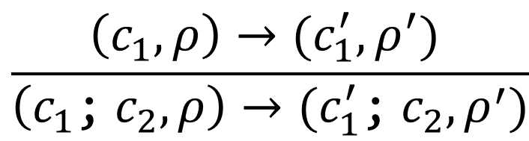
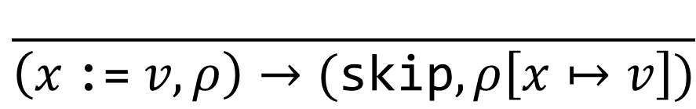
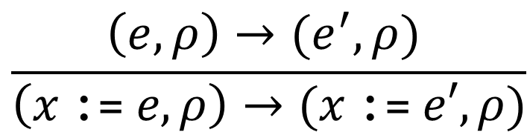
Adding Variables: Semantics
Our programs now have state!
Small-step relation is $\left(t, ρ\right)→\left(t^{′}, ρ^{′}\right)$, where environment $ρ$ is a map from variables to values
$$\frac{\left(e,ρ\right)→(e^{′},ρ) }{\left(x \text{:=} e,ρ\right)→(x \text{:=} e′, ρ)}$$
$$\frac{\left(c_{1},ρ\right)→(c_{1}^{′},ρ^{′}) }{\left(c_{1}\text{;}{ c}_{2}, ρ\right)→(c_{1}^{′}\text{;}{ c}_{2}, ρ^{′})}$$
$$\frac{ }{\left(x \text{:=} v,ρ\right)→(\text{skip},ρ\left[x↦v\right])}$$
$$\frac{ }{\left(\text{skip}\text{;} c_{2},ρ\right)→(c_{2},ρ)}$$
“set $x$ to $v$ in $ρ$”
Notes:
Note that the , is the top-level separator here: the command is c1; c2, and the state is sigma.

Slide 23
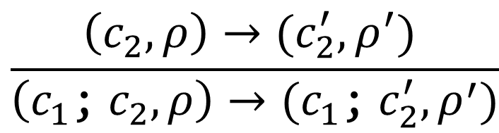
Structural Rule for Sequencing
What if we had
x := 3; x := x + 1; x := 4
Exercise: What should this program evaluate to? What could it evaluate to using this rule?
$$\frac{\left(c_{2},ρ\right)→(c_{2}^{′},ρ^{′}) }{\left(c_{1}\text{;} c_{2},ρ\right)→(c_{1}\text{;} c_{2}^{′}, ρ^{′})}$$
Notes:
What should this program evaluate to?

Slide 24

Structural Rule for Sequencing
What if we had
x := 3; x := x + 1; x := 4
$→$ x := x + 1; x := 4, {x = 3} (by rule 1)
$→$ x := x + 1, {x = 4} (by rule 2)
$→$ skip, {x = 5}
$$\frac{\left(c_{2},ρ\right)→(c_{2}^{′},ρ^{′}) }{\left(c_{1}\text{;} c_{2},ρ\right)→(c_{1}\text{;} c_{2}^{′}, ρ^{′})}$$
Notes:
What should this program evaluate to?

Slide 25
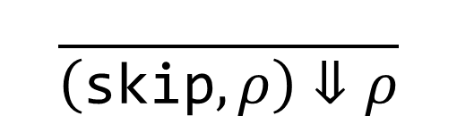
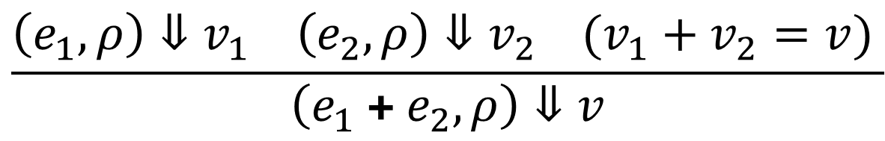
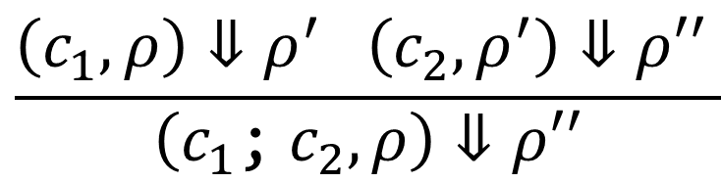

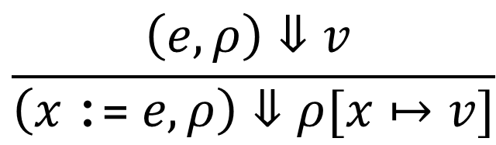


Adding Variables: Big-Step Semantics
$$\left(e, ρ\right)⇓v$$
What does an expression evaluate to?
What does a command evaluate to?
$$\left(c, ρ\right)⇓ρ^{′}$$
$$\frac{ρ\left(x\right)=v }{\left(x,ρ\right)⇓v}$$
$$\frac{\left(e_{1}, ρ\right)⇓v_{1} \left(e_{2},ρ\right)⇓v_{2} (v_{1}+v_{2}=v) }{\left(e_{1} \text{+} e_{2},ρ\right)⇓v}$$
$$\frac{\left(e,ρ\right)⇓v }{\left(x \text{:=} e,ρ\right)⇓ρ[x↦v]}$$
$$\frac{\left(c_{1},ρ\right)⇓ρ^{′} \left(c_{2},ρ^{′}\right)⇓ρ′′ }{\left(c_{1}\text{;}{ c}_{2},ρ\right)⇓ρ′′}$$
$$\frac{ }{\left(\text{skip},ρ\right)⇓ρ}$$

Slide 26
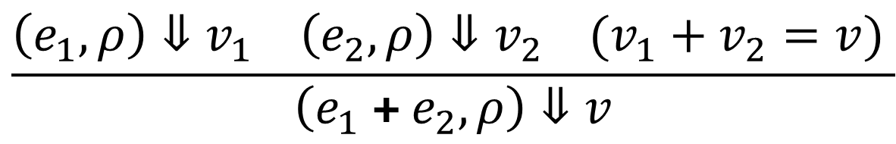

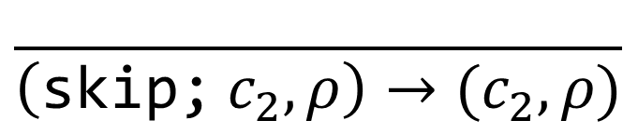
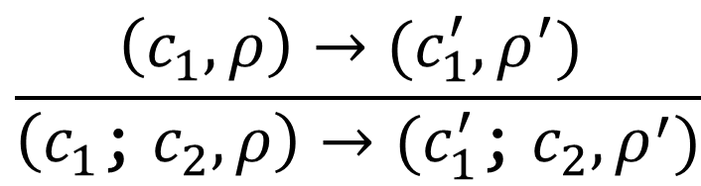
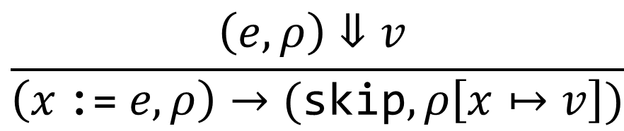
Adding Variables: Hybrid Semantics
Expressions don’t change the state, commands do
So we might only care about intermediate steps for commands
$$\frac{ρ\left(x\right)=v }{\left(x,ρ\right)⇓v}$$
$$\frac{\left(e_{1}, ρ\right)⇓v_{1} \left(e_{2},ρ\right)⇓v_{2} (v_{1}+v_{2}=v) }{\left(e_{1} \text{+} e_{2},ρ\right)⇓v}$$
$$\frac{\left(e,ρ\right)⇓v }{\left(x \text{:=} e,ρ\right)→(\text{skip}, ρ\left[x↦v\right])}$$
$$\frac{\left(c_{1},ρ\right)→(c_{1}^{′},ρ^{′}) }{\left(c_{1}\text{;}{ c}_{2},ρ\right)→(c_{1}^{′}\text{;}{ c}_{2}, ρ^{′})}$$
$$\frac{ }{\left(\text{skip}\text{;}{ c}_{2},ρ\right)→(c_{2},ρ)}$$

Slide 27
Notes:
Poll Title: Do not modify the notes in this section to avoid tampering with the Poll Everywhere activity.
More info at polleverywhere.com/support
Questions
https://www.polleverywhere.com/discourses/SRzwhp4zztmGWgIgz520A

Slide 28

Adding Variables: Interpreter
Follow the big-step semantics
let rec eval_exp (e : exp) : value option =
match e with
| Id x ->
| Add (e1, e2) ->
| …
$$\frac{ρ\left(x\right)=v }{\left(x,ρ\right)⇓v}$$

Slide 29
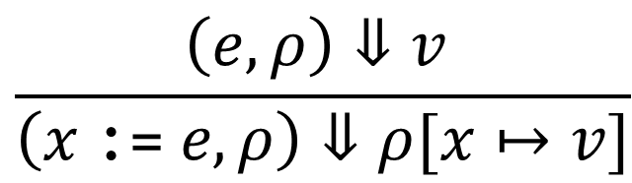

Adding Variables: Interpreter
Follow the big-step semantics
let rec eval_exp (e : exp) (r : env) : value option =
What is the env type? It’s a map that supports two operations: lookup and update
$$\frac{ρ\left(x\right)=v }{\left(x,ρ\right)⇓v}$$
$$\frac{\left(e,ρ\right)⇓v }{\left(x \text{:=} e,ρ\right)⇓ρ[x↦v]}$$

Slide 30
Adding Variables: Interpreter
Follow the big-step semantics
let rec eval_exp (e : exp) (r : env) : value option =
match e with
| Id x ->
| Add (e1, e2) ->
| …
$$\frac{ρ\left(x\right)=v }{\left(x,ρ\right)⇓v}$$

Slide 31
Maps in OCaml
How should we define the environment?
It’s a map from variables to values: we should be able to look up the value of a variable, and set a new value for a variable
let lookup (r : env) (x : ident) : value option = …
let update (r : env) (x : ident) (v : value) : env = …

Slide 32
Maps in OCaml
How should we define environment?
It’s a map from variables to values: we should be able to lookup the value of a variable, and set a new value for a variable
type env = ident -> value option
let lookup (r : env) (x : ident) : value option = …
let update (r : env) (x : ident) (v : value) : state = …

Slide 33
Maps in OCaml
type env = ident -> value option
let lookup (r : env) (x : ident) : value option = r x
let update (r : env) (x : ident) (v : value) : env = …

Slide 34
Maps in OCaml
type env = ident -> value option
let lookup (r : env) (x : ident) : value option = r x
let update (r : env) (x : ident) (v : value) : env =
fun y ->

Slide 35
Maps in OCaml
type env = ident -> value option
let lookup (r : env) (x : ident) : value option = r x
let update (r : env) (x : ident) (v : value) : env =
fun y -> if y = x then Some v else r y

Slide 36
Maps in OCaml
type env = ident -> value option
let update (r : env) (x : ident) (v : value) : env =
fun y -> if y = x then Some v else r y
let empty_env : env = fun _ -> None

Slide 37
Maps in OCaml
let update (r : env) (x : ident) (v : value) : env =
fun y -> if y = x then Some v else r y
let empty_env : env = fun _ -> None
update empty_env “v1” (IntVal 5) = fun y ->
if y = “v1” then Some (IntVal 5) else empty_env y

Slide 38
Maps in OCaml
let update (r : env) (x : ident) (v : value) : env =
fun y -> if y = x then Some v else r y
let empty_env : env = fun _ -> None
update empty_env “v1” (IntVal 5) = fun y ->
if y = “v1” then Some (IntVal 5) else empty_env y

Slide 39
Maps in OCaml
let update (r : env) (x : ident) (v : value) : env =
fun y -> if y = x then Some v else r y
let empty_env : env = fun _ -> None
update empty_env “v1” (IntVal 5) = fun y ->
if y = “v1” then Some (IntVal 5) else None

Slide 40
Maps in OCaml
let update (r : env) (x : ident) (v : value) : env =
fun y -> if y = x then Some v else r y
let empty_env : env = fun _ -> None
update (update empty_env “v1” (IntVal 5)) “v2” (BoolVal true) =
fun y -> if y = “v2” then Some (BoolVal true) else
if y = “v1” then Some (IntVal 5) else None

Slide 41

Notes:
Poll Title: Do not modify the notes in this section to avoid tampering with the Poll Everywhere activity.
More info at polleverywhere.com/support
Questions
https://www.polleverywhere.com/discourses/OD2vaiY4qbLfwkEJUGyvG

Slide 42
Adding Variables: Interpreter
Follow the big-step semantics
let rec eval_exp (e : exp) (r : env) : value option =
match e with
| Id x ->
| Add (e1, e2) ->
| …
$$\frac{ρ\left(x\right)=v }{\left(x,ρ\right)⇓v}$$

Slide 43
Adding Variables: Interpreter
Follow the big-step semantics
let rec eval_exp (e : exp) (r : env) : value option =
match e with
| Id x -> lookup r x
| Add (e1, e2) ->
| …
$$\frac{ρ\left(x\right)=v }{\left(x,ρ\right)⇓v}$$

Slide 44
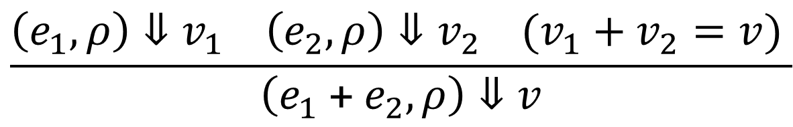
Adding Variables: Interpreter
Follow the big-step semantics
let rec eval_exp (e : exp) (r : env) : value option =
match e with
| Add (e1, e2) ->
(match eval_exp e1 r, eval_exp e2 r with
| Some (IntVal i1), Some (IntVal i2) -> Some (IntVal (i1 + i2))
| _, _ -> None)
$$\frac{\left(e_{1}, ρ\right)⇓v_{1} \left(e_{2},ρ\right)⇓v_{2} (v_{1}+v_{2}=v) }{\left(e_{1} \text{+}{ e}_{2},ρ\right)⇓v}$$

Slide 45
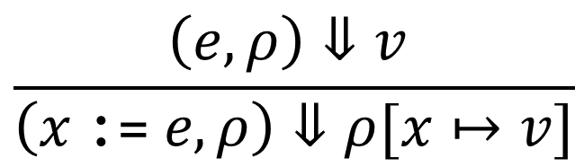
Adding Variables: Interpreter
let rec eval_cmd (c : cmd) (r : env) : env option =
match c with
| Assign (x, e) ->
| Seq (c1, c2) ->
| Skip ->
$$\frac{\left(e,ρ\right)⇓v }{\left(x \text{:=} e,ρ\right)⇓ρ[x↦v]}$$

Slide 46
Adding Variables: Interpreter
let rec eval_cmd (c : cmd) (r : env) : env option =
match c with
| Assign (x, e) ->
(match eval_exp e r with
| Seq (c1, c2) ->
| Skip ->
$$\frac{\left(e,ρ\right)⇓v }{\left(x \text{:=} e,ρ\right)⇓ρ[x↦v]}$$

Slide 47
Adding Variables: Interpreter
let rec eval_cmd (c : cmd) (r : env) : env option =
match c with
| Assign (x, e) ->
(match eval_exp e r with
| Some v -> Some (update r x v)
| None -> None)
| Seq (c1, c2) ->
| Skip ->
$$\frac{\left(e,ρ\right)⇓v }{\left(x \text{:=} e,ρ\right)⇓ρ[x↦v]}$$

Slide 48
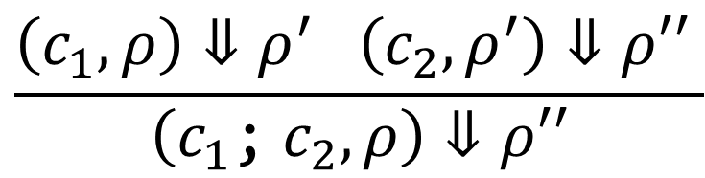
Adding Variables: Interpreter
let rec eval_cmd (c : cmd) (r : env) : env option =
match c with
| …
| Seq (c1, c2) ->
| Skip ->
Exercise: How would you implement this rule in OCaml?
$$\frac{\left(c_{1},ρ\right)⇓ρ^{′} \left(c_{2},ρ^{′}\right)⇓ρ′′ }{\left(c_{1}\text{;} c_{2},ρ\right)⇓ρ′′}$$

Slide 49
Adding Variables: Interpreter
let rec eval_cmd (c : cmd) (r : env) : env option =
match c with
| …
| Seq (c1, c2) ->
match eval_cmd c1 r with
| Some r’ -> eval_cmd c2 r’
| Skip ->
Exercise: How would you implement this rule in OCaml?
$$\frac{\left(c_{1},ρ\right)⇓ρ^{′} \left(c_{2},ρ^{′}\right)⇓ρ′′ }{\left(c_{1}\text{;} c_{2},ρ\right)⇓ρ′′}$$

Slide 50
Adding Variables: Interpreter
let rec eval_cmd (c : cmd) (r : env) : env option =
match c with
| …
| Seq (c1, c2) ->
(match eval_cmd c1 r with
| Some r’ -> eval_cmd c2 r’
| None -> None)
| Skip ->
$$\frac{\left(c_{1},ρ\right)⇓ρ^{′} \left(c_{2},ρ^{′}\right)⇓ρ′′ }{\left(c_{1}\text{;} c_{2},ρ\right)⇓ρ′′}$$

Slide 51
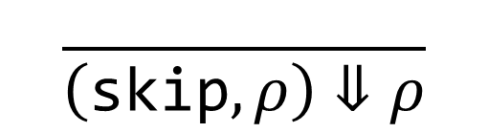
Adding Variables: Interpreter
let rec eval_cmd (c : cmd) (r : env) : env option =
match c with
| …
| Seq (c1, c2) ->
(match eval_cmd c1 r with
| Some r’ -> eval_cmd c2 r’
| None -> None)
| Skip -> Some r
$$\frac{ }{\left(\text{skip},ρ\right)⇓ρ}$$

Slide 52
Notes:
Poll Title: Do not modify the notes in this section to avoid tampering with the Poll Everywhere activity.
More info at polleverywhere.com/support
Questions
https://www.polleverywhere.com/discourses/SRzwhp4zztmGWgIgz520A

Slide 53
Adding Variables: Interpreter
What does the program x := 2; y := x + 3 evaluate to?
eval_cmd (Seq (Assign (“x”, Int 2),
Assign (“y”, Add (Ident “x”, Int 3)))) empty_env;;

Slide 54
Adding Variables: Interpreter
eval_cmd (Seq (Assign (“x”, Int 2),
Assign (“y”, Add (Ident “x”, Int 3)))) empty_env;;
let rec eval_cmd (c : cmd) (r : env) : env option =
match c with
| Seq (c1, c2) ->
(match eval_cmd c1 r with
| Some r’ -> eval_cmd c2 r’
| None -> None)

Slide 55
Adding Variables: Interpreter
eval_cmd (Seq (Assign (“x”, Int 2),
Assign (“y”, Add (Ident “x”, Int 3)))) empty_env;;
let rec eval_cmd (c : cmd) (r : env) : env option =
match c with
| Seq (c1, c2) ->
(match eval_cmd (Assign (“x”, Int 2)) empty_env with
| Some r’ -> eval_cmd (Assign (“y”, Add (Ident “x”, Int 3))) r’
| None -> None)

Slide 56
Adding Variables: Interpreter
eval_cmd (Seq (Assign (“x”, Int 2),
Assign (“y”, Add (Ident “x”, Int 3)))) empty_env;;
match eval_cmd (Assign (“x”, Int 2)) empty_env with
| Some r’ -> eval_cmd (Assign (“y”, Add (Ident “x”, Int 3))) r’
| Assign (x, e) ->
(match eval_exp e r with
| Some v -> Some (update r x v)

Slide 57
Adding Variables: Interpreter
eval_cmd (Seq (Assign (“x”, Int 2),
Assign (“y”, Add (Ident “x”, Int 3)))) empty_env;;
match eval_cmd (Assign (“x”, Int 2)) empty_env with
| Some r’ -> eval_cmd (Assign (“y”, Add (Ident “x”, Int 3))) r’
| Assign (x, e) ->
(match eval_exp (Int 2) empty_env with
| Some v -> Some (update empty_env “x” v)

Slide 58
Adding Variables: Interpreter
eval_cmd (Seq (Assign (“x”, Int 2),
Assign (“y”, Add (Ident “x”, Int 3)))) empty_env;;
match eval_cmd (Assign (“x”, Int 2)) empty_env with
| Some r’ -> eval_cmd (Assign (“y”, Add (Ident “x”, Int 3))) r’
| Assign (x, e) ->
(match Some (IntVal 2) with
| Some v -> Some (update empty_env “x” v)

Slide 59
Adding Variables: Interpreter
eval_cmd (Seq (Assign (“x”, Int 2),
Assign (“y”, Add (Ident “x”, Int 3)))) empty_env;;
match Some {“x” = IntVal 2} with
| Some r’ -> eval_cmd (Assign (“y”, Add (Ident “x”, Int 3))) r’
| Assign (x, e) ->
(match Some (IntVal 2) with
| Some v -> Some (update empty_env “x” v)

Slide 60
Adding Variables: Interpreter
eval_cmd (Seq (Assign (“x”, Int 2),
Assign (“y”, Add (Ident “x”, Int 3)))) empty_env;;
eval_cmd (Assign (“y”, Add (Ident “x”, Int 3))) {“x” = IntVal 2}
| Assign (x, e) ->
(match eval_exp (Add (Ident “x”, Int 3)) {“x” = IntVal 2} with
| Some v -> Some (update {“x” = IntVal 2} “y” v)

Slide 61
Adding Variables: Interpreter
eval_cmd (Seq (Assign (“x”, Int 2),
Assign (“y”, Add (Ident “x”, Int 3)))) empty_env;;
eval_cmd (Assign (“y”, Add (Ident “x”, Int 3))) {“x” = IntVal 2}
| Assign (x, e) ->
(match Some (IntVal 5) with
| Some v -> Some (update {“x” = IntVal 2} “y” v)

Slide 62
Adding Variables: Interpreter
let res = eval_cmd (Seq (Assign (“x”, Int 2),
Assign (“y”, Add (Ident “x”, Int 3)))) empty_env;;
Some {“x” = IntVal 2, “y” = IntVal 5}
match res with Some r -> lookup r “y” | None -> None;;
- : value option = Some (IntVal 5)
Notes:
Since the state is a function, it will just display as <fun> in the OCaml REPL.

Slide 63
Notes:
Poll Title: Do not modify the notes in this section to avoid tampering with the Poll Everywhere activity.
More info at polleverywhere.com/support
Questions
https://www.polleverywhere.com/discourses/SRzwhp4zztmGWgIgz520A

Slide 64
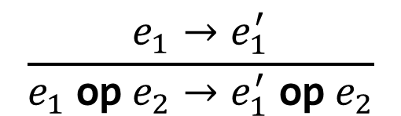

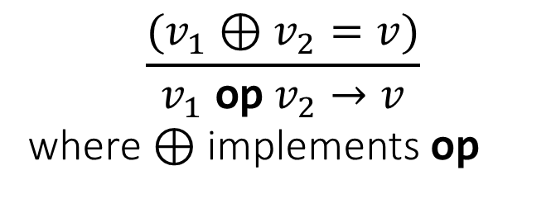
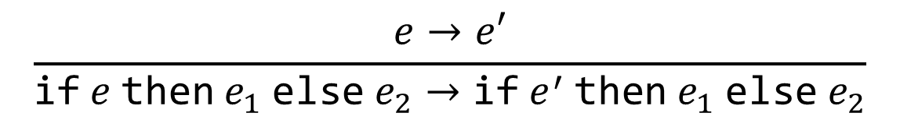


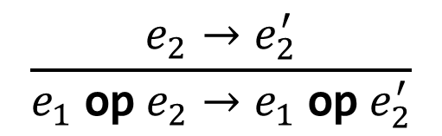
Building Proof Trees
$$\frac{e→e′}{\text{if} e \text{then} e_{1} \text{else} e_{2}→\text{if} e^{′} \text{then} e_{1} \text{else} e_{2}}$$
$$\frac{e_{1}→e_{1}^{′}}{e_{1} \text{op} e_{2}→e_{1}^{′} \text{op} e_{2}}$$
Exercise: Write a proof tree for the first step that the following program takes: $\text{if}\text{ 1+2=3 }\text{then}\text{ 2∗2 }\text{else}\text{ 7}$
$$\frac{}{\text{if} \text{true} \text{then} e_{1} \text{else} e_{2}→e_{1}}$$
$$\frac{e_{2}→e_{2}^{′}}{e_{1} \text{op}{ e}_{2}→e_{1} \text{op} e_{2}^{′}}$$
$$\frac{}{\text{if} \text{false} \text{then} e_{1} \text{else} e_{2}→e_{2}}$$
$$\frac{{(v}_{1} ⊕v_{2}=v)}{v_{1} \text{op} v_{2}→v}$$
where $⊕$ implements $\text{op}$

Slide 65


$$\frac{{(v}_{1} ⊕v_{2}=v)}{v_{1} \text{op} v_{2}→v}$$
where $⊕$ implements $\text{op}$
$$\frac{\frac{\frac{}{1+2→3}}{1+2=3→3=3}}{\begin{aligned}\text{if}\text{ 1+2=3 }\text{then}\text{ 2∗2 }\text{else}\text{ 7}→ \\ if 3=3 then 2∗2 else 7\end{aligned}}$$

Slide 66
Notes:
Poll Title: Do not modify the notes in this section to avoid tampering with the Poll Everywhere activity.
More info at polleverywhere.com/support
Questions
https://www.polleverywhere.com/discourses/SRzwhp4zztmGWgIgz520A

Slide 67


Typing Variables, Approach #3
How do we type variables?
Instead of putting tags in the syntax, we could store them separately, in a type context
New typing judgment: $Γ⊢e :τ$, “$e$ has type $τ$ in context $Γ$”
$Γ$ is a partial function from identifiers to types
Where does $Γ$ come from?
$$\frac{Γ\left(x\right)=τ }{Γ⊢x :τ}$$
$$\frac{(n is a number) }{Γ⊢n :int}$$
$$\frac{Γ⊢e_{1} :int Γ⊢e_{2} :int }{Γ⊢e_{1}+e_{2} :int}$$
Notes:
We said we’d get type information from context – let’s see an example of how we might design that.

Slide 68
IMP with Declarations: Syntax
E ::= …
C ::= …
D ::= T <ident> | D; D
T ::= int | bool
P ::= D; C
Example:
int x;
bool y;
int z;
x := 3;
y := (x = 4);
z := if y then 2 else 4

Slide 69





IMP with Declarations: Types
$d :Γ$ means “$d$ constructs type context $Γ$”
$$\frac{}{\text{int} x :\{x :int\}}$$
$$\frac{}{\text{bool} x :\{x :bool\}}$$
$$\frac{d_{1} :Γ_{1} d_{2} :Γ_{2}}{d_{1}\text{;} d_{2} :Γ_{1}⊎Γ_{2}}$$
$$\frac{d :Γ Γ⊢c :ok}{d\text{;} c :ok}$$

Slide 70


IMP with Declarations: Semantics
eval_prog p =
match p with Prog (d, c) -> eval_cmd c empty_state
$$\frac{}{d;c→(c,∅)}$$
$$\frac{\left(c,∅\right)⇓ρ}{d;c⇓ρ}$$
Notes:
And for an interpreter, same deal – we’d just call eval_cmd with empty_state.

Slide 71
IMP with Declarations: Type Checker
type typ =
type decl =
type prog =
type tycon =
let rec process_decls (d : decl) : tycon =
let typecheck_prog p =
match p with Prog (d, c) -> typecheck_cmd c (process_decls d)
Notes:
And for an interpreter, same deal – we’d just call eval_cmd with empty_state.

Slide 72




Typing Variables, Approach #3
New typing judgment: $Γ⊢e :τ$, “$e$ has type $τ$ in context $Γ$”
$Γ$ is a partial function from identifiers to types
Type context $Γ$ can come from variable declarations
Or we can build it up as we typecheck assignments, etc. (“type inference”)
$$\frac{Γ\left(x\right)=τ }{Γ⊢x :τ}$$
$$\frac{(n is a number) }{Γ⊢n :int}$$
$$\frac{Γ⊢e_{1} :int Γ⊢e_{2} :int }{Γ⊢e_{1}+e_{2} :int}$$
Notes:
We said we’d get type information from context – let’s see an example of how we might design that.

Slide 73
Notes:
Poll Title: Do not modify the notes in this section to avoid tampering with the Poll Everywhere activity.
More info at polleverywhere.com/support
Questions
https://www.polleverywhere.com/discourses/SRzwhp4zztmGWgIgz520A

