Slide 1
CS 476 – Programming Language Design
William Mansky

Slide 2

Notes:
Poll Title: Do not modify the notes in this section to avoid tampering with the Poll Everywhere activity.
More info at polleverywhere.com/support
Questions
https://www.polleverywhere.com/discourses/SRzwhp4zztmGWgIgz520A

Slide 3
Functional Programming
Functions are the basic unit of computation
Functions are values! (“first-class functions”)
  Functions can take functions as arguments, return functions, etc.
Immutable variables by default
Everything is an expression, state changes (“side effects”) are specially marked
Usually contrasted with imperative languages
Examples: F#, OCaml, Lisp, Haskell, lambda-expressions

Slide 4
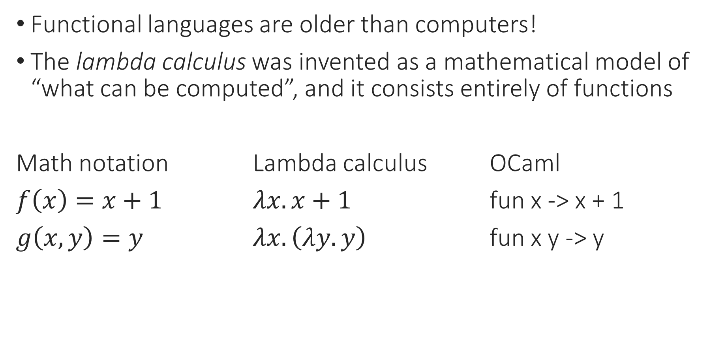
The First Functional Language
Functional languages are older than computers!
The lambda calculus was invented as a mathematical model of “what can be computed”, and it consists entirely of functions
Math notation Lambda calculus OCaml
$f\left(x\right)=x+1$ $λx.x+1$ fun x -> x + 1
$g\left(x,y\right)=y$ $λx. \left(λy. y\right)$ fun x y -> y
Notes:
Note that functions are anonymous: they don’t have names, just arguments and bodies.

Slide 5

Multi-Argument Functions
Math notation: $g\left(x,y\right)=x+y$
$g\left(1, 2\right)$ returns 3
OCaml notation: fun x y -> x + y
(fun x y -> x + y) 1 2 returns 3
What about: (fun x y -> x + y) 1
(fun x y -> x + y) 1 returns (fun y -> 1 + y)
Notes:
Note that functions are anonymous: they don’t have names, just arguments and bodies.

Slide 6
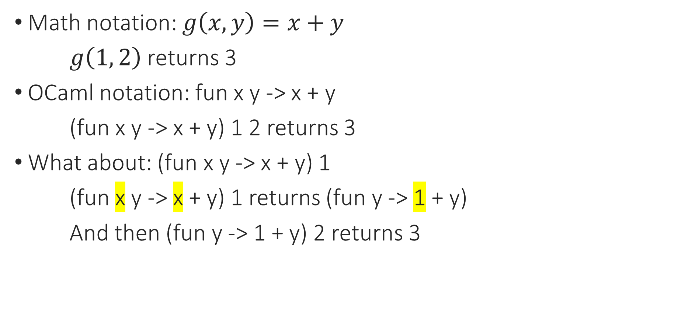
Multi-Argument Functions
Math notation: $g\left(x,y\right)=x+y$
$g\left(1, 2\right)$ returns 3
OCaml notation: fun x y -> x + y
(fun x y -> x + y) 1 2 returns 3
What about: (fun x y -> x + y) 1
(fun x y -> x + y) 1 returns (fun y -> 1 + y)
And then (fun y -> 1 + y) 2 returns 3
Notes:
Note that functions are anonymous: they don’t have names, just arguments and bodies.

Slide 7
Multi-Argument Functions
OCaml notation: fun x y -> x + y
(fun x y -> x + y) 1 2 returns 3
What about: (fun x y -> y) 1
(fun x y -> x + y) 1 returns (fun y -> 1 + y)
And then (fun y -> 1 + y) 2 returns 3
(fun x y -> x + y) 1 2 is actually ((fun x -> (fun y -> x + y)) 1) 2
“Apply this function to 1, get back another function, and then apply that new function to 2”
Notes:
Note that functions are anonymous: they don’t have names, just arguments and bodies.

Slide 8
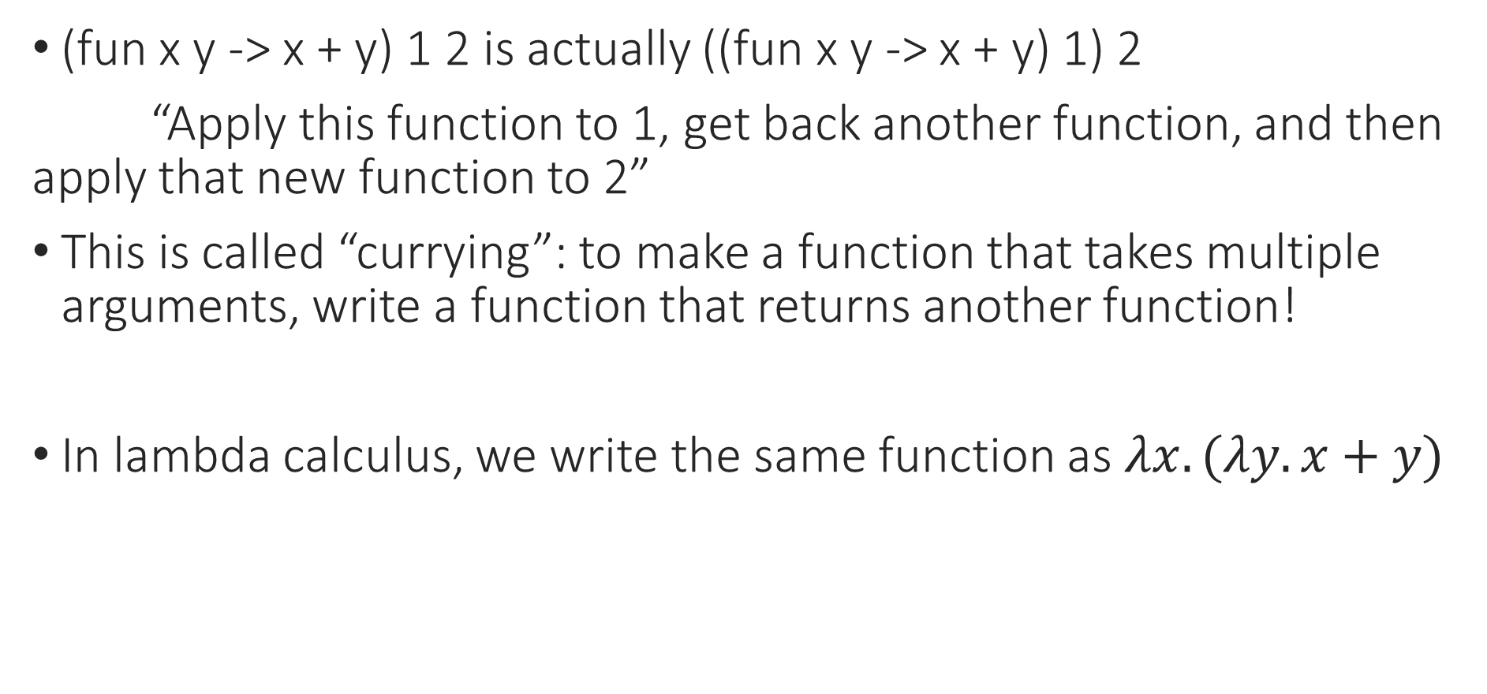
Multi-Argument Functions
(fun x y -> x + y) 1 2 is actually ((fun x y -> x + y) 1) 2
“Apply this function to 1, get back another function, and then apply that new function to 2”
This is called “currying”: to make a function that takes multiple arguments, write a function that returns another function!
In lambda calculus, we write the same function as $λx. (λy. x+y)$
Notes:
Note that functions are anonymous: they don’t have names, just arguments and bodies.

Slide 9
Notes:
Poll Title: Do not modify the notes in this section to avoid tampering with the Poll Everywhere activity.
More info at polleverywhere.com/support
Questions
https://www.polleverywhere.com/discourses/SRzwhp4zztmGWgIgz520A

Slide 10
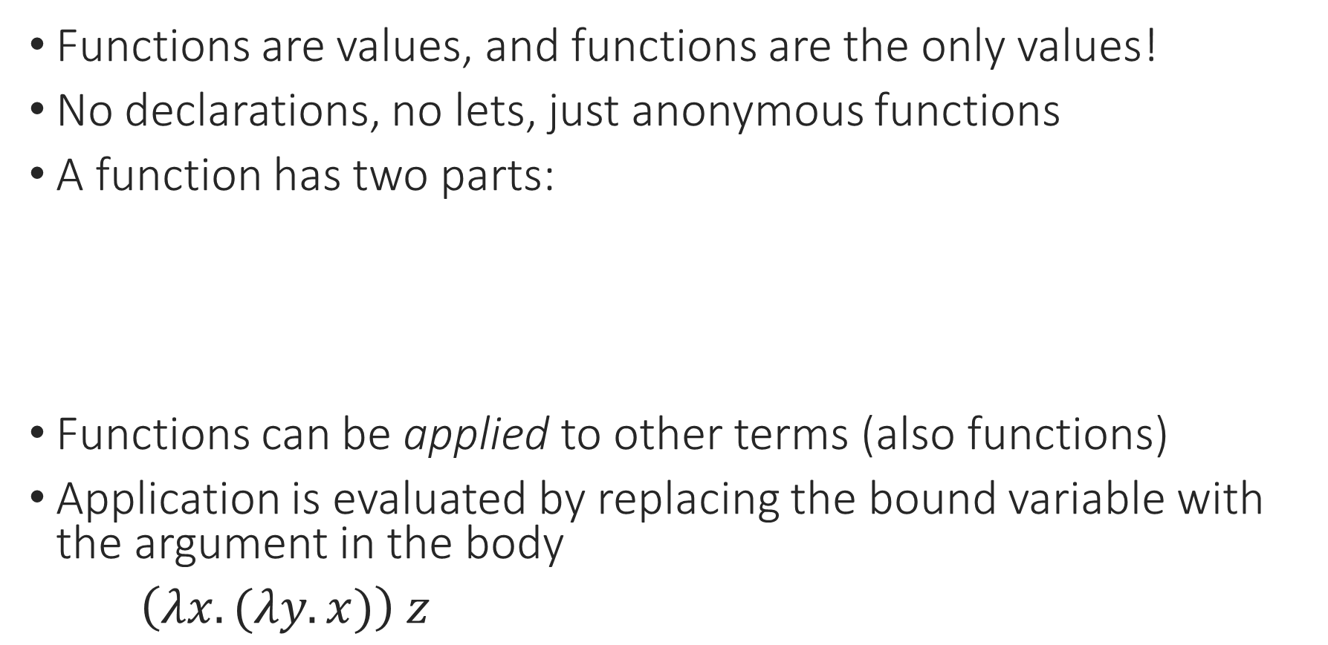
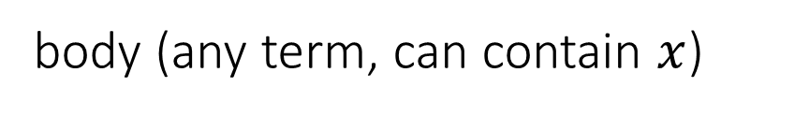

Lambda Calculus Basics
Functions are values, and functions are the only values!
No declarations, no lets, just anonymous functions
A function has two parts:
Functions can be applied to other terms (also functions)
Application is evaluated by replacing the bound variable with the argument in the body
$\left(λx. (λy. x)\right) z$
$$λ x . B$$
argument name
“bound variable”
body (any term, can contain $x$)
Notes:
Captures the idea of “what a function is”
What is this function? What’s the body?

Slide 11
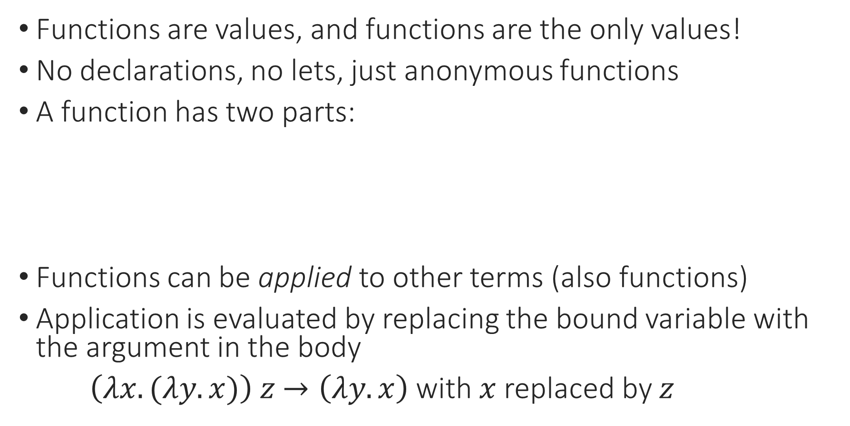
Lambda Calculus Basics
Functions are values, and functions are the only values!
No declarations, no lets, just anonymous functions
A function has two parts:
Functions can be applied to other terms (also functions)
Application is evaluated by replacing the bound variable with the argument in the body
$\left(λx. (λy. x)\right) z$ $→\left(λy. x\right)$ with $x$ replaced by $z$
$$λ x . B$$
argument name
“bound variable”
body (any term, can contain $x$)
Notes:
What is this function? What’s the body?

Slide 12
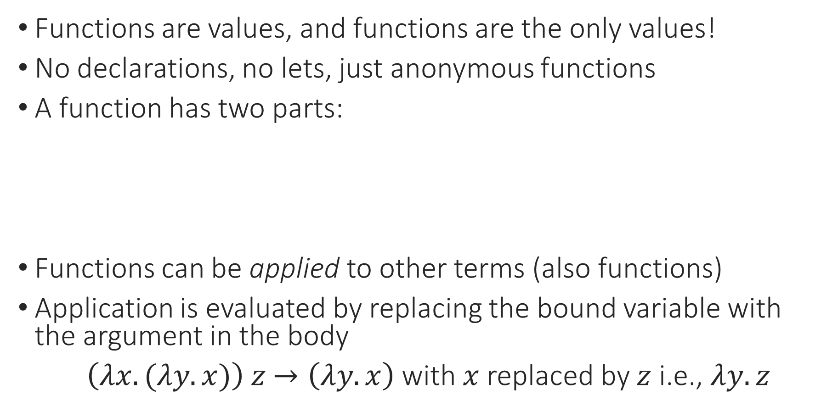
Lambda Calculus Basics
Functions are values, and functions are the only values!
No declarations, no lets, just anonymous functions
A function has two parts:
Functions can be applied to other terms (also functions)
Application is evaluated by replacing the bound variable with the argument in the body
$\left(λx. (λy. x)\right) z$ $→\left(λy. x\right)$ with $x$ replaced by $z$ i.e., $λy. z$
$$λ x . B$$
argument name
“bound variable”
body (any term, can contain $x$)
Notes:
What is this function? What’s the body?

Slide 13
Variable Binding
int f(int x){ return x + 1; }
int x = 5;
f(x + 2);

Slide 14
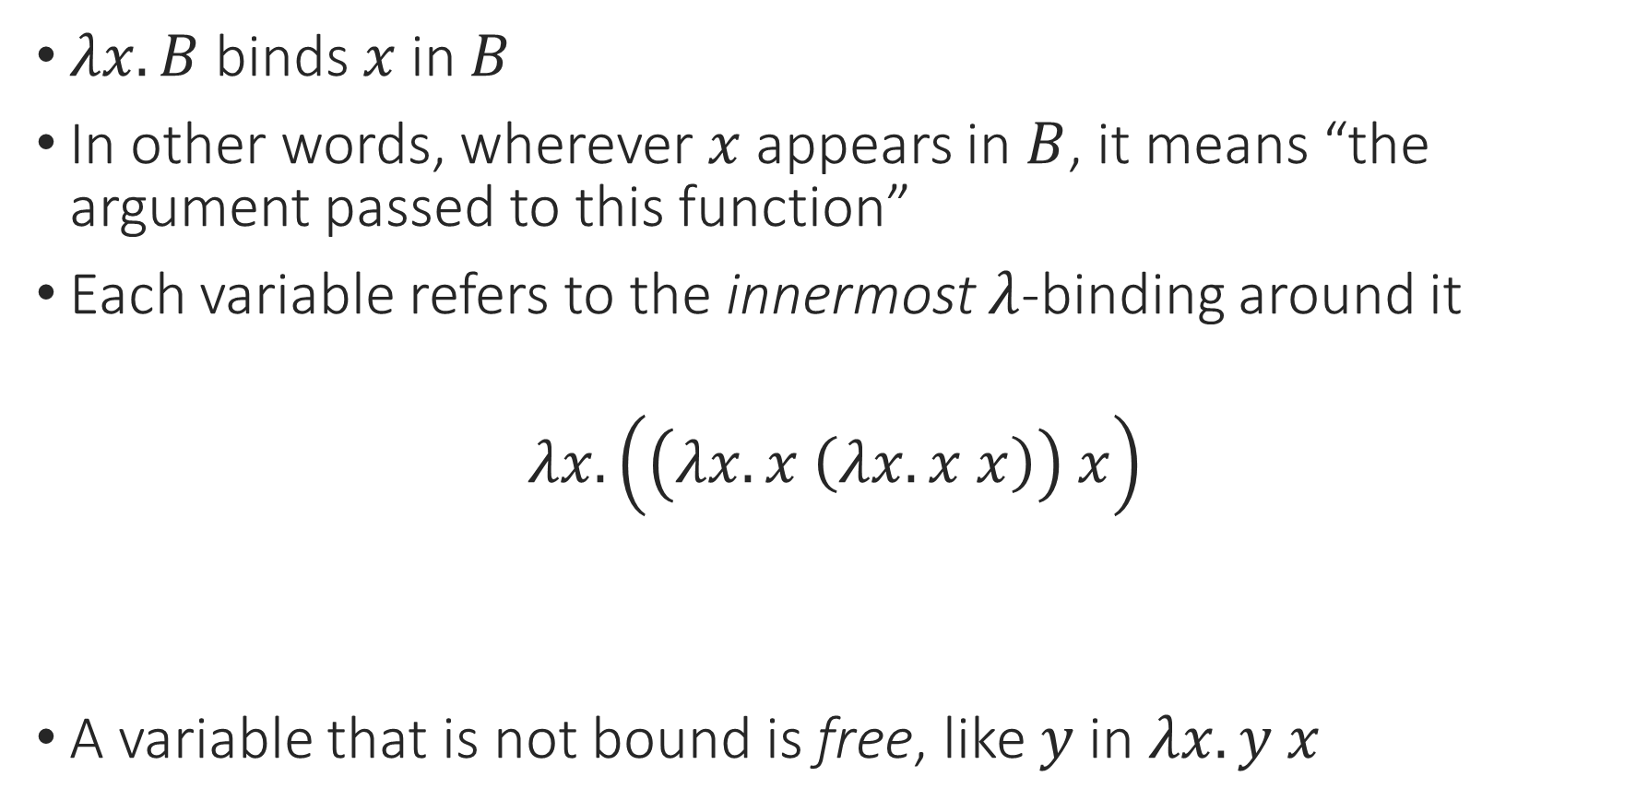
Lambda Calculus: Binding and Scope
$λx. B$ binds $x$ in $B$
In other words, wherever $x$ appears in $B$, it means “the argument passed to this function”
Each variable refers to the innermost $λ$-binding around it
$$λx. \left(\left(λx. x \left(λx. x x\right)\right) x\right)$$
A variable that is not bound is free, like $y$ in $λx. y x$
Notes:
Let’s play “whose parameter is this?”
You might think that we should just not call them all “x”. And you’re right! We need to know this so we can give them better names, consistently.

Slide 15

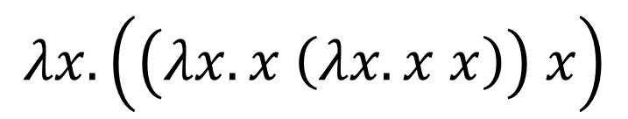
Lambda Calculus: Renaming
The name of the argument to a function doesn’t really matter
$λx. x$ is the same as $λy. y$
We can always rename a bound variable
$$λx. \left(\left(λx. x \left(λx. x x\right)\right) x\right)$$
Notes:
You might think that we should just not call them all “x”. And you’re right! We need to know this so we can give them better names, consistently.

Slide 16
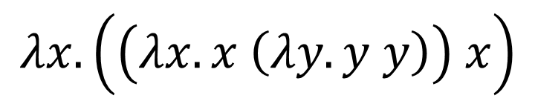
Lambda Calculus: Renaming
The name of the argument to a function doesn’t really matter
$λx. x$ is the same as $λy. y$
We can always rename a bound variable
$$λx. \left(\left(λx. x \left(λy. y y\right)\right) x\right)$$

Slide 17
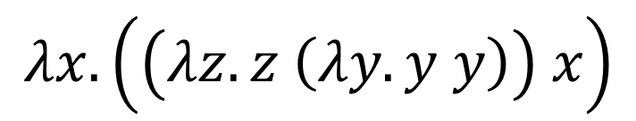
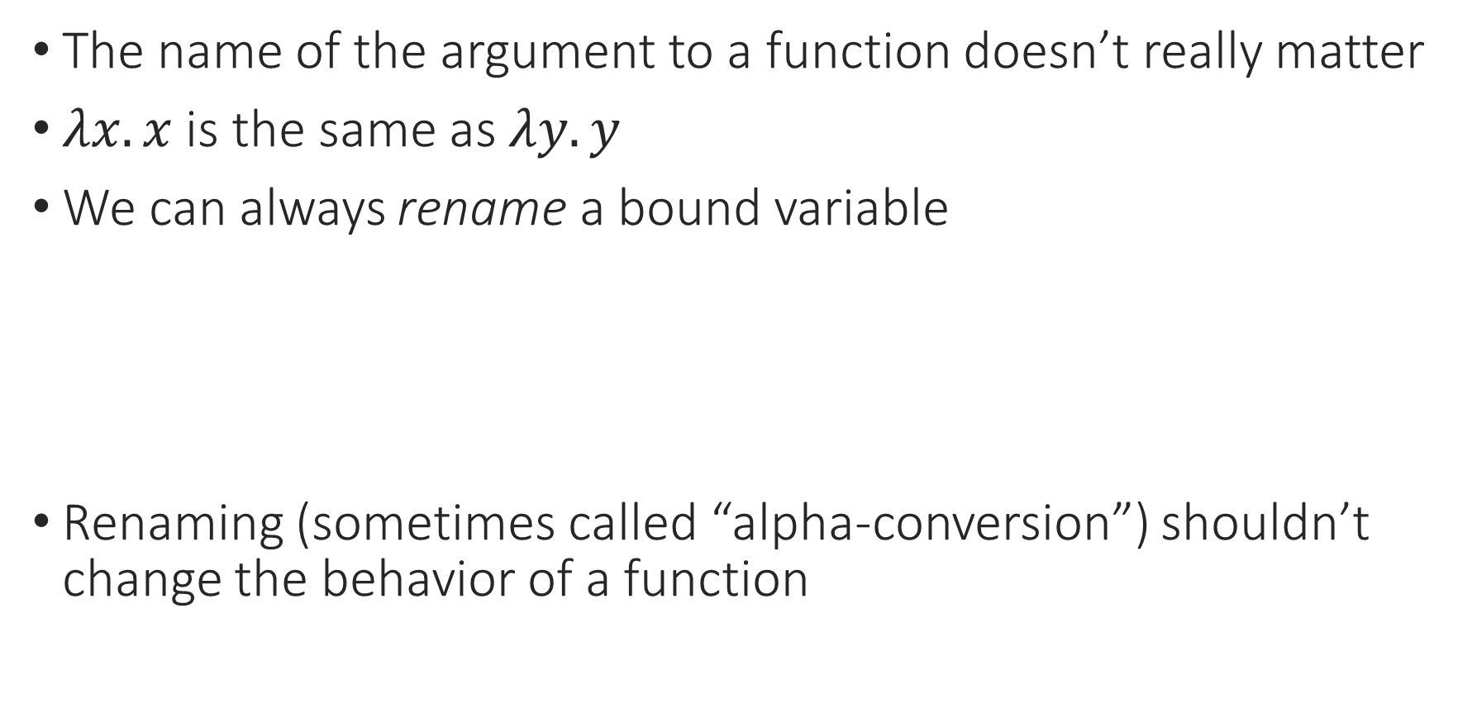
Lambda Calculus: Renaming
The name of the argument to a function doesn’t really matter
$λx. x$ is the same as $λy. y$
We can always rename a bound variable
Renaming (sometimes called “alpha-conversion”) shouldn’t change the behavior of a function
$$λx. \left(\left(λz. z \left(λy. y y\right)\right) x\right)$$

Slide 18
Notes:
Poll Title: Do not modify the notes in this section to avoid tampering with the Poll Everywhere activity.
More info at polleverywhere.com/support
Questions
https://www.polleverywhere.com/discourses/SRzwhp4zztmGWgIgz520A

Slide 19
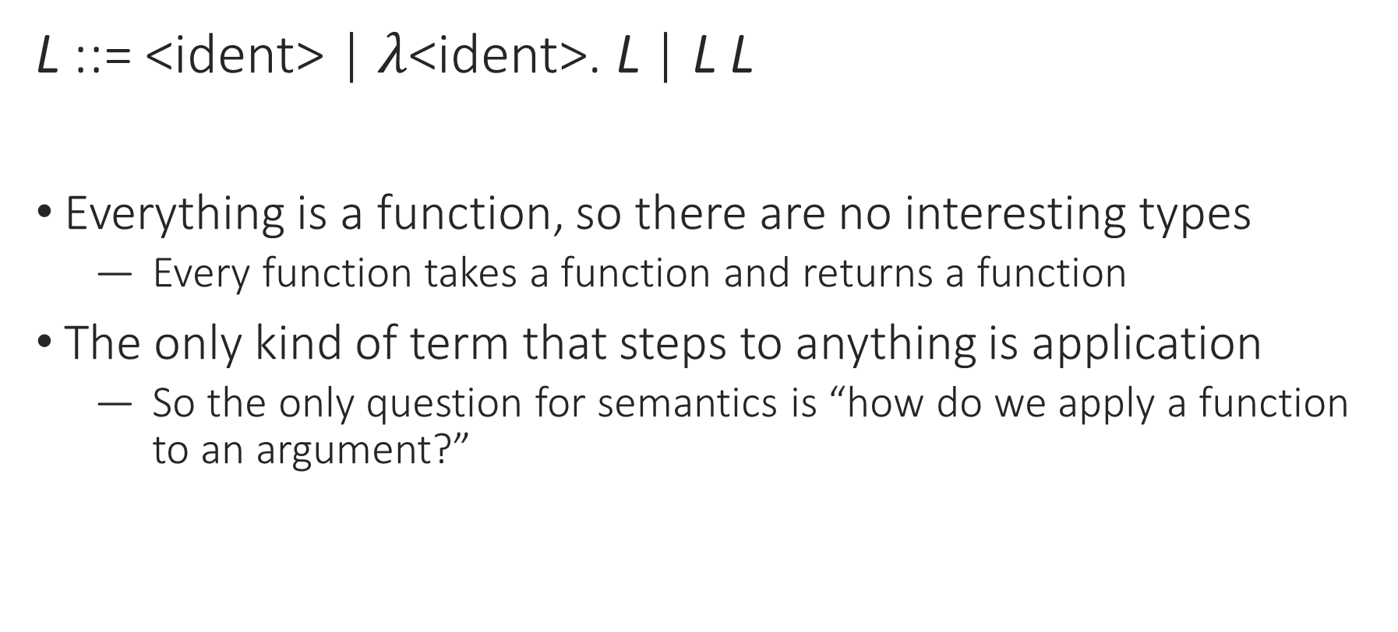
Lambda Calculus: Syntax
L ::= <ident> | $λ$<ident>. L | L L
Everything is a function, so there are no interesting types
  Every function takes a function and returns a function
The only kind of term that steps to anything is application
  So the only question for semantics is “how do we apply a function to an argument?”
Notes:
L L is application, not sequencing!
This is a surprisingly tricky question.

Slide 20

Lambda Calculus: Substitution
In general, $\left(λx. l\right) l_{2}$ evaluates to $\left[x↦l_{2}\right]l$
(“$l$ with $l_{2}$ substituted for $x$”)
$\left(λx. x\right) z$ evaluates to

Slide 21
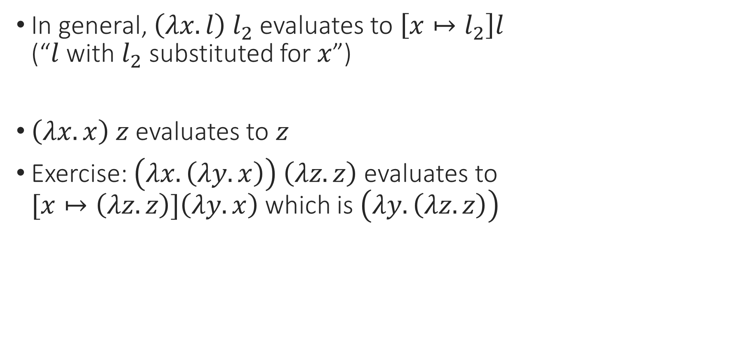
Lambda Calculus: Substitution
In general, $\left(λx. l\right) l_{2}$ evaluates to $\left[x↦l_{2}\right]l$
(“$l$ with $l_{2}$ substituted for $x$”)
$\left(λx. x\right) z$ evaluates to $z$
Exercise: $\left(λx. \left(λy. x\right)\right) \left(λz. z\right)$ evaluates to
$[x↦\left(λz. z\right)]\left(λy. x\right)$ which is $\left(λy.\left(λz. z\right)\right)$

Slide 22

Lambda Calculus: Substitution
In general, $\left(λx. l\right) l_{2}$ evaluates to $\left[x↦l_{2}\right]l$
(“$l$ with $l_{2}$ substituted for $x$”)
$\left(λx. x\right) z$ evaluates to $z$
Exercise: $\left(λx. \left(λy. x\right)\right) z$ evaluates to ?

Slide 23
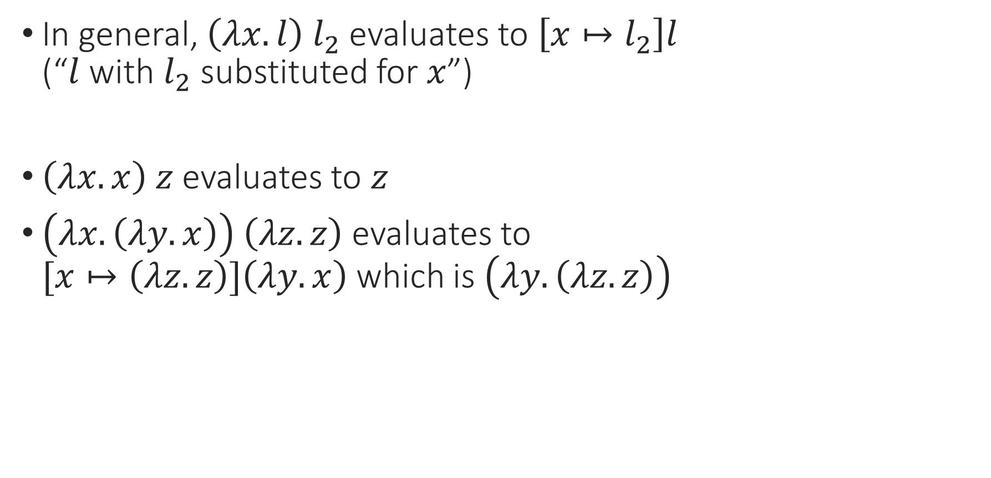
Lambda Calculus: Substitution
In general, $\left(λx. l\right) l_{2}$ evaluates to $\left[x↦l_{2}\right]l$
(“$l$ with $l_{2}$ substituted for $x$”)
$\left(λx. x\right) z$ evaluates to $z$
$\left(λx. \left(λy. x\right)\right) \left(λz. z\right)$ evaluates to
$[x↦\left(λz. z\right)]\left(λy. x\right)$ which is $\left(λy.\left(λz. z\right)\right)$

Slide 24
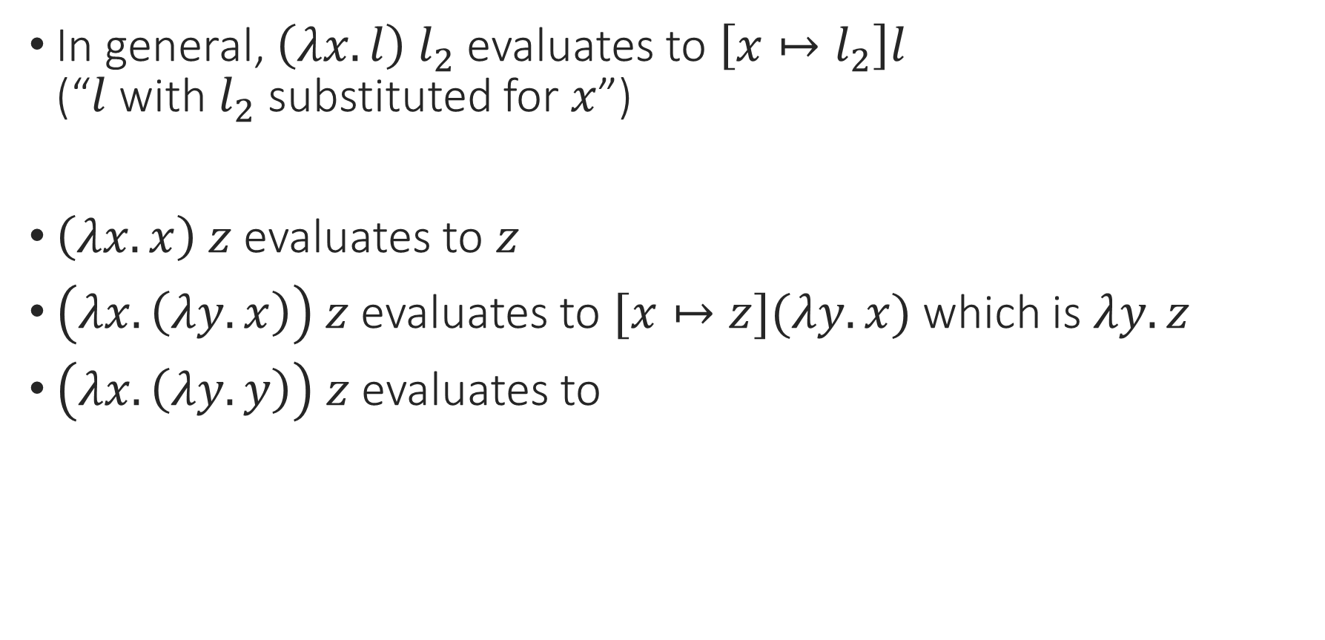
Lambda Calculus: Substitution
In general, $\left(λx. l\right) l_{2}$ evaluates to $\left[x↦l_{2}\right]l$
(“$l$ with $l_{2}$ substituted for $x$”)
$\left(λx. x\right) z$ evaluates to $z$
$\left(λx. \left(λy. x\right)\right) z$ evaluates to $[x↦z](λy. x)$ which is $λy. z$
$\left(λx. \left(λy. y\right)\right) z$ evaluates to

Slide 25
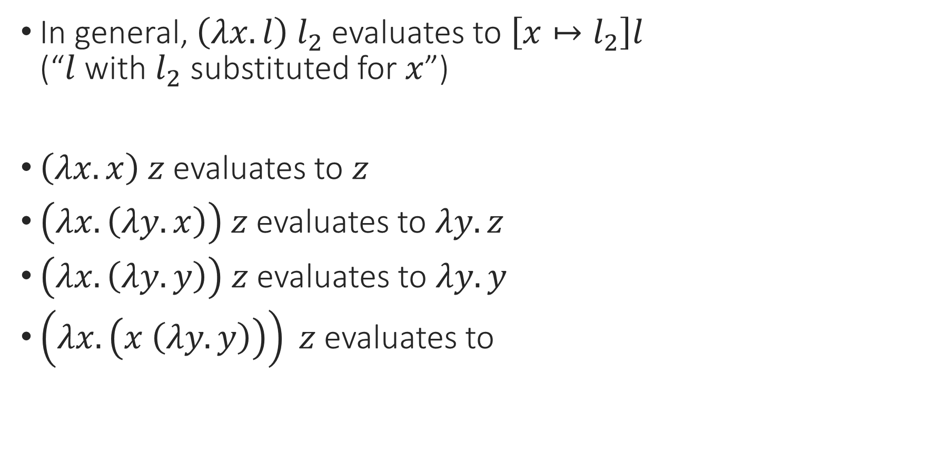
Lambda Calculus: Substitution
In general, $\left(λx. l\right) l_{2}$ evaluates to $\left[x↦l_{2}\right]l$
(“$l$ with $l_{2}$ substituted for $x$”)
$\left(λx. x\right) z$ evaluates to $z$
$\left(λx. \left(λy. x\right)\right) z$ evaluates to $λy. z$
$\left(λx. \left(λy. y\right)\right) z$ evaluates to $λy. y$
$\left(λx. \left(x \left(λy. y\right)\right)\right) z$ evaluates to

Slide 26
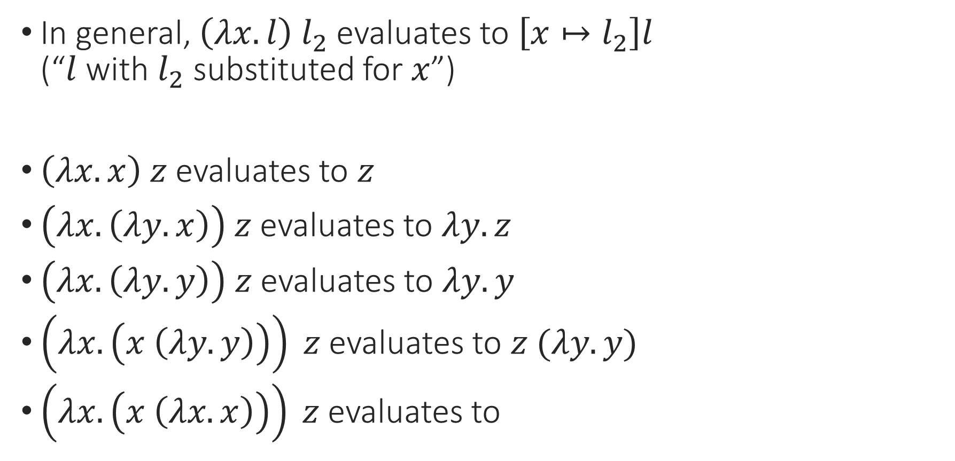
Lambda Calculus: Substitution
In general, $\left(λx. l\right) l_{2}$ evaluates to $\left[x↦l_{2}\right]l$
(“$l$ with $l_{2}$ substituted for $x$”)
$\left(λx. x\right) z$ evaluates to $z$
$\left(λx. \left(λy. x\right)\right) z$ evaluates to $λy. z$
$\left(λx. \left(λy. y\right)\right) z$ evaluates to $λy. y$
$\left(λx. \left(x \left(λy. y\right)\right)\right) z$ evaluates to $z (λy. y)$
$\left(λx. \left(x \left(λx. x\right)\right)\right) z$ evaluates to

Slide 27
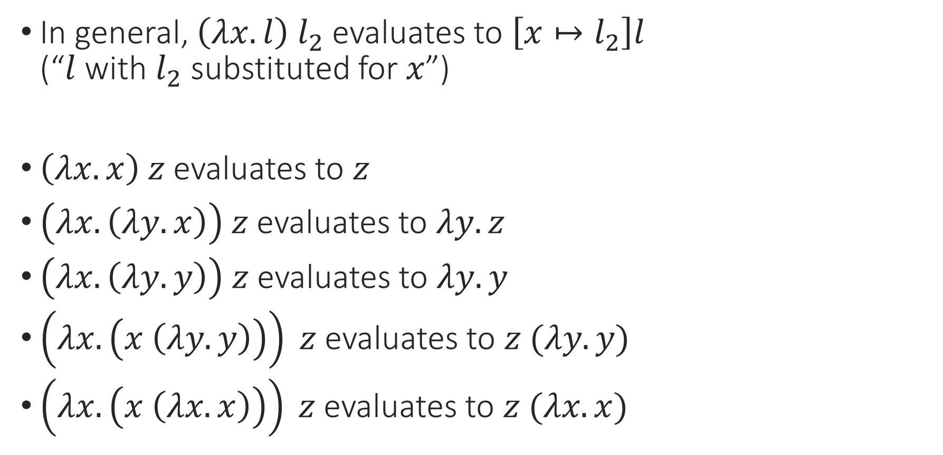
Lambda Calculus: Substitution
In general, $\left(λx. l\right) l_{2}$ evaluates to $\left[x↦l_{2}\right]l$
(“$l$ with $l_{2}$ substituted for $x$”)
$\left(λx. x\right) z$ evaluates to $z$
$\left(λx. \left(λy. x\right)\right) z$ evaluates to $λy. z$
$\left(λx. \left(λy. y\right)\right) z$ evaluates to $λy. y$
$\left(λx. \left(x \left(λy. y\right)\right)\right) z$ evaluates to $z (λy. y)$
$\left(λx. \left(x \left(λx. x\right)\right)\right) z$ evaluates to $z (λx. x)$

Slide 28

Lambda Calculus: Substitution
How do we define substitution? $\left[x↦l_{2}\right]l$
match $l$ with
| $y →$
| $\left(l_{a} l_{b}\right)→$
| $\left(λy. b\right)→$

Slide 29

Lambda Calculus: Substitution
How do we define substitution? $\left[x↦l_{2}\right]l$
match $l$ with
| $y →if y=x then l_{2} else y$
| $\left(l_{a} l_{b}\right)→$
| $\left(λy. b\right)→$

Slide 30

Lambda Calculus: Substitution
How do we define substitution? $\left[x↦l_{2}\right]l$
match $l$ with
| $y →if y=x then l_{2} else y$
| $\left(l_{a} l_{b}\right)→\left(\left[x↦l_{2}\right]l_{a}\right) \left(\left[x↦l_{2}\right]l_{b}\right)$
| $\left(λy. b\right)→$

Slide 31
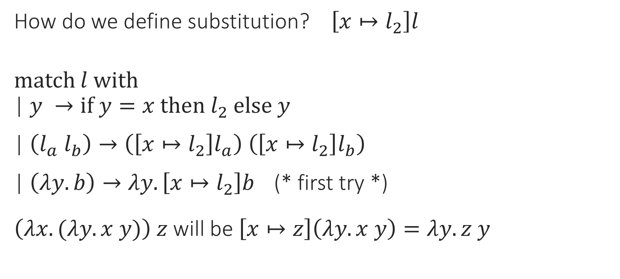
Lambda Calculus: Substitution
How do we define substitution? $\left[x↦l_{2}\right]l$
match $l$ with
| $y →if y=x then l_{2} else y$
| $\left(l_{a} l_{b}\right)→\left(\left[x↦l_{2}\right]l_{a}\right) \left(\left[x↦l_{2}\right]l_{b}\right)$
| $\left(λy. b\right)→λy. \left[x↦l_{2}\right]b$ (* first try *)
$\left(λx. (λy. x y)\right) z$ will be $\left[x↦z\right]\left(λy. x y\right)=λy. z y$

Slide 32
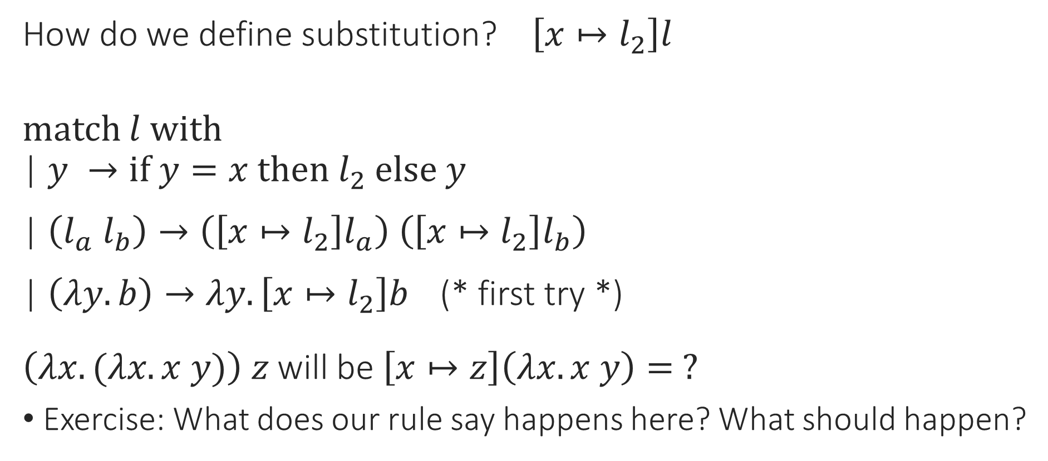
Lambda Calculus: Substitution
How do we define substitution? $\left[x↦l_{2}\right]l$
match $l$ with
| $y →if y=x then l_{2} else y$
| $\left(l_{a} l_{b}\right)→\left(\left[x↦l_{2}\right]l_{a}\right) \left(\left[x↦l_{2}\right]l_{b}\right)$
| $\left(λy. b\right)→λy. \left[x↦l_{2}\right]b$ (* first try *)
$\left(λx. (λx. x y)\right) z$ will be $\left[x↦z\right]\left(λx. x y\right)= ?$
Exercise: What does our rule say happens here? What should happen?

Slide 33
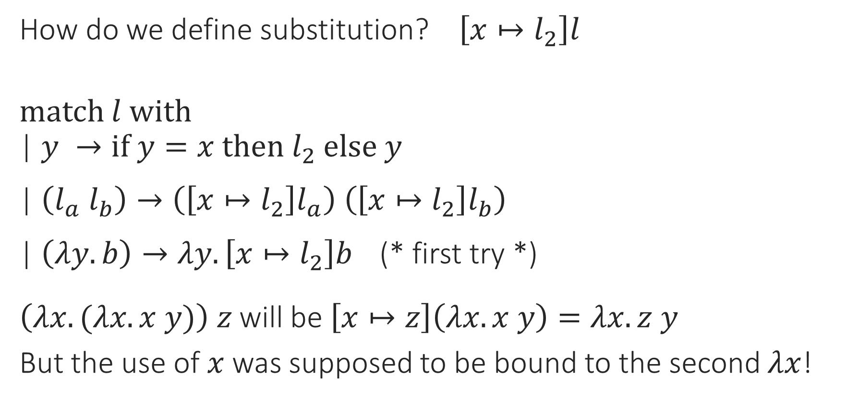
Lambda Calculus: Substitution
How do we define substitution? $\left[x↦l_{2}\right]l$
match $l$ with
| $y →if y=x then l_{2} else y$
| $\left(l_{a} l_{b}\right)→\left(\left[x↦l_{2}\right]l_{a}\right) \left(\left[x↦l_{2}\right]l_{b}\right)$
| $\left(λy. b\right)→λy. \left[x↦l_{2}\right]b$ (* first try *)
$\left(λx. (λx. x y)\right) z$ will be $\left[x↦z\right]\left(λx. x y\right)=λx. z y$
But the use of $x$ was supposed to be bound to the second $λx$!

Slide 34
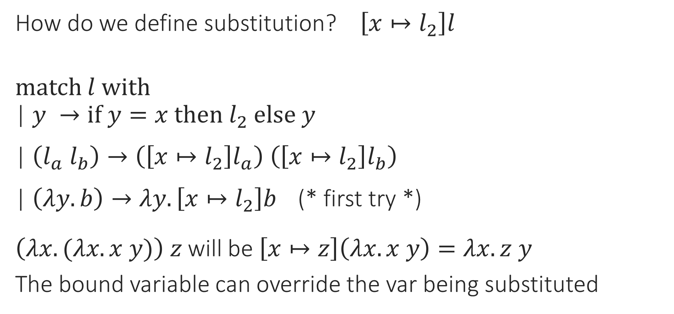
Lambda Calculus: Substitution
How do we define substitution? $\left[x↦l_{2}\right]l$
match $l$ with
| $y →if y=x then l_{2} else y$
| $\left(l_{a} l_{b}\right)→\left(\left[x↦l_{2}\right]l_{a}\right) \left(\left[x↦l_{2}\right]l_{b}\right)$
| $\left(λy. b\right)→λy. \left[x↦l_{2}\right]b$ (* first try *)
$\left(λx. (λx. x y)\right) z$ will be $\left[x↦z\right]\left(λx. x y\right)=λx. z y$
The bound variable can override the var being substituted

Slide 35
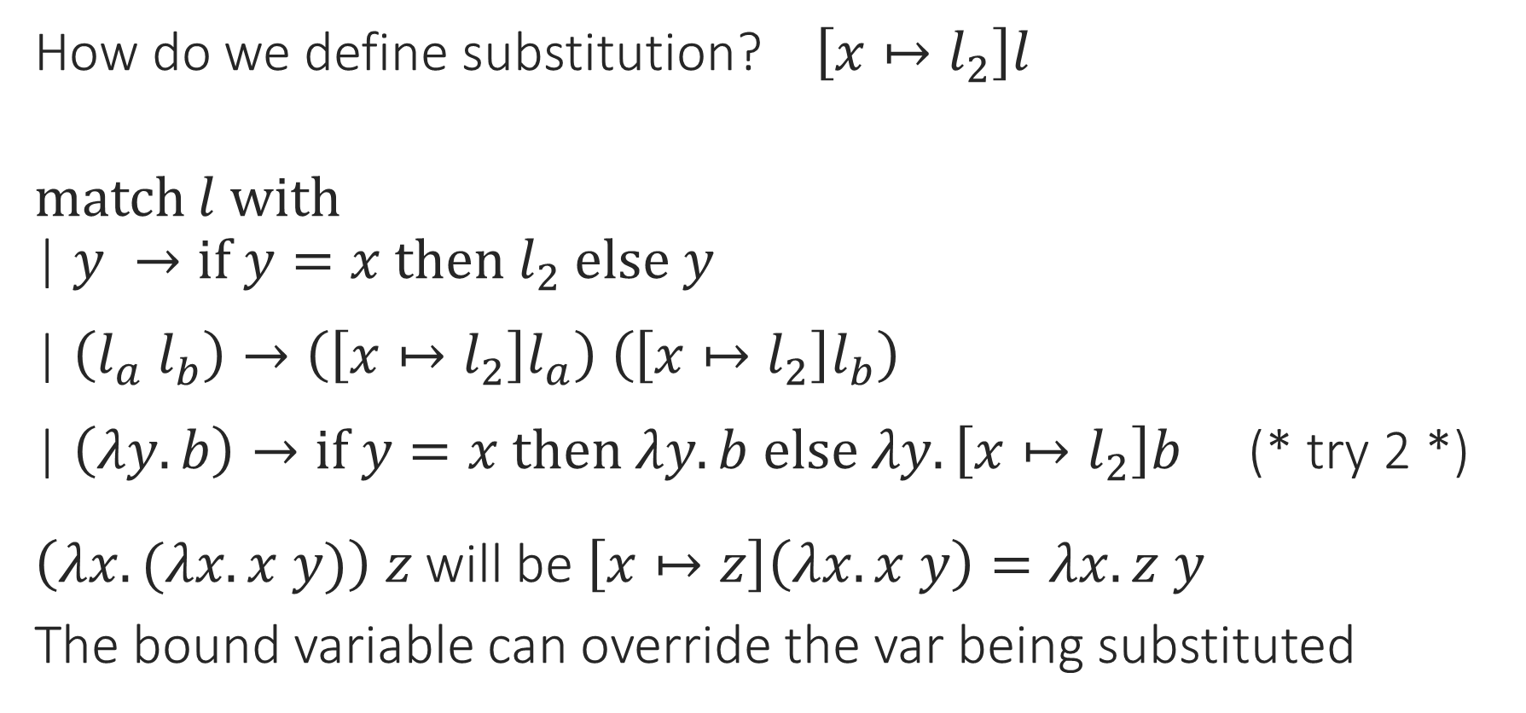
Lambda Calculus: Substitution
How do we define substitution? $\left[x↦l_{2}\right]l$
match $l$ with
| $y →if y=x then l_{2} else y$
| $\left(l_{a} l_{b}\right)→\left(\left[x↦l_{2}\right]l_{a}\right) \left(\left[x↦l_{2}\right]l_{b}\right)$
| $\left(λy. b\right)→if y=x then λy. b else λy. \left[x↦l_{2}\right]b$ (* try 2 *)
$\left(λx. (λx. x y)\right) z$ will be $\left[x↦z\right]\left(λx. x y\right)=λx. z y$
The bound variable can override the var being substituted

Slide 36
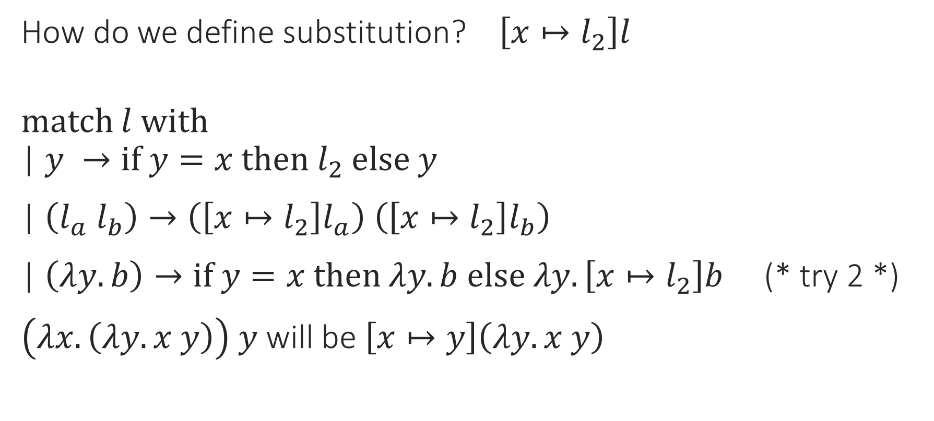
Lambda Calculus: Substitution
How do we define substitution? $\left[x↦l_{2}\right]l$
match $l$ with
| $y →if y=x then l_{2} else y$
| $\left(l_{a} l_{b}\right)→\left(\left[x↦l_{2}\right]l_{a}\right) \left(\left[x↦l_{2}\right]l_{b}\right)$
| $\left(λy. b\right)→if y=x then λy. b else λy. \left[x↦l_{2}\right]b$ (* try 2 *)
$\left(λx. \left(λy. x y\right)\right) y$ will be $\left[x↦y\right]\left(λy. x y\right)$

Slide 37
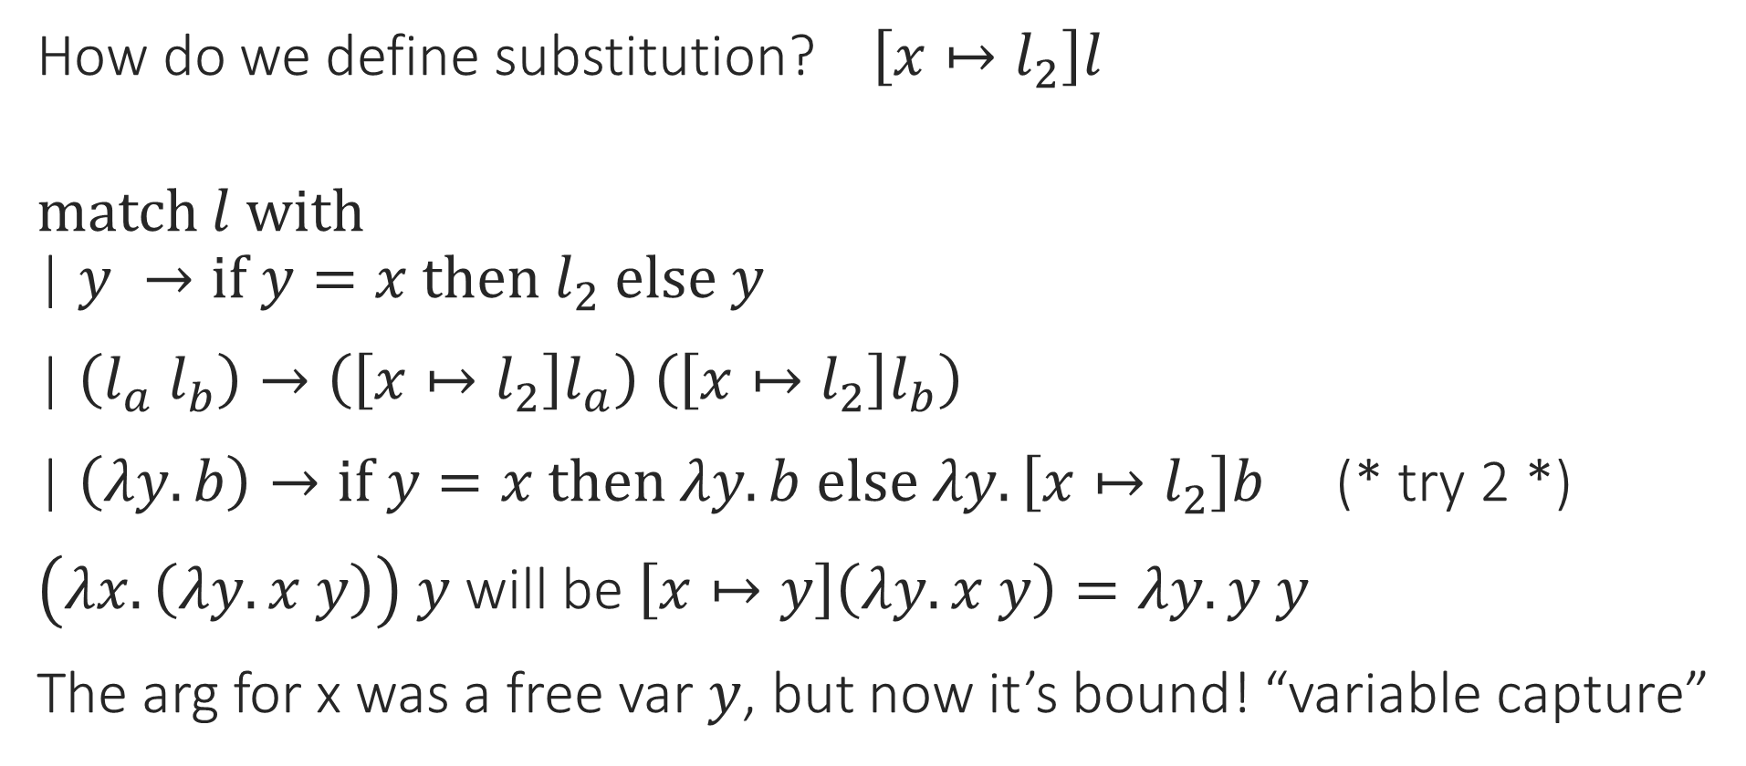
Lambda Calculus: Substitution
How do we define substitution? $\left[x↦l_{2}\right]l$
match $l$ with
| $y →if y=x then l_{2} else y$
| $\left(l_{a} l_{b}\right)→\left(\left[x↦l_{2}\right]l_{a}\right) \left(\left[x↦l_{2}\right]l_{b}\right)$
| $\left(λy. b\right)→if y=x then λy. b else λy. \left[x↦l_{2}\right]b$ (* try 2 *)
$\left(λx. \left(λy. x y\right)\right) y$ will be $\left[x↦y\right]\left(λy. x y\right)=λy. y y$
The arg for x was a free var $y$, but now it’s bound! “variable capture”

Slide 38
Lambda Calculus: Variable Capture
In OCaml:
let f x y = x + y;; (* f = fun x -> fun y -> x + y *)
let y = 5;;
let g = f y;;
(* g = fun y -> y + y would be wrong *)
(* g = fun z -> y + z would be right *)
We can rename the bound var to avoid capturing the free var

Slide 39
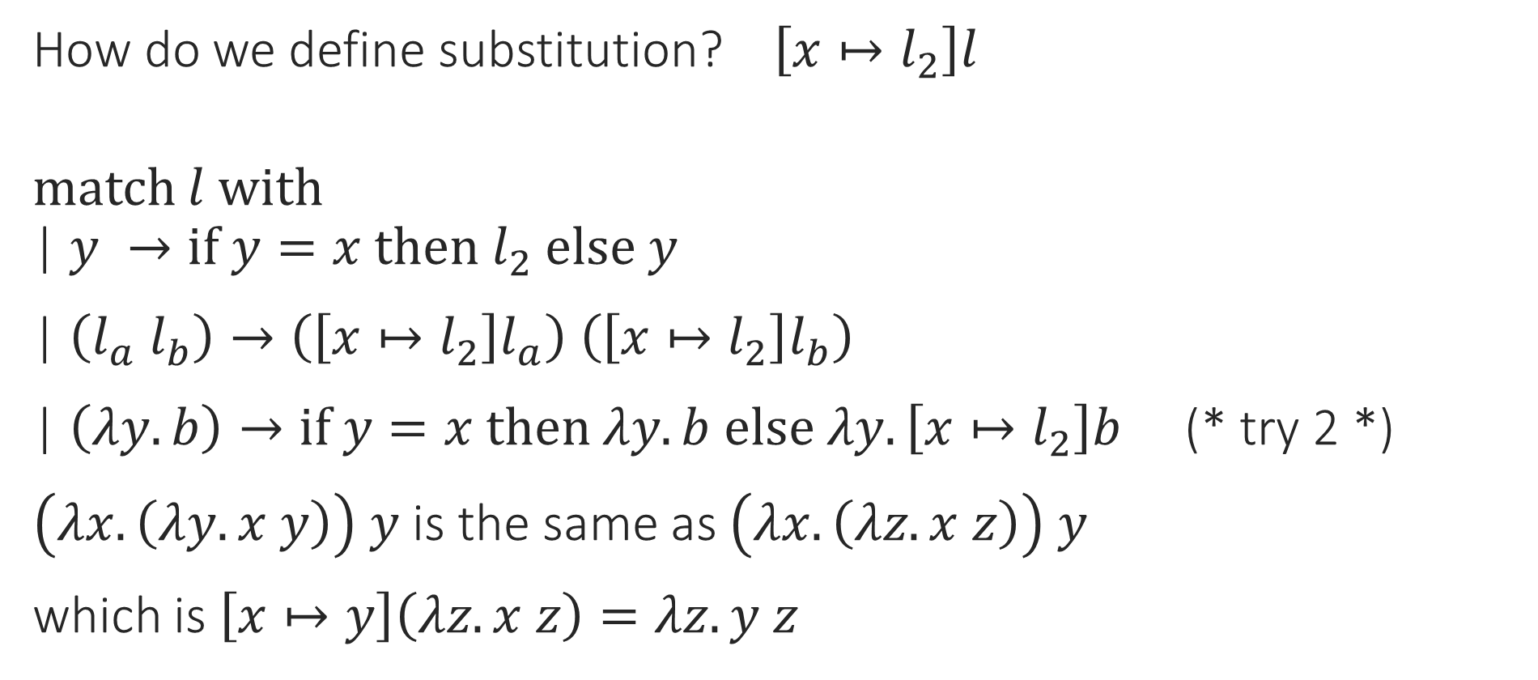
Lambda Calculus: Substitution
How do we define substitution? $\left[x↦l_{2}\right]l$
match $l$ with
| $y →if y=x then l_{2} else y$
| $\left(l_{a} l_{b}\right)→\left(\left[x↦l_{2}\right]l_{a}\right) \left(\left[x↦l_{2}\right]l_{b}\right)$
| $\left(λy. b\right)→if y=x then λy. b else λy. \left[x↦l_{2}\right]b$ (* try 2 *)
$\left(λx. \left(λy. x y\right)\right) y$ is the same as $\left(λx. \left(λz. x z\right)\right) y$
which is $\left[x↦y\right]\left(λz. x z\right)=λz. y z$

Slide 40
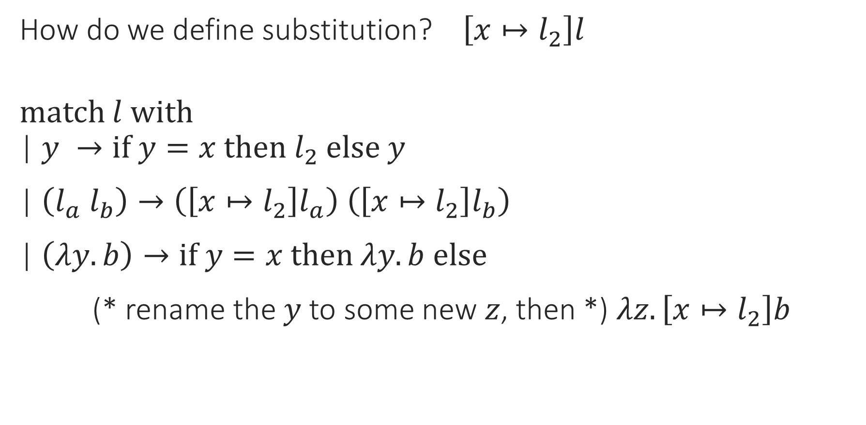
Lambda Calculus: Substitution
How do we define substitution? $\left[x↦l_{2}\right]l$
match $l$ with
| $y →if y=x then l_{2} else y$
| $\left(l_{a} l_{b}\right)→\left(\left[x↦l_{2}\right]l_{a}\right) \left(\left[x↦l_{2}\right]l_{b}\right)$
| $\left(λy. b\right)→if y=x then λy. b else$
(* rename the $y$ to some new $z$, then *) $λz. \left[x↦l_{2}\right]b$

Slide 41
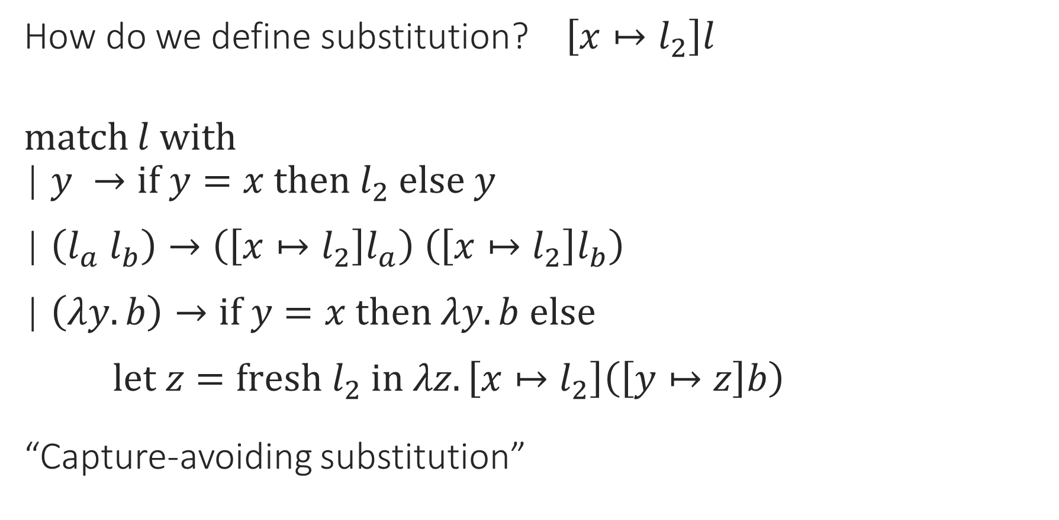
Lambda Calculus: Substitution
How do we define substitution? $\left[x↦l_{2}\right]l$
match $l$ with
| $y →if y=x then l_{2} else y$
| $\left(l_{a} l_{b}\right)→\left(\left[x↦l_{2}\right]l_{a}\right) \left(\left[x↦l_{2}\right]l_{b}\right)$
| $\left(λy. b\right)→if y=x then λy. b else$
$let z=fresh l_{2} in λz.\left[x↦l_{2}\right]\left(\left[y↦z\right]b\right)$
“Capture-avoiding substitution”

Slide 42
Notes:
Poll Title: Do not modify the notes in this section to avoid tampering with the Poll Everywhere activity.
More info at polleverywhere.com/support
Questions
https://www.polleverywhere.com/discourses/SRzwhp4zztmGWgIgz520A

Slide 43

Lambda Calculus: Syntax
L ::= <ident> | $λ$<ident>. L | L L
Notes:
L L is application, not sequencing!

Slide 44

Lambda Calculus: Semantics
L ::= <ident> | $λ$<ident>. L | L L
Functions are values
Notes:
Think of function definitions: we don’t evaluate the body of a function until it’s applied.

Slide 45
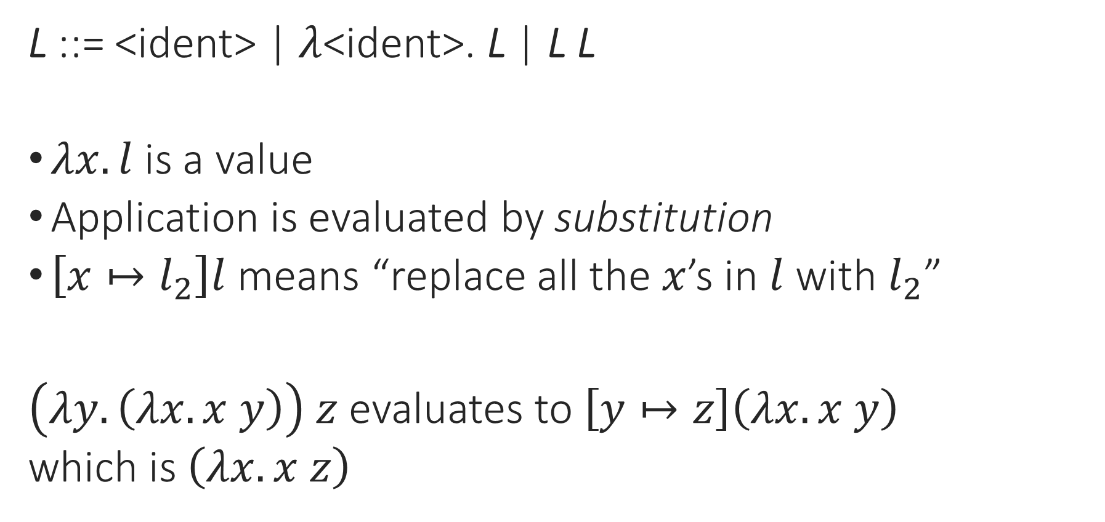
Lambda Calculus: Semantics
L ::= <ident> | $λ$<ident>. L | L L
$λx. l$ is a value
Application is evaluated by substitution
$\left[x↦l_{2}\right]l$ means “replace all the $x$’s in $l$ with $l_{2}$”
$\left(λy. \left(λx. x y\right)\right) z$ evaluates to $\left[y↦z\right]\left(λx. x y\right)$
which is $\left(λx. x z\right)$
Notes:
Think of function definitions: we don’t evaluate the body of a function until it’s applied.

Slide 46


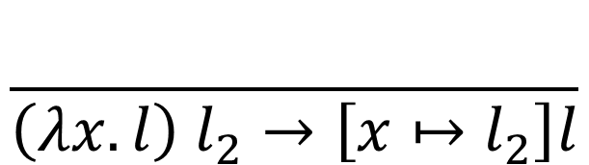
Lambda Calculus: Semantics
L ::= <ident> | $λ$<ident>. L | L L
$λx. l$ is a value
“Call by name”
$$\frac{l_{1}→l_{1}^{′}}{l_{1} l_{2}→l_{1}^{′} l_{2}}$$
$$\frac{}{\left(λx. l\right) l_{2}→\left[x↦l_{2}\right]l}$$
Notes:
Think of function definitions: we don’t evaluate the body of a function until it’s applied.

Slide 47



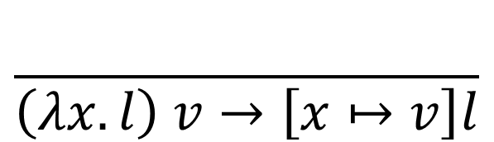
Lambda Calculus: Semantics
L ::= <ident> | $λ$<ident>. L | L L
“Call by value”
$$\frac{l_{1}→l_{1}^{′}}{l_{1} l_{2}→l_{1}^{′} l_{2}}$$
$$\frac{l_{2}→l_{2}^{′}}{v l_{2}→v l_{2}^{′}}$$
$$\frac{}{\left(λx. l\right) v→\left[x↦v\right]l}$$
Notes:
Think of function definitions: we don’t evaluate the body of a function until it’s applied.

Slide 48
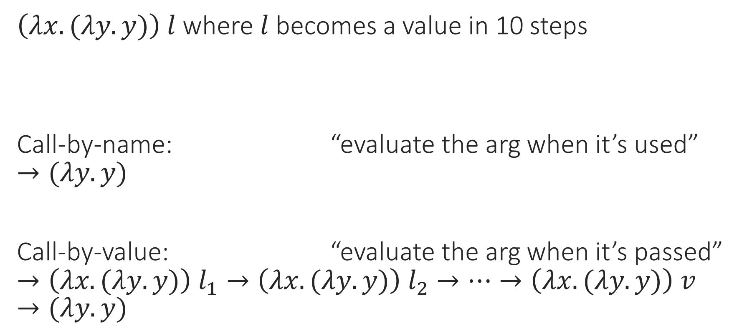
Call-By-Name vs. Call-By-Value
$\left(λx. (λy. y)\right) l$ where $l$ becomes a value in 10 steps
Call-by-name: “evaluate the arg when it’s used”
$$→(λy. y)$$
Call-by-value: “evaluate the arg when it’s passed”
$$→\left(λx.(λy. y)\right) l_{1}→\left(λx.(λy. y)\right) l_{2}→…→\left(λx.(λy. y)\right) v→(λy.y)$$

Slide 49
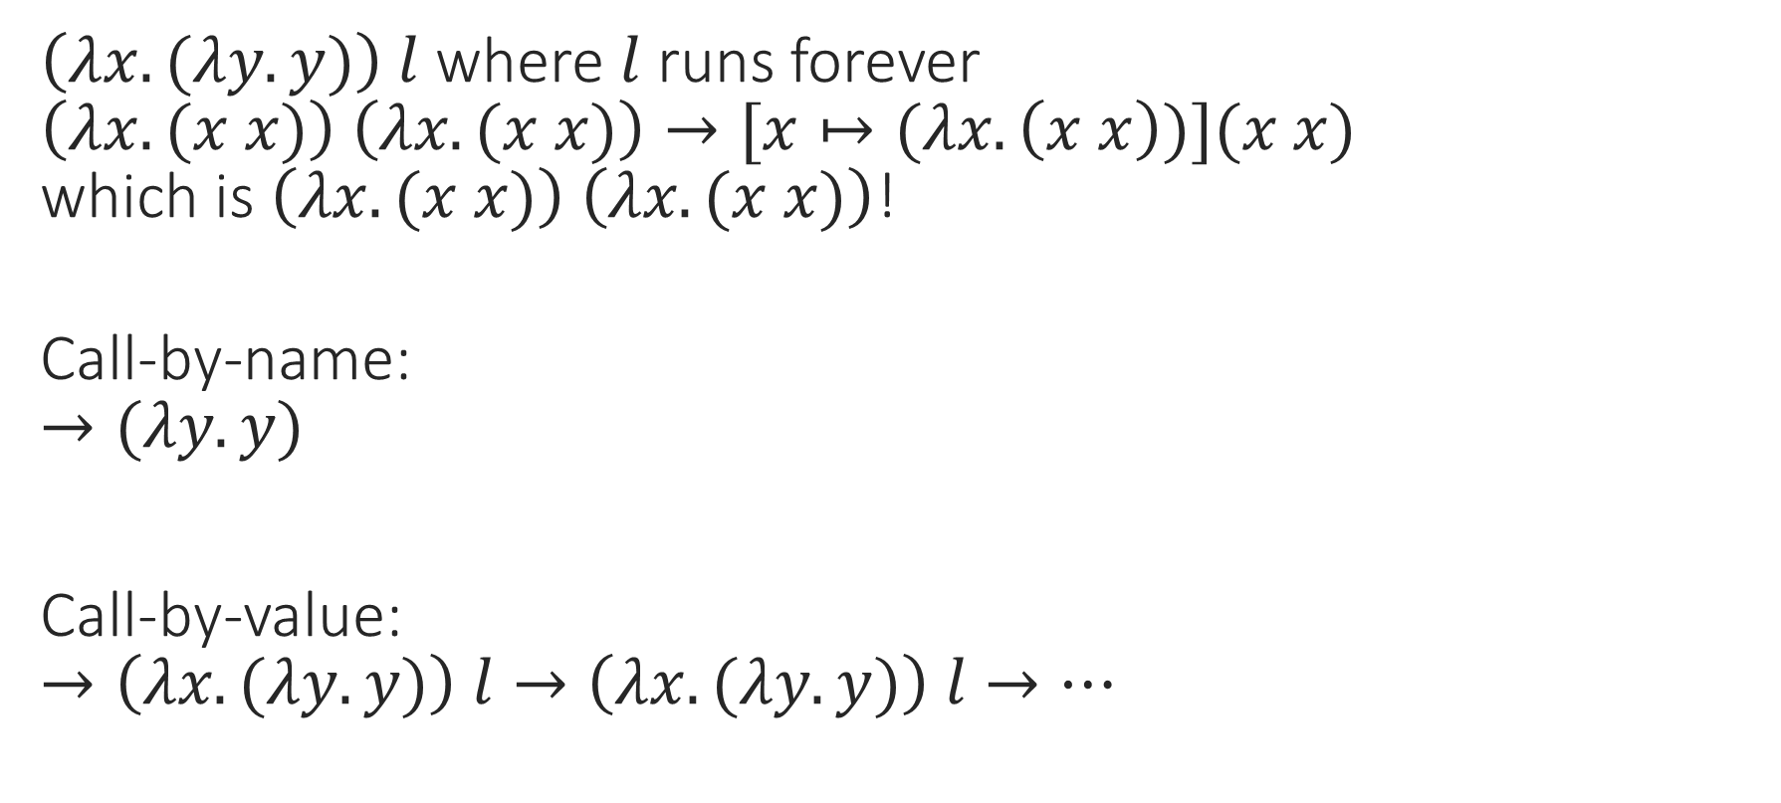
Call-By-Name vs. Call-By-Value
$\left(λx. (λy. y)\right) l$ where $l$ runs forever
$$\left(λx. (x x)\right) \left(λx. (x x)\right)→[x↦(λx. \left(x x\right))](x x)$$
$$\text{which} \text{is} \left(λx. (x x)\right) \left(λx. (x x)\right)\text{!}$$
Call-by-name:
$$→(λy. y)$$
Call-by-value:
$$→\left(λx.(λy. y)\right) l→\left(λx.(λy. y)\right) l→…$$

Slide 50

Call-By-Name vs. Call-By-Value
$\left(λx. …x… x…\right) l$ where $l$ becomes a value in 10 steps
Call-by-name:
$$→ …l…l…→ …l_{1}…l…→ …v…l…→ …v…l_{1}…→…$$
Call-by-value:
$$→\left(λx.…x…x…\right) l_{1}→…→\left(λx.…x…x…\right) v→ …v…v…$$

Slide 51
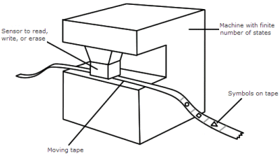



Lambda Calculus and Computability
What can be computed?
$$\left(λx. (λy. x y)\right) \left(λz. z\right)$$
“Turing-complete”
Church, 1936
Turing, 1936
Notes:
So anything that can be computed in modern programming languages can be written in lambda calculus, too. (Not that you want to!)

Slide 52
Notes:
Poll Title: Do not modify the notes in this section to avoid tampering with the Poll Everywhere activity.
More info at polleverywhere.com/support
Questions
https://www.polleverywhere.com/discourses/SRzwhp4zztmGWgIgz520A

Slide 53
Why Functional Programming?
Lambda calculus has some unusual ideas:
  Explicit variable binding
  Evaluation by substitution
  Minimal shared context between functions
This is useful for theory:
  Closer to mathematical functions
  Very simple semantics
  Variable binding, scope, etc. is actually the same as in other languages, but lambda calculus lets us see it more directly
Notes:
Why would we want to code like this?

Slide 54
Why Functional Programming?
Lambda calculus has some unusual ideas:
  Explicit variable binding
  Evaluation by substitution
  Minimal shared context between functions
This is useful for theory
And in practice!
  Programs closer to on-paper task descriptions
  Parallelizes very well (no shared state, mostly pure math)
  Functions as data is useful (most modern languages have lambdas)
Notes:
Why would we want to code like this?

