Slide 1
CS 476/MCS 415: Programming Language Design
https://www.cs.uic.edu/~mansky/teaching/cs476/fa23/

Slide 2
Welcome!
This is CS 476/MCS 415, Programming Language Design
I’m glad you’re here!
Meets MWF 10:00-10:50 AM in BH 208
Office hours 2:00 Monday and Friday in SEO 1331 (me), 1:00 Wednesday and 11:00 Thursday in ??? (TA), and by appointment, in-person and on Zoom via Blackboard
  Office hours are great for homework help!
Notes:
Make sure everyone can hear me

Slide 3
Course Overview
Professor: William Mansky (he/him) (mansky1@uic.edu)
TA: Joseph Wiseman (he/him) (jwisem6@uic.edu)
Prerequisites: CS 341 (functional programming), CS 151 (logic and proofs)
Website: https://www.cs.uic.edu/~mansky/teaching/cs476/fa23/
Anonymous in-class questions: https://pollev.com/wmansky771
Lectures recorded via Zoom on Blackboard
Discussion board on Piazza, assignments via Gradescope

Slide 4
Asking questions
In class: raise your hand anytime
You can ask questions anonymously with PollEverywhere (https://pollev.com/wmansky771)
On Piazza
  Can ask/answer anonymously
  Can post privately to instructors
  Can answer other students’ questions
In office hours
If you have a question, someone else probably has the same question!
Notes:
Stop for questions!

Slide 5

Notes:
Poll Title: Do not modify the notes in this section to avoid tampering with the Poll Everywhere activity.
More info at polleverywhere.com/support
Questions
https://www.polleverywhere.com/discourses/p2pykZB7ifMumvCFR9ys1

Slide 6
Programming Language Design
Up till now, you’ve interacted with PLs as users
We’ll look at PLs as designers (how should the language work?) and implementers (how do we get a computer to run it?)
We’ll look at different kinds of languages and features (imperative, OO, functional, pointers, concurrency, etc.) and figure out how to describe them, and what choices we can make about how they work!

Slide 7
Structure of a language
Syntax
  Concrete: what do programs look like?
  Abstract: what are the pieces of a program?
Semantics
  Static: which programs make sense?
  Dynamic: what do programs do when we run them?
Pragmatics
  Implementation: how can we actually make the semantics happen?
  IDE, tool support, etc.
Notes:
We’ll focus mainly on these points: (abstract syntax, semantics, a bit of implementation)

Slide 8
Metalanguages
We want to describe how programming languages should work
We need a metalanguage: a language for talking about programming languages
Metalanguage 1: English (or other natural language)
“The code x := y + z sets the value of x to the value of y plus the value of z.”

Slide 9
Metalanguages: Natural Language
Metalanguage 1: English (or other natural language)
“The code x := y + z sets the value of x to the value of y plus the value of z.”
Pros: intuitive, familiar, easy to write
Cons: ambiguous, informal
Notes:
How do we know the values of y and z? Do y and z have to be variables, or can they also be numbers/something else?

Slide 10
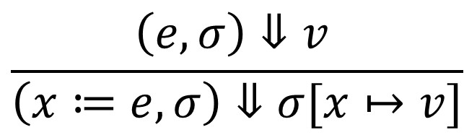
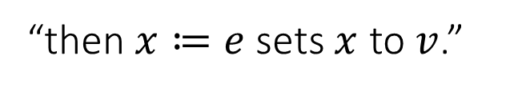

Metalanguages: Inference Rules
Metalanguage 2: mathematical logic
Pros: precise, formal
Cons: hard to read and write (we’ll work on that!), hard to apply to real programs
$$\frac{\left(e,σ\right)⇓v }{\left(x≔e,σ\right)⇓σ[x↦v]}$$
“If the value of $e$ is $v$…”
“then $x≔e$sets $x$ to $v$.”

Slide 11
Metalanguages: Interpreters
Metalanguage 3: the OCaml programming language
match s with
| Assign x e => update env x (eval env e)
Pros: precise, executable, designed to describe programming languages
Cons: can be tricky to write (we’ll work on that!), has to produce a single answer

Slide 12
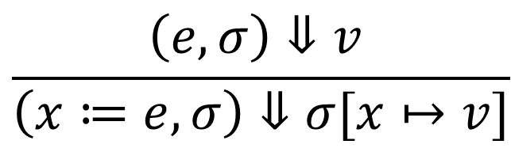
Metalanguages
We want to describe how languages should work, and write code that actually runs those languages
Natural language: “x := y + z sets x to be y plus z”
Inference rules:
OCaml: match s with
| Assign x e => update env x (eval env e)
We’ll learn to translate between these three metalanguages!
$$\frac{\left(e,σ\right)⇓v }{\left(x≔e,σ\right)⇓σ[x↦v]}$$

Slide 13
Notes:
Poll Title: Do not modify the notes in this section to avoid tampering with the Poll Everywhere activity.
More info at polleverywhere.com/support
Questions
https://www.polleverywhere.com/discourses/p2pykZB7ifMumvCFR9ys1

Slide 14
Course outline
Syntax: grammars, abstract syntax
Operational semantics and interpreters
Type systems: checking, inference, safety
Language types: imperative, functional, OO, logic, …
Extra features: exceptions, concurrency, …
Notes:
Stop for questions!

Slide 15
In-Class Exercises
One question every class, submitted through Gradescope
Answer them in class if you attend live, or whenever you watch the lecture (within 7 days) if you’re watching the recordings
You don’t have to get them right to get credit! Just give your best guess.
course code Y732V4
Today’s exercise: What’s one question about programming languages you’d like to be able to answer by the end of this course?
Notes:
Please do them during class if you’re attending! It helps me figure out what to explain further, and if you don’t they turn into more homework.

Slide 16
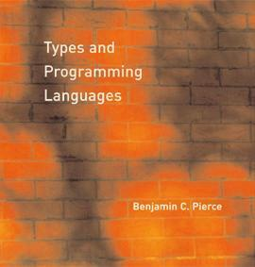
Textbook
Types and Programming Languages, Pierce, 2002
Available online through the library, so
you don’t need to buy it
Notes:
We’ll be skipping around a bit, and I’ll also post readings from a couple of other books. The book will be most useful as a reference.

Slide 17
Grading
In-class exercises: 25%
Assignments: 60%
Final project: 15%
Participation: up to 5% extra credit (asking questions in class, posting on Piazza, etc.)
Final grades will be curved (but only up)

Slide 18
Assignments
Programming assignments in OCaml: write an interpreter for a language/feature, implement a type checker, etc.
Written homework: try out logical systems, write proofs about programs
Each assignment will be submitted twice
  First submission: write as much as you can; you’ll receive full credit as long as you submit anything, and I’ll give you feedback
  Second submission: I’ll actually test your code/check your work and grade you on correctness
Collaboration encouraged, but you must write up your own solution, and cite all sources (websites, collaborators, etc.)
Submitted and returned via Gradescope (course code Y732V4)

Slide 19
Notes:
Poll Title: Do not modify the notes in this section to avoid tampering with the Poll Everywhere activity.
More info at polleverywhere.com/support
Questions
https://www.polleverywhere.com/discourses/p2pykZB7ifMumvCFR9ys1

Slide 20
The OCaml Programming Language
OCaml: a functional language in the ML (“metalanguage”) family
  ML family also includes SML, F#, F*, etc.
  Designed to operate on elements of programming languages
Strongly-typed functional language with references, based on lambda calculus with pattern-matching

Slide 21
OCaml: The Read-Eval-Print Loop (REPL)
You can run code without installing at https://try.ocamlpro.com/
(demo)
Can also be compiled

Slide 22
HW1 – Getting Started with OCaml
Posted on the course website
Set up your OCaml programming environment and write some simple functions in OCaml
First submission due Thursday 8/24 at 11:59 PM
  Do as much as you can, get feedback on where you got stuck!
Submit via Gradescope
Notes:
Walk through setting up?

Slide 23
Notes:
Poll Title: Do not modify the notes in this section to avoid tampering with the Poll Everywhere activity.
More info at polleverywhere.com/support
Questions
https://www.polleverywhere.com/discourses/p2pykZB7ifMumvCFR9ys1

Slide 24
Tuples and Functions
let p1 = (4, "hi");;
(* p1 has type “int * string” *)
let p2 = (3, 5, 2);;
(* p2 has type “int * int * int” *)
let incr x y = (x + 1, y + 2);;
(* incr has type “int -> int -> int * int” *)
incr 5 6;;
(* returns (6, 8) *)

Slide 25
Inductive Data Types
Define a type by giving a list of cases
type season = Spring | Summer | Fall | Winter
example values: Summer Fall
type value = Intval of int | Stringval of string
| Floatval of float
example values: Intval 3 Stringval “hi!”
type intlist = Nil | Cons of int * intlist
example values: Nil Cons (1, Nil)
Cons (1, Cons (2, Cons (3, Nil)))

Slide 26
Pattern-Matching and Recursion
type season = Spring | Summer | Fall | Winter
let get_temp s =
match s with
| Spring -> 70
| Summer -> 80
| Fall -> 70
| Winter -> 30

Slide 27
Pattern-Matching and Recursion
type value = Intval of int | Stringval of string
| Floatval of float
let print_val v =
match v with
| Intval i ->
| Stringval s ->
| Floatval f ->
i, s, f are new variables declared in the match cases

Slide 28
Pattern-Matching and Recursion
type value = Intval of int | Stringval of string
| Floatval of float
let print_val v =
match v with
| Intval i -> print_int i
| Stringval s -> print_string s
| Floatval f -> print_float f
i, s, f are new variables declared in the match cases

Slide 29
Pattern-Matching and Recursion
type intlist = Nil | Cons of int * intlist
let rec length l =
match l with
| Nil -> 0
| Cons (i, rest) -> length rest + 1
Notes:
This is going to be the engine of almost everything we do in this class.

Slide 30
Common OCaml Errors
This expression has type ... but is here used with type ...
let add1 x = x + 1;;
add1 “hi”;;

Slide 31
Common OCaml Errors
This expression has type ... but is here used with type ...
let add1 x = x + 1;;
add1 “hi”;;
Error: This expression has type string but an expression was expected of type int
Think about which of those types is wrong!

Slide 32
Common OCaml Errors
This expression has type ... but is here used with type ...
let add1 (x : string) = x ^ “1”;;
add1 “hi”;;
(* returns “hi1” *)
Think about which of those types is wrong!

Slide 33
Common OCaml Errors
This pattern-matching is not exhaustive
type value = Intval of int | Stringval of string
| Floatval of float
let print_val v =
match v with
| Intval i -> print_int i
| Stringval s -> print_string s
Warning: this pattern matching is not exhaustive.
Here is an example of a case that is not matched: Floatval _

Slide 34
Common OCaml Errors
This match case is unused
type intlist = Nil | Cons of int * intlist
let rec length l =
match l with
| Nil -> 0
| Cons (i, rest) -> length rest + 1
| Cons (j, rest) -> length rest + 2

Slide 35
Common OCaml Errors
This match case is unused
type intlist = Nil | Cons of int * intlist
let rec length l =
match l with
| Nil -> 0
| Cons (i, rest) -> length rest + 1
| Cons (j, rest) -> length rest + 2
Warning: this match case is unused

Slide 36
Common OCaml Errors
This match case is unused
type intlist = Nil | Cons of int * intlist
let rec length l =
match l with
| nil -> 0
| Cons (i, i, rest) -> length rest + 1
Warning: this match case is unused
Constructors start with capital letters, variables start with lowercase letters!
every argument matches this case

Slide 37
Common OCaml Errors
This expression has type ... but is here used with type ...
This pattern-matching is not exhaustive
This match case is unused
For more, see https://www2.ocaml.org/learn/tutorials/common_error_messages.html

Slide 38
Notes:
Poll Title: Do not modify the notes in this section to avoid tampering with the Poll Everywhere activity.
More info at polleverywhere.com/support
Questions
https://www.polleverywhere.com/discourses/p2pykZB7ifMumvCFR9ys1

